Slide 1
ShieldCoin Blockchain
Dhruvkumar Patel - 240347007017
Siddhant Desai - 240347007014
Aditya Gidh - 240347007010

Slide 2
Architecture Component Diagram
Core Module
Blockchain, Blocks, Transactions
Crypto Module
Wallet, Signature, Encryption
ShieldCoin
Network Module
DHT, P2P Messaging
API Module
RESTful Endpoints
Utils Module
Storage, Logging, Config

Slide 3
Architecture Overview
Core Components: Blockchain, Blocks, Transactions
Cryptography: Wallet, Key Management, Signatures
Networking: DHT Node, Peer Discovery, Message Propagation
API: RESTful Interface for Blockchain Interaction
Utilities: Storage, Logging, Configuration

Slide 4
Core Module Components
Core
Block
Contains transactions
Transaction Pool
Pending tx storage
Blockchain
Main chain manager
Transaction
Value transfer record

Slide 5
Core Module
Block: Individual units containing transactions and metadata
Blockchain: Manages chain of blocks and implements consensus
Transaction: Records of value transfers between addresses
Transaction Pool: Temporary storage for unconfirmed transactions

Slide 6
Block Structure
Index
Nonce
Transactions
Hash
Timestamp
Previous Hash

Slide 7
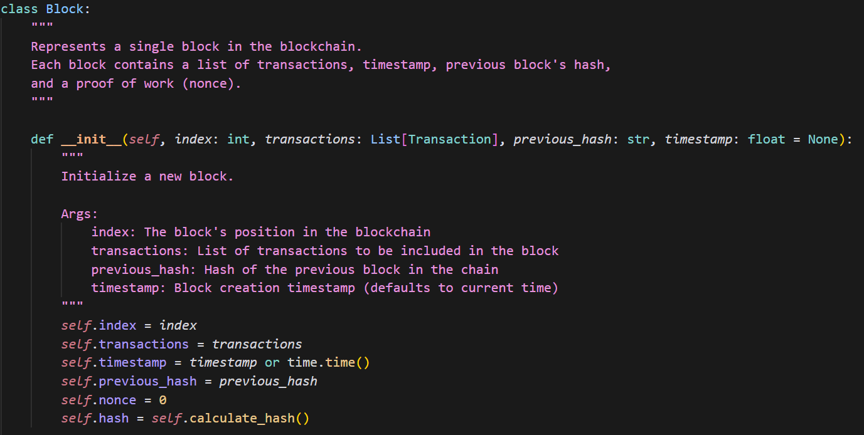
Block Implementation

Slide 8
Functions of Block Class
Calculate hash
Mine the block
Validate the block
Serialization

Slide 9
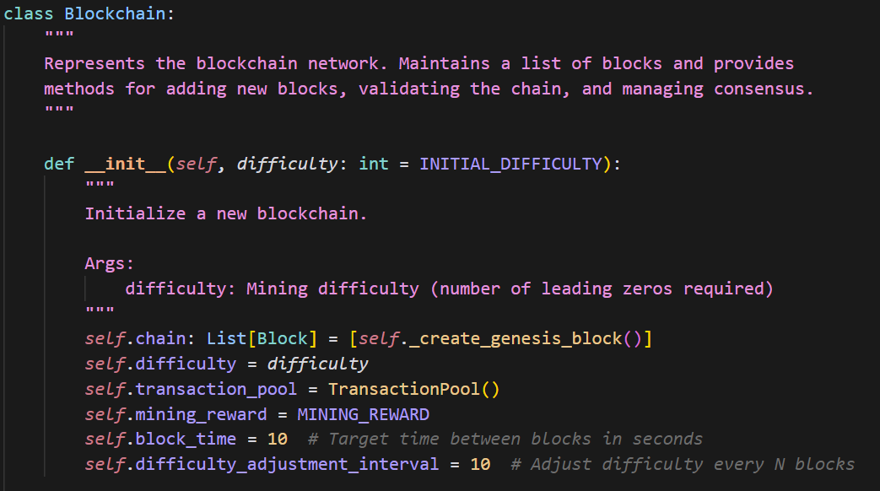
Blockchain Implementation

Slide 10
Functions of Blockchain
Create Genesis Block
Get Latest Block
Add Transaction to the block
Mine pending Transactions
Add Block to the chain
Replace the chain based on PoW
Validate the block
Validate the chain
Difficulty adjustment
Serialization

Slide 11
Consensus Process
Receive New Block
Validate Block Structure
Verify Transactions
Check Proof of Work
Compare Chain Length
Replace Local Chain
Yes
Is chain longer?
No
Keep Current Chain
Update Peers

Slide 12
Mining Process Flowchart
Start Mining
Create Reward Transaction
Collect Pending Transactions
Create New Block
Find Valid Hash (PoW)
Add Block to Chain
Clear Transaction Pool

Slide 13
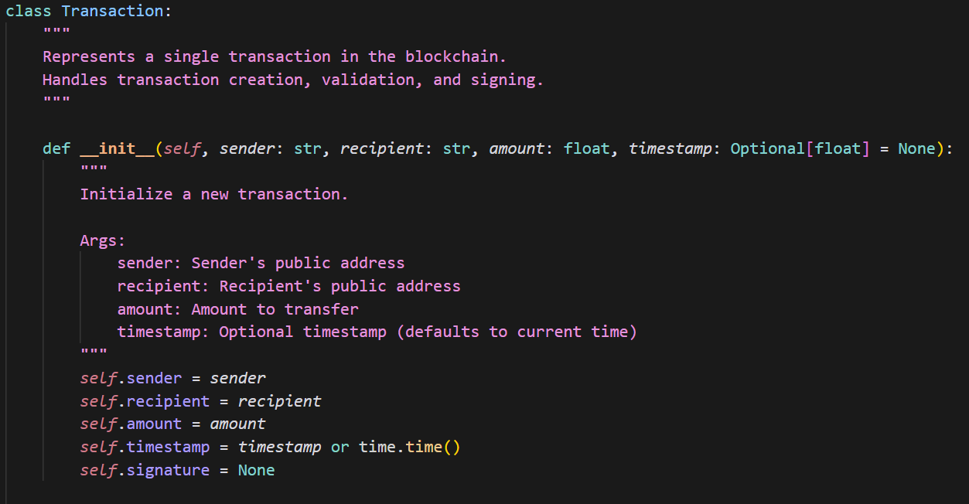
Transaction Implementation

Slide 14
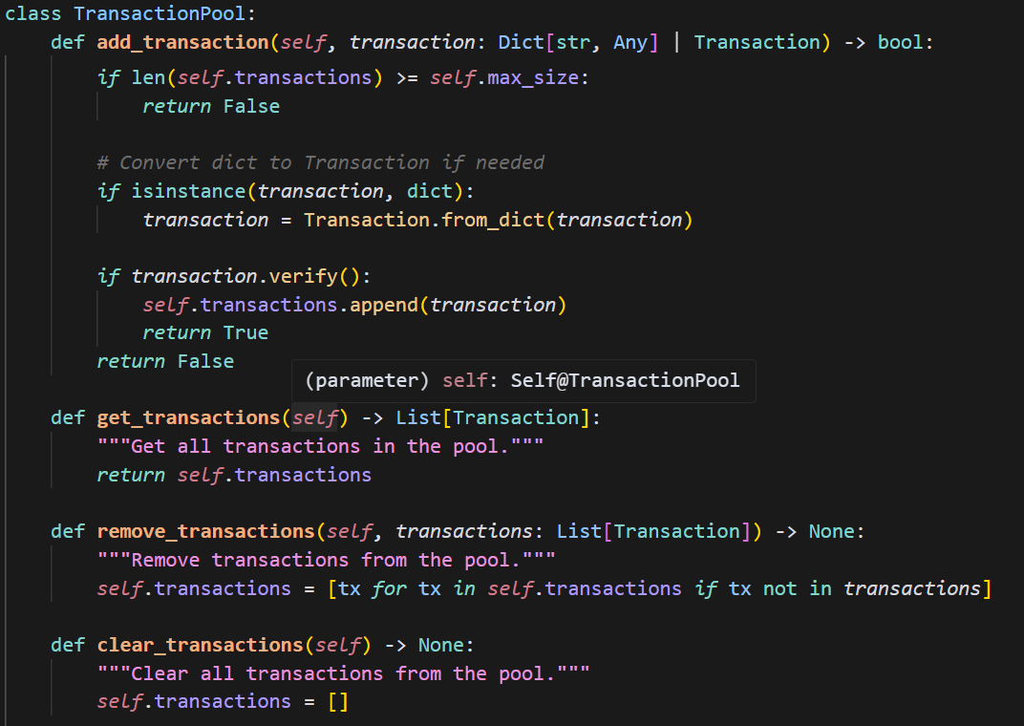
Transaction Pool Functions

Slide 15
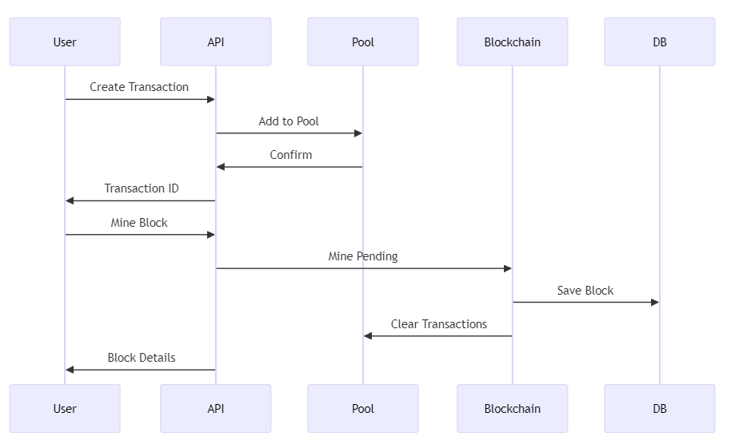
Transaction Flow

Slide 16
Utils Module
The utils folder contains several utility modules that provide supporting functionality for the core blockchain system:
storage.py :
Handles persistent storage operations
Provides methods for saving and loading blockchain data
Manages serialization/deserialization of blockchain components
Implements file-based storage for wallets, blockchain, and peer information
logger.py :
Custom logging configuration
Configurable log levels (INFO, DEBUG, ERROR)
Formats log messages with timestamps and contextual information
Supports both console and file-based logging

Slide 17
Utils Module
initializer.py :
Bootstrap functionality for the blockchain system
Sets up the initial environment
Loads or creates configuration files
Initializes core components and establishes connections
database.py:
The largest utility module
Provides database abstraction for blockchain storage
Implements SQL schema and queries for blockchain data
Handles transaction history, block storage, and user account data
Includes connection pooling and error handling

Slide 18
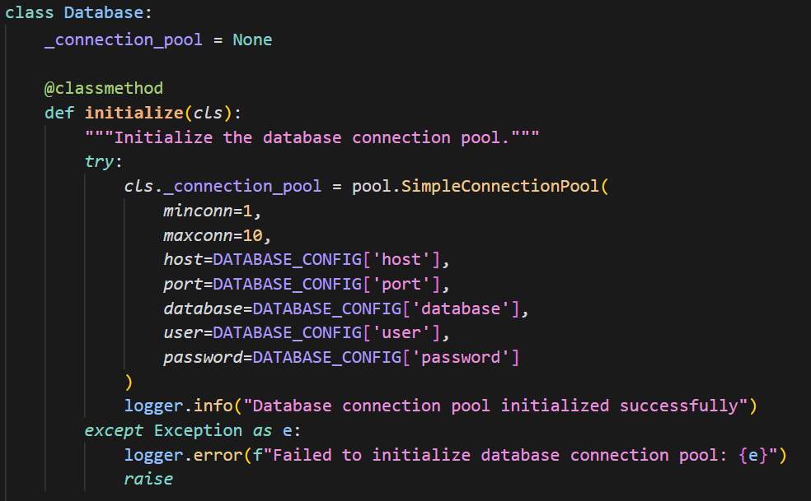
Database Implementation

Slide 19
Database Functions
Get and Return Connection
Create Table
Get and Save Blocks
Get Pending Transaction
Save Transactions
Get and Save Wallet
Get Peers

Slide 20
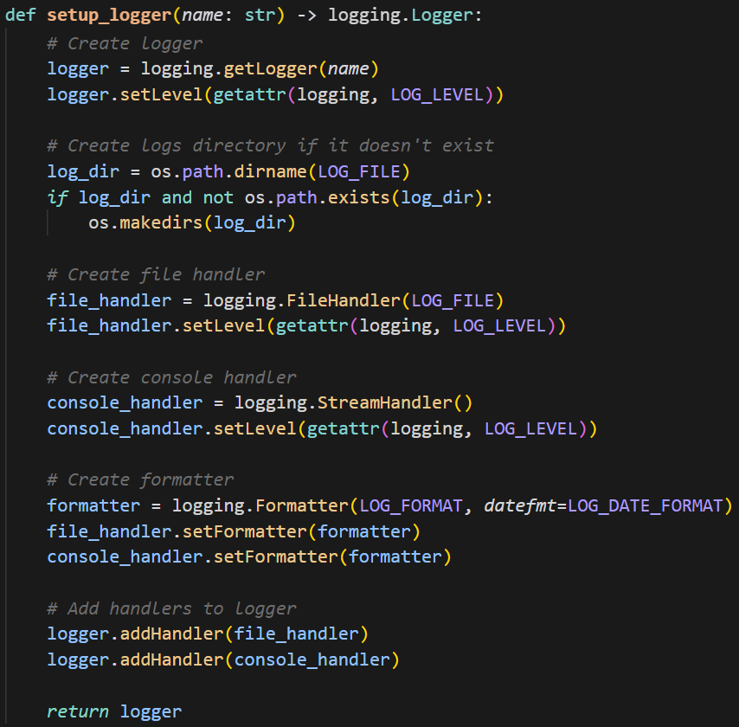
Logger Implementation

Slide 21
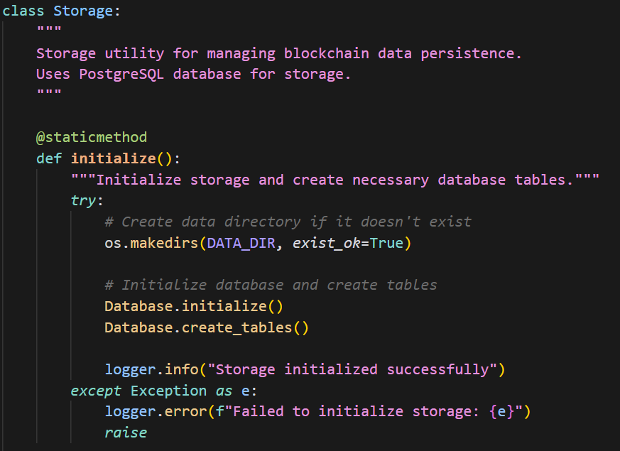
Storage Implementation

Slide 22
Storage Functions
Save and Load Blockchain
Save and Load Wallet
Save and Load Peers

Slide 23
Cryptography Module
Wallet: Handles key generation, storage, and transaction signing
Uses RSA for asymmetric encryption
Generates unique address from public key hash
Signs transactions with private key
Provides methods for wallet export/import

Slide 24
Wallet Operations
Generate Private Key
Derive Public Key
Generate Address (Hash)
Create Transaction
Verify Transaction
Sign Transaction
Submit Transaction

Slide 25
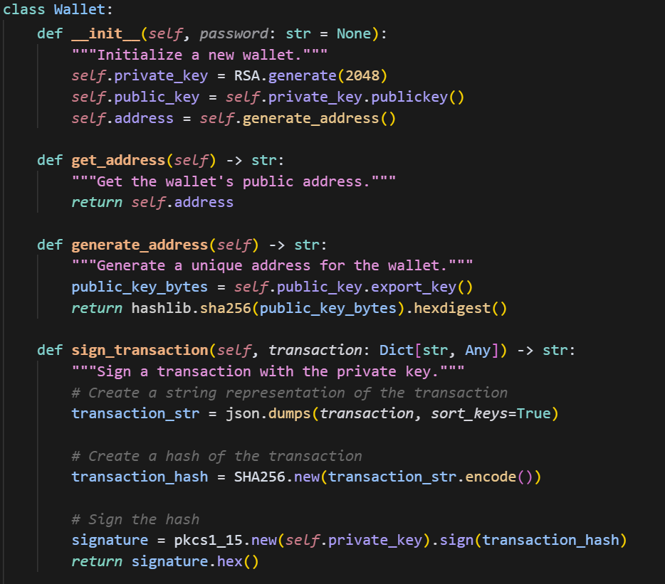
Wallet Implementation and Functions

Slide 26
DHT Network Module
Distributed Hash Table (DHT) for peer-to-peer networking
Handles peer discovery and management
Broadcasts new blocks and transactions
Synchronizes blockchain across nodes
Implements message passing protocol

Slide 27
DHT Network Components
P2P
DHT Node
Local node instance
Message Handling
Process commands
Peer Discovery
Find network nodes
Chain Sync
Keep chain updated

Slide 28
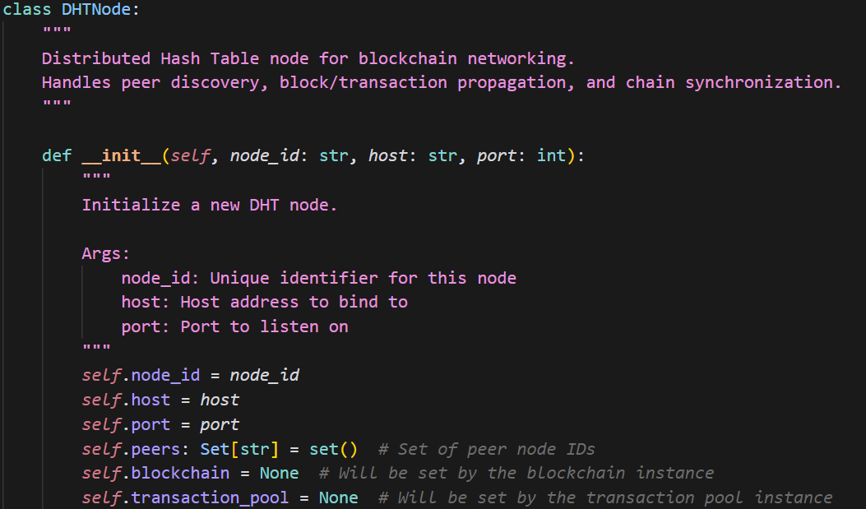
DHT Implementation

Slide 29
DHT Functions
Register Blockchain instance to the node
Register Transaction Pool to the node
Add and Remove peer from the network
Broadcast Block and Transaction to all peers
Request chain
Message Handling
Handle new block, transaction received from a peer

Slide 30
API Module
RESTful API built with Flask
Endpoints for blockchain interaction:
View blockchain state
Create transactions
Mine new blocks
Manage wallet
Network operations

Slide 31
API Endpoints Overview
/chain
Get blockchain data
/transactions/new
Create transaction
/transactions/pending
View pending tx
/mine
Mine new block
/nodes/register
Add new node
/nodes/resolve
Consensus
/wallet/new
Create wallet
/wallet/balance
Get balance

Slide 32
Configuration
Centralized configuration via config.py
Blockchain parameters: difficulty, block time, rewards
Network settings: ports, peers, sync intervals
Security settings: key sizes, algorithms
Storage paths and database configuration
API configuration: host, port, rate limits

Slide 33
Security Features
Asymmetric Cryptography for Wallet Security
Transaction Signing and Verification
Hash-based Proof of Work Consensus
Configurable Difficulty Adjustment
Chain Validation and Integrity Checks

Slide 34
Potential Enhancements
Use of CSRF token for api
Security within the gap between adding block to chain and clearing transaction pool
Using existing methods for implementing conversion of block to dictionary and vice versa
Keeping the track of number of transaction of miners while adding the block to the chain
Add function to load and update existing wallet instead of creating new every time

Slide 35
Thank You
ShieldCoin: Securing the Future of Digital Transactions

