Slide 1
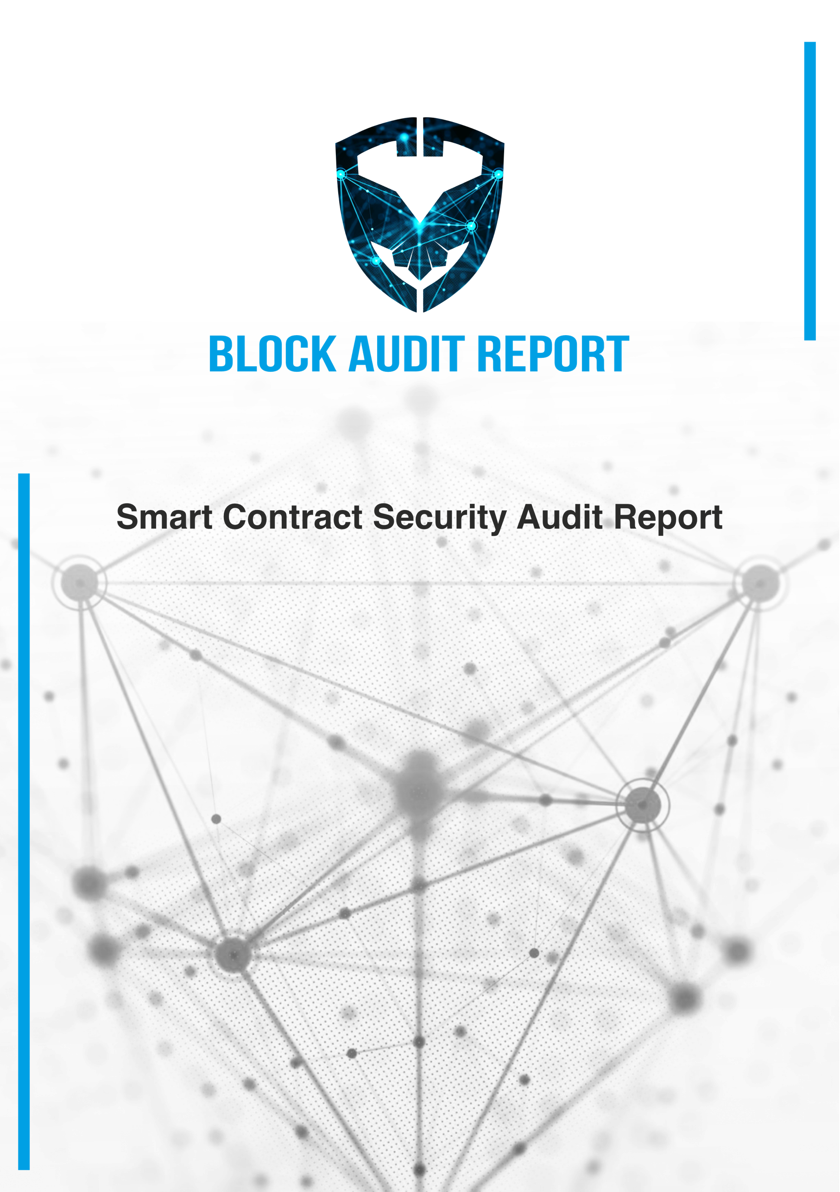
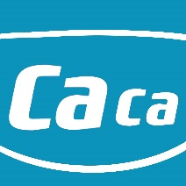
CACA

Slide 2
Block Audit Report Team received the CACA team’s application for smart contract security audit of Gun Hunter on November 26, 2021. The following are the details and results of this smart contract security audit:
Project Name: CACA
The Contract address: 0x60C8c07cd7ac9479bDbd11268Ee6E1f8c211e9d0 Link Address:
https://bscscan.com/address/0x60C8c07cd7ac9479bDbd11268Ee6E1f8c211e9d0#code
The audit items and results:
(Other unknown security vulnerabilities are not included in the audit responsibility scope)
Audit Result: Passed
Audit Number: BAR0012526112021 Audit Date: November 26, 2021
Audit Team: Block Audit Report Team

Slide 3
Table of Content
Introduction ............................................................................................................................................... 4 Auditing Approach and Methodologies applied ..................................................................................4 Audit Details .........................................................................................................................................4
Audit Goals ................................................................................................................................................. 5
Security .................................................................................................................................................5
Sound Architecture ..............................................................................................................................5
Code Correctness and Quality .............................................................................................................5
Security....................................................................................................................................................... 5
High level severity issues......................................................................................................................5
Medium level severity issues ...............................................................................................................5
Low level severity issues ......................................................................................................................5
Issues Checking Status .......................................................................................................................6
Manual Audit:.......................................................................................................................................... 7-8
Critical level severity issues..................................................................................................................7
High level severity issues......................................................................................................................7
Medium level severity issues ...............................................................................................................7
Low level severity issues ......................................................................................................................8
Owner Privileges...................................................................................................................................8
Automated Audit........................................................................................................................................ 9
Remix Compiler Warnings ....................................................................................................................9
Disclaimer ................................................................................................................................................. 10
Summary .................................................................................................................................................. 11

Slide 4
Introduction
This Audit Report mainly focuses on the overall security of CACA Smart Contract. With this
report, we have tried to ensure the reliability and correctness of their smart contract by complete and rigorous assessment of their system's architecture and the smart contract codebase.
Auditing Approach and Methodologies applied
The Block Audit Report team has performed rigorous testing of the project starting with analyzing the code design patterns in which we reviewed the smart contract architecture to ensure it is structured and safe use of third-party smart contracts and libraries.
Our team then performed a formal line by line inspection of the Smart Contract to find any potential issue like race conditions, transaction-ordering dependence, timestamp dependence, and denial of service attacks.
In the Unit testing Phase, we coded/conducted custom unit tests written for each function in the contract to verify that each function works as expected.
In Automated Testing, we tested the Smart Contract with our in-house developed tools to identify vulnerabilities and security flaws.
The code was tested in collaboration of our multiple team members and this included -
Testing the functionality of the Smart Contract to determine proper logic has been followed throughout the whole process.
Analyzing the complexity of the code in depth and detailed, manual review of the code, line- by-line.
Deploying the code on testnet using multiple clients to run live tests.
Analyzing failure preparations to check how the Smart Contract performs in case of any bugs and vulnerabilities.
Checking whether all the libraries used in the code are on the latest version.
Analyzing the security of the on-chain data.
Audit Details
Project Name: CACA
Website/ bscscan Code (Mainnet):
0x60C8c07cd7ac9479bDbd11268Ee6E1f8c211e9d0
Languages: Solidity (Smart contract)
Platforms and Tools: Remix IDE, Truffle, Truffle Team, Ganache, Solhint, VScode, Mythril, Contract Library, Slither

Slide 5
Audit Goals
The focus of the audit was to verify that the Smart Contract System is secure, resilient and working according to the specifications. The audit activities can be grouped in the following three categories:
Security
Identifying security related issues within each contract and the system of contract.
Sound Architecture
Evaluation of the architecture of this system through the lens of established smart contract best practices and general software best practices.
Code Correctness and Quality
A full review of the contract source code. The primary areas of focus include:
Accuracy
Readability
Sections of code with high complexity
Quantity and quality of test coverage
Issue Categories
Every issue in this report was assigned a severity level from the following:
High level severity issues
Issues on this level are critical to the smart contract’s performance/functionality and should be fixed before moving to a live environment.
Medium level severity issues
1. Issues on this level could potentially bring problems and should eventually be fixed.
Low level severity issues
Issues on this level are minor details and warningJs that can remain unfixed but would be better fixed at some point in the future.

Slide 6
Issues Checking Status
№ | Issue description | Checking status
1 | Compiler warnings. | Passed
2 | Race conditions and Reentrancy. Cross-function race conditions. | Passed
3 | Possible delays in data delivery. | Passed
4 | Oracle calls. | Passed
5 | Front running. | Passed
6 | Timestamp dependence. | Passed
7 | Integer Overflow and Underflow. | Passed
8 | DoS with Revert. | Passed
9 | DoS with block gas limit. | Passed
10 | Methods execution permissions. | Passed
11 | Economy model. | Passed
12 | The impact of the exchange rate on the logic. | Passed
13 | Private user data leaks. | Passed
14 | Malicious Event log. | Passed
15 | Scoping and Declarations. | Passed
16 | Uninitialized storage pointers. | Passed
17 | Arithmetic accuracy. | Passed
18 | Design Logic. | Passed
19 | Cross-function race conditions. | Passed
20 | Safe Zeppelin module. | Passed
21 | Fallback function security. | Passed

Slide 7
Manual Audit:
For this section the code was tested/read line by line by our developers. We also used Remix IDE’s JavaScript VM and Kovan networks to test the contract functionality.
Files in scope
All solidity files in:
https://bscscan.com/address/0x60C8c07cd7ac9479bDbd11268Ee6E1f8c211e9d0#code
File 1 of 1: CACA.sol | Passed
Critical Severity Issues
No critical severity issues found.
High Severity Issues
No high severity issues found.
Medium Severity Issues
No medium severity issues found.

Slide 8
Low Severity Issues
No low severity issues found.
Owner privileges
None

Slide 9
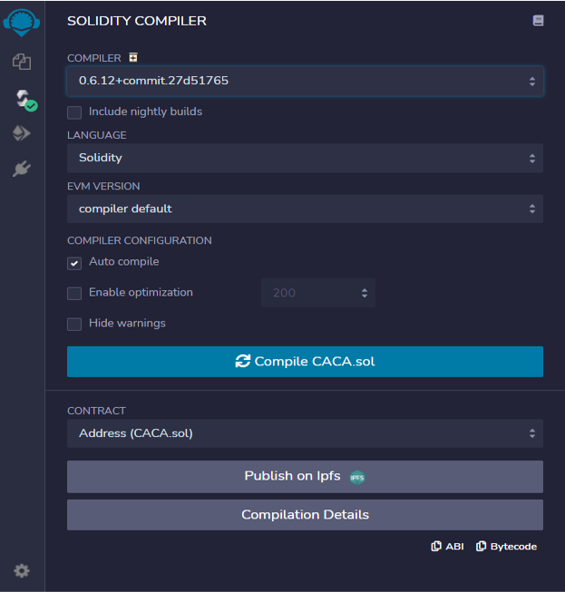
Automated Audit
Remix Compiler Warnings
It throws warnings by Solidity’s compiler. If it encounters any errors the contract cannot be compiled and deployed.

Slide 10
Disclaimer
This is a limited report on our findings based on our analysis, in accordance with good industry practice as at the date of this report, in relation to cybersecurity vulnerabilities and issues in the framework and algorithms based on smart contracts, the details of which are set out in this report. In order to get a full view of our analysis, it is crucial for you to read the full report. While we have done our best in conducting our analysis and producing this report, it is important to note that you should not rely on this report and cannot claim against us on the basis of what it says or doesn’t say, or how we produced it, and it is important for you to conduct your own independent investigations before making any decisions. We go into more detail on this in the below disclaimer below – please make sure to read it in full.
DISCLAIMER: By reading this report or any part of it, you agree to the terms of this disclaimer. If you do not agree to the terms, then please immediately cease reading this report, and delete and destroy any and all copies of this report downloaded and/or printed by you. This report is provided for information purposes only and on a non-reliance basis, and does not constitute investment advice. No one shall have any right to rely on the report or its contents, and BlockAudit and its affiliates (including holding companies, shareholders, subsidiaries, employees, directors, officers and other representatives) (BlockAudit) owe no duty of care towards you or any other person, nor does BlockAudit make any warranty or representation to any person on the accuracy or completeness of the report. The report is provided "as is", without any conditions, warranties or other terms of any kind except as set out in this disclaimer, and BlockAudit hereby excludes all representations, warranties, conditions and other terms (including, without limitation, the warranties implied by law of satisfactory quality, fitness for purpose and the use of reasonable care and skill) which, but for this clause, might have effect in relation to the report. Except and only to the extent that it is prohibited by law, BlockAudit hereby excludes all liability and responsibility, and neither you nor any other person shall have any claim against BlockAudit, for any amount or kind of loss or damage that may result to you or any other person (including without limitation, any direct, indirect, special, punitive, consequential or pure economic loss or damages, or any loss of income, profits, goodwill, data, contracts, use of money, or business interruption, and whether in delict, tort (including without limitation negligence), contract, breach of statutory duty, misrepresentation (whether innocent or negligent) or otherwise under any claim of any nature whatsoever in any jurisdiction) in any way arising from or connected with this report and the use, inability to use or the results of use of this report, and any reliance on this report.
The analysis of the security is purely based on the smart contracts alone. No applications or operations were reviewed for security. No product code has been reviewed.

Slide 11
Summary
Smart contracts do not contain any high severity issues! Note:
Please check the disclaimer above and note, the audit makes no statements or warranties on business model, investment attractiveness or code sustainability. The report is provided for the only contract mentioned in the report and does not include any other potential contracts deployed by Owner.

Slide 12
