Slide 1
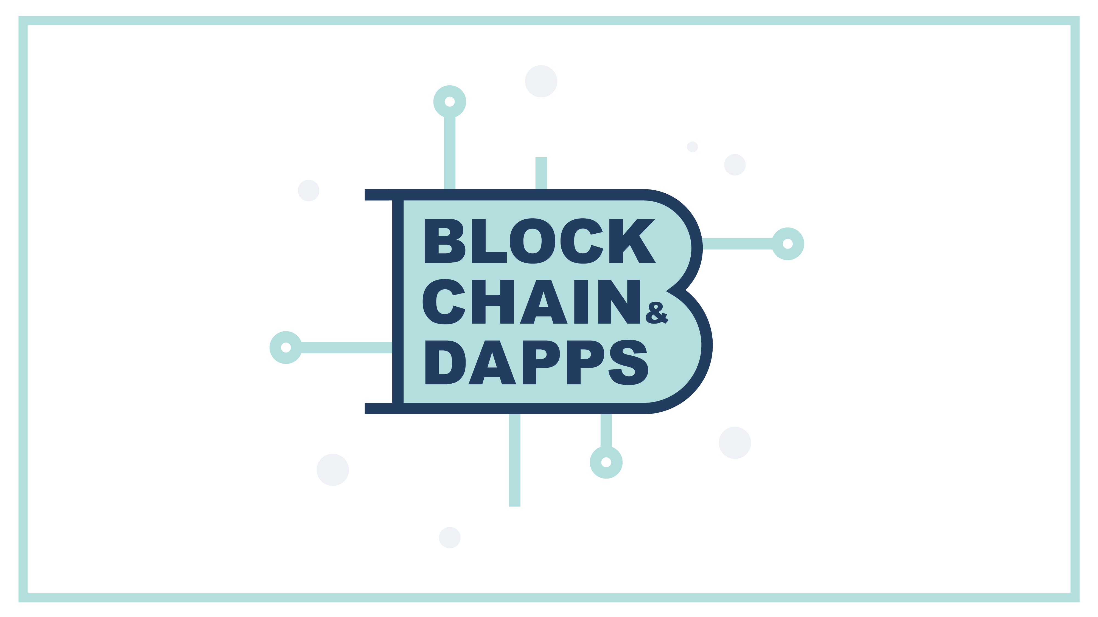

Slide 2
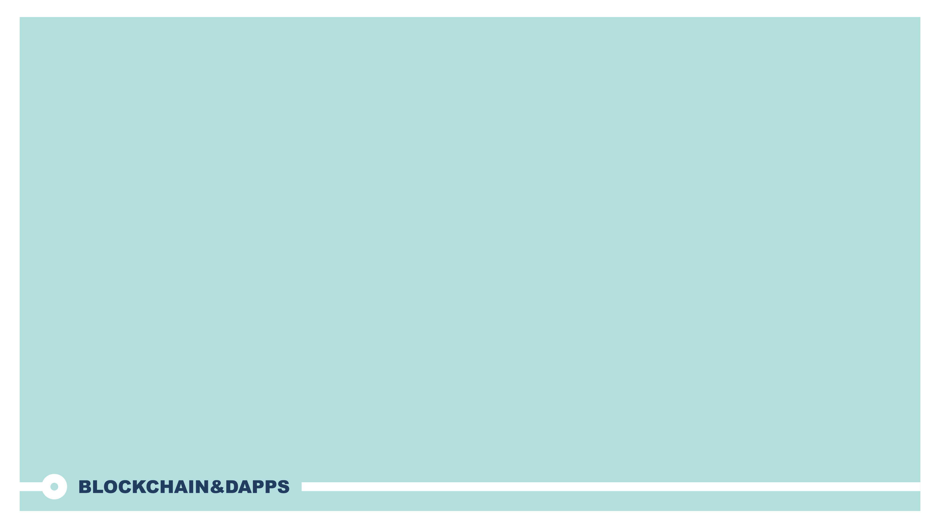

Kenneth Hu
I am a software developer , not trader.
I am enthusiast, not expert.
Ethereum, Bitcoin, AR, ChatBot
Email: Kenneth.hu@Hotmail.com
Founder of Blockchain&Dapps meetup
Founder of Singapore IOTA meetupz

Slide 3
What is Blockchain
MetaMask is a bridge that allows you to visit the distributed web of tomorrow in your browser today. It allows you to run Ethereum dApps right in your browser without running a full Ethereum node.
MetaMask includes a secure identity vault, providing a user interface to manage your identities on different sites and sign blockchain transactions.

Slide 4
How Blockchain work?
Transaction
Chain
Ledger
Mining
Immutable
Consensus
Block

Slide 5


What is transaction?
Transaction: “ is a transfer of value”
Kenneth
Alice
$30 SGD

Slide 6

What is ledger?
What is Immutable?
Immutable : The ledger cannot be changed. Ever!
Ledger : “a collection of financial accounts or transactions”
Ledger
Kenneth Alice
#30
Amy Jen
#50

Slide 7
What is block?
Block : A block records some or all of the most recent transactions. Thus a block is like a page of a ledger or record book.
BLOCK
Block Header
Hash of previous block header
Timestamp
Merkle root
Nonce
Transactions

Slide 8
Block header
Hash of previous block header
Timestamp : It indicates when the block was created.
Merkle root : hash-based data structure that is a generalization of the hash list.
Nonce :Counter used for the Proof of Work algorithm. Each time you mine, the nonce increases by 1 .
BLOCK Header
Hash of previous block header
Timestamp
Merkle root
Nonce

Slide 9
Blockchain
BLOCK 1 HEADER
BLOCK 2 HEADER
BLOCK 3 HEADER
Hash of previous block header
Hash of previous block header
Hash of previous block header
Merkle root
Merkle root
Merkle root
Block 1
transactions
Block 2
transactions
Block 3
transactions

Slide 10
Mining
Proof of Work
Creating the candidate block
Block’s Block header data
Hash of previous block header
Timestamp
No : (
Increment the nonce by 1.
Hash again!
Merkle root
Nonce
Is hash (A8SBERA….) lower than the target? (check the leading zeros)
HASHING ( SHA256 )
YES! Problem Solved.

Slide 11
Validate the new block
Block header hash is less than the target
Block size is within acceptable limits
Block timestamp is less than two hours in the future.
The first transaction is a coinbase transaction ( and only the first )
The coinbase transaction has a valid reward.
All transactions within the blocks are valid ( also have a checklist on their own )
Source : https://dev.to/damcosset/blockchain-what-is-mining-2eod

Slide 12

Sandra → David 10 BTC
David → Sandra 5 BTC
Blockchain network
Mary → Sandra 10 BTC
Node
Brian → List 3.02 BTC
Lisa → Sandra 10 BTC
BLOCK #187
Block ID
0x0235de9a6
BLOCK #186
BLOCK #186
BLOCK #186
BLOCK #186
Block ID
0x6e257071cec
Block ID
0x6e257071cec
Block ID
0x6e257071cec
Block ID
0x6e257071cec
Previous Block
0x6e257071cec
Previous Block
0x1dcc4de8dec
Previous Block
0x1dcc4de8dec
Previous Block
0x1dcc4de8dec
Previous Block
0x1dcc4de8dec
Transactions
Lisa → Sandra 10 BTC
Brian → List 5 BTC
Mary → Sandra 10 BTC
…… →……… .. BTC
Transactions
Transactions
Transactions
Transactions
Blockchain
Time

Slide 13
What does “distributed” mean ?
Distributed: A distributed ledger is a database that is consensually shared and synchronized across network spread across multiple node
Ledger
node
Ledger
Ledger
Ledger
node
node
node
Ledger
Ledger
node
node

Slide 14
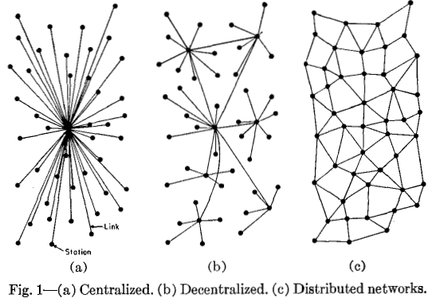
Is A blockchain the centralized, decentralized or distributed application ?

Slide 15
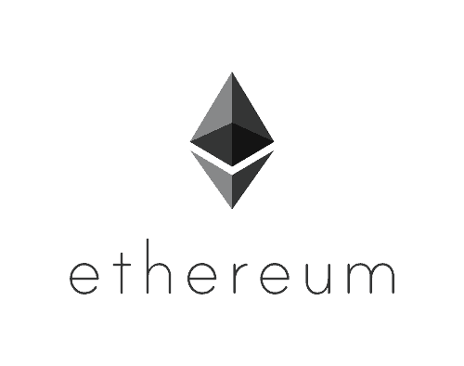
What is Ethereum ?
This is how Ethereum’s website defines itself:
“Ethereum is a decentralized platform that runs smart contracts: applications that run exactly as programmed without any possibility of downtime, censorship, fraud or third party interference. These apps run on a custom built blockchain, an enormously powerful shared global infrastructure that can move value around and represent the ownership of property.”

Slide 16

MetaMask
What’s METAMASK
How to use METAMASK
Create Account
Import Accounts
Private key
JSON File
Network

Slide 17
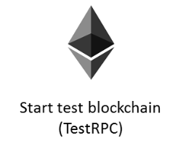
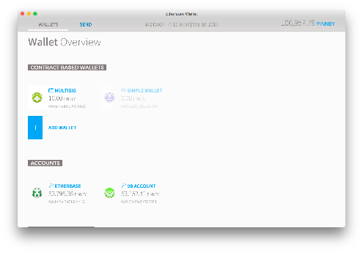



Ethereum blockchain Network
Mainnet
Ethereum Wallet
ROPSTEN
RINKEBY
KOVAN

Slide 18
Network ID
Network | Network ID | Note
Main | 1
Morden | 2 | Deprecated
Ropsten | 3
Rinkeby | 4
Kovan | 42

Slide 19
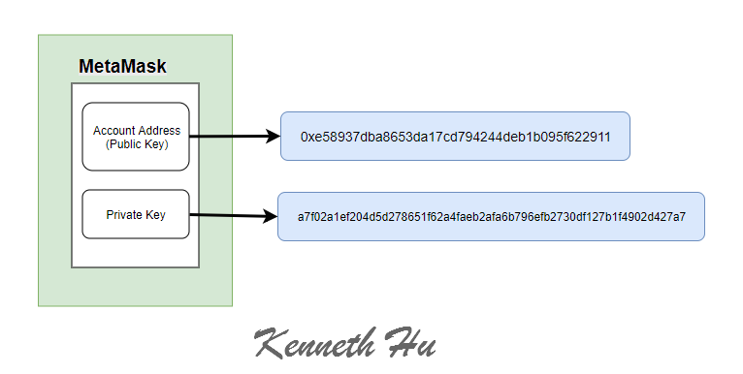
Account

Slide 20
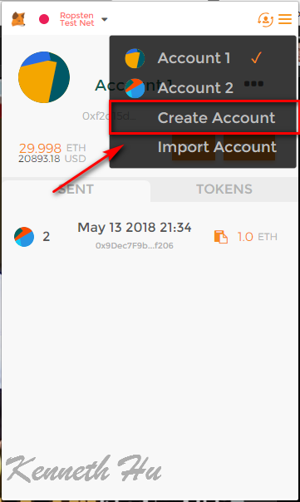
Create Account
Main
0xe589….
Ropsten
0xe589….
Public Key (Account)
Kovan
0xe589….
Private Key
Rinkeby
0xe589….

Slide 21
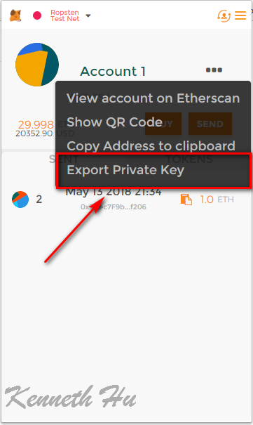
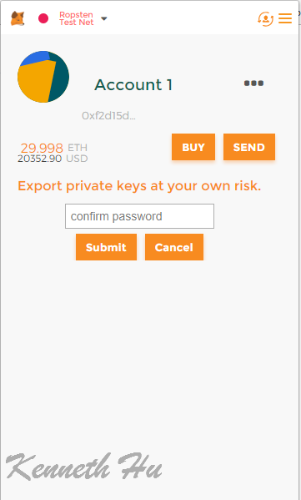
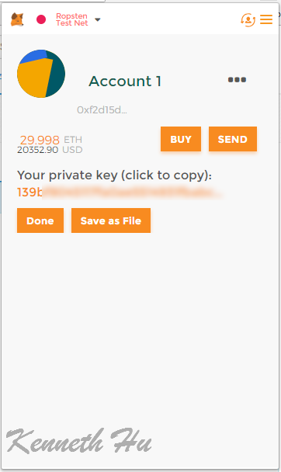
Metamask - Export Account
Export Account →Export Private Key

Slide 22
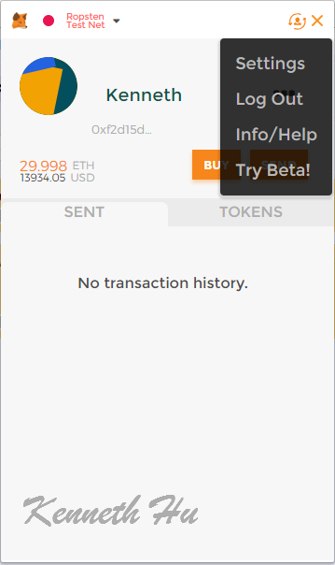
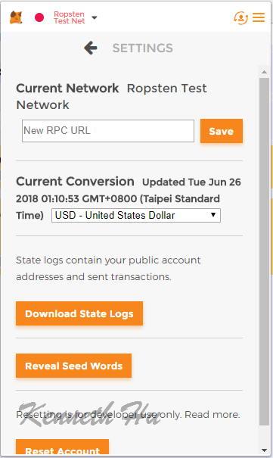
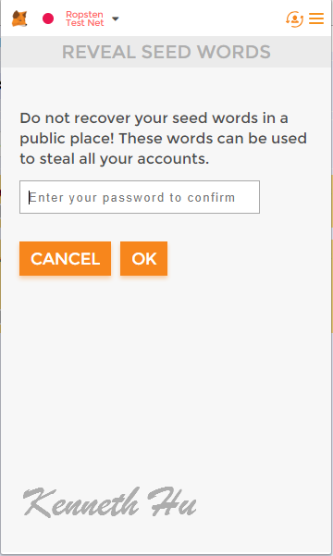
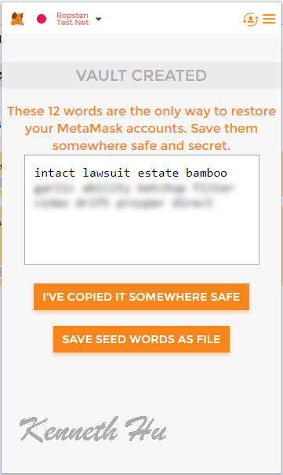
Metamask - Export Account
Export Account → Export Seed

Slide 23
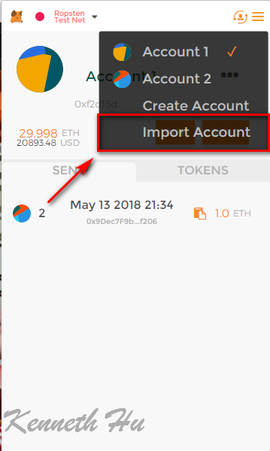
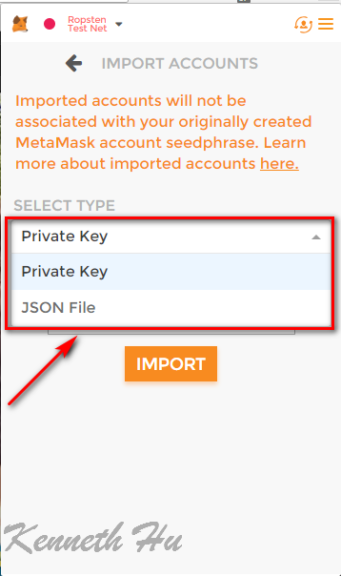
Metamask - Import Account
Private Key
JSON File

Slide 24
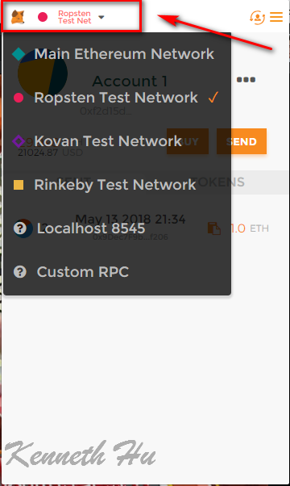
Metamask - Network
Main Ethereum Network
Ropsten Test Network
Kovan Test Network
Rinkeby Test Network
Localhost 8545
Custom RPC

Slide 25
Metamask – Get Ether
Ropsten faucet
https://faucet.metamask.io/
Kovan faucet
https://gitter.im/kovan-testnet/faucet
Rinkeby faucet
https://faucet.rinkeby.io/
Twitter
Google
Facebook

Slide 26
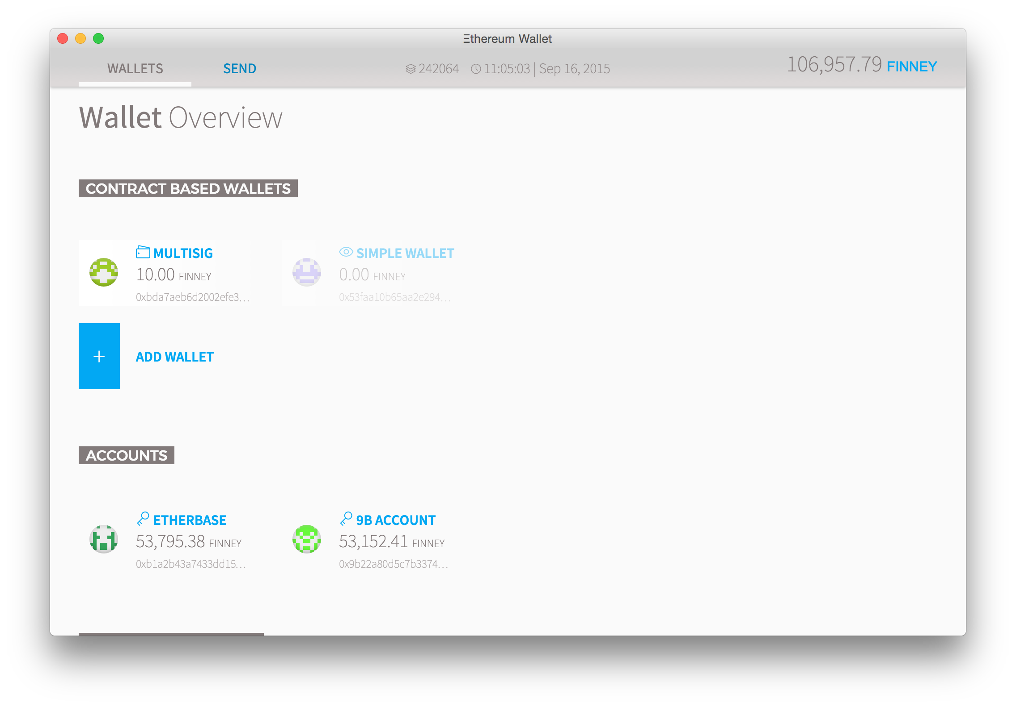
Dapps – Ethereum wallet
https://wallet.ethereum.org

Slide 27
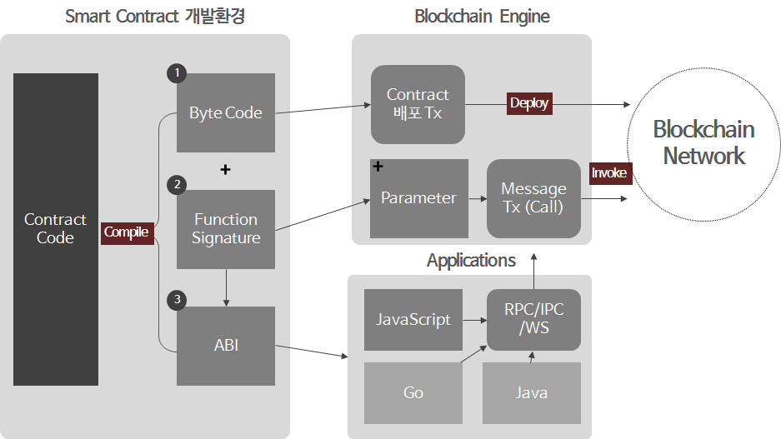
How to interact with Web3

Slide 28
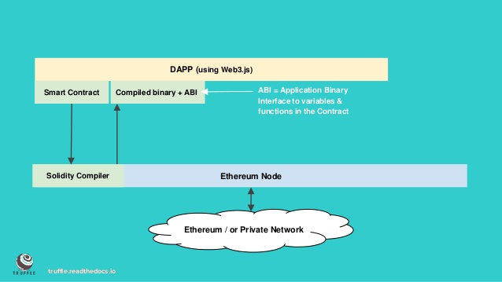
How to interact with Web3

Slide 29
