Slide 1

Ethereum Experiencing --build a pet shop with truffle
BoB Jiang
HiBlock blockchain developer community

Slide 2
Agenda
Introduce Ethereum
Prepare Developer Environment
Create project
Program your first smart contract with solidity
Compile and migrate your contract with truffle
User Interface (UI)

Slide 3
What is Ethereum
Ethereum is a decentralized platform that runs smart contracts: applications that run exactly as programmed without any possibility of downtime, censorship, fraud or third-party interference.
On traditional server architectures, every application has to set up its own servers that run their own code in isolated silos, making sharing of data hard. If a single app is compromised or goes offline, many users and other apps are affected. (E.g Lazada)
On a blockchain, anyone can set up a node that replicates the necessary data for all nodes to reach an agreement and be compensated by users and app developers. This allows user data to remain private and apps to be decentralized like the Internet was supposed to work.

Slide 4
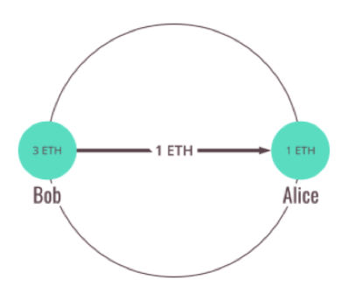
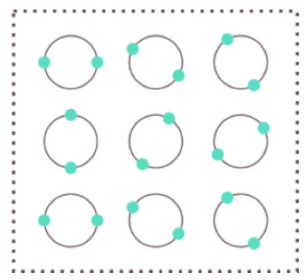
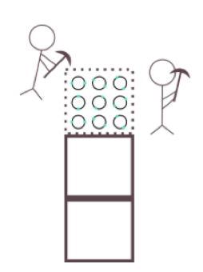
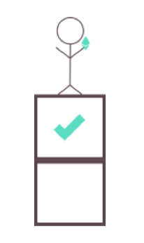
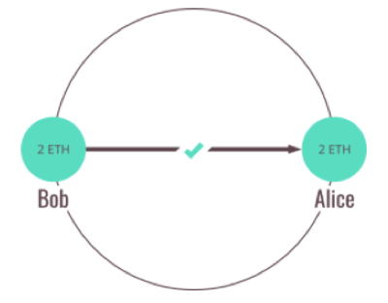

Blockchain basis
NODE
P2P
NETWORK
P2P
… more ethereum nodes

Slide 5
What is Ethereum Virtual Machine
The Ethereum Virtual Machine or EVM is the runtime environment for smart contracts in Ethereum.
Accounts
Transactions
Gas
https://solidity.readthedocs.io/en/v0.4.23/introduction-to-smart-contracts.html#overview

Slide 6
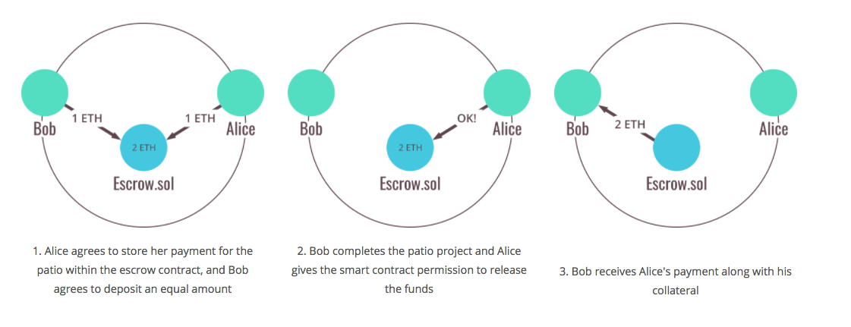
What is Smart Contract

Slide 7
Let’s do IT

Slide 8
Agenda
Introduce Ethereum
Prepare Developer Environment
Create project
Program your first smart contract with solidity
Compile and migrate your contract with truffle
User Interface (UI)

Slide 9
Context
BoB would like to hold a pet shop for adopting pets. The shop has only 16 pets at this time, and they are already there. As an initial PoC, BoB wants to see a dapp which associates an Ethereum address with a pet to be adopted.
In this example, website structure will be supplied, so we will focus on program our smart contract and front-end logic.
Our focus: smart contract with solidity, and interact with smart contract with web3

Slide 10
Developer environment
Node.js 6+ with npm (bundled)
Git
Compile/migrate(deploy): truffle
Ethereum private(test) chain: ganache
http://truffleframework.com/ganache

Slide 11
Create project
Truffle box - http://truffleframework.com/boxes
truffle unbox pet-shop
truffle init

Slide 12
Program & Compile & Deploy
Compile
Deploy
Smart Contract
.json
bytecode or
ABI…
Ethereum;
Address of contract
Font-end
web3 provider
initiate
call function
https://github.com/ethereum/wiki/wiki/JavaScript-API#web3setprovider

Slide 13
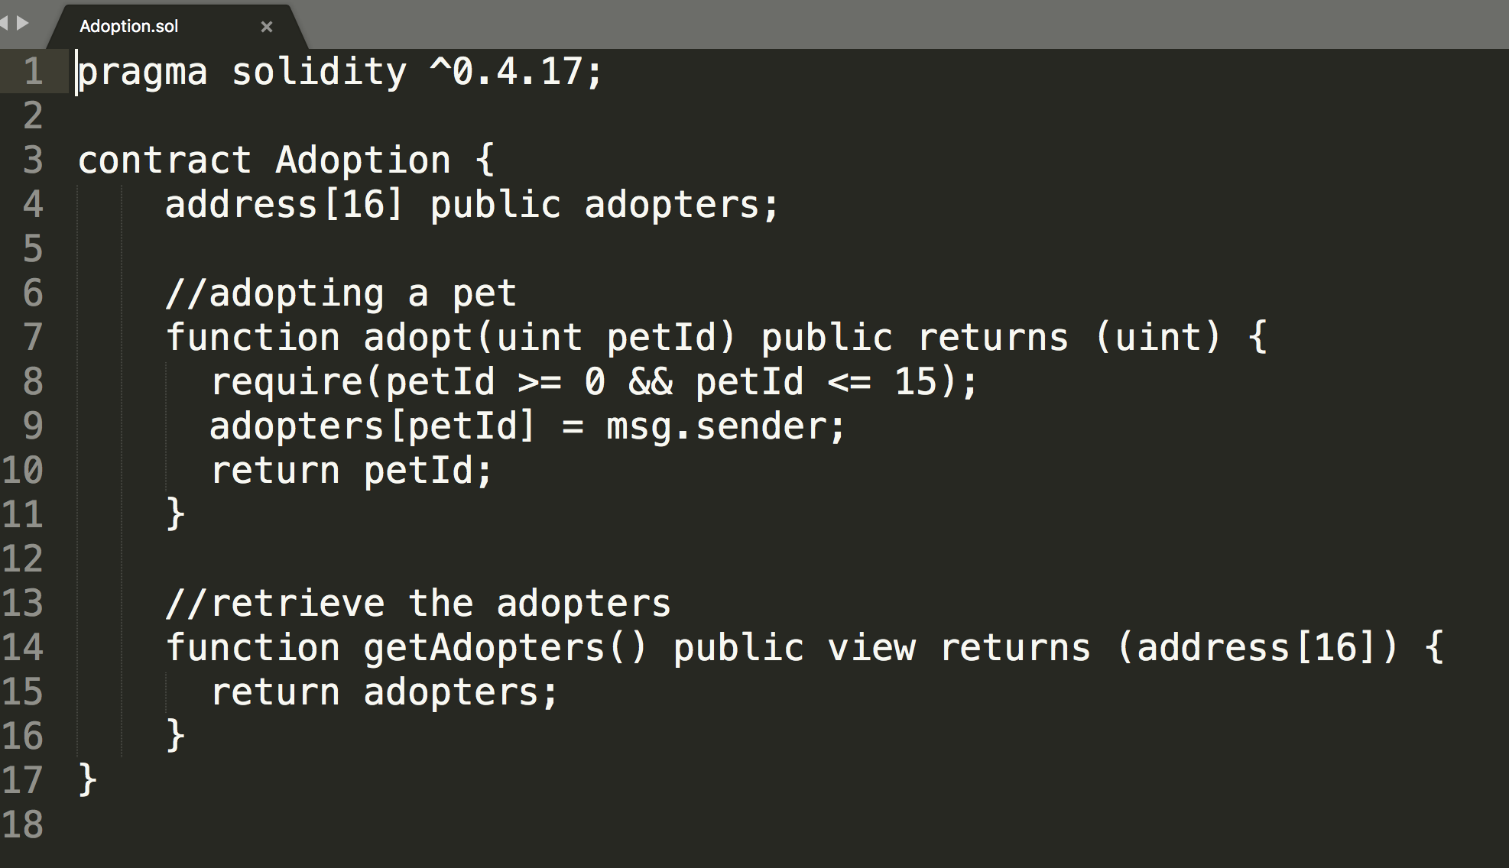

Slide 14
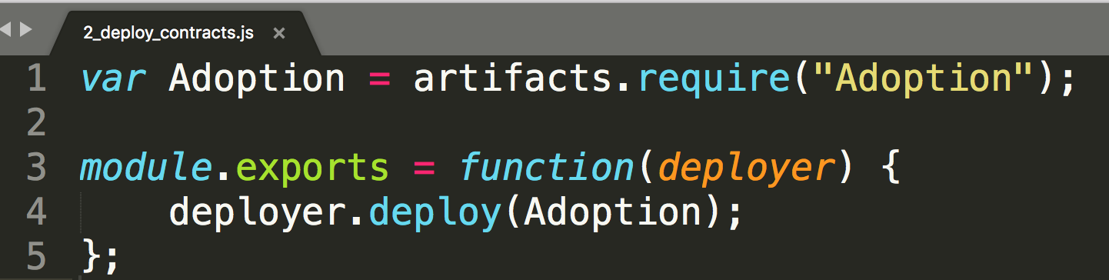
Compile & Migrate
truffle compile
prepare migration script -
truffle migrate

Slide 15
UI
init
initWeb3
initContract
markAdopted
handleAdopt
https://github.com/ethereum/web3.js/

Slide 16
References
https://solidity.readthedocs.io/
http://truffleframework.com/tutorials/ethereum-overview
http://truffleframework.com/tutorials/pet-shop
https://github.com/BlockGathering/public-course/ (slides and source codes)

Slide 17
Contact me:
slides will be shared in telegram group:
https://t.me/hiblock
twitter: https://twitter.com/HiBlock_Net
Thanks!
Notes:
在 “幻灯片放映”模式，单击箭头进入 PowerPoint 入门中心。

Slide 18
Easter Egg 1
Assignment
https://github.com/Olympus-Labs/community
By 5/15/2018
Each complete the assignment, will win 20 MOT
code
test pass
pull request
leave your ether wallet address, e.g AlphaWallet
Best one will win 200 MOT

Slide 19

Easter Egg 2

