Slide 1
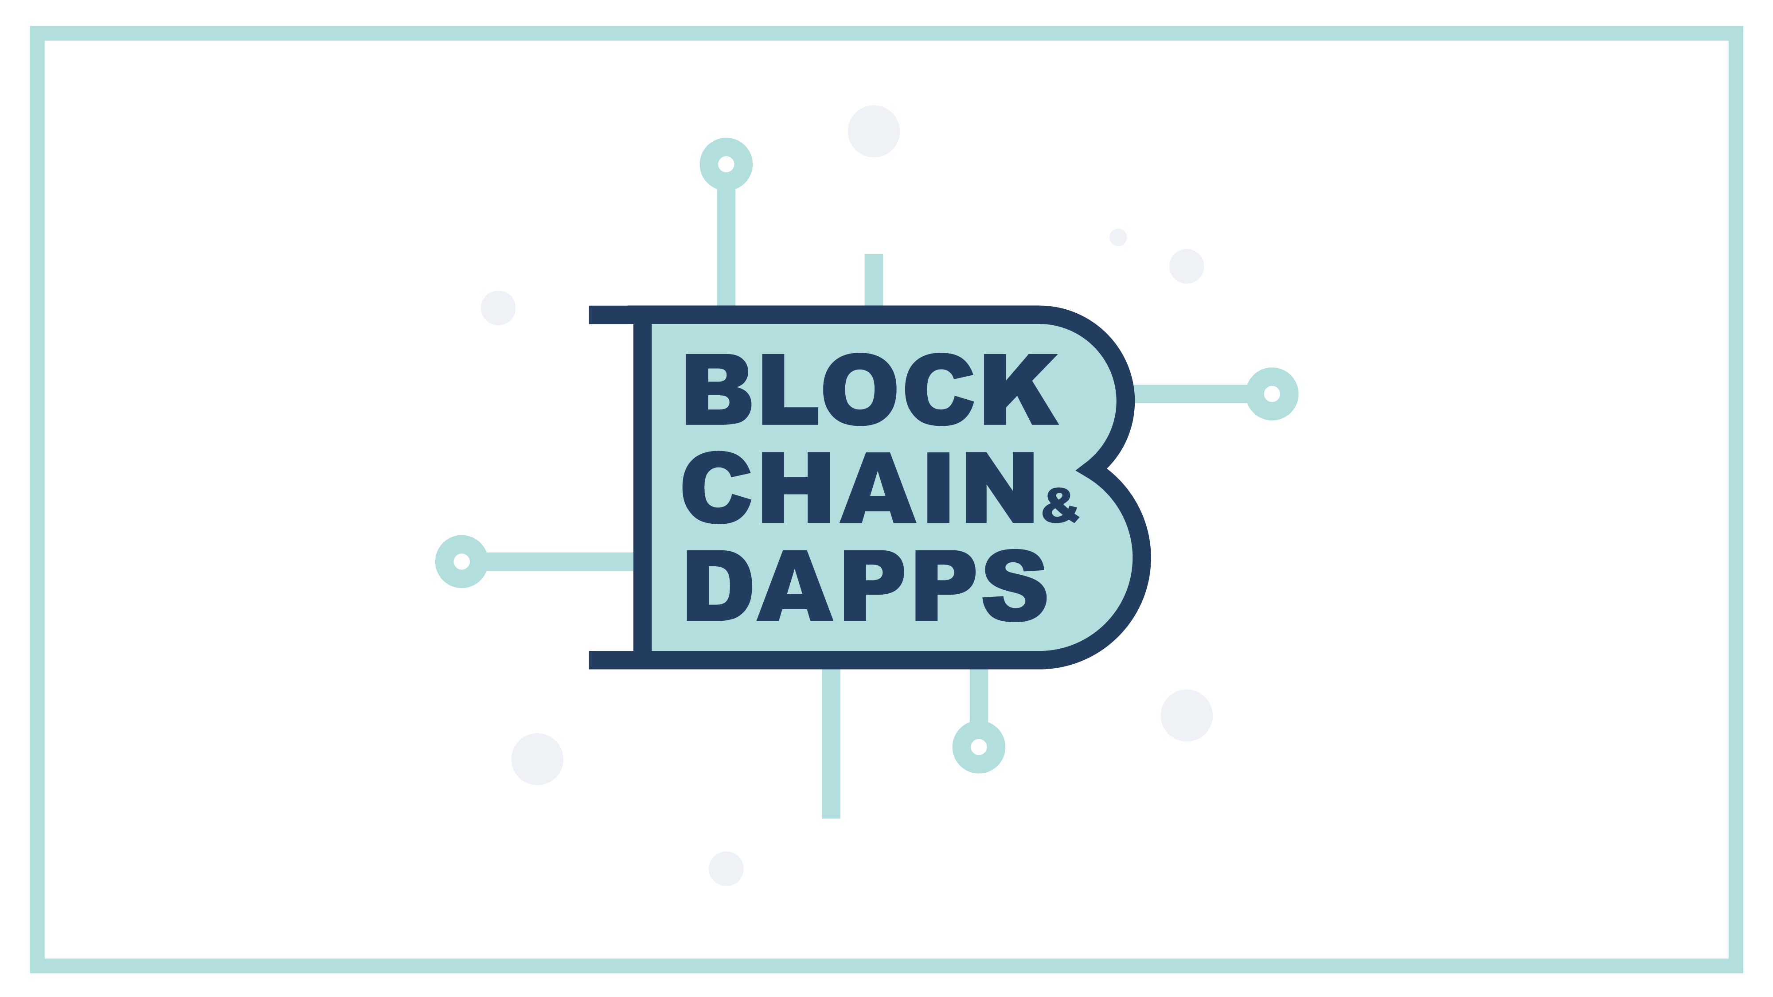

Slide 2

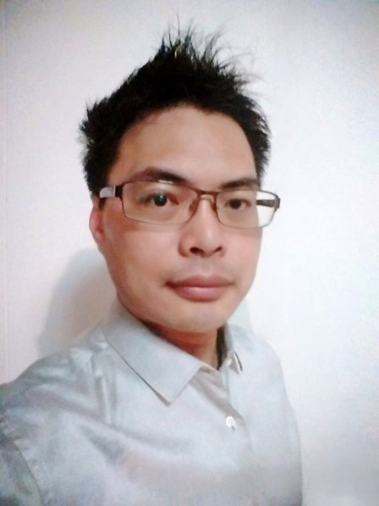
Kenneth Hu
I am a software developer , not trader.
I am enthusiast, not expert.
Ethereum, Bitcoin, AR, ChatBot
Email: Kenneth.hu@Hotmail.com
Founder of Blockchain&Dapps meetup
Founder of Singapore IOTA meetupz

Slide 3
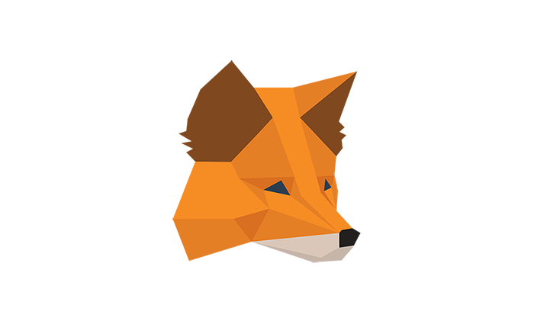
MetaMask
A Ether Wallet
Chrome、Firefox and Opera Plugin
Similar to MIST-Browser
No geth node
Is a bridge
Like a “light-client”
A “Key store” for your private keys
Notes:
Metamask is a cryptocurrency wallet which can be used on the Chrome, Firefox and Brave browsers. It’s also a browser extension. This means that it works like a bridge between normal browsers and the Ethereum blockchain.

Slide 4
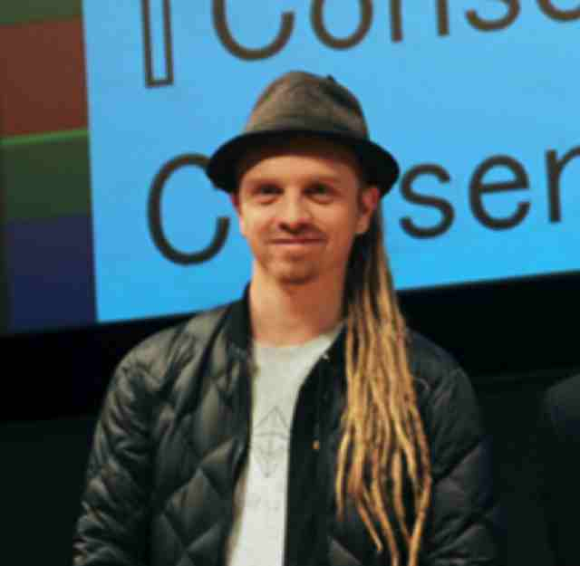
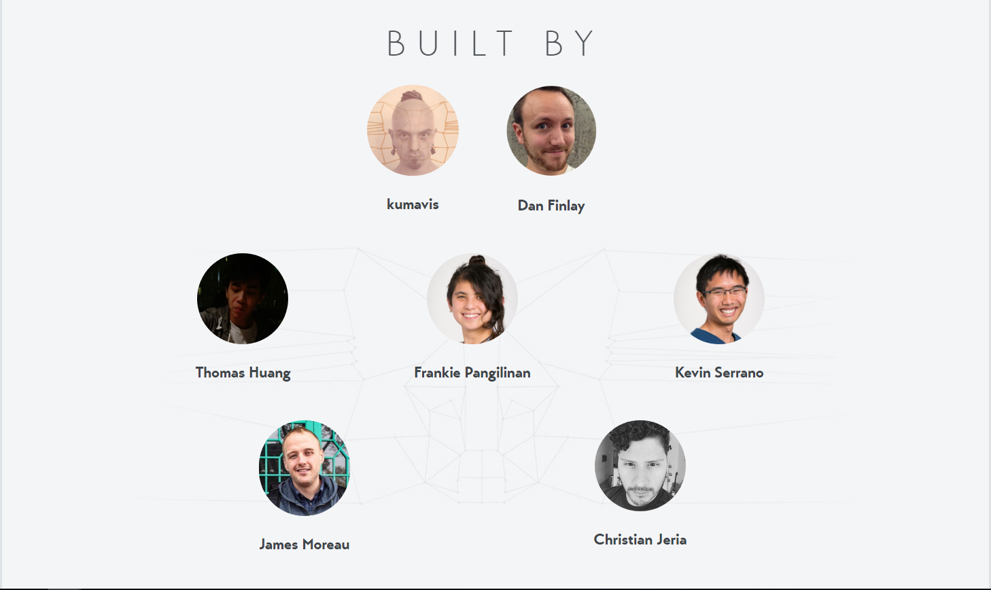
MetaMask – dev team
Team leader : Aaron “kumavis” Davis
Designer : Christian Jeria
Notes:
Metamask is a cryptocurrency wallet which can be used on the Chrome, Firefox and Brave browsers. It’s also a browser extension. This means that it works like a bridge between normal browsers and the Ethereum blockchain.

Slide 5
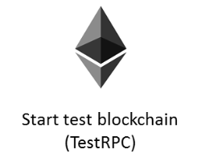



Metamask supported networks
Mainnet
ROPSTEN
RINKEBY
KOVAN

Slide 6
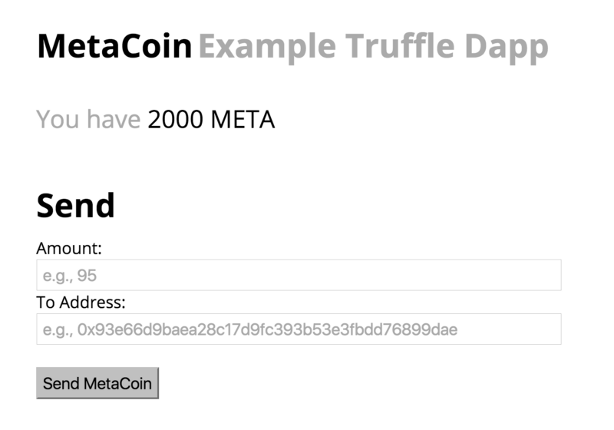

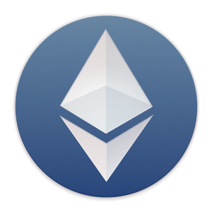
Metamask - Dapps
Blockchain

Slide 7
MetaMask : The Good stuff
Open source
HD setting (Hierarchical deterministic )
Built-in coin purchasing
Coinbase
ShapeShift
Simple interface
Local key storage
Community - over 40 thousand followers on Twitter
Notes:
https://www.bitdegree.org/tutorials/metamask/

Slide 8
MetaMask : The Bad stuff
Easy to lost your private key or seeds if you did not do backup
Online
Only support hot storage
Notes:
https://www.bitdegree.org/tutorials/metamask/
Online wallets have advantages and disadvantages. One of the main disadvantages is security. Any information that’s stored online is more at risk from hackers than information that’s stored offline. MetaMask doesn’t provide enough security by itself.

Slide 9


How the metamask works
Infura – Ethereum node
Ethereum blockchain network

Slide 10
How the metamask works
Difference : Call/Transaction
Transaction Invoked through injected web3
Web3.eth.sendTransaction(…)
Popup appears
User accepts transaction
MetaMask Plugin signs transaction
Sent through the network
Call
Data is downloaded from the Network

Slide 11
DATA SOURCE
Data needs to come from somewhere
RPC Interface of some kind
Infura
Scalable Blockchain Infrastructure
500 Million Requests per Day
“HOSTED BLOCKCHAIN”
Like running your geth node lik ganache, testrpc… etc.

Slide 12


How transactions work visually
3. signs transaction with User’s private key
1. starts transaction
Mainnet
4. Sends the signed transaction to infura
5. Published on the network
2. User submits transaction

Slide 13
How calls work visually
1. Asks for information (call)
2. Forwards the call via RPC to infura
3. Node sends Data back
Mainnet

Slide 14
Is it “SECURE” ?
Private keys are only stored on your browser
Don’t lose the seed or password
Not totally decentralized
You have to trust infura

Slide 15
MetaMask
How to use METAMASK
Create Account
Export Account
Import Accounts
Private key
JSON File
Send Ether
Buy Ether
Network

Slide 16
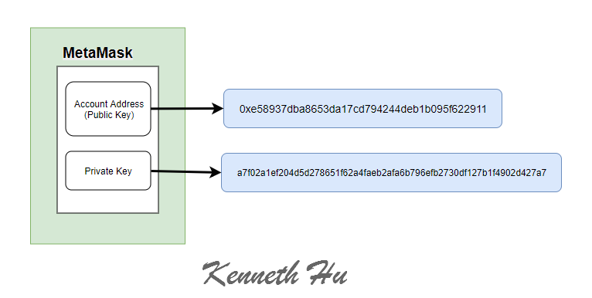
Account

Slide 17
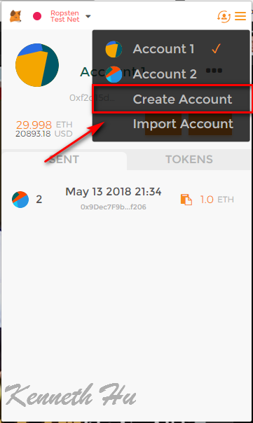
Create Account
Main
0xe589….
Ropsten
0xe589….
Public Key (Account)
Kovan
0xe589….
Private Key
Rinkeby
0xe589….

Slide 18
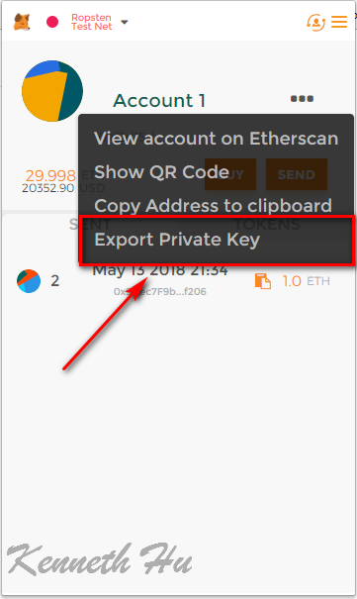
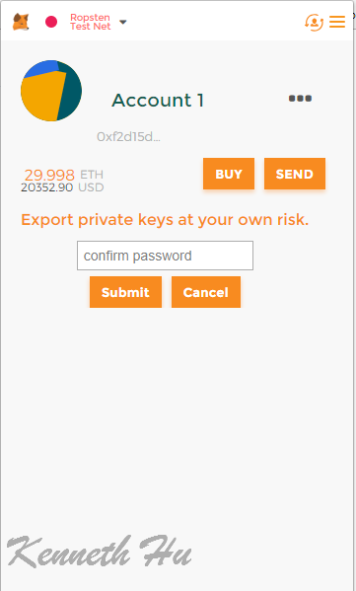
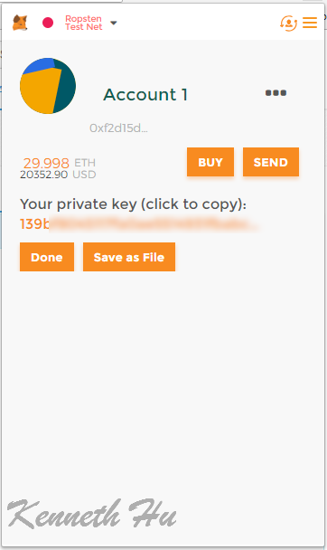
Metamask – Export account
Export account →Export private key

Slide 19
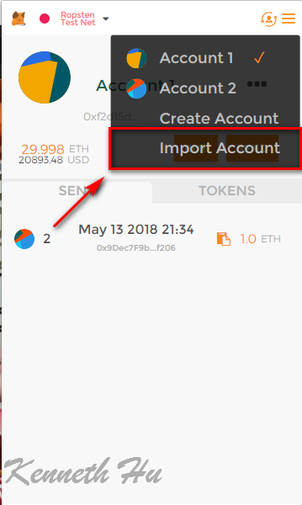
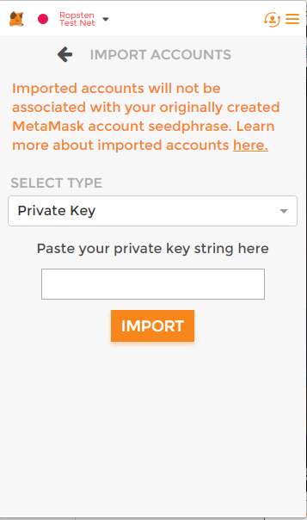
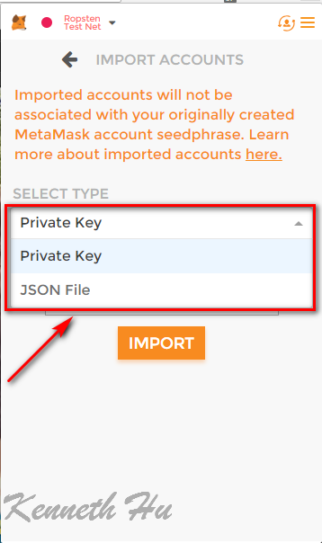
Metamask – Import account
Private Key
JSON File

Slide 20
Metamask – send Ether
Click “SEND”

Slide 21
Metamask – Buy Ether
Coinbase
ShapeShift

Slide 22
Metamask – Buy Ether
Coinbase ShapeShift

Slide 23
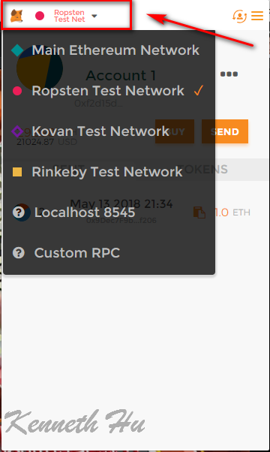
Metamask – Network
Main Ethereum Network
Ropsten Test Network
Kovan Test Network
Rinkeby Test Network
Localhost 8545
Custom RPC

Slide 24
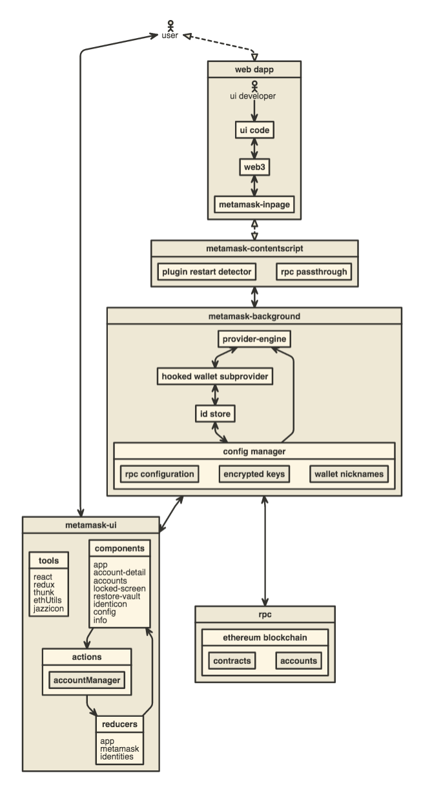
Metamask –Architecture

Slide 25
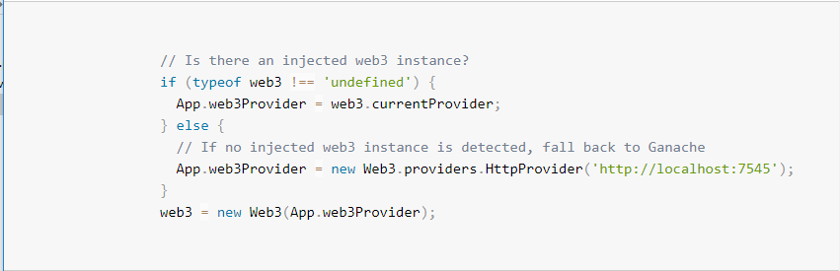
Metamask –web3
Metamask already initial web3 object

Slide 26
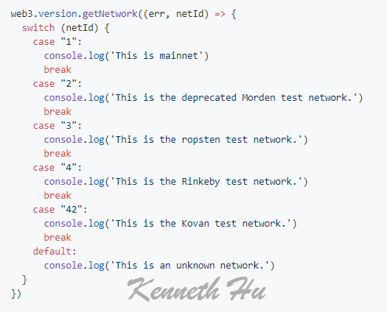
Network check

Slide 27
