Slide 1
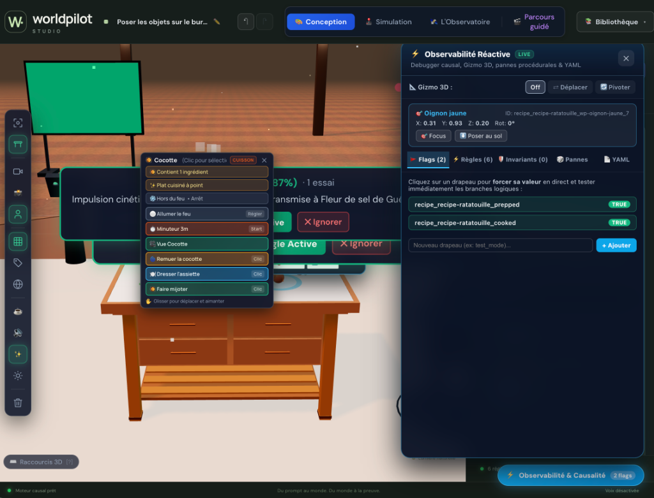
VICTORIA VR HACKATHON • AI BUILDERS FOR THE AI VERSE
WorldPilot: From Prompt-to-Scene to Formally Verified 3D Worlds
Why iterative 3D world-building breaks when AI regenerates scenes — and how a causal compiler fixes it.
THE BOTTLENECK
Prompt #1 Is Easy. Prompt #2 Breaks.
One-shot AI scene generators overwrite spatial rules, quest wiring, and safety invariants on subsequent edits.
THE PARADIGM SHIFT
Neuro-Symbolic Causal Compiler (WorldIR)
Prompts compile into atomic, reversible WorldPatches over a typed Entity + Rule + Invariant graph.
ZERO RUNTIME LLM
60 FPS Local • 0 eval() • 100/100 Certified
No generated JS/C# code and no LLM in the 60 FPS loop — safe, deterministic, and offline-ready.
LIVE IN WORLDPILOT: 3D Studio + F2 Reactive Causal Debugger + 1-Click In-Situ Rule Promotion
1 / 6 • WorldPilot Studio • Declarative Causal Engine for the AI Verse
Notes:
SPEAKER NOTES — SLIDE 1:
Generating a 3D scene from a first prompt is solved. What breaks every existing AI world builder is Prompt #2, #3, and #4.
When a creator modifies an object, naive LLM pipelines regenerate the scene and silently destroy previously authored causal rules.
WorldPilot compiles natural language into atomic WorldPatches on a formal intermediate representation (WorldIR), keeping the runtime 100% deterministic at 60 FPS.

Slide 2
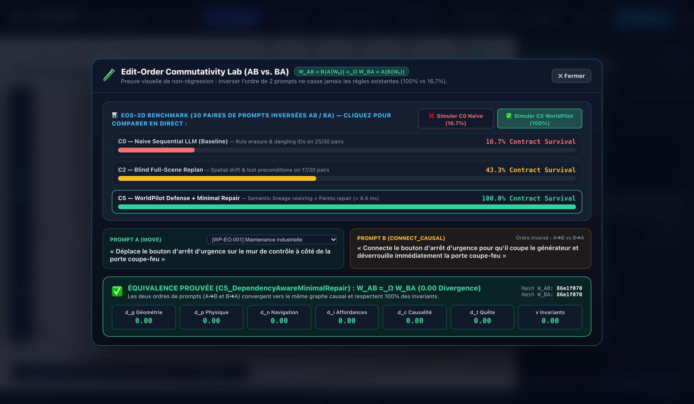
PILLAR 1 • NON-DESTRUCTIVE EDITING & COMMUTATIVITY
Edit-Order Invariance: W_AB ≈ W_BA (100% vs. 16.7% Survival)
Replacing an entity rewires its entire causal & pedagogical lineage automatically instead of orphaning rules.
100% vs. 16.7%
EOS-3D Benchmark (120 Paired Runs)
Naive sequential LLM edits (C0) lose 83.3% of behavioral contracts; WorldPilot (C5) preserves 100%.
SEMANTIC LINEAGE
Battery 12V ➔ Emergency Generator
Entity replacement automatically rebinds triggers, predicates, quest steps, and safety invariants.
D_Ω = 0.00
7-Layer Behavioral Equivalence Proof
Order A➔B and Order B➔A converge to identical state hashes (86e1f070) across all 7 WorldIR layers.
LIVE IN WORLDPILOT (`test ab ba`): Edit-Order Commutativity Lab Proving W_AB ≈_Ω W_BA (100% vs. 16.7%)
2 / 6 • Trigger live in WorldPilot: type `test ab ba` or click `🧪 AB≈BA : 100% vs 16.7%` in F2
Notes:
SPEAKER NOTES — SLIDE 2:
In WorldPilot, typing `test ab ba` or clicking the `AB≈BA : 100% vs 16.7%` badge inside F2 opens our live Edit-Order Commutativity Lab.
You can toggle live between C0 Naive Sequential (16.7% contract survival) and C5 WorldPilot Defense (100% contract survival, 0.00 divergence across all 7 layers).

Slide 3
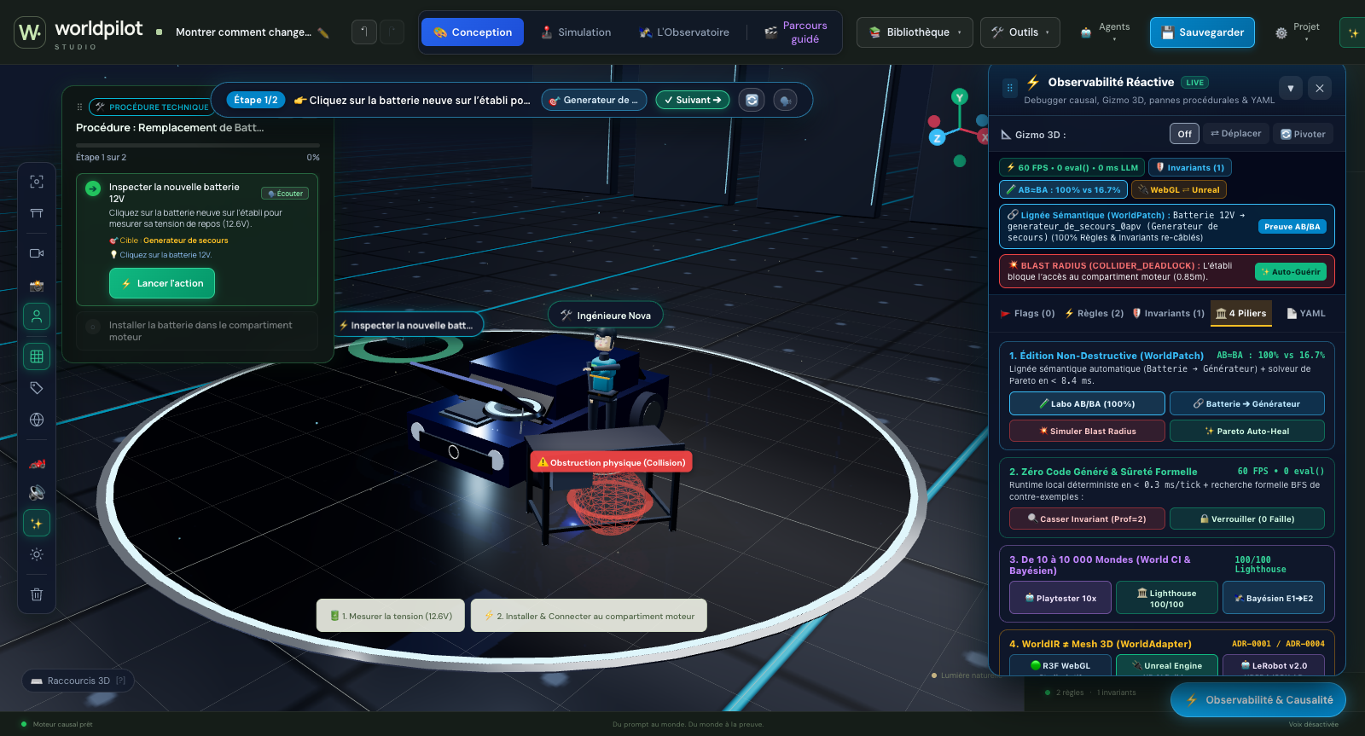
PILLAR 2 • SPATIAL CONFLICT DETECTION & AUTO-HEAL
3D Blast Radius Guard & < 8.4 ms Pareto Minimal Repair
Detecting physical-logical deadlocks in real time and repairing them without undoing the author’s intent.
COLLIDER_DEADLOCK
Cross-Rule Spatial Blast Radius (Score 0.64)
Moving the workbench in front of the engine bay is immediately flagged for blocking an existing rule.
< 8.4 ms SOLVER
Pareto Minimal Displacement (+0.85m)
Computes the smallest geometric shift that restores full clearance while keeping the workbench nearby.
0 REGRESSIONS
Formal Safety Counterexample Lock
Bounded BFS finds depth-2 safety violations and locks `require_flag(battery_inspected == TRUE)`.
LIVE IN WORLDPILOT (F2): 3D Collision Sphere + Semantic Lineage Banner + 1-Click `✨ Auto-Guérir` Pareto Repair
3 / 6 • Trigger live in WorldPilot: click `💥 Simuler Blast Radius` then `✨ Auto-Guérir` inside F2 > 4 Piliers
Notes:
SPEAKER NOTES — SLIDE 3:
When an edit creates a spatial deadlock with an earlier rule, WorldPilot surfaces a red Blast Radius banner inside F2 and renders the 3D obstruction sphere.
One click on `Auto-Guérir` (or typing `Corrige le conflit spatial sans annuler mon intention`) runs our <8.4ms Pareto solver to shift the workbench by +0.85m.

Slide 4
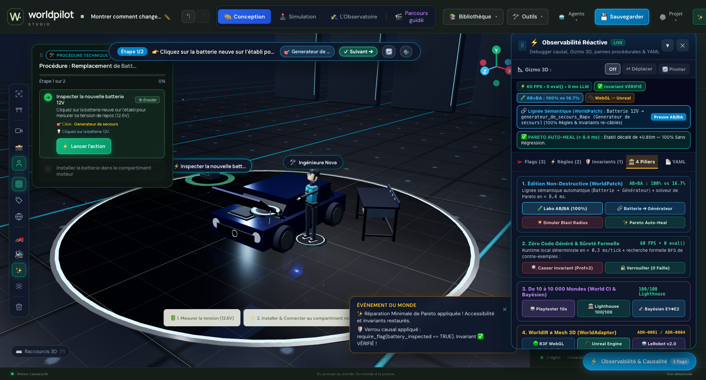
PILLAR 3 • ZERO GENERATED CODE & WORLD CI (10 TO 10,000 WORLDS)
60 FPS Deterministic Runtime & Autonomous World CI Pipeline
Why we never generate runtime JS/C# code — and how we certify 10,000 worlds without human QA.
0 eval() • <0.3 ms
LLM at Compile-Time Only, Never at Runtime
Zero hallucinated scripts, zero code-injection surface, zero token cost or latency during 60 FPS gameplay.
10x PLAYTESTER
Autonomous Monte-Carlo Bots (Cmd+Y)
Adversarial & exploratory bots stress-test every quest branch and detect reachability dead-ends in seconds.
100 / 100 GATE
Spatial Lighthouse Audit (Cmd+P)
Automated 5-axis publication gate: Causal Integrity, Spatial Ergonomics, Pedagogy, Perf & Accessibility.
LIVE IN WORLDPILOT (`F2 > 🏛️ 4 Piliers`): Verified Invariants + Pareto Auto-Heal + Live UnrealWorldAdapter Bridge
4 / 6 • Trigger live in WorldPilot: open `F2 > 🏛️ 4 Piliers` or press `Cmd+K`, `Cmd+Y`, `Cmd+P`
Notes:
SPEAKER NOTES — SLIDE 4:
Inside F2, the new `4 Piliers` tab gives judges 1-click access to every verification gate: the AB/BA Lab, Blast Radius & Pareto Auto-Heal, 10x Playtester, Spatial Lighthouse 100/100, and the UnrealWorldAdapter bridge.

Slide 5
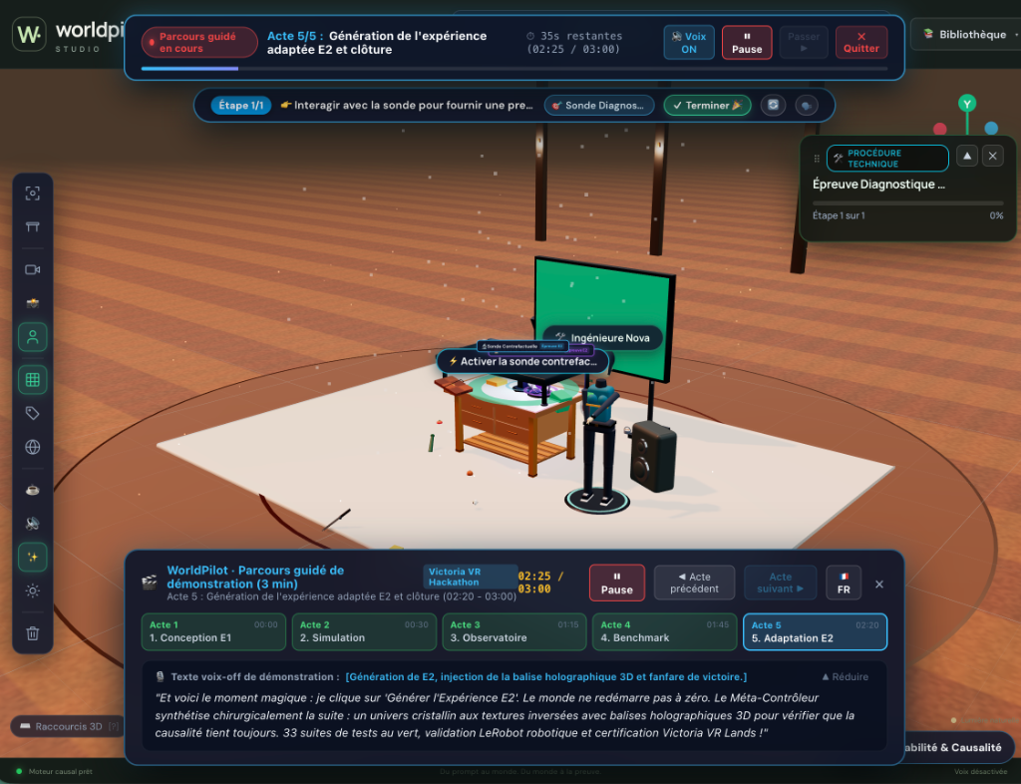
ADAPTIVE INTELLIGENCE • BAYESIAN TELEMETRY & COUNTERFACTUAL WORLDS
Distinguishing Lucky Guesses (27%) from True Mastery (95%)
When a user succeeds by trial-and-error, WorldPilot mutates the 3D world (E1 ➔ E2) to verify transfer.
P(L) = 27% vs 95%
Bayesian Knowledge Tracing on 3D Actions
Identical task completion yields 27% mastery under hesitant trial-and-error vs. 95% on a clean trajectory.
E1 ➔ E2 MUTATION
Isomorphic Counterfactual World Synthesis
Automatically compiles a new physical topology testing the exact same causal graph against rote memorization.
IN-SITU EMERGENCE
Shadow Behavior ➔ Formal Rule in 1 Click
Repeated unscripted 3D player actions are detected and promoted into deterministic WorldIR rules.
LIVE IN WORLDPILOT (`F3` & Guided Tour): Bayesian Mastery Diagnosis + 1-Click Counterfactual Transfer Probe (E1 ➔ E2)
5 / 6 • Trigger live in WorldPilot: press `F3` (Observatoire Causal) or launch `🎬 Parcours guidé`
Notes:
SPEAKER NOTES — SLIDE 5:
Completion is not comprehension. WorldPilot tracks 3D hesitation and causal errors in real time, computing a Bayesian posterior P(L).
When trial-and-error is detected (27%), WorldPilot synthesizes an isomorphic counterfactual world (E1 -> E2) in one click.

Slide 6
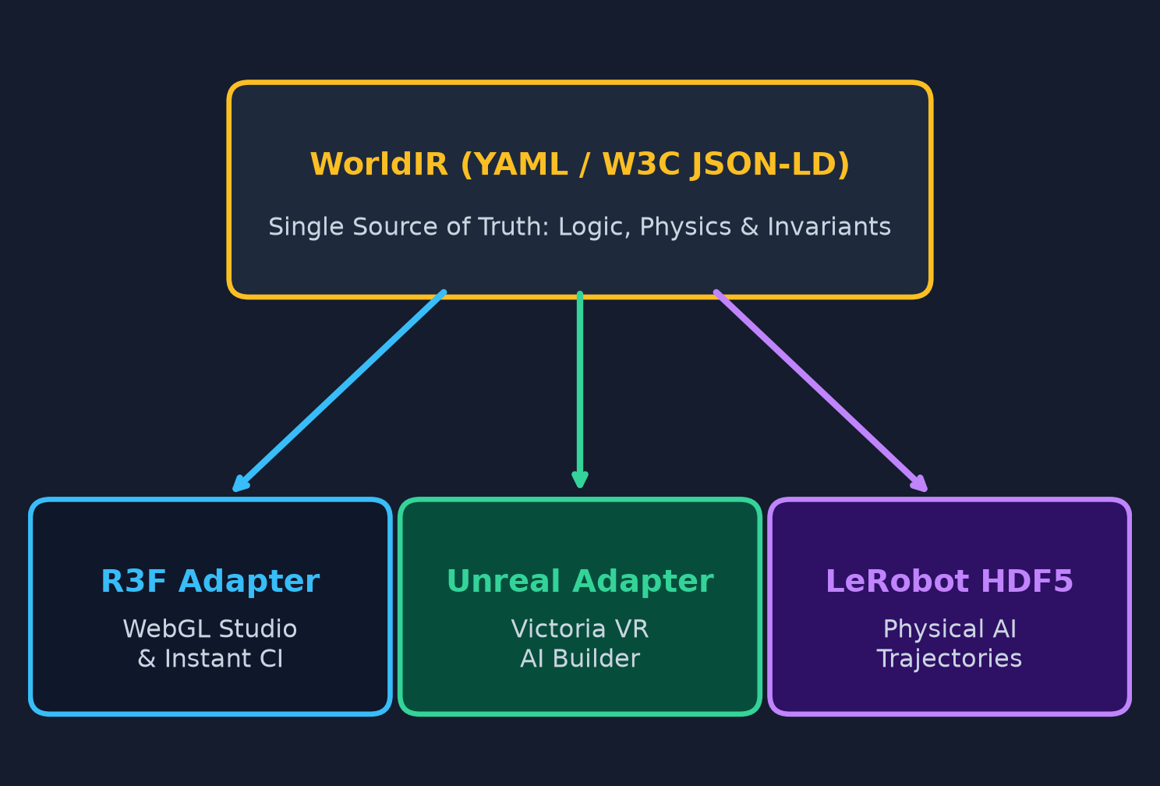
PILLAR 4 • PORTABLE WORLD SUBSTRATE FOR VICTORIA VR & EMBODIED AI
“3D Rendering Is Not the World”: 1 WorldIR ➔ 3 Execution Targets
Decoupling causal world semantics from the rendering engine via the strict WorldAdapter contract.
WEBGL TODAY
R3FWorldAdapter (Instant Browser Studio)
Zero-install 60 FPS authoring, live F2 causal debugging, and instant URL/YAML world sharing.
VICTORIA VR READY
UnrealWorldAdapter (AI Builder Bridge)
Maps WorldIR entities, PBR materials, sockets & verified causal graphs directly to Unreal Engine VR.
EMBODIED AI
LeRobot v2.0 HDF5 + W3C JSON-LD
Every verified 3D interaction exports 6-DoF trajectories & causal graphs for robotics and AI agents.
PORTABLE ARCHITECTURE (ADR-0001 / ADR-0004): One Verified WorldIR Graph Powering WebGL, Victoria VR & LeRobot v2.0
6 / 6 • WorldPilot • The Causal Compiler & Verification Layer for the Victoria VR Ecosystem
Notes:
SPEAKER NOTES — SLIDE 6:
Because 3D rendering is only a projection of the world, WorldPilot isolates all rendering inside a strict 5-method WorldAdapter interface.
The exact same verified WorldIR graph runs in React Three Fiber today, maps to Unreal Engine for Victoria VR AI Builder tomorrow, and exports LeRobot v2.0 HDF5 trajectories.

