Slide 1
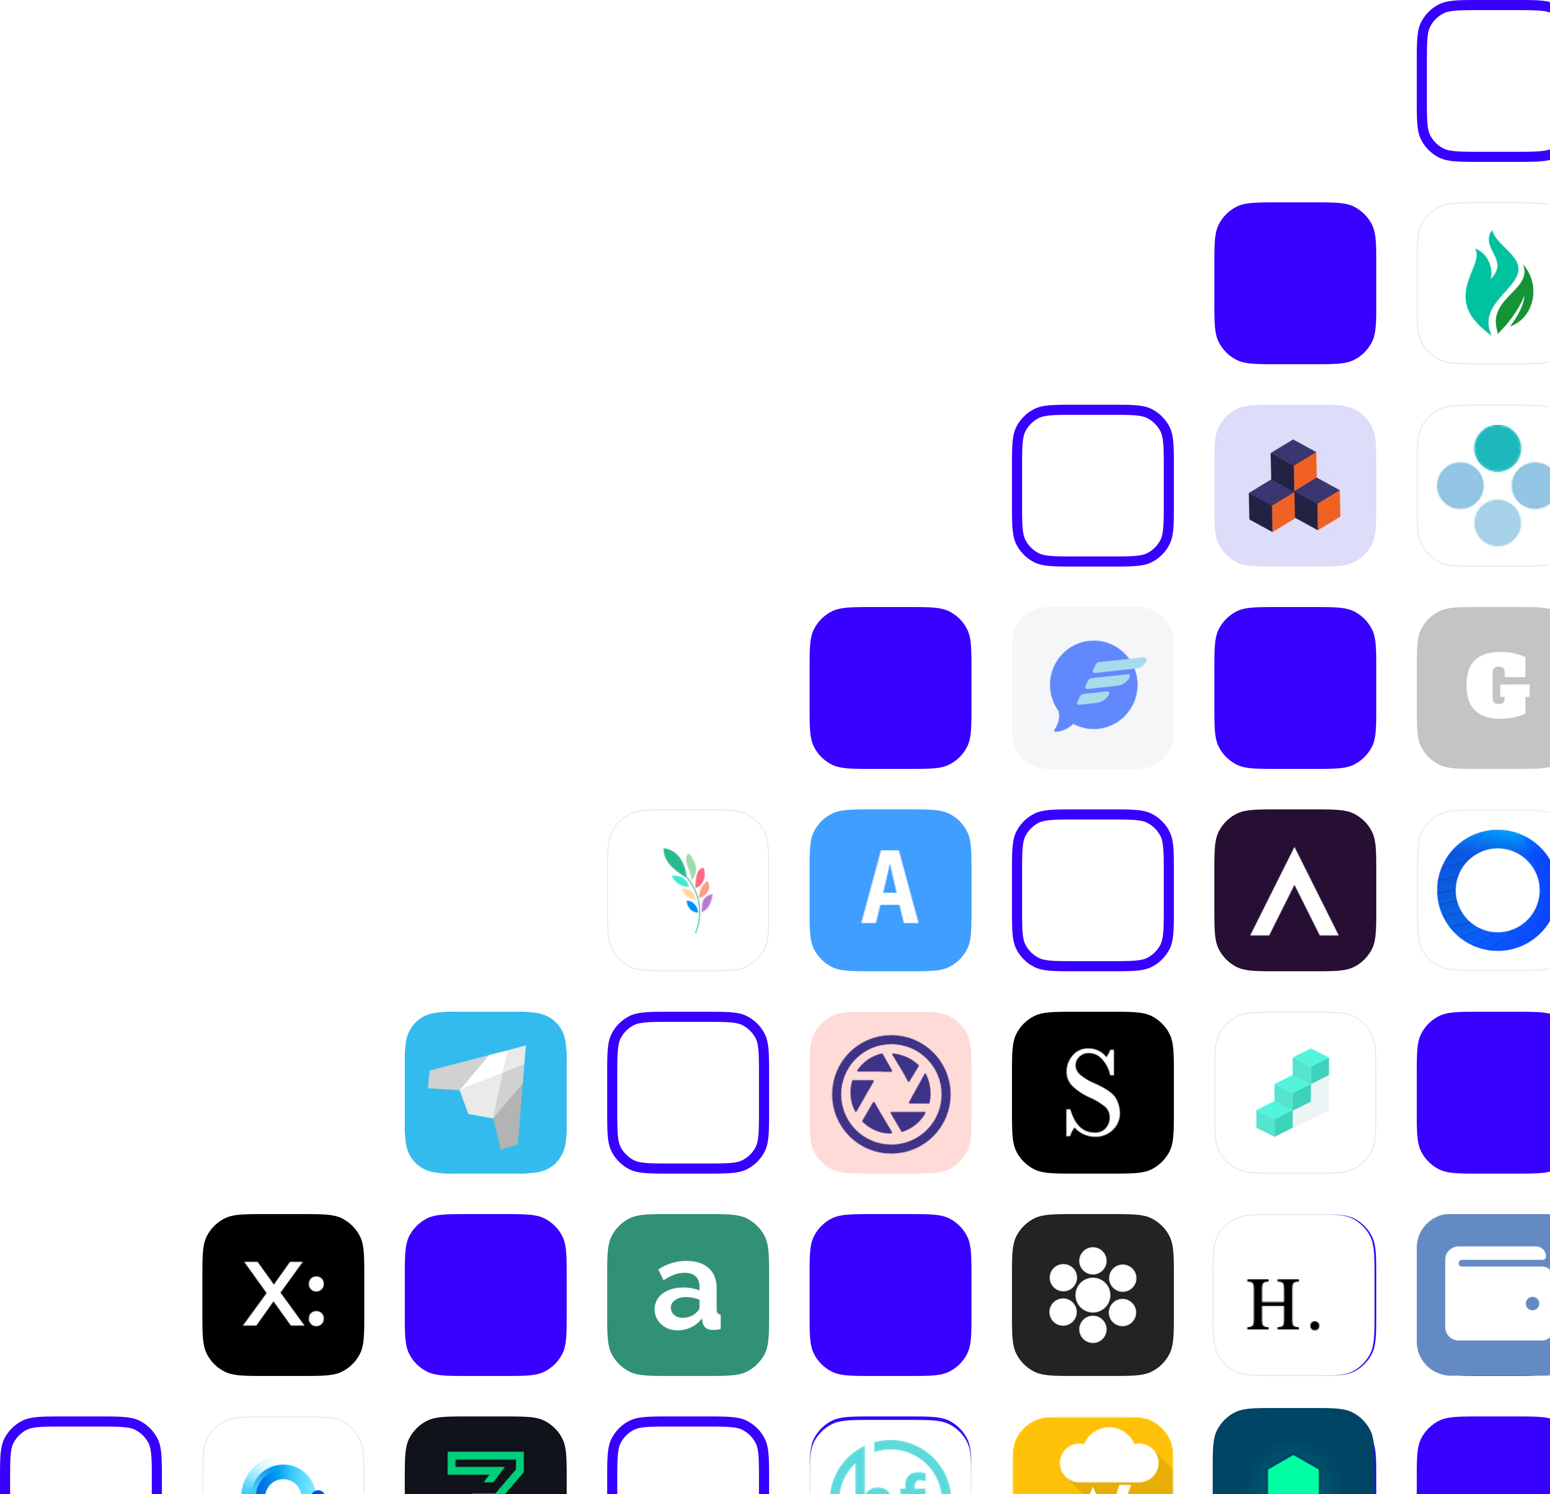
Building Decentralized Apps
with Blockstack
Harini Rajan
blocksurvey.org

Slide 2
Agenda
Blockstack Ecosystem
Blockstack Architecture
Demo to build a DApp in Blockstack
Blockstack Vs Ethereum
App Mining
Can't Be Evil Contest

Slide 3
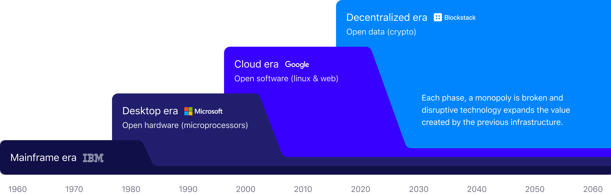
What does
Can’t Be Evil
Mean?
Current era
Data & trust breaches are causing consumers to second-guess data silos
Developers want more room for innovation outside of current data-monopolies
Developers want to reduce cost, overhead, and liability of deploying apps
Decentralized era
No data-monopolies, data is user owned and can be used in any app
Universal, password-less authentication
Apps run on user devices, explicit user opt-in and increased security

Slide 4
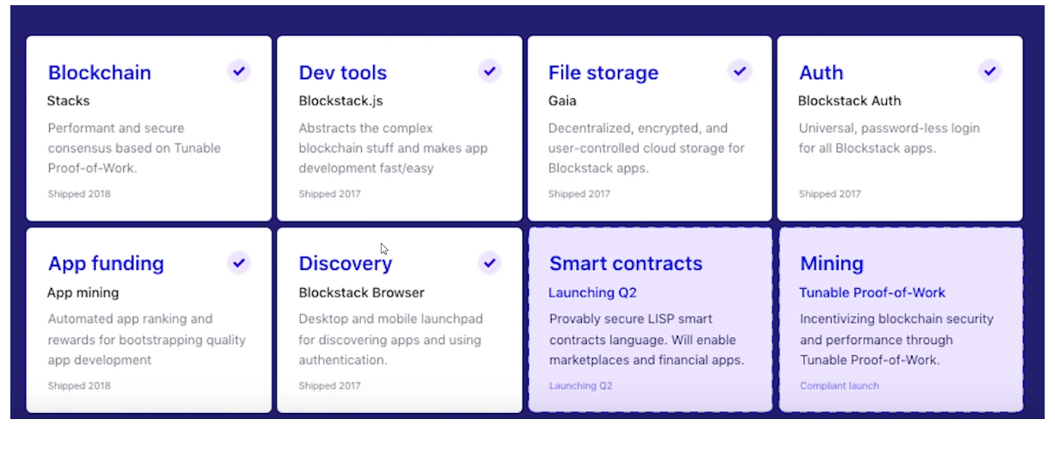
Blockstack Ecosystem
Notes:
Virtual chain
Blockstack.js
Gaia- encrypted private data locker
Mining - POW and POB

Slide 5
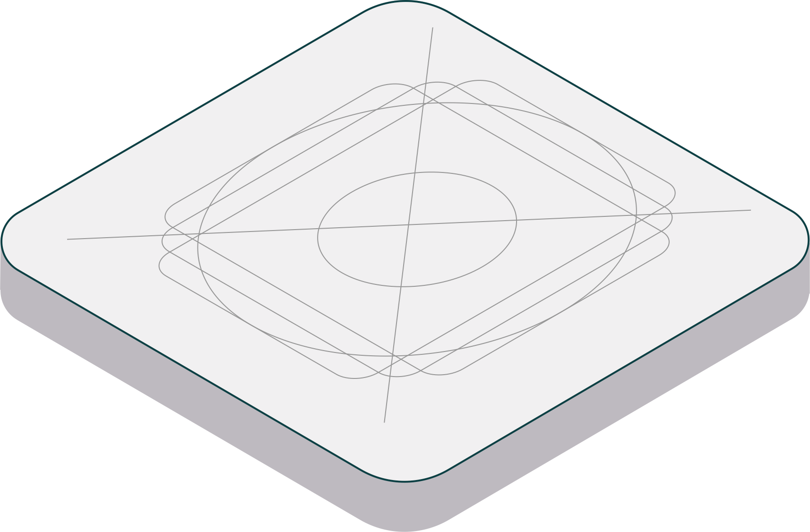
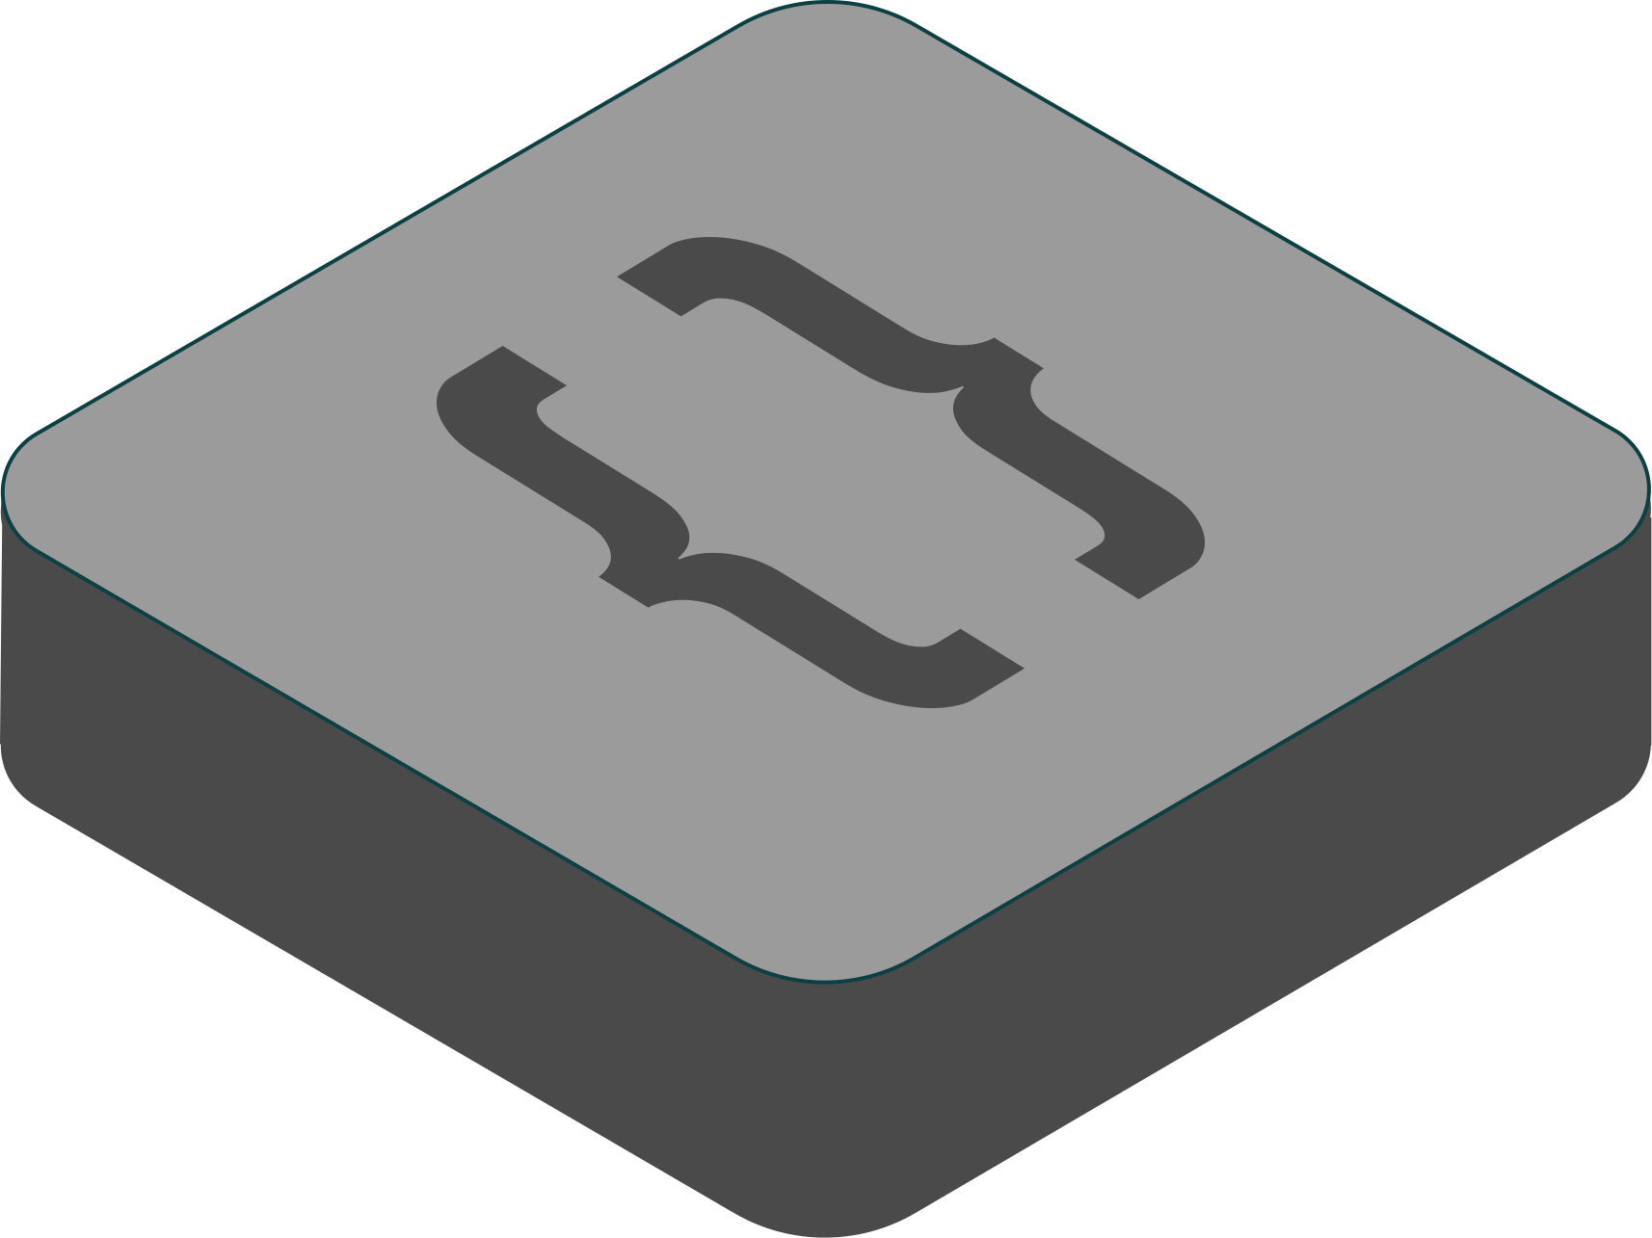
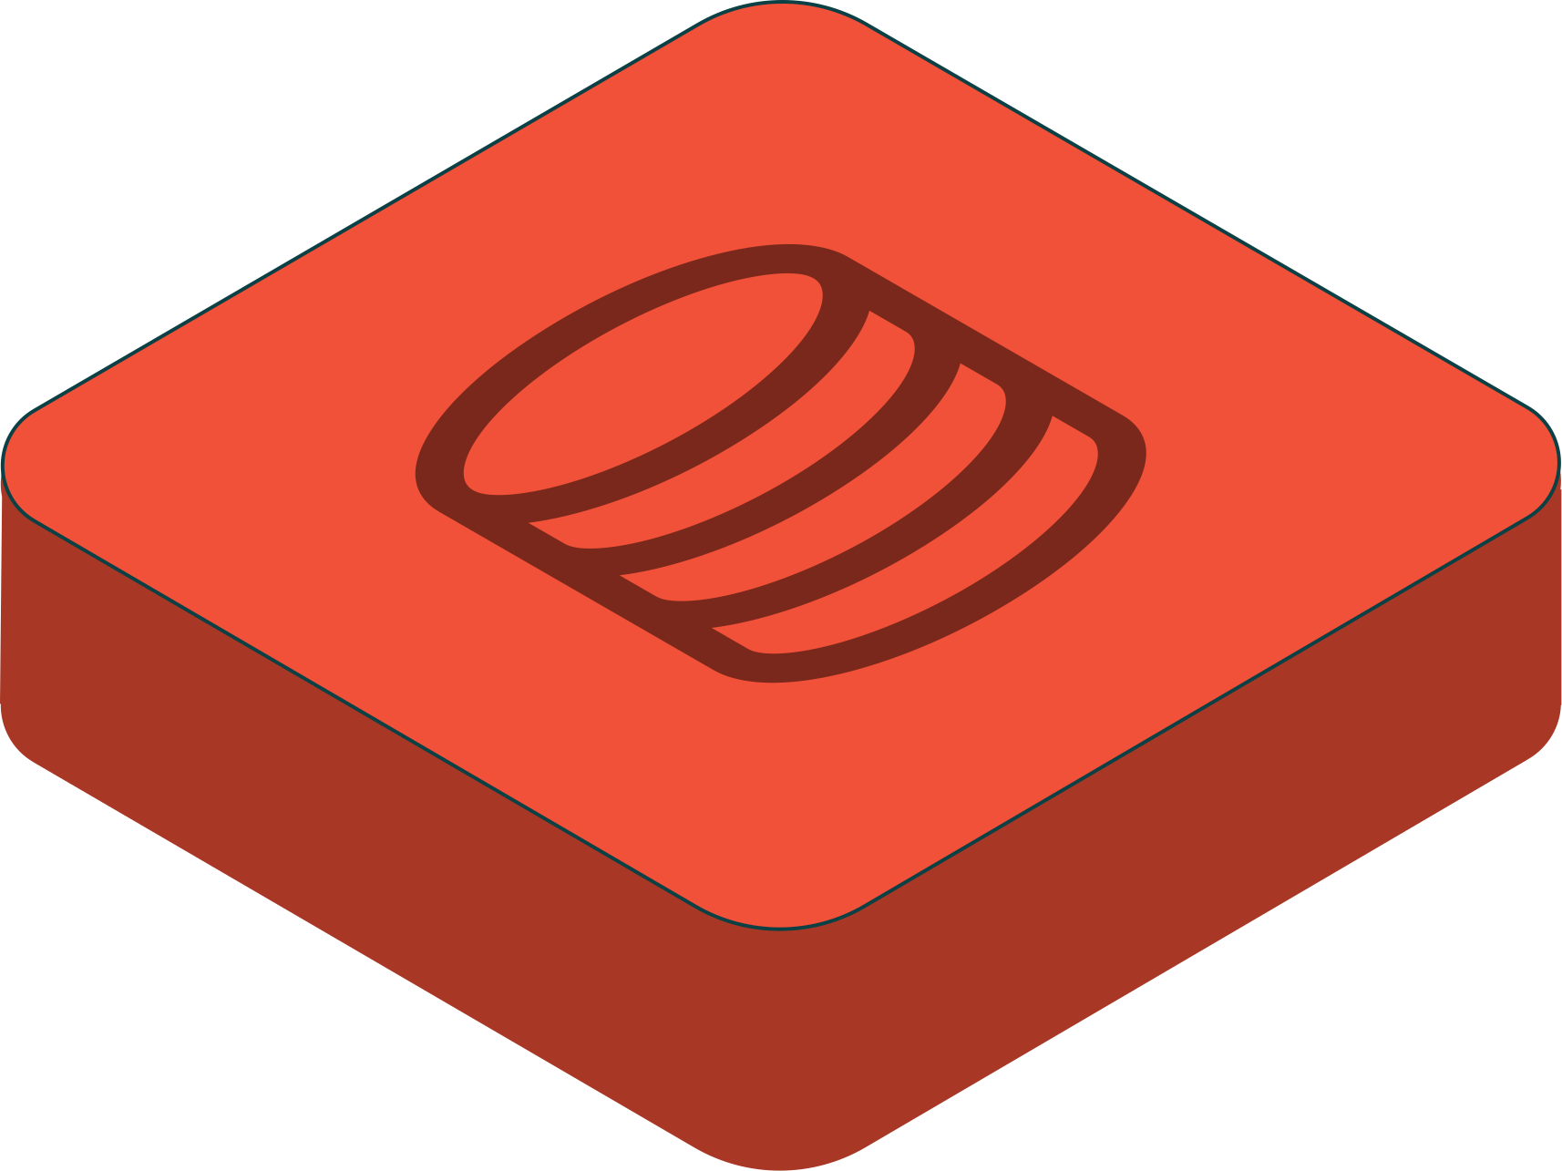
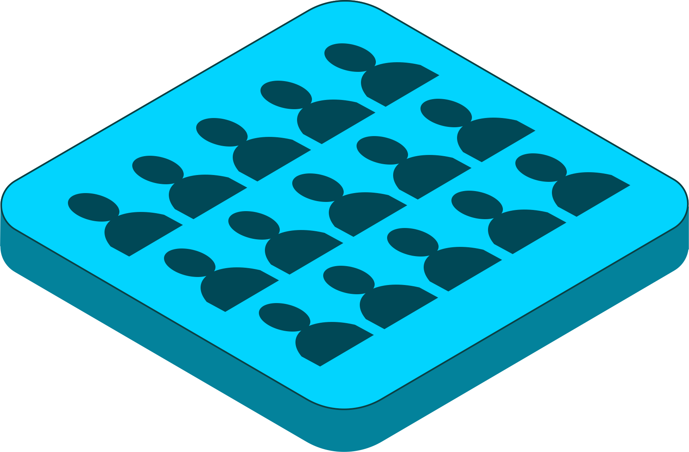
App Model
Design
Codebase
Database
Userbase
Reference slide :-Blockstack@ludovic

Slide 6
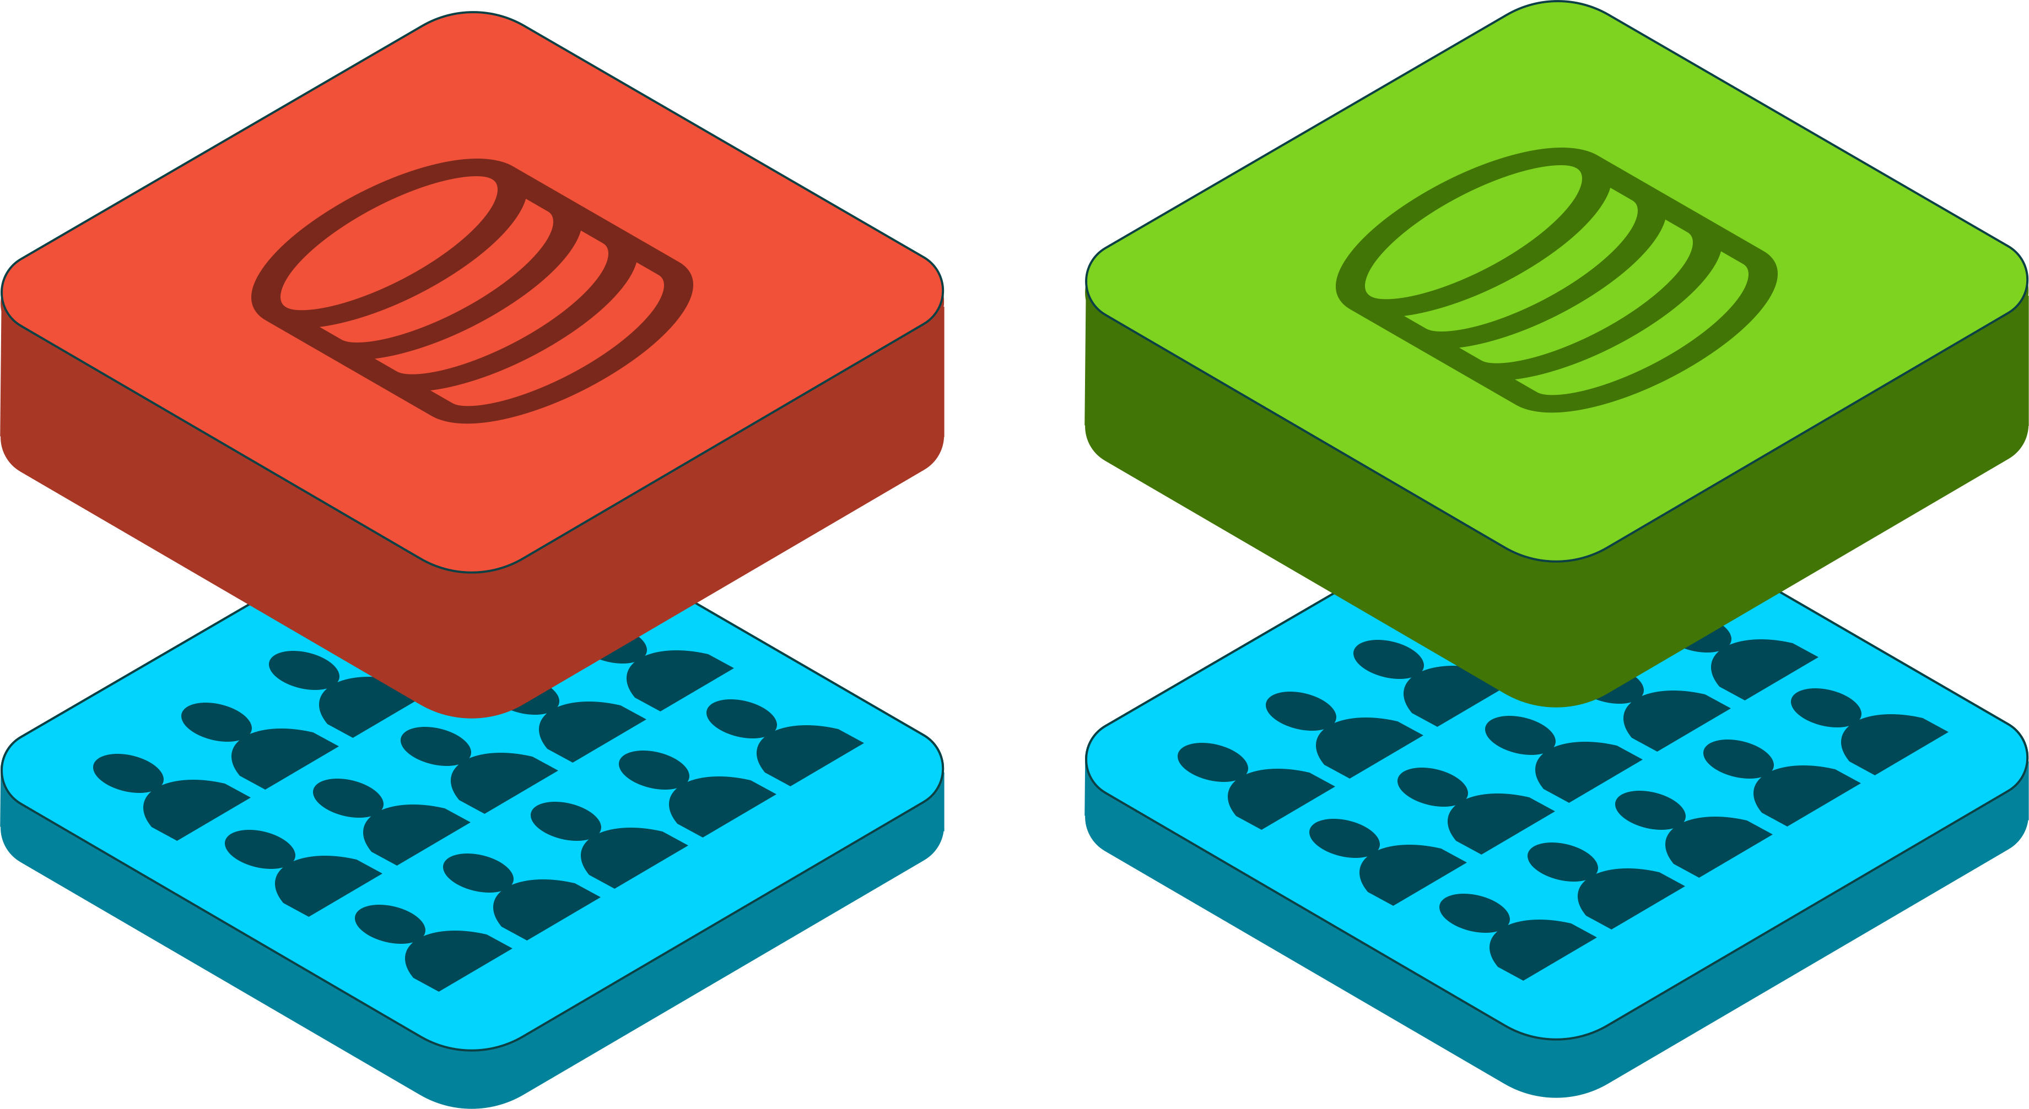
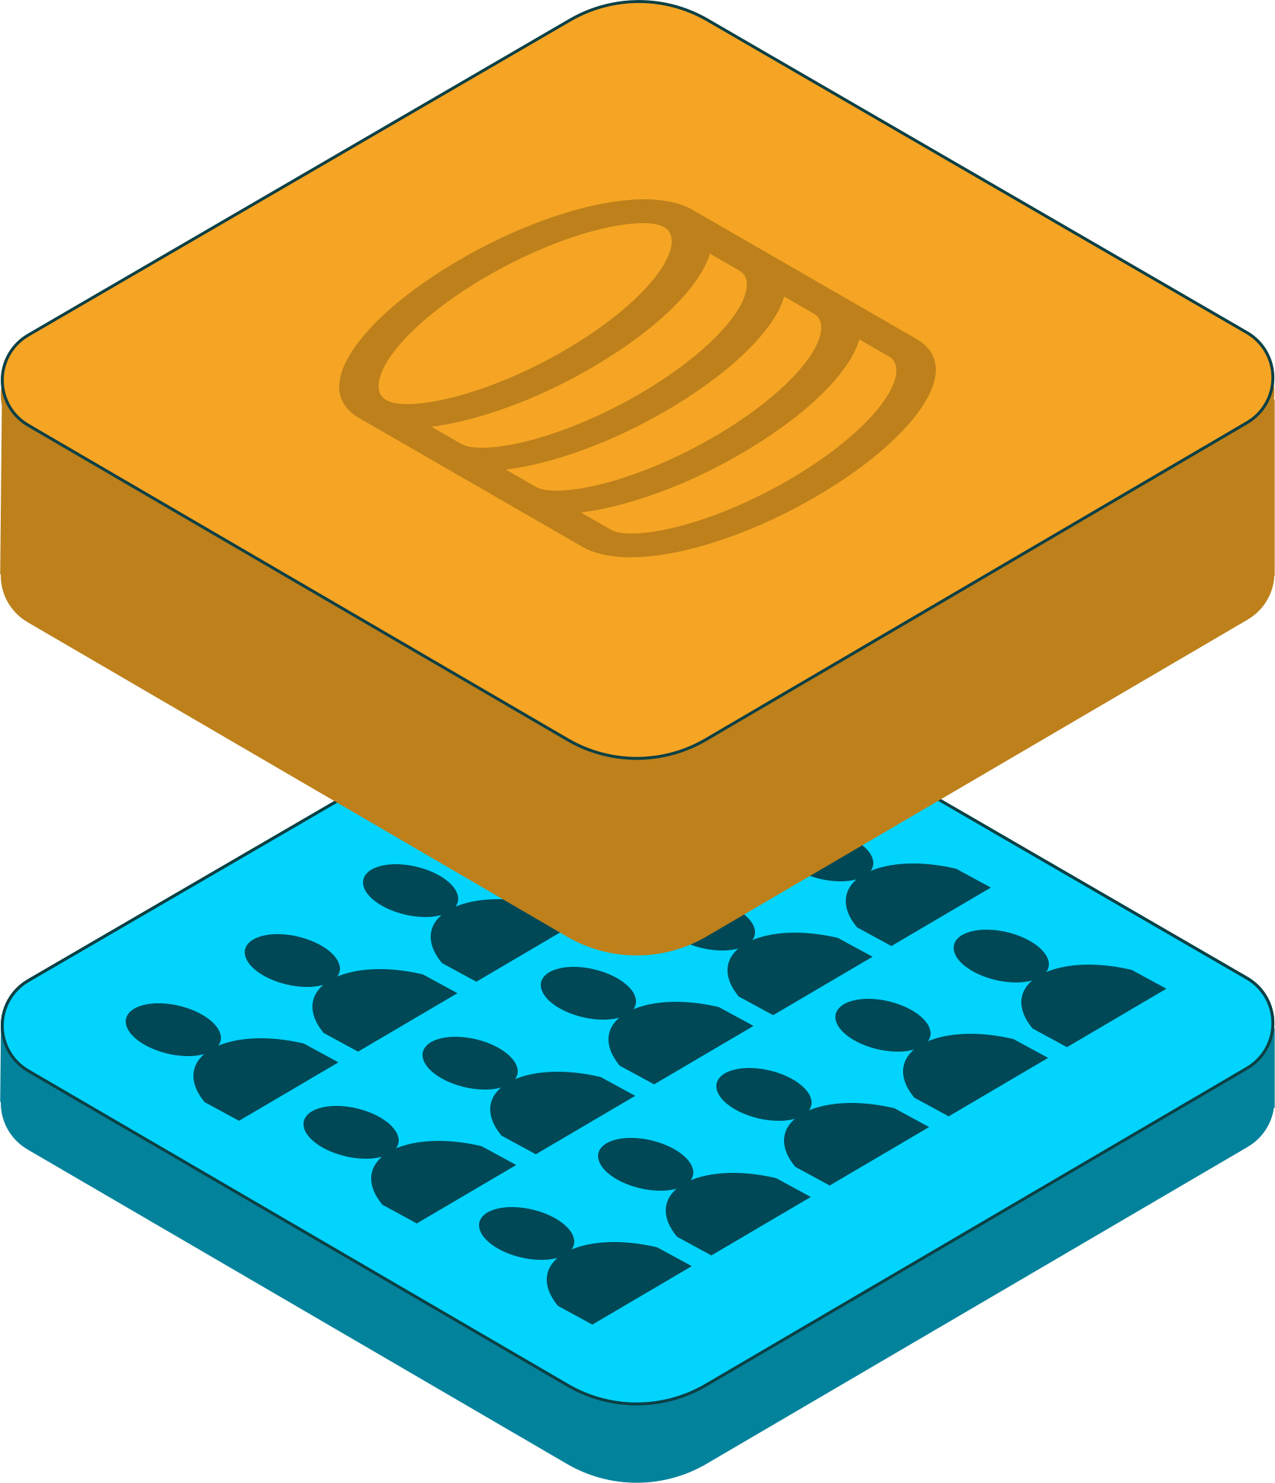
At Scale
APP STORE CASE
…
App #N
App #1
App #2
Reference slide :-Blockstack@ludovic

Slide 7
User concerns
Multiple Account maintenance
No data ownership
Data at risk
Data Loss if app shut down
Reference slide :-Blockstack@ludovic

Slide 8
Developer concerns
Identity Management System
Server and Database Maintenance
Scalability-Infrastructure cost
Security concerns
Reference slide :-Blockstack@ludovic

Slide 9
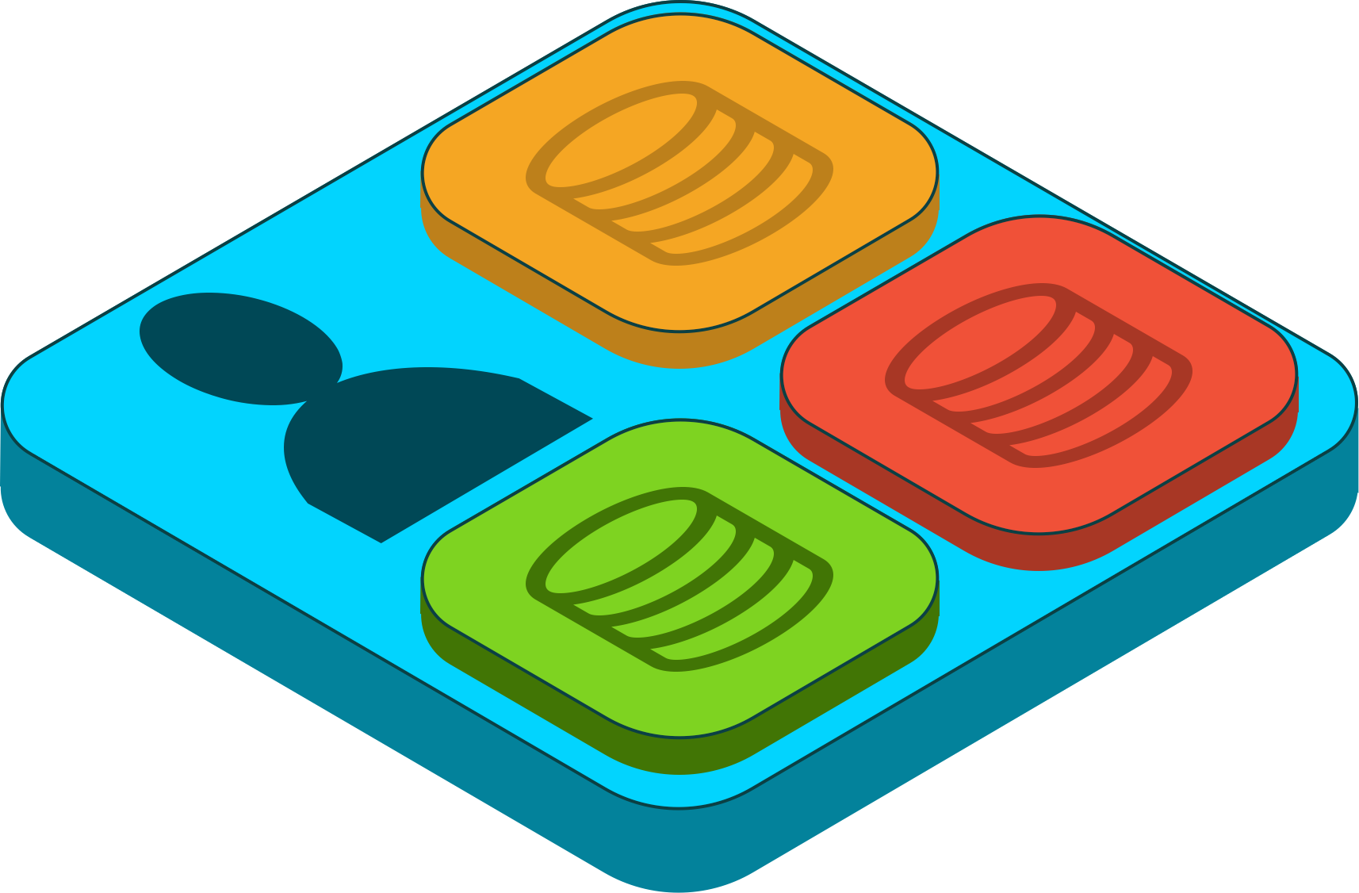
DAPP IS THE NEW WAY
→
Reference slide :-Blockstack@ludovic

Slide 10
New paradigm
NEW RULES
Users own their identity
Leveraging Public Blockchain
Users own their data
Leveraging Cryptography + Cloud Computing
Reference slide :-Blockstack@ludovic

Slide 11
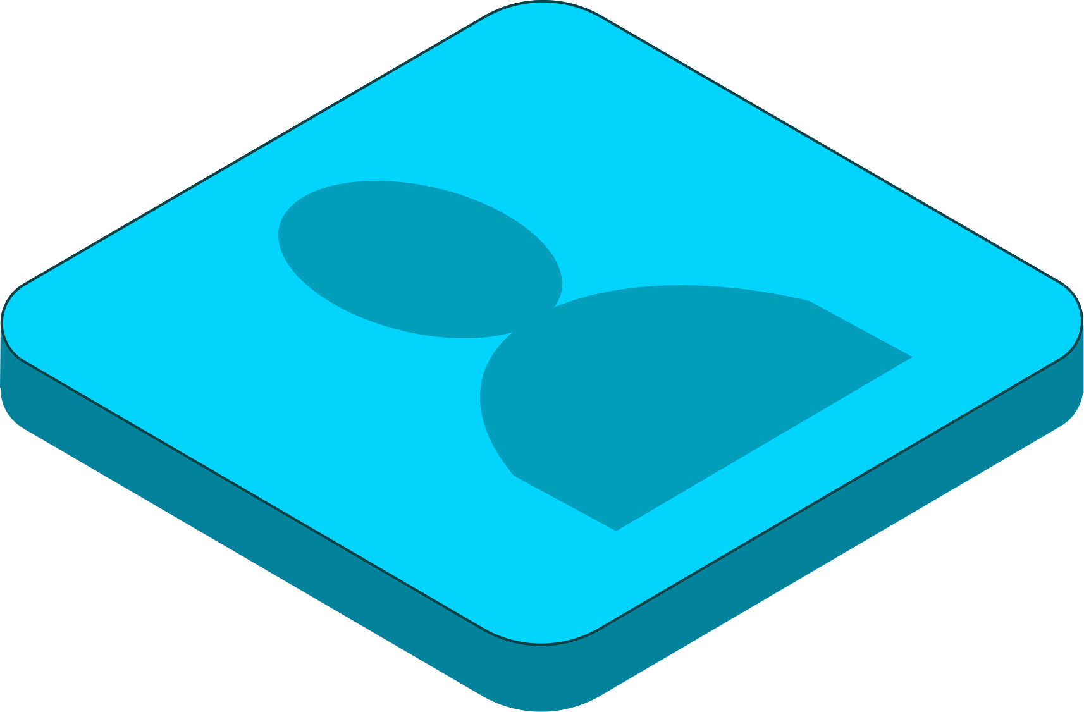
Identity Layer-Blockstack ID
Universal Login
Leveraging Public blockchain and BNS
OAuth-like flow
Public blockchain
Output: authorized key-pair
Reference slide :-Blockstack@ludovic
Notes:
DNS and BNS , routing layer /name database - Atlas
Blockstack Browser

Slide 12
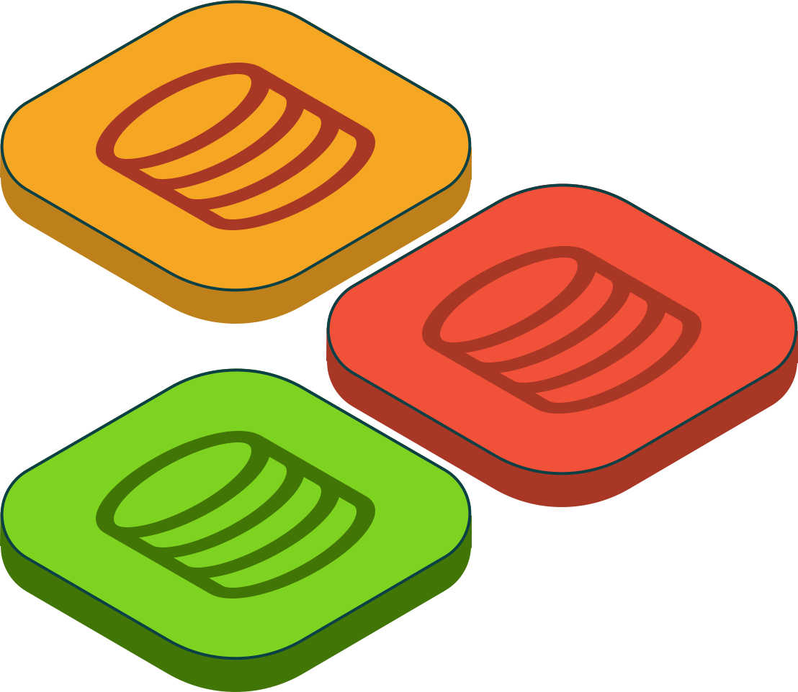
Data Layer
GAIA
Run on AWS, GCP, Azure, IPFS, etc
App storage sandboxed
Reference slide :-Blockstack@ludovic
Notes:
Encrypted data storage in user preffered storage provider .

Slide 13
App Layer
YOUR DAPP!
Reference slide :-Blockstack@ludovic

Slide 14
DEMO
Notes:
Signup
Signin(Auth request/response)- show the public address and gaia hub call
Show the signin APIs and Storage APIs

Slide 15
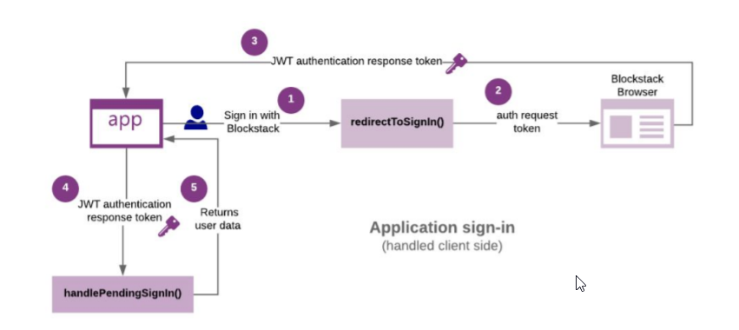
Blockstack Authentication

Slide 16
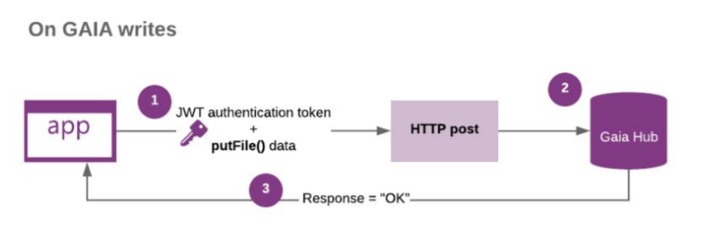
Gaia Storage

Slide 17
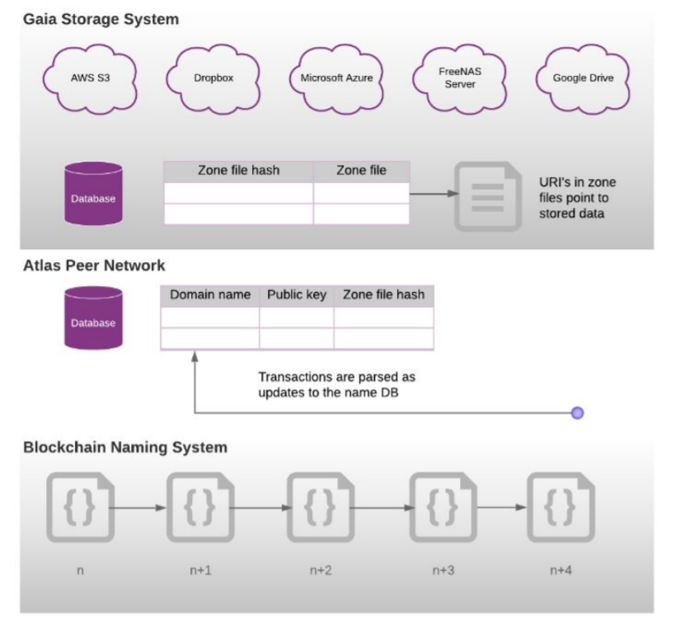
Blockstack Architecture

Slide 18
Blockstack vs Ethereum
Property | Ethereum | Blockstack
Programming language | Solidity | Any existing apps / Clarity
Storage | On-chain mostly or Off-chain in swarm | Off-chain (Gaia)
General | Heavy Blockchain | Light Blockchain
Scalability in data storage | Works as per basic block chain scalability | Highly scalable since data storage is off-chain.
Notes:
trust to trust design principle
Your node can choose to process computations for only the state machines that you’re interested in. Instead of processing all transactions/computations from all the nodes, you only process the stuff you’re interested in while remaining on the same global network. This would help you avoid scaling issues.

Slide 19
Clarity Smart contracts
Non Turing complete
Non intended to be compiled
Pre development phase .
Advantages :-
Static Analysis is possible .
Eradicates compiler bugs .
Prevents reentrancy / attacks like DAO attack.

Slide 20
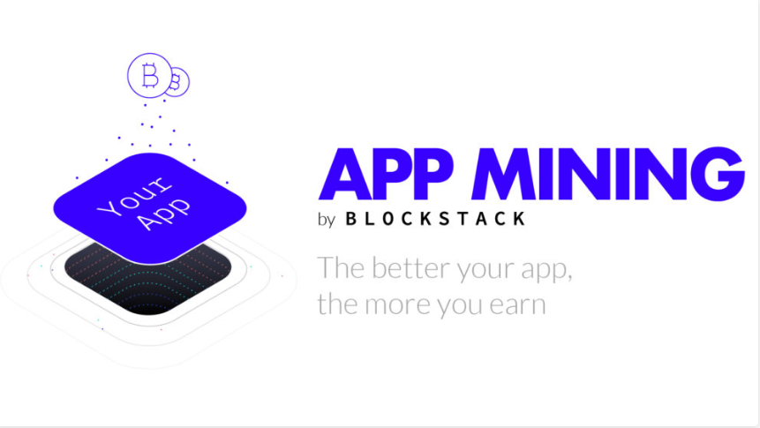

Slide 21
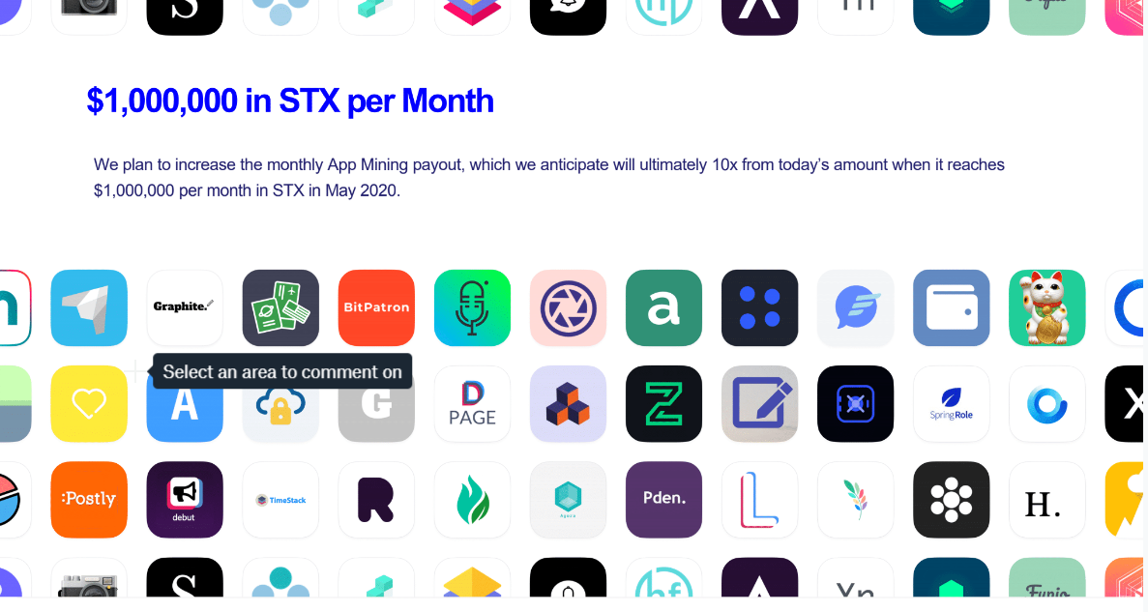

Slide 22
App Review
App Review Partners
Product Hunt
Awario
TryMyUI
New Internet Labs
Notes:
Score algorithm and calculation

Slide 23
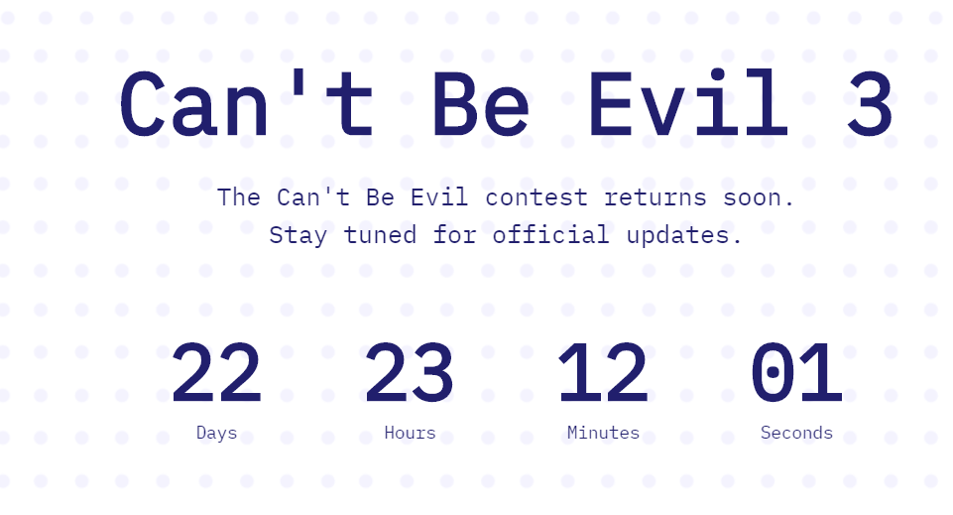
Notes:
Dont be Evil / Cant be evil
Another reward program
Receive incentives

Slide 24
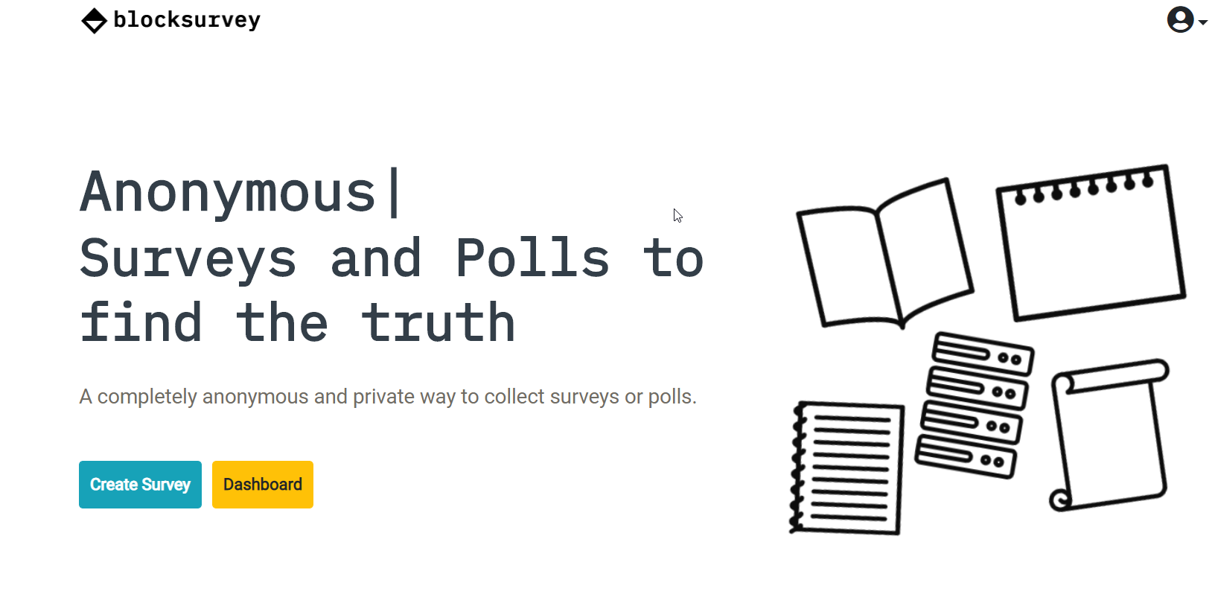
blocksurvey.org - Privacy Focused Survey
Notes:
Rewarded in App Mining/ Participated in Cant be Evil 1
Show the rewards in App.co
How we are eveolving with blockstack support

Slide 25
Useful Resources
https://docs.blockstack.org/develop/auth_provider.html
https://blockstack.github.io/blockstack.js/
https://core.blockstack.org/
https://browser.blockstack.org/
https://explorer.blockstack.org/
https://docs.blockstack.org/core/smart/overview.html
Github source code for demo app:- https://github.com/BlockSurvey/blockstack-angular

Slide 26
References
Building Decentralized Apps with Blockstack presentation by Ludo Galabru - Engineering Partner and Xan Ditkoff - Production Partner
https://www.youtube.com/playlist?list=PLXS8JJHIn4nEv_LcXIaklH_QAZaDEVD8q
https://docs.blockstack.org

Slide 27
Thank You
Slack :- HariniRajan@chat.blockstack.org
Gmail:- sweethari89@gmail.com/contact@blocksurvey.org

Slide 28
Q&A

