Slide 1
MolMap: A Molecule Representation Method Based on High-level Features

Slide 2
Molmap generate procedures
Sample data
Feature extraction
Calculate feature pairwise distance
Feature 2D embedding
MolMap
Gaussian smoothing
Linear assignment to grid

Slide 3
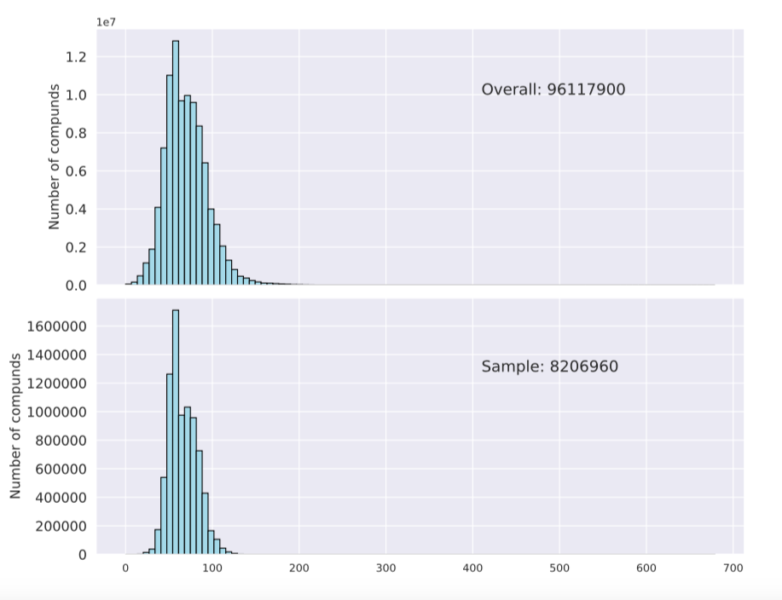
Step1: Sampling data
Sample a database of Pubchem of total 9611790 compounds based on the ECFP 2048 bits
Finally we got 8206960 unique diversity compounds

Slide 4
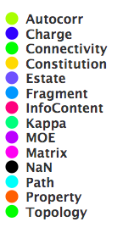
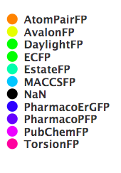
Step2: Feature extraction
1) Descriptors: total 1456 vectors, with 13 types
2) Fingerprints: total 12108 bits, with 9 kinds of FPs

Slide 5
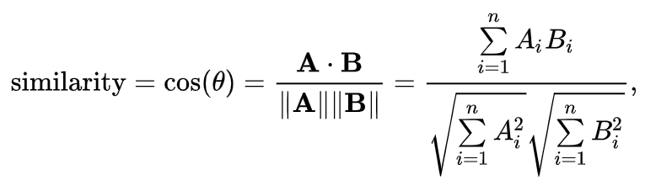
Step3: Feature pairwise distance
Cosine distance is applied: 1-similarity
The pairwise feature distances for both descriptors and fingerprints were calculated among 8206960 compounds

Slide 6
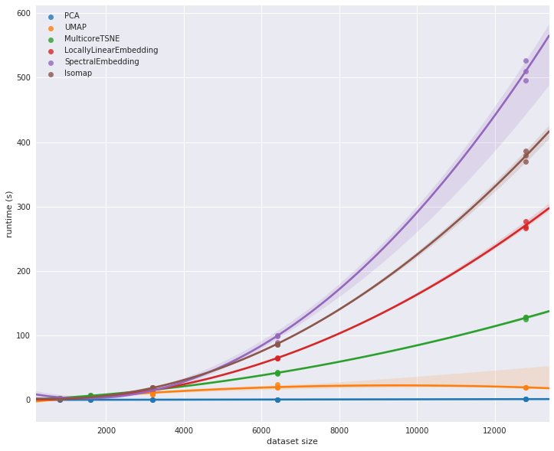
Step4: Feature embedding
Methods: UMAP, MDS, T-SNE
Since UMAP is more accuracy and faster, so we use UMAP as first choice
https://umap-learn.readthedocs.io/en/latest/benchmarking.html#performance-scaling-by-dataset-size
Becht, Etienne, et al. "Dimensionality reduction for visualizing single-cell data using UMAP." Nature biotechnology 37.1 (2019): 38.

Slide 7
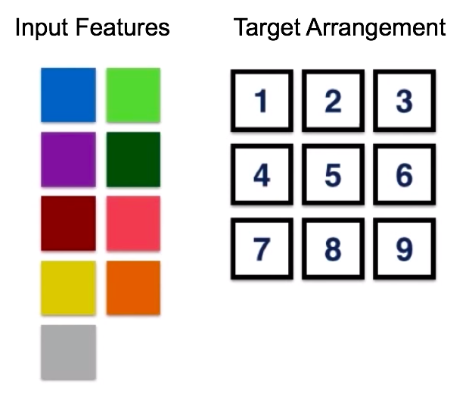
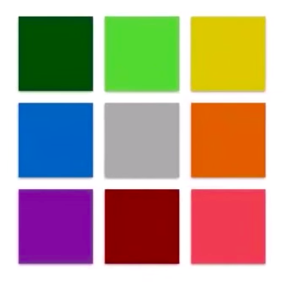
Step5: Feature assignment
Optimal arrangement
assignment

Slide 8
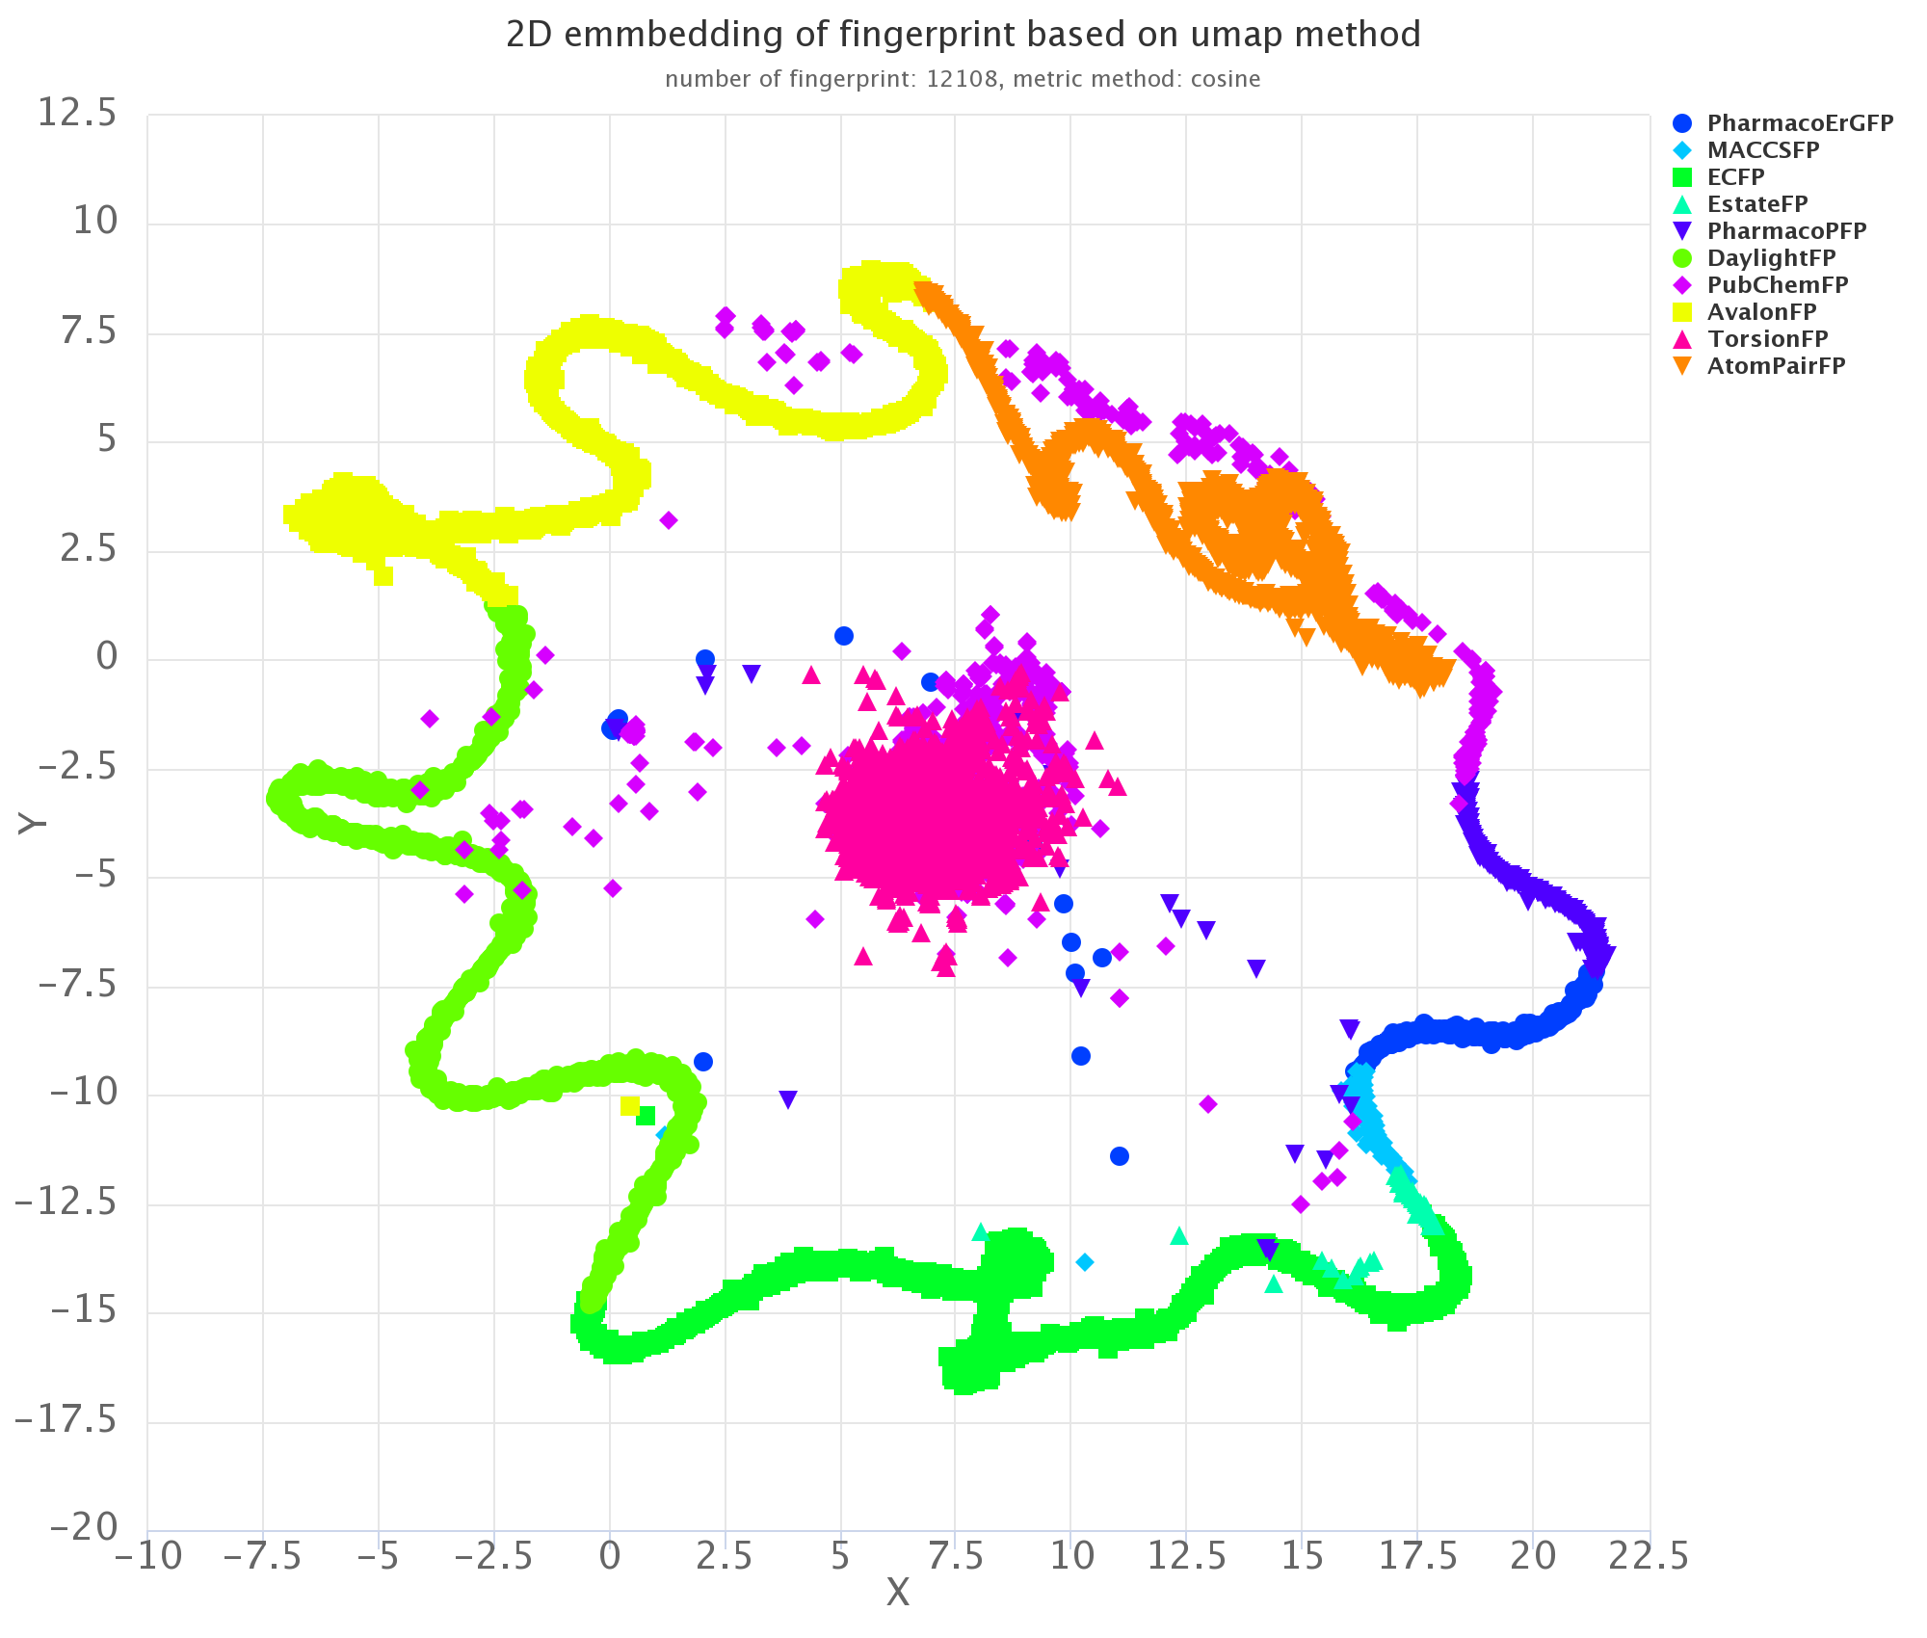
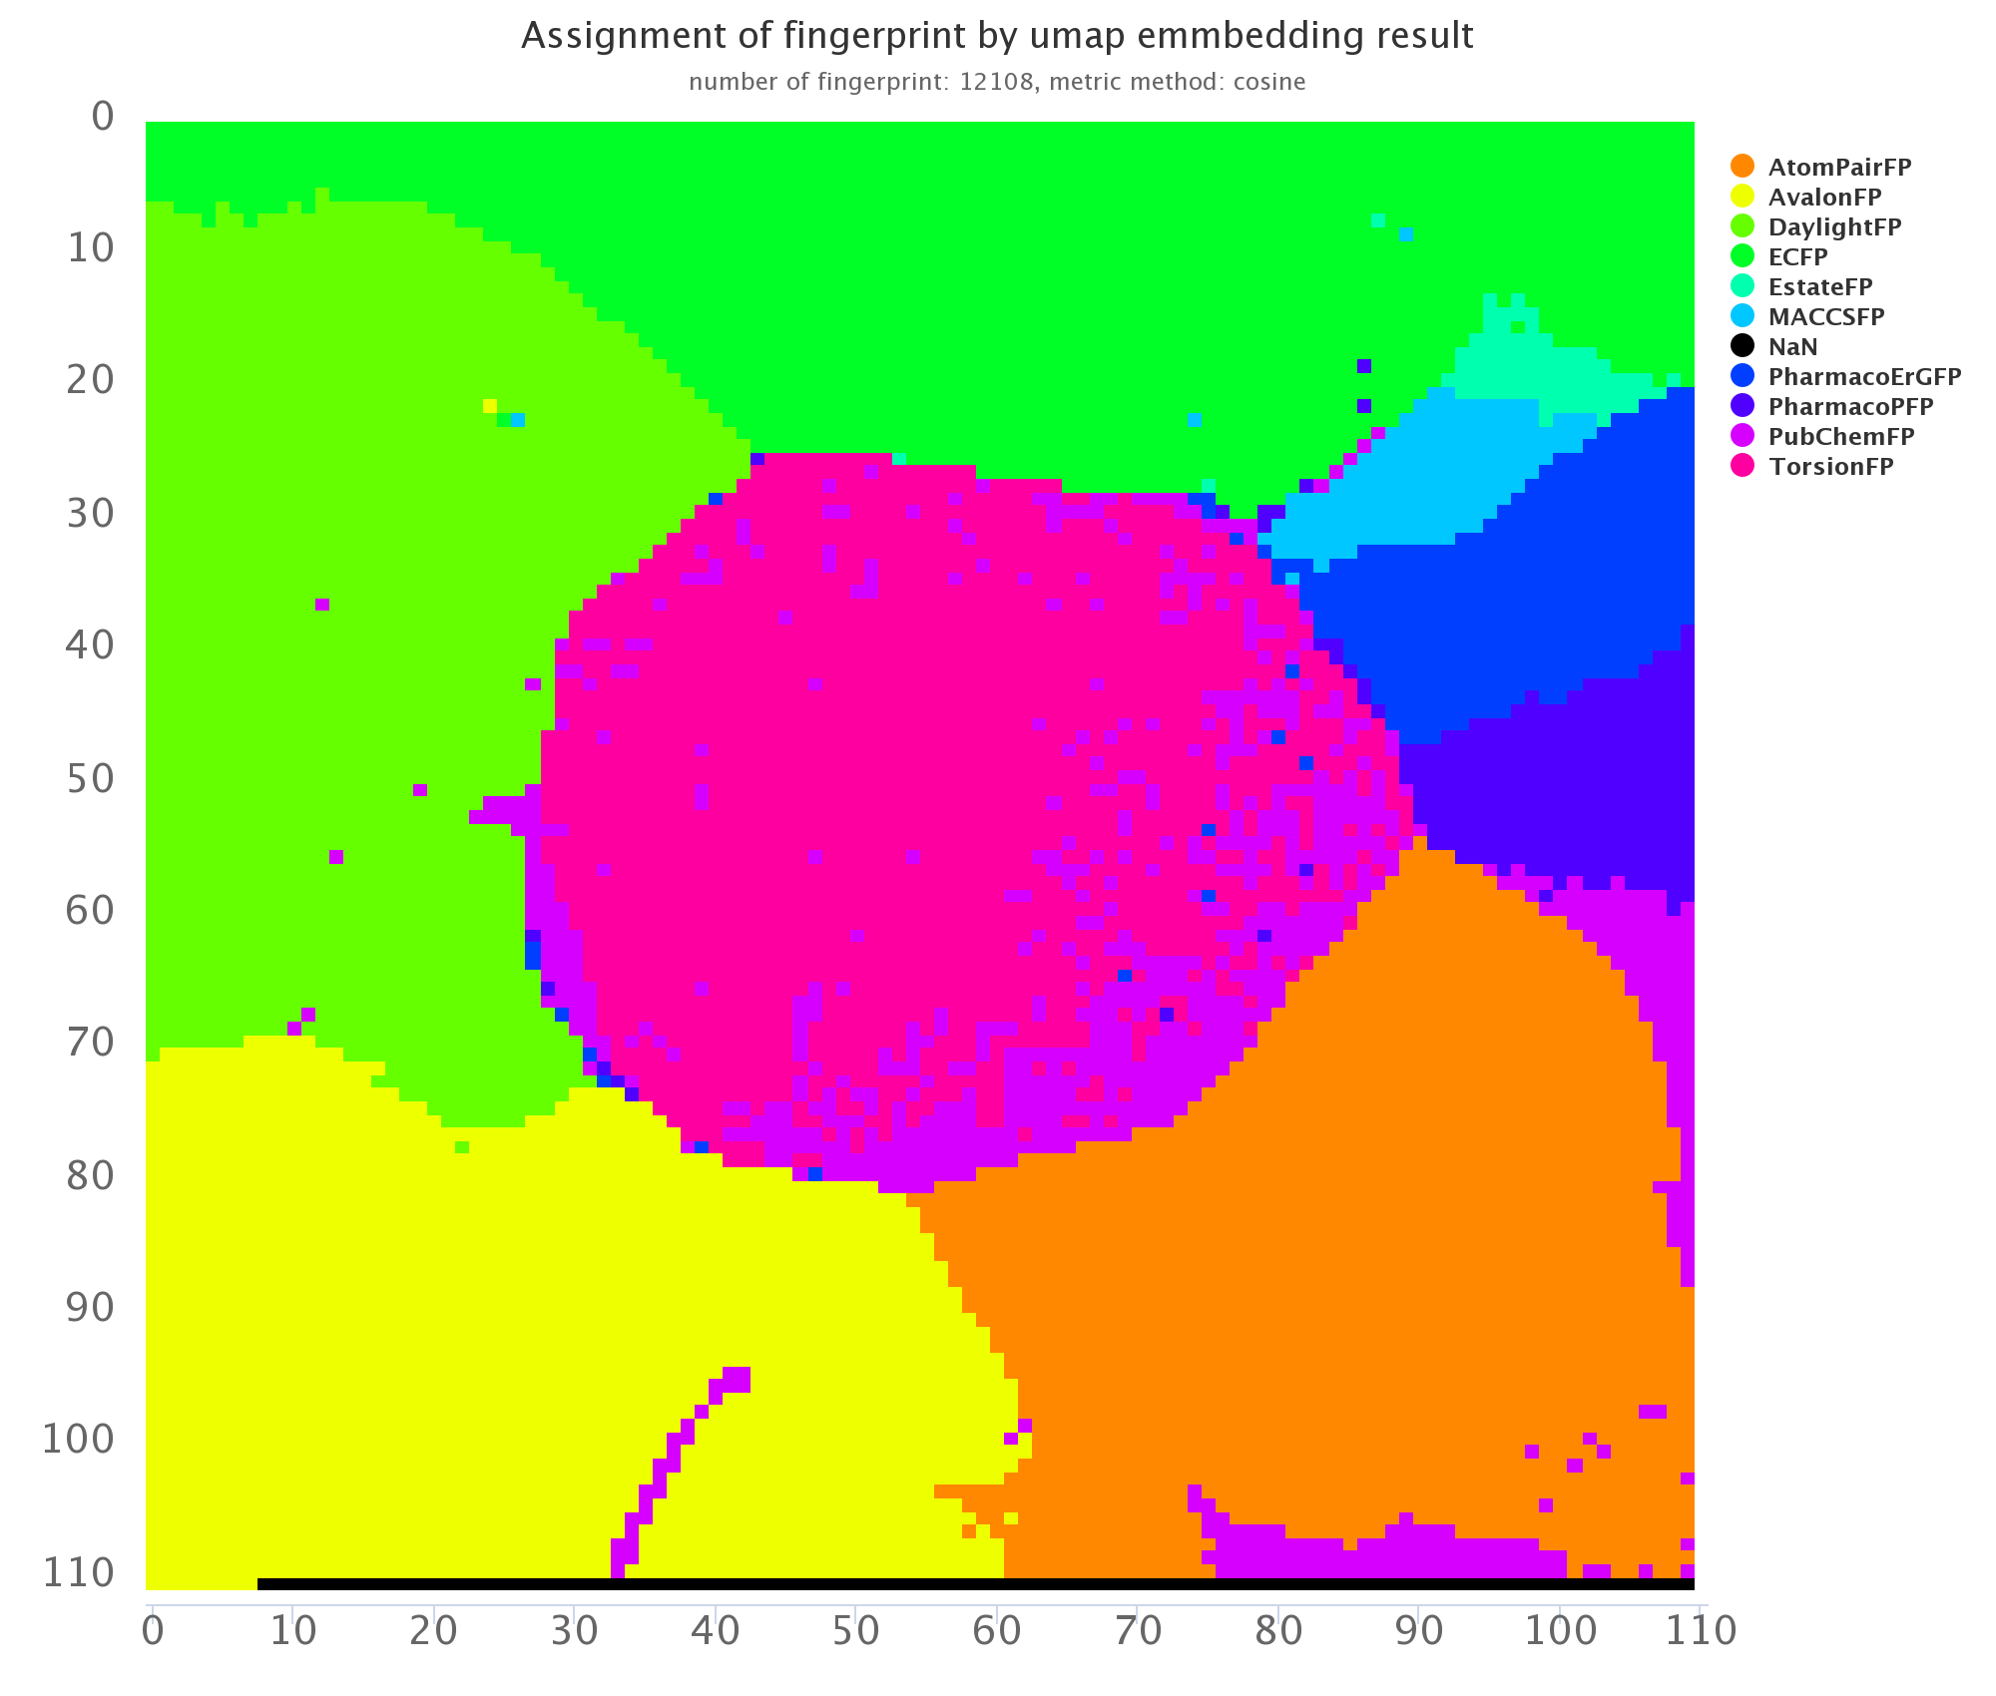
Fingerprints assignment
assignment

Slide 9




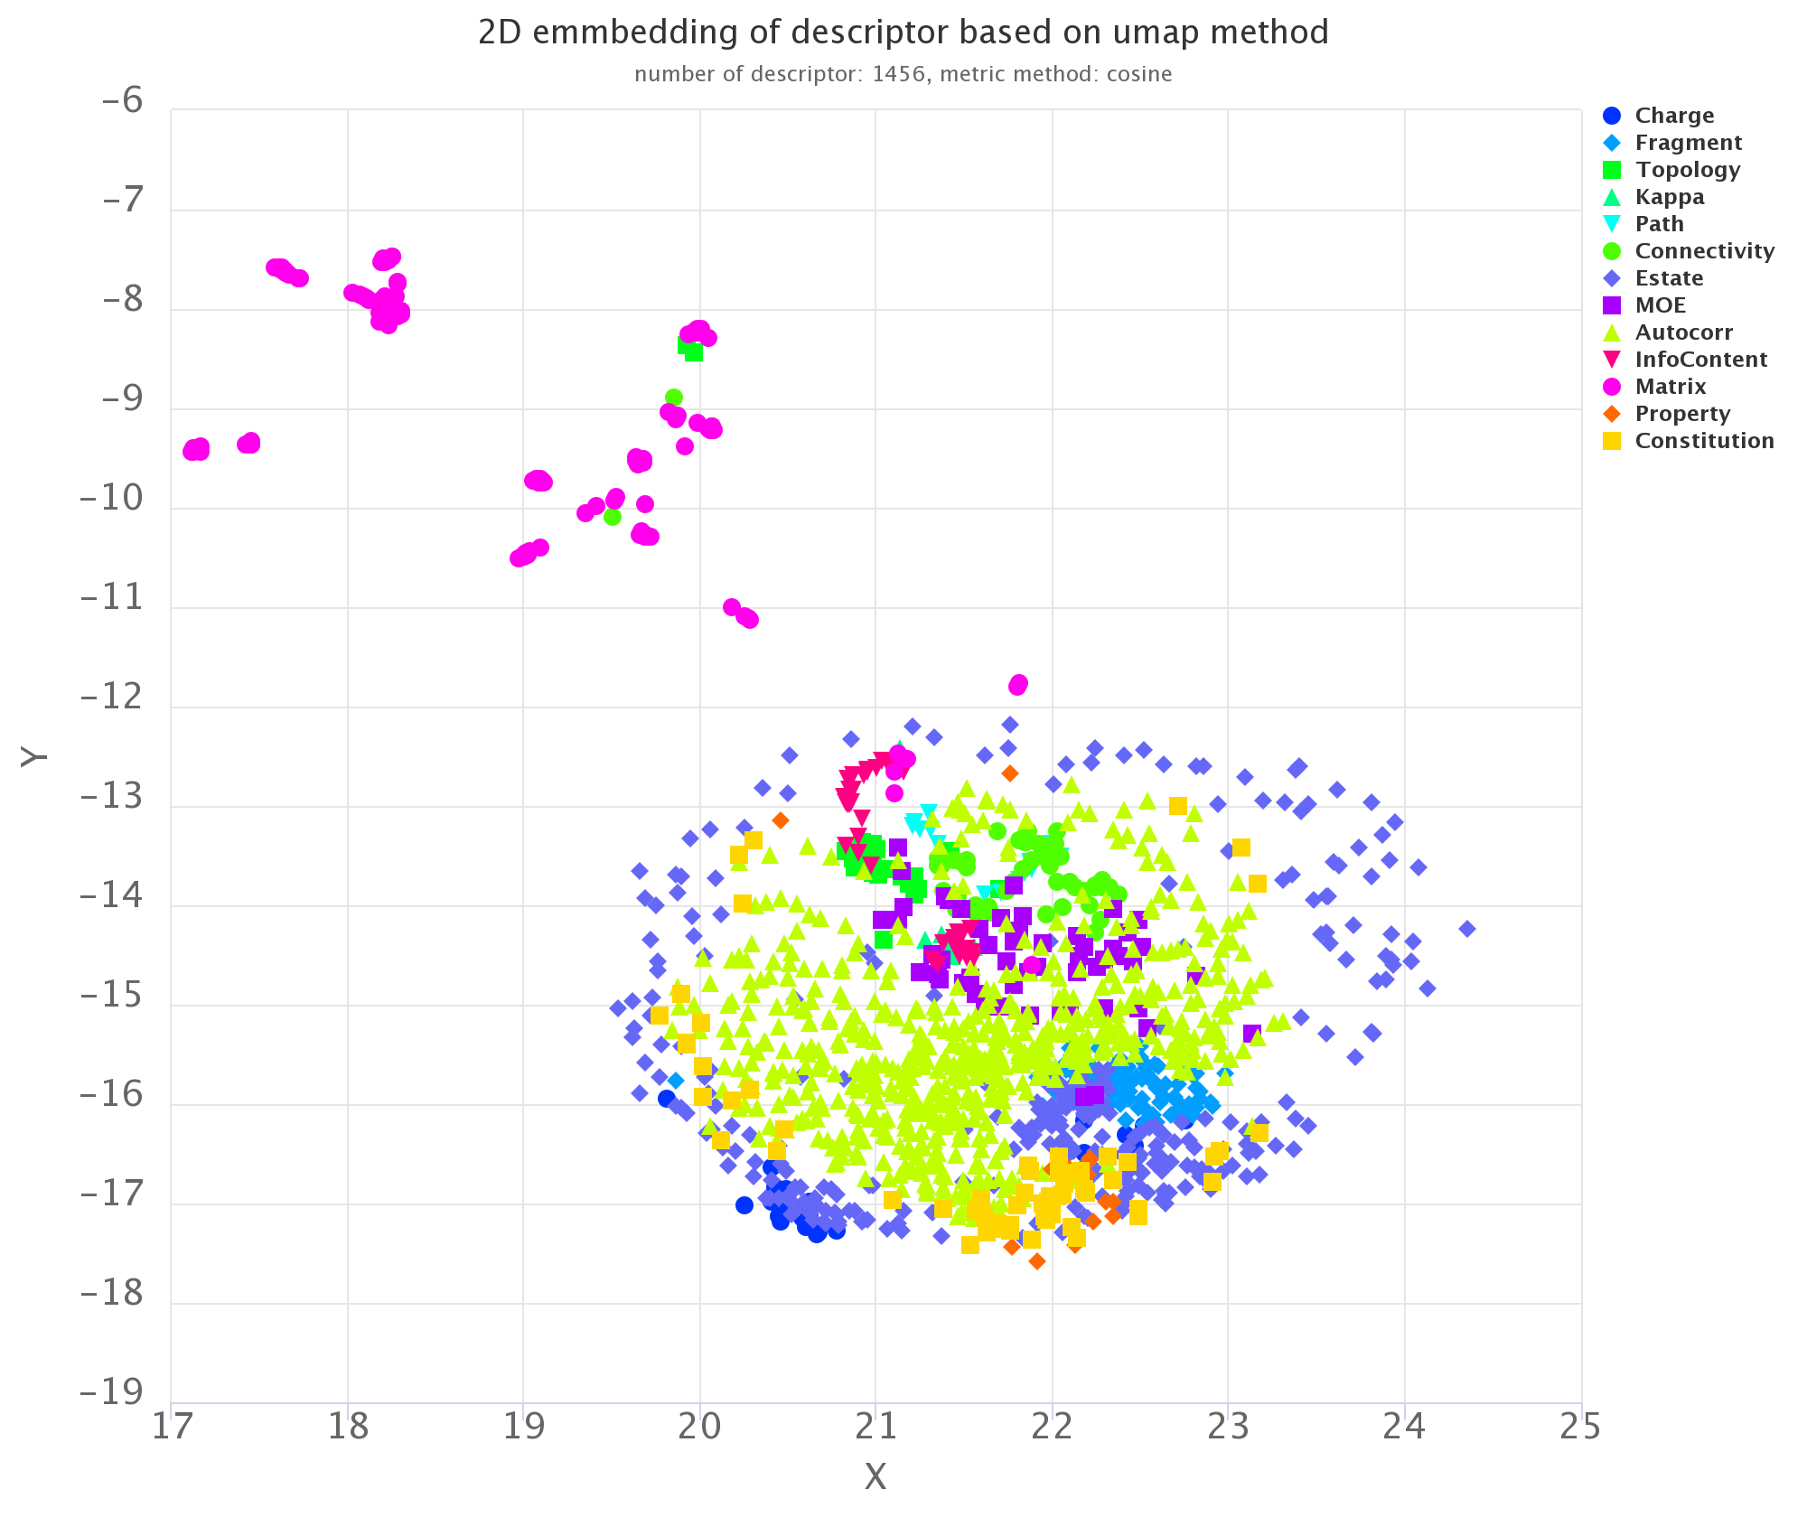
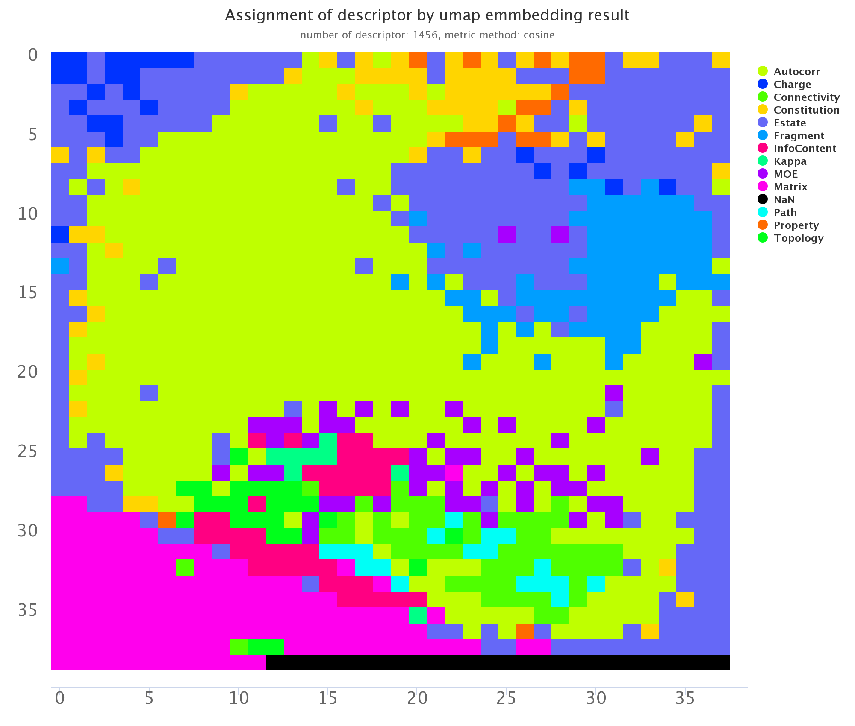
Descriptors assignment
assignment

Slide 10

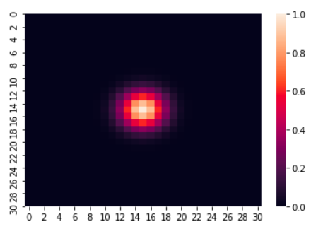
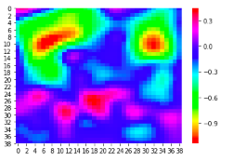
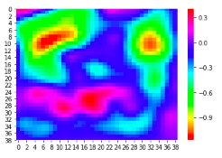
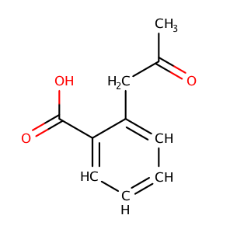
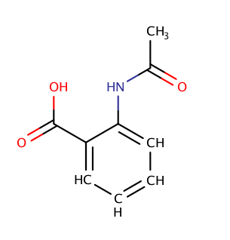
Step6: Gaussian Smoothing
remove detail and noise
Gaussian kernel: sigma = 1.8, size = (31, 31)

Slide 11
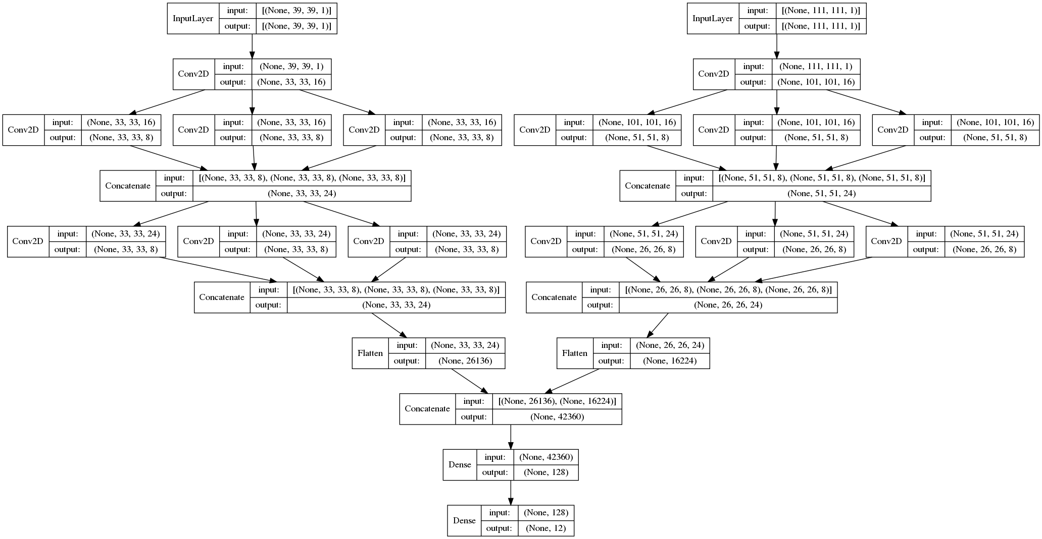
Model backbone
descriptors
fingerprints
Inception
layer
Szegedy, Christian, et al. "Scalable, high-quality object detection." arXiv preprint arXiv:1412.1441 (2014).

Slide 12
Training
Dataset random split to 0.1, 0.1, 0.8 as testing, validation and training set;
Early Stopping techniques: with a patient of 10 epochs, based on the loss of validation set
Model performance were evaluated based on testing set

Slide 13
Benchmark datasets <MoluculeNet>
ESOL: includes 1128 compounds and their water solubility.
Lipop: contains an octanol/water distribution coefficient at pH 7.4 measured experimentally. The dataset has 4200 compounds
Tox21: contains 8014 compounds and corresponding toxicity data against 12 targets.
SIDER: contains marketed drugs and their adverse drug reactions (ADR) against 27 System-Organs Class
Wu, Zhenqin, et al. "MoleculeNet: a benchmark for molecular machine learning." Chemical science 9.2 (2018): 513-530.

Slide 14
Performance on benchmark testing set
data sets | no. of compounds | task types | metrics | previous best | Attentive FP | Ours
ESOL | 1128 | single task regression | RMSE | 0.58 | 0.503 | 0.63
Lipop | 4200 | single task regression | RMSE | 1.15 | 0.736 | 1.11
Tox21 | 8014 | multi task classification | ROC | 0.829 | 0.85 | 0.84
SIDER | 1427 | multi task classification | ROC | 0.684 | 0.637 | 0.67
Xiong, Zhaoping, et al. "Pushing the Boundaries of Molecular Representation for Drug Discovery with the Graph Attention Mechanism." Journal of medicinal chemistry (2019).

Slide 15
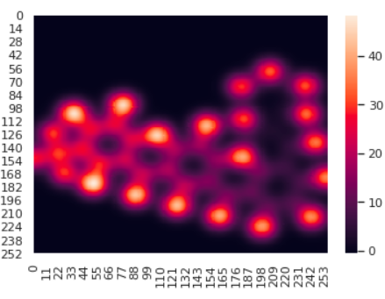
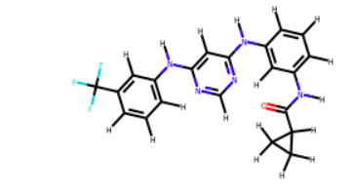
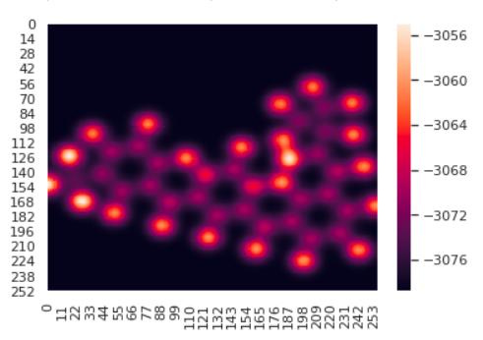
AtomMap
Atomic number
Estate indices

Slide 16
Atom features(115)
'is_H', 'is_B', 'is_C', 'is_N', 'is_O', 'is_F', 'is_P', 'is_S', 'is_Cl', 'is_Br', 'is_I',
'is_ssBH', 'is_sssB', 'is_ssssB', 'is_sCH3', 'is_dCH2', 'is_ssCH2', 'is_tCH', 'is_dsCH', 'is_aaCH', 'is_sssCH', 'is_ddC', 'is_tsC', 'is_dssC', 'is_aasC', 'is_aaaC', 'is_ssssC', 'is_sNH3', 'is_sNH2', 'is_ssNH2', 'is_dNH', 'is_ssNH', 'is_aaNH', 'is_tN', 'is_sssNH', 'is_dsN', 'is_aaN', 'is_sssN', 'is_ddsN', 'is_aasN', 'is_ssssN', 'is_sOH', 'is_dO', 'is_ssO', 'is_aaO', 'is_sPH2', 'is_ssPH', 'is_sssP', 'is_dsssP', 'is_sssssP', 'is_sSH', 'is_dS', 'is_ssS', 'is_aaS', 'is_dssS', 'is_ddssS',
'is_S_hybridized', 'is_SP_hybridized', 'is_SP2_hybridized', 'is_SP3_hybridized',
'is_chirality_R', 'is_chirality_S',
'num_ROTATABLE_bonds', 'num_SINGLE_bonds', 'num_DOUBLE_bonds', 'num_TRIPLE_bonds', 'num_AROMATIC_bonds',
'is_in_Ring', 'is_in_AromaticRing', 'is_in_3MemberedRings', 'is_in_4MemberedRings', 'is_in_5MemberedRings', 'is_in_6MemberedRings',
'is_h_acceptor', 'is_h_donor', 'is_hetero', 'estate_indice', 'logp_contribs', 'mr_contribs', 'tpsa_contribs', 'asa_contribs', 'atomic_number', 'degree', 'explicit_valence', 'implicit_valence', 'valence', 'num_implicit_hydrogens', 'num_explicit_hydrogens', 'num_hydrogens', 'formal_charge', 'gasteiger_charge',
'period', 'atomic_mass', 'density', 'melting_point', 'boiling_point', 'atomic_radius', 'atomic_volume', 'covalent_radius', 'covalent_volume', 'van_der_waals_radius', 'van_der_waals_volume', 'specific_heat', 'heat_of_formation', 'thermal_conductivity', 'pauling_electronegativity', 'sanderson_electronegativity', 'allen_electronegativity', 'ghosh_electronegativity', 'first_ionisation_energy', 'most_stable_oxidation_states', 'lattice_constant', 'electron_affinity', 'dipole_polarizability', 'dispersion_coefficient'

