Slide 1
Chemical Structure Standardisation
The ChEMBL database and the standardiser tool
Francis Atkinson
Chemogenomics Group
EMBL-EBI

Slide 2
What is ChEMBL?
A freely-available source of bioactivity data
Secure on-line access
Downloadable in a variety of formats
Core is data from key MedChem journals
J. Med. Chem, Bioorg. Med. Chem. Lett.
Manually extracted by CRO
Supplemented by…
Subset of data from PubChem
Deposited datasets
NTD consortia, GSK kinase set (PKIS) etc.
Accelrys Direct chemistry cartridge for Oracle

Slide 3
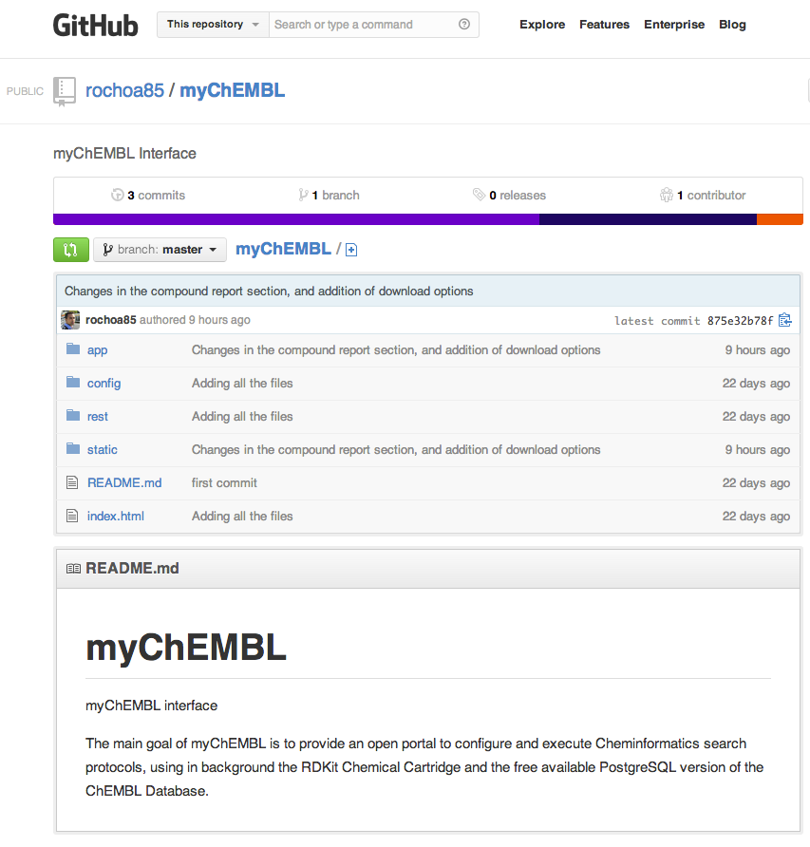
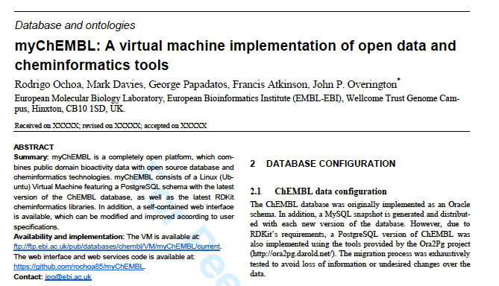
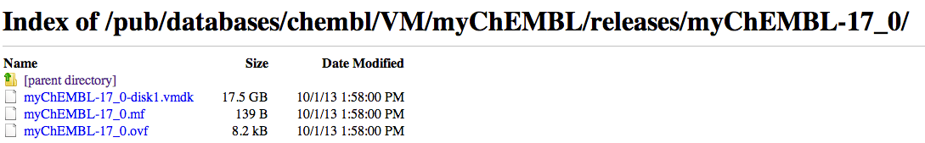
myChEMBL
Postgres/RDKit version of ChEMBL
packaged for distribution as VM

Slide 4
Heterogeneous sources of structures
Chemical Literature
Redrawn by CRO from depictions in articles
PubChem
Other bioactivity databases
Data depositions
Typically received as MDL molfiles

Slide 5
Multiple representations
Hypervalent vs. charge-separated
Charged vs. neutral salts
Chemical cartridge will treat these as different
Could cause SSS to fail if alternative depiction used as query
Standardization is required

Slide 6


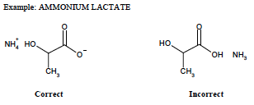
Standardisation
The FDA have published a compound depiction SOP for their Substance Registration System
Used as basis for ChEMBL standardisation rules
with some modifications, e.g. …
ChEMBL would treat these the same as other salts, i.e. they would be neutralized

Slide 7
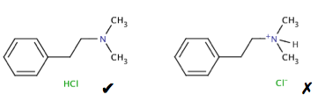
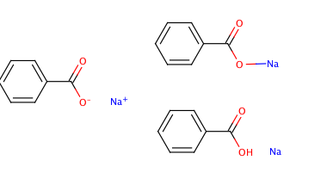

Examples of rules: charges
Consistent rules for drawing salts
Compounds to be charge-neutral if possible
quaternary N an exception if counterion unknown

Slide 8


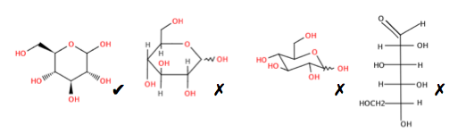
Example of rules: functional groups
Charge-separated preferred over hypervalent
Stylistic rules for sugars, peptides, steroids etc.

Slide 9
Salt stripping
Salt/solvate components should not affect the biological activity of a compound
There can be exceptions
e.g. salt form may affect solubility
However, any 3D or QSAR modelling should be done using only the bioactive ‘parent’
It is desirable to be able to view compounds with a common parent together
It can be appropriate to aggregate data for the parent compound

Slide 10
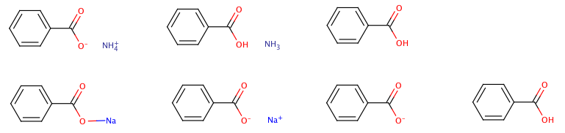
Salt stripping (2)
Counterions and solvent molecules are removed using a custom ‘salt dictionary’
Acids with inorganic cations may require a further round of charge-neutralization…
The parent is registered as a separate structure
The parent and original salt are linked via the ‘molecule hierarchy’ table
Strip salts
neutralise
Salt
Parent
As stored in ChEMBL
Break bond
Strip salts
neutralise

Slide 11

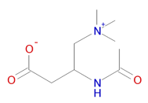
Curator intervention
Structures with permanent charges
i.e. counterion not recorded
Zero charge used as check on neutralization steps
Zwitterions
Naïve neutralization could introduce errors
These types automatically routed for inspection
Possible manual standardisation

Slide 12

Inorganics & organometallics
Handled poorly by current chemoinformatics tools…
multicenter bonding
coordination complexes
Non tetrahedral stereochemistry
Cannot distinguish cis- and trans-platins
Charge-balancing, salt-stripping etc. are difficult
Cannot be properly searched for by cartridge
Not put through main standardisation process
May be redrawn for clarity in some cases
e.g. approved drugs such as the platins
Structures now excluded (post-CHEMBL17)
~3200 structures affected
Bioactivities are retained
ferrocene ?!

Slide 13
Implementation
Rules implemented using Pipeline Pilot
Run by ChEMBL’s chemical curator
Some manual intervention in difficult cases
Protocols not currently publically available
Tightly coupled with data-loading pipeline
Subject to change as new issues identified
Pipeline Pilot is commercial software
We have a interest in an FOSS equivalent…
e.g. for loading proprietary data into myChEMBL

Slide 14
standardiser
Tool to pre-process structures for modelling
Molecular representation can affect results…
Descriptors, forcefields, QM
Need to standardise representation
Common to both training and application
‘Inspired by’ ChEMBL curation & InChI preprocessing
Only interested in parent (bioactive) component
Standardise tautomers
i.e. hydroxy-pyridine -> pyridone
Not tautomer canonicalization
No manual intervention
Implemented in Python & RDKit
Runs under Python2.6+
Fully open-source

Slide 15
Procedure
Break bonds to Group I or II metals
Neutralize charges by adding/removing protons
Apply standardization rules
Neutralize any charges exposed by rules
Discard any salt/solvate components
Return standardized parent

Slide 16
Limitations
Rule set could be expanded
e.g. will review RCS / CVSP rules
No attempt to handle inorganics
Impractical with current tools
No attempt to produce ‘canonical’ tautomer
Could flag tautomeric molecules for inspection?
re-charging not handled

Slide 17
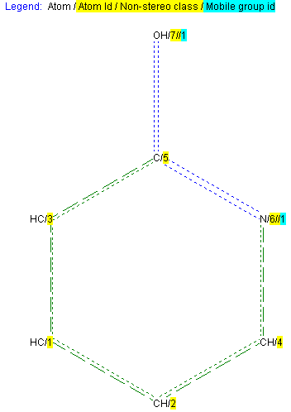
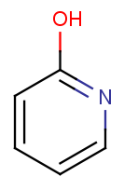
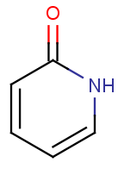
Key differences to ChEMBL
ChEMBL makes no attempt to standardise tautomers
InChI codes are used for registration (i.e. assignment of database identifiers/keys)
i.e. two molecules are the if they have the same InChI
For any molecule, the first-encountered tautomer will always be used
to generate images, for searching and in downloadable SDF files etc.
Thus, for example: if the first time a molecule encountered it is shown as the hydroxy-pyridine, this tautomer will be stored (as a molfile) and will be used for the depiction of this molecule even where an alternative tautomer is encountered in a later document
By contrast, standardiser does attempt to standardise tautomers
e.g. the pyridone is preferred, as it is likely to be the lower-energy tautomer
ChEMBL
standardiser
Encountered first: molfile stored in database against this InChI
Encountered second: hydroxy-pyridine molfile will be used for depiction etc.
hydroxy-pyridine
pyridone
input
output
﻿InChI=1S/C5H5NO/c7-5-3-1-2-4-6-5/h1-4H,(H,6,7)

Slide 18
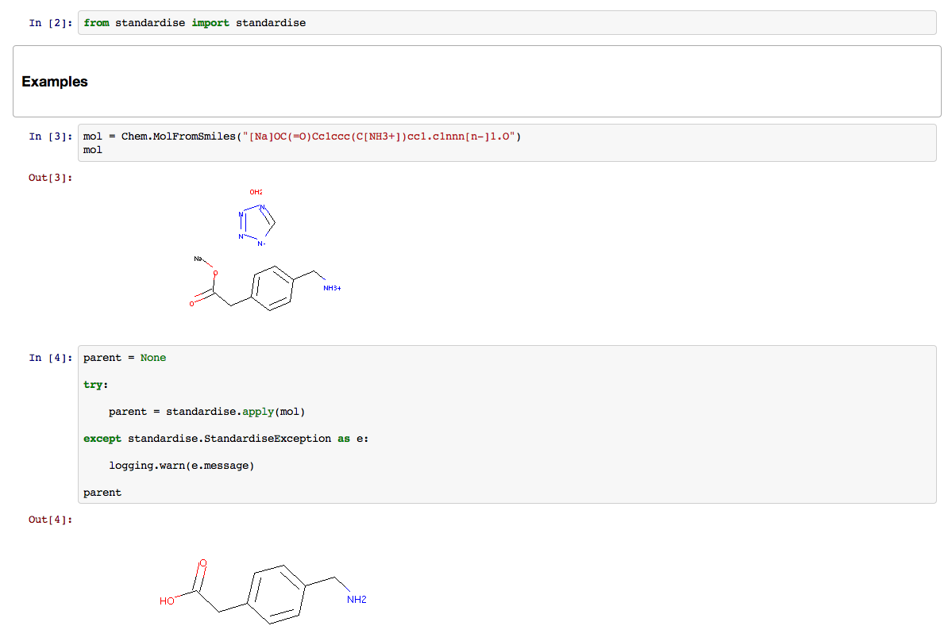
Example
Provided as a Python package
Compatible with python2.6 (for etoxws VM)
A simple driver program for batch processing is included
Accepts SDF or SMILES input

Slide 19
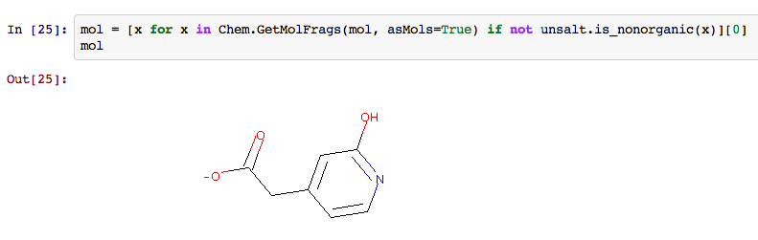
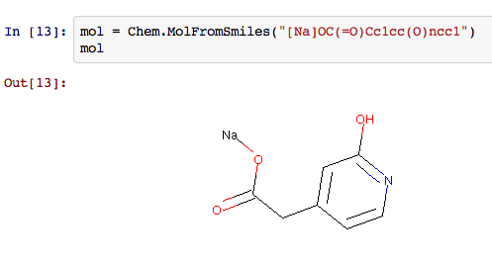
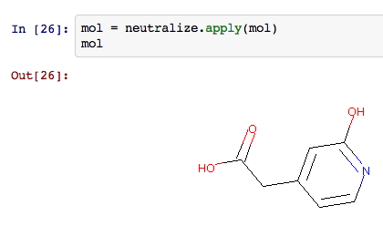
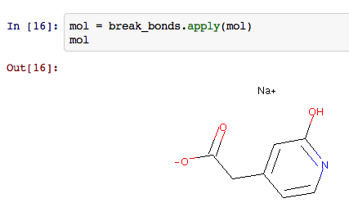
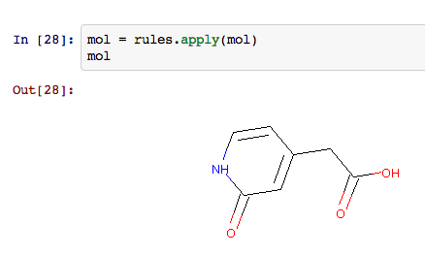
Modules within package
Modules implementing different steps may be called independently
could be incorporated into different workflows

Slide 20
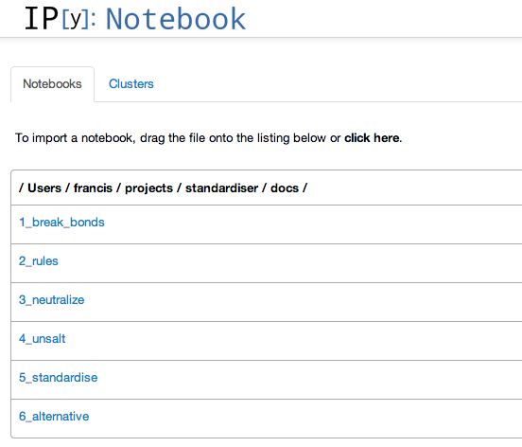
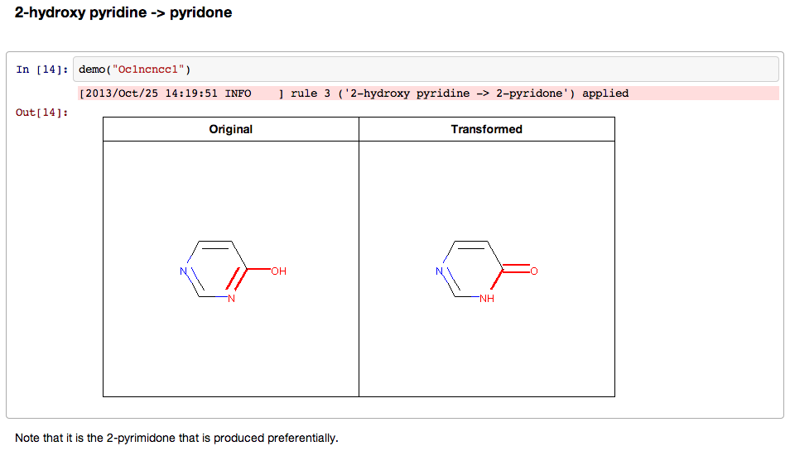
Documentation
Provided as IPython Notebooks
Also available as static web pages

Slide 21
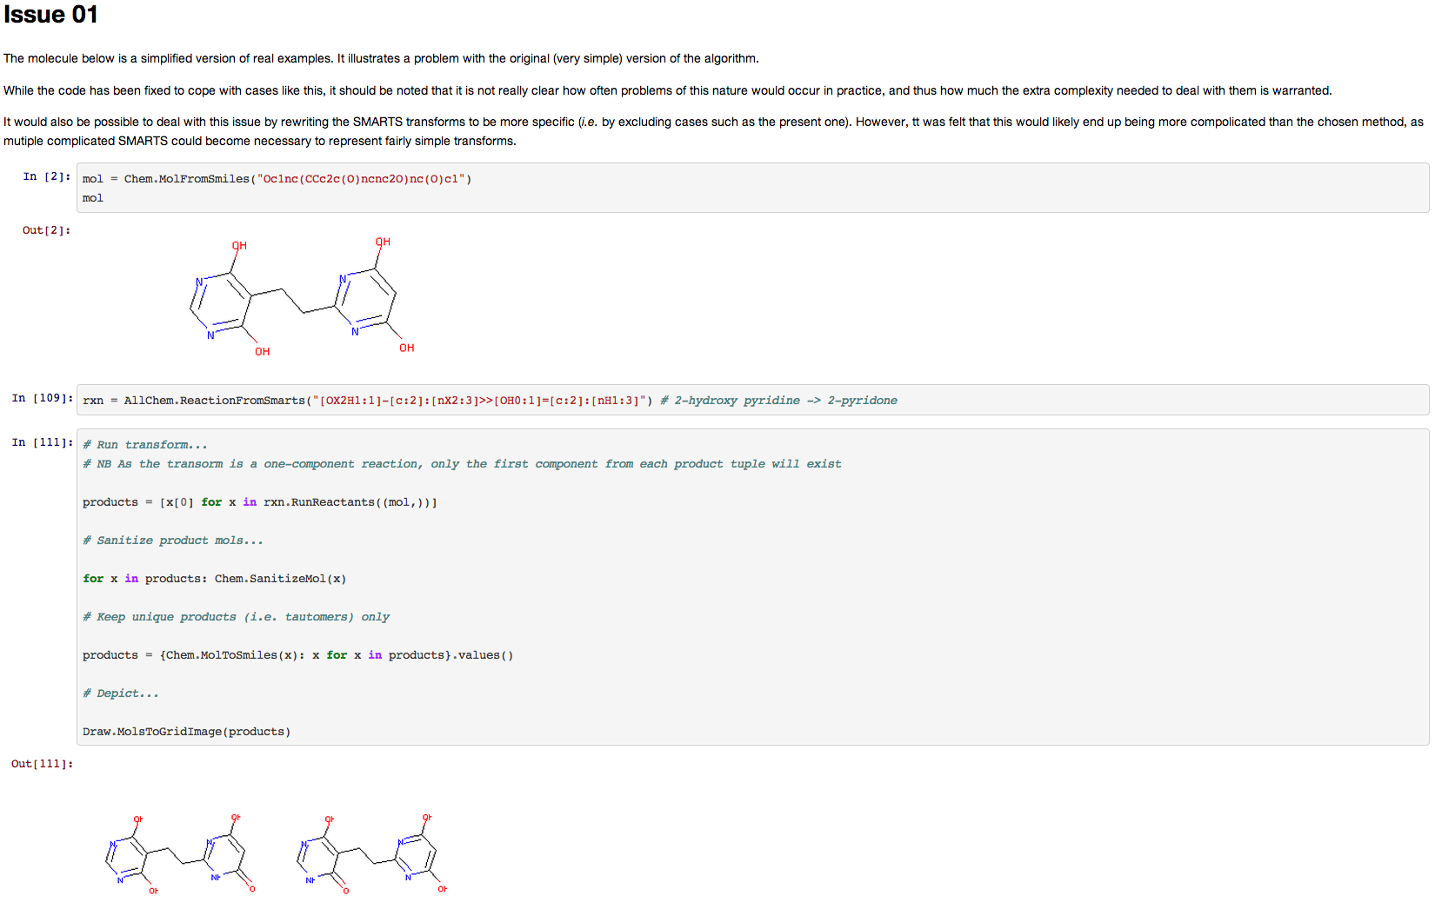
Futher Documentation
Also included are some pages describing issues encountered
Intended to stimulate debate on future directions of tool

Slide 22
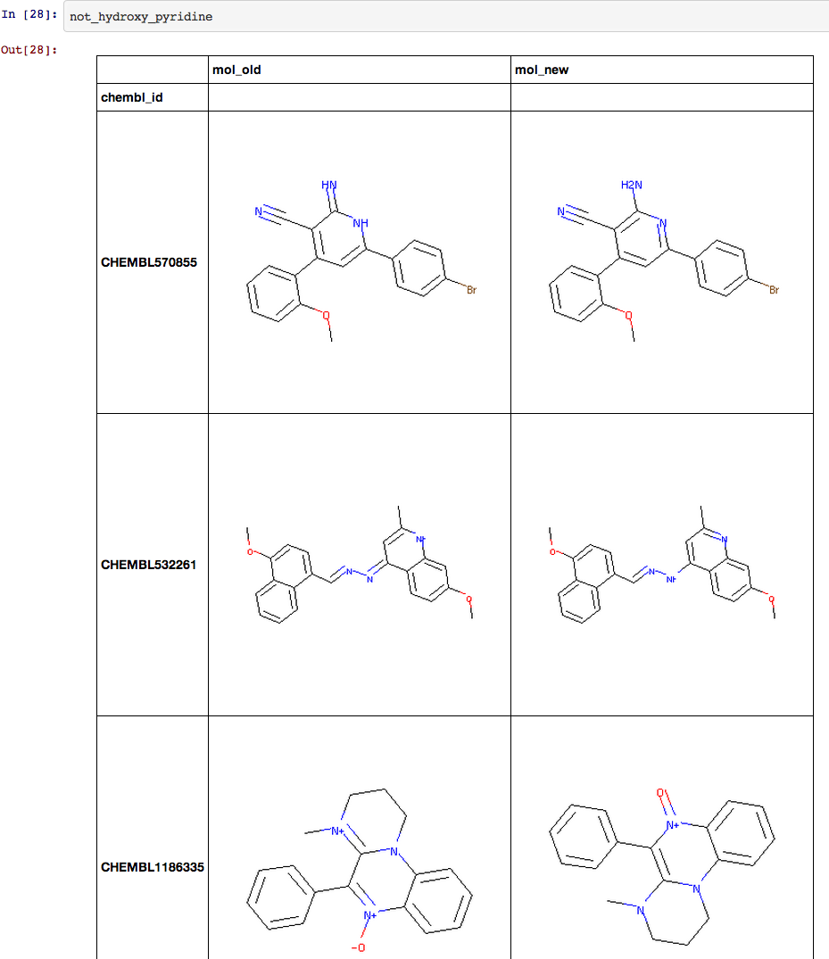
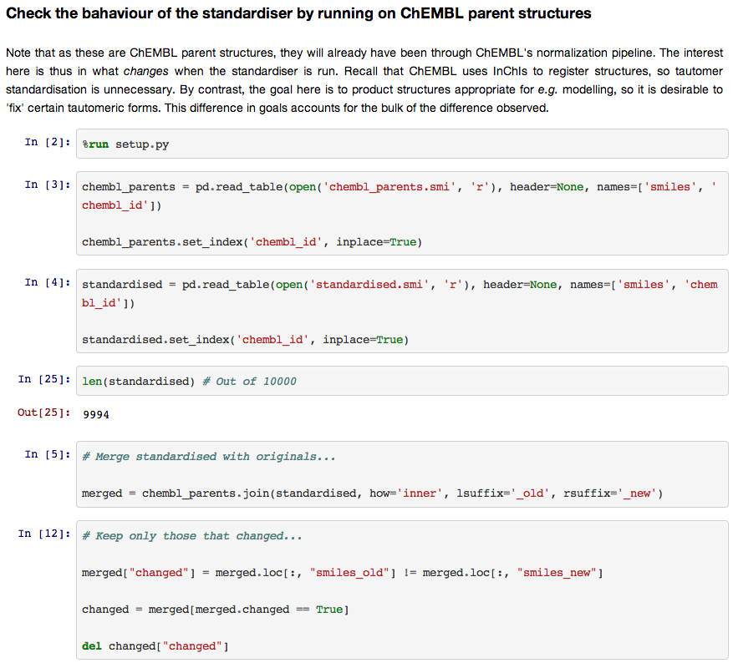
Futher Documentation
The tool will be run on diverse test sets and the results posted
Again, designed to detect flaws and promote discussion
One example up so far…
This isn’t good…

Slide 23
Future developments
We would like to open-source this code
Tool would improve as more bugs/issues are found
e.g. establish wiki for community annotation of rules
Need to tidy up code and documentation
More testing on diverse compound sets
Incorporate into registration tool for myChEMBL
Longer term project
recall differences between standardisation for modelling and for database registration

