Slide 1


Beyond Smart Contracts
A Front End Workshop for Blockchain Apps
By: Robert Tanniru – Co-Founder of Gaming

Slide 2
Imagine this…
You’ve completed your first smart contract!

Slide 3
Imagine this…
You’ve completed your first smart contract!
Submitted it to Ethereum Main Network

Slide 4
Imagine this…
You’ve completed your first smart contract!
Submitted it to Ethereum Main Network
Time to rake in the profits right?

Slide 5
Imagine this…
You’ve completed your first smart contract!
Submitted it to Ethereum Main Network
Time to rake in the profits right?
Wrong!

Slide 6
Imagine this…
You’ve completed your first smart contract!
Submitted it to Ethereum Main Network
Time to rake in the profits right?
Wrong!
How are user’s going to interact with it and why should they?

Slide 7
Workshop Roadmap
Overview of Ethereum smart contracts
How to add value with front-end integration
Deep dive into example dApp
--- break to create teams ---
Brainstorming of dApp ideas and technical setup
Implementation time
Presentations of dApp ideas
Judging and Prizes!

Slide 8
Ethereum Smart Contracts
Coding language – Solidity
Efficiency is paramount
Every unneeded instruction is costly
Think of Ethereum as a Database
Main functions: create, read, update, delete

Slide 9
Smart Contracts Require Trust
Smart contracts should be:
Open source
Heavily tested and validated
Shared with the community and reused by others
Only changeable if community is aware and approves of the change
Do not be concerned with protecting the code of a smart contract

Slide 10
Smart Contracts are not Intellectual Property
Virtually impossible to prevent others from copying code
Even if raw code is not provided, can still be de-compiled
Contracts do not add value by themselves
Anyone can create any assets they want
Contracts must be paired with great front-end to have value
No one will use a smart contract with no UI

Slide 11
Adding Value with Front-End Integration
Front-end code (with web3) adds value by providing:
A user-friendly interface to smart contract functions
Off-chain features for on-chain assets (rendering/gameplay/etc.)
Community interaction
Integration with other dApps
Front-end code is integral to a successful dApp.

Slide 12
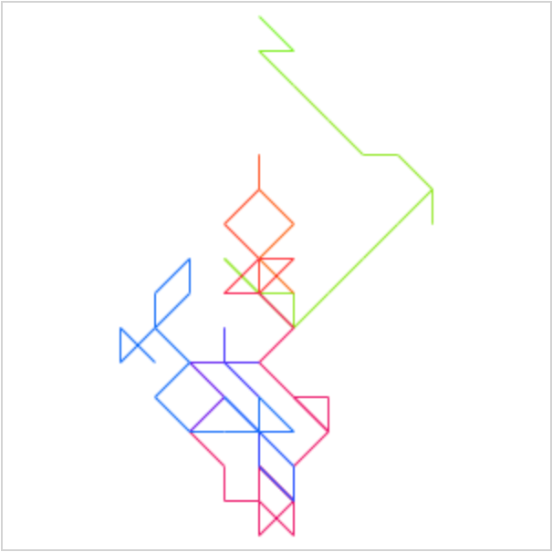
Front-End Example CryptoSquiggles

