Slide 1
啊哈！EOSJS

Slide 2
碎碎念
Dapp开发前端必然是要操作智能合约的，EOSJS扮演的角色就是在前端要对智能合约进行操作的API。
EOSJS@20.0.0稳定版发布，这和之前的版本相差还是非常大的，今天我们就讨论稳定版叭。
DAPP开发入门——啊哈！EOSJS稳定版！
https://blog.csdn.net/qq_41555552/article/details/90289869

Slide 3
安装
npm install eosjs

Slide 4
Basic Usage
Signature Provider
JSON-RPC
API

Slide 5
Signature Provider
The Signature Provider holds private keys and is responsible for signing transactions.
Using the JsSignatureProvider in the browser is not secure and should only be used for development purposes. Use a secure vault outside of the context of the webpage to ensure security when signing transactions in production

Slide 6
JSON-RPC
const rpc = new JsonRpc('http://127.0.0.1:8888', { fetch });
实现接口
AuthorityProvider
AbiProvider

Slide 7
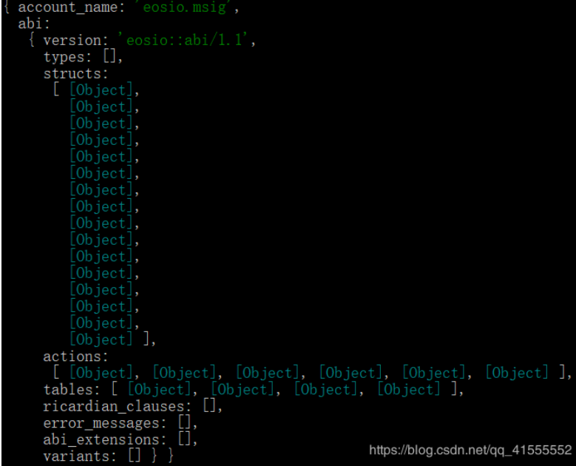
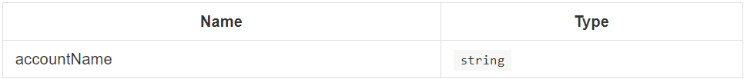
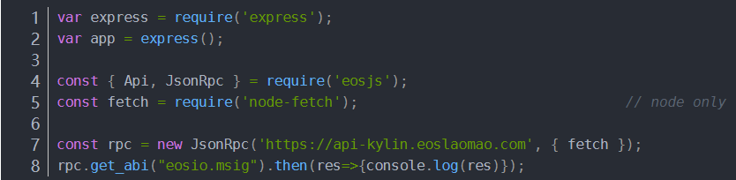
get_abi
get_abi(accountName: string): Promise<GetAbiResult>

Slide 8
get_account
get_account(accountName: string): Promise<any>

Slide 9
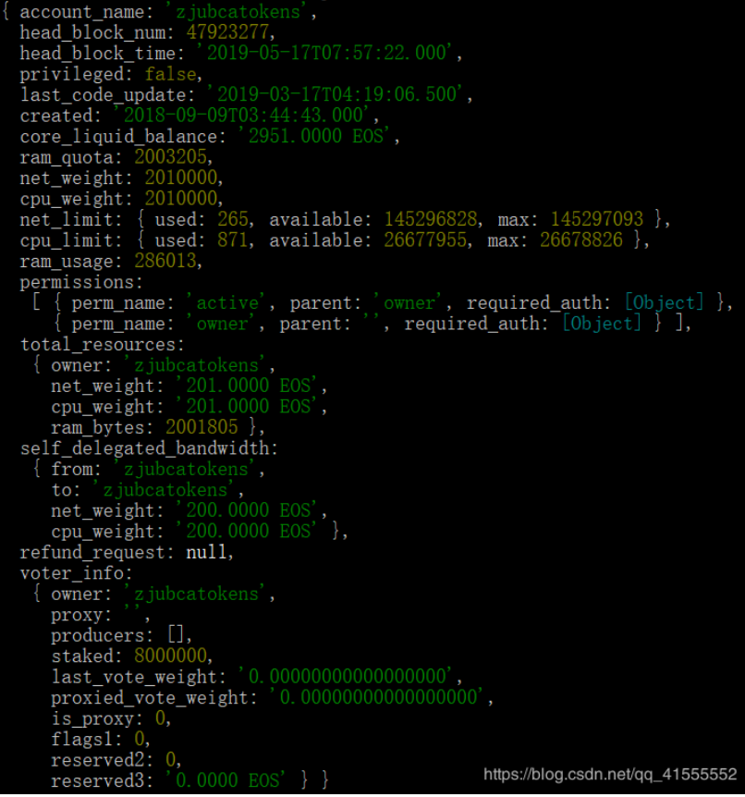
get_account
rpc.get_account("zjubcatokens").then(res=>{console.log(res)});

Slide 10
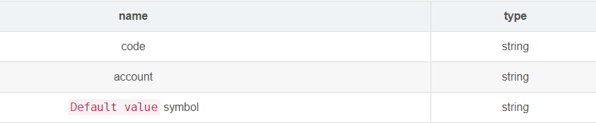
get_currency_balance
get_currency_balance(code: string, account: string, symbol?: string): Promise<any>

Slide 11
get_currency_balance
rpc.get_currency_balance("zjubcatokens","yangjiani233").then(res=>{console.log(res)});

Slide 12
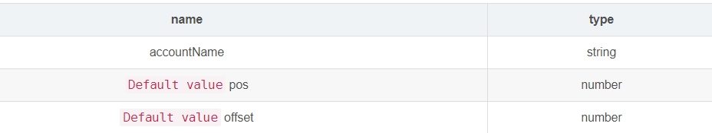
history_get_actions
history_get_actions(accountName: string, pos?: number, offset?: number): Promise<any>

Slide 13
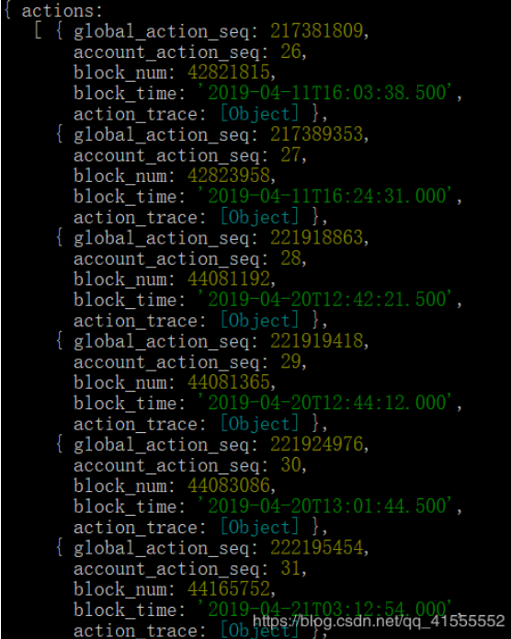
history_get_actions
rpc.history_get_actions("zjubcatokens").then(res=>{console.log(res)});

Slide 14
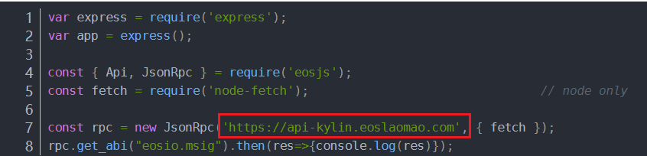
url

Slide 15
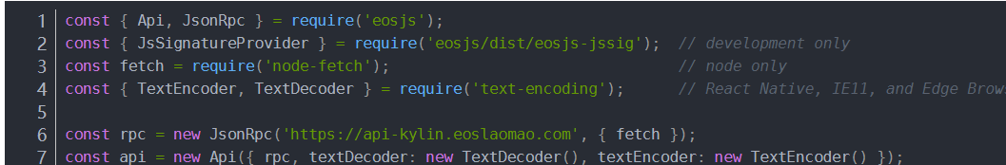
API

Slide 16
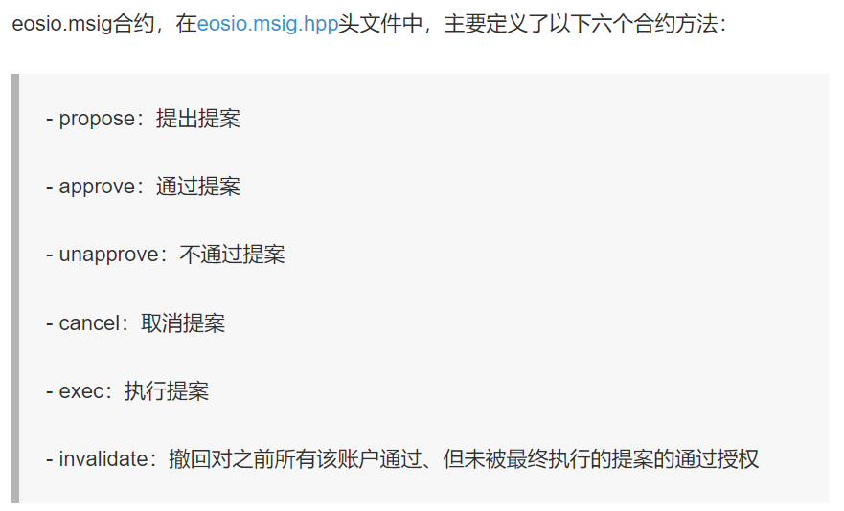

Slide 17
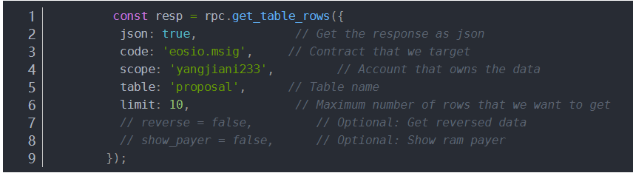
Get proposal

Slide 18
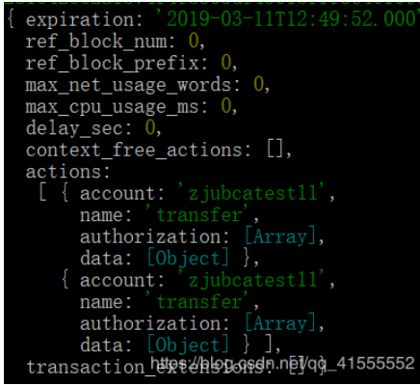
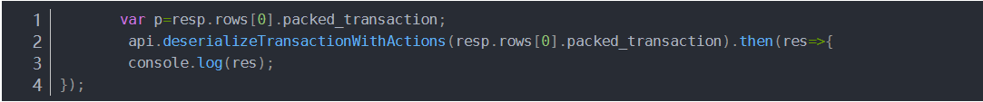
deserializeTransactionWithActions
deserializeTransactionWithActions(transaction: Uint8Array | string): Promise<any>

Slide 19
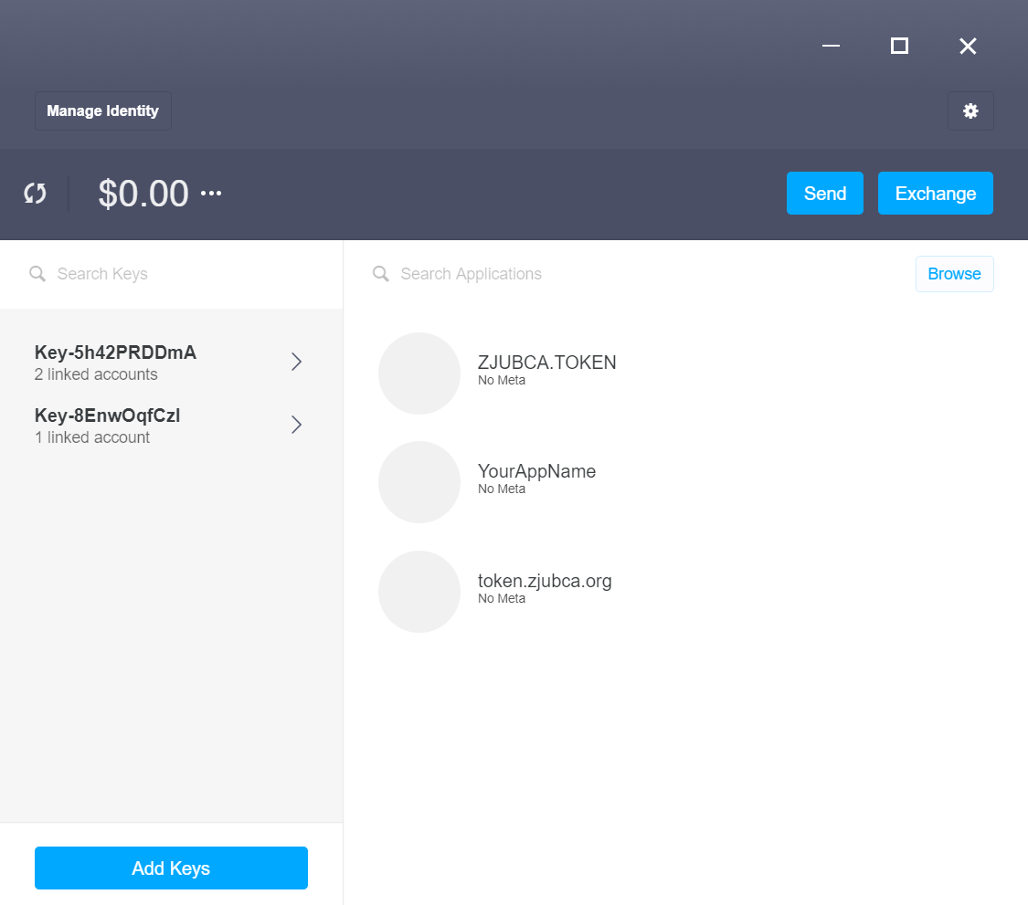
Scatter

Slide 20
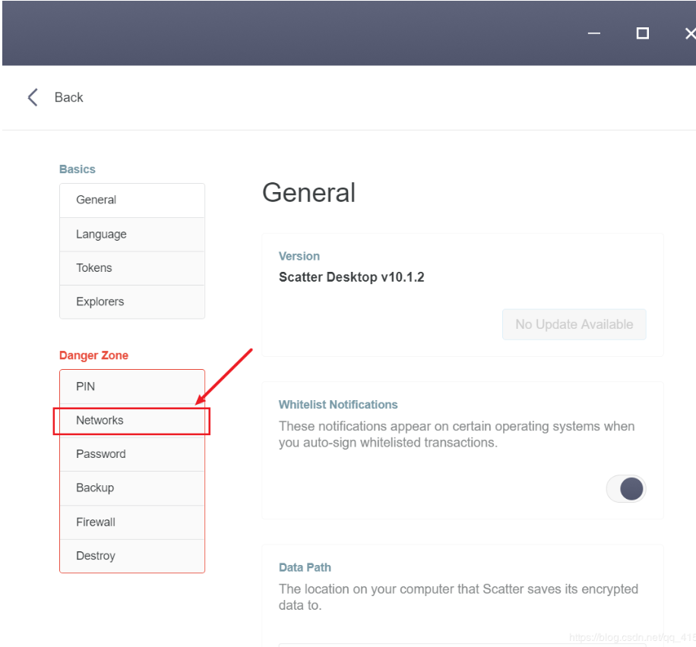
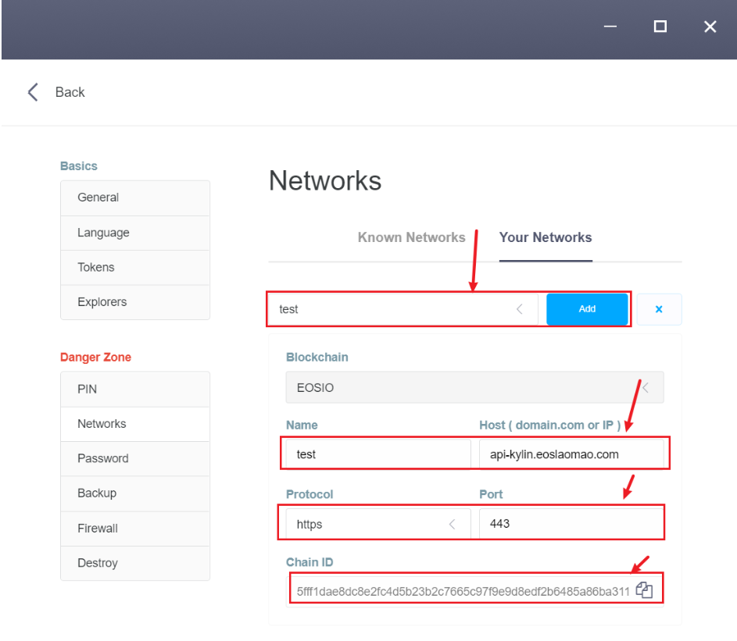
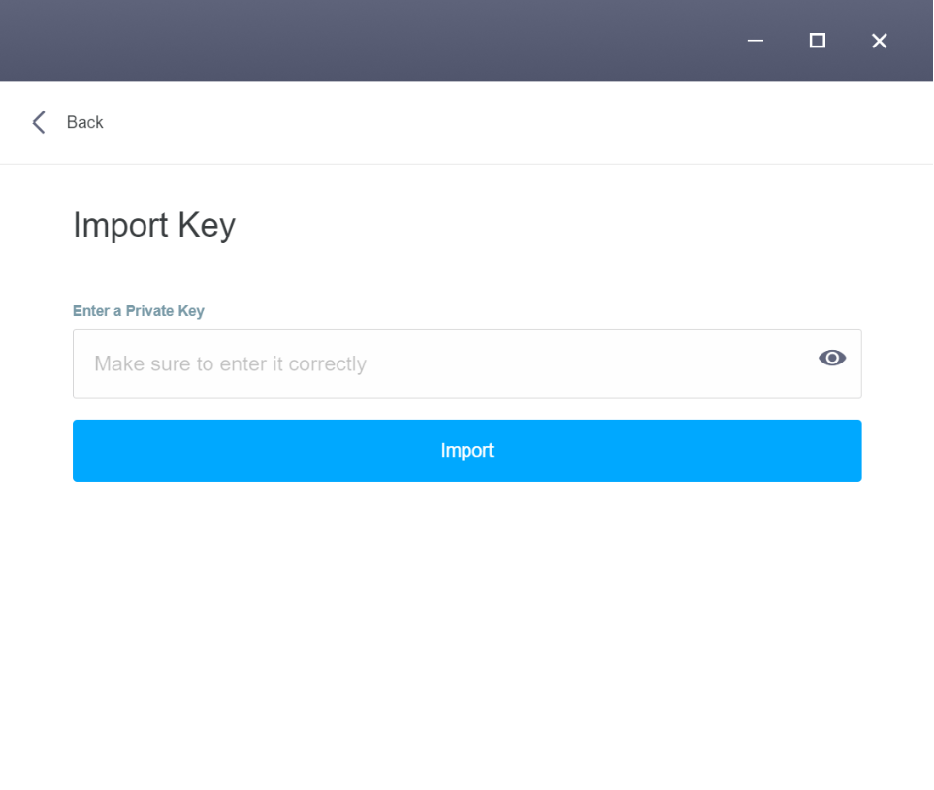
networks

Slide 21
install
npm i -S scatterjs-core
npm i -S scatterjs-plugin-eosjs2

Slide 22
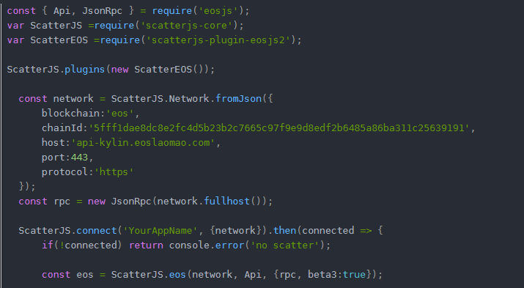

Slide 23
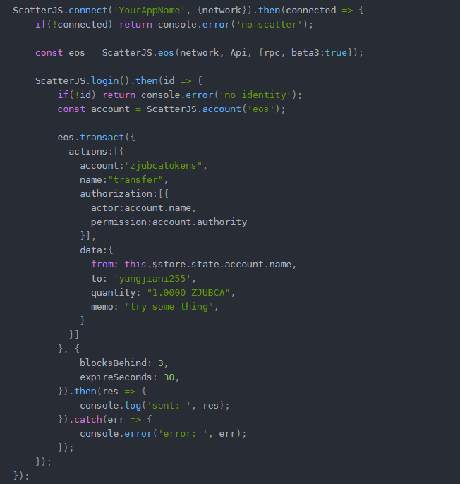

Slide 24
THANKS

