Slide 1
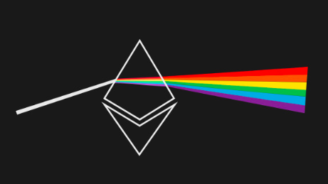
ClusterING ETHEREUM ADDRESSES
identifying patterns in transaction size, type, volume, and frequency

Slide 2
What is ETHEREUM?
open-source blockchain platform
decentralized payment network
platform for decentralized applications called smart contracts

Slide 3


THE PROCESS
250k economically important addresses chosen
25 characteristic features engineered
Dataset scaled and transformed
K-Means⁺⁺ clustering algorithm selected
Labels scraped from Etherscan.io block explorer
Notes:
add overview of what features are

Slide 4
THE FEATURES
Incoming | Outgoing | Miscellaneous
Transactions sent | Transactions received | Active months
Ether sent | Ether received | Ether balance
USD sent | USD received | Number of tokens used
Monthly transactions sent | Monthly transactions received | Smart contracts created
Monthly ether sent | Monthly ether received | Smart contract transactions
Monthly USD sent | Monthly USD received
Time between sent transactions Average Standard Deviation | Time between received transactions Average Standard Deviation
Notes:
s

Slide 5
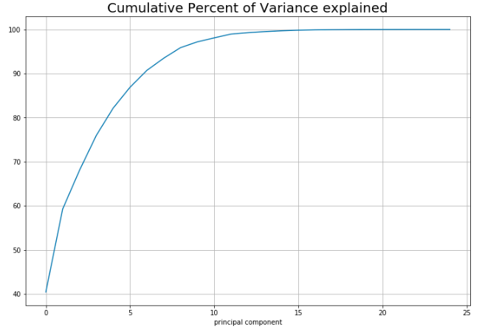
Dimensionality reduction

Slide 6
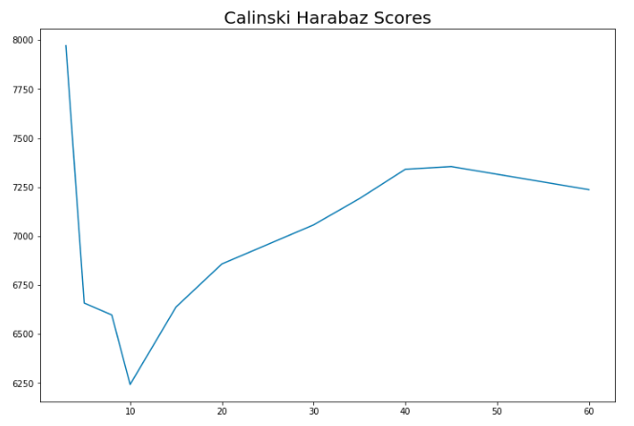
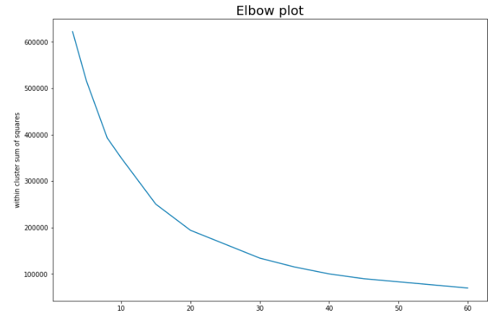
Optimal number of clusters is about 40

Slide 7
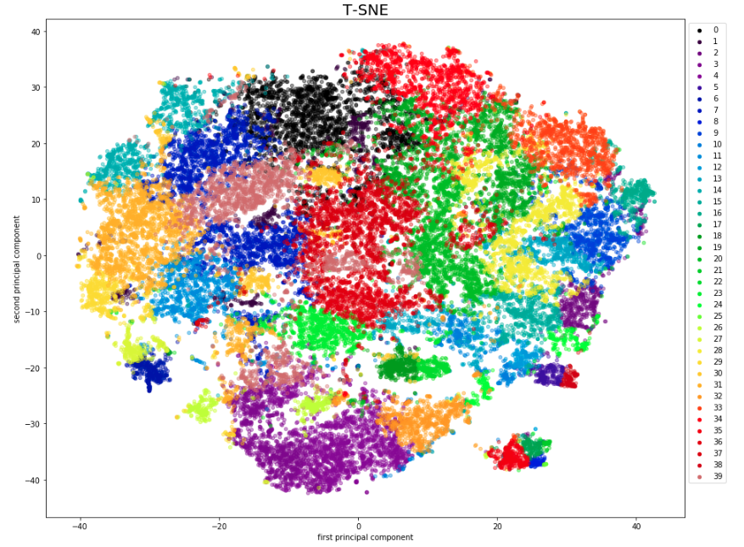

Slide 8
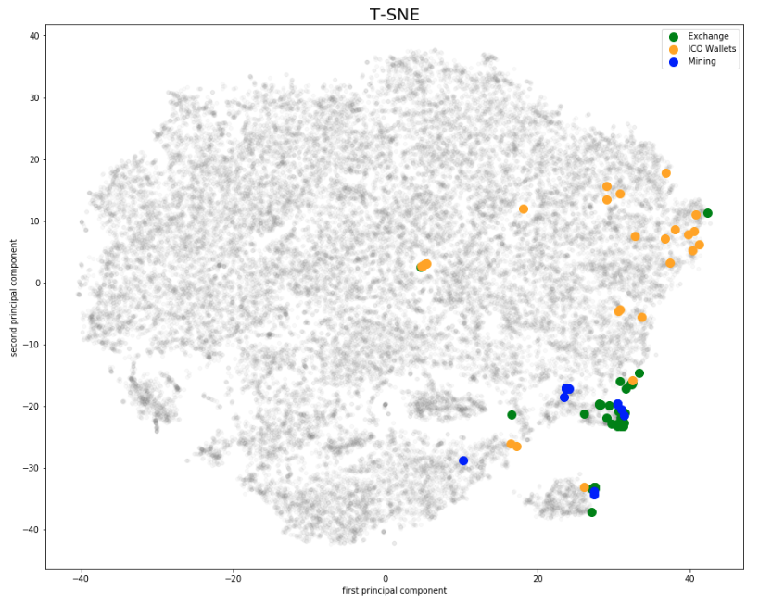

Slide 9
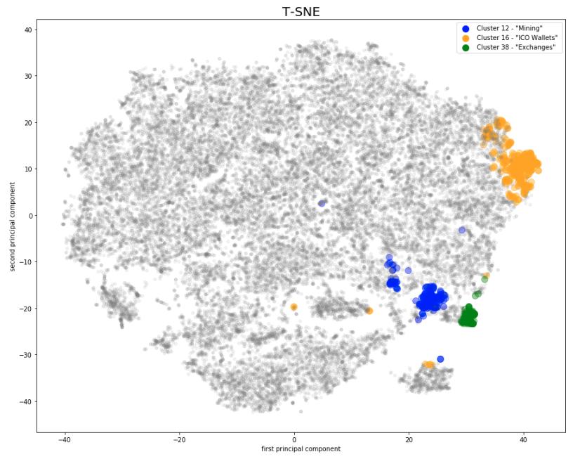
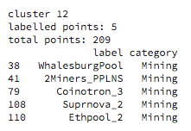
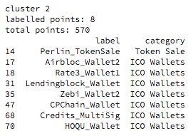
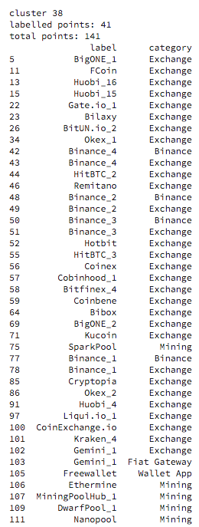

Slide 10
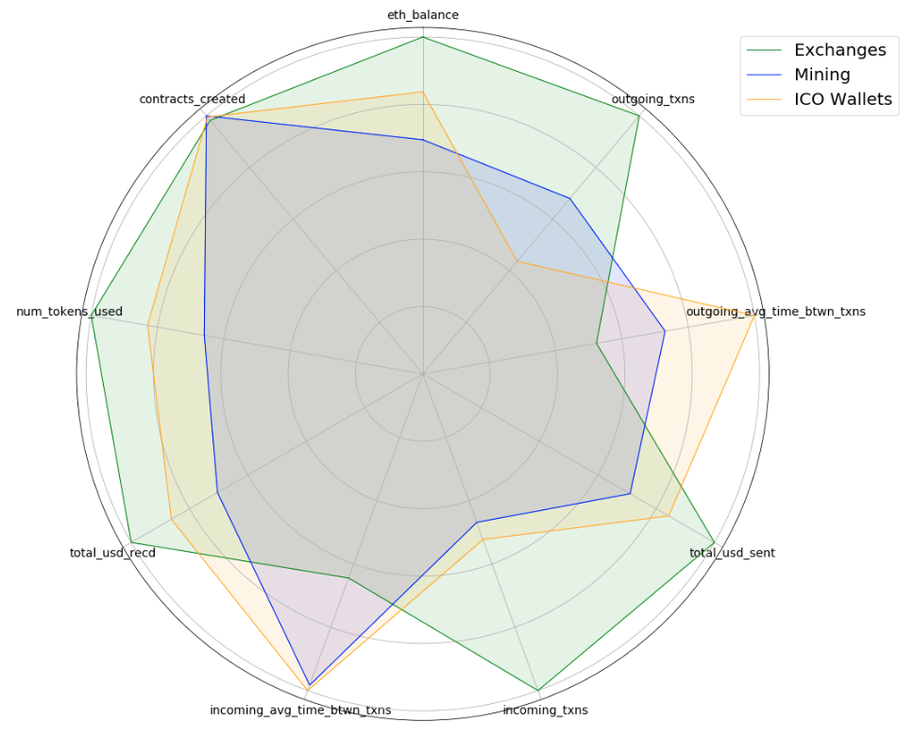

Slide 11
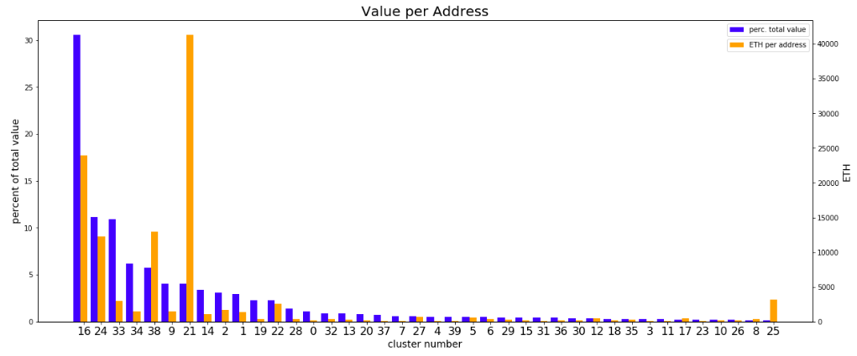

Slide 12
NEXT STEPS
Create more smart contract features
Create graph analysis features
Track movement of funds over time
Distinguish bots from humans
Enhance supervised learning approaches

