Slide 1




GIT
By Ali Khorsandfard (English) April 2023

Slide 2
Agenda
Install it on our PC!
Create your First Repository
Command : git status

Slide 3
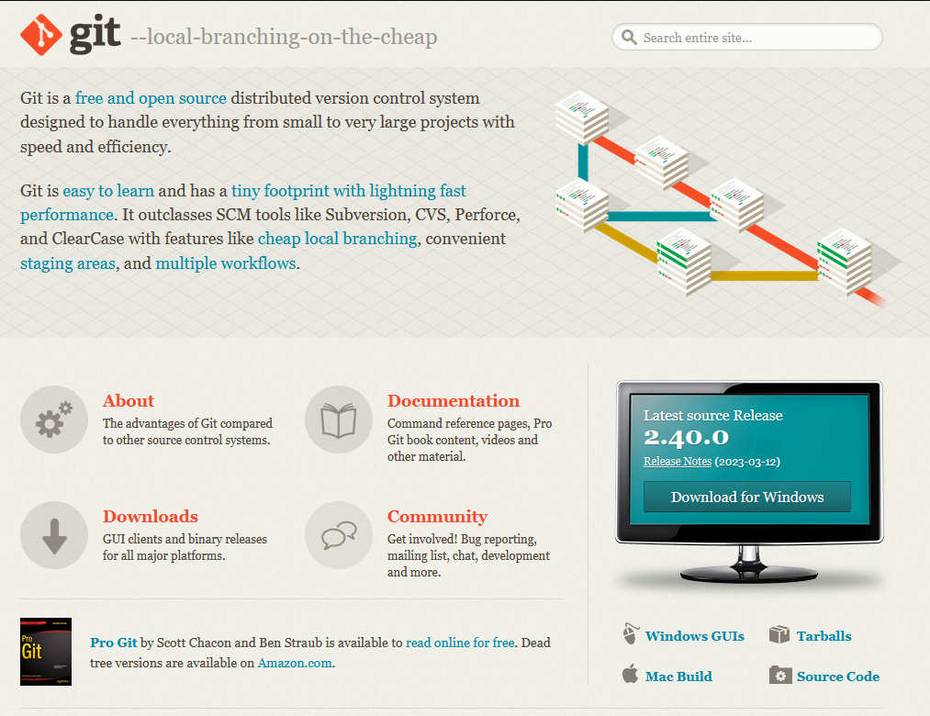
Install Git on Your PC!
Visit https://git-scm.com/ and download/install software.
You can also check GUI’s software based on your need! For example Sourcetree software. It is free!
Check if it is installed:
Open CMD
Type: git --version

Slide 4
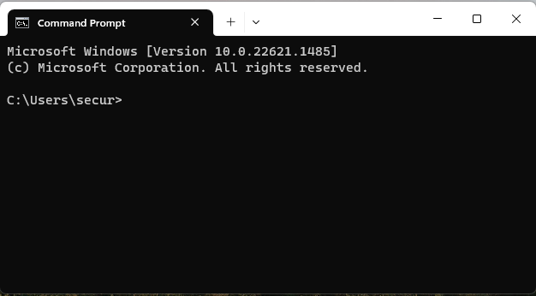
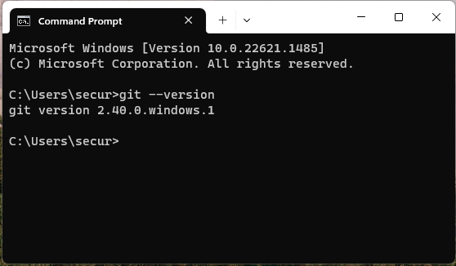
Check if you successfully install git
Open command prompt on your windows. The path doesn’t matter
Type following command:
git -–version and press enter
You shall see answer like the picture
The version number can be different on your machine.
If you see answer git version xxx it means you installed git successfully.
It is the path

Slide 5
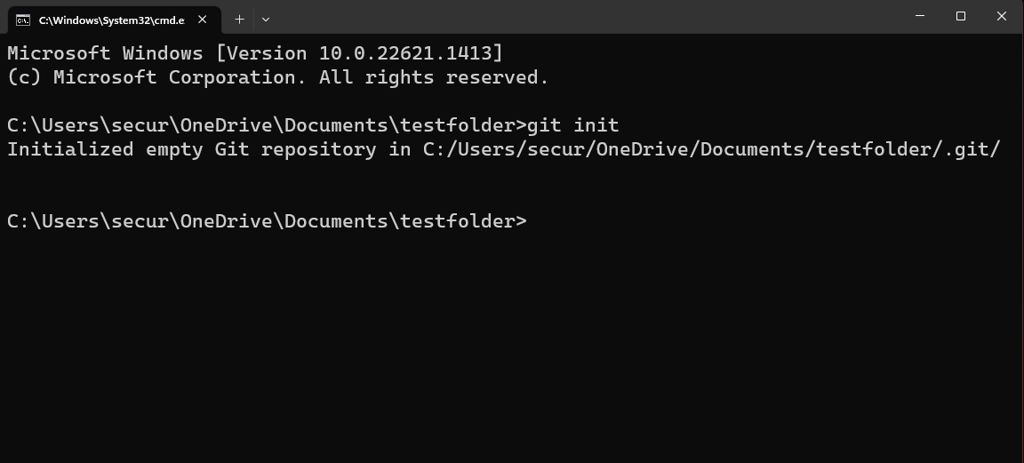
Create your First Repository
Create folder anywhere on your PC
open CMD and go to the folder path that you have created
Type: git init and press Enter
You shall see Initialized empty Git repository in …

Slide 6
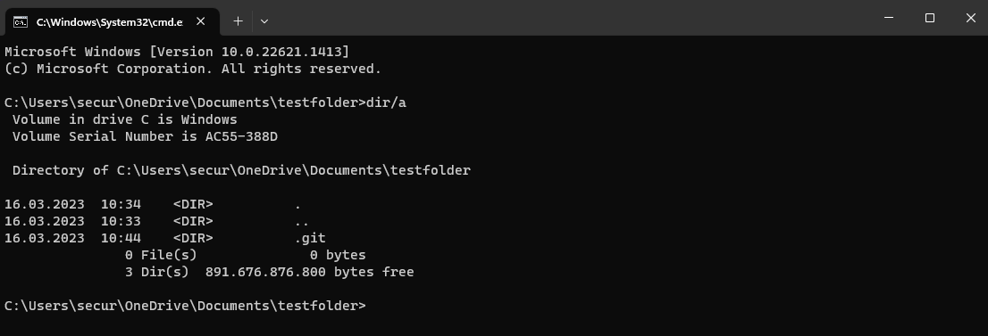
Check Repository
After creating your git Repositoy with git init command
Type dir/a
you see git init created a hidden folder called .git

Slide 7
What is folder .git?
Git follows every single change in whole directory and sub directory that it initialized with command “git init”.
For tracking any change in file it need a database.
.git folder , is database and everything git need for this purpose.
Never Ever touch or delete this folder

Slide 8
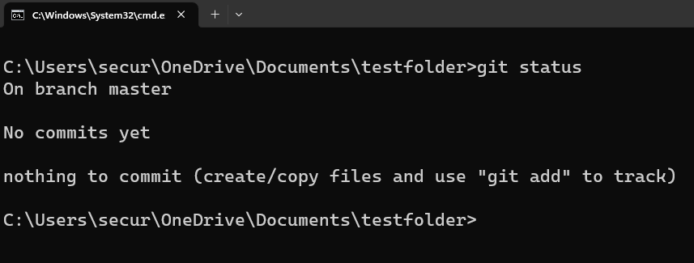
git status
Type git status in CMD.
Please pay attention to :
On branch master

Slide 9
Training
Install Git on your PC/Laptop
Open CMD and type: “git -–version”
Create a new folder anywhere on your PC or Laptop
Go to folder address with command line
Type command: “git init”
Check if git folder is generated by Typing command: “dir/a”
Type command “git status” to see information about current status.
pay attention on current beanch and read answer carefully
3 times Repeat items 2 – 8

Slide 10
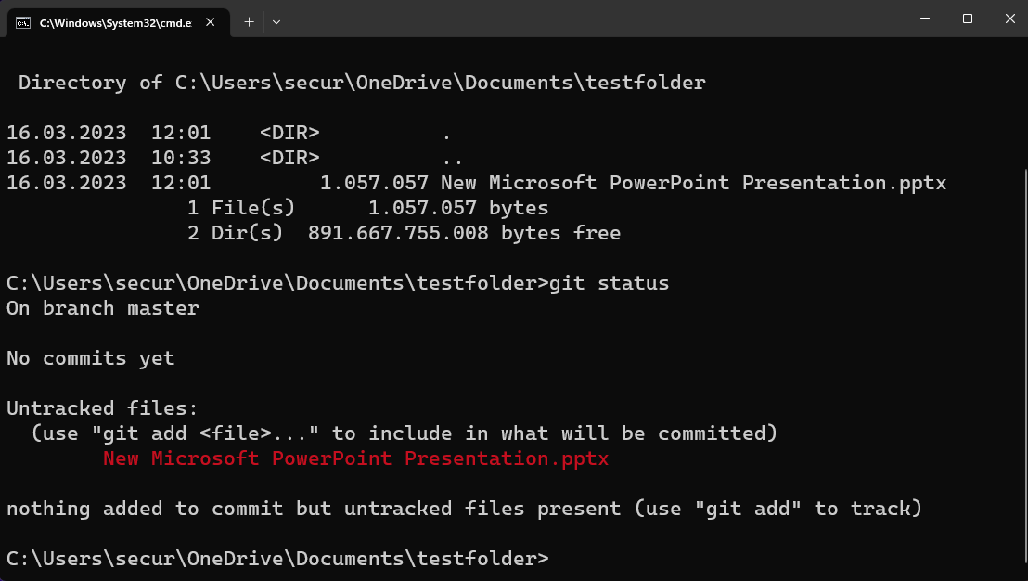
Add new File in Directory
Create new folder and go inside and type “git init” in cmd.
Just create new PowerPoint file inside the folder you have just created. you can add some slides and design. Then save the file
Now go to cmd and run again command git status
You can see git detect new file!
If you delete .git folder git status doesn’t work and say:
fatal: not a git repository (or any of the parent directories): .git

