Slide 1
Startup Value Index
The live score Australian evaluators screen on — by BlockID
TRE · Traction & Revenue Evidence
One score across 8 dimensions, backed by evidence, updated weekly.
Built for Australian angel groups, accelerators, funds and advisers.
Do Van Long, founder · Sydney · Pre-seed A$500K
20
MPC · Market Pull & Category
18
FTV · Founder & Team Value
115
15
PTD · Product & Tech Depth
12
CGH · Capital & Governance Health
Startup Value Index
12
IRI · Investor Readiness Index
10
LCO · Legal & Compliance
8
SVM · Strategic Vision & Moat
5
Startup Value Index by BlockID — Auschain PTY LTD | ACN 659 615 111 | Confidential 1/12
Notes:
We're building the credit score for startups, for the people who back them.
Answers: C4, C10
Sources: web/src/lib/report-pipeline/dimension-owners.ts (weights) | web/src/lib/svi-analysis.ts (SVI_BENCHMARKS stage 2 p50 = 115)

Slide 2
Forty decks. One weekend. No rubric.
What screening a cycle looks like today
Sydney Angels: about 40 applicants a cycle, 30–60 minutes each to read.
Every screener uses a different gut rubric; scores don't compare.
Founders who are passed on hear nothing — and pitch the same deck again.
40
applicants per Sydney Angels cycle, 30–60 minutes each to read
Startup Value Index by BlockID — Auschain PTY LTD | ACN 659 615 111 | Confidential 2/12
Notes:
Sydney Angels see about forty applicants a cycle — read at forty minutes each, that's a lost weekend and no shared score.
Answers: C1, C7
Sources: docs/plans/evaluator-traction-2026-09-10.md §2 (Sydney Angels ~40 applicants × 6 cycles; 30–40 decks/day; 30–60 min per deck) | docs/plans/evaluator-traction-2026-09-10.md Appendix D (Sydney Angels 1,302 applications 2014–21)

Slide 3
Evaluators pay. Founders get the feedback.
A two-sided loop that starts on the paying side
Founder: free score → A$3 Trusted Business Report → joins the index.
Evaluator: Scout, Firm or Program subscription; verdict PASS / TRACK / PROCEED.
Passed founders get the reasons and a re-score path back.
Founder
Free score
A$3 report
Index
Re-score
Reasons to founder
PASS / TRACK / PROCEED
Evaluator (Scout / Firm / Program)
loop: every verdict sends reasons back, and the founder can re-score
Startup Value Index by BlockID — Auschain PTY LTD | ACN 659 615 111 | Confidential 3/12
Notes:
The people who screen pay us; the founders they pass on get the reasons and a way back.
Answers: C2, C3, C8, C10
Sources: web/src/config/pricing/plans.csv (Scout / Firm / Program rows) | web/src/lib/credits.ts (A$3 Trusted Business Report) | web/src/lib/evaluations/progress-radar.ts (weekly evaluator radar, re-score)

Slide 4
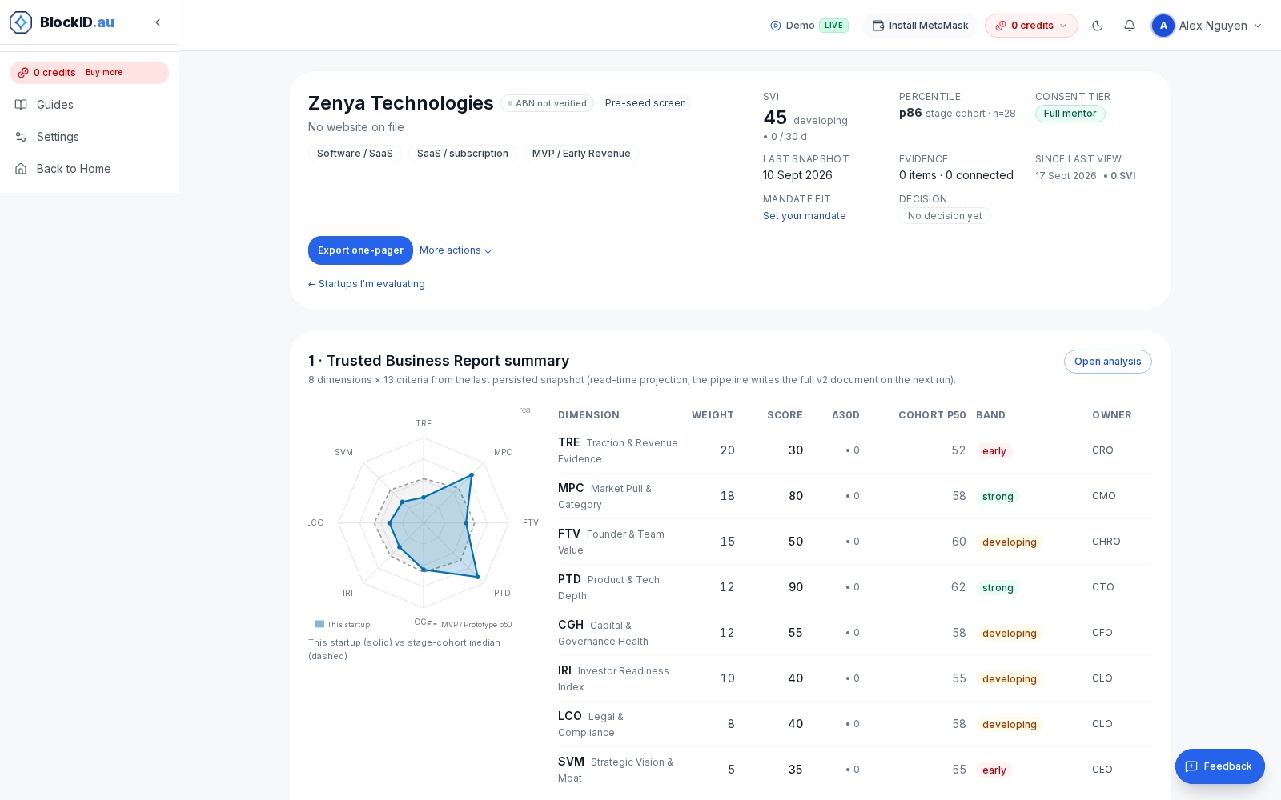
Add a startup. Read the dossier. Send verdict.
The evaluator workspace — one startup, one dossier, one decision
Add a startup by deck, URL or ABN — scored in minutes.
Dossier: score, 8 dimensions, evidence, red flags, questions to ask.
Record the verdict; the founder sees the reasons this quarter.
/workspace/evaluations/[id] — investor dossier (seeded evaluator)
Startup Value Index by BlockID — Auschain PTY LTD | ACN 659 615 111 | Confidential 4/12
Notes:
You add the startup, read the dossier and record a verdict — the founder gets the reasons, not a form letter.
Answers: C8, C1
Sources: web/src/lib/evaluations/progress-radar.ts (evaluations rows, dossier, reports) | docs/plans/investor-clarity-2026-09-15/10-ba-investor-dossier-taxonomy.md (dossier blocks) | G13 S-D2 (assessment write path — founder-visible share "this quarter")

Slide 5
Not a prompt. A rubric with receipts.
Why the same startup gets the same score twice
Rubric 8 × 13
Evidence ladder 0.2 → 1.0
Fixed rubric v2.1.0: 8 dimensions, 13 criteria, fixed weights.
Evidence weighted 0.2 (self-declared) to 1.0 (third-party verified).
An auditor agent checks claims; every event is hash-chained.
8 dimensions, 13 criteria, fixed weights 20/18/15/12/12/10/8/5 — engine v2.1.0
self-declared 0.2 · public URL 0.35 · document 0.5 · connected source 0.75 · transactions 0.9 · third-party verified 1.0
Audit
Weekly Δ
Auditor agent flags unsupported claims; every event is hash-chained and re-verified by cron
Score re-snapshotted weekly; evaluators see movers, new evidence and deadlines
Startup Value Index by BlockID — Auschain PTY LTD | ACN 659 615 111 | Confidential 5/12
Notes:
A chatbot gives you an opinion; we give you the same rubric every time, with the evidence weighted and audited.
Answers: C5, C4
Sources: web/src/lib/svi-analysis.ts (SVI_VERSION 2.1.0; EVIDENCE_CONFIDENCE ~L79) | web/src/lib/report-pipeline/dimension-owners.ts (weights 20/18/15/12/12/10/8/5) | web/src/lib/evaluation-criteria.ts (13 criteria) | web/src/lib/audit/chain-verify.ts (hash chain verification) | web/src/lib/evaluations/progress-radar.ts (weekly Δ) | docs/plans/evaluator-traction-2026-09-10.md §4 (llm-auditor, ChatGPT variance evidence)

Slide 6
A$3 is a lead. Programs are the revenue.
One ladder, priced per year (list price × 12)
The A$3 report is the lead; it costs cents to produce.
Evaluator subscriptions A$79 to A$999 a month; cohorts A$5K–15K a year.
Base case month 12: A$386K ARR from ~180 paying organisations.
Base case month 12: A$386K ARR from ~180 paying orgs = the money of 130,000 A$3 reports
Startup Value Index by BlockID — Auschain PTY LTD | ACN 659 615 111 | Confidential 6/12
Notes:
Three dollars buys us a founder; three hundred and forty-nine a month is what a program pays to screen its whole intake.
Answers: C2, C3
Sources: web/src/config/pricing/plans.csv (Scout 7900 / Firm 14900 / Program 34900 cents per month; Cohort Starter 500000 / Growth 1500000 cents annual) | plan §3.2 pricing ladder v4 (Fund A$999, Cohort 25 A$5,000/yr, Cohort 100 A$15,000/yr — planned, Stripe mint human-gated) | plan §3.3 ARR bottom-up (base M12 A$386K; 187 paying orgs) | plan §0 (COGS ≈ A$0.001 per report, DeepInfra)

Slide 7
Australia, counted one evaluator at a time
Bottom-up, Australia only — organisations that screen startups for a living
~249 accelerators and incubators; 18 early-stage VC funds; 135 investor organisations.
~1,000 active angels; 4,345 accounting firms touching ESIC and R&D claims.
Serviceable: ~5,700 organisations ≈ A$12M ARR at list prices.
≈A$12M ARR serviceable across ~5,700 organisations at list price
Startup Value Index by BlockID — Auschain PTY LTD | ACN 659 615 111 | Confidential 7/12
Notes:
We counted the buyers one by one — roughly five and a half thousand Australian organisations screen startups for a living.
Answers: C9, C2
Sources: docs/plans/evaluator-traction-2026-09-10.md §2 + Appendix D (18 VC funds, 135 investor orgs, ~249 accelerators, ~1,000 Cut Through contributors, 4,345 accounting firms) | plan §2.2 slide 7 (≈A$12M ARR serviceable, ~5,700 orgs)

Slide 8
Data about deals vs judgement about a startup
Where the existing tools sit — and the empty corner
Live weekly
Deal data (Crunchbase, PitchBook US$15–20k/seat) tells you about other companies.
CRMs (Affinity US$2–2.7k/seat) track relationships; valuers charge A$2,985+ per report.
We are the only live, evidence-weighted judgement about one startup.
Startup Value Index
from A$3 per startup, weekly
Affinity · Dealum · F6S
Affinity US$2–2.7k/seat
Crunchbase · PitchBook · Techboard
PitchBook US$15–20k/seat
Equidam · valuers · ChatGPT
valuers A$2,985–3,990 per report
Static
Data about deals
Judgement about one startup
Startup Value Index by BlockID — Auschain PTY LTD | ACN 659 615 111 | Confidential 8/12
Notes:
Crunchbase tells you what happened to other companies; we tell you what's true about this one, this week.
Answers: C4, C5
Sources: docs/plans/evaluator-traction-2026-09-10.md §2 (PitchBook US$15–20k/seat; Affinity US$2,000–2,700/seat/yr; AU desktop valuation A$2,985–3,990) | docs/plans/evaluator-traction-2026-09-10.md Appendix A (54-row competitor table)

Slide 9
Live product, real depth, first pilots
What is live today, and what starts this quarter
Shipped: rubric, dossier, evaluator ladder with billing, weekly snapshots, audit chain.
Pipeline: 5 accelerator pilots Sep–Nov 2026; [[LOI placeholder]].
Programs: Founder Institute, Spacecubed AI Fellowship, NVIDIA Inception, Stripe for Startups.
182
3,302
startups analysed
weekly snapshots
Founder Institute
Spacecubed AI Fellowship
NVIDIA Inception
Stripe for Startups
Startup Value Index by BlockID — Auschain PTY LTD | ACN 659 615 111 | Confidential 9/12
Notes:
One hundred and eighty-two startups scored, three thousand weekly snapshots, and the first accelerator pilots start this month.
Answers: C9, C6
Sources: docs/plans/reviews/capacity-audit-2026-09-13.md (svi_analyses 182; svi_snapshots 3,302) | web/content/reports/ceo-daily-2026-09-16.md (Analyses 182) | plan §4 GTM (5 pilots cap, Sep–Nov; LOI names only with written consent — F-9) | memory feedback_accelerator_pitch_rules.md (confirmed credentials FI / Spacecubed AI Fellowship / NVIDIA Inception)

Slide 10
A researcher who ships, hiring the seller
Team today, and the one seat this raise fills first
11 specialist agents
Do Van Long — founder; method grounded in doctoral research (DBA) on startup valuation.
Built and shipped the product solo: 11 specialist agents plus an auditor.
OPEN: commercial co-founder for evaluator sales — active search.
Do Van Long
Founder & CEO — Auschain PTY LTD
Method grounded in the founder's doctoral research (DBA) on startup valuation; built and shipped the product
CEO
CFO
CMO
CTO
COO
CPO
CRO
CHRO
CLO
CISO
CDO
Auditor agent (checks every report)
OPEN — Commercial co-founder (evaluator sales), active search
Startup Value Index by BlockID — Auschain PTY LTD | ACN 659 615 111 | Confidential 10/12
Notes:
I built the method in my doctoral research and the product with my own hands; the next seat is the person who sells it.
Answers: C6
Sources: docs/plans/evaluator-traction-2026-09-10.md §4a row 2 (11 C-Level agents + llm-auditor) and row 6 (DBA wording rule) | web/content/team-roster.json (agent roster) | memory feedback_accelerator_pitch_rules.md (commercial co-founder = active priority)

Slide 11
A$500K pre-seed: rubric to revenue
Use of funds and the month-12 milestones the money buys
Commercial co-founder + engineering — A$250K (50%)
Co-founder + engineering A$250K (50%) · Evaluator GTM A$140K (28%) · Trust + data A$110K (22%).
Month 12: 10 Programs, 3 Cohort 25, 2 Funds, 5 Intake links, 500 evaluator sign-ups.
Pre-money A$2.5–4.0M; SAFE cap A$3.5M, 20% discount; ~18 months runway.
Evaluator GTM — A$140K (28%)
Trust + data — A$110K (22%)
M3
Co-founder hired; 5 pilots running; feedback letters live
M6
Intake links live; 300 evaluator sign-ups; A$5K MRR
M12
10 Programs · 3 Cohort 25 · 2 Funds · 5 Intake links · 500 evaluator sign-ups · backtest published · A$10K MRR floor
Startup Value Index by BlockID — Auschain PTY LTD | ACN 659 615 111 | Confidential 11/12
Notes:
Five hundred thousand takes us from a working rubric to a six-figure annual run-rate, sold to programs.
Answers: C2, C9
Sources: plan §7 F-1 (use of funds 50/28/22) and F-2 (pre-money A$2.5–4.0M, SAFE cap A$3.5M, 20% discount) | plan §2.2 (M12 milestones; bear A$153K / base A$386K ARR; runway ≈ 18 months at ~A$27K/month) | plan §4 (D30/D60/D90 evaluator sign-ups 120/300/500; MRR A$1.5K/5K/10K) | [object Object] | .claude/goals/unicorn-masterplan.md (Pre-Seed A$500K row — use-of-funds table superseded by F-1)

Slide 12
Three things to remember
Startup Value Index — by BlockID
1
One rubric, every deal.
Same 8 dimensions, 13 criteria, evidence-weighted.
2
Evaluators pay. Founders get the feedback.
Programs, firms and angel groups buy; founders they pass on get the reasons, not silence.
3
A live index, not a static report.
The score moves weekly; the index gets more valuable with every startup scored.
Do Van Long · admin@blockid.au · blockid.au/pricing?persona=investor · Auschain PTY LTD ACN 659 615 111
Startup Value Index by BlockID — Auschain PTY LTD | ACN 659 615 111 | Confidential 12/12
Notes:
One rubric for every deal; evaluators pay and founders get the feedback; a live index, not a static report.
Answers: C7, C1
Sources: plan §2.1 (positioning + KM1–KM3) | web/src/lib/marketing/hero-variants.ts (I3 brand-forward line, speakability rules)

