Slide 1

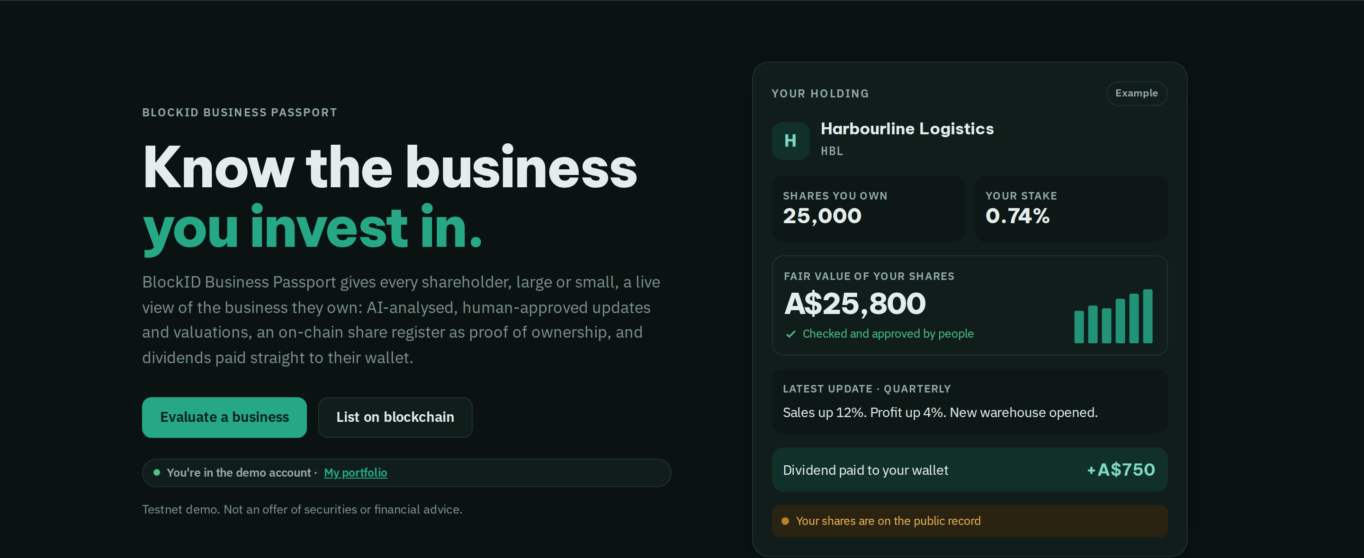
BlockID Business Passport
Know the business
you invest in.
BlockID Business Passport gives every shareholder, large or small, a live view of the business they own: AI-analysed, human-approved updates and valuations, an on-chain share register as proof of ownership, and dividends paid straight to their wallet.
13
38
A$87B
businesses listed
share records on blockchain
fair value checked by people
Live today at eth.blockid.au
Understand it · Follow it · Own it · Get paid · Check it
eth.blockid.au · Testnet demo. Not an offer of securities or financial advice.
Notes:
[0:00–0:20] Know the business you invest in. BlockID Business Passport gives every shareholder, large or small, a live view of the business they own: updates and valuations analysed by AI and approved by a person, a share register on blockchain as proof of ownership, and dividends paid straight to their wallet.

Slide 2




2 / 9 · THE PROBLEM
Investing in a business is hard to follow.
You don't really understand the business
You lose sight of it after you invest
You're not sure what you own
Dividends are slow, or never arrive
Reports are long, late or missing. The numbers are hard to compare.
Sales, profit and new share sales happen without you seeing them.
Ownership sits in a spreadsheet. Your stake can shrink and no one tells you.
Paperwork and bank transfers, if they happen at all.
Big or small, most investors in a business face the same four gaps.
eth.blockid.au · Testnet demo. Not an offer of securities or financial advice.
Notes:
[0:20–0:40] Whether you put in a thousand dollars or a million, investing in a business is hard to follow. You don't really understand it, you lose sight of it after you invest, you're not sure what you own — your stake can shrink and nobody tells you — and dividends are slow or never arrive.

Slide 3
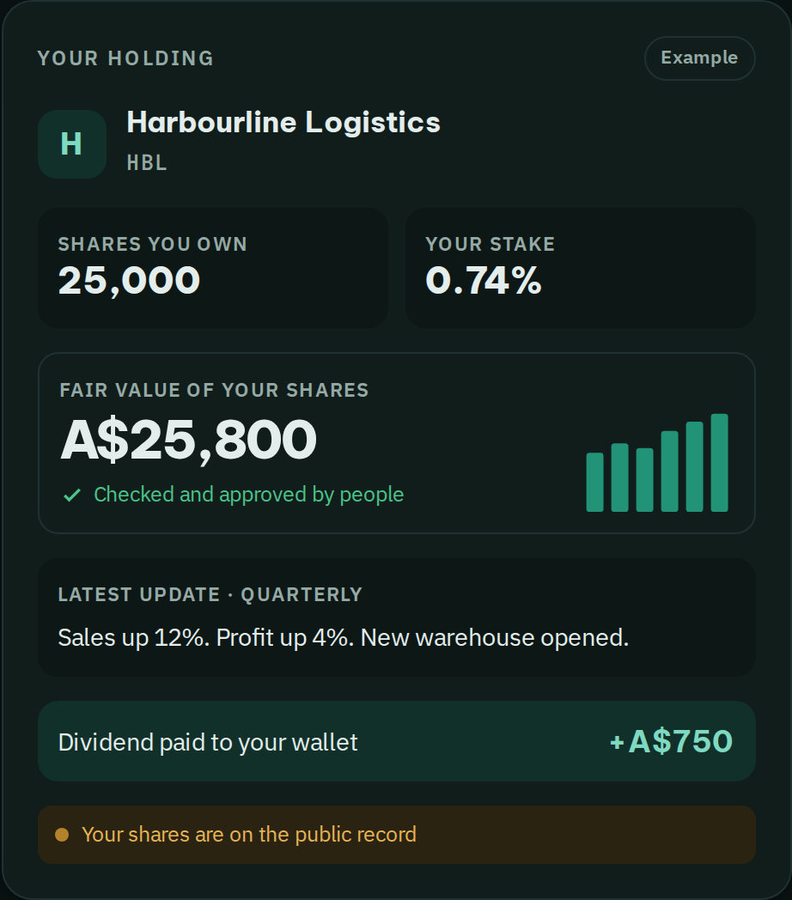





3 / 9 · THE SOLUTION
One passport per business. Five things every investor gets.
Understand it
A plain report. Every number linked to where it came from.
Follow it
Regular updates and a fair value, approved by a person.
Own it
Your shares on a public share register — your proof.
Get paid
Dividends go straight into your wallet, automatically.
Check it
Anyone can check the numbers and the register.
What a shareholder sees
eth.blockid.au · Testnet demo. Not an offer of securities or financial advice.
Notes:
[0:40–1:00] BlockID gives each business a passport, and every investor gets five things: understand it, follow it, own it, get paid, and check it. On the right is what a shareholder sees: the shares they own, their stake, a fair value approved by people, the latest update and the dividend paid to their wallet.

Slide 4
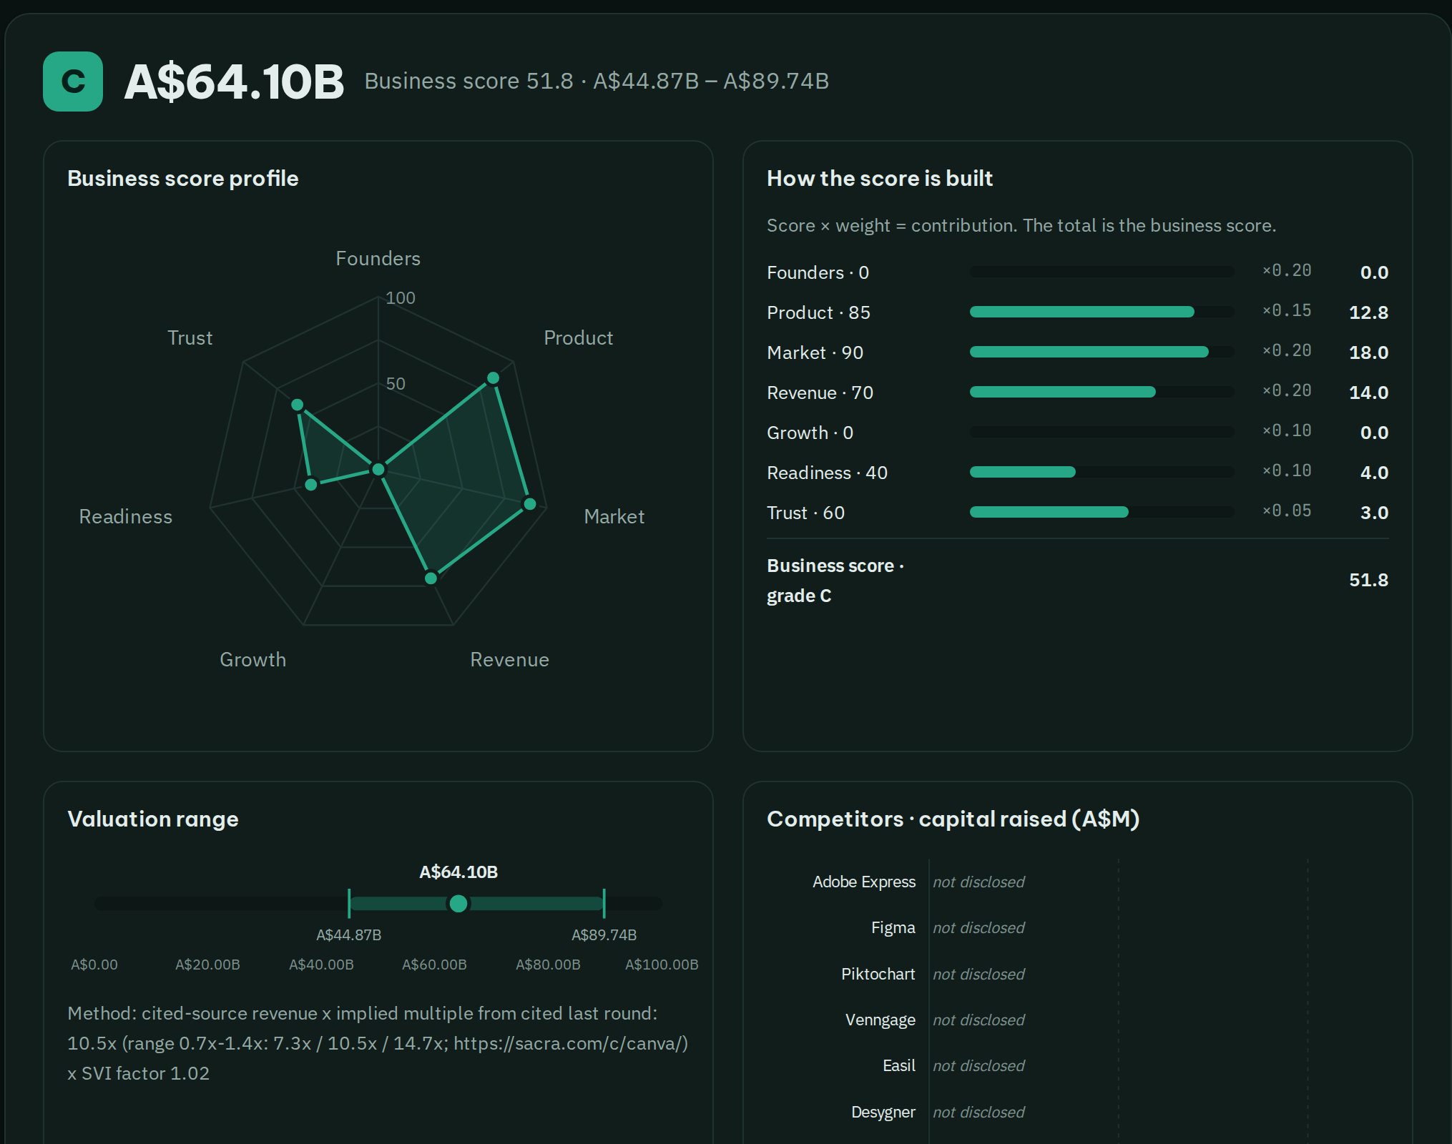
4 / 9 · UNDERSTAND IT
A fair value you can trace, approved by a person.
Paste a website. Get a plain report in minutes.
Clear business score A–E and a low · mid · high value.
Every figure links to its source. No source, no number.
A person checks and approves before anyone sees it.
Canva: A$64B mid value, every source listed, approved by a person.
eth.blockid.au · Testnet demo. Not an offer of securities or financial advice.
Notes:
[1:00–1:25] Understand it. Paste any business website and in minutes you get a plain report: a business score, a value range, competitors and the sources behind every number. If there's no source, the number is dropped. A person reviews and approves it before investors see it. Here's Canva.

Slide 5
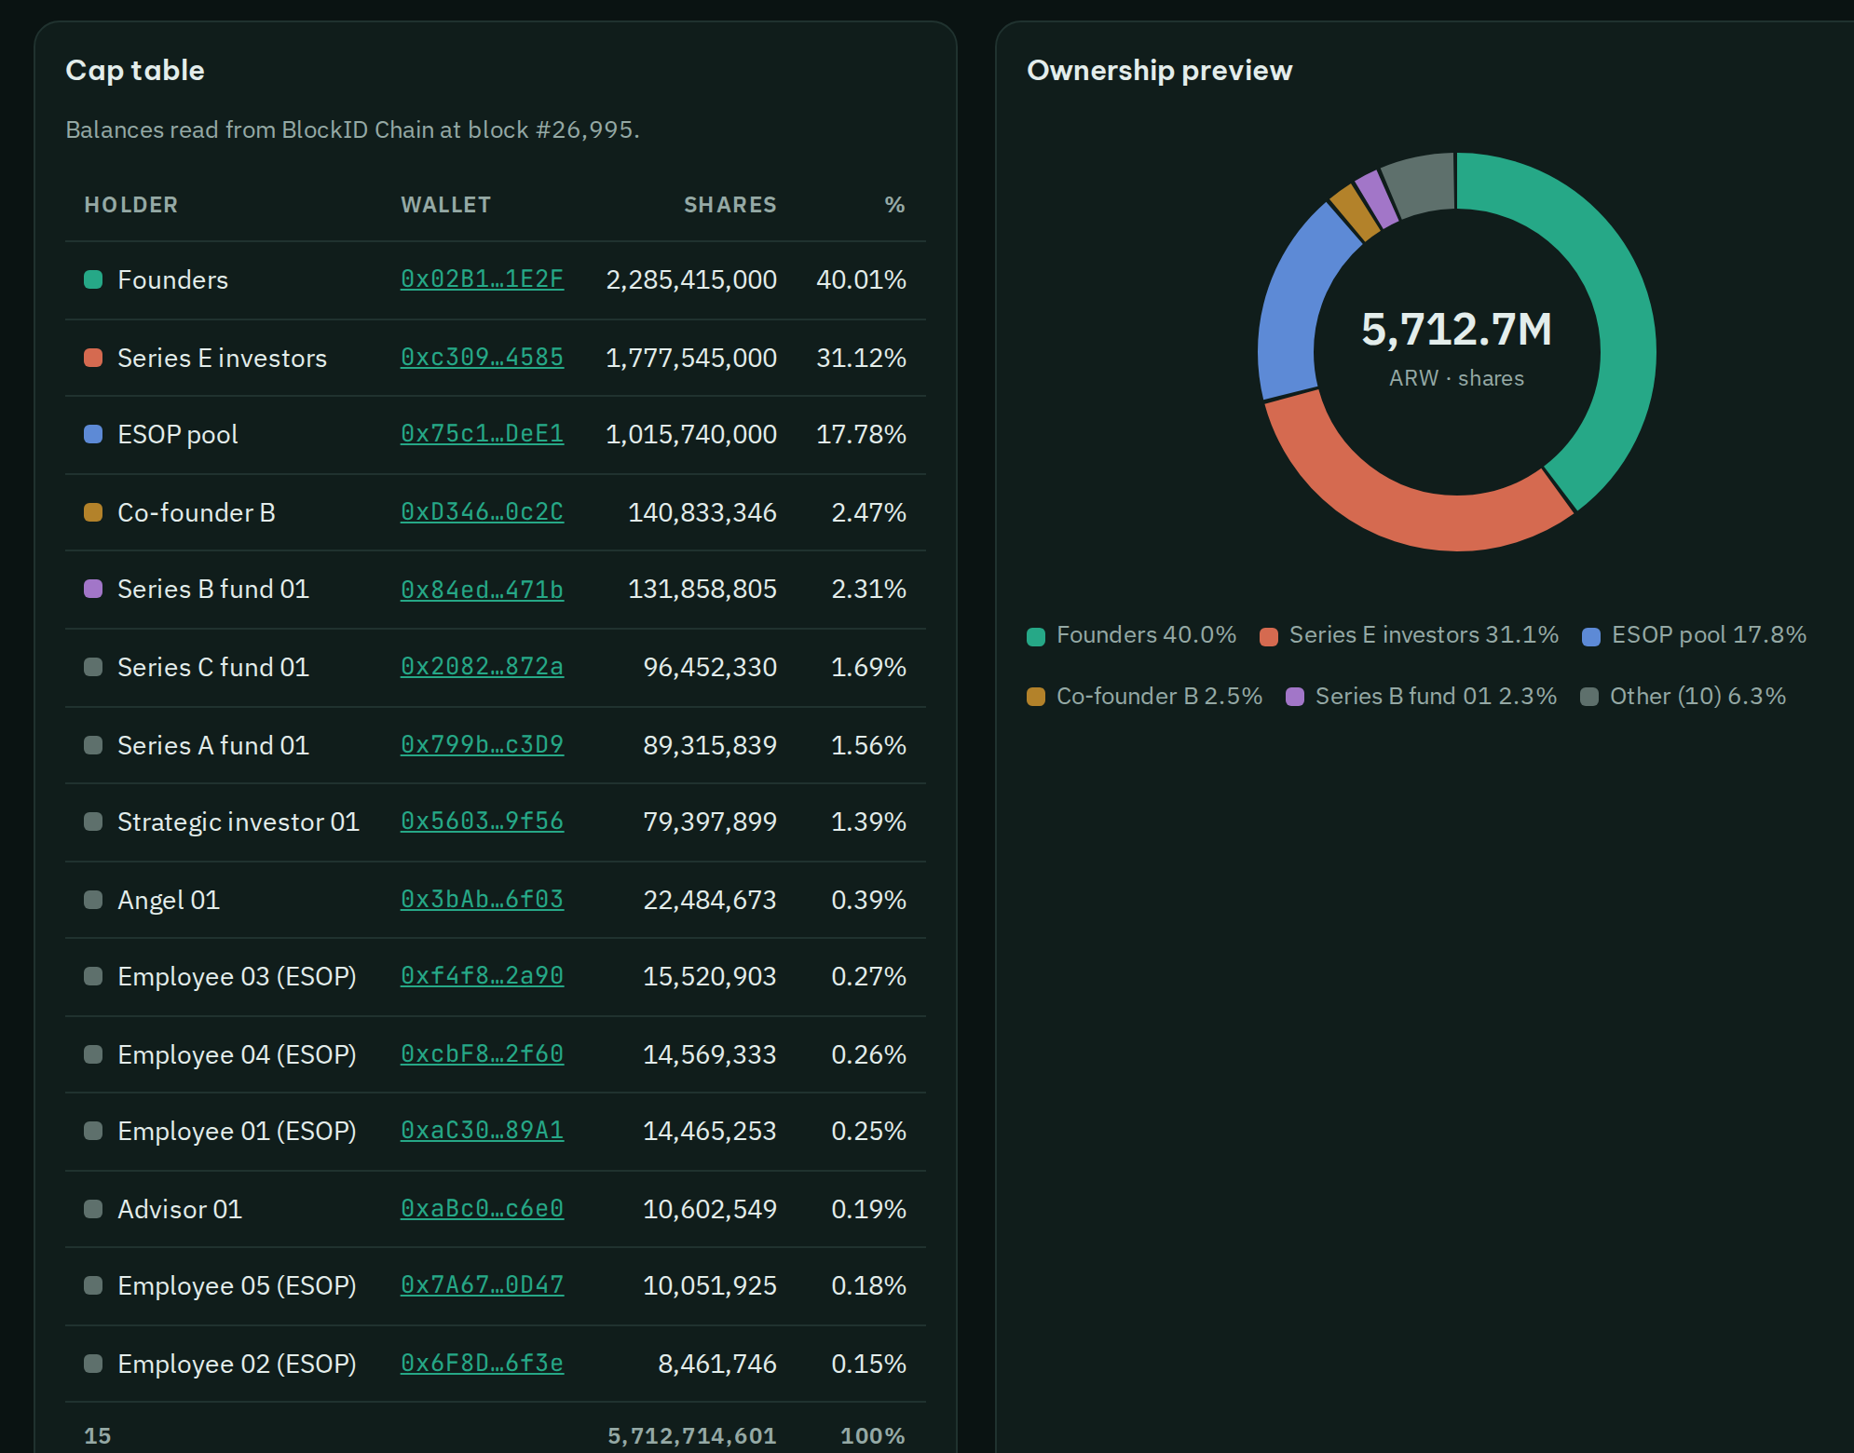
5 / 9 · OWN IT
Your shares are on the record. The record is your proof.
Every holder, wallet and share count in one share register.
Recorded on blockchain and copied to two public blockchains.
New shares need a person's approval — you see the dilution first.
Hold your shares in your own wallet, or sign in with Google.
13 businesses listed · 38 share records on blockchain
eth.blockid.au · Testnet demo. Not an offer of securities or financial advice.
Notes:
[1:25–1:45] Own it. When a business lists, its shares are recorded in a share register on blockchain and copied to two public blockchains. That record is your proof of ownership. New shares need a person's approval, and you see the dilution first. You can hold shares in your own wallet or simply sign in with Google.

Slide 6
6 / 9 · FOLLOW IT · GET PAID
Same update for everyone. Dividends to your wallet.
1
Business shares its numbers
weekly, monthly, quarterly or yearly
2
Plain-language update + fair value
a person approves it before it goes out
3
Every investor gets it at once
record stored on blockchain, anyone can check
4
Dividend rule approved once
24 hours to cancel, then paid to every wallet — no fees for holders
eth.blockid.au · Testnet demo. Not an offer of securities or financial advice.
Notes:
[1:45–2:05] Follow it and get paid. The business shares its numbers on a regular schedule. We turn them into a plain-language update with a fair value, a person approves it, and every investor gets it at the same time. Dividends follow a rule approved once: after each update there are 24 hours to cancel, then the dividend is paid to every wallet automatically — holders pay no fees.

Slide 7
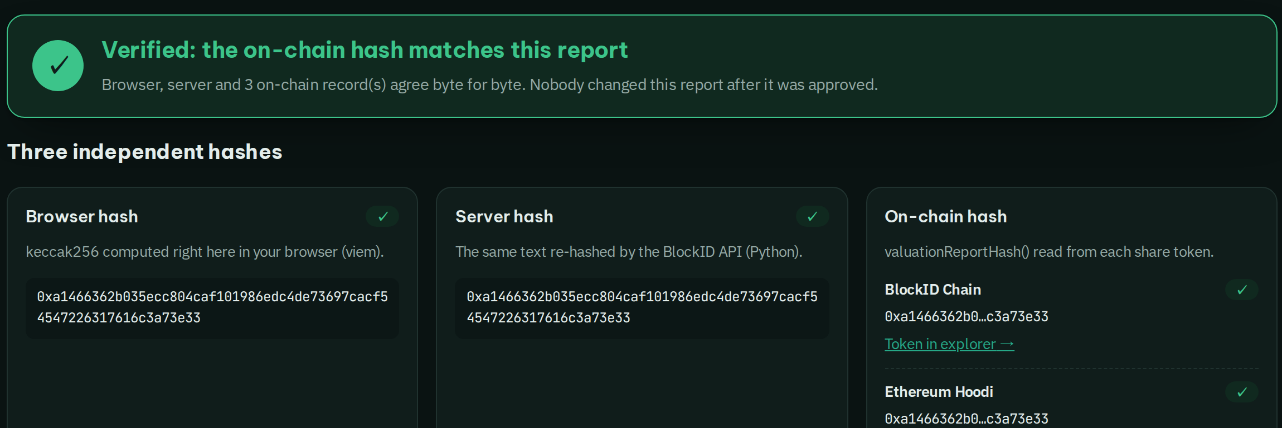
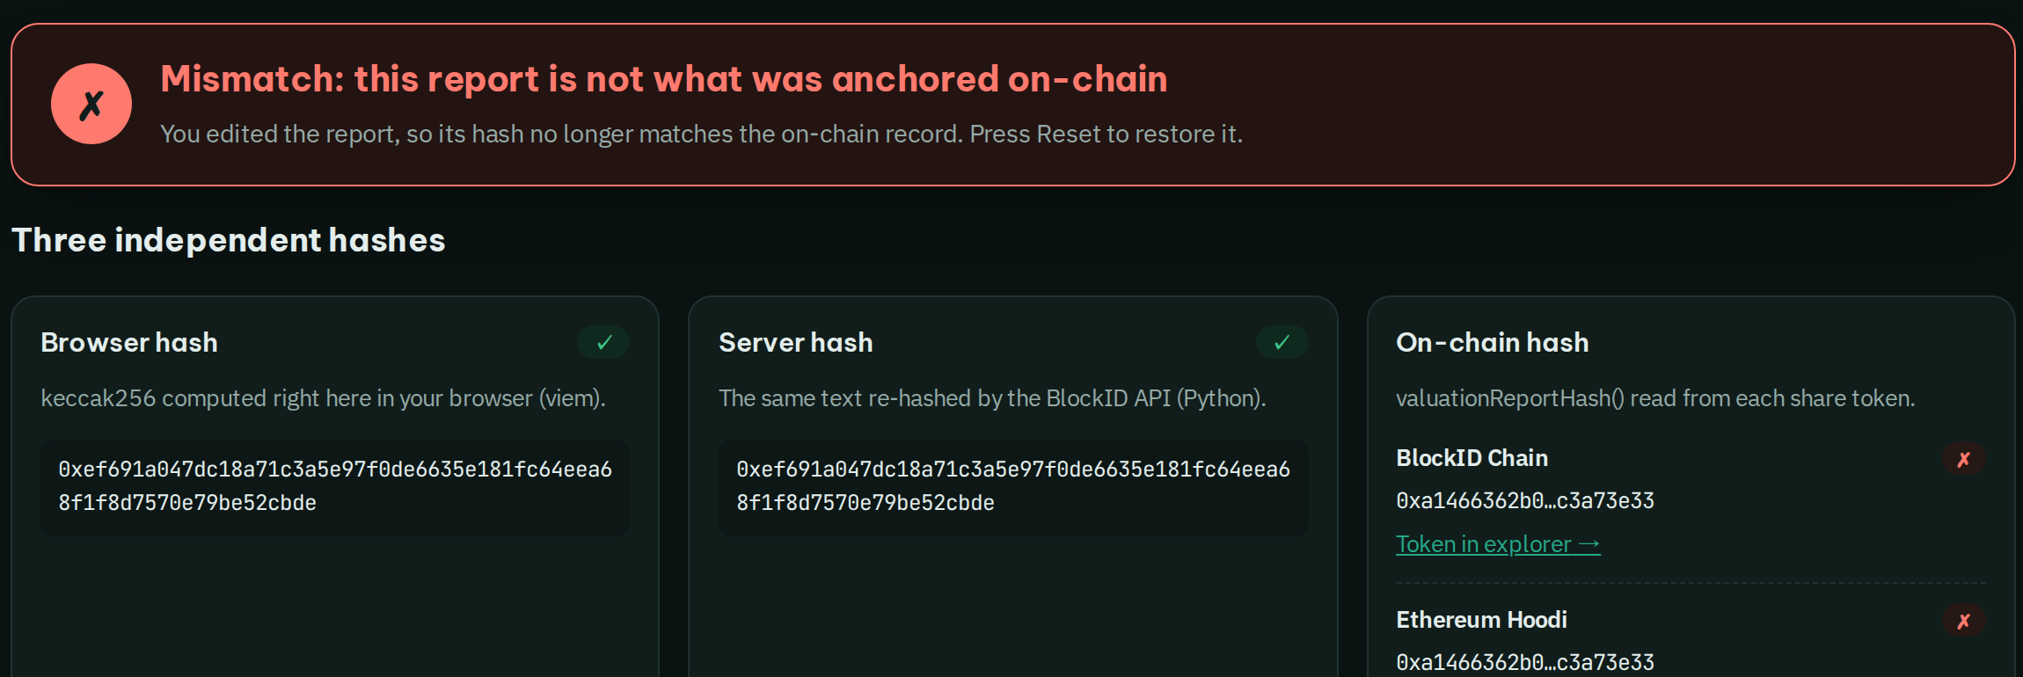



7 / 9 · CHECK IT
Don't trust us. Check it yourself, in your browser.
✓ The report matches the record on 3 blockchains
✗ Change one number and it turns red
1. Your browser hashes the report
2. Reads the hash from BlockID, HashKey, Ethereum
3. Same = ✓ · changed = ✗
No login needed: eth.blockid.au/verify
eth.blockid.au · Testnet demo. Not an offer of securities or financial advice.
Notes:
[2:05–2:25] Check it. You don't have to trust us. The check page recomputes the report in your own browser and compares it with the record on three blockchains. Change a single number and it turns red. No login needed.

Slide 8
8 / 9 · HOW IT'S BUILT
Two blockchain layers. Only approved actions reach them.
PEOPLE
who uses it
Investors
Businesses
Approvers
portfolio · updates · dividends
list · shareholders · updates
a person signs every step
APP & SERVICES
off-chain, no keys except issuer
Anyone checks
Web app
Analysis
Approval
Issuer
eth.blockid.au
Google · browser key · MetaMask
AI reads sources,
formula sets value
(no keys)
admin wallet signs
one approval
only key holder
isolated network
acts on approved rows
/verify recomputes the report hash in the browser and reads it from all 3 chains.
Explorers:
scan.blockid.au
HashKey · Etherscan
Match = ✓
Any change = ✗
signs
LAYER 1
BlockID EVM · chain 262626
BlockID Chain — the share register of record · gas price 0
Identity registry
(KYC holders)
Share token
1 token = 1 share
Dividends
paid in mAUD
Report hash
fair value proof
sync: same balances + root
LAYER 2
HashKey Chain · chain 133
HashKey Chain — public proof for real-world assets
Ethereum
Mirror share token
(same balances)
Cap-table root
(Merkle)
Agent provenance
(who proposed)
Hoodi testnet · chain 560048
mirror token + cap-table root
(public anchor)
eth.blockid.au · Testnet demo. Not an offer of securities or financial advice.
Notes:
[2:25–2:40] How it's built. People use one web app. Analysis never holds keys; a person approves; only the isolated issuer signs. Layer 1 is our BlockID Chain, the share register of record with zero gas. Layer 2 is HashKey Chain, the public proof layer for real-world assets: the same balances, a cap-table root and a record of which agent proposed what, also anchored on Ethereum. Anyone can check all three from the browser.

Slide 9
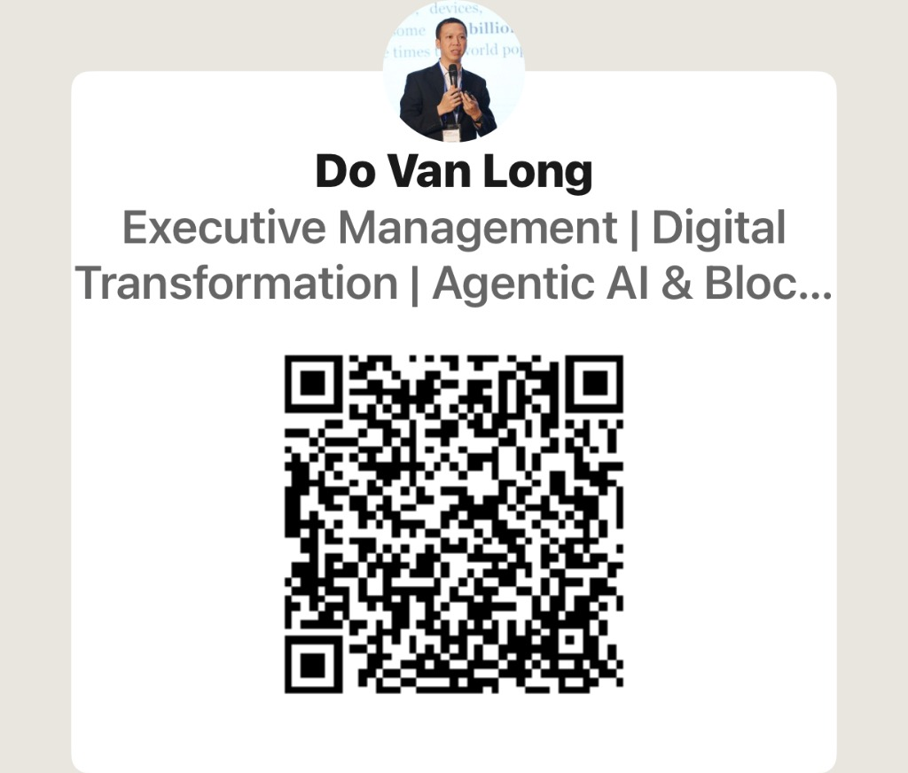

9 / 9 · LIVE TODAY · THE ASK
Live today. Looking for pilot businesses and partners.
13
38
A$87B
3
businesses listed
share records on blockchain
fair value checked by people
blockchains, every record checkable
Try it now
eth.blockid.au
WHO PAYS
WHO IT'S FOR
Businesses: listing fee + share-register subscription
Investors, retail and professional
Connect with the founder
Per share transfer fee
Businesses raising from them (AU · VN)
We're looking for
Pilot businesses · investor communities · licensed partners
0.5–1% of each dividend round
Accelerators, VCs, licensed partners
Long Do · info@blockid.au
linkedin.com/in/dovanlong
eth.blockid.au · Testnet demo. Not an offer of securities or financial advice.
Notes:
[2:40–3:00] This is live today: thirteen businesses listed, thirty-eight share records on blockchain and eighty-seven billion dollars of fair value checked by people. Businesses pay a listing fee and a share-register subscription, plus a small fee per transfer and per dividend round. We're looking for pilot businesses, investor communities and licensed partners. Scan to try it, or scan to connect with me. Know the business you invest in. Thank you.

