Slide 1

EAG GLOBAL BUILDATHON · SYDNEY · 26 SEP 2026
Know what your startup is worth, and who owns it.
Agents propose. Humans approve. Chains prove.
AI values a startup from its website with every figure cited; one human approval issues KYC-gated shares on a zero-gas chain and anchors the cap table on Ethereum and HashKey Chain.
Sydney Hackathon
Real-World Ethereum Apps
HashKey Chain · RWA
eth.blockid.au · github.com/Blockid-au/eth-blockid-hackathon
Notes:
0:00–0:15. I'm Long Do, founder of BlockID. Our promise in one line: know what your startup is worth, and who owns it. Agents propose, humans approve, chains prove.

Slide 2



Why: startup equity still lives in spreadsheets
Founders, investors and regulators all pay for it
Cap tables in Excel
Valuations are opaque
Owners can't verify
Share registers are emailed files. Nobody can prove who owns what, or when it changed.
Early-stage valuations are expensive, slow and rarely show their sources or maths.
Investors trust PDFs. Dividends and new issuances are manual and error-prone.
A$5.4bn across ~390 Australian startup deals in 2025 — each needs a valuation and a share register.
Source: Cut Through Venture & Folklore, State of Australian Startup Funding 2025
BlockID Startup Passport · eth.blockid.au · Testnet demo, not an offer of securities 2
Notes:
0:15–0:35. Why we built this: equity for small companies is still managed in spreadsheets; valuations are opaque; shareholders cannot verify anything. In Australia alone about A$5.4bn went into ~390 startup deals last year — every one needs this.

Slide 3



ELEVATOR PITCH
BlockID turns your company website into an evidence-cited valuation in minutes, then turns your shareholder list into a verified, KYC-gated cap table you can grow and pay dividends from — on-chain, with AI that never holds the keys.
1 · Agents propose
→
2 · Humans approve
→
3 · Chains prove
AI reads the website, finds competitors (3 searches), scores 7 SVI dimensions. A fixed formula computes the value; the report hash is recorded.
An admin with their own wallet reviews valuation and shareholders, and signs one approval. Agents have no keys and no route to the issuer.
The isolated issuer creates the register on zero-gas BlockID EVM, then mirrors and anchors it on Ethereum Hoodi and HashKey Chain.
BlockID Startup Passport · eth.blockid.au · Testnet demo, not an offer of securities 3
Notes:
0:35–0:55. The pitch: website in, cited valuation out; shareholder list in, verified on-chain cap table out. Three steps — agents propose, humans approve, chains prove.

Slide 4
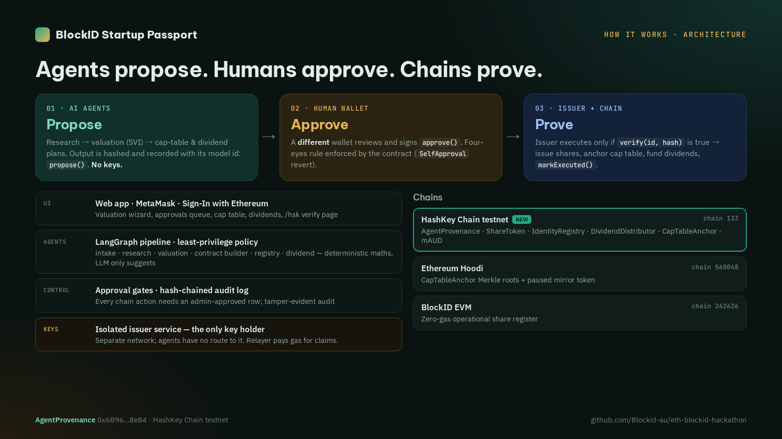
How it works
The only component with a key is an isolated issuer that acts on human-approved rows
LangGraph agents
least-privilege policy in code; LLM only scores
Approval gates
SIWE / admin session, atomic claims, audit log
Isolated issuer
own network; AI worker cannot reach it
3 chains
BlockID EVM 262626 · Hoodi 560048 · HashKey 133
12 architecture diagrams in the repo: docs/ARCHITECTURE-DIAGRAMS.md
BlockID Startup Passport · eth.blockid.au · Testnet demo, not an offer of securities 4
Notes:
0:55–1:10. Architecture: agents in a LangGraph pipeline with permissions enforced in code; human approval gates; an isolated issuer — the only key holder — on its own network; three chains. Full diagrams are in the repo.

Slide 5
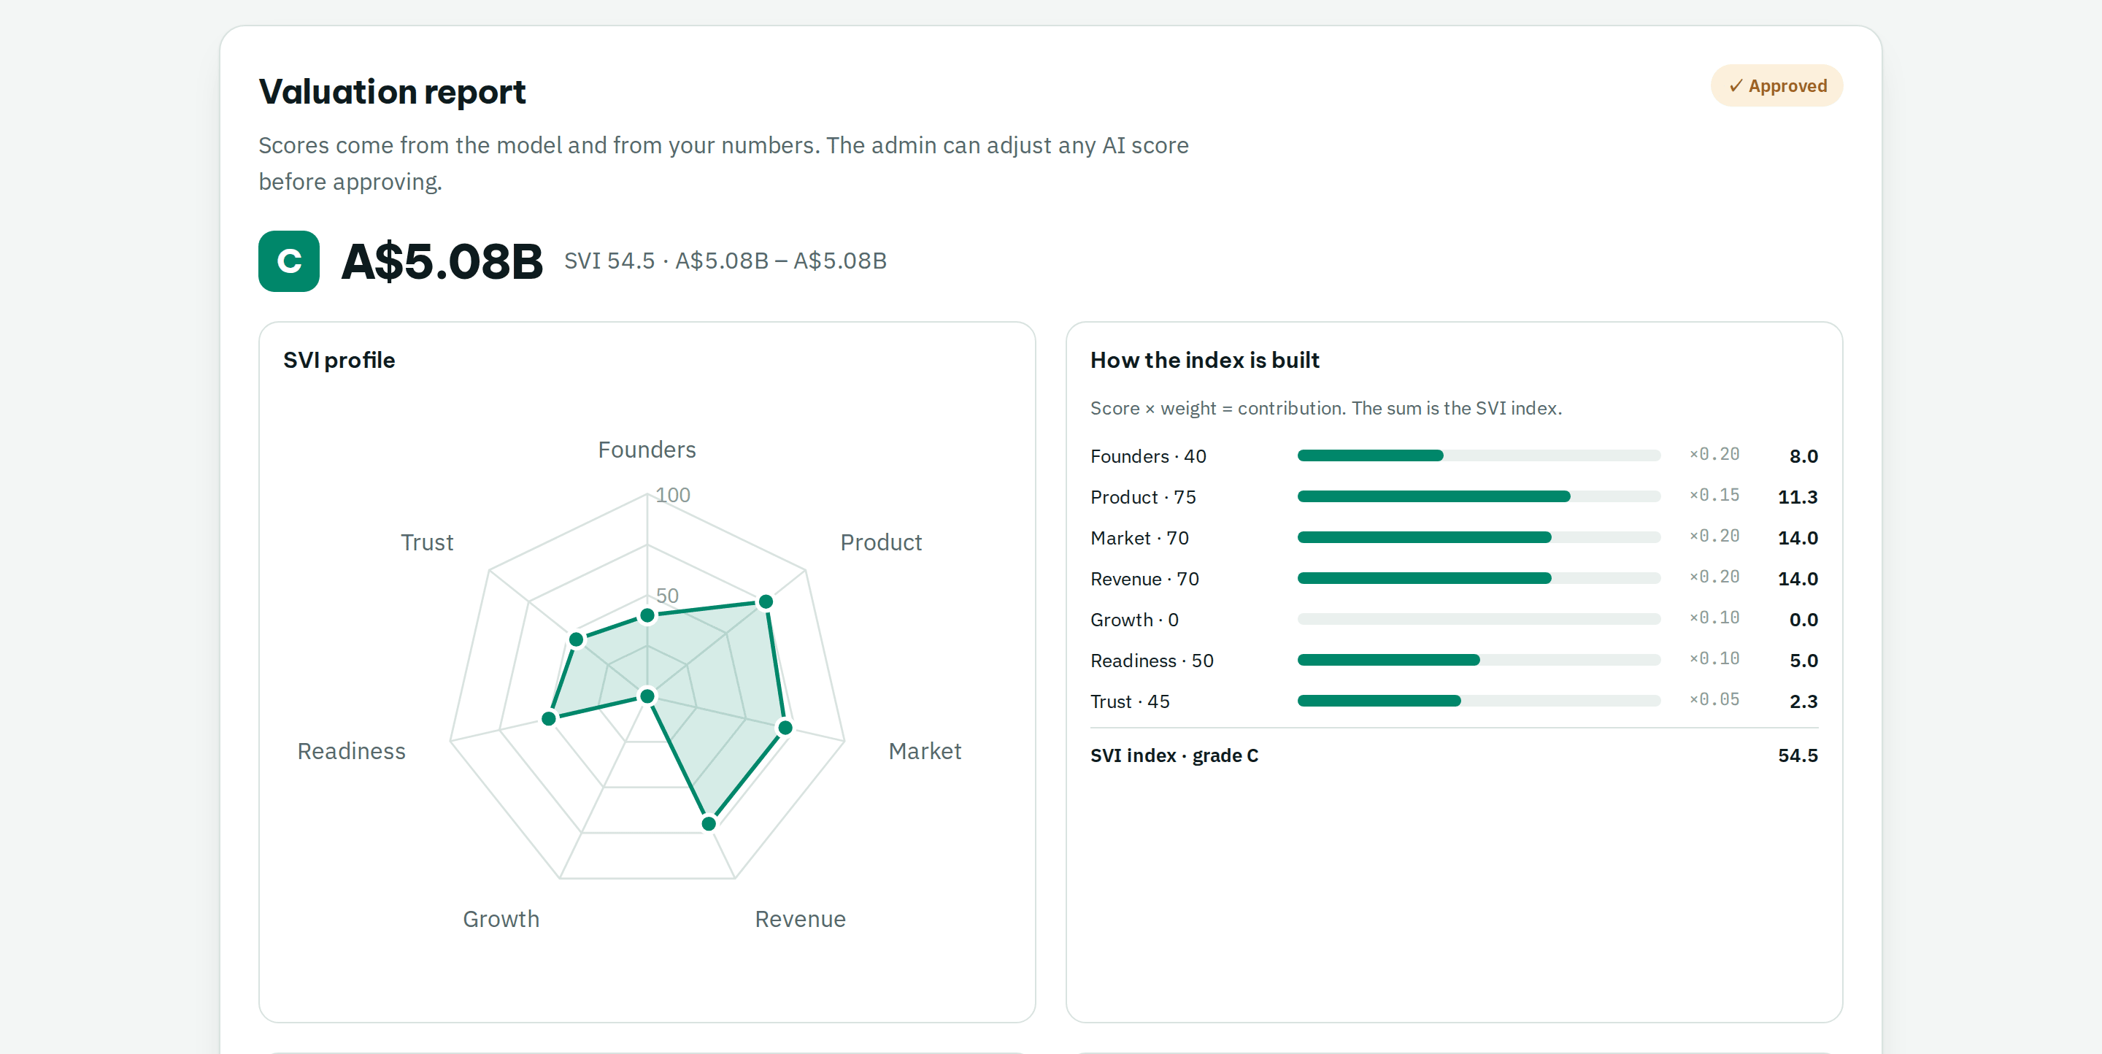



Auditable AI valuation
LLM suggests scores · code computes · every figure links to a fetched source
6 pages + 3 searches
Bounded research budget: competitors, market, valuation benchmark
Fixed SVI formula
7 weighted dimensions → grade A–E → A$ low · mid · high
Cited or dropped
Findings citing a page the agent did not fetch are removed
Example: Airwallex → 8 competitors from search (Wise, Revolut, OFX, Payoneer…) → SVI 54.5 (C)
BlockID Startup Passport · eth.blockid.au · Testnet demo, not an offer of securities 5
Notes:
1:10–1:35. The valuation: the agent reads six pages, runs exactly three searches, and scores seven SVI dimensions. The model only suggests scores; a fixed public formula computes the value, and anything not backed by a fetched source is dropped. For Airwallex it found eight real competitors from search.

Slide 6
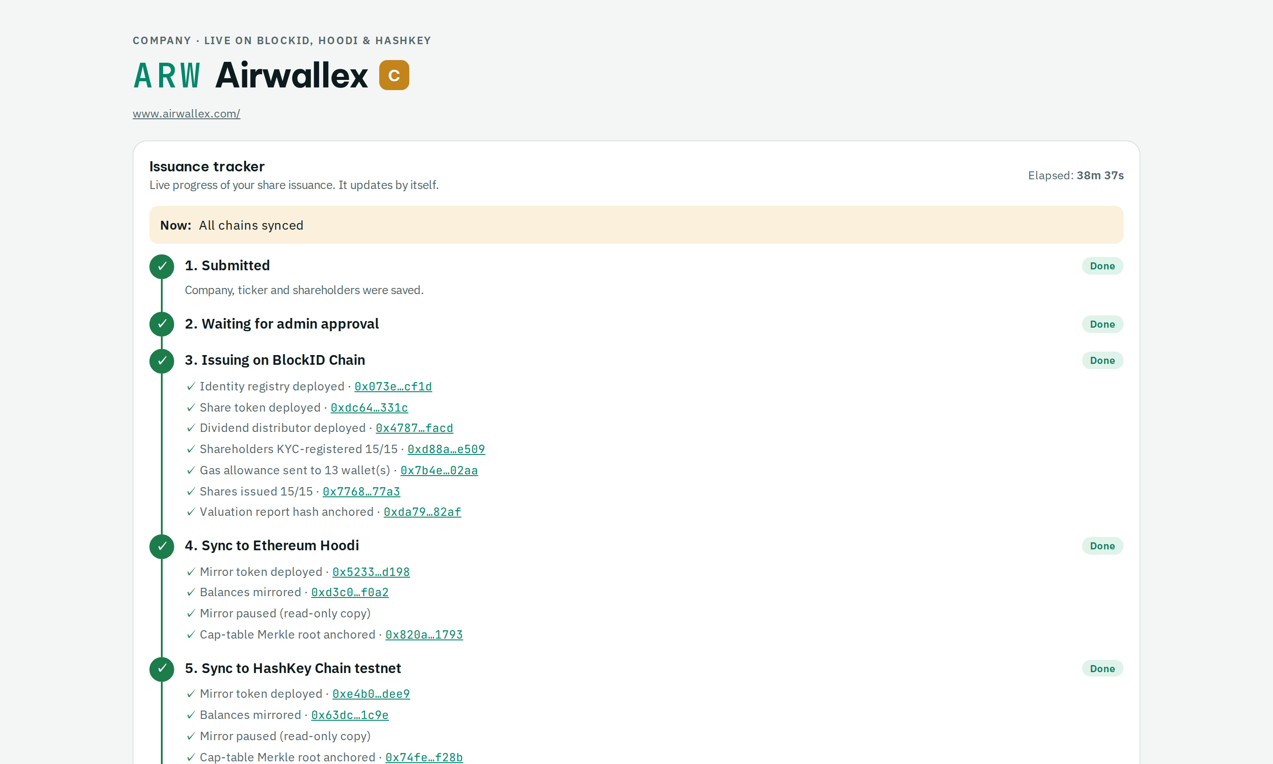
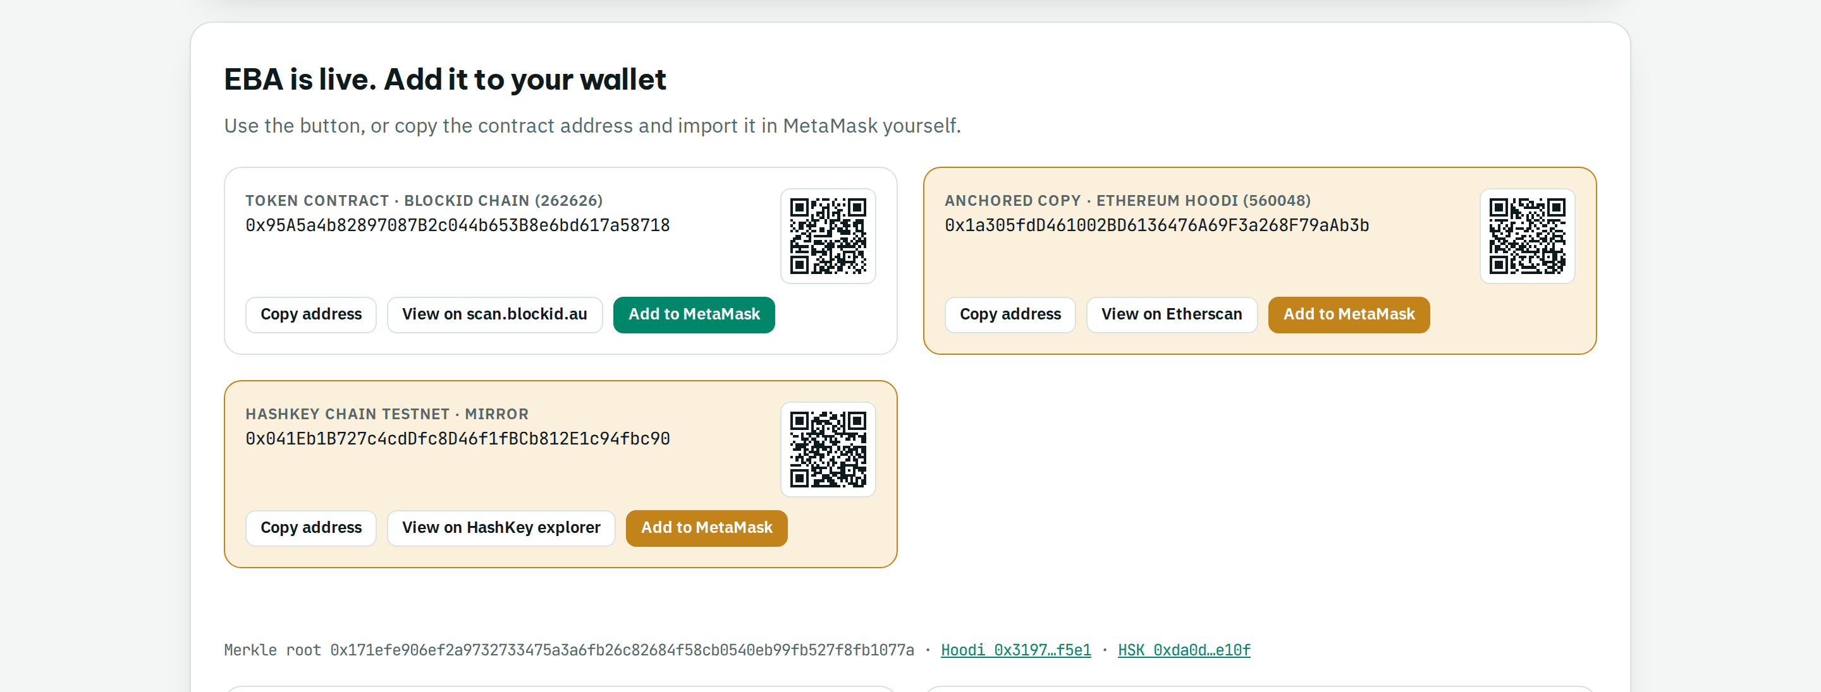
One approval → three chains
Created on zero-gas BlockID EVM first, then synced to Ethereum and HashKey — live tracker for the founder
BlockID EVM · 262626 · gas 0
Ethereum Hoodi · 560048
HashKey Chain testnet · 133
Add to MetaMask · QR
Paused mirror token + Merkle root of the cap table on every chain; shareholders import the token and prove their balance.
BlockID Startup Passport · eth.blockid.au · Testnet demo, not an offer of securities 6
Notes:
1:35–2:00. One human approval. The issuer creates the register on our zero-gas chain — registry, token, KYC, shares — then mirrors it to Ethereum Hoodi and HashKey Chain. The founder watches every step live; shareholders add the token to MetaMask on any of the three chains.

Slide 7
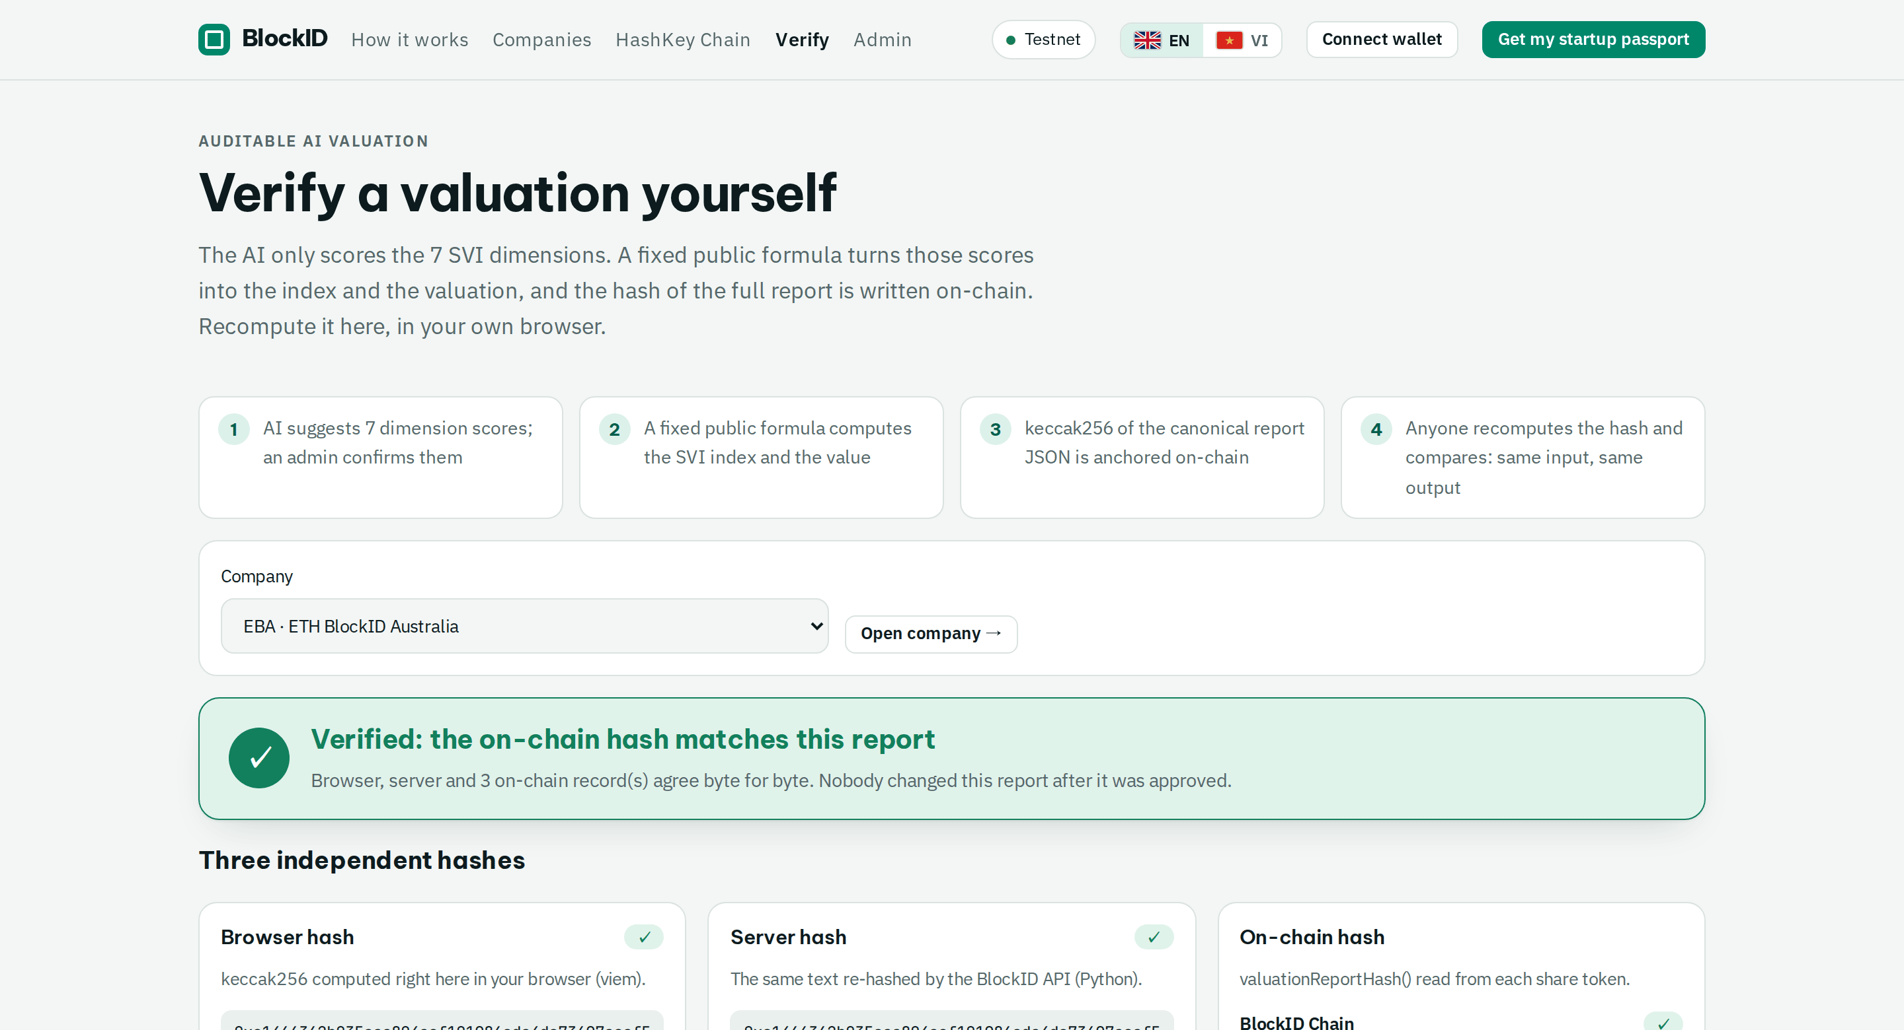
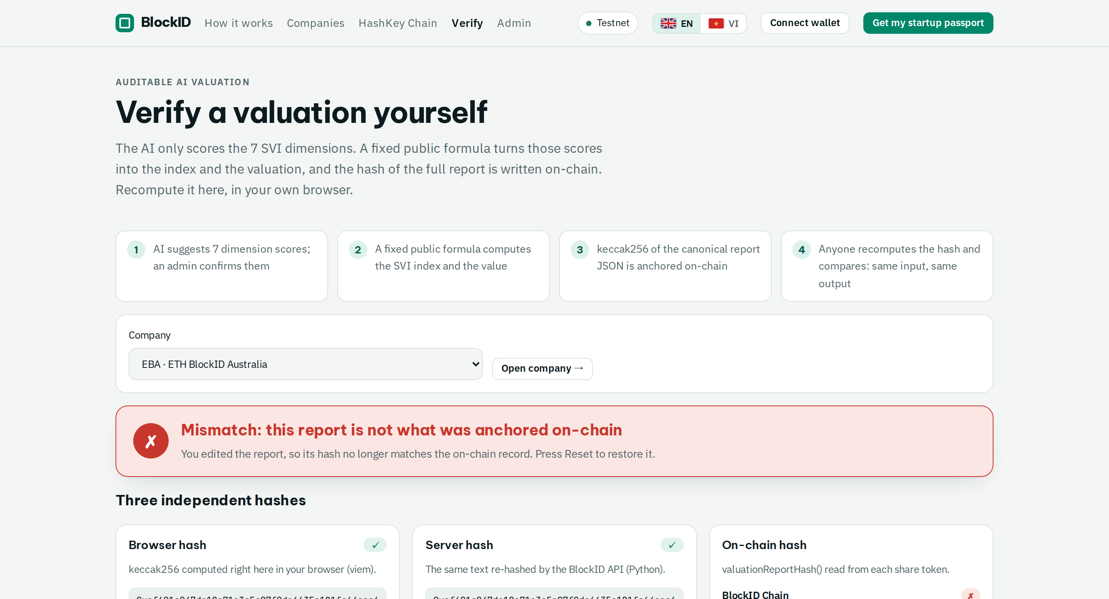
Anyone can verify it
keccak256 of the report recomputed in the browser = server = on-chain on 3 chains. Change one score → mismatch.
✓ Verified on BlockID · Hoodi · HashKey
✗ Tamper test: one score changed
Try it: eth.blockid.au/verify/EBA — no login needed
BlockID Startup Passport · eth.blockid.au · Testnet demo, not an offer of securities 7
Notes:
2:00–2:15. And you don't have to trust us: /verify recomputes the report hash in your browser and compares it with the hash stored on all three chains. Change a single score and it turns red.

Slide 8
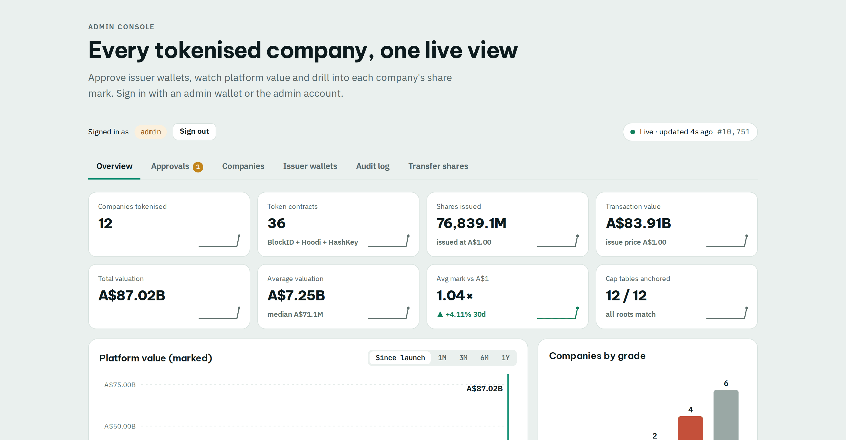
What we shipped — live, not a mock-up
https://eth.blockid.au · https://scan.blockid.au · HashKey testnet contracts
7
21
A$444M
100%
companies tokenised
from real websites
share-token contracts
on 3 chains
marked valuation
under management
report hashes verified
on every chain
140+ automated tests (110 backend, 30 Foundry) · internal security review fixed
Merkle dividends paid on-chain; relayer pays holders' gas
Blockscout explorer + zero-gas Cosmos EVM chain we operate
12 architecture diagrams · 39-screen feature gallery · open source (MIT)
BlockID Startup Passport · eth.blockid.au · Testnet demo, not an offer of securities 8
Notes:
2:15–2:35. Results: seven real companies tokenised from their websites, twenty-one share-token contracts across three chains, A$444M of marked valuation, every report hash verified. 140+ tests, a security review, dividends paid on-chain, our own zero-gas chain and explorer.

Slide 9




Who buys it
Start with the people who issue and administer startup equity
Founders & SMEs (AU · VN)
Accelerators & VCs
Valuation + share register + dividends without a law-firm bill
Portfolio cap tables, standard valuations, verifiable reporting
CSF intermediaries & transfer agents
RWA ecosystems (HashKey)
Licensed partners who need compliant, auditable registers
Tokenised private equity as a compliant real-world asset
REVENUE
Issuance fee
Cap-table SaaS
Transfer agent
Dividends
Custody
per company
annual
per transfer
0.5–1% per round
on AUM, via licensed partner
BlockID Startup Passport · eth.blockid.au · Testnet demo, not an offer of securities 9
Notes:
2:35–2:45. Who buys: founders and SMEs in Australia and Vietnam, accelerators and VCs, licensed crowd-funding intermediaries and transfer agents, and RWA ecosystems like HashKey. Revenue: issuance fees, cap-table SaaS, transfer-agent fees, a small share of dividend rounds, custody via partners.

Slide 10
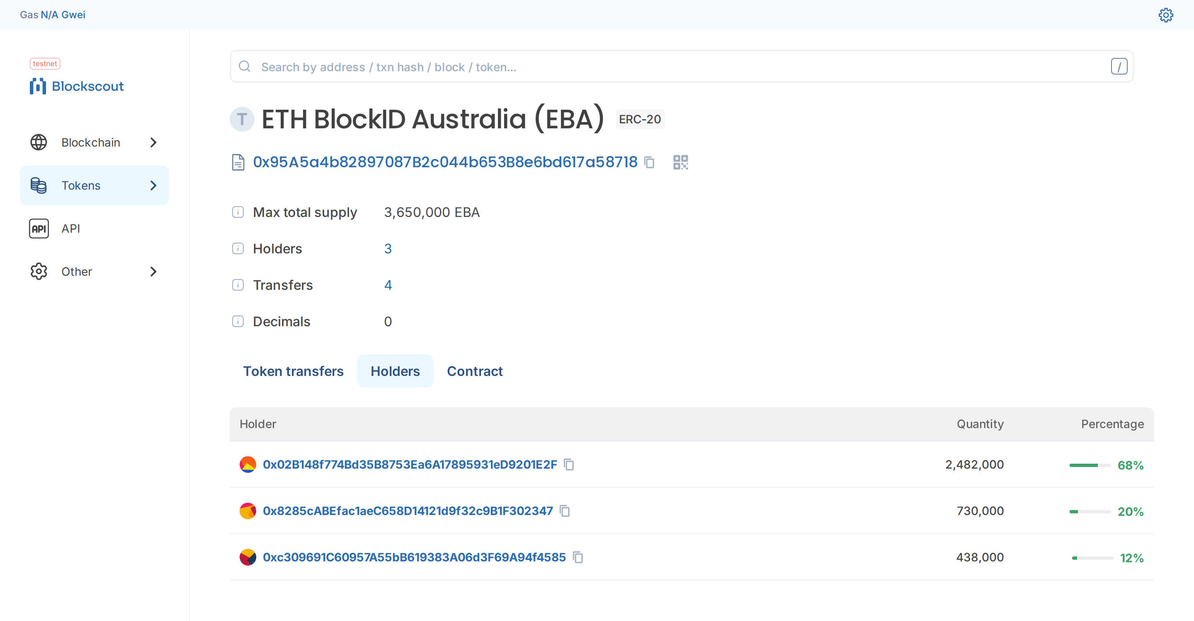




Built for trust and compliance
Testnet today — designed for a licensed path
Agents never hold keys
Isolated issuer on its own network, acts only on atomically claimed, admin-approved rows
KYC on every transfer
ERC-3643-style IdentityRegistry: shares can only move to verified wallets
Hardened platform
SSRF-safe crawler, CSRF origin checks, CSP, RPC allowlist, rate limits
Every share token is public on scan.blockid.au (Blockscout): holders, transfers, contract
Regulatory path
AU Digital Assets Framework (from Apr 2027), CSF / AFSL partner, audited ERC-3643
BlockID Startup Passport · eth.blockid.au · Testnet demo, not an offer of securities 10
Notes:
Q&A backup. Trust: agents never hold keys; KYC is enforced on every transfer; the platform passed an internal security review; and the legal path runs through Australia's Digital Assets Framework and licensed CSF/AFSL partners.

Slide 11
Roadmap
From hackathon to pilot
NOW · 2 weeks
NEXT · Q4 2026
LATER · 2027
Safe 2-of-3 multisig for admin roles
Invariant + Halmos CI for contracts
On-chain monitoring and tracing
Valuation eval / red-team harness
Pilot with 5–10 AU & VN startups
Real KYC (FrankieOne, VNPT/FPT eKYC)
Calibrated multiples + backtests
EAS valuation attestations
Licensed partner / Digital Assets Framework
Audited ERC-3643 suite, HashKey mainnet
Scoped agent permissions (7702 / 7579)
ERC-8004 agent identity & reputation
BlockID Startup Passport · eth.blockid.au · Testnet demo, not an offer of securities 11
Notes:
2:45–2:55. Next two weeks: multisig admin, stronger contract CI and monitoring. Q4: a pilot with 5–10 startups, real KYC and calibrated valuations. 2027: licensed partner, audited ERC-3643, HashKey mainnet.

Slide 12
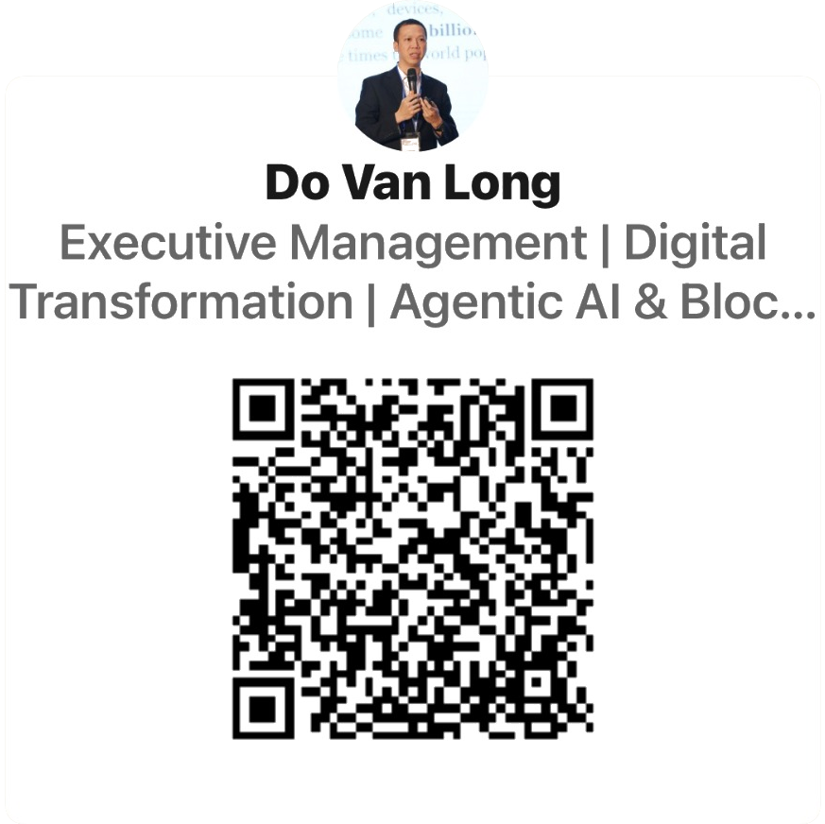

Try it now.
Know what your startup is worth, and who owns it.
Long Do (Đỗ Văn Long)
WE'RE LOOKING FOR
Founder & CEO, Auschain Pty Ltd (BlockID.au, StartupValueIndex.com)
Pilot startups, accelerators, licensed CSF partners, HashKey ecosystem support
23+ years in IT; founder of Vietnam Blockchain Corporation — 50+ blockchain projects, 45+ awards
National-scale deployments: Agridential, CovidPass.vn (with Vietnam's Ministry of Health)
DBA candidate, SSBM Geneva — thesis: the Startup Value Index (SVI)
eth.blockid.au
scan.blockid.au
github.com/Blockid-au/eth-blockid-hackathon
long@blockid.au
linkedin.com/in/dovanlong
Connect on LinkedIn
Scan to connect with Long Do
BlockID Startup Passport · eth.blockid.au · Testnet demo, not an offer of securities 12
Notes:
2:55–3:00. Try it now at eth.blockid.au — the QR code takes you there. We're looking for pilot startups, accelerators and licensed partners. Thank you.

