Slide 1
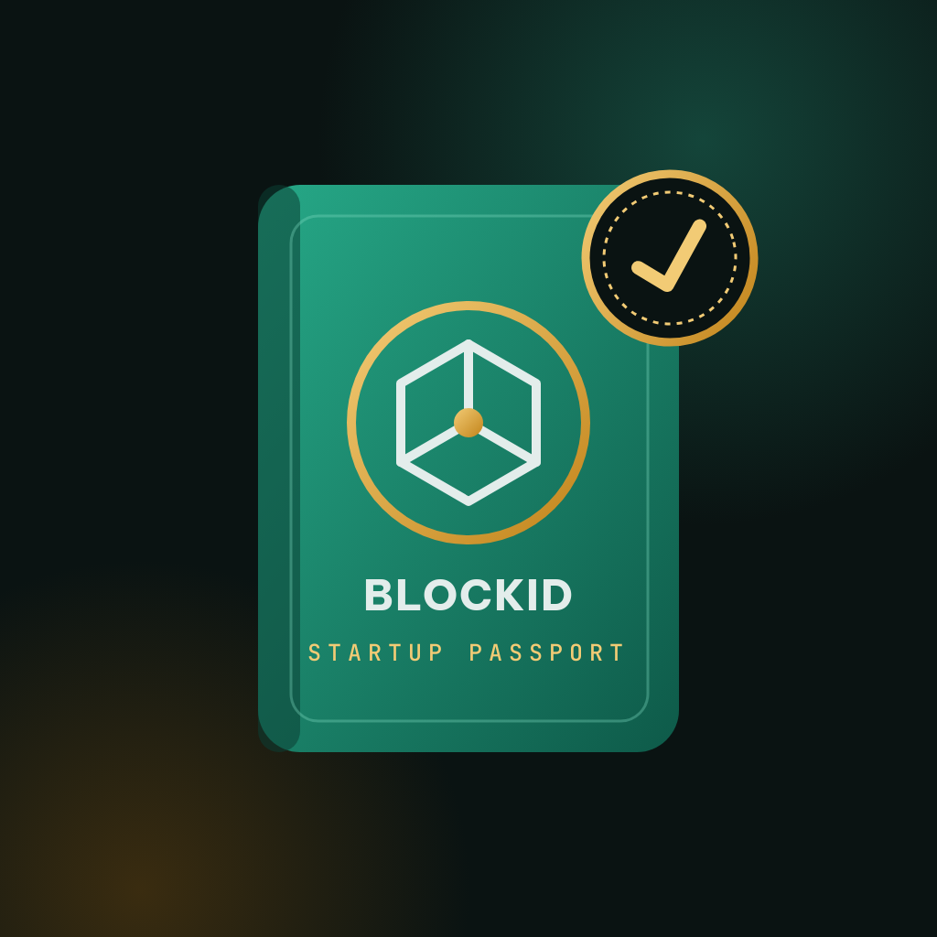
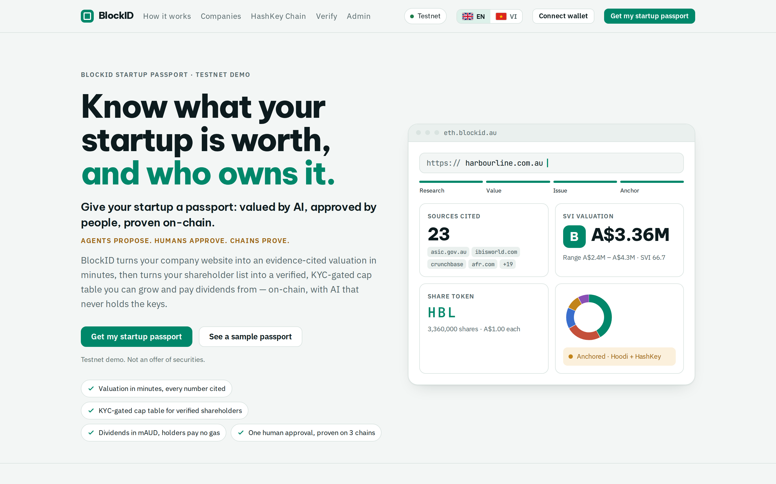
BlockID Startup Passport
Know what your startup is worth, and who owns it.
Agents propose. Humans approve. Chains prove.
AI valuation you can audit + tokenised shares you can prove — for every startup.
Sydney Hackathon · Real-World Ethereum Apps · HashKey Chain (RWA)
eth.blockid.au · Testnet demo, not an offer of securities
Notes:
[0:00–0:20] Every startup has two questions it can't answer cheaply: what are we worth, and who exactly owns us? BlockID answers both. Agents propose, humans approve, chains prove.

Slide 2
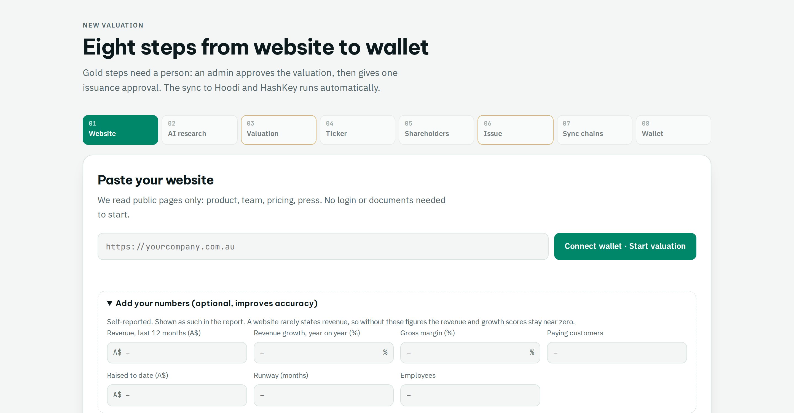
2 / 7 · PROBLEM → SOLUTION
Website in. Cited valuation and verified cap table out.
TODAY
Cap tables in Excel — nobody can prove ownership
Valuations slow, costly and unsourced
Shareholders can't verify anything
WITH BLOCKID
Minutes: AI valuation with every figure cited
One approval: KYC-gated shares on-chain
Anyone can verify, on three chains
eth.blockid.au · Testnet demo, not an offer of securities
Notes:
[0:20–0:45] Today cap tables live in spreadsheets, valuations are slow and unsourced, and shareholders can't verify anything. With BlockID the founder pastes a website, gets a cited valuation in minutes, and after one approval has KYC-gated shares on-chain that anyone can verify.

Slide 3






3 / 7 · HOW IT WORKS
Agents propose. Humans approve. Chains prove.
FOUNDER
AI AGENTS
HUMAN GATE
ISSUER
3 CHAINS
PROOF
Pastes website
Read site · ≤6 pages
Admin reviews
Only key holder
BlockID EVM · gas 0
Token in MetaMask
Adds shareholders + wallets
Competitors · ≤3 searches
Signs with own wallet
Isolated network
Ethereum Hoodi
/verify on 3 chains
Optional revenue figures
Market · cited only
One approval
Acts on approved rows
HashKey testnet
Dashboard · explorer
SVI formula → value
no keys
4-eyes
AI can't reach it
register → mirror → root
Under the hood LLM: SambaNova → Claude → DeepInfra · Search: Brave → Claude web search · Postgres job queue · Merkle cap-table roots in CapTableAnchor · nginx + Cloudflare, CSP, SSRF-safe crawler
eth.blockid.au · Testnet demo, not an offer of securities
Notes:
[0:45–1:15] The whole system on one slide. The founder gives a website and a shareholder list. AI agents read six pages, run three searches, and a fixed formula computes the value — the agents hold no keys. A human admin signs one approval. Only then does the isolated issuer, the only component with a key, create the register on our zero-gas chain and mirror it to Ethereum and HashKey. The proof: tokens in MetaMask, a verify page, a public explorer.

Slide 4
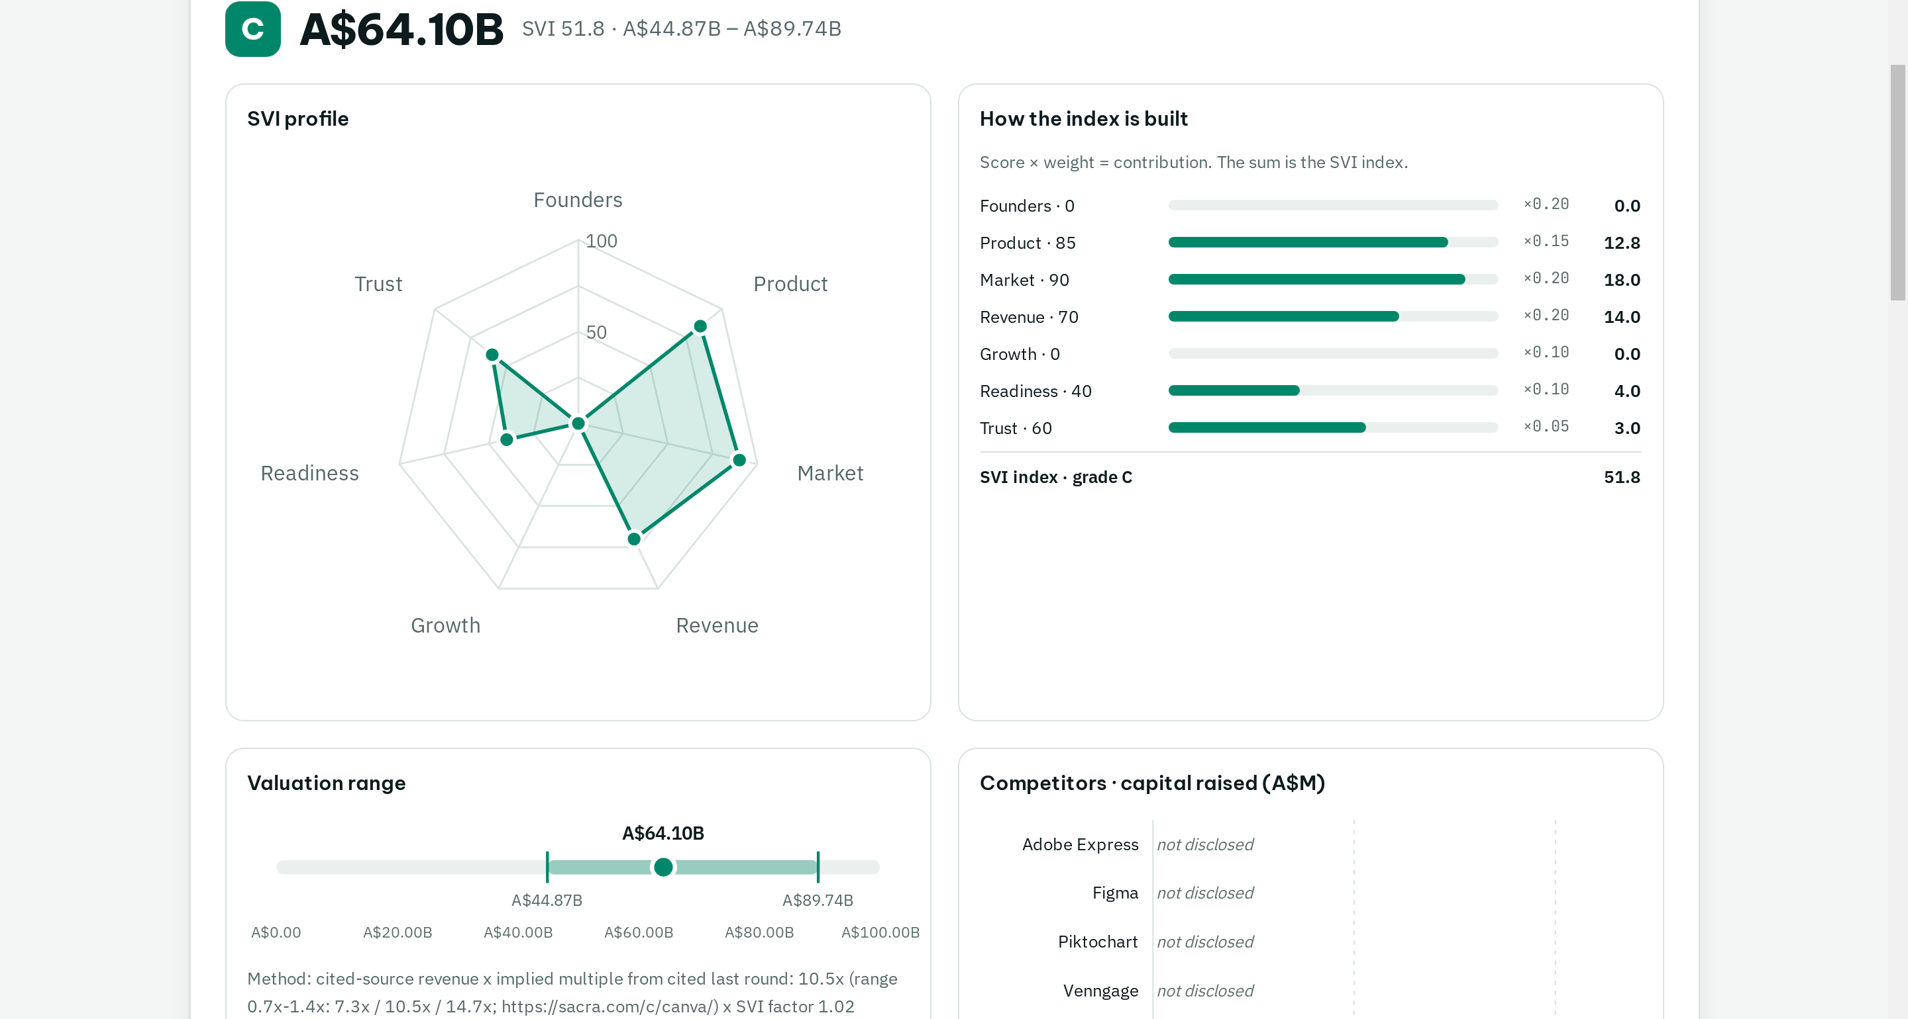
4 / 7 · AUDITABLE AI VALUATION
AI scores. A fixed formula decides. Every figure is cited.
7 SVI dimensions, fixed public weights
Grade A–E → A$ low · mid · high
Uncited claims are dropped
Admin can override any AI score
Canva: 9 competitors · ARR A$6B cited · 10.5x implied · A$64B mid
eth.blockid.au · Testnet demo, not an offer of securities
Notes:
[1:15–1:40] The AI only suggests scores. A fixed, public formula turns seven weighted dimensions into a grade and a valuation range, and any claim without a fetched source is dropped. For Canva it found nine real competitors, a cited ARR of A$6 billion and an implied multiple from its last round.

Slide 5
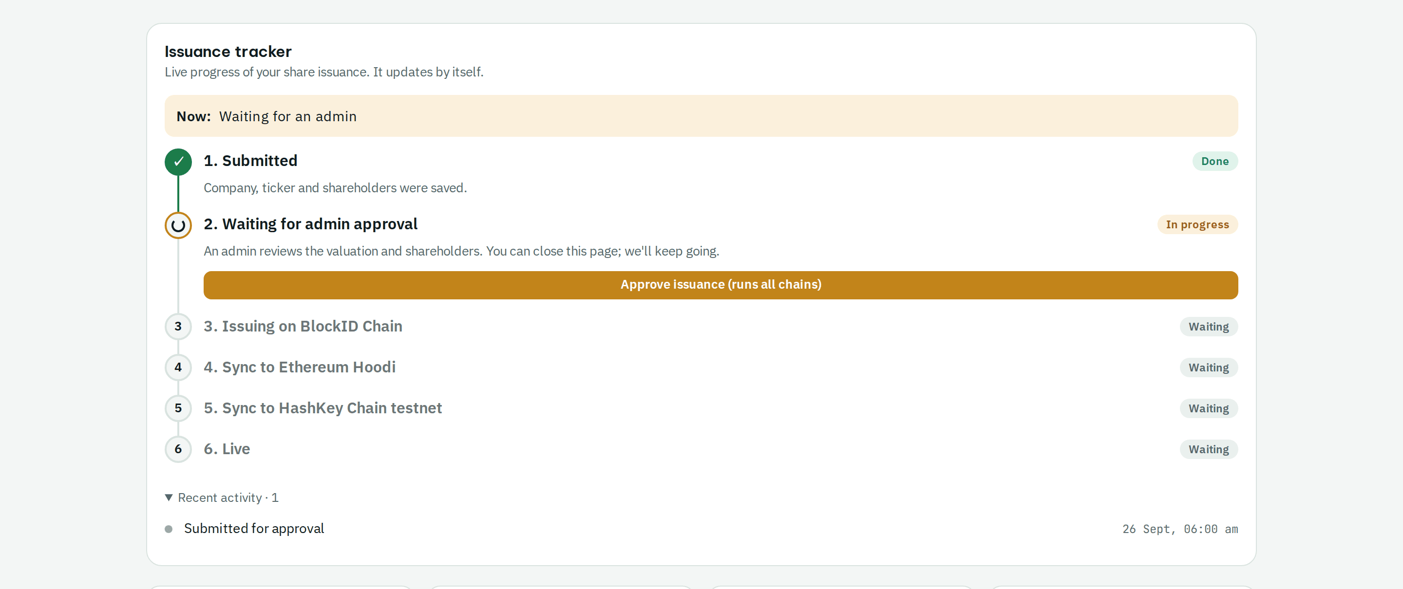
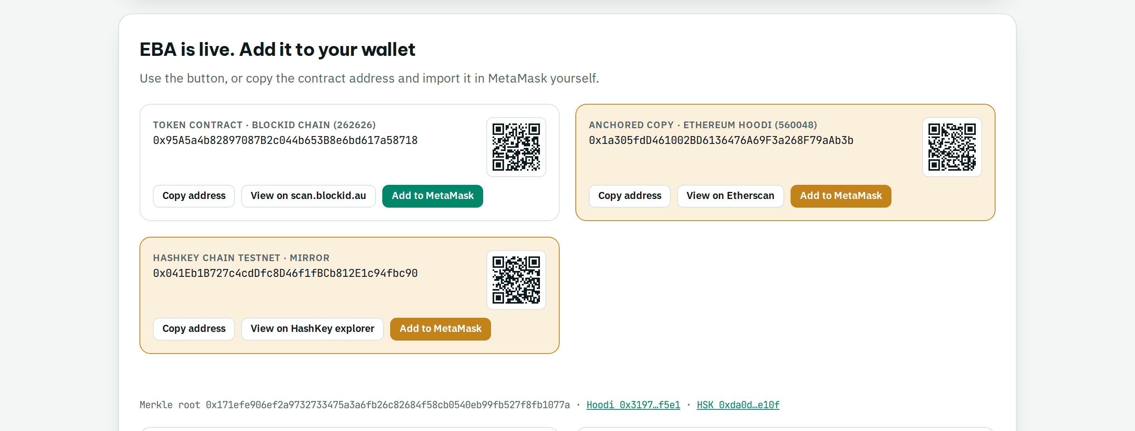
5 / 7 · ONE APPROVAL
One approval creates the register on three chains.
BlockID EVM
Ethereum Hoodi
HashKey testnet
register of record · gas 0
paused mirror + Merkle root
paused mirror + Merkle root
Founder watches every step live; shareholders add the token to MetaMask on any chain.
eth.blockid.au · Testnet demo, not an offer of securities
Notes:
[1:40–2:05] One approval. The issuer creates the share register on our zero-gas chain — registry, KYC, shares — then mirrors it with a Merkle root to Ethereum Hoodi and HashKey. The founder watches every step live, and shareholders add the token to MetaMask.

Slide 6
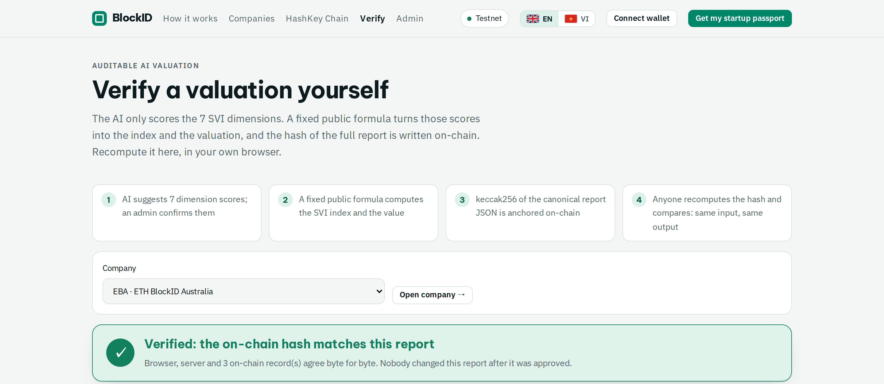
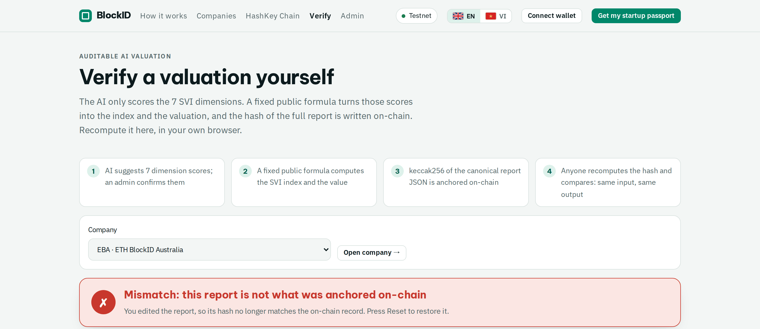
6 / 7 · PROOF
Anyone can prove the report was never changed.
✓ Browser = server = on-chain on BlockID · Hoodi · HashKey
✗ Change one score → hash no longer matches
Try it, no login: eth.blockid.au/verify/EBA
eth.blockid.au · Testnet demo, not an offer of securities
Notes:
[2:05–2:25] You don't have to trust us. The verify page recomputes the report hash in your browser and compares it with the hash on all three chains. Change one score and it turns red.

Slide 7

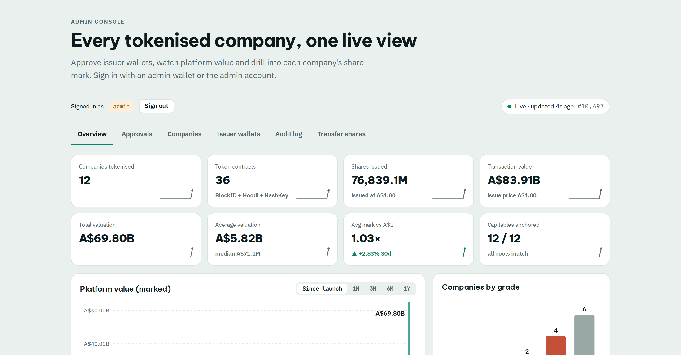
7 / 7 · LIVE TODAY
Live today — and built for the people who issue equity.
12
36
A$87B
12/12
companies tokenised
token contracts, 3 chains
valuation on-chain
hashes verified
WHO BUYS
Founders & SMEs (AU · VN)
Try it now
Accelerators & VCs
eth.blockid.au
Licensed CSF / transfer agents
Looking for: pilot startups, accelerators, licensed partners
RWA ecosystems (HashKey)
Long Do · long@blockid.au
Fees: issuance · cap-table SaaS · transfers · dividends
eth.blockid.au · Testnet demo, not an offer of securities
Notes:
[2:25–3:00] This is live today: twelve real companies, thirty-six token contracts on three chains, A$87 billion of valuation on-chain, every hash verified. Our full demo run took Canva from its website to a share register on three chains, a new round, a dividend and a shareholder transfer in eleven minutes. Our customers are founders, accelerators and licensed intermediaries who issue and administer startup equity. Scan the code and try it at eth.blockid.au — we're looking for pilot startups and licensed partners. Thank you.

