Slide 1

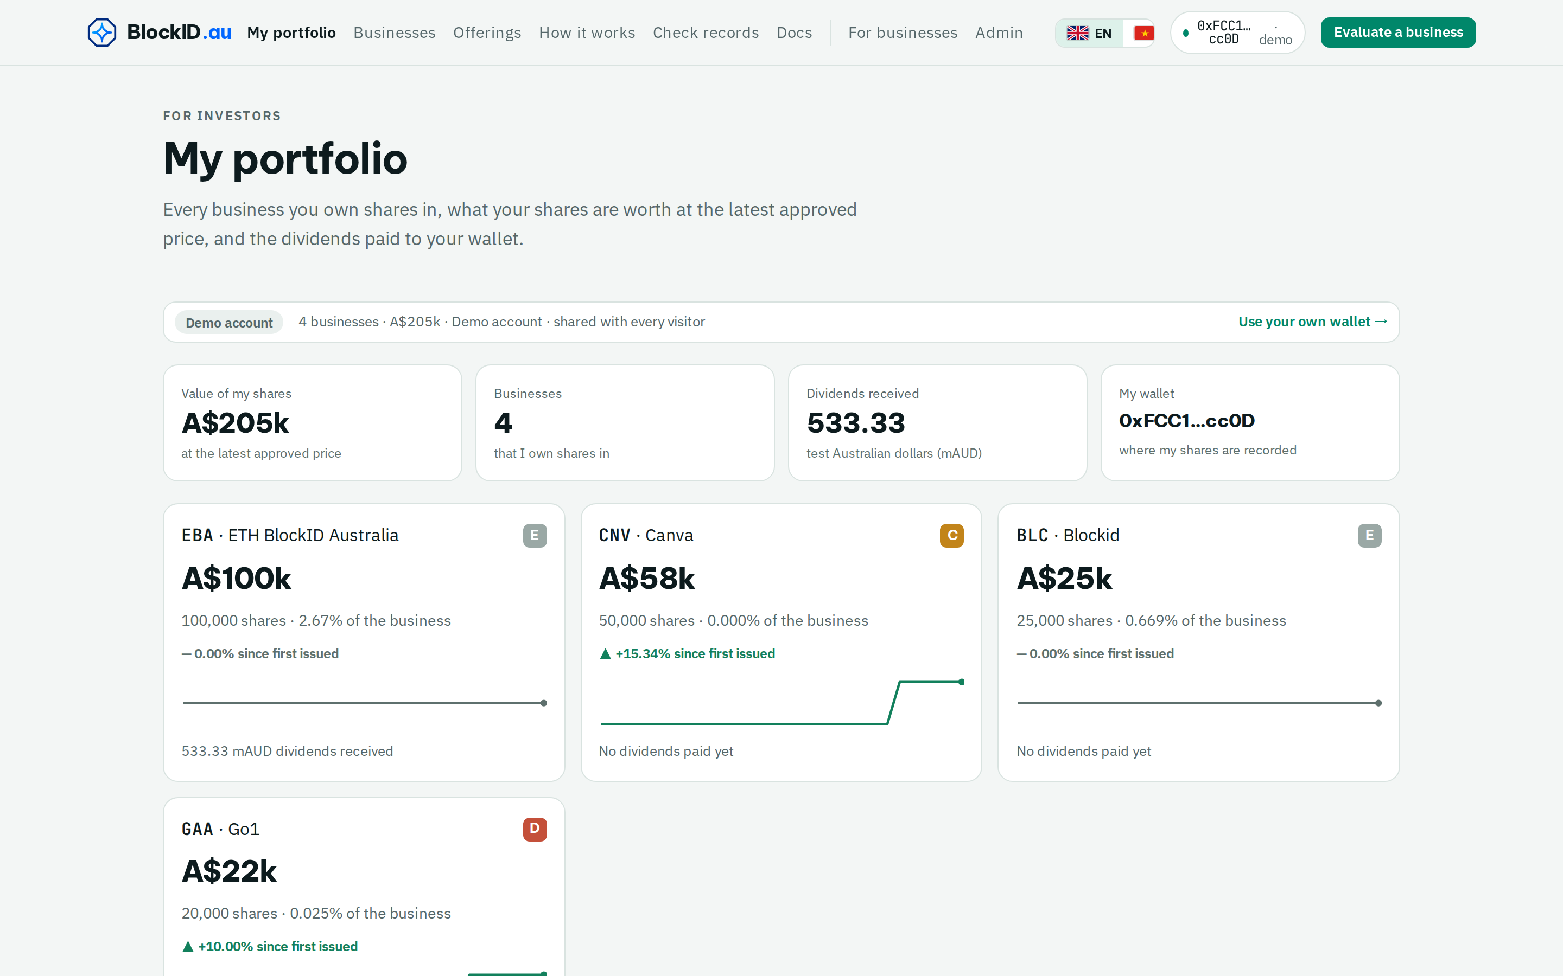
BlockID Business Passport
eth.blockid.au/i · demo investor account
Know the business
you invest in.
BlockID Business Passport gives every shareholder, large or small, a live view of the business they own: AI-analysed, human-approved updates and valuations, an on-chain share register as proof of ownership, and dividends paid straight to their wallet.
14
42
3
Understand it · Follow it · Own it · Get paid · Check it
sample listings (demo data)
share records on blockchain
blockchains, every record checkable
Working end to end on testnet at eth.blockid.au
eth.blockid.au · Testnet demo. Not an offer of securities or financial advice.
Notes:
[0:00–0:12] Know the business you invest in. BlockID Business Passport gives every shareholder, large or small, a live view of the business they own: checked updates and valuations, a share register on blockchain as proof of ownership, and dividends paid straight to their wallet.

Slide 2




2 / 13 · THE PROBLEM
Investing in a business is hard to follow.
You don't really understand the business
You lose sight of it after you invest
You're not sure what you own
Dividends are slow, or never arrive
Reports are long, late or missing. The numbers are hard to compare.
Sales, profit and new share sales happen without you seeing them.
Ownership sits in a spreadsheet. Your stake can shrink and no one tells you.
Paperwork and bank transfers, if they happen at all.
Big or small, most investors in a business face the same four gaps.
eth.blockid.au · Testnet demo. Not an offer of securities or financial advice.
Notes:
[0:12–0:24] Today investors lose sight of a business the day they invest. The numbers are hard to trust, ownership sits in a spreadsheet, so a stake can shrink without notice, and dividends are slow or never arrive.

Slide 3
3 / 13 · THE MARKET
Trillions in private businesses. Investors still can't see inside.
How big is it? (US$ trillion)
11%
of value paid back to private-equity investors in 2024, the lowest in a decade (2014–17 average: 29%). Bain, Mar 2025
2.81M + 1M+
businesses in Australia (ABS, Jun 2026) and Vietnam (NSO, 2025). SMEs are ~90% of all firms (World Bank).
16%
of alternative assets are held by individuals, who own ~50% of global wealth: retail access is the growth path. Bain, 2023
Sources: Crunchbase, Jan 2026 ($425B VC in 2025) · Carta.com, 2026 ($4.5T+ on platform) · Citi GPS, Jun 2026 ($5.5T base case) · Preqin, Oct 2025 ($32T by 2030).
eth.blockid.au · Testnet demo. Not an offer of securities or financial advice.
Notes:
[0:24–0:42] The need is large. Alternative assets are heading to thirty-two trillion dollars by 2030 (Preqin), and venture investors put in four hundred and twenty-five billion in 2025 (Crunchbase). Yet in 2024 private equity paid back just eleven percent of its value, a ten-year low (Bain). Australia has 2.8 million businesses and Vietnam over a million, and individuals hold half of global wealth but only sixteen percent of alternatives. Investors need trusted values, regular updates and dividends on time.

Slide 4

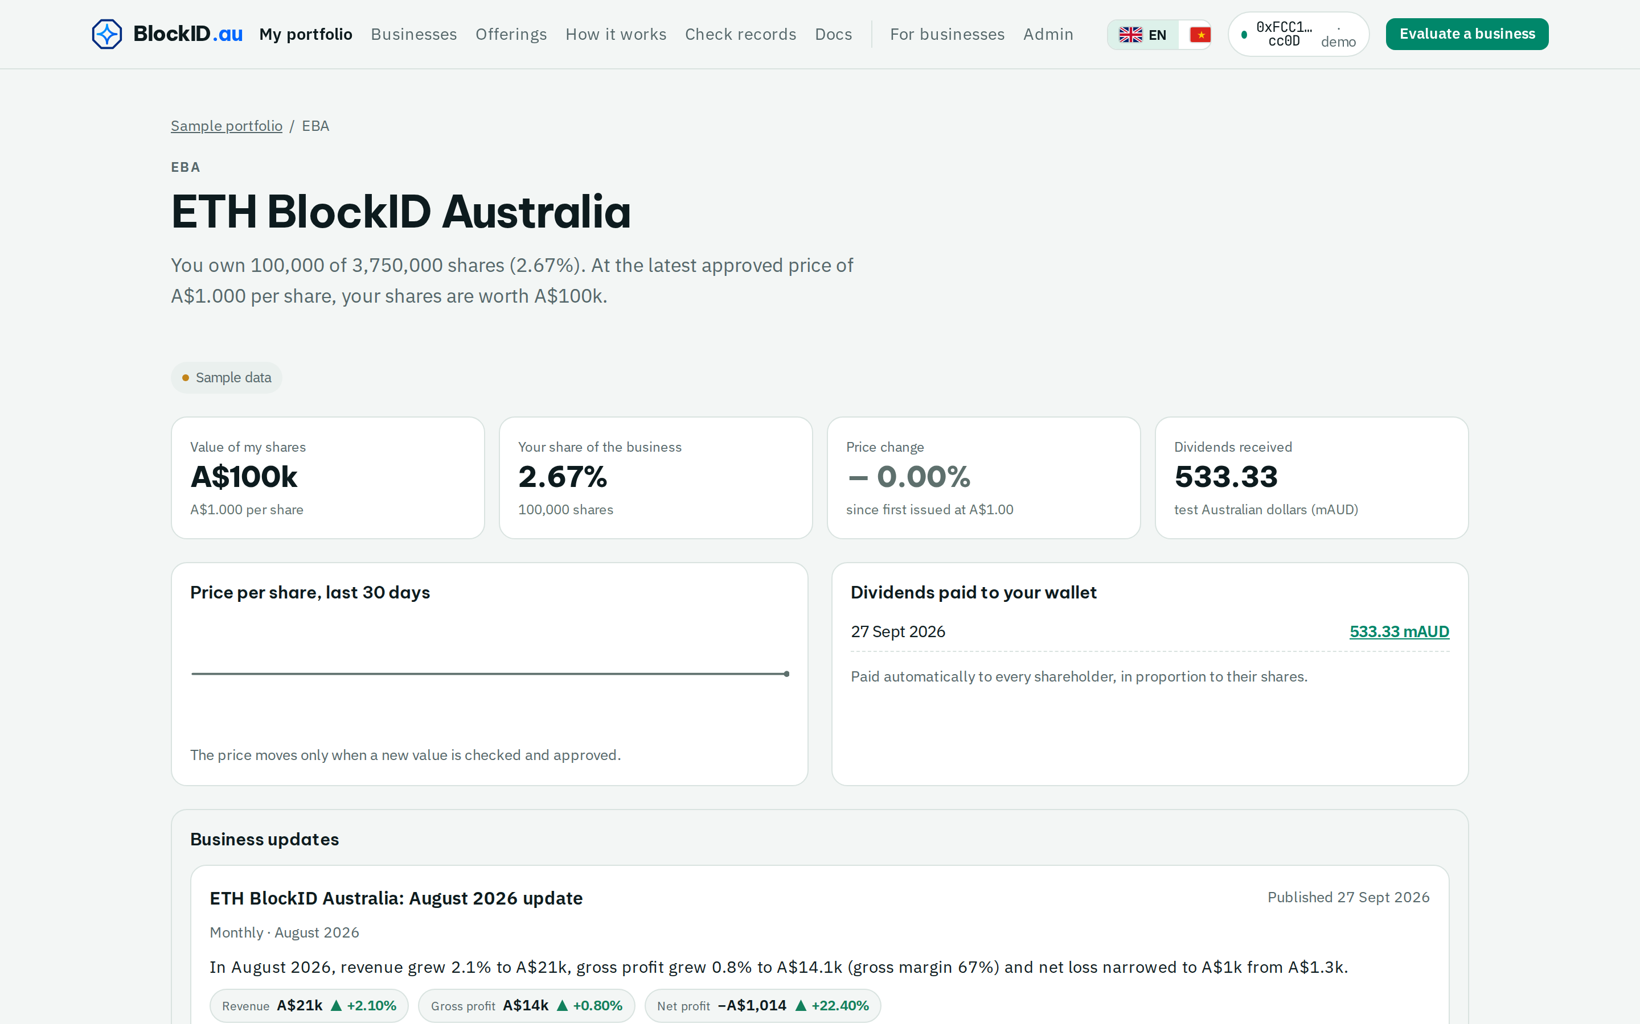




4 / 13 · THE SOLUTION
One passport per business. Five things every investor gets.
Understand it
A plain report. Every number linked to where it came from.
eth.blockid.au/i/demo/EBA
Follow it
Regular updates and a fair value, approved by a person.
Own it
Your shares on a public share register — your proof.
Get paid
Dividends go straight into your wallet, automatically.
Check it
Anyone can check the numbers and the register.
What a shareholder sees: the live demo account
eth.blockid.au · Testnet demo. Not an offer of securities or financial advice.
Notes:
[0:42–0:52] So we built one passport per business. Every investor can understand it, follow it, own it, get paid, and check it for themselves.

Slide 5
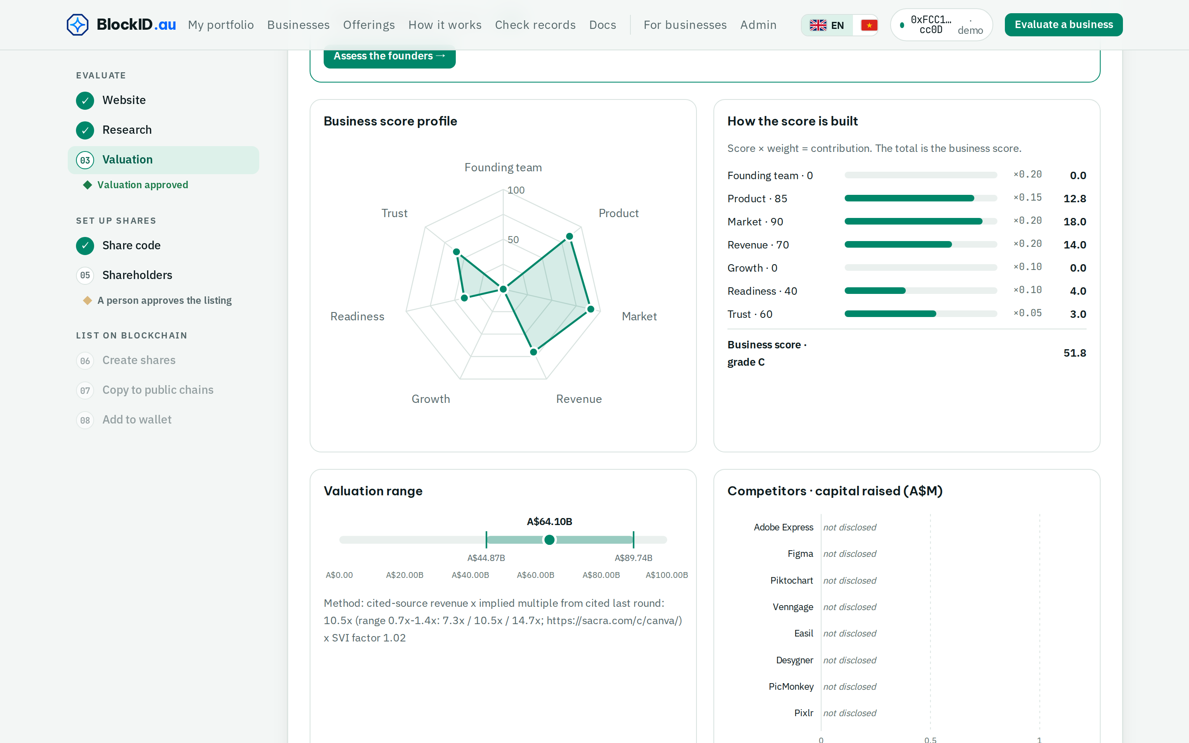
5 / 13 · UNDERSTAND IT
A fair value you can trace, approved by a person.
eth.blockid.au/v/be5a8a832b474459/report · Canva
Paste a website. Get a plain report in minutes.
Clear business score A–E and a low · mid · high value.
Every figure links to its source. No source, no number.
A person checks and approves before anyone sees it.
Canva: A$64B mid value, every source listed, approved by a person.
eth.blockid.au · Testnet demo. Not an offer of securities or financial advice.
Notes:
[0:52–1:05] Understand it. Paste a website and get a plain report in minutes: a grade from A to E and a low, mid and high value. AI agents do the research but hold no keys; every figure links to its source, and a person approves it.

Slide 6
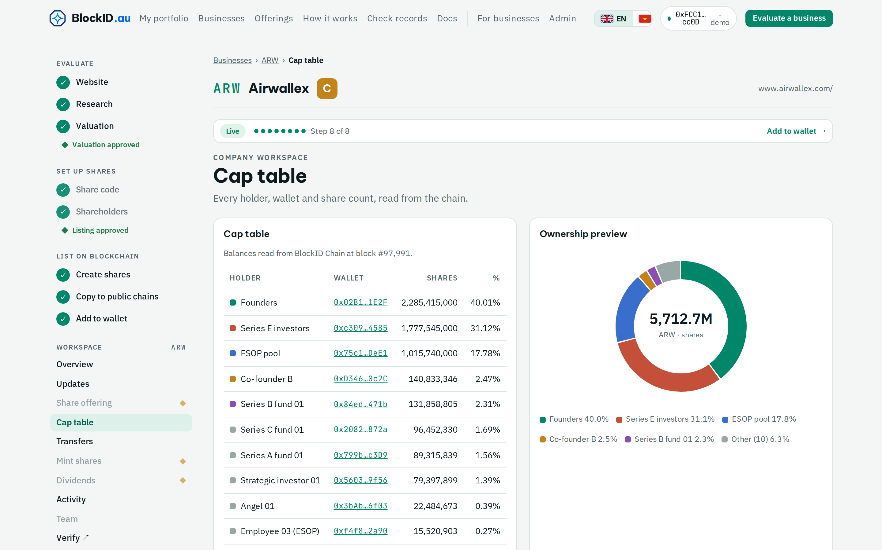
6 / 13 · OWN IT
Your shares are on the record. The record is your proof.
eth.blockid.au/c/ARW/cap-table
Every holder, wallet and share count in one share register.
Recorded on blockchain and copied to two public blockchains.
New shares need a person's approval — you see the dilution first.
Hold your shares in your own wallet, or sign in with Google.
14 sample listings · 42 share records on blockchain
eth.blockid.au · Testnet demo. Not an offer of securities or financial advice.
Notes:
[1:05–1:15] Own it. Every holder and share count sits in one share register on blockchain, copied to Ethereum and HashKey Chain. New shares need a person's approval, and investors see the dilution first.

Slide 7
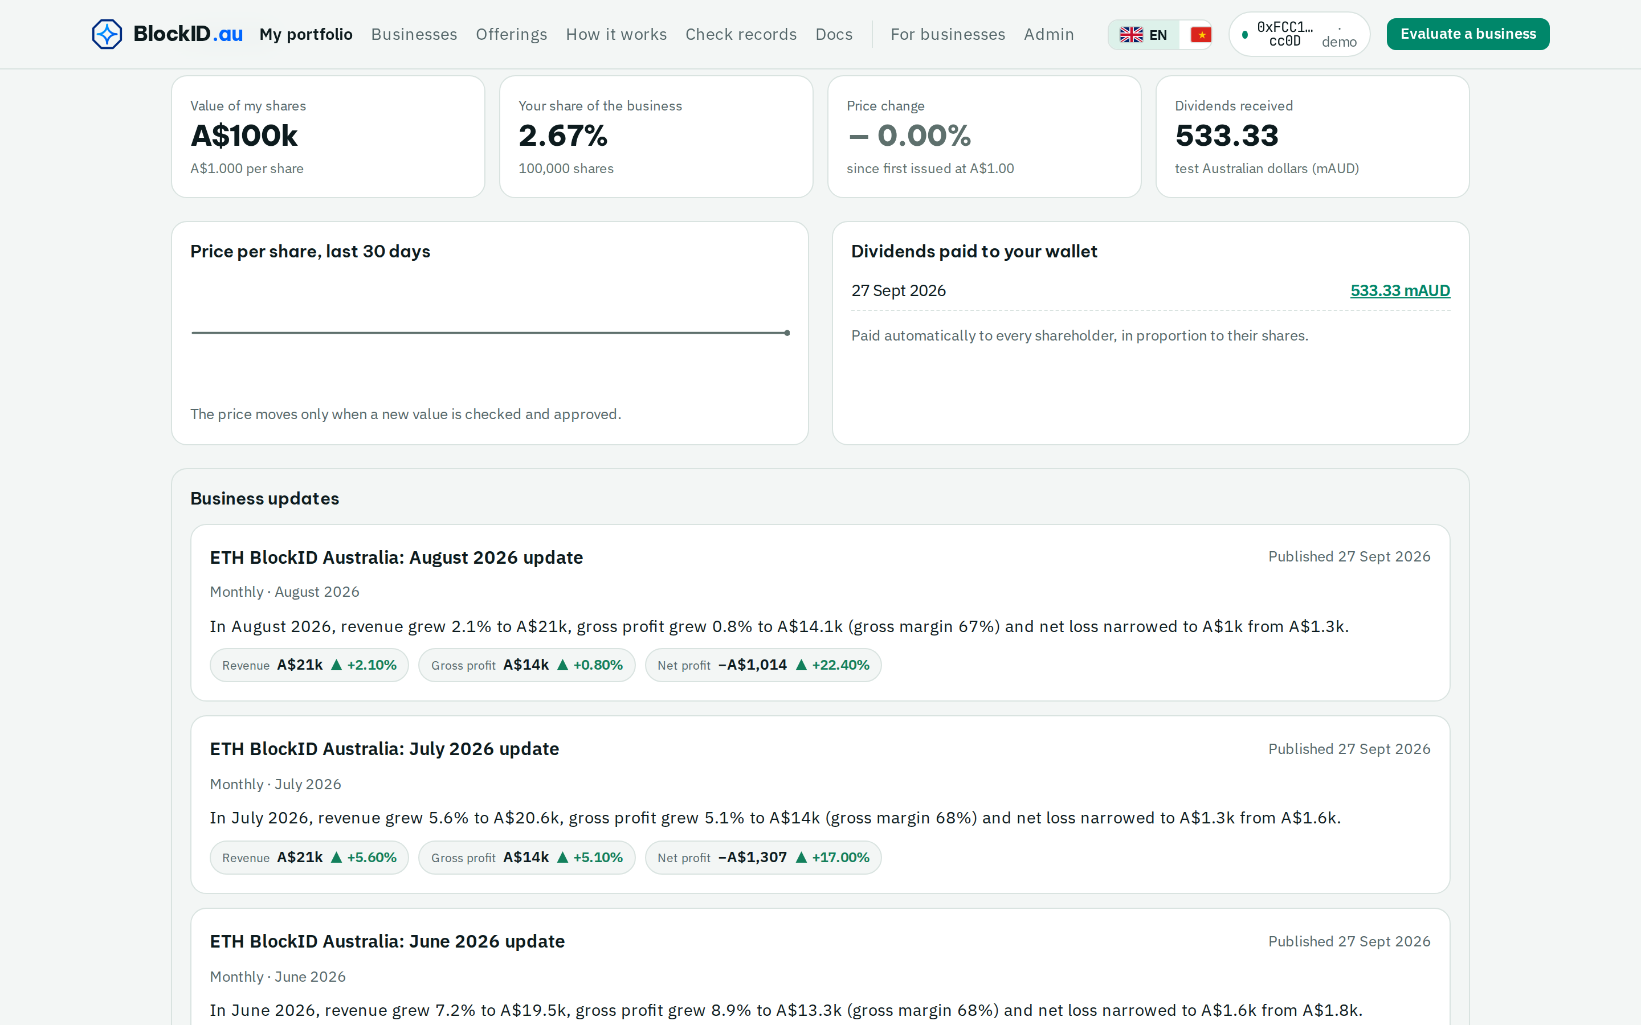
7 / 13 · FOLLOW IT · GET PAID
Same update for everyone. Dividends to your wallet.
eth.blockid.au/i/demo/EBA
Business shares its numbers
1
weekly, monthly, quarterly or yearly
2
Plain-language update + fair value
a person approves it before it goes out
3
Every investor gets it at once
record stored on blockchain, anyone can check
4
Dividend rule approved once
24 hours to cancel, then paid to every wallet — no fees for holders
eth.blockid.au · Testnet demo. Not an offer of securities or financial advice.
Notes:
[1:15–1:27] Follow it and get paid. The business shares its numbers on a schedule; a person approves the update and every investor gets it at the same time. Dividends go to every wallet, with no fees for holders.

Slide 8
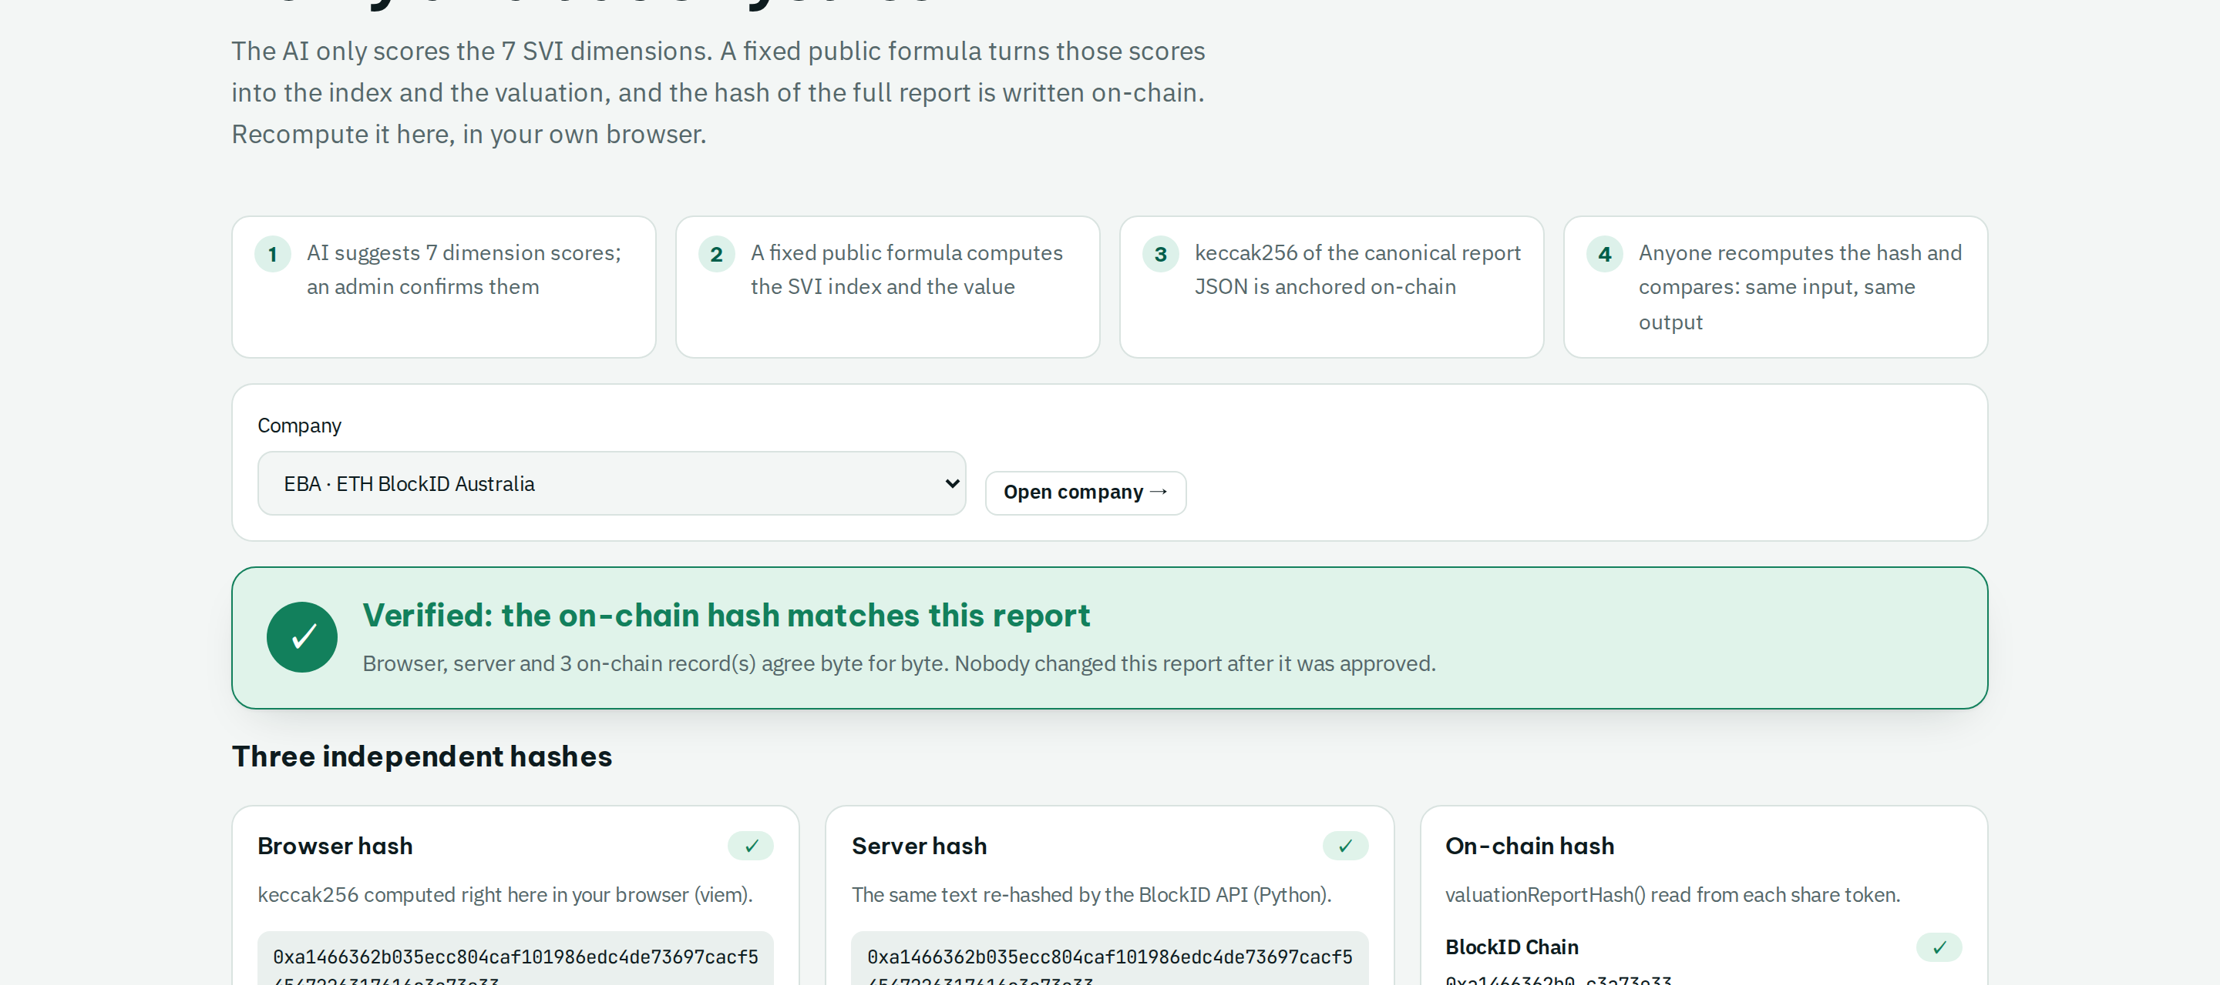
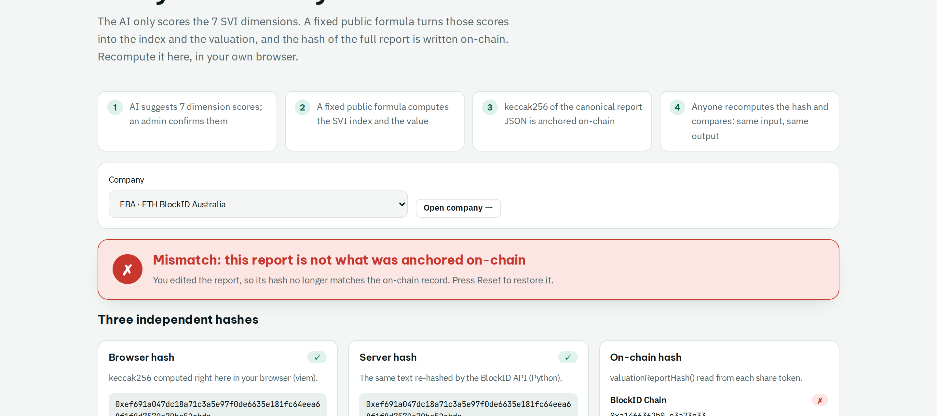



8 / 13 · CHECK IT
Don't trust us. Check it yourself, in your browser.
eth.blockid.au/verify/EBA
eth.blockid.au/verify/EBA · tamper test
✓ The report matches the record on 3 blockchains
✗ Change one number and it turns red
1. Your browser hashes the report
2. Reads the hash from BlockID, HashKey, Ethereum
3. Same = ✓ · changed = ✗
eth.blockid.au · Testnet demo. Not an offer of securities or financial advice.
Notes:
[1:27–1:37] Check it. Don't trust us. Your browser hashes the report and compares it with three blockchains. Change one number and it turns red.

Slide 9
9 / 13 · INVESTOR PROTECTION
Real benefits for investors. Clear duties for the business.
INVESTORS GET
THE BUSINESS MUST
Cash back to PE investors (% of NAV)
A checked value: every figure sourced, approved by a person
Keep a share register: already the law (AU Corporations Act s169 · VN Law on Enterprises 2020 Art. 122)
The same update as everyone, at the same time
Report on schedule; CSF companies report yearly, audit above A$3M raised (ASIC RG 261)
Proof of ownership: a live share register on blockchain
Get a person to approve every new share, dividend and transfer
Dividends on schedule, straight to the wallet, no fees
Bain Global PE Report, Mar 2025
Answer the risks the numbers flag, on the record
A$837.7M
Dilution shown before any new shares are issued
lost to investment scams in Australia in 2025. NASC, Targeting Scams 2025
eth.blockid.au · Testnet demo. Not an offer of securities or financial advice.
Notes:
[1:37–1:57] What does each side get? Investors get a checked value, the same update at the same time, proof of ownership and dividends on time. In return the business keeps a live share register, which Australian and Vietnamese law already require, reports on schedule (ASIC RG 261 for crowd-funded companies), and gets a person to approve every new share and dividend. With A$838 million lost to investment scams in Australia in 2025, checkable records matter.

Slide 10
10 / 13 · CUSTODY · TOKENISED ASSETS
Built for the tokenised future: clear custody from day one.
Tokenised real-world assets on-chain (US$ billion)
$5.5T by 2030
tokenised assets, Citi GPS base case (Jun 2026; bear $2.7T, bull $8.2T)
THE RULES ARE ARRIVING
Dec 2024 EU MiCA: custody and segregation of client assets
Sep 2025 Vietnam Resolution 05/2025: 5-year crypto-asset pilot
Jan 2026 Vietnam Law 71/2025: digital assets are property
Apr 2026 Australia Digital Assets Framework: licensed custody platforms
BLOCKID CUSTODY DESIGN
Keys only in an isolated issuer · every holder verified (KYC) · register anchored on 3 chains · a licensed custodian plugs in, investors keep proof
rwa.xyz "distributed" assets, excl. stablecoins (1 Oct 2026: $38.66B, 5.02M holders). Earlier points: PYMNTS, ByteTree, Yellow citing rwa.xyz.
eth.blockid.au · Testnet demo. Not an offer of securities or financial advice.
Notes:
[1:57–2:15] This also prepares for tokenised assets. Tokenised real-world assets on-chain grew from about seven to thirty-nine billion dollars in nineteen months (rwa.xyz), and Citi expects five and a half trillion by 2030. New rules in Europe, Vietnam and Australia require proper custody. In BlockID, keys sit only in an isolated issuer, every holder is verified, every record is anchored on three chains, and a licensed custodian can plug in.

Slide 11
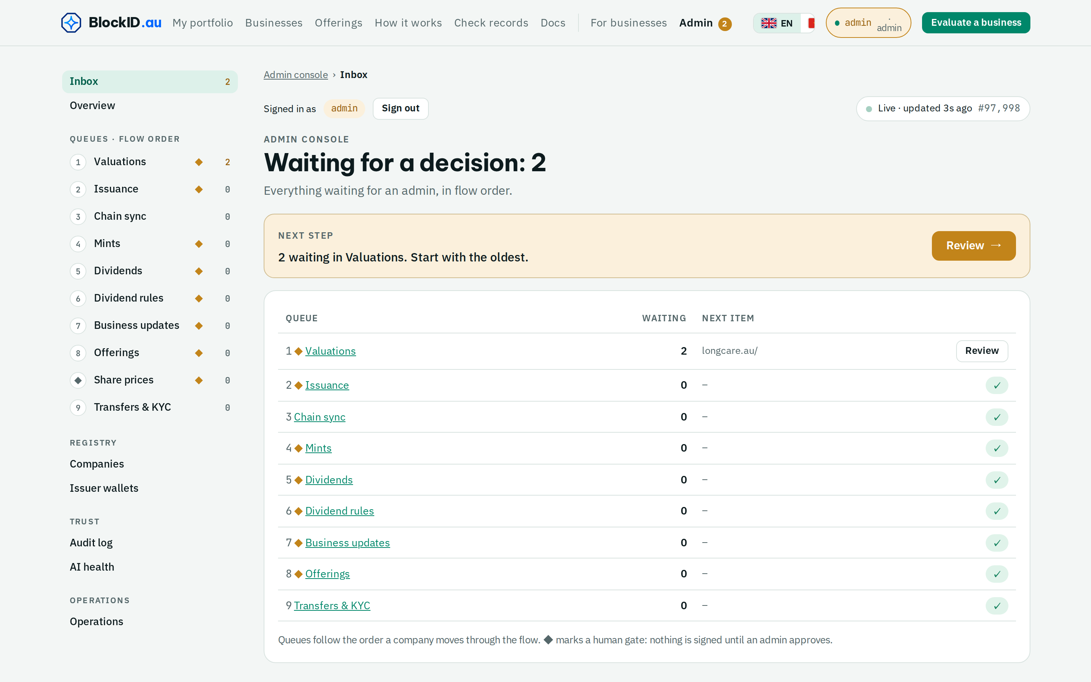
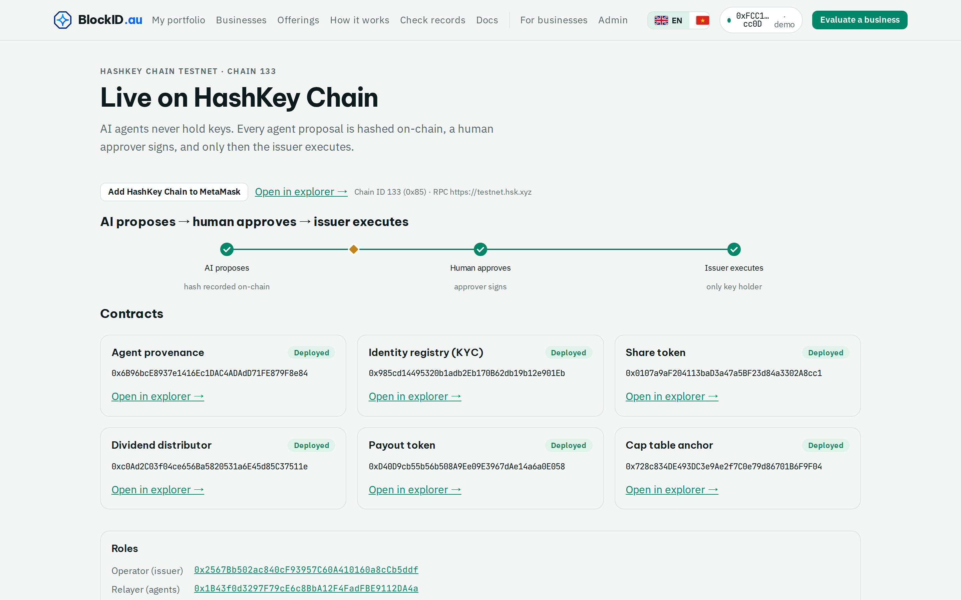
11 / 13 · HOW IT'S BUILT
Agents propose. Humans approve. Chains prove.
eth.blockid.au/admin · a person approves
eth.blockid.au/hsk · HashKey Chain, chain 133
AI agents propose
→
A person approves
→
Isolated issuer acts
research and value; no keys, no network path to keys
admin wallet signs one approval, four-eyes rule on chain
only key holder; writes BlockID Chain, mirrors Ethereum + HashKey
eth.blockid.au · Testnet demo. Not an offer of securities or financial advice.
Notes:
[2:15–2:30] Under the hood, only approved actions reach the chain. AI runs with no keys, an admin wallet signs one approval, and only then does the isolated issuer act. Our AgentProvenance contract on HashKey Chain records who proposed and who approved. Agents propose. Humans approve. Chains prove.

Slide 12



12 / 13 · THE TEAM
Built by founders who have run tech at scale.
DL
Do Van Long
TT
Truong Quoc Tuan
Founder & CEO
Co-founder
Former CTO of major Vietnamese corporations
Former CTO of major Vietnamese corporations
Founded Vietnam Blockchain Corporation (2016) and Auschain (Sydney)
Capital-markets experience (Dragon Capital Group)
Built Agridential, national-scale blockchain traceability
Investor, partner and finance side of BlockID
Australia Global Talent visa (subclass 858)
Australia Global Talent visa (subclass 858)
Tech team in Vietnam
Business team in Sydney
Built end to end, in house
Blockchain, AI and fintech engineers (Vietnam Blockchain Corporation, since 2016)
Pilots, partners and licensing in Australia (Auschain)
Smart contracts, AI agents, key-holding issuer, web app, 3 chains
eth.blockid.au · Testnet demo. Not an offer of securities or financial advice.
Notes:
[2:30–2:45] Who builds it? Founder Do Van Long and co-founder Truong Quoc Tuan are both former CTOs of major Vietnamese corporations and hold Australia's Global Talent visa. A strong tech team in Vietnam and a business team in Sydney built this whole system in house, ready to grow globally.

Slide 13
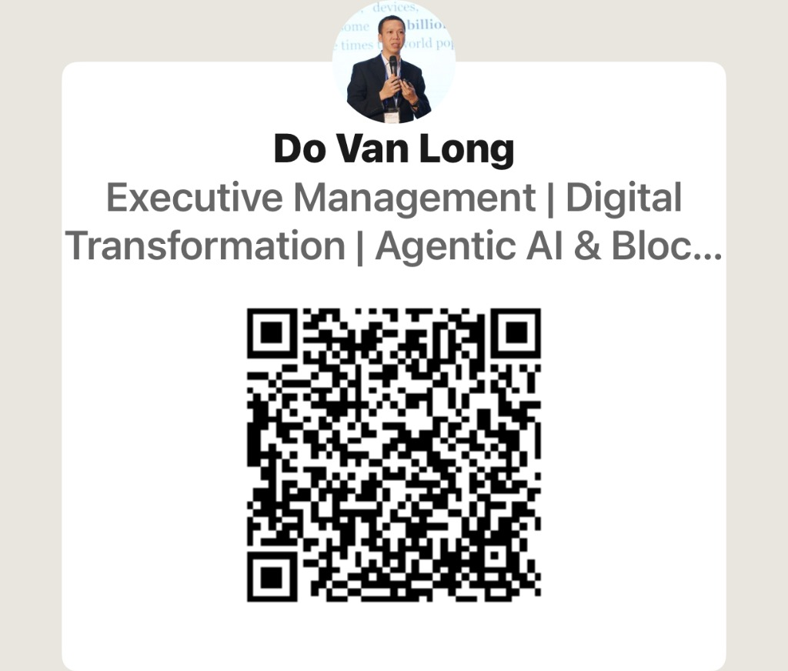

13 / 13 · WORKING TODAY · THE ASK
Working on testnet. Looking for our first pilot businesses.
14
42
3
Next
sample listings built from public data
share records on blockchain
blockchains, every record checkable
first real pilots in AU · VN
Try it now
eth.blockid.au
WHO PAYS
WHO IT'S FOR
Businesses: listing fee + share-register subscription
Investors, retail and professional
Connect with the founder
Per share transfer fee
Businesses raising from them (AU · VN)
We're looking for
Pilot businesses · investor communities · licensed partners
0.5–1% of each dividend round
Accelerators, VCs, licensed partners
Long Do · admin@blockid.au
linkedin.com/in/dovanlong
eth.blockid.au · Testnet demo. Not an offer of securities or financial advice.
Notes:
[2:45–3:00] The whole flow works on testnet today: fourteen sample listings and forty-two token contracts on three chains, with no real users yet. Next: pilot businesses in Australia and Vietnam, investor communities and licensed custody partners. Businesses pay a listing fee, a register subscription and small transfer and dividend fees. Try it at eth.blockid.au. Thank you.

