Slide 1

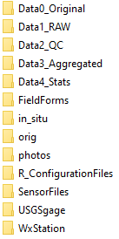
Recommended folder organizational scheme
1. Set up a folder for each site
2. Within each site folder, set up subfolders
(which you can download from the hyperlink above)
3. Populate folders
(see descriptions below)
Site X

