Slide 1
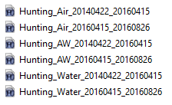
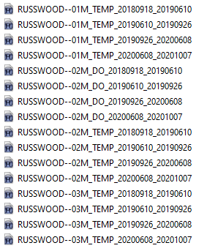
Example files from a RMN stream site, where one temperature sensor was deployed on land and the other in the water. In the AW files, air and water sensor data were combined into the same file.
Example files for a lake RMN site where temperature sensors were deployed at multiple depths and DO sensors were also deployed. The two types of sensors overlapped at the 2M depth and the second part of the file name (DataType) was used to distinguish between the two (TEMP vs. DO).

