Slide 1
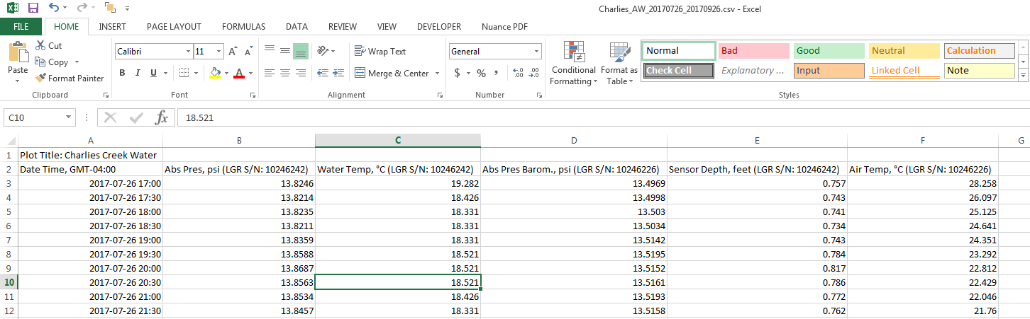
SiteID
Need to add a new column titled ‘SiteID’ and figure out the best way for people to enter the SiteID
Cell F2
Air Temp, °C (LGR S/N: 10246226)
Change ‘Air Temp, °C (LGR S/N: 10246226)’ to ‘Air Temp C’
Create new column titled ‘Air LoggerID’ and move ‘LGR S/N: LGR S/N: 10246226’ to that column
Cell B2
Abs Pres, psi (LGR S/N: 10246242)
Change ‘Abs Pres, psi’ to ‘Water P psi’
& remove (LGR S/N: 10246242) – we can carry that info over from the Water Temp cell – see below
Cell D2
Abs Pres Barom., psi (LGR S/N: 10246226)
Change ‘Abs Pres Barom., psi’ to ‘Air BP psi’
& remove (LGR S/N: 10246242) – we can carry that info over from the Air Temp cell – see below
Either delete the first row (‘Plot Title’) or make what comes after ‘Plot Title:’ the SiteID. However, I’m not sure people will remember to fill ‘Plot Title’ out properly in HOBOWare
Time setting
It’d be great to be able to retain the time zone information. In this example, ideally the R code could pull ‘GMT-04:00’ from cell A2 and put it into a new column titled ‘Offset from GMT’
Cell C2
Water Temp, °C (LGR S/N: 10246242)
Change ‘Water Temp, °C’ to ‘Water Temp C’
Create new column titled ‘Water LoggerID’ and move ‘LGR S/N: 10246242’ to that column
Cell E2
Sensor Depth, feet (LGR S/N: 10246242)
Change ‘Sensor Depth, feet’ to ‘Sensor Depth ft’ & remove (LGR S/N: 10246242) – we can carry that info over from the Water Temp cell
Date Time
Cell A2 needs to be updated to read ‘Date Time’

