Slide 1
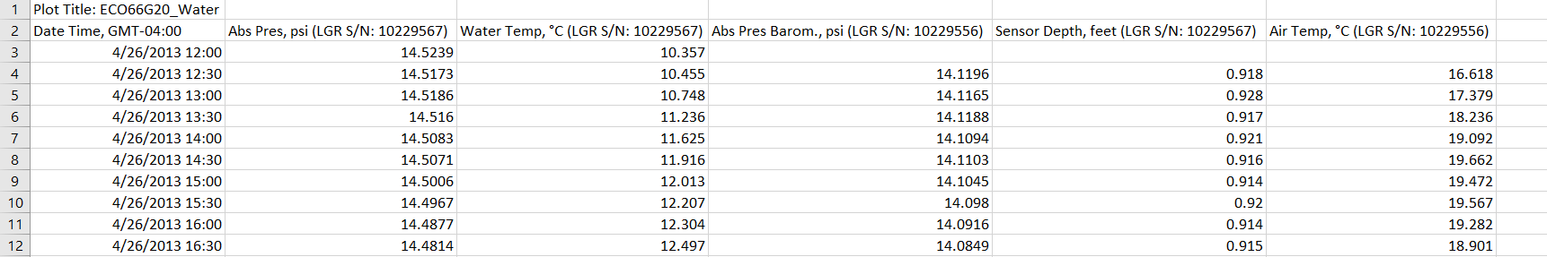
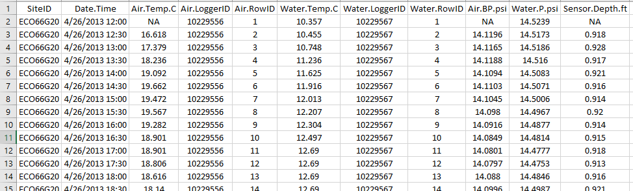
Running the HOBOware reformat function
(example file: HOBO U20 water level logger)
Before
After

