Slide 1
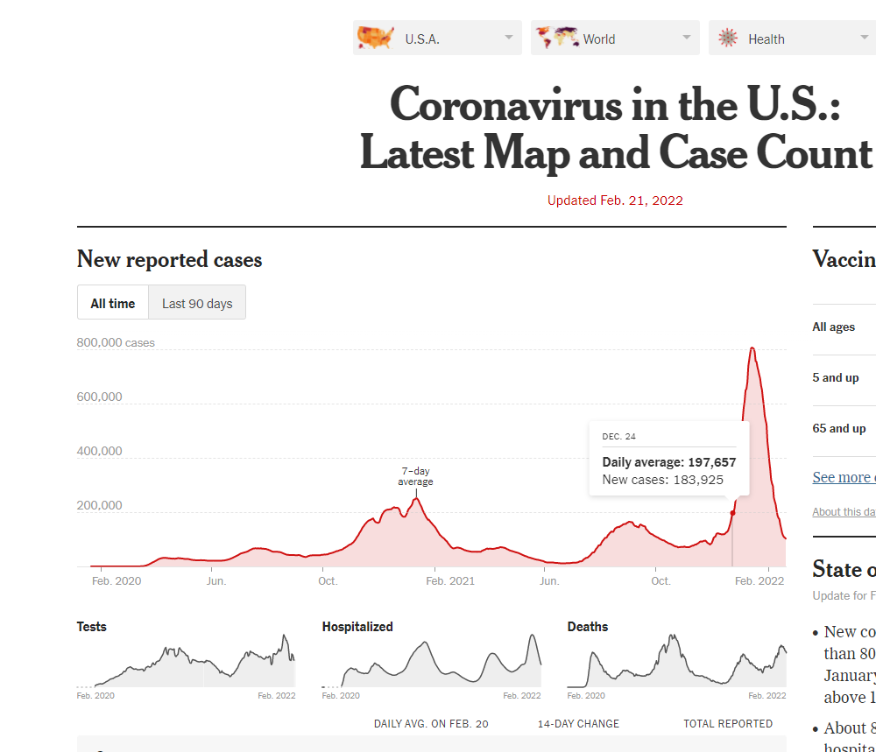
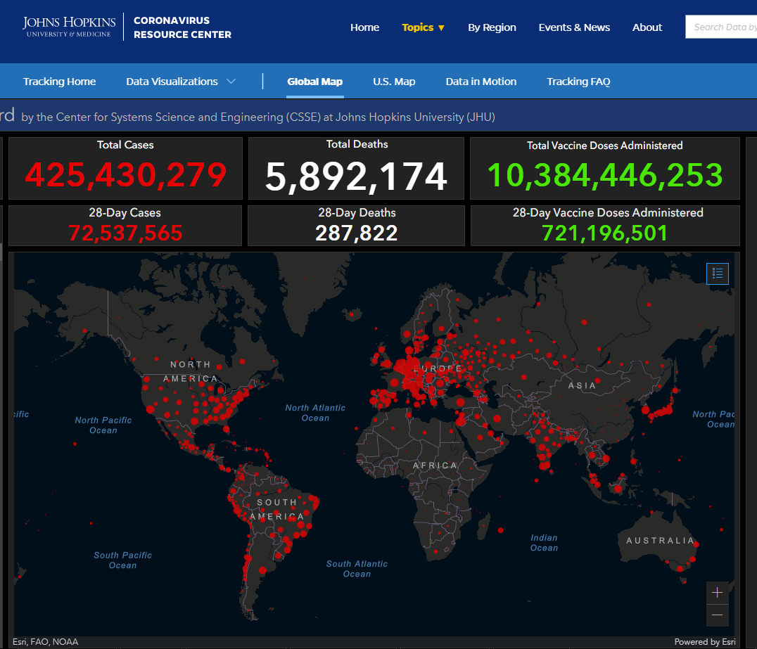

Slide 2
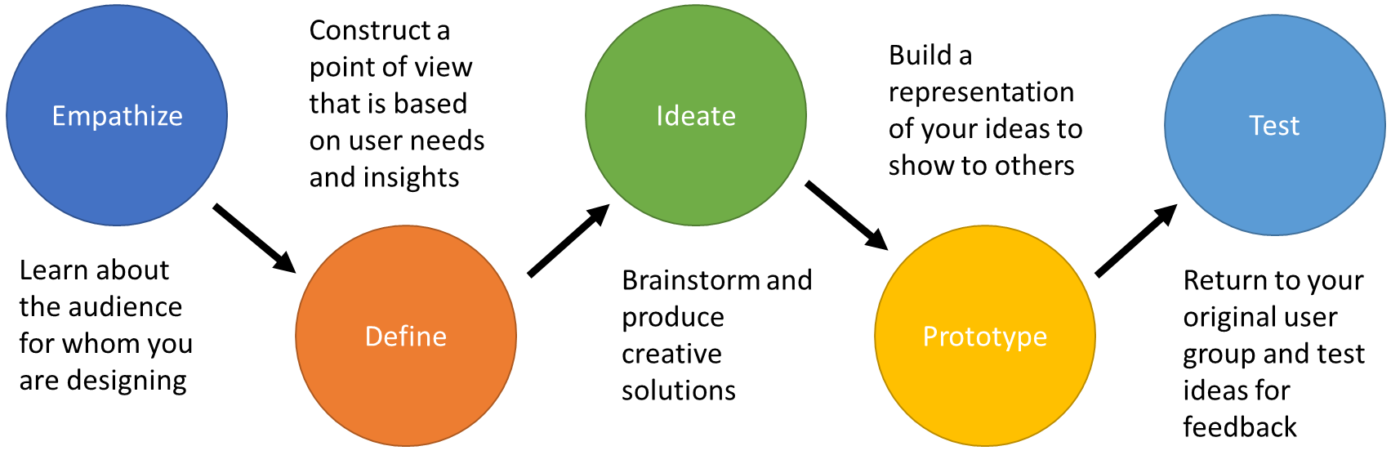
Empathize
Construct a point of view that is based on user needs and insights
Ideate
Test
Build a representation of your ideas to show to others
Define
Prototype
Learn about the audience for whom you are designing
Brainstorm and produce creative solutions
Return to your original user group and test ideas for feedback

Slide 3

