Slide 1


BLOG - PORTAL
Now Easy to SHARE KNOWLEDGE
Team Members
Project Owner
Madhur Jatiya
Harsh Ojha, Mohammad Nabi Hasan, Ashutosh Tigga, Ayushi Vishkarma
Aishwary Singh Rathore
Sakshi Katiyar

Slide 2
Agenda
Project Overview
Use Case Diagram
Sequence Diagram
Entity Relationship Diagram
Project Screenshorts

Slide 3

Project Overview
Online Blog-Portal to share knowledge among Nucleusteq employees.
Employees can see approved blogs, filter by technology, and search by heading.
Employees can see our own blogs, filter by technology and status, and search by heading.
Employees can write and edit blogs, which are reviewed by admins before being published.
Employees can like, dislike, comment, and report on blogs.
Admins can see all unapprove blogs and Approve/Reject blog.
Admins can see reported blogs and take appropriate actions like delete blog or delete report.

Slide 4
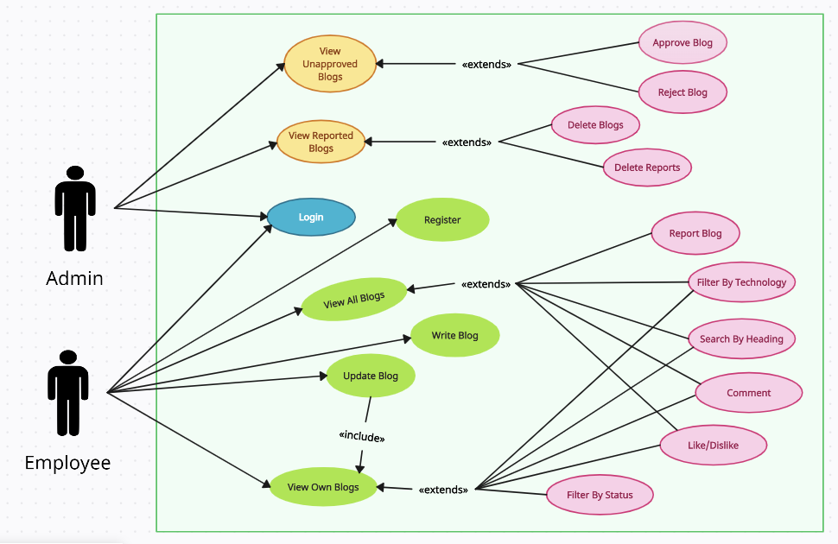

Use Case Diagram

Slide 5

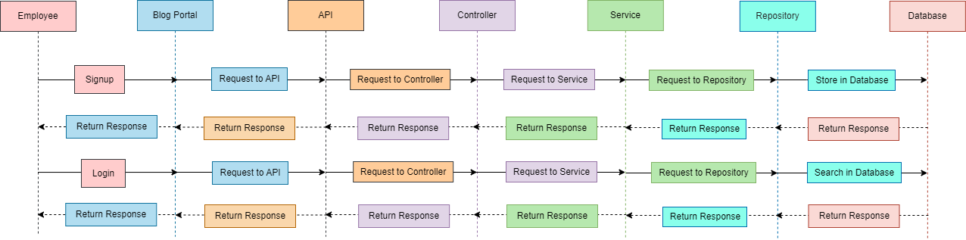
Sequence Diagram

Slide 6
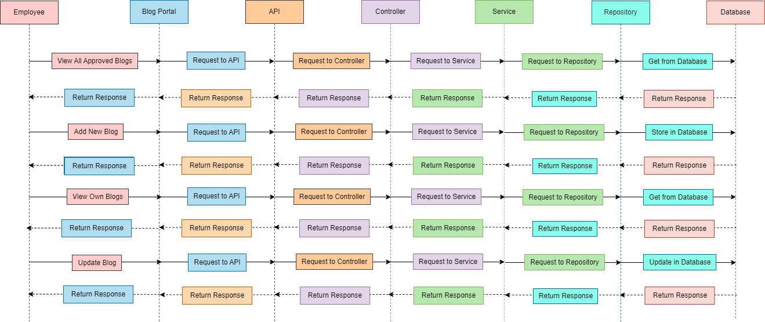
Sequence Diagram

Slide 7
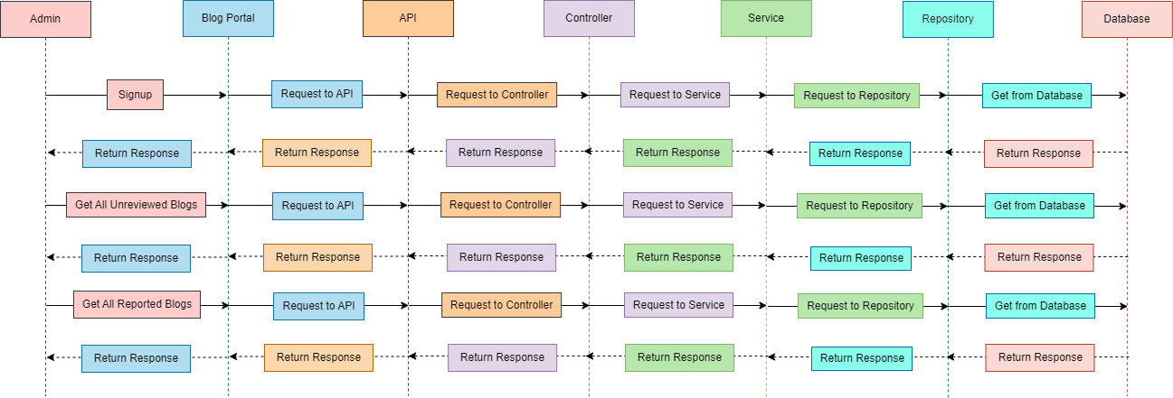
Sequence Diagram

Slide 8
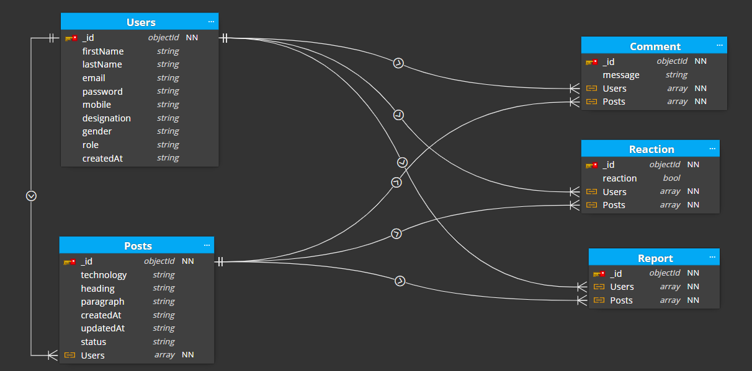

Entity Relationship Diagram

Slide 9
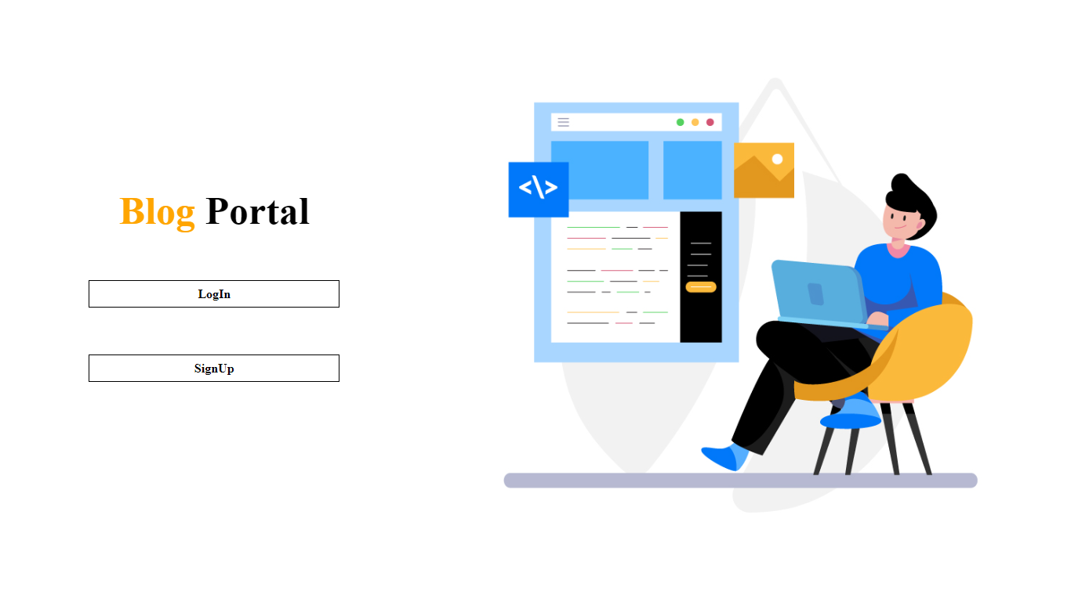
Project Screenshots
Home
Page

Slide 10
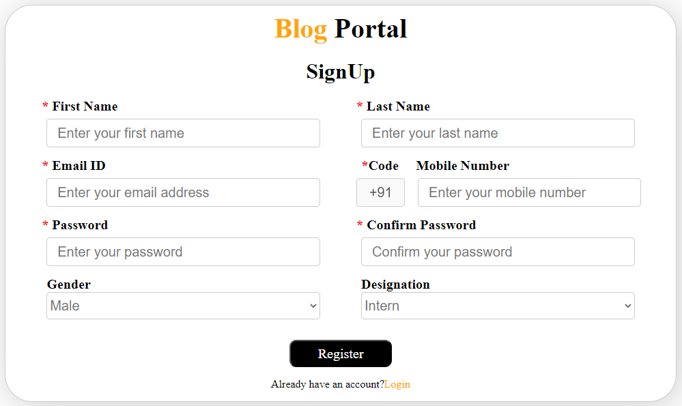
Project Screenshots
Signup
Page

Slide 11
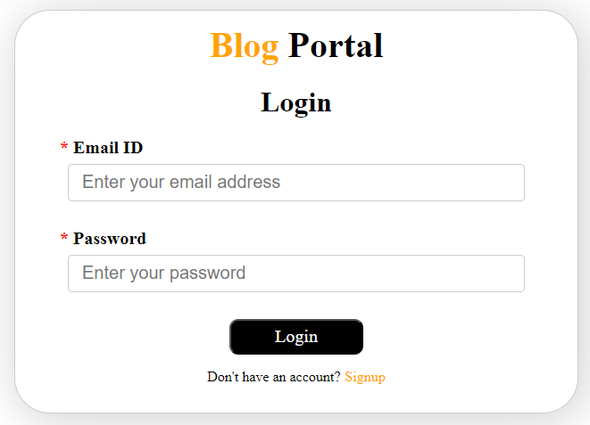
Project Screenshots
Login Page

Slide 12
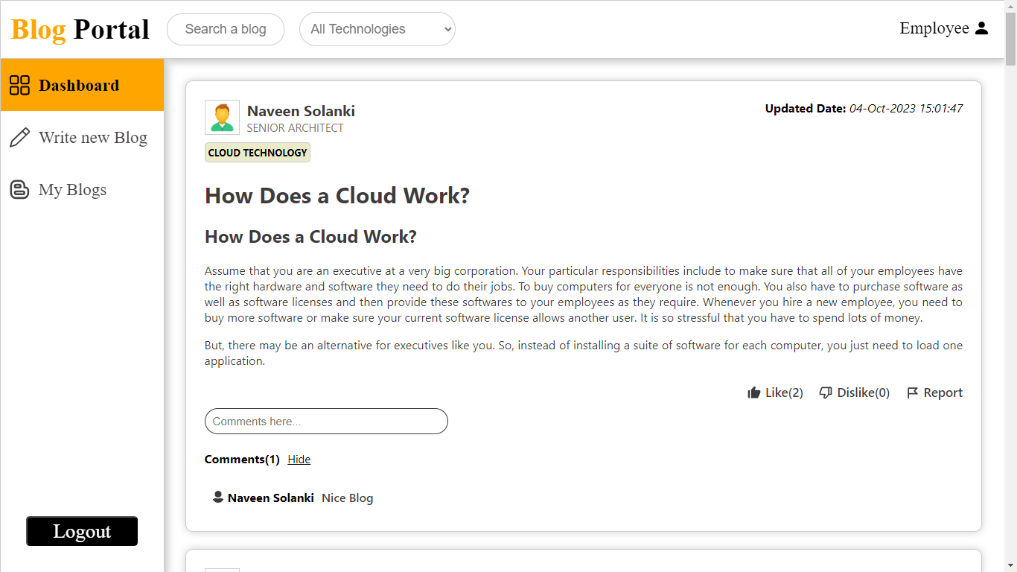
Project Screenshots
Dashboard
Page

Slide 13
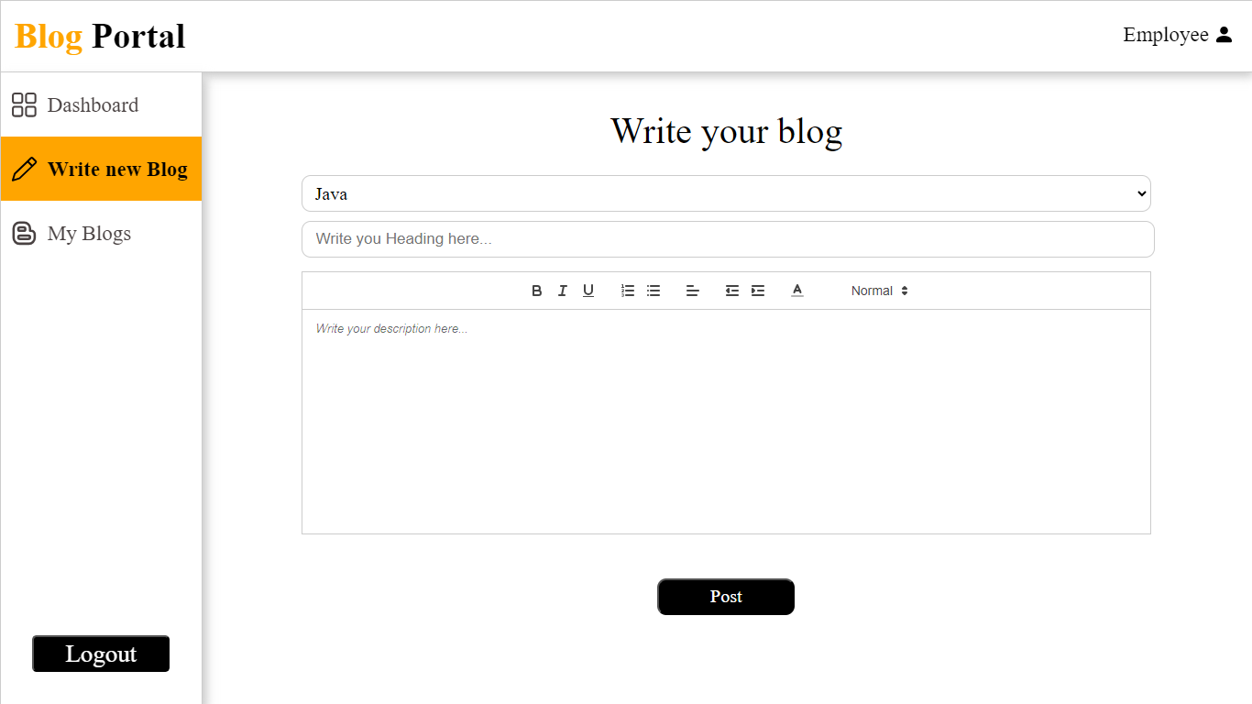
Project Screenshots
Write Blog
Page

Slide 14
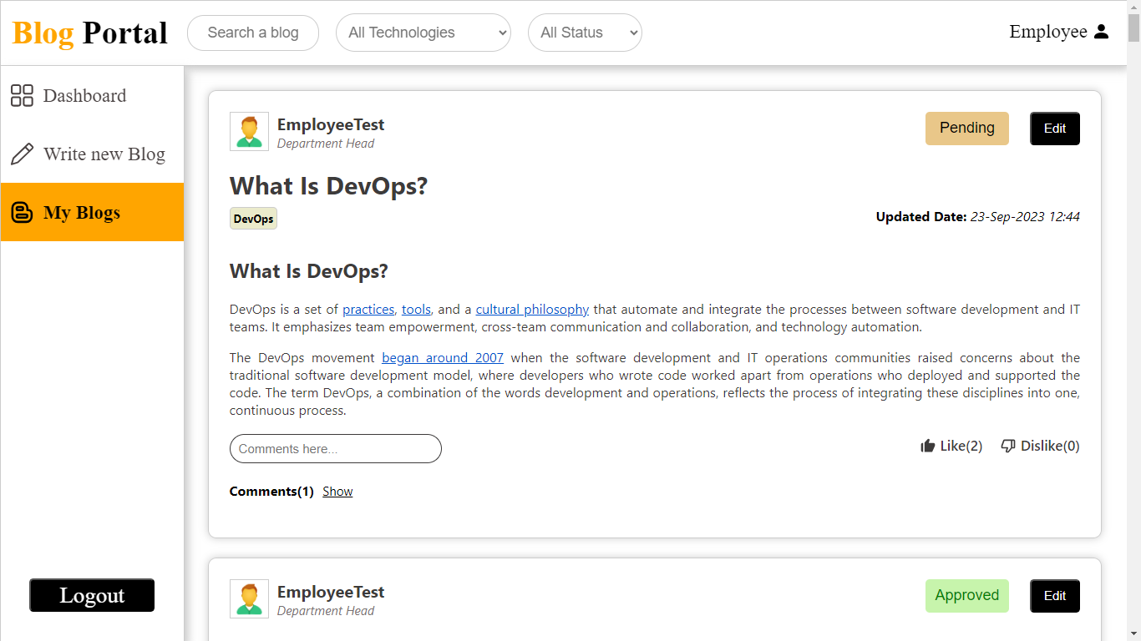
Project Screenshots
My Blogs
Page

Slide 15
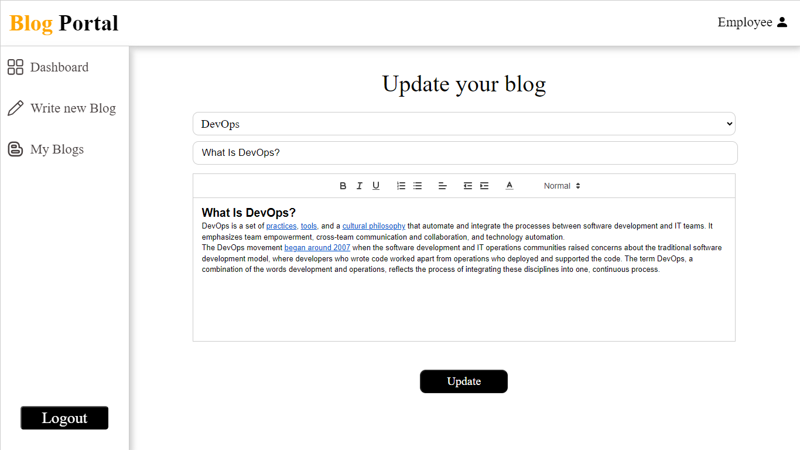
Project Screenshots
Update Blog
Page

Slide 16
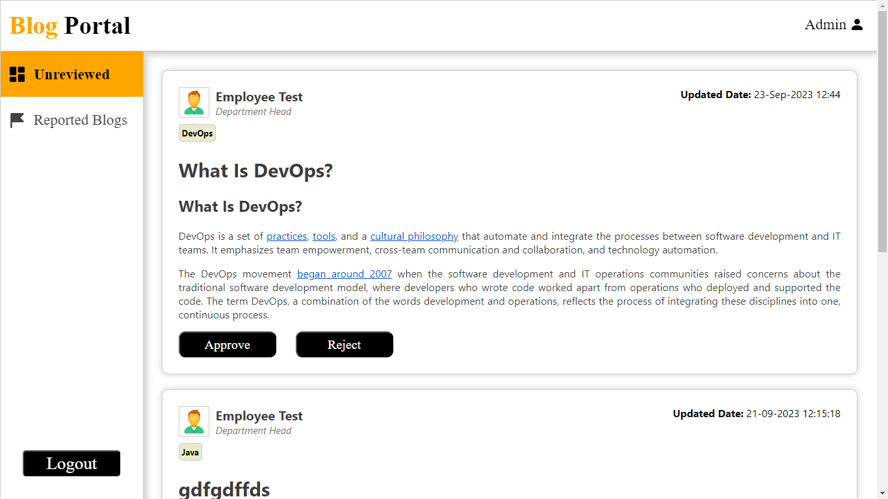
Project Screenshots
Unreviewed Blog Page

Slide 17
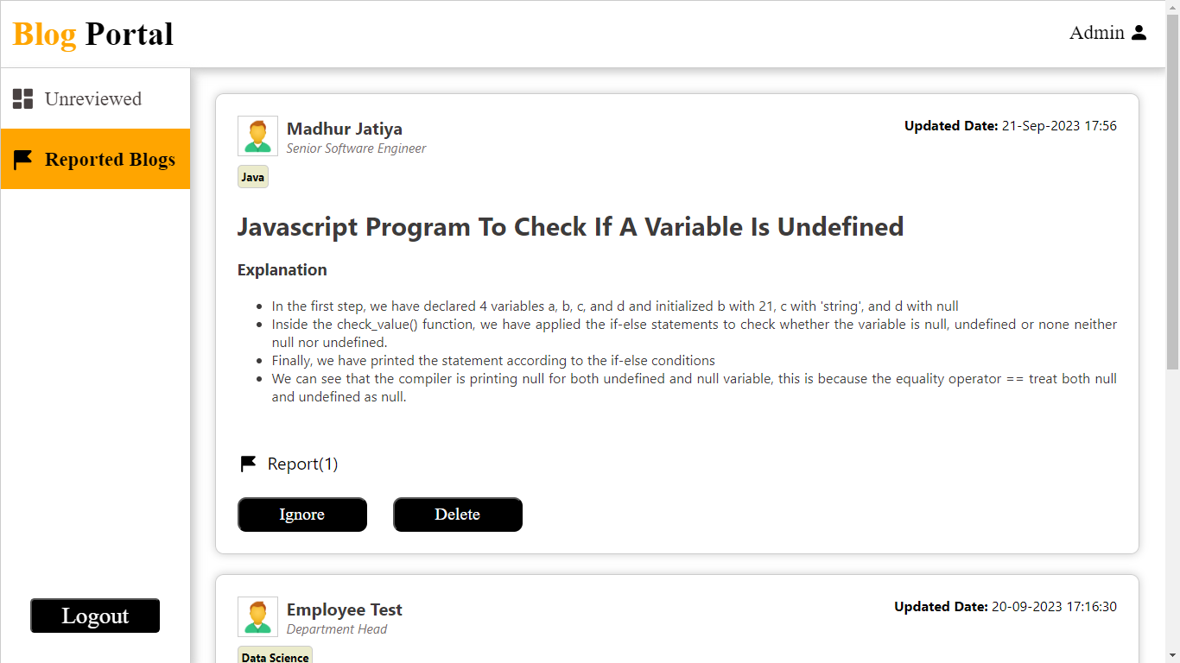
Project Screenshots
Reported
Blog Page

Slide 18

Thank You

