Slide 1
Modeling of a differential drive vehicle

Slide 2
Modeling of a differential drive vehicle
Kinematic model
Kinematic constraints
Dynamic model
DC motor model
Reference frames
Kinematics basics
Dynamics basics
Jacopo Tani (ETHZ)

Slide 3

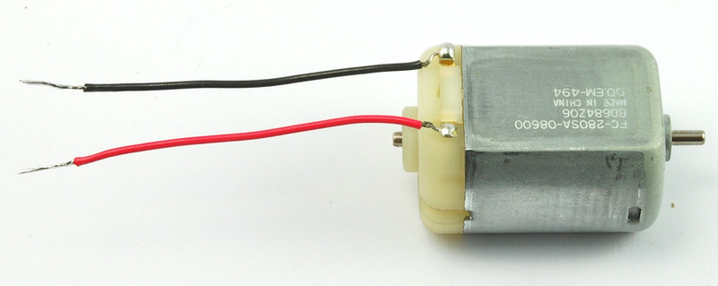
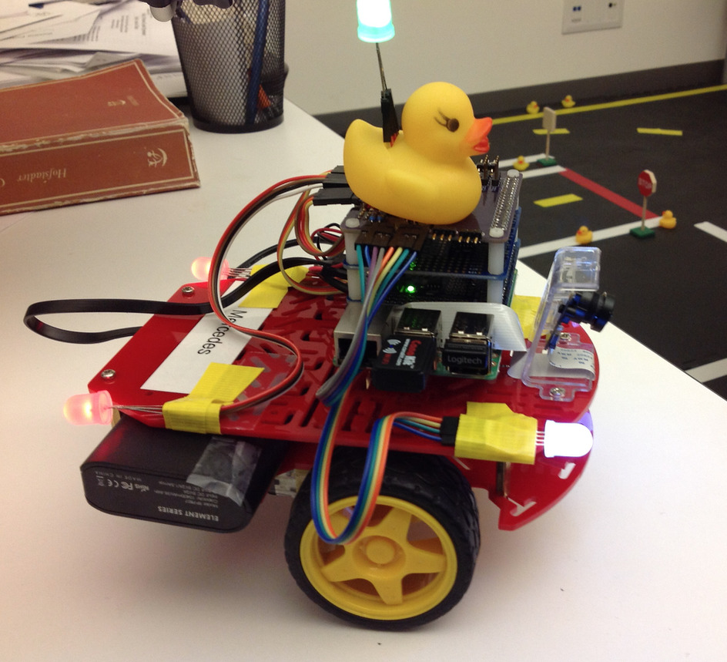








Our favorite slide
Disturbances
$$d(t)$$
Measurement noise
$$n(t)$$
Controller
Actuator
$$r(t)$$
$$u_{d}(t)$$
$$u(t)$$
$$y(t)$$
$$y_{m}(t)$$
Reference
path
Desired plant input
Input
Output
Measurement
Plant
Sensor
Today we build a mathematical model for a differential drive robot
Notes:
Today’s lecture objective is to obtain a mathematical model of the plant, including the actuator dynamics.
It is important for controlling the Duckiebot later on

Slide 4
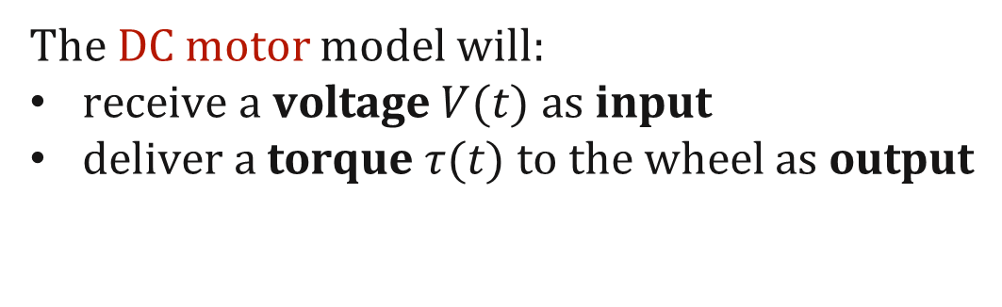
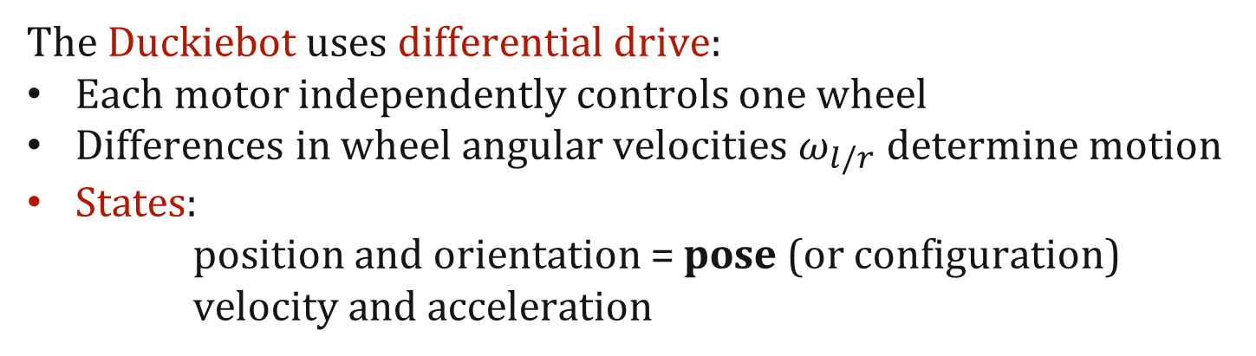
Intuition
The Duckiebot uses differential drive:
Each motor independently controls one wheel
Differences in wheel angular velocities $ω_{l/r}$ determine motion
States:
position and orientation = pose (or configuration)
velocity and acceleration
The DC motor model will:
receive a voltage $V(t)$ as input
deliver a torque $τ(t)$ to the wheel as output
Notes:
Today’s lecture objective is to obtain a mathematical model of the plant, including the actuator dynamics.
It is important for understanding the behavior of the Duckiebot and controlling it later on

Slide 5
Battle plan
Introduce relevant reference frames (inertial, body)
Make assumptions and translate them in kinematic constraints
Figure out the kinematics of the robot
Figure out the dynamics of the robot
Draw conclusions

Slide 6
Battle plan
Introduce relevant reference frames (inertial, body)
Make assumptions and translate them in kinematic constraints
Figure out the kinematics of the robot
Figure out the dynamics of the robot
Draw conclusions

Slide 7
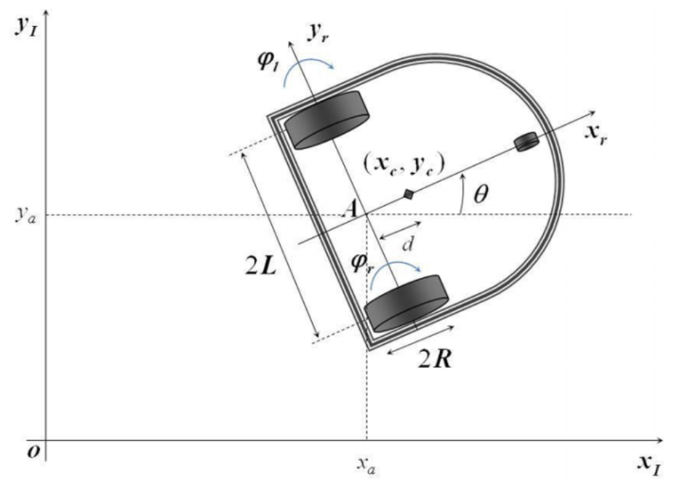

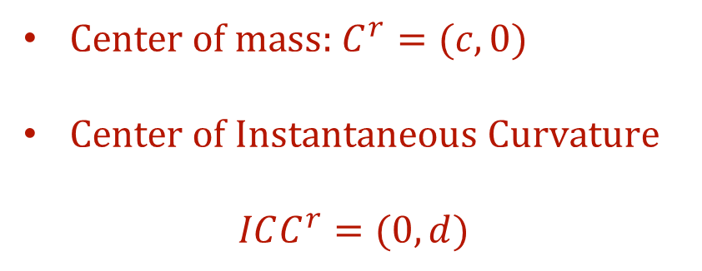


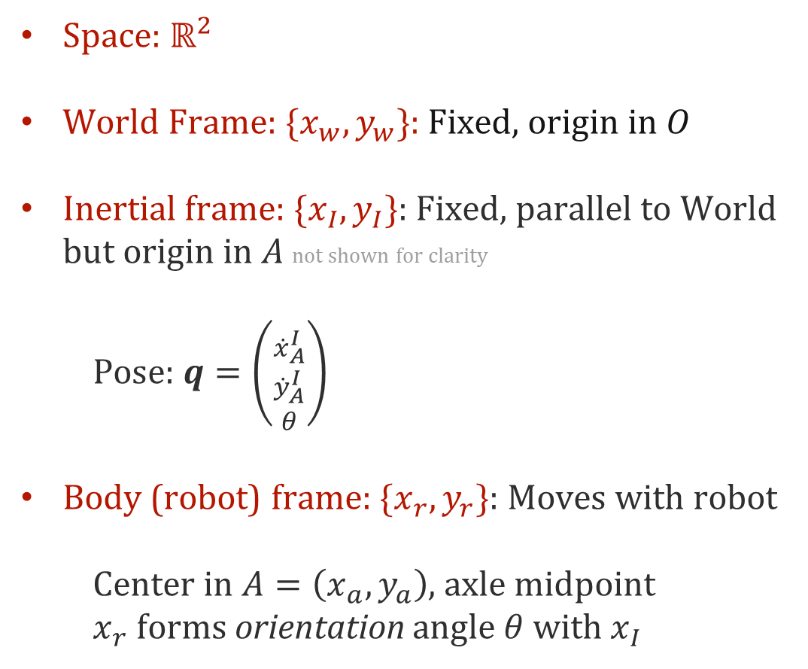



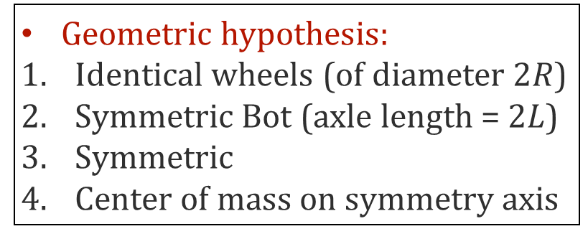

Reference frames and notation
Space: $ℝ^{2}$
World Frame: $\{x_{w}, y_{w}\}$: Fixed, origin in $O$
Inertial frame: $\{x_{I}, y_{I}\}$: Fixed, parallel to World but origin in $A$ not shown for clarity
Pose: $q=\left({{\dot{x}}_{A}^{I} \atop \begin{aligned}{\dot{y}}_{A}^{I} \\ θ\end{aligned}}\right)$
Body (robot) frame: $\{x_{r}, y_{r}\}$: Moves with robot
Center in $A=\left(x_{a}, y_{a}\right)$, axle midpoint
$x_{r}$ forms orientation angle $θ$ with $x_{I}$
Geometric hypothesis:
Identical wheels (of diameter $2R$)
Symmetric Bot (axle length = $2L$)
Symmetric
Center of mass on symmetry axis
ICC
$$ω$$
$$y_{w}$$
$$d$$
$$v_{l}$$
$$c$$
$$v_{r}$$
In robot frame
Center of mass: $C^{r}=(c,0)$
Center of Instantaneous Curvature
$$ICC^{r}=(0,d)$$
$$x_{w}$$

Slide 8



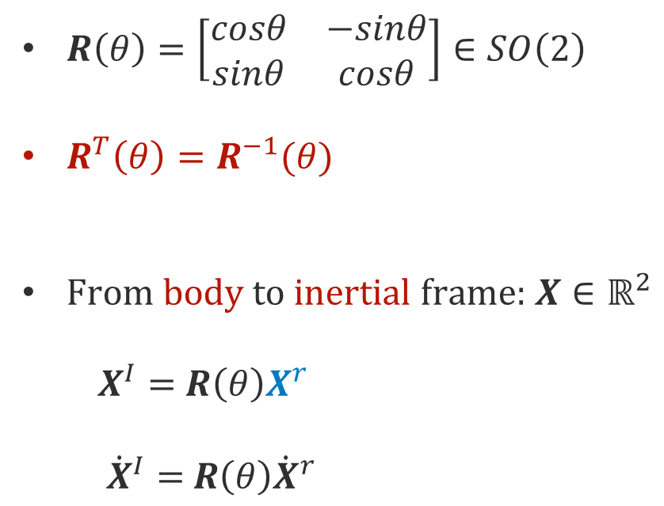
Moving between frames
$R\left(θ\right)=\left[\begin{matrix}cosθ & −sinθ \\ sinθ & cosθ\end{matrix}\right]∈SO\left(2\right)$
$R^{T}\left(θ\right)=R^{−1}(θ)$
From body to inertial frame: $X∈ℝ^{2}$
$X^{I}=$ $R\left(θ\right)X^{r}$
${\dot{X}}^{I}=$ $R\left(θ\right){\dot{X}}^{r}$
ICC
$$ω$$
$$y_{w}$$
$$d$$
$$v_{l}$$
$$X^{r}$$
$$c$$
$$v_{r}$$
$$X$$
$$X^{I}$$
$$x_{w}$$

Slide 9
Battle plan
Introduce relevant reference frames (inertial, body)
Make assumptions and translate them in kinematic constraints
Figure out the kinematics of the robot
Figure out the dynamics of the robot
Draw conclusions

Slide 10
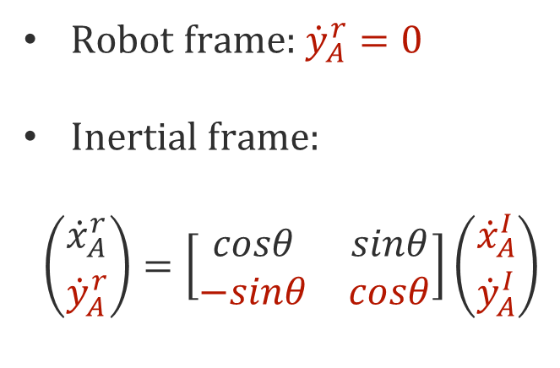


Kinematic constraint: no lateral slipping
This constraint imposes that the robot cannot move sideways (in the robot frame)
Robot frame: ${\dot{y}}_{A}^{r}=0$
Inertial frame:
$$\left({{\dot{x}}_{A}^{r} \atop {\dot{y}}_{A}^{r}}\right)=\left[\begin{matrix}cosθ & sinθ \\ −sinθ & cosθ\end{matrix}\right]\left({{\dot{x}}_{A}^{I} \atop {\dot{y}}_{A}^{I}}\right)$$
ICC
$$ω$$
$$y_{w}$$
$$d$$
$$v_{l}$$
$$⇒$$
$${\dot{y}}_{A}^{I}cosθ−{\dot{x}}_{A}^{I}sinθ=0$$
$$c$$
$$v_{r}$$
$$x_{w}$$

Slide 11


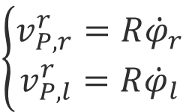




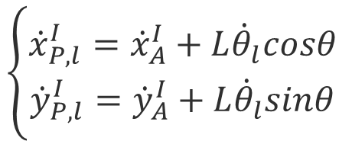
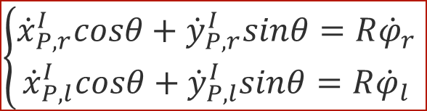
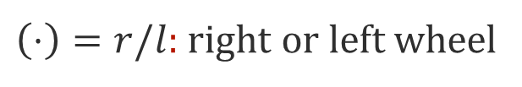
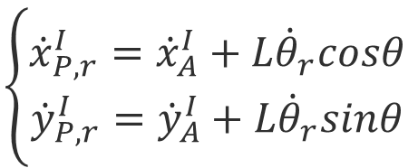


Kinematic constraint: pure rolling
Robot frame:
Kinematic hypothesis
Rigid body
$$\left\{\begin{aligned}v_{P,r}^{r}=R{\dot{φ}}_{r} \\ v_{P,l}^{r}=R{\dot{φ}}_{l}\end{aligned}\right.$$
Inertial frame (Hp: rigid body motion):
$$ω=\dot{θ}$$
$$\left\{\begin{aligned}{\dot{x}}_{P,r}^{I}={\dot{x}}_{A}^{I}+L{\dot{θ}}_{r}cosθ \\ {\dot{y}}_{P,r}^{I}={\dot{y}}_{A}^{I}+L{\dot{θ}}_{r}sinθ\end{aligned}\right.$$
$$A$$
${\dot{φ}}_{(⋅)}$
$$\left\{\begin{aligned}{\dot{x}}_{P,l}^{I}={\dot{x}}_{A}^{I}+L{\dot{θ}}_{l}cosθ \\ {\dot{y}}_{P,l}^{I}={\dot{y}}_{A}^{I}+L{\dot{θ}}_{l}sinθ\end{aligned}\right.$$
$$L$$
$$2R$$
(Using no lateral slipping too):
$$P$$
$$v_{P,(⋅)}^{r}$$
$$\left\{\begin{aligned}{\dot{x}}_{P,r}^{I}cosθ+{\dot{y}}_{P,r}^{I}sinθ=R{\dot{φ}}_{r} \\ {\dot{x}}_{P,l}^{I}cosθ+{\dot{y}}_{P,l}^{I}sinθ=R{\dot{φ}}_{l}\end{aligned}\right.$$
$\left(⋅\right)=r/l$: right or left wheel
$$⇒$$
This constraint imposes that the robot wheels cannot slip

Slide 12
Battle plan
Introduce relevant reference frames (inertial, body)
Make assumptions and translate them in kinematic constraints
Figure out the kinematics of the robot
Figure out the dynamics of the robot
Draw conclusions

Slide 13
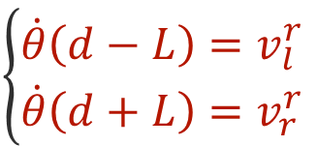
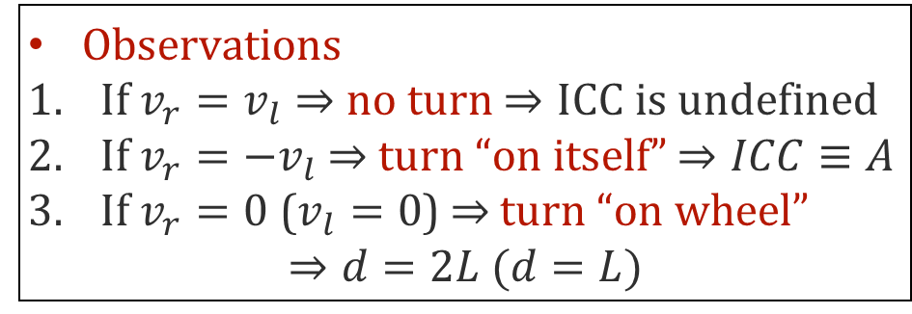
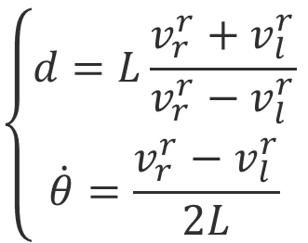
Kinematics
All points in the rotation field (centered at $ICC$) are subject to velocity orthogonal to the axle
$$\left\{\begin{aligned}d=L\frac{v_{r}^{r}+v_{l}^{r}}{v_{r}^{r}−v_{l}^{r}} \\ \dot{θ}=\frac{v_{r}^{r}−v_{l}^{r}}{2L}\end{aligned}\right.$$
$$\left\{\begin{aligned}\dot{θ}\left(d−L\right)=v_{l}^{r} \\ \dot{θ}\left(d+L\right)=v_{r}^{r}\end{aligned}\right.$$
ICC
$$ω$$
$$y_{w}$$
Observations
If $v_{r}=v_{l}⇒$ no turn $⇒ICC$ is undefined
If $v_{r}={−v}_{l} ⇒$ turn “on itself” $⇒ICC≡A$
If $v_{r}=0$ ($v_{l}=0$) $⇒$ turn “on wheel”
$$⇒d=2L (d=L)$$
$$d$$
$$v_{l}$$
$$c$$
$$v_{r}$$
$$x_{w}$$

Slide 14




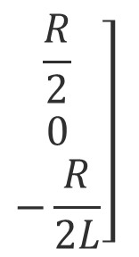
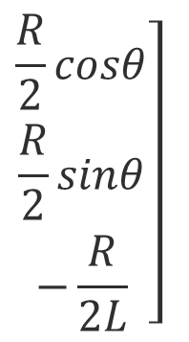

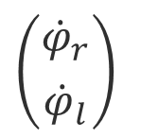

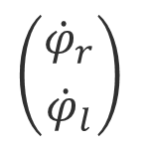



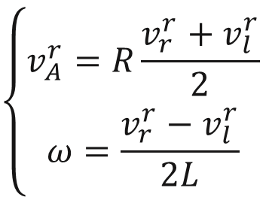


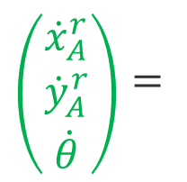
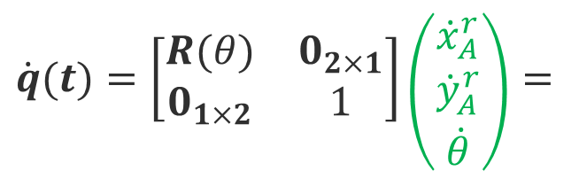

Kinematics: forward kinematics
Option 1
Option 2
$$\dot{θ}d=v_{A}^{r}$$
$$+$$
Kinematic constraints
$$\left\{\begin{aligned}\dot{θ}\left(d−L\right)=v_{l}^{r} \\ \dot{θ}\left(d+L\right)=v_{r}^{r}\end{aligned}\right.$$
$$+$$
$$\dot{θ}d=v_{A}^{r}$$
$$\left[\begin{aligned}\frac{R}{2} \\ 0 \\ \frac{R}{2L}\end{aligned}\right.$$
$$\left.\begin{aligned}\frac{R}{2} \\ 0 \\ −\frac{R}{2L}\end{aligned}\right]$$
$$\left\{\begin{aligned}v_{A}^{r}=R\frac{v_{r}^{r}+v_{l}^{r}}{2} \\ ω=\frac{v_{r}^{r}−v_{l}^{r}}{2L}\end{aligned}\right.$$
$$\left({{\dot{x}}_{A}^{r} \atop \begin{aligned}{\dot{y}}_{A}^{r} \\ \dot{θ}\end{aligned}}\right)=$$
$$\left({{\dot{φ}}_{r} \atop {\dot{φ}}_{l}}\right)$$
Robot frame:
Inertial frame:
$$\left[\begin{aligned}\frac{R}{2}cosθ \\ \frac{R}{2}sinθ \\ \frac{R}{2L}\end{aligned}\right.$$
$$\left.\begin{aligned}\frac{R}{2}cosθ \\ \frac{R}{2}sinθ \\ −\frac{R}{2L}\end{aligned}\right]$$
$$\dot{q}(t)=\left[\begin{matrix}R(θ) & 0_{2×1} \\ 0_{1×2} & 1\end{matrix}\right]\left({{\dot{x}}_{A}^{r} \atop \begin{aligned}{\dot{y}}_{A}^{r} \\ \dot{θ}\end{aligned}}\right)=$$
$$\left({{\dot{φ}}_{r} \atop {\dot{φ}}_{l}}\right)$$
$$\begin{matrix}cosθ & 0 \\ sinθ & 0 \\ 0 & 1\end{matrix}$$
$$\left({v \atop ω}\right)$$
$$=$$

Slide 15
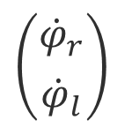
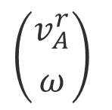

Pit Stop
We got to something: a relation between the angular rates of the wheels and the pose
$$\left({{\dot{φ}}_{r} \atop {\dot{φ}}_{l}}\right)$$
either
Forward Kinematics
$$\dot{q}(t)$$
$$\left({v_{A}^{r} \atop ω}\right)$$
or
Who doesn’t like duckies?

Slide 16
Battle plan
Introduce relevant reference frames (inertial, body)
Make assumptions and translate them in kinematic constraints
Figure out the kinematics of the robot
Figure out the dynamics of the robot
Draw conclusions

Slide 17
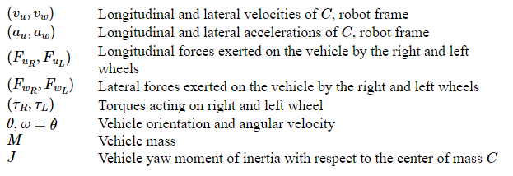
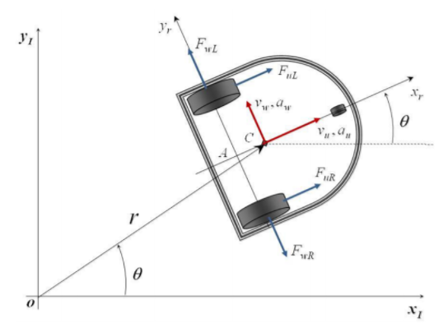


Dynamics: notations (just for reference)
$$2L$$
$$c$$

Slide 18







Polar coordinates kinematics
Analysis is simpler in polar coordinates: step back and recall kinematics of rotating systems
$r\left(t\right)=r\left(t\right)e^{jθ(t)}$
Radial component
Tangential component
$$\dot{r}\left(t\right)=…=v_{u}(t)e^{jθ\left(t\right)}+v_{w}(t)e^{j(θ\left(t\right)+\frac{π}{2})}$$
$$\ddot{r}\left(t\right)=…=a_{u}(t)e^{jθ\left(t\right)}+a_{w}(t)e^{j(θ\left(t\right)+\frac{π}{2})}$$
$$v_{u}(t)=\dot{r}(t)$$
$$v_{w}(t)=r\left(t\right)\dot{θ}(t)$$
$$a_{u}(t)=\ddot{r}\left(t\right)−r\left(t\right){\dot{θ}}^{2}(t)$$
$$2L$$
$$c$$
$$a_{w}(t)=2 \dot{r}\left(t\right)\dot{θ}\left(t\right)−r\left(t\right) \ddot{θ} (t)$$

Slide 19

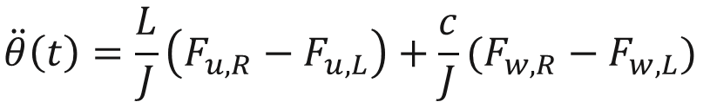


Dynamic equilibria
The only modeled forces are those acting on the wheels
Forces: radial direction
$$Ma_{u}\left(t\right)=F_{u,L}+F_{u,R}$$
Forces: tangential direction
$$Ma_{w}\left(t\right)=F_{w,L}−F_{w,R}$$
Moments: yaw axis passing through $A$
$$\ddot{θ}\left(t\right)=\frac{L}{J}\left(F_{u,R}−F_{u,L}\right)+\frac{c}{J}(F_{w,R}−F_{w,L})$$
$$c$$
$$2L$$

Slide 20




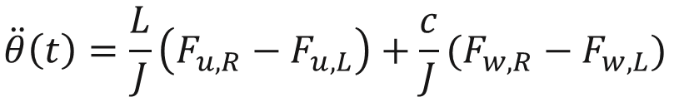

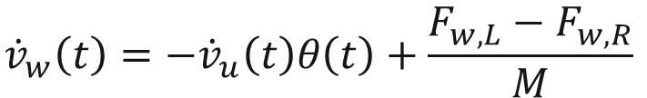
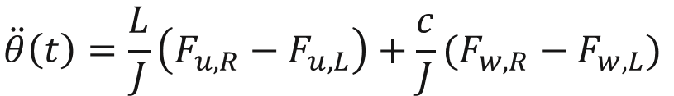
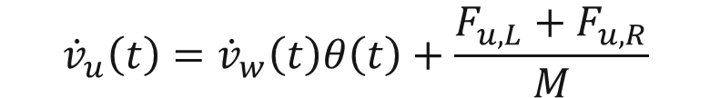


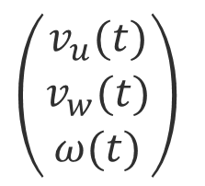
Dynamical model: general
$$v_{u}(t)=\dot{r}(t)$$
$$Ma_{u}\left(t\right)=F_{u,L}+F_{u,R}$$
$$v_{w}(t)=r\left(t\right)\dot{θ}(t)$$
$$Ma_{w}\left(t\right)=F_{w,L}−F_{w,R}$$
$$a_{u}(t)=\ddot{r}\left(t\right)−r\left(t\right){\dot{θ}}^{2}(t)$$
$$\ddot{θ}\left(t\right)=\frac{L}{J}\left(F_{u,R}−F_{u,L}\right)+\frac{c}{J}(F_{w,R}−F_{w,L})$$
$$a_{w}(t)=2 \dot{r}\left(t\right)\dot{θ}\left(t\right)−r\left(t\right) \ddot{θ} (t)$$
$$\left(\begin{aligned}v_{u}(t) \\ v_{w}(t) \\ ω(t)\end{aligned}\right)$$
$${\dot{v}}_{u}\left(t\right)={\dot{v}}_{w}\left(t\right)θ\left(t\right)+\frac{F_{u,L}+F_{u,R}}{M}$$
$$F_{u,L}(t), F_{u,R}(t)$$
$${\dot{v}}_{w}\left(t\right)=−{\dot{v}}_{u}\left(t\right)θ\left(t\right)+\frac{F_{w,L}−F_{w,R}}{M}$$
$$\ddot{θ}\left(t\right)=\frac{L}{J}\left(F_{u,R}−F_{u,L}\right)+\frac{c}{J}(F_{w,R}−F_{w,L})$$
General dynamic model in polar coordinates: coupled and nonlinear.
Does not account for kinematic constraints yet

Slide 21

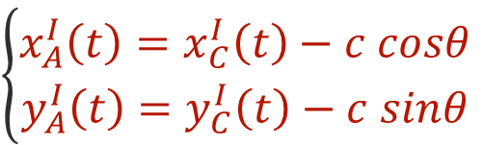

Dynamics: Imposing the kinematic constraints
Imposing the kinematic constraints decouples the equations
Objective: Express velocity of $A$ in local frame and set to zero (no lateral slipping): $v_{A}^{r}\left(t\right)={\dot{y}}_{A}^{r}=0$
Steps:
Express $q_{polar}(t)$ back in Cartesian components, obtain $v_{C}^{I}(t)$
Derive $v_{A}^{I}(t)$ as a function of $v_{C}^{I}(t)$ from:
Obtain $v_{A}^{r}\left(t\right)=R^{T}(θ)v_{A}^{I}\left(t\right)$
Set ${\dot{y}}_{A}^{r}\left(t\right)=0$
Result:
$$\left\{\begin{aligned}x_{A}^{I}\left(t\right)=x_{C}^{I}\left(t\right)−c cosθ \\ y_{A}^{I}\left(t\right)=y_{C}^{I}\left(t\right)−c sinθ\end{aligned}\right.$$
$$2L$$
$$c$$
$$v_{w}(t)=c \dot{θ}$$

Slide 22

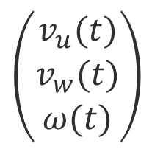
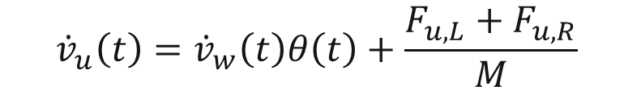
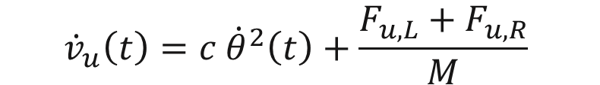

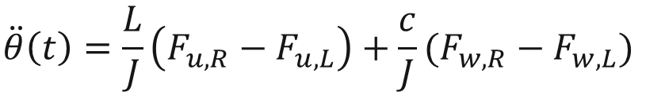
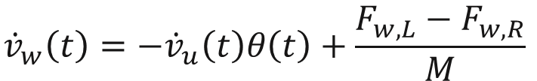
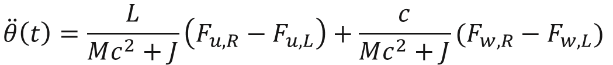
Dynamics: simplified differential drive vehicle model
$${\dot{v}}_{u}\left(t\right)={\dot{v}}_{w}\left(t\right)θ\left(t\right)+\frac{F_{u,L}+F_{u,R}}{M}$$
$${\dot{v}}_{w}\left(t\right)=−{\dot{v}}_{u}\left(t\right)θ\left(t\right)+\frac{F_{w,L}−F_{w,R}}{M}$$
$$\ddot{θ}\left(t\right)=\frac{L}{J}\left(F_{u,R}−F_{u,L}\right)+\frac{c}{J}(F_{w,R}−F_{w,L})$$
$$v_{w}(t)=c \dot{θ}$$
$${\dot{v}}_{u}\left(t\right)=c {\dot{θ}}^{2}\left(t\right)+\frac{F_{u,L}+F_{u,R}}{M}$$
$$\left(\begin{aligned}v_{u}(t) \\ v_{w}(t) \\ ω(t)\end{aligned}\right)$$
$$F_{u,L}(t), F_{u,R}(t)$$
$${\dot{v}}_{w}\left(t\right)=c \dot{θ}(t)$$
$$\ddot{θ}\left(t\right)=\frac{L}{Mc^{2}+J}\left(F_{u,R}−F_{u,L}\right)+\frac{c}{Mc^{2}+J}(F_{w,R}−F_{w,L})$$
Simplified dynamic model in polar coordinates: coupled and nonlinear.
One extra thing we can do: look at torques instead of forces $(F_{u,\left(⋅\right)}R=τ_{(⋅)})$

Slide 23

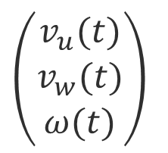

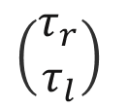
Point of the situation
Expressing the torques through: $F_{u,\left(⋅\right)}R=τ_{\left(⋅\right) }$in the simplified model yields:
The dynamic model:
Disturbances
$$\left[\begin{matrix}M & 0 \\ 0 & Mc^{2}+J\end{matrix}\right]\left[\begin{aligned}{\dot{v}}_{u} \\ \ddot{θ}\end{aligned}\right]+\left[\begin{matrix}0 & −Mc\dot{θ} \\ Mc\dot{θ} & 0\end{matrix}\right]\left[\begin{aligned}v_{u} \\ \dot{θ}\end{aligned}\right]=\frac{1}{R}\left[\begin{matrix}1 & 1 \\ L & −L\end{matrix}\right]\left[\begin{aligned}τ_{r} \\ τ_{l}\end{aligned}\right]+τ_{d}$$
$$v_{w}(t)=c \dot{θ}$$
$$τ_{d}$$
$$\left(\begin{aligned}v_{u}(t) \\ v_{w}(t) \\ ω(t)\end{aligned}\right)$$
$$\left(\begin{aligned}τ_{r} \\ τ_{l}\end{aligned}\right)$$
Dynamic model
Still, what we really command to the vehicle are voltages, not torques.
We miss the actuator (DC motor) dynamics.

Slide 24
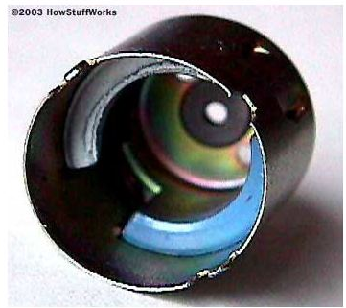








DC motor modeling
The dynamics of a DC motor is governed by:
The DC motor model:
$$V\left(t\right)=R i\left(t\right)+L \frac{di}{dt}\left(t\right)+e\left(t\right)$$
$$V(t)$$
$$τ(t)$$
$$e\left(t\right)=K_{b} \dot{φ}(t)$$
$$τ\left(t\right)=K_{i} i(t)$$
Back emf constant
Torque constant

Slide 25
Battle plan
Introduce relevant reference frames (inertial, body)
Make assumptions and translate them in kinematic constraints
Figure out the kinematics of the robot
Figure out the dynamics of the robot
Draw conclusions

Slide 26






Model Summary
We have derived a model of a differential drive robot that receives voltages as inputs and delivers a pose as output
$$V_{l}(t)$$
Left DC motor
model
$$τ_{l}(t)$$
$$τ_{d}$$
$$\left(\begin{aligned}τ_{r} \\ τ_{l}\end{aligned}\right)$$
$$\left({v_{A}^{r} \atop ω}\right)$$
Dynamic model
Forward Kinematics
$$\dot{q}(t)$$
$$V_{r}(t)$$
Right DC motor
model
$$τ_{r}(t)$$
(The transformation $v_{C}→v_{A}$ is omitted for clarity)

Slide 27

Limitations of the model: summary
Geometric hypothesis:
Identical wheels (of diameter $2R$)
Symmetric Bot (axle length = $2L$)
Symmetric
Center of mass on symmetry axis
Kinematic hypothesis
Rigid body
Kinematic constraints
No lateral slipping
Pure rolling
Unmodeled dynamics
Castor wheel
Out of plane dynamics
Friction (to some degree with disturbances)

Slide 28
Conclusions
Disturbances
$$d(t)$$
Measurement noise
$$n(t)$$
Controller
Actuator
$$r(t)$$
$$u_{d}(t)$$
$$u(t)$$
$$y(t)$$
$$y_{m}(t)$$
Reference
path
Desired plant input
Input
Output
Measurement
Plant
Sensor
Today we have built a mathematical model for a differential drive robot
and
we have discussed its limitations
“All models are wrong, but some are useful.”
-XXX?

Slide 29
Next Steps
The model has many parameters that need to be identified
Even among nominally equal vehicle, details may vary due to manufacturing, assembly, etc.
The process of “system identification” of a vehicle goes by “odometry”
In the next classes we will address odometry and, more relevant for Duckietown, visual odometry.
“All models are wrong, but some are useful.”
-XXX?

Slide 30
How to use the theme
Double click on the file themes/DuckietownColorfulTheme2.kth
You can add it to your themes library.
To convert an existing presentation, use File / Change Theme.

Slide 31
Organization of the lectures/ repo.
0_drafts/: anything goes here. Feel free to make subfolders.
1_beta/: put things here that must be reviewed by others.
2_given/:
when you give the lecture, save it here with the timestamp and the name of the location.
Also save a .pdf version.
These timestamped .key and .pdf files are the ones to be linked to from the class page
These files are never modified after they are timestamped.
3_ideal/: later, here we will assemble the “ideal” version of the slides.

Slide 32
Getting the URL to share
Go to Github, click on the file.
On the file page, copy the link that is on the Download button.
They look like this:
https://github.com/duckietown/lectures/raw/master/duckietown-master.pdf
https://github.com/duckietown/lectures/raw/master/duckietown-master.key

