Slide 1
Introduction to ROS
Slides modified from Programming for Robotics – ROS Course of ETHZ
http://www.rsl.ethz.ch/education-students/lectures/ros.html

Slide 2
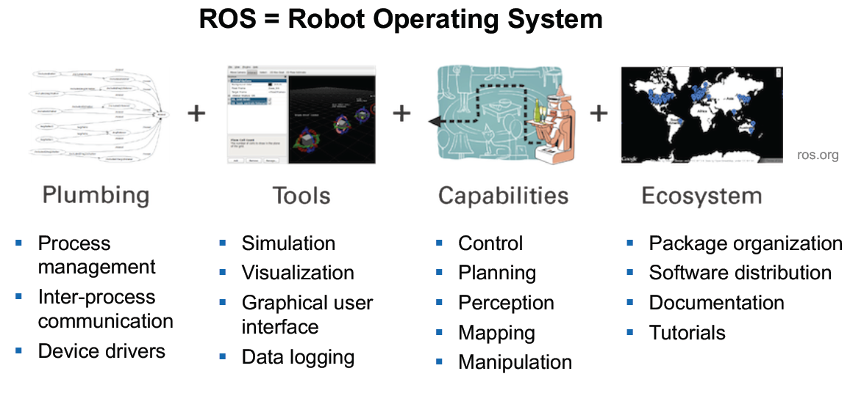
What is ROS

Slide 3
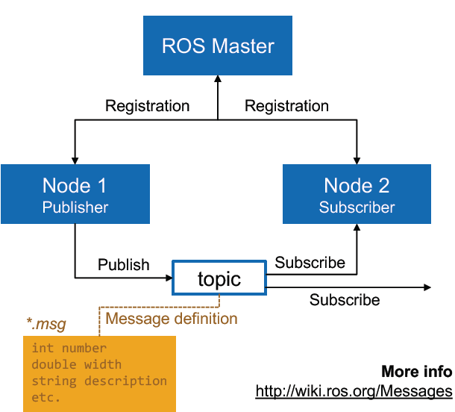
Main Concepts
Notes:
Today’s lecture objective is to obtain a mathematical model of the plant, including the actuator dynamics.
It is important for controlling the Duckiebot later on

Slide 4
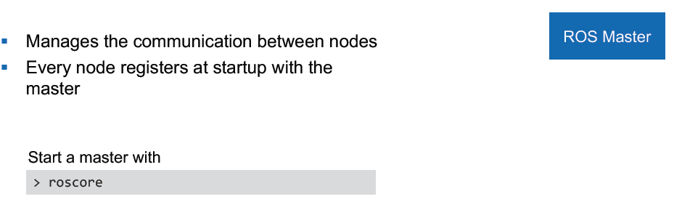
Master Node
Notes:
Today’s lecture objective is to obtain a mathematical model of the plant, including the actuator dynamics.
It is important for controlling the Duckiebot later on

Slide 5
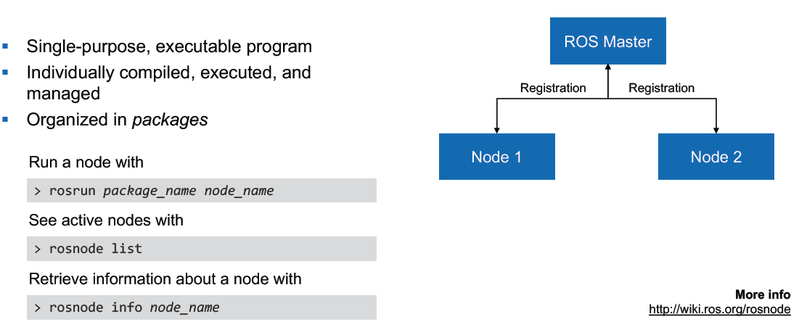
Nodes
Notes:
Today’s lecture objective is to obtain a mathematical model of the plant, including the actuator dynamics.
It is important for controlling the Duckiebot later on

Slide 6
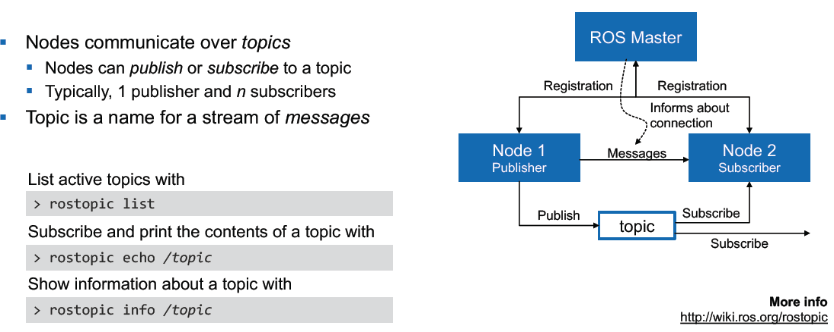
Topics

Slide 7
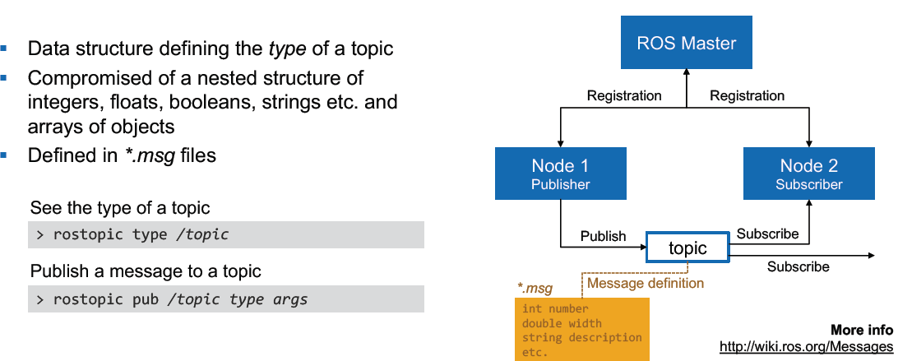
Messages

Slide 8
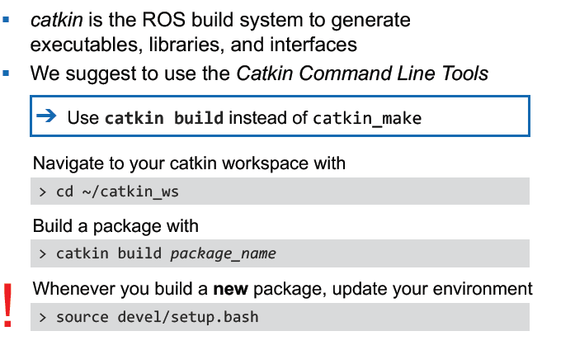
Catkin Build System

Slide 9
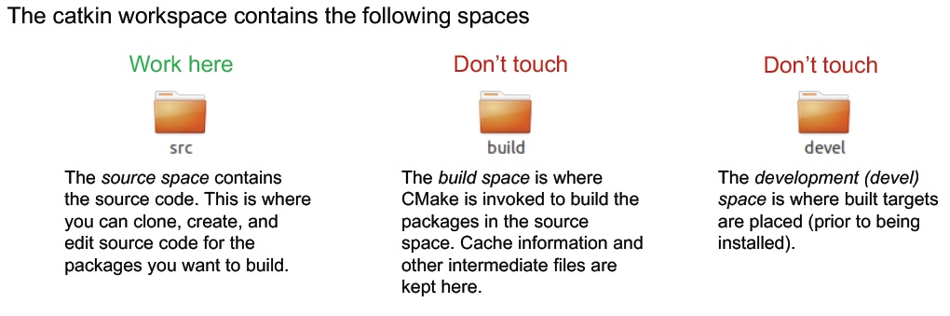
Catkin Build System – File Structure

Slide 10
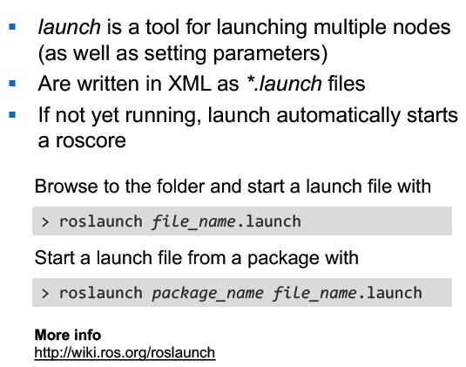
ROS Launch

Slide 11
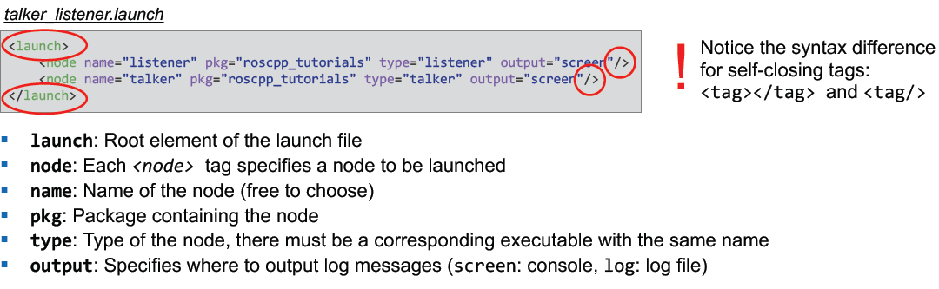
ROS Launch – File Structure ( Necessary?)

Slide 12
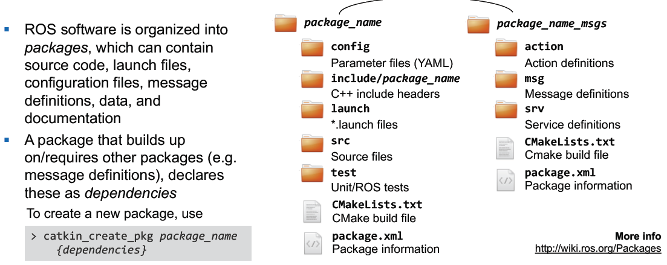
Packages

