Slide 1
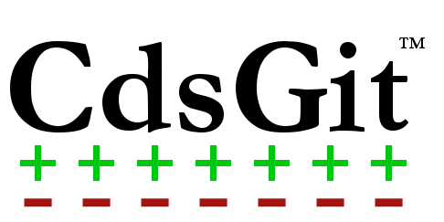
Git Integration for Cadence Virtuoso

Slide 2

What is Git?
Powerful revision control system
Obsoletes systems like SVN, CVS, etc..
Fast
Distributed
Utilizes branching effectively
Countless open and closed source utilities
Software Industry Leading (from git-scm.com)

Slide 3
What is CdsGit?
Graphically integrates Git into Cadence Virtuoso
Simplifies common Git operations
Command line can be daunting
CdsGit interface optimized for mixed signal design flow
Built-in Merge and Diff tools:
Schematics
Layouts
Any text file (config views, verilog/A/AMS etc.)

Slide 4
CdsGit Use Cases
ASIC design
Collaborate between team members (layout, design, digital)
Review modifications before merge
Automate regressions
Integrated team communication using GitLab
Shared Libraries
Strictly manage changes in shared IP libraries
Prevent unauthorized changes by protecting branches
Allow others to easily contribute (crowd-source)
Maintain agile development

Slide 5
Why Another SCM?
Other SCM’s | Git + CdsGit
Not distributed Central connection fails, work stops | Distributed Work offline at remote sites
Check-in / Check-out slows design | Make changes, choose what to commit
Branching and merging is daunting and poorly controlled | Designed to branch and merge
Closed source | CdsGit is proprietary The Git repository it manages is not
Small community | Millions of Git users, ask Google!
Few/No plugins and utilities | Git has many open source plug-ins Most notably GitLab
No merging | Merge schematics/layouts
Pay per user in the repository Very expensive company wide | Pay per user only for CdsGit integration Inexpensive company wide

