Slide 1
Volatility & Volume
Detailed Analysis on Relationships
FESX Case Study

Slide 2
Summary of Development
Background
Motivation: observed, prolonged and growing gap between implied and realized volatility on the equity index market and dropping volumes in futures on said markets ( e.g. FESX, FDAX)
Initial ad-hoc results discovered that the difference between the two volatilities is an important factor in explaining volumes but raised additional questions that this project attempts to answer
Current Approach
The period taken for study is 02.01.2017 – 12.10.2021 on the FESX market
More extensive calculation were made to better represent Realized Volatility, Implied Volatility and Volume
Realized Volatility during one day reconstructed from overnight and intraday components
Overnight Volatility is the volatility between close at day t-1 and open on day t
Intraday Volatility is the volatility throughout the trading day based on intraday returns
30day Historic Volatility was taken as a benchmark
Implied Volatility was proxied using VSTOXX and the Black-Scholes formula
Volume was represented as deseasoned front month Traded Contracts as well as Traded Contracts over Open Interest
In order to capture as much information as possible in a multivariate model, a Vector Auto Regression (VAR) was fit to the data
Impulse Response functions were derived from the model to understand how shocks in realized and implied volatility as well as their difference will affect Volume
Tests were conducted for presence of structural breaks in the time series around the time of the pandemic

Slide 3
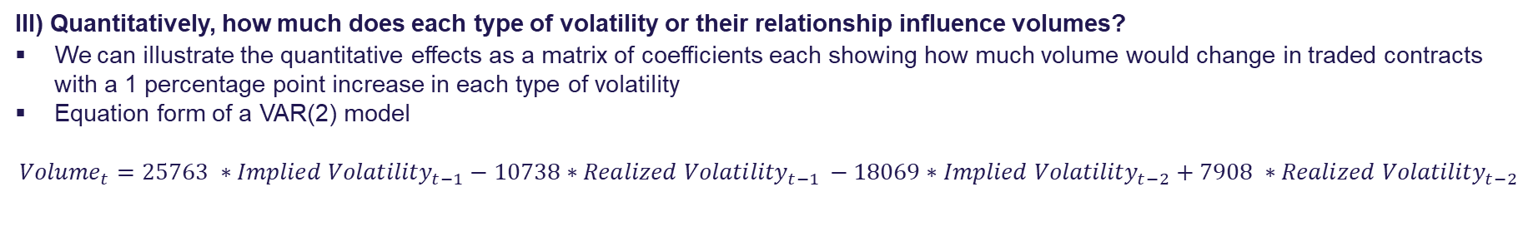
Three Project Questions
I) How relevant is the difference between implied and realized volatility and how to express it, with or without lag?
The difference between implied and realized volatility is an important factor in explaining volumes
The initial effect of an increase in this spread has positive effects on FESX volumes, however prolonged periods of implied volatility higher than realized volatility have ultimately negative effects
In 2021 199 trading days saw implied volatility higher than realized on the ESX50 market, since the start of covid around 9.5% trading days had realized volatility above implied volatility
Lagging implied volatility to account for its forward-looking nature makes the results more evident but it is not a crucial factor and whether lagging was applied or not the model results were robust
II) Does the effect of volatility on volume hold or does it change over market phases?
On a 95% confidence level we can confirm the presence of structural breaks in the time series before and after 11.03.2020, the day a global pandemic was announced
The presence of structural breaks is robust to calculations of all variables involved in the model
Implied volatility has an inverse relationship with volumes post covid, compared to the positive relationship pre covid
III) Quantitatively, how much does each type of volatility or their relationship influence volumes?
We can illustrate the quantitative effects as a matrix of coefficients each showing how much volume would change in traded contracts with a 1 percentage point increase in each type of volatility
Equation form of a VAR(2) model
$${Volume}_{t}=25763 ∗{Implied Volatility}_{t−1}−10738∗{Realized Volatility}_{t−1 }−18069∗{Implied Volatility}_{t−2}+7908 ∗{Realized Volatility}_{t−2}$$
*Applying lag or not to implied volatility changes the impact of difference for 3000 contracts, keeping the sign same

Slide 4
Research
1

Slide 5
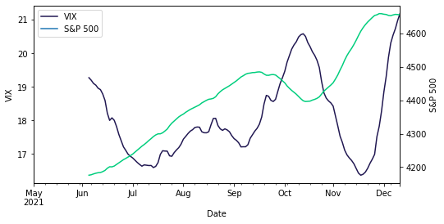
A relevant topic across Financial Markets¹
CBOE
CBOE reported a yearly record spread between implied and realized volatility on 08.09 on the S&P500 and 27.09. on the Russell 2000. Previous comparable levels in 2016 after USA elections. Realized volatility was ~8% of implied.
CBOE launched 3-month implied correlation index on 01.07.2021 to help traders implement dispersion trading strategies designed to trade this spread
Volatility Product Volumes
EUREX
CBOE
CME
12% YTD increase in VSTOXX related volumes 21v20²
4% YTD increase in VIX underlying volumes 21v20
133% YTD increase in VOLQ underlying volumes 21v20
Volatility vs Index Levels
Volatility is no longer synonymous with falling markets
VIX and S&P 500 moving in tandem
Similar Picture in the last 12 trading days on the Euro STOXX 50 and VSTOXX
Volatility product volumes performing well in relatively calm markets with traders buying dips
Note : 25 period smoothing applied for easier trend detection
1 All links in References at the end
2 Dates 29.10.2021 29.10.2020 taken

Slide 6
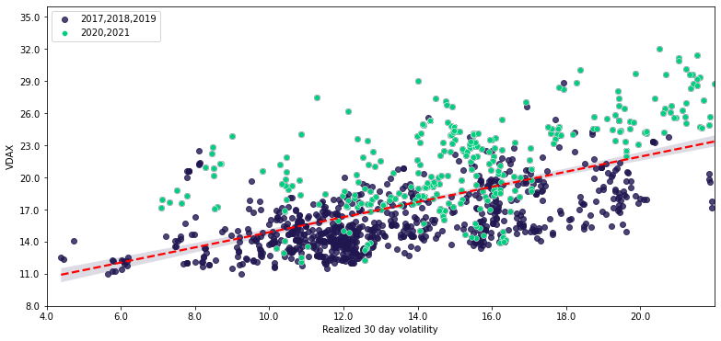
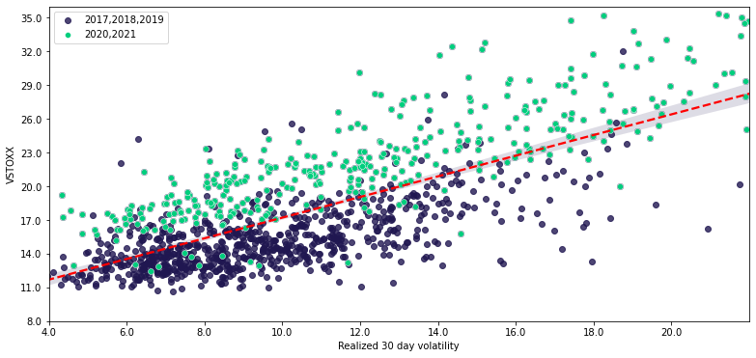
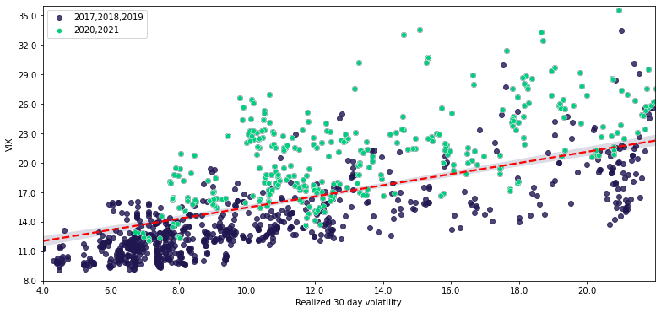
The Volatility Gap is Growing
Background
In the post covid world we have seen a growing gap between implied and realized volatility in global equity indices.
Record level spreads have been noticed in most, if not all benchmark products during the period 2020-2021
At the same time Volumes YTD in Equity Index Futures are globally significantly smaller comparing to the same period in 2020
Volumes YTD 21v20
EUREX
CME
EURONEXT
ICE
DAX -40%
ESX50 -33%
S&P500 -19.3%
NSDQ100 -9.6%¹
Equity Index Futures Segment -15%²
Equity Index Futures Segment -16.6%³
Graphical Representation
DAX
ESX50
S&P500
The implied and realized volatility pairs (each pair is a trading day) that are above the average long term trend line are almost exclusively from the last two years, when a shift in paradigm was first observed and the gap started growing.
A similar pattern can be observed in virtually every Equity Index and more examples can be found in Appendix I
Since the usage of derivatives on Equity Indices is closely related to volatility expectations as well as the maintenance of a portfolio when the volatility realizes, can this growing gap in volatilities at least partially answer why volumes are falling ?
1 Volume & Open Interest Reports (cmegroup.com) 2 Euronext announces volumes for October 2021 | euronext.com 3 ICE Report Center - Data (theice.com)

Slide 7
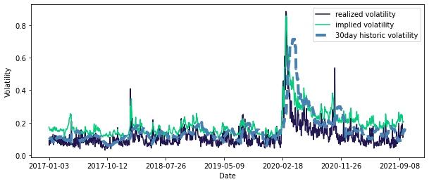
Our Approach
Volatility Preparation
Realized volatility was reconstructed from 15sec price data on ESX50 by separate calculations for overnight¹ and intraday² components
VSTOXX was used as a proxy for implied volatility
Other benchmark calculations were used to compare model outputs and determine how robust the results are (e.g. 30day historic volatility and Black-Scholes calculated implied volatility)
Reconstructed volatility proved to be almost 3 times more precise in explaining volume according to R² and informational capacity comparing to 30day historic volatility
30day historic volatility is smoothed since it represents the average of last 30 days, containing less information, while ignoring intraday movements
1 Squared log returns between close on $t−1$ and open on $t$
2 Sum of five minute squared log returns during the trading day $t$

Slide 8
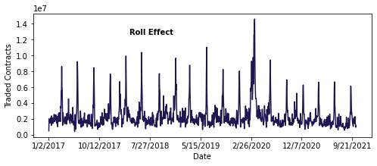
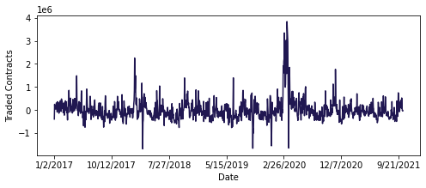
Our Approach
Volume Preparation
Raw traded contracts data was not suitable for mathematical analysis due to large seasonal components driving volumes
The seasonal components cleaned from the data are roll effect ,days of the week ,days around Christmas, number of days until contract expiry and cyclical yearly effects
A model was fit to explain volumes based on these seasonal components, whatever it could not explain (around 75%) was used in later research as a volume proxy
Other measurements of volume were also taken as benchmarks, e.g. Front Month volume and Traded Contracts/Open Interest which proved to be a quite precise proxy for volume
Before Cleaning
After Cleaning

Slide 9
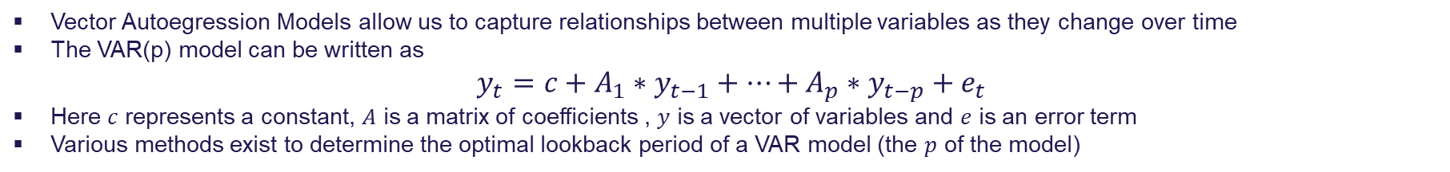
VAR Models
Vector Autoegression Models allow us to capture relationships between multiple variables as they change over time
The VAR(p) model can be written as
$$y_{t}=c+A_{1}∗y_{t−1}+…+A_{p}∗y_{t−p}+e_{t}$$
Here $c$ represents a constant, $A$ is a matrix of coefficients , $y$ is a vector of variables and $e$ is an error term
Various methods exist to determine the optimal lookback period of a VAR model (the $p$ of the model)
Table of VAR(2) coefficients
Volume Volatility Coefficients (in contracts traded)
Front Month Deseasoned | Reconstructed Realized Volatility | -10738
Front Month Deseasoned FESX | VSTOXX Implied Volatility | 25763
Front Month Deseasoned FESX | Implied Volatility – Realized Volatility (no lag) | 11889
Front Month Deseasoned FESX | Implied Volatility – Realized Volatility (lagged) | 7674
New | Reconstructed Realized Volatility (t-2) | 7908
 | VSTOXX Implied Volatility (t-2) | -18069
 | Implied Volatility – Realized Volatility (no lag) (t-2) | -6146
 | Implied Volatility – Realized Volatility (lagged)(t-2) | -9791
There is a cyclical nature to volatility that can be seen through changing signs in successive lookback periods
This pattern continues long into the past showing the long memory of volatility (specially realized) and volume and is robust to proxy calculations
Although in a VAR(1) model implied volatility has a strictly positive and realized volatility a strictly negative sign, we see in more complex models that their influence on volume has a more complex effect changing through time

Slide 10
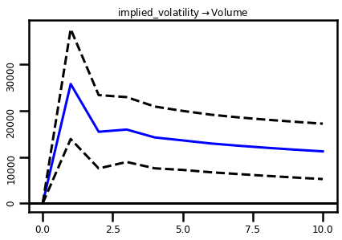
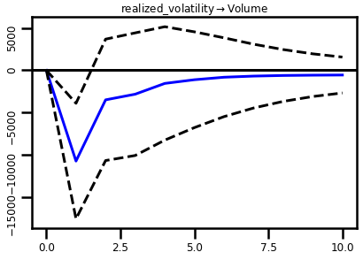
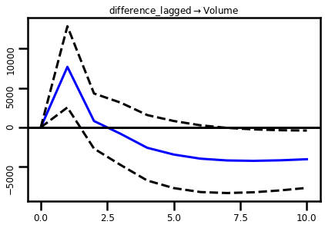
Impulse Response Functions
Impulse Response Functions allow us to calculate and graphically present what would happen with the number of traded contracts in our VAR model through time, if a shock is introduced into one of the variables
Observations
A shock in implied and realized volatility have a mirror effect on volume, implied giving an initial positive effect and realized an initial negative effect on traded contracts
The shocks fade away in effect after 15 trading days for implied volatility and 10 trading days for realized volatility
Their difference has an initial positive effect on volume with the effects gradually turning negative and showing very long memory persisting after more than 20 trading days
Cumulative effects on volume can be seen in Appendix II, the cumulative effect of the lagged difference being around – 80 000 contracts after a prolonged 20 days lasting shock

Slide 11
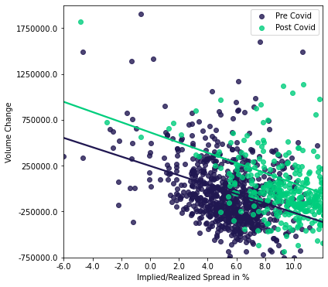
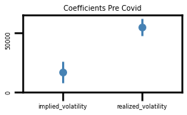
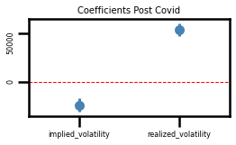
Structural Break COVID-19
The logic of the test is to fit three models, one on the period pre covid, one on the period post covid and one master model over the entire period from 02.01.2017 – 12.10.2021
A statistical test is applied to measure how much do the coefficients of these models differ from each other and whether - based on their differences – we can determine that there was a structural break around the time of 11.03.2020
The tests are unanimous and on a confidence level of 95% determined a presence of a structural break in the time series volume vs implied and realized volatility as well as volume vs the difference between the two
Results were robust to changes in calculation of implied, realized volatility, volume as well as to how the difference was calculated with or without lag, showing very strong evidence of structural breaks
Two models visualized
Coefficients pre and post COVID
As assumed the coefficient for implied volatility in the post covid world has a negative sign, indicating a negative effect on volumes

Slide 12
Open Questions?
Due to the growing gap between implied and realized volatility, the disturbed relationship between them post COVID-19 and the definite effect on volumes we have seen due to exposure to a prolonged period of implied volatility being multiple times higher than realized in any given day, we could expand the research even further.
Expand the analysis on to other products, especially Options as they are extra sensitive to volatility
Find a way to introduce non-linearity in the models and explore non linear relationships
Refine calculation of variables even further and use the fact that we have at our disposal extremely granular price data down to level of seconds
Account for the impact of pricing measures on volumes
Expand the space of variables considered, and develop a prediction engine for volume based on volatility

Slide 13
Appendix
2

Slide 14
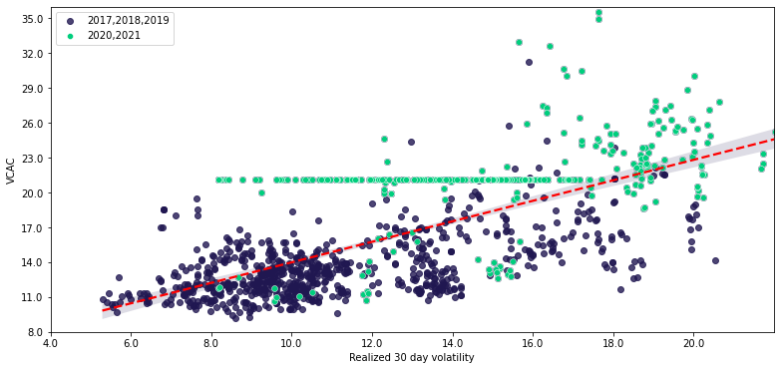
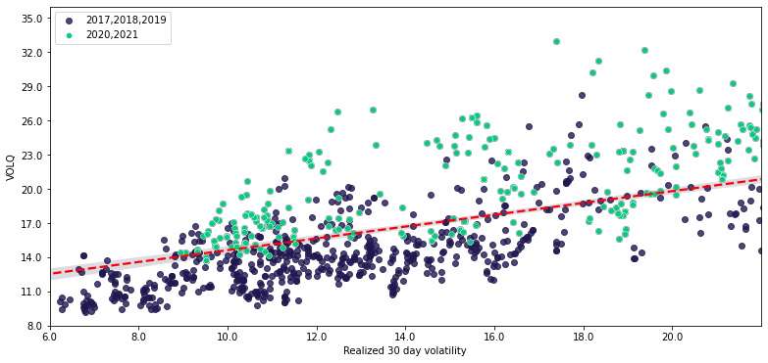
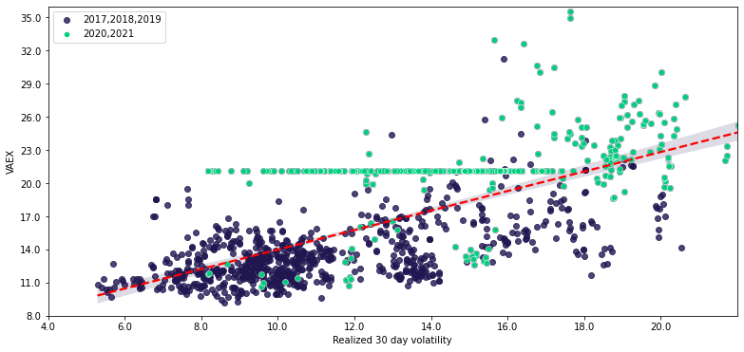
Appendix I More Equity Index Implied / realized volatility pairs
CAC40
Nasdaq
AEX

Slide 15
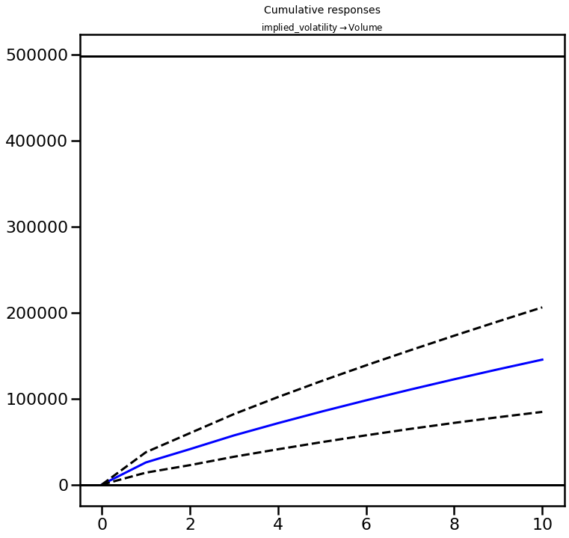
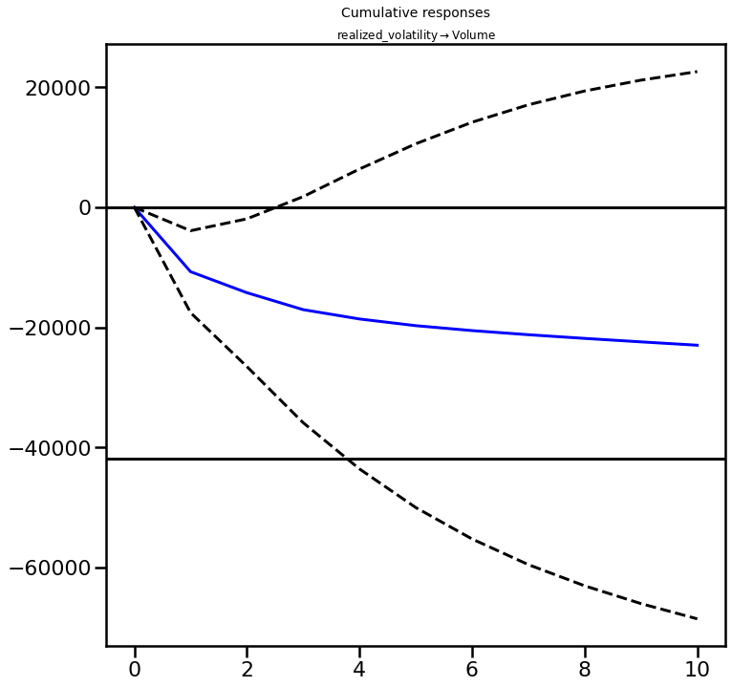
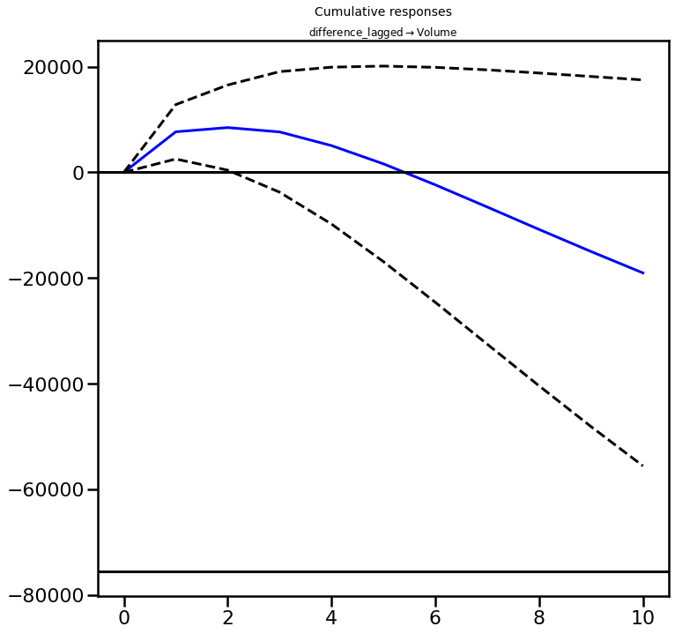
Appendix II Impulse Response Functions

Slide 16
Appendix III References
Luu, James C. , Martin P. , 2002 „Testing the Mixture of distributions hypothesis using „realized“ volatility“
Lütkepohl H., 2005, Springer, „New Introduction to Time Series Analysis“
Bessembinder H., Seguin J.,1999, „Price Volatility, Trading Volumes and Market Depth“
Chow G.,1960, Econometrica, „Tests of Equality between coefficients in two linear regressions“
Web_Volume_Comparison_CME.pdf (cmegroup.com)
The Week that Was: September 6 to September 10 (cboe.com)
Cboe Announces Launch of New Cboe 3-Month Implied Correlation Index | CBOE
Exploring the Benefits of Small-Cap Stocks and MRUT Options (cboe.com)
Inside Volatility Trading: Professional Sports, Global Equity Markets and Volatility (cboe.com)
VIX Options Trader Reaps Win in 19 Hours as Stocks Resume Swoon – Bloomberg
Options Craze Is Rewriting Rules of VIX, S&P 500 Relationship – Bloomberg
VIX Options Trader Reaps Win in 19 Hours as Stocks Resume Swoon – Bloomberg
How to Handle S&P 500 Swinging Most in a Year as VIX Soars – Bloomberg

