Slide 1
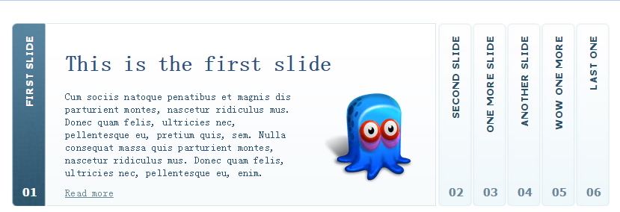
http://www.jq22.com/yanshi5507

Slide 2
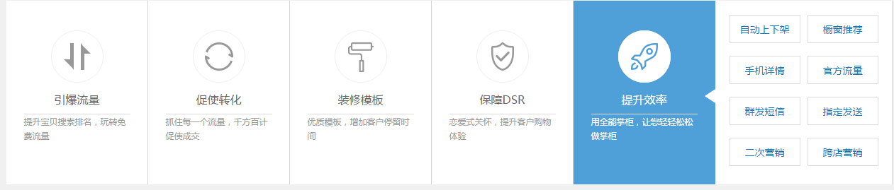
http://www.jq22.com/yanshi13383

Slide 3
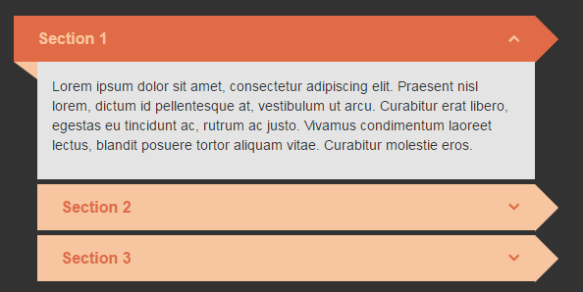
http://www.jq22.com/yanshi15758

Slide 4

http://www.jq22.com/yanshi14426

Slide 5
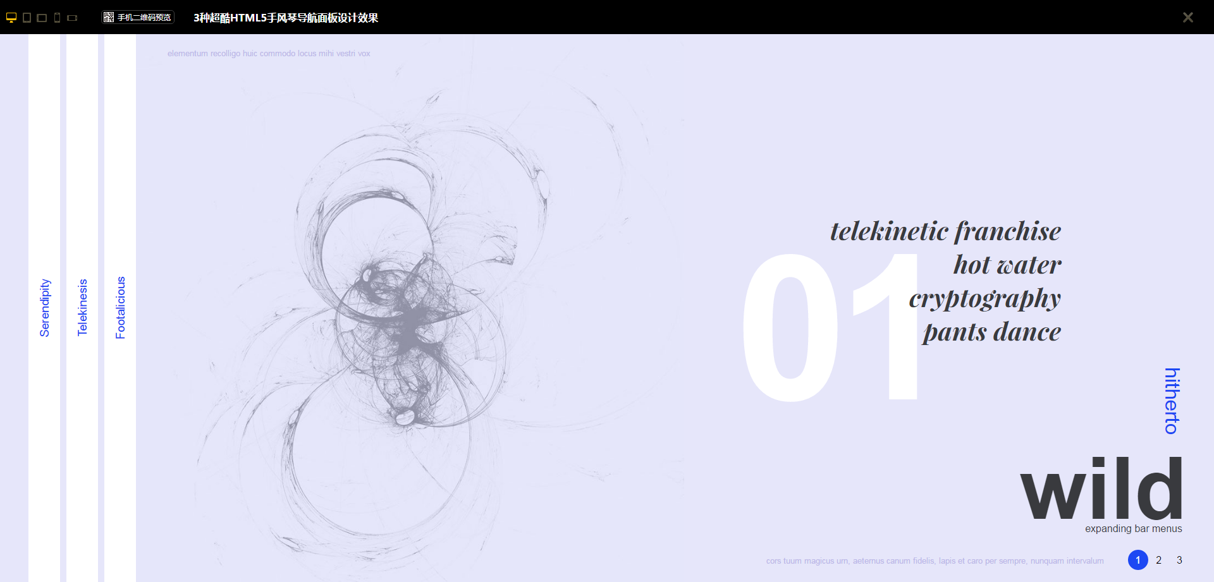
http://www.jq22.com/yanshi13340

Slide 6
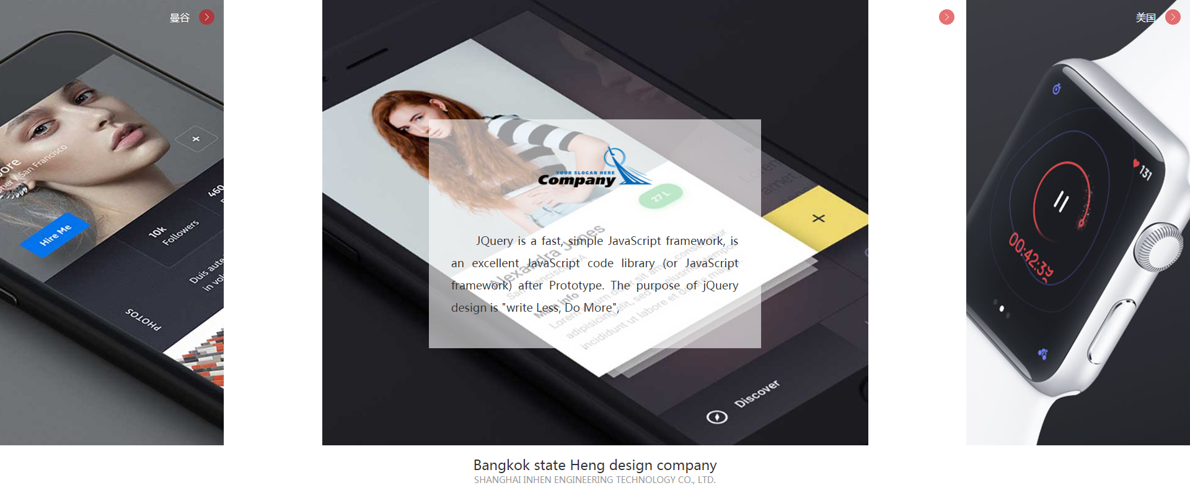
http://www.jq22.com/yanshi12969

Slide 7
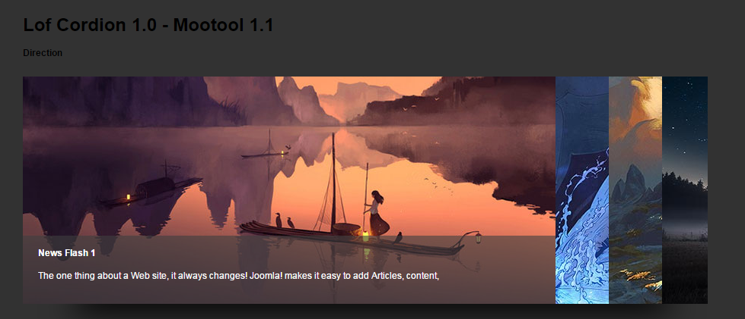
http://www.jq22.com/yanshi12547

Slide 8
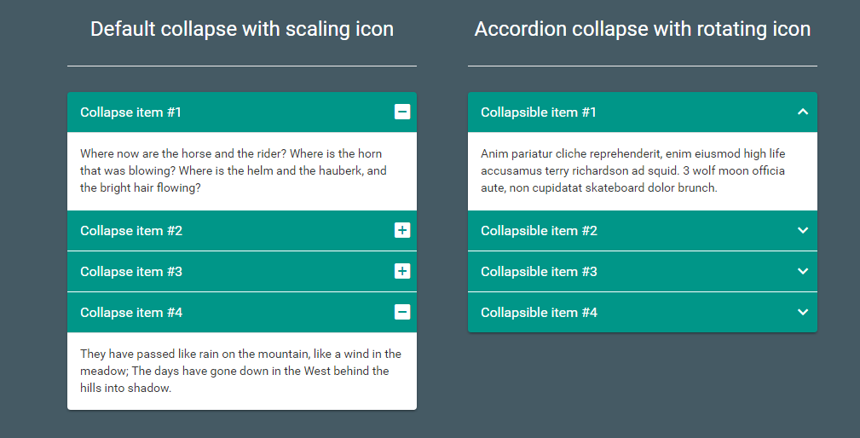
http://www.jq22.com/yanshi11675

Slide 9
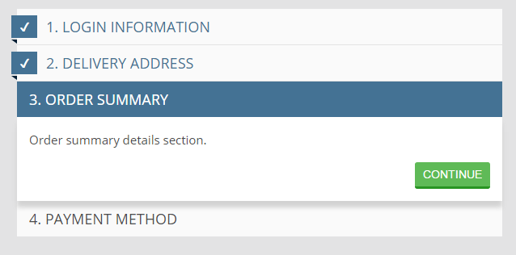
http://www.jq22.com/yanshi9219

Slide 10
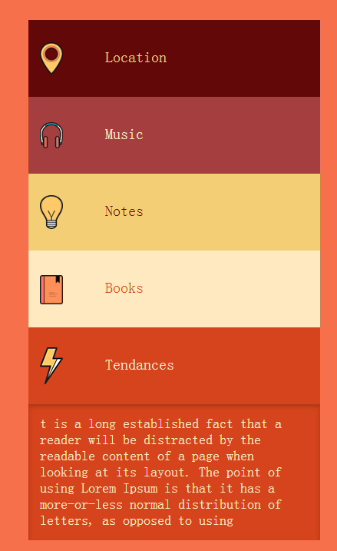
http://www.jq22.com/yanshi8384

Slide 11
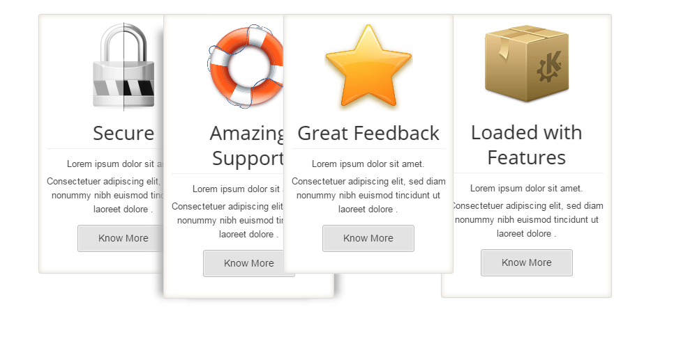
http://www.jq22.com/yanshi8258
这个里面有5个

Slide 12

http://www.jq22.com/yanshi5038

Slide 13

http://www.jq22.com/yanshi3583

Slide 14
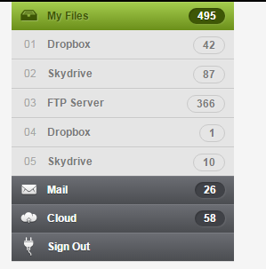
http://www.jq22.com/yanshi1722

Slide 15

http://www.jq22.com/yanshi1611

