Slide 1

http://www.jq22.com/yanshi5508

Slide 2

http://www.jq22.com/yanshi10220

Slide 3

http://www.internetke.com/jsEffects/2015030702/

Slide 4
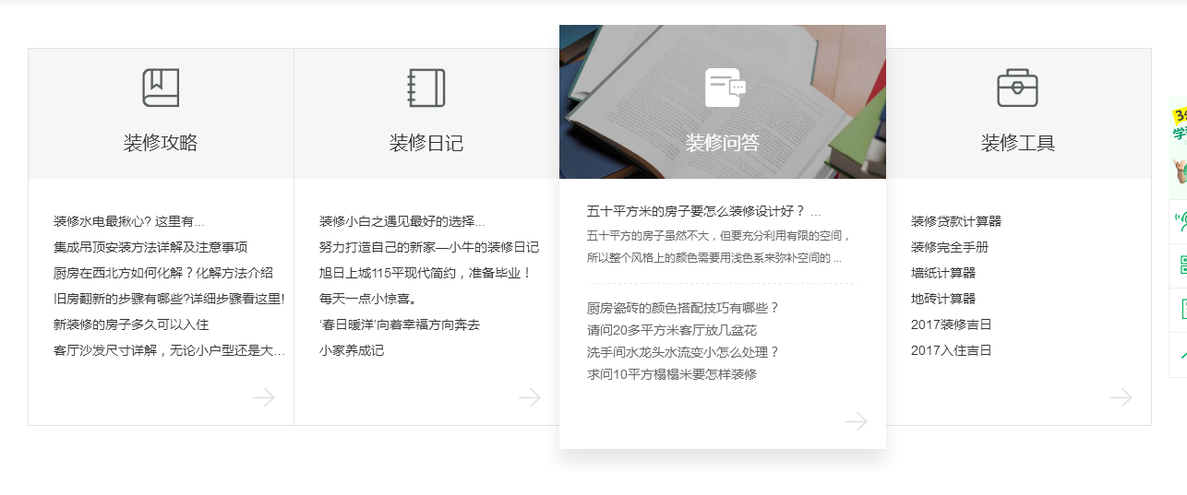
http://fs.to8to.com/

Slide 5

http://www.lanrenzhijia.com/demos/46/4677/demo/

Slide 6
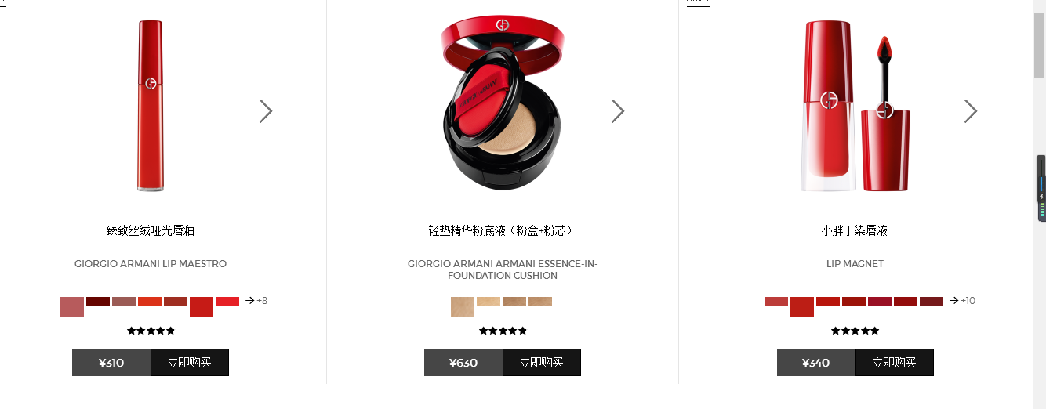
http://www.giorgioarmanibeauty.cn/ 1、鼠标悬停色系切换图片 2、左右箭头切换图片

