Slide 1
VIEW
Presented By
Mounika Jeela

Slide 2
Contents
Introduction to View
Difference between View and Table
Advantages of View
Disadvantages of View

Slide 3
Views
Views in SQL are considered as a virtual table. A view also contains rows and columns
To create the view, we can select the fields from one or more tables present in the database.
A view can either have specific rows based on certain condition or all the rows of a table.

Slide 4
Creating View from a single table
Syntax:-
CREATE VIEW view_name AS
SELECT column1, column2.....
FROM table_name
WHERE condition;

Slide 5
Creating View from multiple tables
Syntax:-
CREATE VIEW view_name AS
SELECT table1.column1, table2.column2
FROM table1, table2
WHERE table1.column1 = table2.column1;

Slide 6
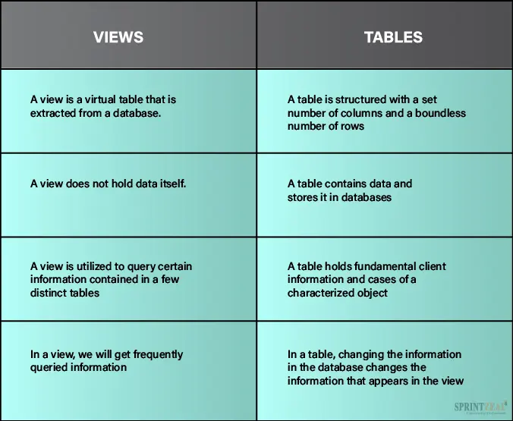
Difference Between View and Table

Slide 7
Advantages of View
Complexity: Views help to reduce the complexity. Different views can be created on the same base table for different users.
Security: It increases the security by excluding the sensitive information from the view.
Query Simplicity: It helps to simplify commands from the user. A view can draw data from several different tables and present it as a single table.
Consistency: A view can present a consistent, unchanged image of the structure of the database. Views can be used to rename the columns without affecting the base table.
Data Integrity: If data is accessed and entered through a view, the DBMS can automatically check the data to ensure that it meets the specified integrity constraints.
Storage Capacity: Views take very little space to store the data.

Slide 8
Disadvantage of View
You cannot INSERT if the base table has any not null column that do not appear in view.
You cannot INSERT or UPDATE if any of the column referenced in the INSERT or UPDATE contains group functions or columns defined by expression.
You can't execute INSERT, UPDATE, DELETE statements on a view if with read only option is enabled.
You can't be created view on temporary tables.
You cannot INSERT, UPDATE, DELETE if the view contains group functions GROUP BY, DISTINCT or a reference to a psuedocolumn rownum.
You can't pass parameters to the SQL server views.

Slide 9


