Slide 1
Blood Bank Management System

Slide 2

TEAM MEMBERS :-
1.Abhishek Singh 2.Soumick Ghosh 3.Dheeraj Patel 4.Mukund Kumar 5.Poonam Satghare 6.Rohit Shinde 7.Shanu Parasar 8.Suvajit Sahoo 9.Bhakti Patil 10.Kalyani Wakchaure 11.Rahul Deshmukh 12.Vaibhav Wadekar 13.Akhila G 14.Vijaya Laxmi

Slide 3
PROJECT ABSTRACT:-
BBMS allows to store, process, retrieve and analyze information with respective to the administrative and inventory management within a blood bank.
Blood Bank Management system will have following objectives:
Blood Donation Camp Management
Blood Donor Management – Donor Registration, Managing donor information, recording their physical and medical details
Blood Bank Stock Management
Transferring blood online from one blood bank to another

Slide 4
PROJECT DETAILS :-
Project Name | Blood Bank Management System
Objective | The System provides online information of blood bank and administrators can also manage all information about patient , Blood Bank.
Platform | Windows Application
Front End | Window Presentation Foundation(WPF)
Back End | MICROSOFT SQL SERVER 2012
Middle End | ASP.NET 4.5 C#
Other Tools | Visual Studio
Internal Guide | Mr. Aditya Bokade

Slide 5
BLOOD BANK ADMINISTRATOR HANDLES – Login to System 2. Arrange Blood Donation Camp 3. Add the blood details in inventory 4. Register the Donor either in the blood donation camp or in any hospital 5. Update the blood details in inventory, if it is given to any hospital or other blood bank 6. Delete the blood details in case it is expired, unsuitable 7. Transfer the blood from one blood bank to another blood bank 8. View Blood Bank Inventory details 9. View Donor List

Slide 6
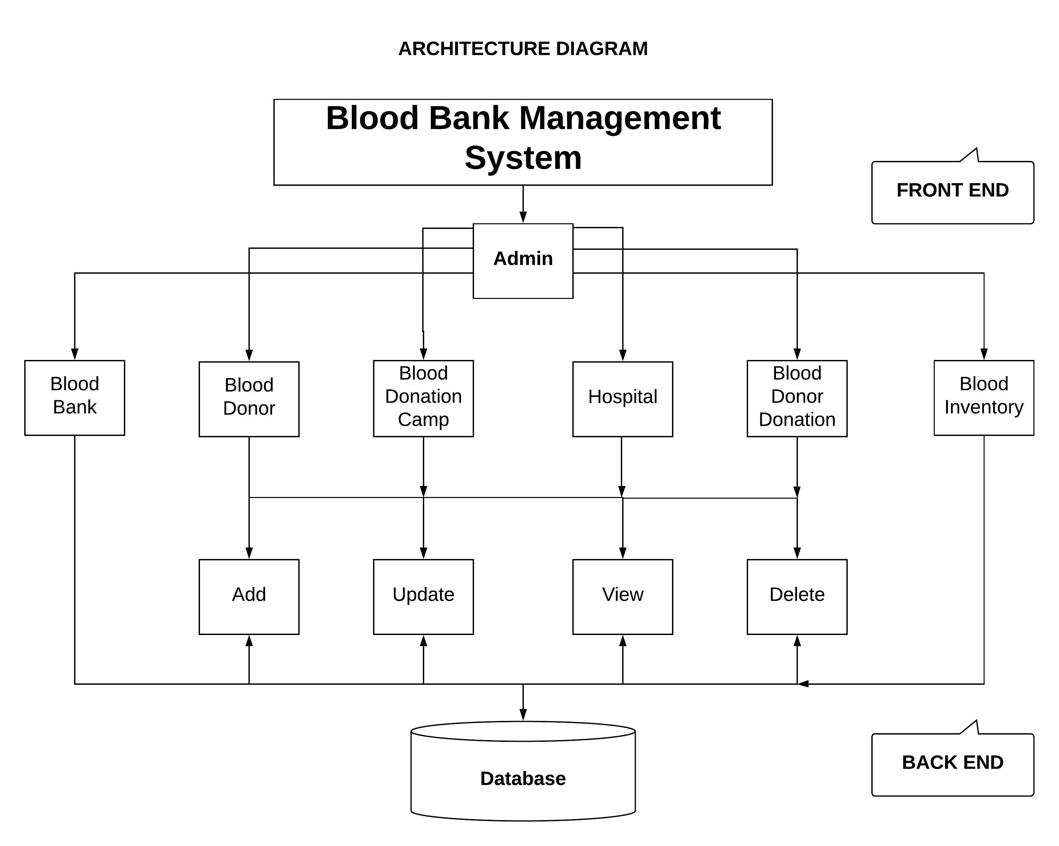
DIAGRAM DEPICTING ENTIRE PROJECT :-

Slide 7
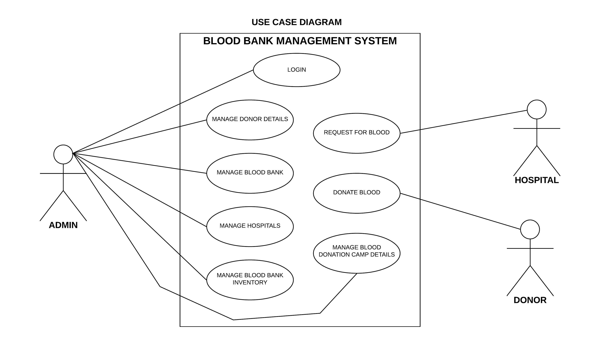

Slide 8
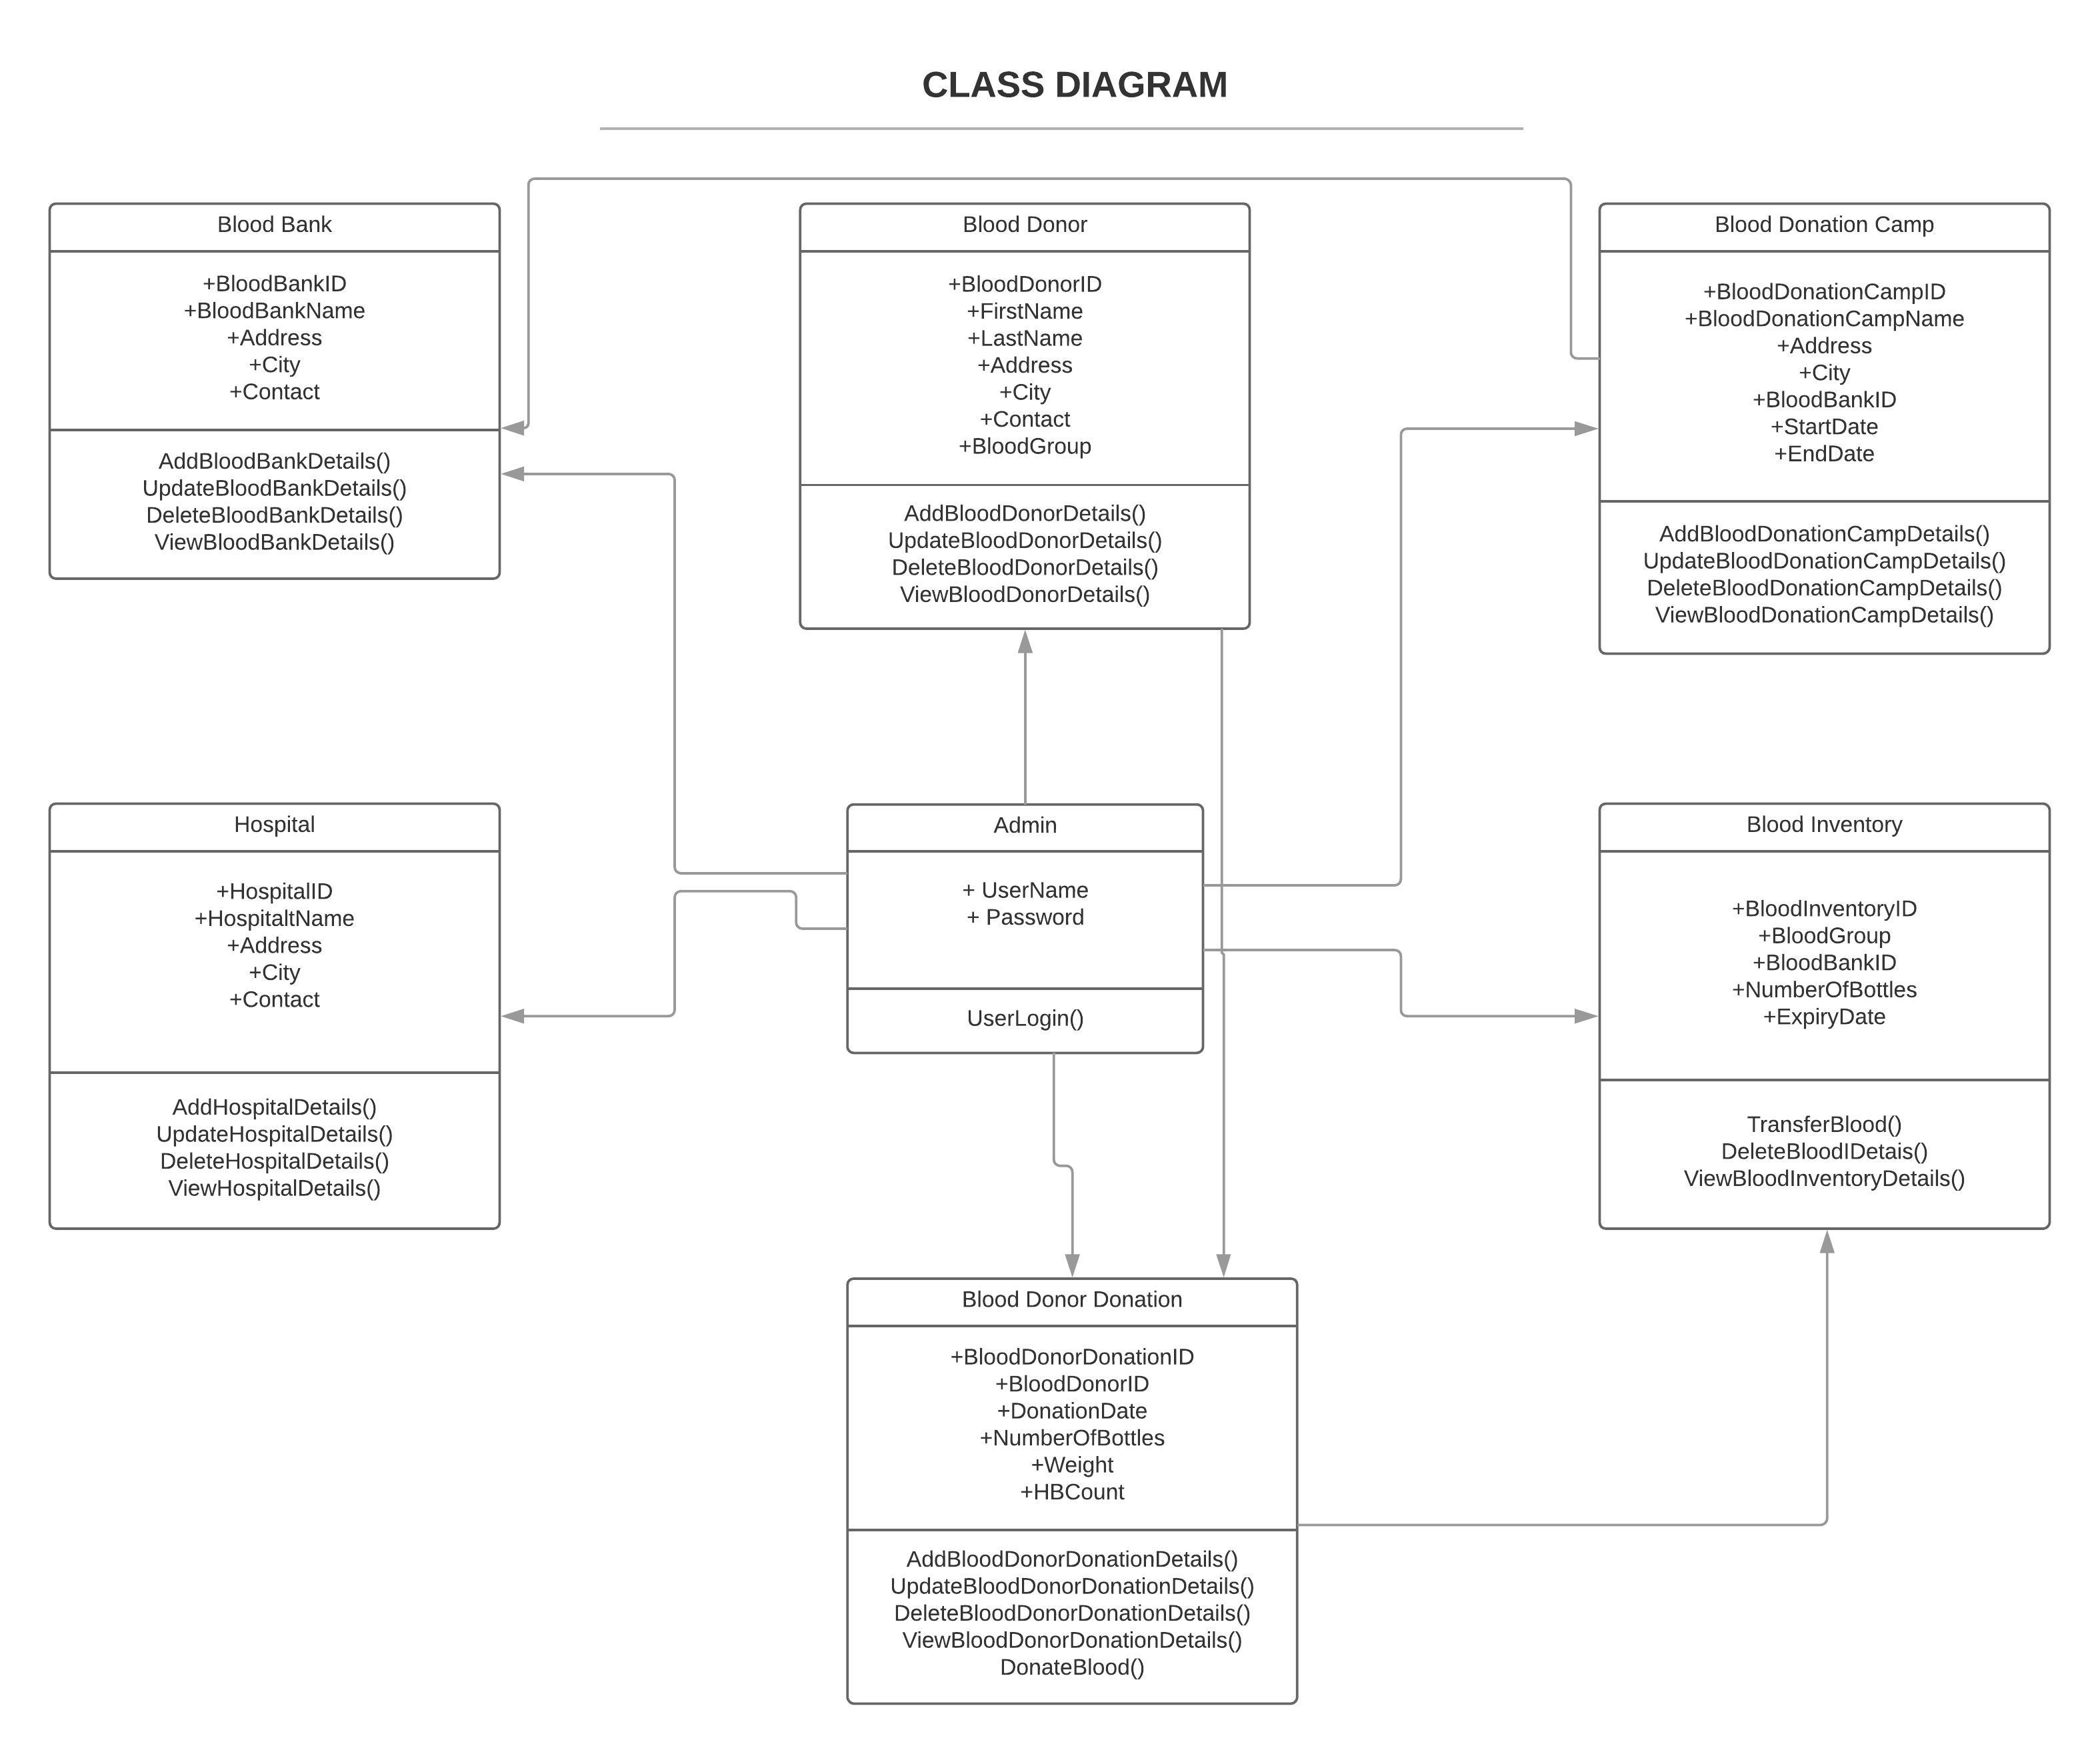
IGATE Sensitive

Slide 9
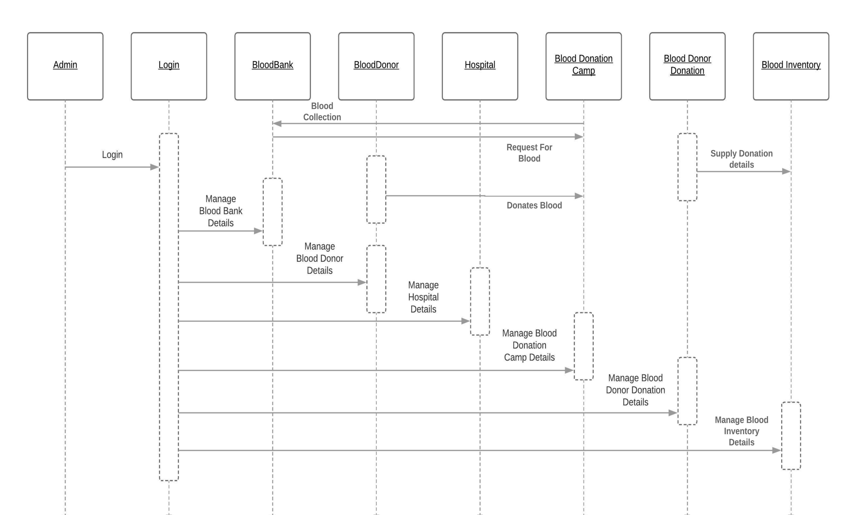
SEQUENCE DIAGRAM

Slide 10
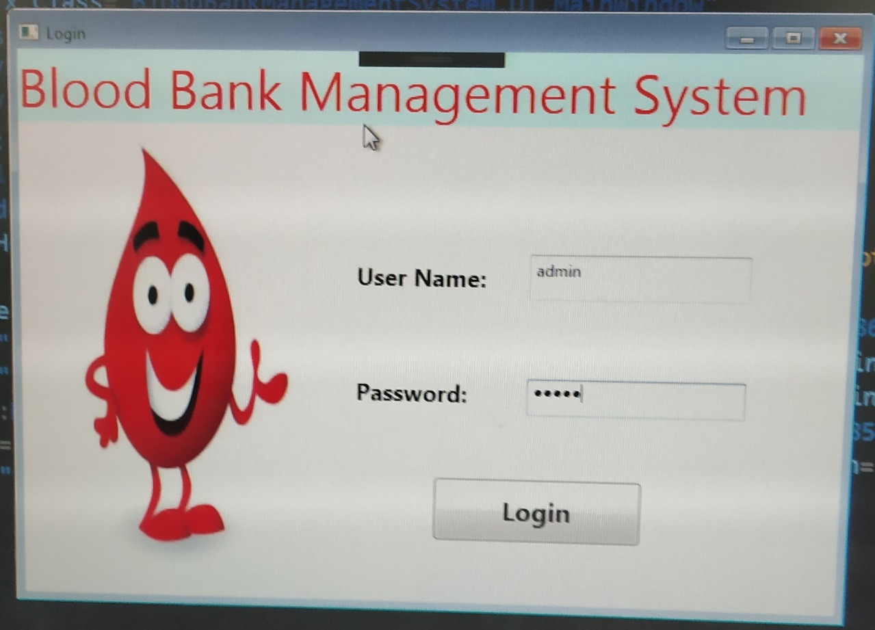
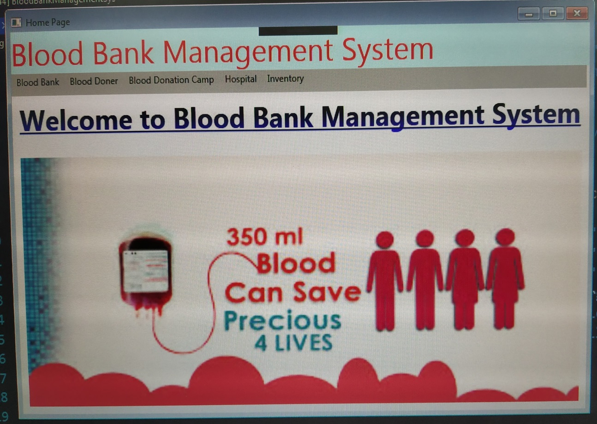
SCREEN SHOTS :-
IGATE Sensitive

Slide 11
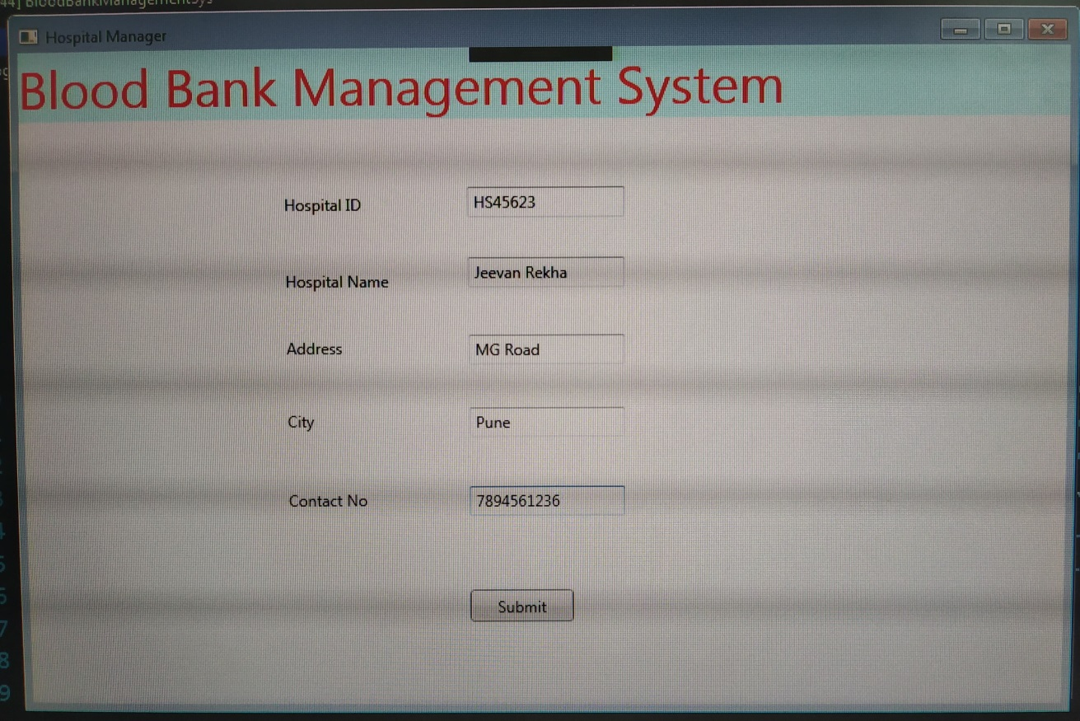
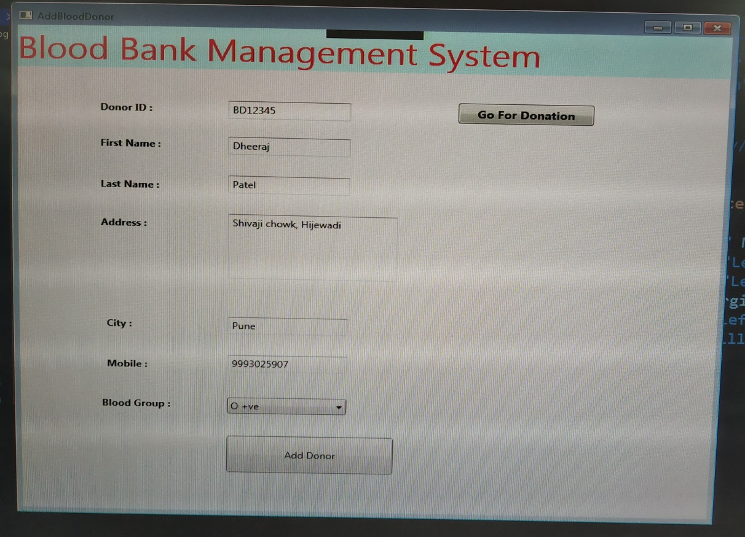
SCREEN SHOTS :-

Slide 12
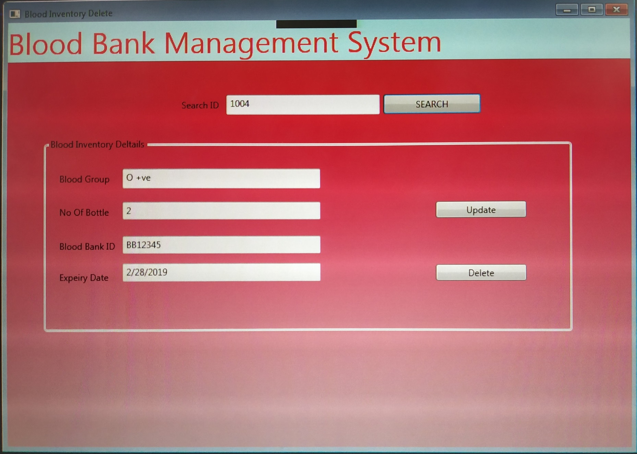
SCREEN SHOTS :-

Slide 13
FUTURE ENHANCEMENTS :-
Future enhancement on Blood Bank Management System Will be : - 1.Through online directory user can also search any blood bank data by location. 2.User can also manage module.

Slide 14
THANK YOU

