Slide 1
Mini Project-<<Topic>>

Slide 2

Team Members
1.Abhishek Singh 2.Soumick Ghosh 3.Dheeraj Patel 4.Mukund Kumar 5.Poonam Satghare 6.Rohit Shinde 7.Shanu Parasar 8.Suvajit Sahoo 9.Bhakti Patil 10.Kalyani 11.Rahul Deshmukh 12.Vaibhav Wadekar

Slide 3
Project Details
Project Name | Blood Bank Management System
Objective | The System provides online information of blood bank and administrators can also manage all information about patient , bloodbank.
Platform | Windows Application
Front End | Window Presentation Foundation(WPF)
Back End | MICROSOFT SQL SERVER 2012
Middle Part | ASP.NET 4.5 C#
Other Tools | Visual Studio
Internal Guide | Mr Aditya Bokade
Develop By

Slide 4
Diagram Depicting Entire Project

Slide 5
Use Case Diagram
ROLE OF BLOOD BANK ADMINISTRATOR
BLOOD BANK ADMINISTRATOR HANDLES – 1. Login to System 2. Arrange Blood Donation Camp 3. Add the blood details in inventory 4. Register the Donor either in the blood donation camp or in any hospital 5. Update the blood details in inventory, if it is given to any hospital or other blood bank 6. Delete the blood details in case it is expired, unsuitable 7. Transfer the blood from one blood bank to another blood bank 8. View Blood Bank Inventory details 9. View Donor List

Slide 6
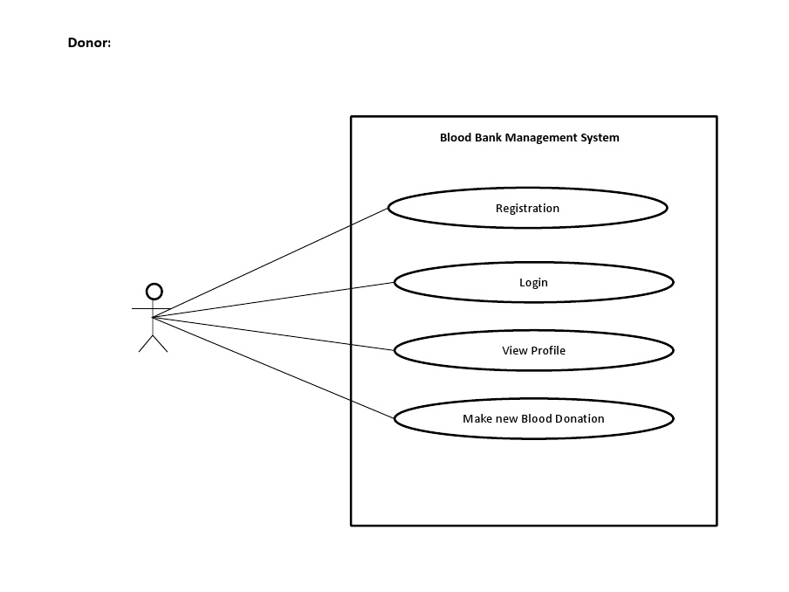
Class Diagram

Slide 7
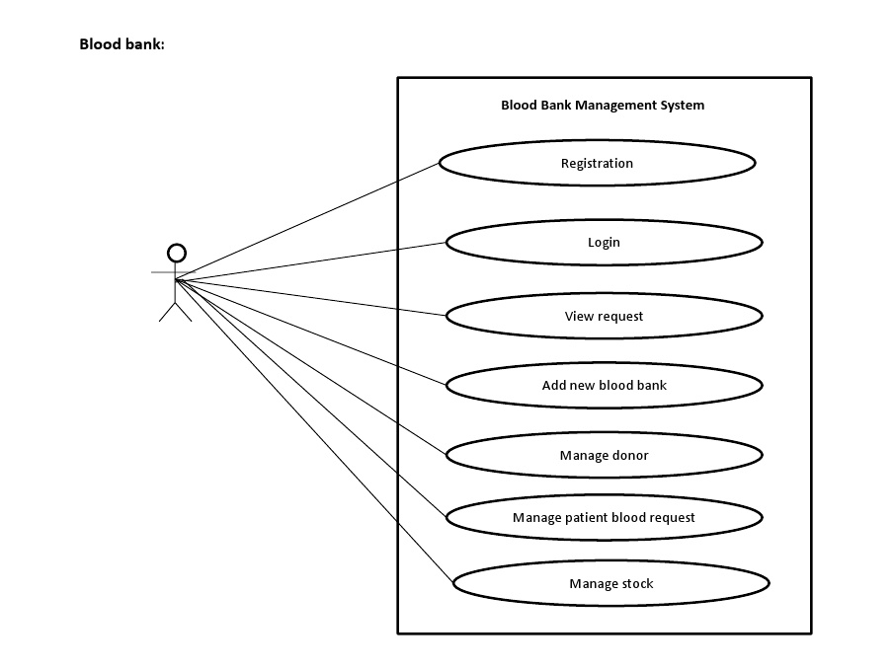
Class Diagram

Slide 8
Screen shots

Slide 9
Screen shots

Slide 10
Future Enhancements
Future enhancement on Blood Bank Management System Will be 1.Through online directory user can also search any bloodbank data by location. 2.User can also manage module.

Slide 11
Thanks

