Slide 1




Taiwan 2018
#JCConf

Slide 2

http://bit.ly/jcconf2018-spring-cloud

Slide 3


Requirements
Some knowledge of Spring Framework
preferably Spring Boot
Some basic knowledge of docker run, trace logs of container, etc..

Slide 4
Overview

Slide 5
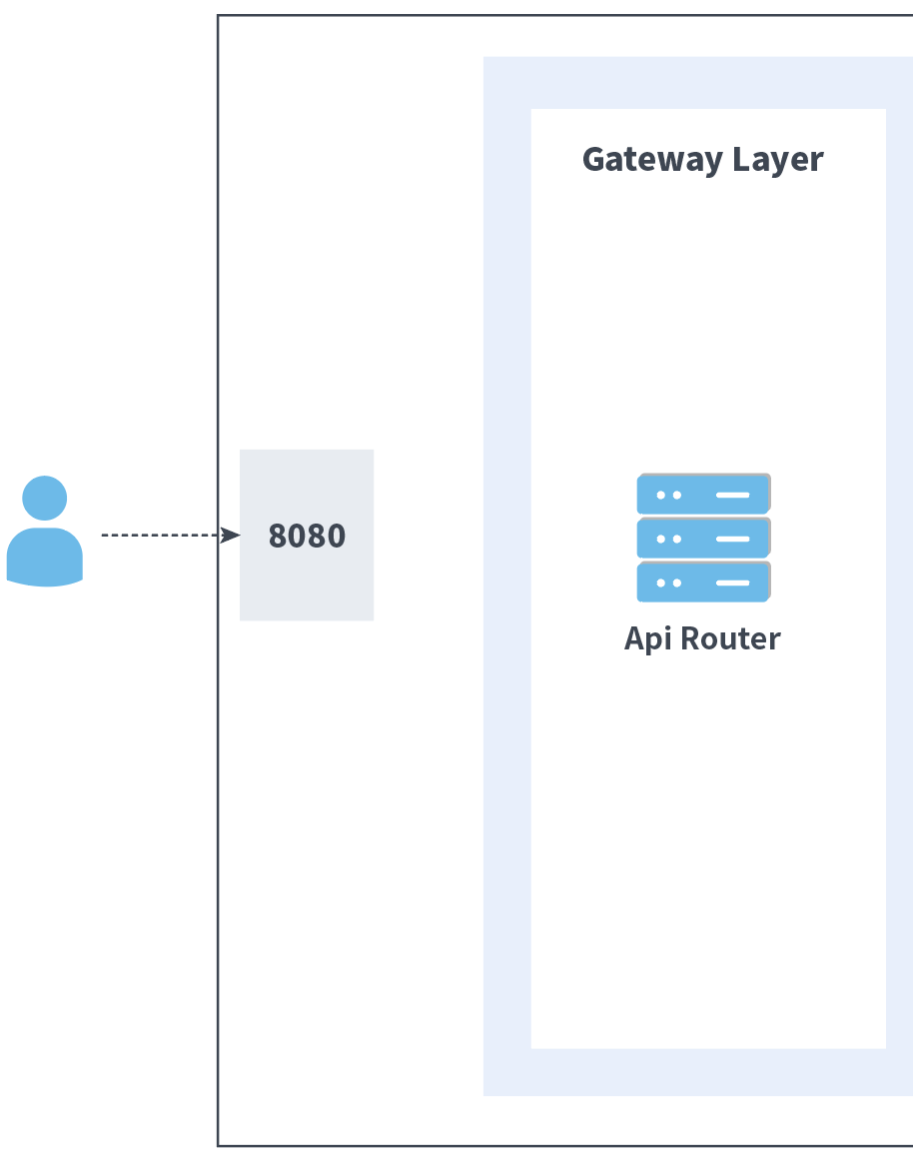
Modules

Slide 6
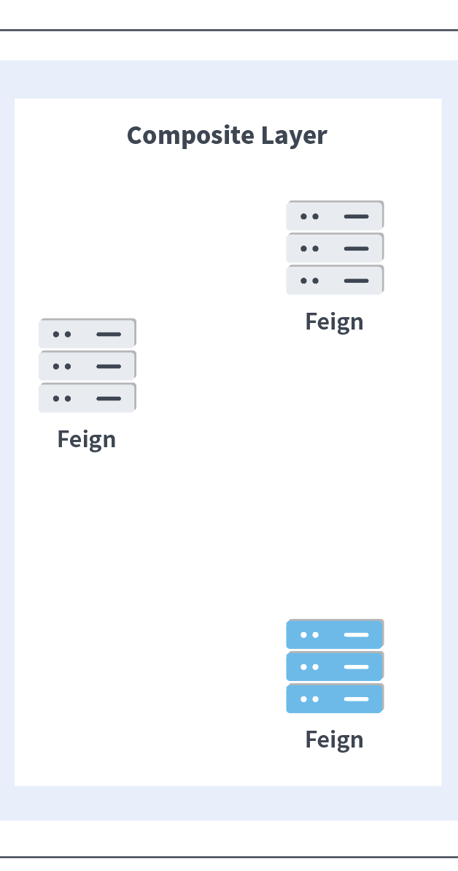
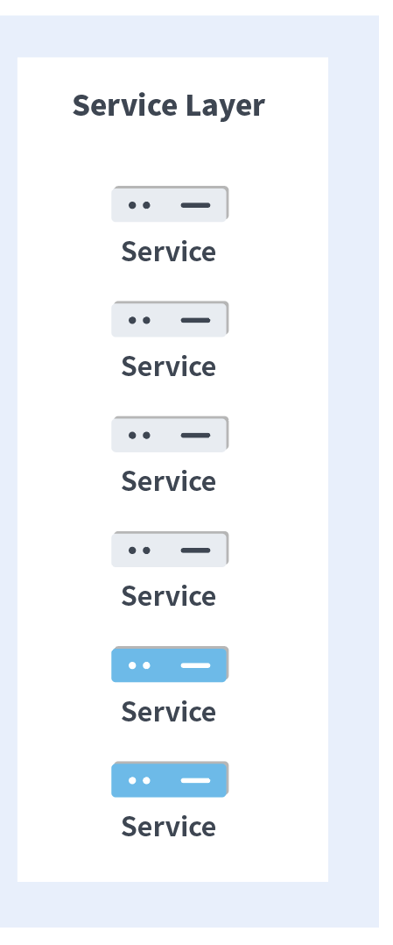
Modules

Slide 7
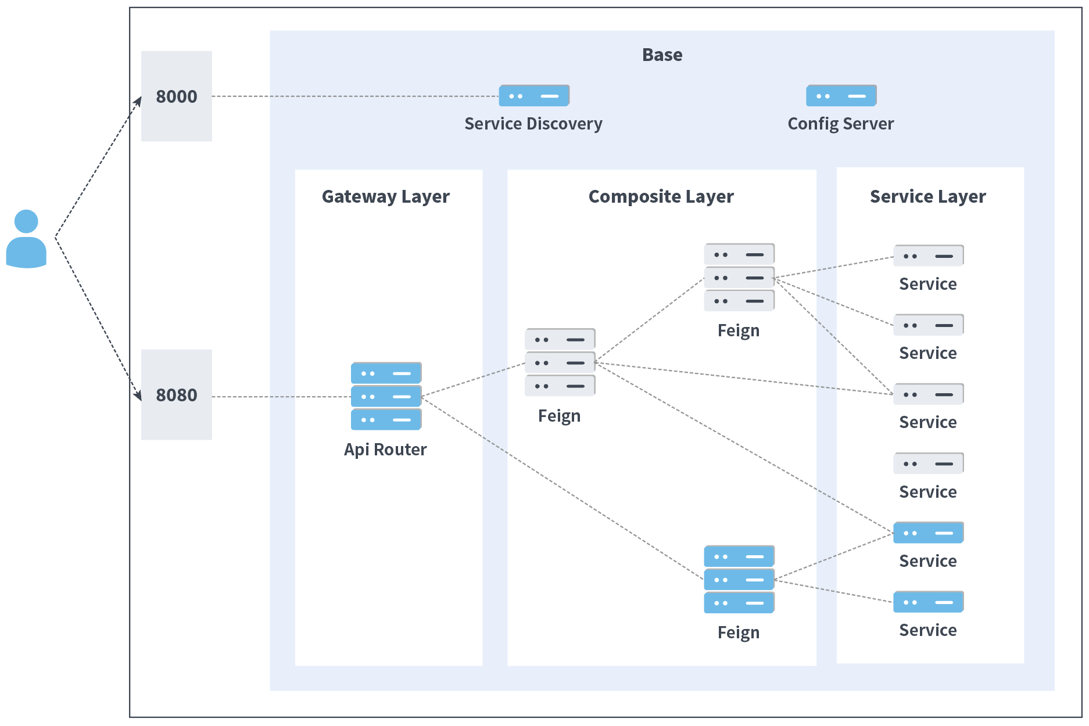
Modules
本次介紹僅針對藍色的部分

Slide 8
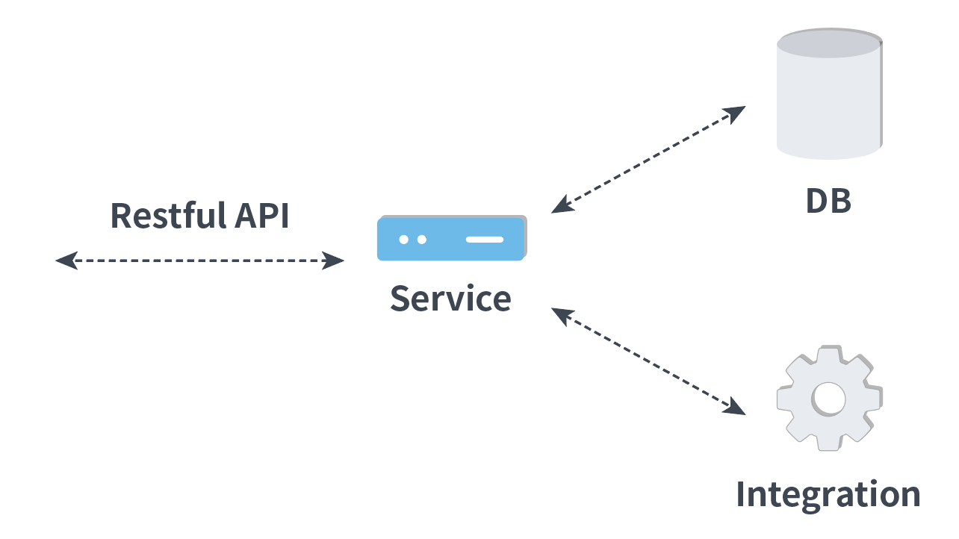
Service

Slide 9
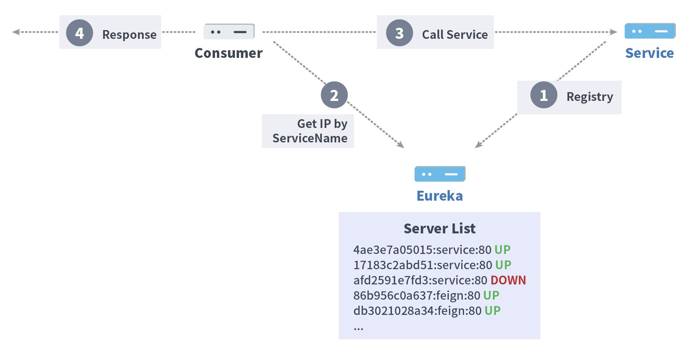
Eureka

Slide 10
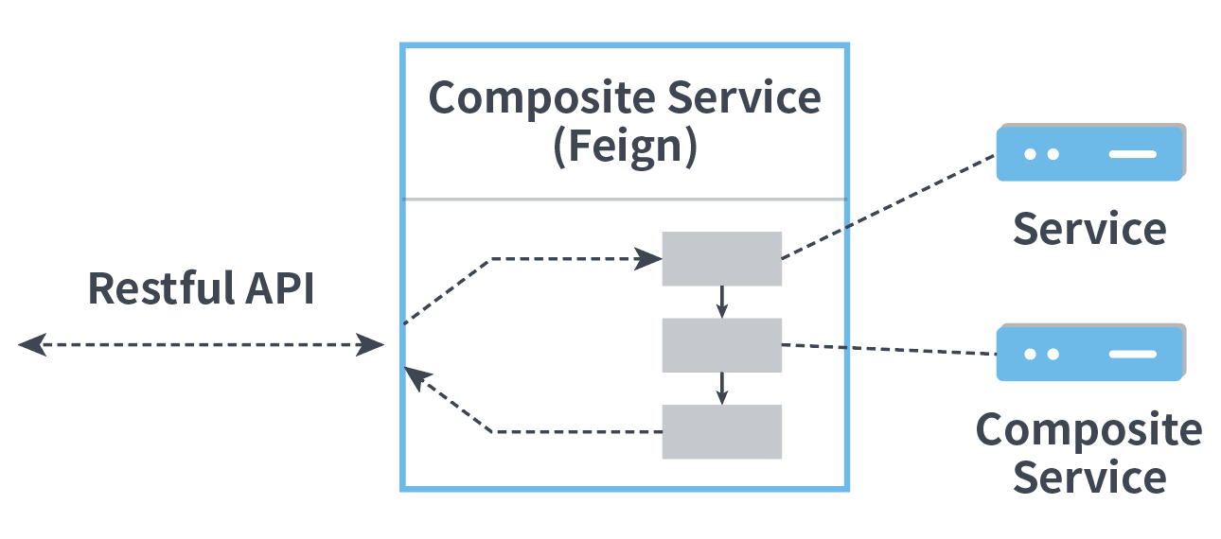
Feign

Slide 11
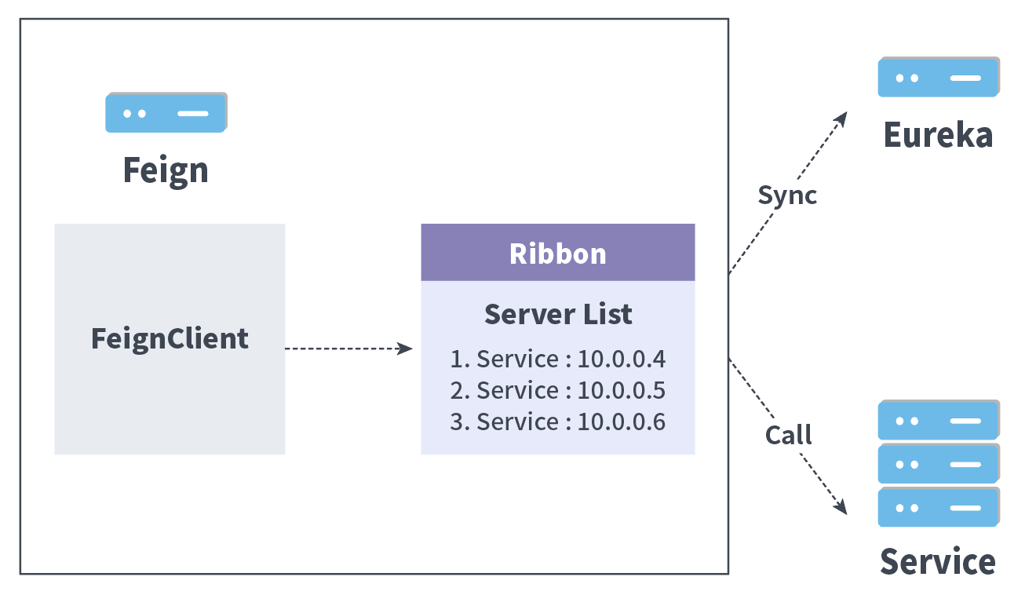
How it works

Slide 12
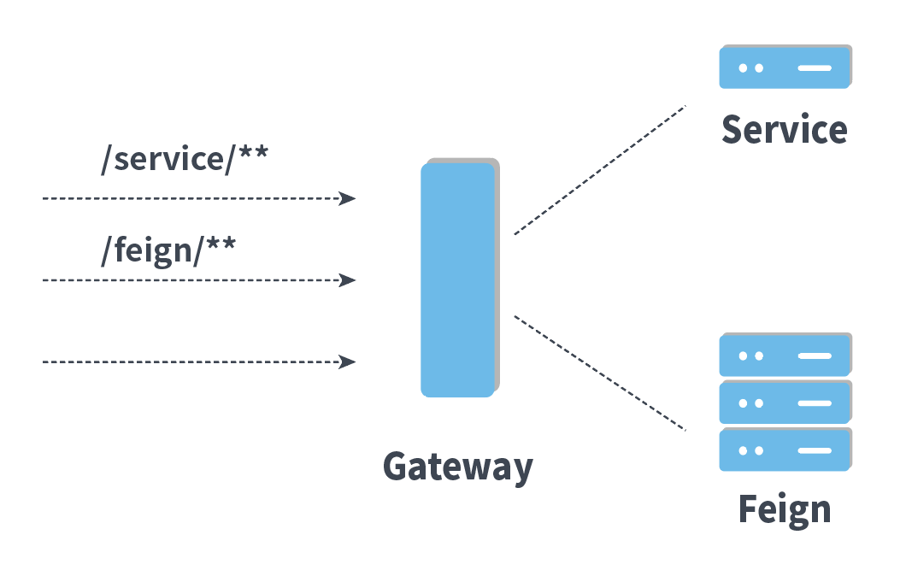
Gateway

Slide 13
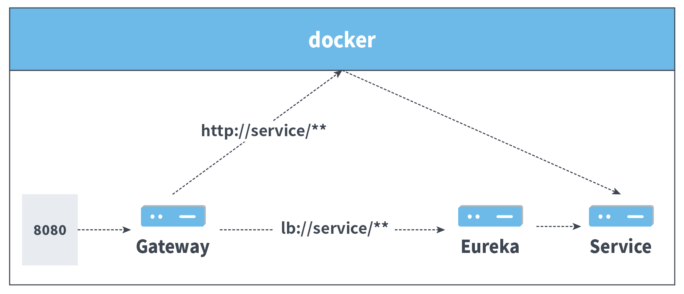
Docker Network & Loadbalance

Slide 14
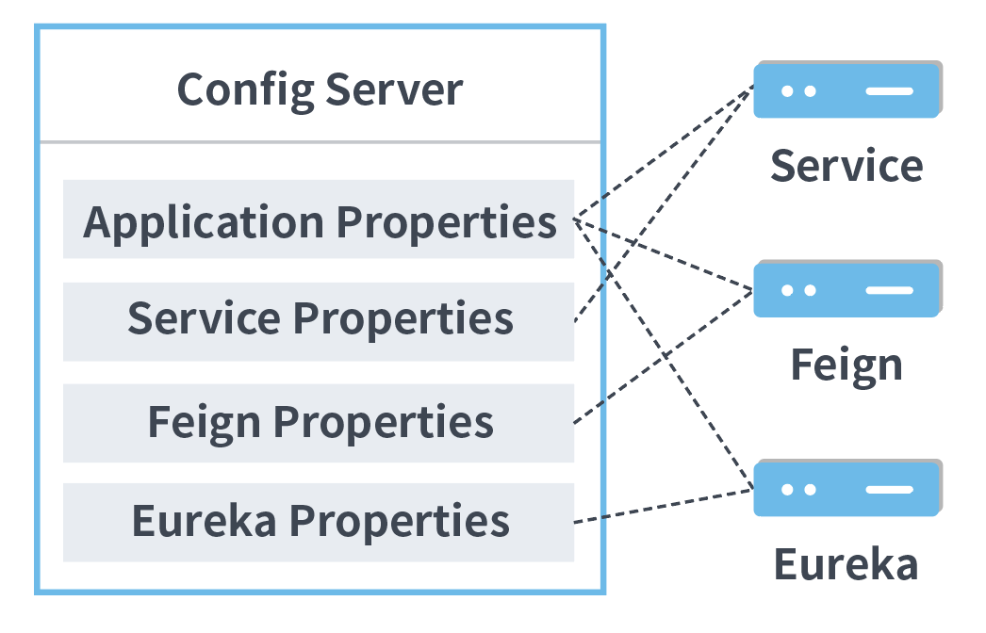
Config Server

Slide 16
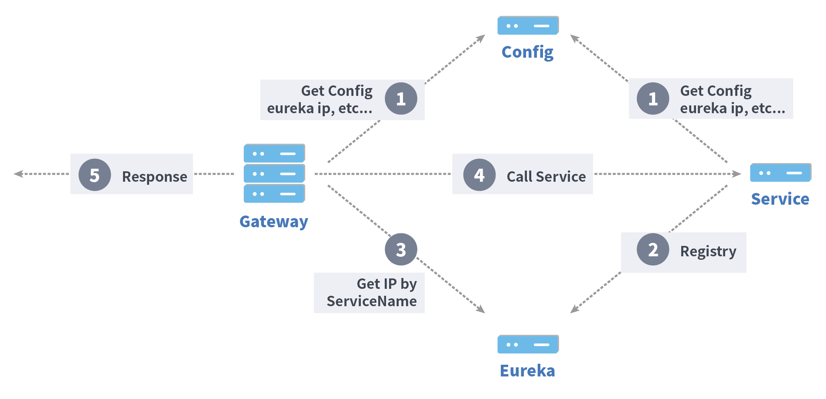
Flow
ConfigServer 啟動
Eureka 啟動
CompositeService
BaseService 啟動
並嘗試向 Eureka 註冊 ServiceName

Slide 17

Prerequisites
Docker
請從 Docker Store 選擇適合的版本下載安裝
or
Docker Compose
如果你是安裝 Docker for Windows 或是 Docker for Mac 則已經內涵 Compose
Linux 請參考 Install Compose on Linux systems

Slide 18
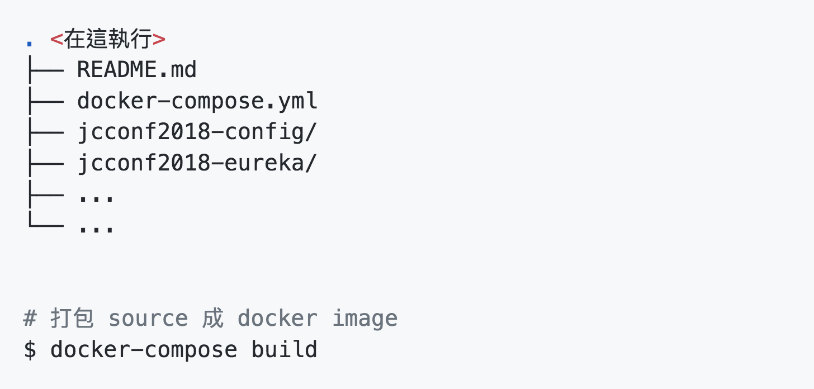
Build
將此 repository clone 到本機後
本篇的所有指令都是在 repository 的根目錄執行

Slide 19
Q&A

