Slide 1

Dennis
2016/11/6

Slide 2
How to install RabbitMQ?
先安裝 erlang –http://www.erlang.org/downloads
再安裝RabbitMQ Server-http://www.rabbitmq.com/install-windows-manual.html#find-rabbitmq-on-windows

Slide 3
什麼是Queue ?

Slide 4


Slide 5
What is RabbitMQ ?
RabbitMQ is a messaging broker - an intermediary for messaging. It gives your applications a common platform to send and receive messages, and your messages a safe place to live until received

Slide 6
RabbitMQ 實作了 AMQP 但沒有實作 JMS

Slide 7
開始前先介紹兩個名詞

Slide 8



以下我們用這個符號代表 Producer
這個符號代表 Consumer
這個代表 Queue

Slide 9

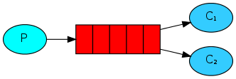
以下搭配程式做介紹
“Hello World”
Work Queues

Slide 10
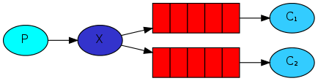
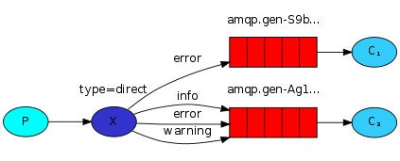
Publish/Subscribe
Routing

Slide 11
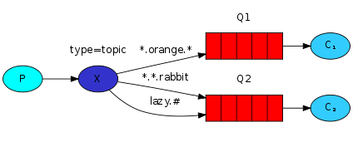
Topics

Slide 12
資料來源
https://www.rabbitmq.com/features.html
http://www.computechsos.com/services/misc/repair-queue/

