Slide 1
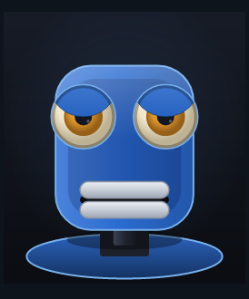
UBIQSYSTEMS · FINAL PRESENTATION
OhBot
Behaviours Engine
Final Project presentation.
Robin · Sebastian · Jason August 2026
Ms. Mimic, drawn live by the GUI
Notes:
Crime. Do Crime.

Slide 2
ARCHITECTURE
The system today
Badges show what moved since the midterm, amber coloured is new or upgraded.
LLM source
Gemini · Ollama · scripted
SAME
Stream processor
strips tags, emits events
SAME
Speech engine
6 voices · lip sync · word timeline
UPGRADED
Behaviour modules
blink · listening nod · sway · idle
NEW
AI GESTURE MODEL
Motor mixer
hardware · sim · virtual · console
UPGRADED
Robin's Conv1d + GRU, trained on BEAT2 mocap. drives absolute joint targets into the mixer.
Control server + GUI
WebSocket RPC, Avalonia client
NEW
The mixer's output is what the face preview and the servos both read.
Architecture
Notes:
Part 3, the new Architecture
The LLM Sources have been not touched. Don’t break whats working essentially.
The Stream Processor samea.
Speech Engine has been fully changed (OhBot Say got axed) and has been replaced with my voice system.
Behaviour (Jason stuff)
Motor Mixer now includes a Virtual variant (That the pictureee oml)
Python raw switch over to a Control Server style. Plus the GUI based on Avalonia

Slide 3
RECAP · THE THESIS
Every midterm promise delievered
The midterm ended on a slide called "Problems and future stuff". We did it all.
✓
“Custom ohbot.say()”
A six-engine speech engine
✓
“More fluent interrupting”
Word-boundary stop with a fade
✓
“Proper emotion keys”
emotions.py, an RPC, GUI control
✓
“Better action definitions”
behaviors.py ambient modules
✓
“Lag on LLM receive”
Synthesis prefetch
TTS VOICES
DESKTOP GUI
AUTOMATED TESTS
PLATFORMS
MACHINE SETUP
1 → 6
none → yes
0 → 29
1 → 3
by hand → 1 button
espeak → six engines, auto fallback
Avalonia, cross-platform client
incl. agentic work
Windows · Linux · Pi
for the core setup
The GUI and Robin's AI gesture model are also included.
Recap
Notes:
Part 2 of Midterm update, and also essentially the overview.
Replacing of the normal ohbot.say due to multitude of annoyances and also introduction of custom voices.
Interrupting feels better now, no more wait till end o sentence.
Feel emotions feat Jason
Actions are cooler, feat Jason
LLM Lag (Mostly) resolved. Now only initial Lag during setup and very first comms for warmup
Ofc GUI and Robins ML project

Slide 4
Part One
Architecture, LLM
and more
Sebastian & Jason
AI gesture model

Slide 5
SPEECH
ohbot.say() is gone
src/obot/speech/ did not exist in June.
MIDTERM
NOW
ohbot.say(sentence, False, True)
obot.speech.SpeechEngine
One blocking call into stock espeak.
Six engines, with automatic fallback.
Duration was guessed: words / 2.5 + 0.4.
Stops on a word boundary, then fades.
"Stop" meant taskkill on the process.
Lips and markers driven by the real audio.
Speech engine
Notes:
The normal OhBot say function was completely redone.
Instead of using the premade, we decided to make a custom one.
Basic stuff first, 6 different voices. Including Viper, Edge, Piper, Google Text to Speech and more.
Sobald die Speechengine aufgerufen wird, werden drei teile gebaut mit dem PCM buffer.
Eine Timeline, womit die wörter gemappt werden (clip.timeline gibt jedes wort ein start_s und end_s zeitbereich)
Mundöffnung ration welche via clip.mouth per frame festgestellt wird. Der build_mouth_track macht dann daraus noch ein attack release window (Siehe MouthSettings later) für mehr custom power.
Clip.pose kommt von Robins ML arbeitne, sorgt für ein posing vom OhBot beim reden.
If there is an interrupt occurring, it will do a fadeout (also blocking all other flags) and fully stop after some padding.
Wir messen NICHT akkurat wie genau ein wort braucht (zu viel arbeit), aber für unsere Actions wie das NOD ist das trotzdem ein guter Treffer am richtigen Wort.

Slide 6
SPEECH
Six voices in a chain
Edge
Kokoro
gTTS
Gemini
Piper
Local
ONLINE
OFFLINE
ONLINE
ONLINE
OFFLINE
OFFLINE
the chain
Edge
Kokoro
Piper
Local
An engine that throws is benched
Without the bench, a dead network makes every sentence pay a full timeout before falling through.
For 90 s
then quietly retried.
Speech engine
Notes:
The Six voices, with Edge being our default.
A Backup chain (Seen on first startup later when the first response appears) checks which voices will be available and which ones are not. It then prepares the autochain
Engines get Benched if they annoy us.
If all fail, it tries again. If all six end up benched, the bench clears. It cannot deadlock itself into silence.

Slide 7
SPEECH
Hiding the latency
Fixing the Lag and Delay issues in the Talking
BEFORE: THEY TAKE TURNS
synth
play
synth
play
synth
play
8.1
NOW: THE NEXT ONE RENDERS WHILE THIS ONE PLAYS
synthesis
S1
S2
S3
playback
play 1
play 2
play 3
6.1
The TTS round-trip now hides behind playback. At most two syntheses run at once. Enough to stay ahead, not enough to rate-limit our LLM-API.
▲
Speech engine
Notes:
Before, mainly due to our Say command, we worked in a single pipeline. Resulting in the long waits between sentences and even issues on interrupting and context.
Now, we only have to wait out the first LLM Communication. But, this just makes it look like the OhBot is thinking a bit, so it goes well. Afterwards, while the synth is playing, the next one gets generated.
This allows us to always have the next communication ready with no more delay.

Slide 8
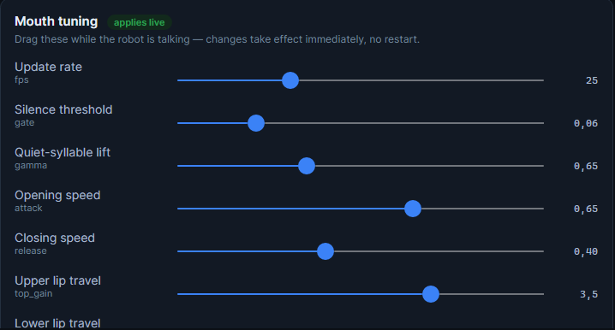
SPEECH
Lip sync measures amplitude
RMS envelope
Noise gate
Gamma
Attack / release
Lip deltas
25 fps
Eliminate low level noise
Gamma curve to boost low syllables
Mouth opens fast and closes slow
Create volume curve
Lip Position
to both servos
Tune mid-sentence
The sliders mutate the same config object the running engine reads, so the mouth changes mid-sentence, with no restart.
Save, and the physical robot uses the identical values.
Speech engine

Slide 9
SPEECH
[Nod] on the exact word
Sure - I can [Nod] do that for you.
The tag is stripped and its character offset recorded.
The offset is mapped onto the word timeline above.
Sure
-
I
can
do
that
for
you.
word timeline, derived from the synthesized audio
The playback clock is checked against it every 40 ms.
the nod fires here
It replaced a characters / 80 guess, which drifted with every change of voice, rate or engine.
×
Speech engine
Notes:
The 40 ms tick is 1 / mouth fps, clamped between 10 and 50 ms.
The Actions have been redefined. Instead of playing at the start of the sentence or with our rough math of Total_Char / 80 we can now use the audio to give us a timeline of what happens. This allows us to finely pinpoint where things happen even on Lag, Internet Issues or total failure of a component. We sync this via a internal 40ms clock.
In the example, that means it fires just before the do happens.
Still *somewhat* guess work, but instead of 20% accurate, its now around the 90% mark due to finer control.

Slide 10
LISTENING
Hearing the user
Three additions. The detector underneath them is unchanged.
Streaming Vosk
One-click model setup
Graphical mic picking
The transcript now fills in word by word as you speak, instead of appearing all at once when you stop.
Four Vosk models, English and German, fast or accurate. Downloaded, unzipped and configured for you.
A device dropdown and a live level meter, instead of an ASCII bar in a terminal.
865d0ef · 6 July
9d4ac68 · 13 July
new RPCs
Deliberately unchanged since the midterm: the VAD design and all of its constants, the three listen modes, the keyboard bindings, the echo-suppression multiplier and the ambient calibration.
·
Listening
Notes:
Part 1 of Listening
Vosk, our old detection method, is still the same as the Midterms. Don’t change what works great.
This includes the Echo suppression, Ambient calibration, types of comms and bindings.
New is the way we work with Vosk, it now Streams the words by word. So it’s a good amount more accurate and you know what you are saying to it.
Incase the device this runs on has the space for it, like on a windows PC, you can choose to now even get the larger model, making wrong translations less likely.
And, via the Setup, choosing Mics and such is easier.
File size is between 40 to 200 MB for the small ones, and up to 2GB for the large ones.

Slide 11
LISTENING
The bug that ate the first word
1 frame reached the recognizer
Before
Onset waits for four loud frames in a row before it believes you started talking.
1
2
3
4
5
6
But only the fourth was handed over. The three that proved it, where the word began, were dropped.
all 6 do
After
Fixed with a 6-frame rolling buffer.
1
2
3
4
5
6
Listening
Notes:
Listening part 2
Before, we had the issue that when we started talking that it skipped the first word we did. That sucked and was annoying.
Now it keeps a buffer that holds the last six frames. When a loud noise occurs or you talk in general, it will pick up the first word way better than before.

Slide 12
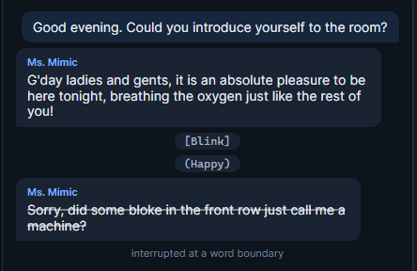
LISTENING
Interrupting, properly
The trigger path is unchanged. What changed is what happens to the audio.
MIDTERM
Kill the espeak process, timed against a word-count estimate. Too jarring mid-word, so it could only stop at whole sentences.
NOW
The engine knows where the current word ends, finishes it, then a 12 ms fade takes it to silence. It stops one word after you speak, not one sentence.
Interruptions
Notes:
Before with the Interuptions, as mentioned before, it was a hard cutoff.
This was done by literally stopping the espeak process as a whole which would only end at the end of the full sentence. Awkwaaard
Now, we handle it via our Custom OhBot say command line, allowing us to flag the word end and introduce a fade out (very short one) to avoid crackling.
The core method of our Interruption logic and Processing of it (LLM knowing where you cut it off) remain unchanged.
GUI after this, get rdy.

Slide 13
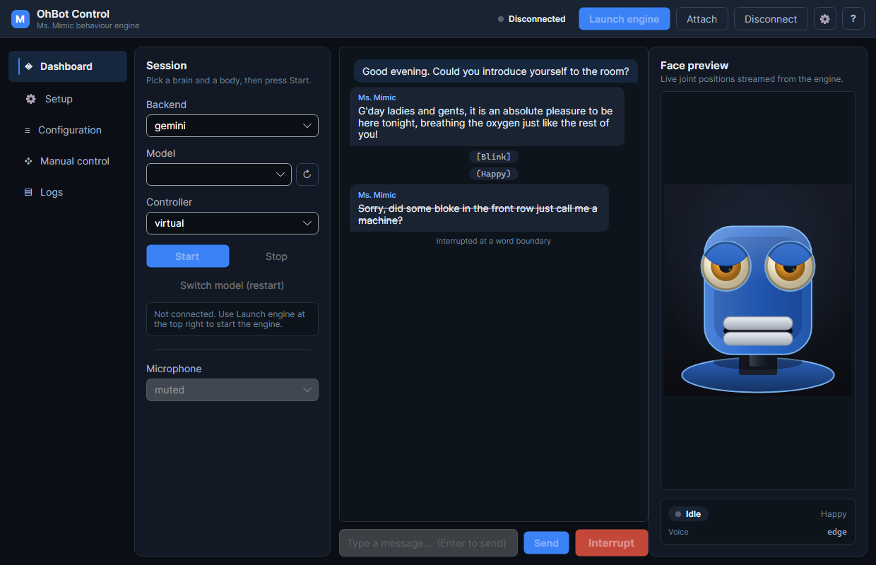
GUI
A GUI for the whole workflow
At the midterm there was none. The project was a terminal and a hand-edited config.json.
5*
pages, one face preview
3
platforms, one codebase
Avalonia on .NET 10 Windows, Linux and the Pi from the same codebase.
It reads and writes the same config.json as the terminal app, so the two never disagree and may be used together.
Desktop GUI
Notes:
Behold. The GUI.
Its based on Net10 Avalonia and was written via 5k lines of C# and 1,5k Lines of XAML. As of 18th it comes with 5 Pages, as seen in the pic, but as I made it easy to introduce more pages, we added one for the ML stuffs.
Showcase of it will occur later.

Slide 14
GUI
Thin client, fat engine
WebSocket
JSON · 127.0.0.1:8765
ObotControl.App
python -m obot --serve
calls
Avalonia. Draws things, forwards clicks.
Knows nothing about the pipeline.
asyncio pipelines, the serial port, the audio devices, the COM objects.
events
All the intelligence stays in Python. The GUI never re-implements a line of the pipeline, as it calls RPC methods and renders what comes back.
Why: the engine already owns the asyncio pipelines, the serial port, the audio devices and the Windows COM objects. Duplicating any of that would have meant fighting over locks and keeping both in sync.
Desktop GUI
Notes:
The GUI is simple. It just handles the communication between the Python material and shows it to use in a Graphical manner instead of a Terminal.
We do this via a Websocket the Python opens up, where we then send calls while Python returns events.
I did not want to merge the Python material into the GUI, especially due to me switching around stuff a lot in the starting phase. Plus, this still allows non GUI handling and Testing.
WinUI3 was the start of it (not in the GitHub as its under my “messaroundfindout” section.
The GUI attempts auto Reconnects and allows startup of the Python if not up already. And setup, see later.

Slide 15
GUI
Drawing the robot
15 FPS of simulated Robot goodness.
The head yaws, nods and tilts with parallax. The eyes are glossy spheres under sliding lids. The mouth is two independent lip plates. It’s as close as possible to the real OhBot.
It means you can build, demo and debug the whole system with no robot present. The preview moves exactly* as the servos would.
It got reused: Robin's pipeline streams converted BEAT2 clips through the same protocol, so mocap can be eyeballed here before anything is trained on it.
↻
Desktop GUI
Notes:
Due to need to test the Robot without a long drive to the University, I made the GUI also host a simulated Robot head.
(Earlier version of it can be seen in the GIT).
All of the motors copy what the real thing would do. With Limits and positions. It also comes with the benefit of being able to see if the Real Robot has issues!
Robin used this system a lot. Especially for rework work as we could not always open up a Liveshare session.

Slide 16
BABY MODE
EZ Mode: the problem
“
A teammate with a fresh laptop/installation and no Python wants to run the robot, but the Setup is time consuming.
“
Install Python. The right version depending on OS
Create a virtual environment (venv)
Activate it and its requirements.
pip install -e .
Pick the right requirements file
Find and unzip a Vosk model of the correct
Hand-edit a JSON file and grab corresponding keys
…and any one of those failing gives them an error message that means nothing and would require me to help out.
Zero terminal commands. Zero admin rights. Nothing broken on their machine.
EZ Mode
Notes:
Biggest issue during Setup or giving it to someone new for testing or such, was the actual setup of the setup.
Way to many small things, due to the nature of python, that could fuck you over.
Now, we made it E Z. Or, as I marked in the code, Baby Mode.

Slide 17
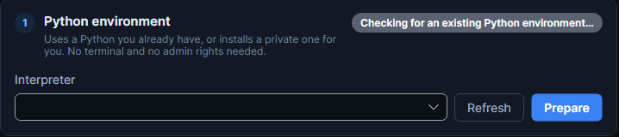
BABY MODE
EZ Mode: how it works
PythonEnvironmentService handles it.
TIER 1 || PREFERRED
Reuse whatever is already there: any venv under the repo, or a system interpreter on PATH, as long as it reports 3.12.
nothing usable found
No administrator rights.*
TIER 2 || FALLBACK
Download a private Python 3.12.10 via python.org on Windows, python-build-standalone elsewhere with a checksum-verify, into our own folder.
It never touches `PATH` or an existing install.
It prefers what you already have.
Why 3.12? Audio-stack wheels are only reliable there. And Ubuntu 25+ ships something newer, so Tier 2 has to exist.
Either way: venv OhBots → pip install -e . → per-platform requirements → verify by importing.
?
EZ Mode
Notes:
On the GUI under the Setup page, a scanner can be found. Here it will determine if we can fulfill Tier 1
Or if we have to go for Tier 2.
It will grab all CORE components (NOT ML!) and prepare them in a private local .venv
Due to the auto setup no admin rights or sudo will be needed, with one exception in rare cases. And it wont mess with existing things while remaining future proof.

Slide 18
BABY MODE
One codebase, three platforms
Commit 65c8879, 19 July.
Windows
Linux
Raspberry Pi
SAPI voices, python.org installer, a dedicated COM thread.
espeak-ng, python-build-standalone, no root required.
The same Avalonia binary; the engine local or over the network.
One issue remains for Linux: Some system components are expected:
sudo apt install libportaudio2 espeak-ng. The GUI will detect the missing one and inform you.
!
EZ Mode
Notes:
With the Avalonia Push, besides of course EZ Mode, we also ensured cross platform compatibility. Especially for Robin and his ML research..
Windows essentially can grab everything itself, the Pi can work closely with the Avalonia libraries and grab the rest over network if needed.
Linux will need ONE sudo line as seen on screen. This is due to the Audio handling and default OhBot voice backup and translation.
Robin time

Slide 19
PART TWO
Teaching the robot
to gesture
Robin
AI gesture model

Slide 20
Pipeline Overview
New Pipeline
ML gesture model for dynamic head movement
Scripted mouth for audio-based mouth movement
Merged movement of ML Gesture, scripted mouth and Behavior modules
AI gesture model · Robin
Notes:
New Pipeline elements
Behaviour modules
Scripted Mouth
ML gesture (for the machine learning behaviour)
All can influence the robots movements thanks to the offset system

Slide 21
Data
BEAT2 Dataset
Speech audio
Body Pose
Hand Pose
Facial Expression
Global Translation
30 fps
.wav files, 16khz mono
float32 axis-angle rotations (T, 63)
float32 axis-angle rotations (T, 90)
FLAME Blendshaps (T, 100)
float64 XYZ position (T, 3)
~ 60h
Introduced in EMAGE: Towards Unified Holistic Co-Speech Gesture Generation via Expressive Masked Audio Gesture Modeling building on the BEAT dataset
Standard benchmark in co-speech gesture generation field
Unified Body, Hand and Facial Expression
Speech engine
Notes:
We chose BEAT2
Released early 2024
Has become the standard benchmark
Dataset mainly comprised of Speech, Body pose, Hand pose, facial expressions and global Translations
Additionally Metadata, Jaw and eye orientation
About 60h of recording (mostly english)
Way to much data for the ohbot

Slide 22
Data
Conversion Before vs. After Training
After Training
BEAT2
ML Training
Inference
Convert to Ohbot
Ohbot
Inference
Before Training
BEAT2
Convert to Ohbot
ML Training
Inference
Ohbot
Inference
AI gesture model · Robin
Notes:
After Training
Drop in with other premade ML models
Larger Model and more overhead
Before Training
Smaller model
Less overhead during inference

Slide 23
Data
Converting BEAT2 to Ohbot
BEAT2
Head & body motion capture
(T x 55 x 3) + (T, 100)
Beat2_to_ohbot.py
Axis value curves
Ohbot
T x 8 x 1
AI gesture model · Robin
Notes:
Reducing dataset from 265 values to 8 (33 times less)
Calibration
Conversion
Highly parallalized (~1min conversion)

Slide 24
Model
Model Structure
Hybrid CNN + RNN for temporal memory
Conv1d x2: Local audio feature Extraction (38%)
GRU: Temporal memory / sequence modeling (61%)
Linear head: Map hidden state to servo axies (1%)
Sigmoid: Scale head output to [0, 10]
AI gesture model · Robin
Notes:
Conv1d block1: detects short duration audio patterns spanning 5 frames (like hight frequency dominates)
Conv1d block2: combines features of previous layer (a vowel-to-consonant transition is happening)
Layers use a sliding window with kernel 5
GRU: decides what to remember and what to forget

Slide 25
Training
The training pipeline
85% train / 15% evaluation split
Specify model size during the beginning of a training run
Pipeline allows resumption of previous runs
After each epoch
checkpoint: save current training state for next epoch
best_model: save current state as best model based on evaluation loss
During end of training clip increasing error for non forward look
AI gesture model · Robin

Slide 26
Training
Comparing Learning Rates
conv_ch: 32
GRU: 64
epochs: 25
lr: 0.0005
lr: 0.001
lr: 0.002
AI gesture model · Robin

Slide 27
Training
Comparing Model Sizes
conv_ch: 32
GRU: 64
lr: 0.001
Min Evaluation Loss: ~1.2 (epoch 80)
conv_ch: 128
GRU: 256
lr: 0.001
Min Evaluation Loss: ~1.15 (epoch 73)
conv_ch: 24
GRU: 48
lr: 0.001
Min Evaluation Loss: ~1.23 (epoch 84)
Default
Large
Small
AI gesture model · Robin

Slide 28
conv_ch: 32
GRU: 64
lr: 0.001
Min Evaluation Loss: ~1.2 (epoch 80)

Slide 29
conv_ch: 128
GRU: 256
lr: 0.001
Min Evaluation Loss: ~1.15 (epoch 73)

Slide 30
conv_ch: 24
GRU: 48
lr: 0.001
Min Evaluation Loss: ~1.23 (epoch 84)

Slide 33
Limitations and future improvements
Currently pure audio input for the ML model
BEAT2 contains additional metadata (including emotion keys)
GPU acceleration
Improved BEAT2 to Ohbot conversion
Extraction of accurate Eye and Mouth movement from BEAT2
Sentence based clip generation
The ML model's history state does not extend past the sentence start
AI gesture model · Robin

Slide 34
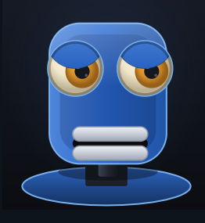
PART THREE
Motion, inside
the mixer
Jason
Motion and controller · Jason

Slide 35
New Mixer
Old Setup
Movement via Offset
called in each Mixer-Loop
Send request
Offset Queue
Action
Applies relative
Delta
Allowed for actions during speech
Movements would expire via decrementing
Did not allow for change of Lips → Locked by Speak function
Motion Offset
Motion and controller · Jason

Slide 36
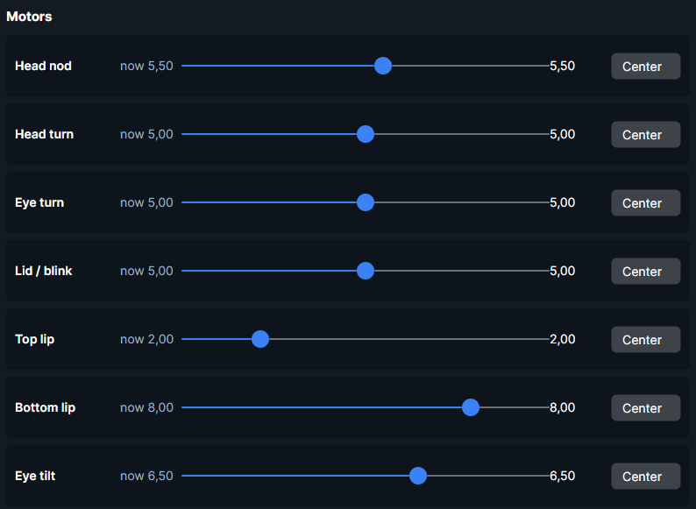
New Mixer
Building a new Mixer
Combining Lip and Emotional Movement
Emotions "set tone" of the speech
Speech Engine calculates lip movement for sentence
Lips applied as Delta on emotion
Emotion determined by [emotion] inside text string
Bias of emotions set in robot/emotions.py
Modular; new emotions easily addable
Easily combined with movement actions (nod, blink)
Motion and controller · Jason
Visualization of "Happy" Emotion Servo Bias

Slide 37
Motion Offset
New Motion Offset
ML Lip Movement
All the new influences
ML Movement
Explicit Actions (Nod, Headshake)
Motion Offset
Custom Say Function
Automated Actions (Blink)
Emotions (Lip Setup)
Motion and controller · Jason

Slide 38
Smooth Movement
Smoothing the motion
For more natural looking movement
Normally
Joints would snap to new position, looks both robotic and damages motors
In Addition:
Edge Detection prevents Joints from attempting to move past its limits, preventing ruggish movement
With new implementation
Joints move at rate, max_step decides maximum distance it can cover per tick
Now
Motion and controller · Jason

Slide 39
THANK YOU
Questions?
OhBot Behaviours Engine · UbiqSystems · Robin, Sebastian and Jason
github.com/… ← paste the repository link here before presenting

