Slide 1
DEVELOPMENT OF MVP MACHINE LEARNING SYSTEM FOR PREDICTING THE PROFITABILITY OF THE FILM BUSINESS
DEPARTMENT OF INFORMATION TECHNOLOGIES IN BUSINESS
SOFTWARE ENGINEERING
PERM, 2022
PROJECT PROPOSAL
Elizar Chepokov, SE-18-2
Supervisor: Professor of the Department of Information Technology in Business,
Doctor of Technical Sciences, Leonid Yasnitsky

Slide 2
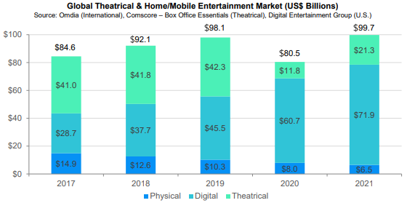
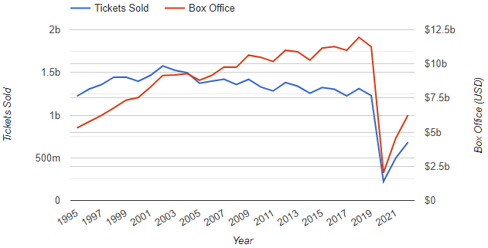
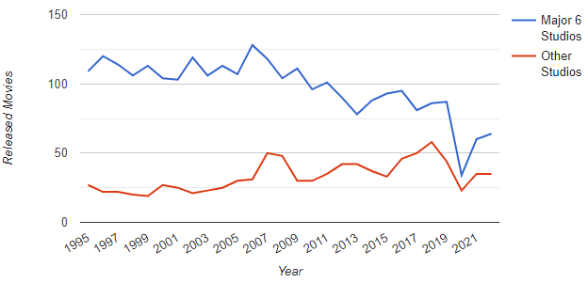
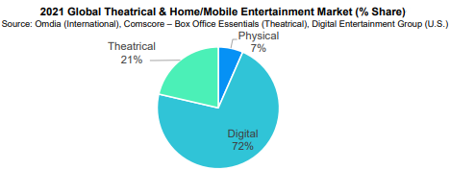
Relevance of the work:
Software Engineering,
Chepokov Elizar
Project Proposal
Development of mvp machine learning system for predicting the profitability of the film business

Slide 3
Problem statement:
Software Engineering,
Chepokov Elizar
Project Proposal
Development of mvp machine learning system for predicting the profitability of the film business
Existing problems:
Most predictions are based on intuition.
Missing number of elements in statistical sampling.
Laboriousness and time-consuming complex analysis of strengths and weaknesses by human forces.
Purpose: creation of the system, determining the directions and principles of effective management of the cinematic business process.

Slide 4
Delimitations of the study:
Software Engineering,
Chepokov Elizar
Project Proposal
Development of mvp machine learning system for predicting the profitability of the film business
Object: the machine learning algorithm system.
Subject: the development of a machine learning system algorithm.
Tasks:
To analyze the area of interest.
Design a machine learning and additional systems.
Implement a machine learning system.

Slide 5


Methods:
Software Engineering,
Chepokov Elizar
Project Proposal
Development of mvp machine learning system for predicting the profitability of the film business

Slide 6
Results Anticipated:
Software Engineering,
Chepokov Elizar
Project Proposal
Development of mvp machine learning system for predicting the profitability of the film business
Machine learning system for predicting profitability of the film business.
Faster receipt of future movie box office predictions and a set of tips to increase the profitability of the movie.

Slide 7
Software Engineering,
Chepokov Elizar
Project Proposal
Development of mvp machine learning system for predicting the profitability of the film business

