Slide 1
UUUG First Meeting
Welcome to the Utah Unity User Group
August 13th 2015

Slide 2
Agenda
Thanks to our sponsors
Discuss group format/logistics
Any cool Unity news to share?
Anyone looking for work or employees?
Presentation on UI
Share techniques or polish projects in groups
Notes:
Talk about why I formed the group: Help learn unity, no other group in state, network. Hoping for at least quarterly meetings with presentations.
Unity Announcements: Still can get early bird ticket prices to Unite converence in Boston.
Vision Summit 2016 - Februrary 10-11 2016, Hollywood California.

Slide 3
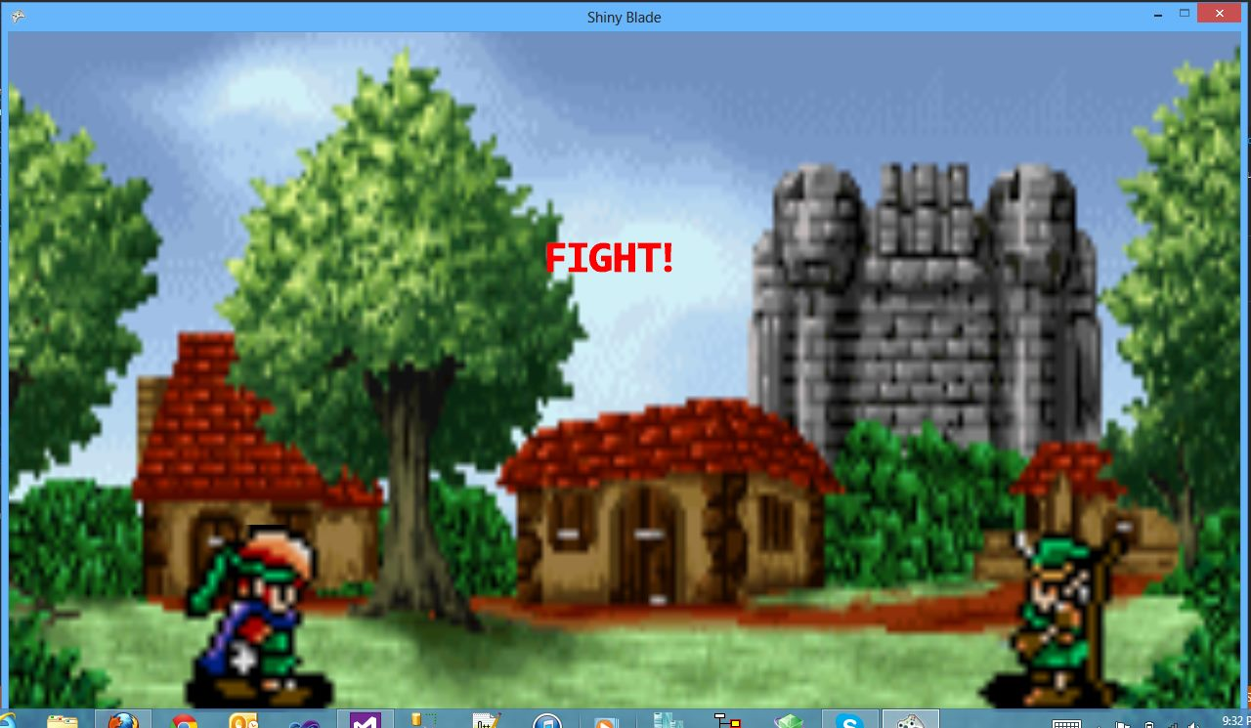
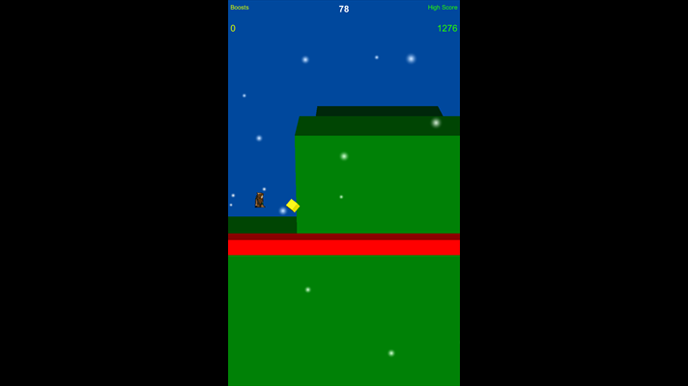
About Me
Started game dev with XNA in April 2012
Started learning Unity with release of 4.3 2D tools (November 2013)
Released Windows Phone game Archner built with Unity (June 2014)
My favorite games:
FF Tactics, Metal Gear Solid 2, Shadow of the Colossus, Mirrors Edge, Halo 1, Mario 64, Zelda TP, Metroid Prime, FF7, Mario 3
Notes:
Share my Unity Setup.

Slide 4
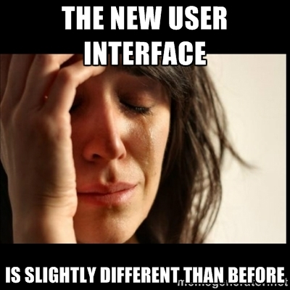
User interface in Unity 5

Slide 5
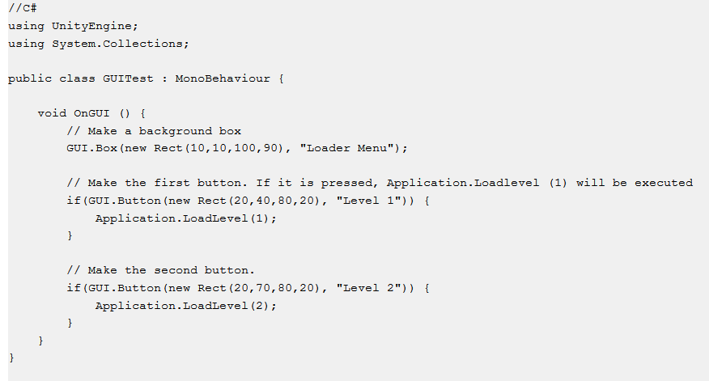
Old way of doing UI
OnGUI
Notes:
Open the GUI script and show the different properties of the GUI object.

Slide 6
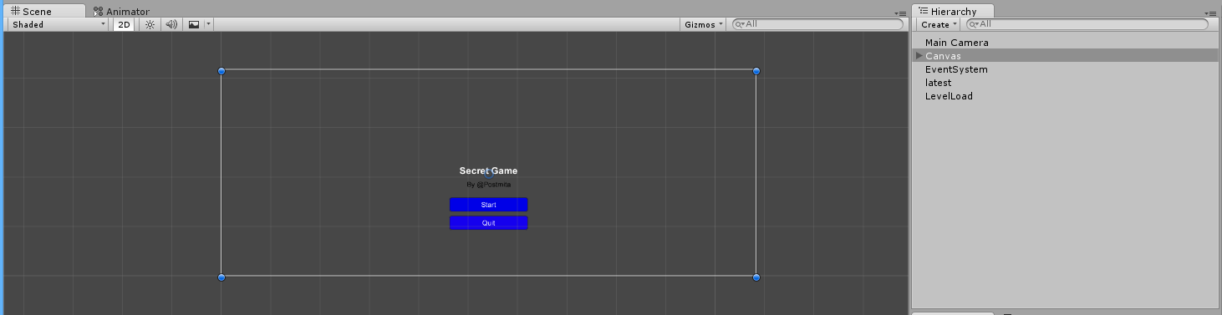
User Interface controls in Unity 5
Canvas
All UI elements live inside a canvas Game Object.
If a UI element is created a Canvas is automatically created if needed.
It’s shown as a rectangle in the Scene view.

Slide 7
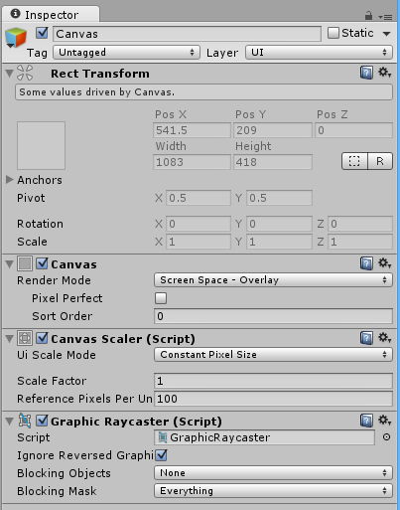
Canvas
UI elements are drawn in order – Top to Bottom, back to front.
Render modes: Screen Space Overlay
UI elements are rendered on top of the scene.
If resolution changed canvas will change to match size
Screen Space Camera
Canvas is placed a distance from a specified camera and sized based on that.
World Space (part of game world)
The Canvas behaves like other objects in the scene and render in front or behind objects.
Notes:
Show FPS Scene.

Slide 8

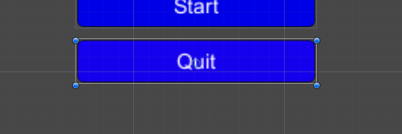
The Rect Tool
Used to Move, Resize, and Rotate UI elements.
Click and Drag to move
Resize by clicking on edges and dragging.
Rotated by clicking and dragging on corners.
<T> to select it via keyboard.

Slide 9
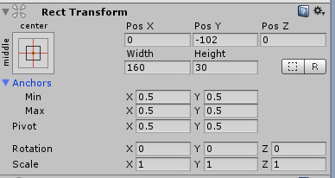
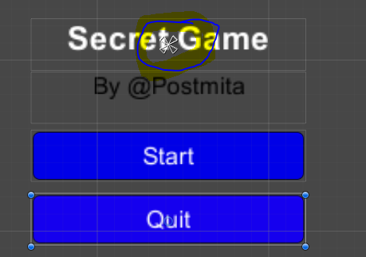
Rect Tranform
UI elements have a Rect Transform instead of regular Transform
Has position, rotation and scale
Has Width and height to specify dimensions of the rectangle.
When using the rect tool it will change width and height instead of Scale.
The pivot point affects outcome
Anchors are used to keep the UI element attached to the anchor point.
The anchor Min corresponds to lower left and Max corresponds to upper right handles in the Scene view.
Notes:
Show the anchor settings.

Slide 10
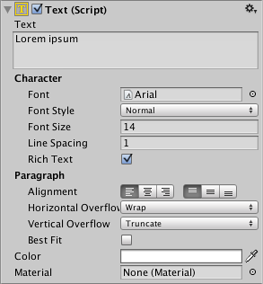
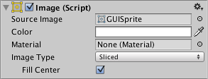
Visual Components
Text
Raw Image
Mask
Effects
Image
Types:
Sliced
Simple
Tiled
Filled

Slide 11


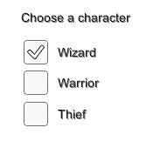



Interaction Components
Button
Toggle
Toggle Group
Slider
Scrollbar
Input Field
Notes:
Talk about and show buttons.

Slide 12
Transitions (buttons and sliders)
Types:
Color Tint – Changes colors based on state
Sprite Swap – Changes sprites based on state
Animation – Animates to change set based on state.
States
Normal
Highlighted
Pressed
Disabled

Slide 13
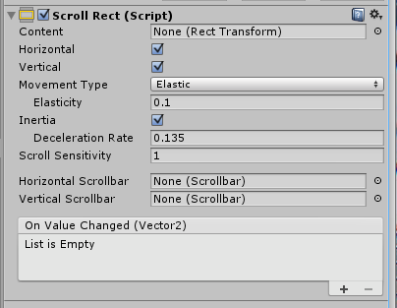
Scroll Rect
Allows content to be scrolled or clicked and dragged.
Commonly used with a mask to hide the other content.
Scroll bars will automatically hook up.
Movement types:
Unrestricted
Elastic
Clamped
Notes:
Show destiny scroll in FPS Scene.

Slide 14
Rich Text
Tag | Description | Example | Notes
b | Renders the text in boldface. | We are <b>not</b> amused.
i | Renders the text in italics. | We are <i>usually</i> not amused.
size | Sets the size of the text according to the parameter value, given in pixels. | We are <size=50>largely</size> unaffected. | Although this tag is available for Debug.Log, you will find that the line spacing in the window bar and Console looks strange if the size is set too large.
color | Sets the color of the text according to the parameter value. The color can be specified in the traditional HTML format. #rrggbbaa …where the letters correspond to pairs of hexadecimal digits denoting the red, green, blue and alpha (transparency) values for the color. For example, cyan at full opacity would be specified by | <color=#00ffffff>… | Another option is to use the name of the color. This is easier to understand but naturally, the range of colors is limited and full opacity is always assumed. <color=cyan>… The available color names are given in the table below.
Text for UI elements and meshes can have multiple font styles and sizes.
Similar to HTML by putting the section in a pair of matching tags: We are <b>not</b> amused.
Debug.Log() can also have markup tags.
Color tags can be used.
Notes:
Show click methods from old GUI script.

Slide 15
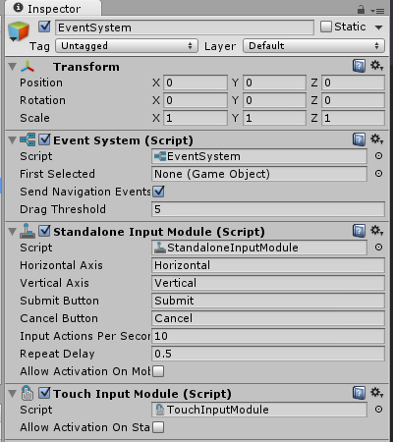
Event System
The Event system object is created whenever a canvas is created.
Event components can be added to UI items.
Notes:
Let’s do an event system in the destiny scene. Or in the FPS. Add an event to the Image and have it do something when the pointer enters.

Slide 16
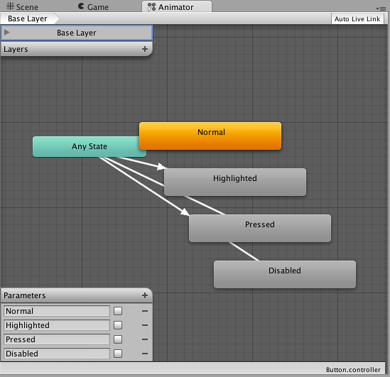
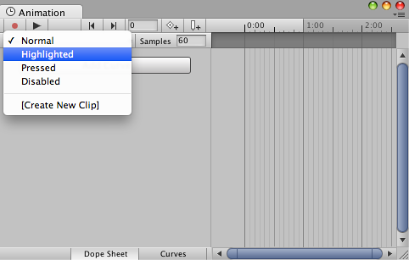
UI Animation Integration
Allows for transitions between control states.
Animator Component needs to be attached.
The states can be recorded and edited using the Animation window.
Properties can have parameters set per keyframe.
Sharing animator controllers can have several buttons share the same behavior.

Slide 17
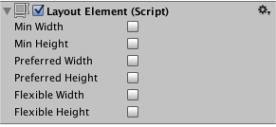
Auto layout
Property: | Function:
Min Width | The minimum width this layout element should have.
Min Height | The minimum height this layout element should have.
Preferred Width | The preferred width this layout element should have before additional available width is allocated.
Preferred Height | The preferred height this layout element should have before additional available height is allocated.
Flexible Width | The relative amount of additional available width this layout element should fill out relative to its siblings.
Flexible Height | The relative amount of additional available height this layout element should fill out relative to its siblings.
Layout Element Component
Allows you to override the minimum, preferred, or flexible size.
Enable the checkbox for a property you want to override.

Slide 18
Questions
Questions?
Jokes?

Slide 19
Contact info
Twitter: @Postmita
Email: jvpostma@gmail.com
Dev blog: Postmita.blogspot.com

