Slide 1
Bloom
Simple, Safe, Fun Book Vernacular Production Software

Slide 2
Summary
Bloom is a proposed desktop computer software application. It aims to encourage a low-training, high-output system where native speakers and their advocates work together to both foster community authorship and access to external material in the vernacular.

Slide 3
User Profiles
Like WeSay, there are two intended users:
The primary user is a Mother Tongue Literacy Worker. She has basic computer skills, little access to technical help.
The secondary user is the Advisor/Advocate. He or she has more advanced computer skills and lots of access to technical help.

Slide 4
Key Ideas
The key ideas of Bloom are simple.
Provide lots of templates, and let people fill them in.
The closest analogy is how presentation software (e.g. PowerPoint) works. These programs generally encourage pumping out the content, not tweaking the layout.
Hide the file system, just show books.
Make it trivial to share the library with remote colleagues.

Slide 5
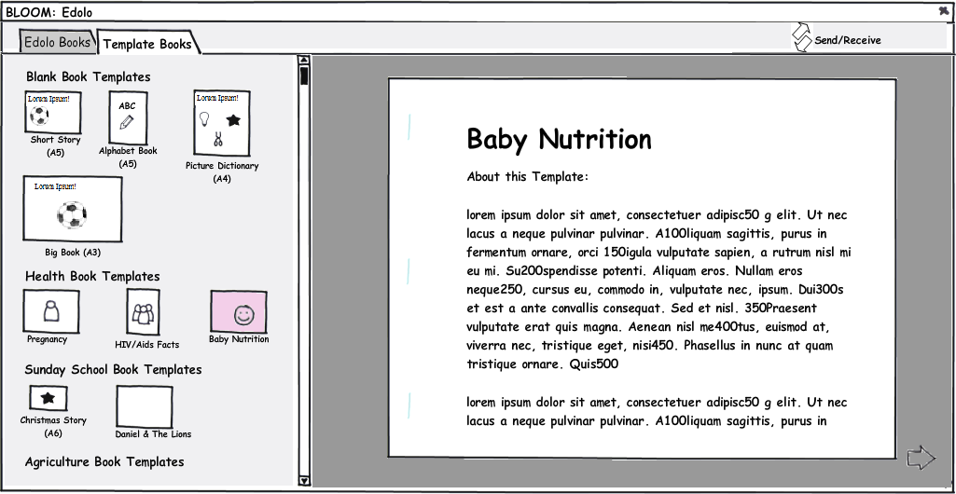
Templates
Bloom attempts to make things simple by replacing many of the operations of normal Page Layout applications (flow, size, format, crop, etc.) with ready-made templates.
So the first step in making a book is looking through the available templates and choosing one to use as the basis for a book.

Slide 6
Blank Book Templates
The templates at the top are just layout aids. These are used for locally authored titles.
A template has a paper size and orientation.
(nb: Picture Dictionary is perhaps out of place in this illustration… if it comes with illustrations and national-language words, then it’s more of a shell book)

Slide 7
Shell Book Templates
At the bottom of the Templates tab are templates which come with content in one or more major languages. With these, your job is to translate them.
This part of the task should be very similar to Mike Trainum’s “ShellBook Maker” program, so it has not been illustrated in this document. The user can read what the page says English and Tok Pisin versions, and also read other background material related to the page. He cannot add new pages. If his text is too long, the type-face automatically shrinks.

Slide 8
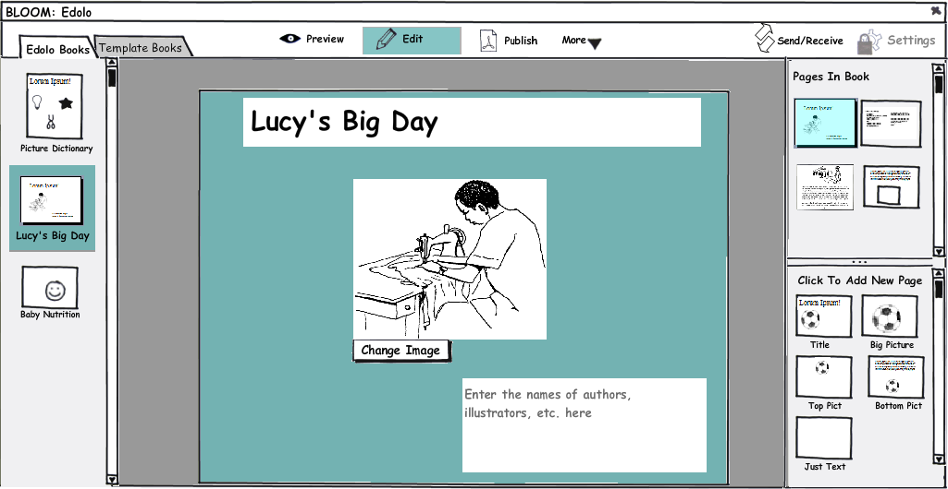
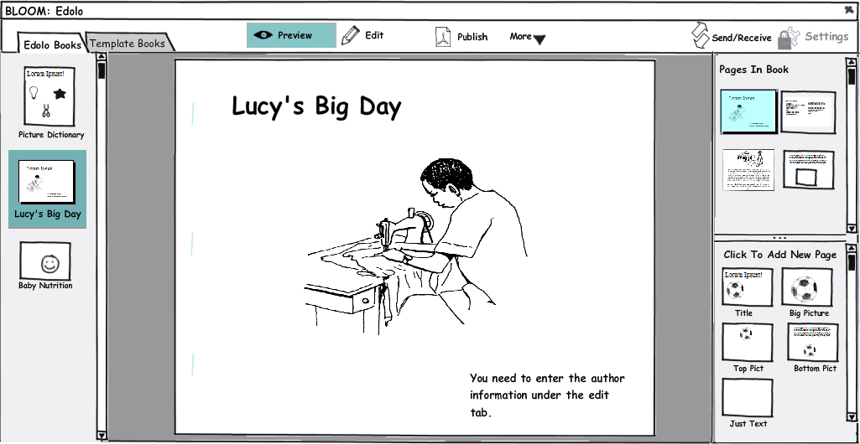
Our books collection
The collection of vernacular books in our library is shown under a tab. Clicking on one lets us preview, edit, or publish it.
Notice that the user never has to go find a book on her hard drive.
If more than one person is working on books, those books will appear in everyone else’s library when they do a Send/Receive.

Slide 9
Here we see the cover of the book, in Edit mode. The user has 3 things to do. She’s already typed in the title & chosen an illustration. She hasn’t yet entered the names of the authors.

Slide 10
In the upper right, we see all the pages which are in the book so far. The current page is always highlighted. Clicking on one takes us to that page. Dragging them reorders the page.

Slide 11
In the lower left, we see the kinds of blank pages which this book templates provides. Clicking on one adds it to the book we’re working on.

Slide 12
MetaData
An important task in book making is getting all the meta data together. Who holds the copyright? How is it licensed? Who to contact for more copies? ISBN number, etc.

Slide 13
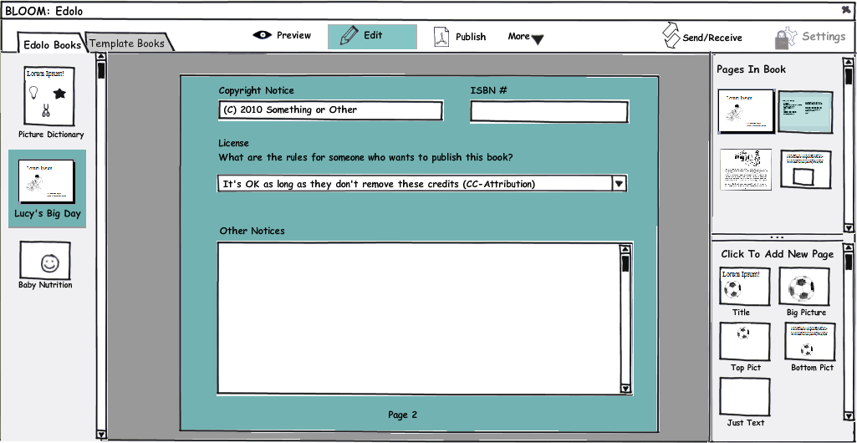
Notice the “Edit” tab doesn't attempt to give WYSIWYG... instead it is optimized to help you know what to do.

Slide 14
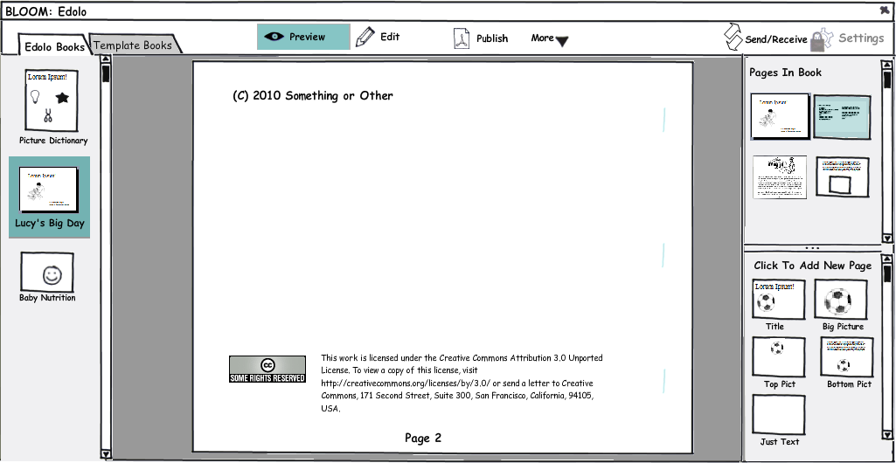
Then in “preview”, we see how that data will appear in the printed document.

Slide 15
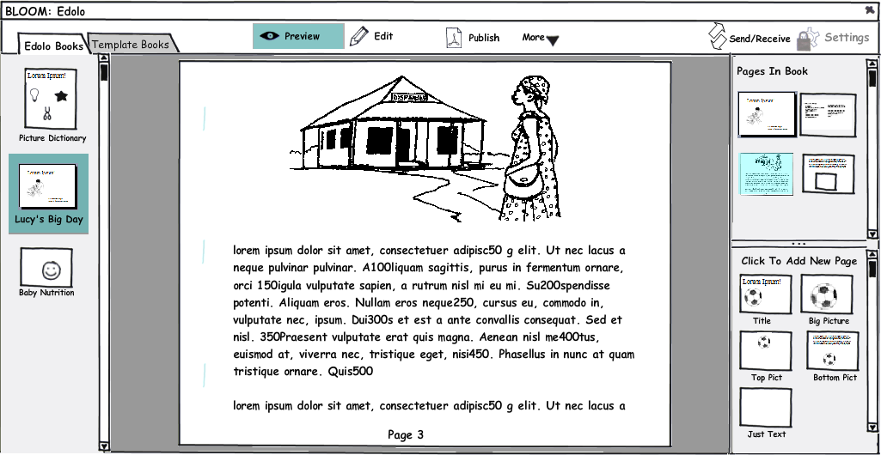
Here we see the a completed page under “Preview” mode. You may be able to make out the faint staple marks on the left side.

Slide 16
Illustrations
When the template has an illustration frame, it provides buttons for getting the illustration in. The adviser will enable the buttons which make sense for this user. These might include getting a picture from a disk, from a gallery (e.g. Art of Reading), a scanner, or a digital camera (with some automatic filter for turning the image into hi-contrast line art, if that's possible).
We would try to avoid cropping and sizing options, at least initially, doing as much as possible automatically (e.g. expanding the image to fit the frame).

Slide 17
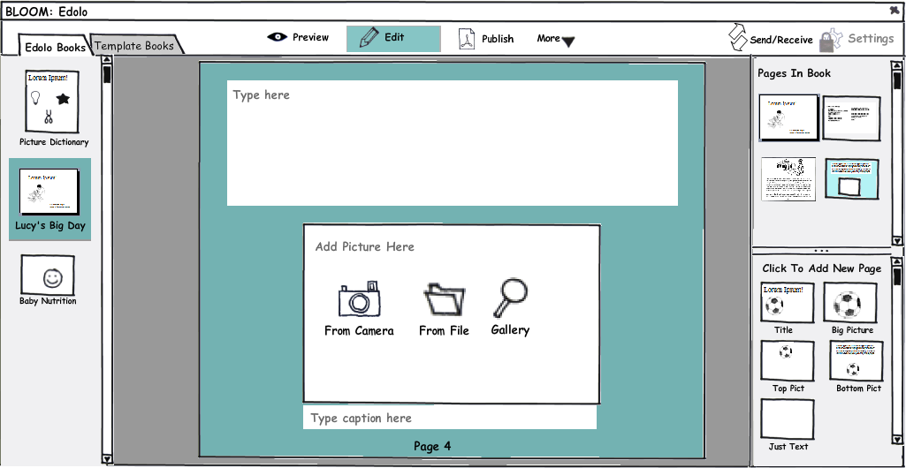

Slide 18
Publish Mode
Here, I'm trying to see how much Bloom could help people with the physical act of printing and assembling books. The following is of course specific to this pesky landscape A5 format of the selected book. Other formats would have different instructions. We could easily include a short video, as well.

Slide 19
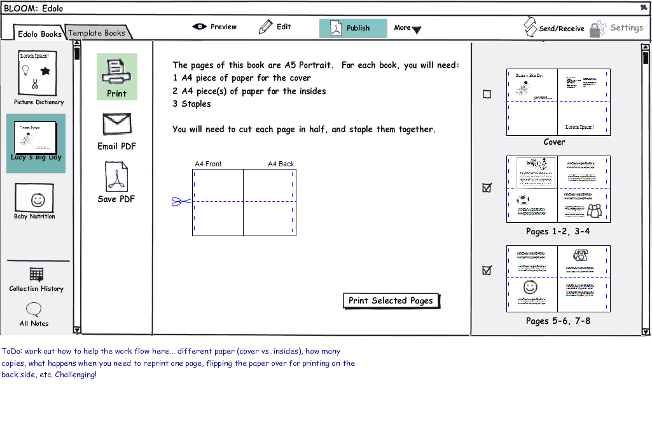

Slide 20

History & Notes
Using the Chorus library, Bloom would be able to send changes and receive the changes of other team members over the internet, via USB flash drives, or a local network. Thus all of our work is safe & viewable by the advisor. Also, any new template books that have been built could show up in our list of available templates.
In addition to this sending and receiving, Chorus opens up the ability to offer History and Notes features.
In the following slides, I look at how that might look if incorporated into Bloom.

Slide 21
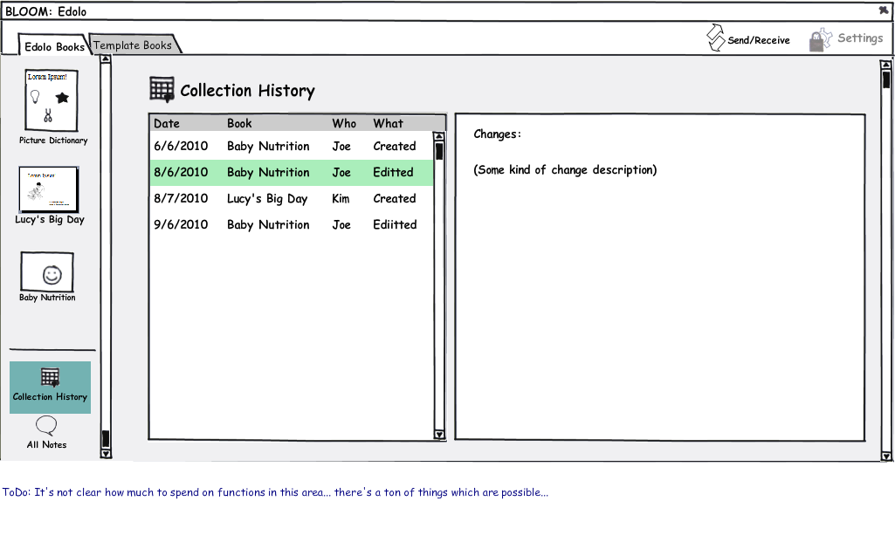

Slide 22
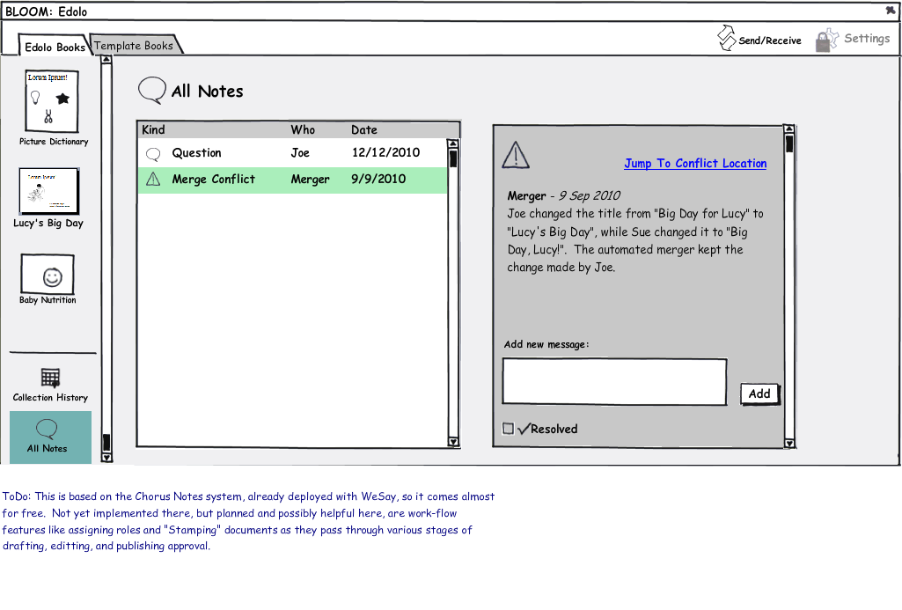

Slide 23
Settings
With WeSay, we had good success with separating the program into 2 parts... the “Configuration Tool” and WeSay itself.
With Bloom, I'm trying to get rid of the separate applications, while keeping the benefits. All settings are under a single tab, which would ordinarily be locked. When locked, the adviser can still get to it by pressing some magic key combination.

Slide 24
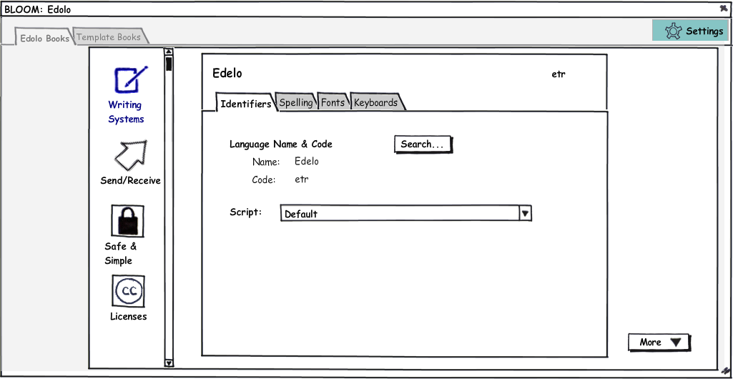

Slide 25
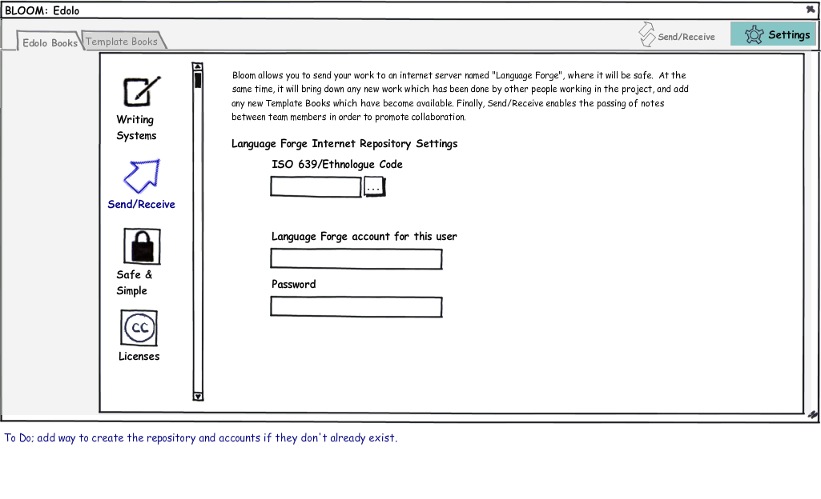

Slide 26
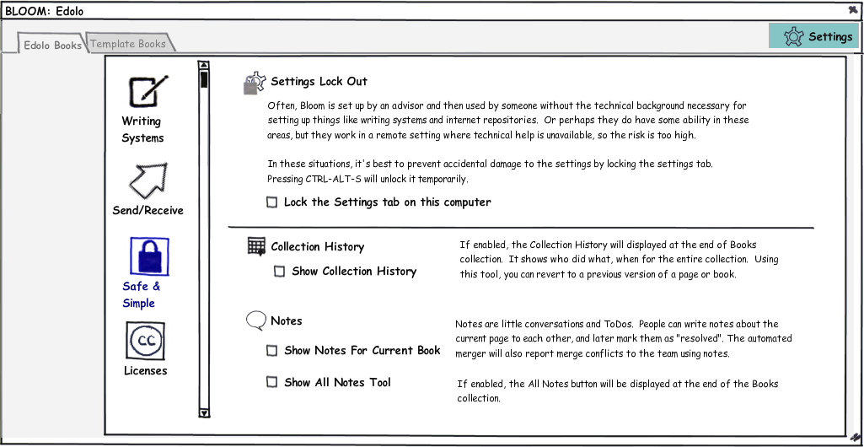

Slide 27
