Slide 1

Easy, Fun Vernacular Book Production

Slide 2
Audience
This document is intended to help Literacy Consultants understand and give feedback on the Bloom concept.

Slide 3
Summary
Bloom is a proposed desktop computer software application. It aims to encourage a low-training, high-output system where mother tongue speakers and their advocates work together to foster both community authorship and access to external material in the vernacular.

Slide 4
User Profiles
Like WeSay, there are two intended users:
The primary user is a Mother Tongue Literacy Worker. She has basic computer skills, little access to technical help.
The secondary user is the Advisor/Advocate. He or she has more advanced computer skills and lots of access to technical help.

Slide 5
Key Goals
Templates
Provide lots of templates, and let people fill them in.
The closest analogy is how presentation software (e.g. PowerPoint) works. These programs generally encourage pumping out the content, not tweaking the layout.
No File System
Hide the file system, just show books.
Sharing
Make it trivial to share the library with remote colleagues.
Customizing
Make it easy to get existing templates/shell books into the system.
Tweaking
Make it easy to open the resulting books in a full-strength page layout program for tweaking.

Slide 6
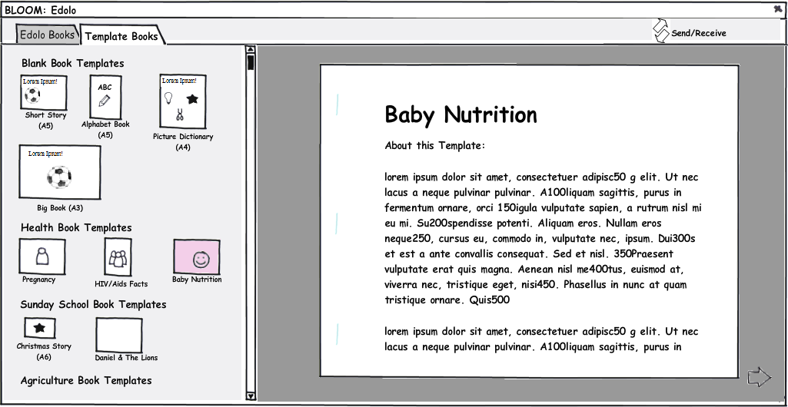
Templates
Bloom keeps things simple by replacing many of the operations of normal Page Layout applications (flow, size, format, crop, etc.) with ready-made templates.
So the first step in making a book is looking through the available templates and choosing one to use as the basis for a book.

Slide 7
Templates
Where do templates come from?
Bloom would come with some templates, but literacy advisors could copy them and make their own. They are just files, editable in some full-strength open-source program. See the section on “File Formats” for more information.
Templates would also be available on internet repositories. In areas with occasional internet access, advisors could set up Bloom to “subscribe” to one or more of these, so that as new templates become available, they would show up in Bloom.

Slide 8
Templates
The actual templates would be created by literacy specialists, or you yourself, not by a software developer.
Therefore, pay no attention to the details of the templates you see in this document.
These details are not part of the proposal.

Slide 9
Blank Book Templates
The templates at the top are just layout aids. These are used for locally authored titles.
A template has a paper size and orientation.
(nb: Picture Dictionary is perhaps out of place in this illustration… if it comes with illustrations and national-language words, then it’s more of a shell book)

Slide 10
Shell Book Templates
At the bottom of the Templates tab are templates which come with content in one or more major languages. With these, the user’s job is to translate them.
This part of the task should be very similar to Mike Trainum’s “ShellBook Maker” program, so it has not been illustrated in this document. The user can read what the page says in national language versions, and also read other background material related to the page. He cannot add new pages.

Slide 11
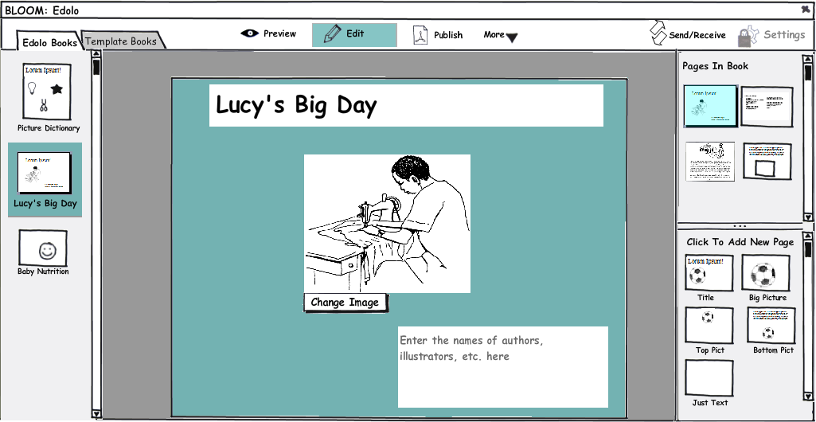
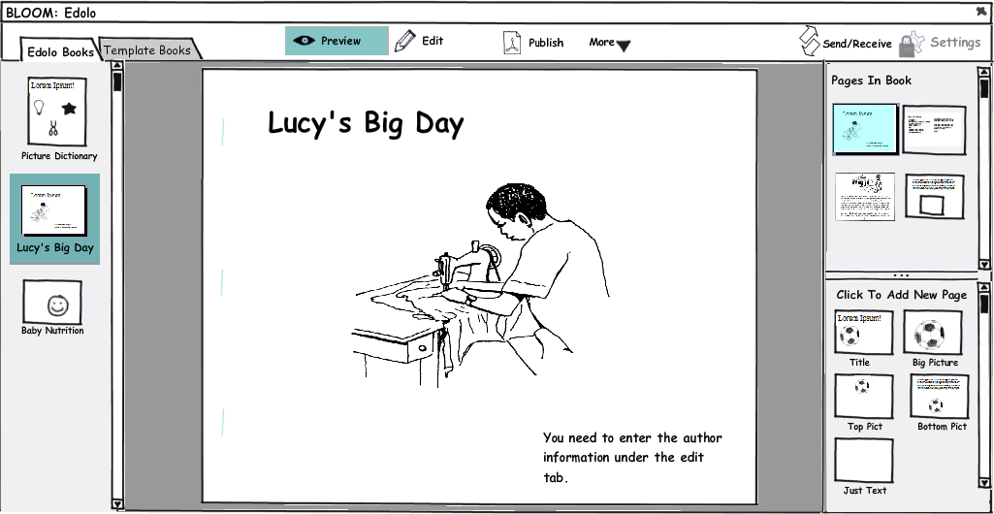
Our books collection
The collection of vernacular books in our library is shown under a tab. Clicking on one lets us preview, edit, or publish it.
Notice that the user never has to go find a book on her hard drive.
If more than one person is working on books, those books will appear in everyone else’s library when they do a Send/Receive.

Slide 12
Here we see the cover of the book, in Edit mode. The user has 3 things to do. She’s already typed in the title & chosen an illustration. She hasn’t yet entered the names of the authors.

Slide 13
In the upper right, we see all the pages which are in the book so far. The current page is always highlighted. Clicking on one takes us to that page. Dragging them reorders the page.

Slide 14
In the lower left, we see the kinds of blank pages which this book templates provides. Clicking on one adds it to the book we’re working on.

Slide 15
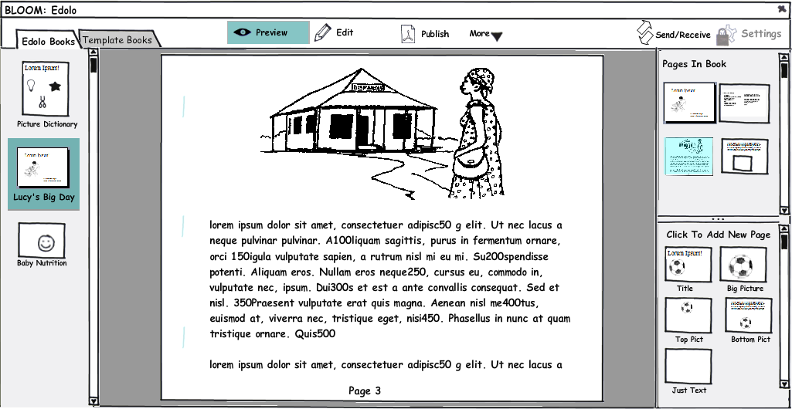
Here we see the a completed page under “Preview” mode. You may be able to make out the faint staple marks on the left side.

Slide 16
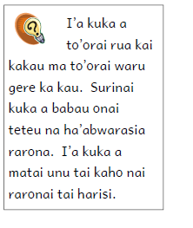
Text Sizing
What to do when the amount of text exceeds the room we have to put it in? In some situations, it may be OK to automatically shrink the text. The template would define a ideal font size, and a minimum size. If these two numbers are the same, then you can only type until the box is filled up. If the minimum is smaller, then once the box is filled, but you keep typing, the text gets smaller. When the font reaches the minimum size for that box, you can’t type any more.
I’m unable to say how often this will be useful. For sure, we’ve been told that in some situations, like a primer, we want to keep the font size consistent throughout. In that case, we would like to be able to shrink pictures to fit. This may be complicated to pull off, as it may require that page elements know their relationship to each other, for example, in the illustration here, the page knows that the text should wrap around the picture. It’s unlikely that early versions of Bloom would have that feature.

Slide 17
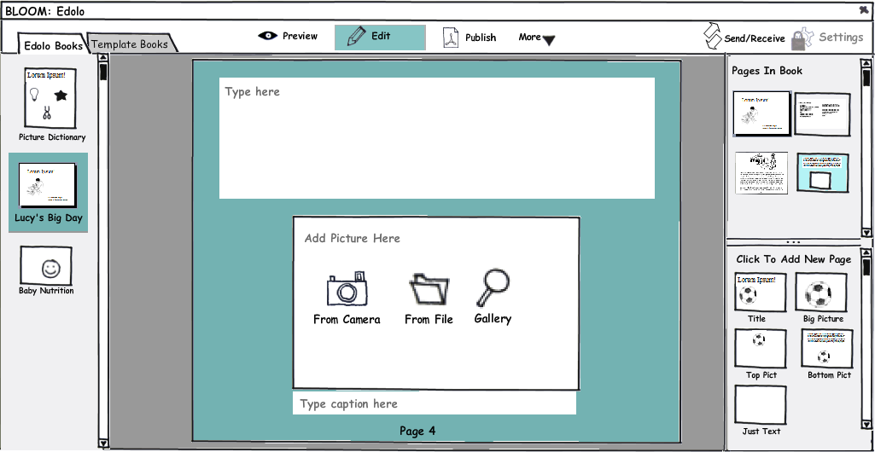
Illustrations
When the template has an illustration frame, it provides buttons for getting the illustration in. The adviser will enable the buttons which make sense for this user. These might include getting a picture from a disk, from a gallery (e.g. Art of Reading), a scanner, or a digital camera (with some automatic filter for turning the image into hi-contrast line art, if that's possible).

Slide 18
Illustrations
We would try to avoid cropping and sizing options, at least initially, doing as much as possible automatically (e.g. expanding the image to fit the frame).
Some automatic things we could do:
Illustrations would be copied into the document itself, so that the picture cannot be accidentally separated from the document.
Large photos would be compressed down to what makes sense for printing.
When scanning or photographing a line drawing, an image filter could be automatically applied to improve the contrast and filter out noise.

Slide 19
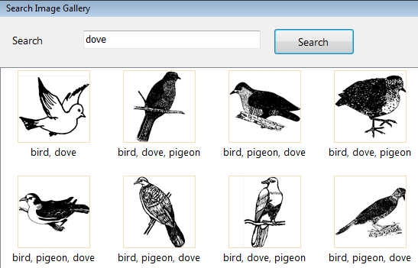
Illustrations
The gallery button would open a searchable set of thumbnails, like we have in WeSay. In addition to SIL’s Art Of Reading, advisors could set up their own galleries.

Slide 20
Illustration Licenses
Keeping track of and honoring copyrights and licenses is a little recognized problem, at least in SIL. It is technically possible to keep this information with each image file. For example, Art of Reading could easily embed, in each illustration file, the fact that it may be freely used but not modified. Other images may have an “attribution” license, where they may be freely used but the work must be attributed to the artist, say, on the meta data page.
A nice thing for Bloom to do, then, would be to help the user ensure that the license applied to the book is compatible with those of the illustrations, and to automatically include any attributions it finds in the illustrations.

Slide 21
MetaData
An important task in book making is getting all the meta data together. Who holds the copyright? How is it licensed? Who to contact for more copies? ISBN number, etc.

Slide 22
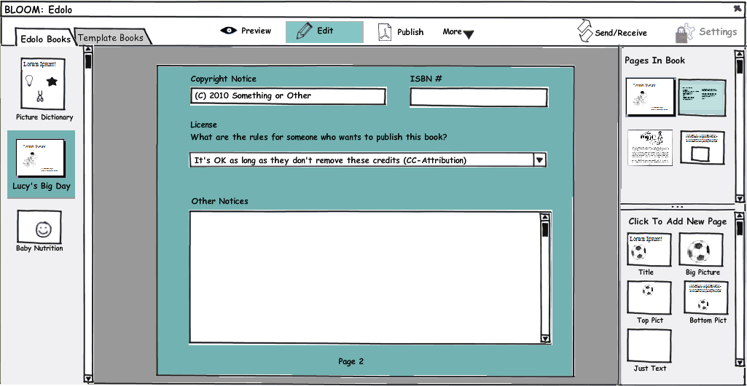
Notice the “Edit” tab doesn't attempt to give WYSIWYG... instead it is optimized to help you know what to do.

Slide 23
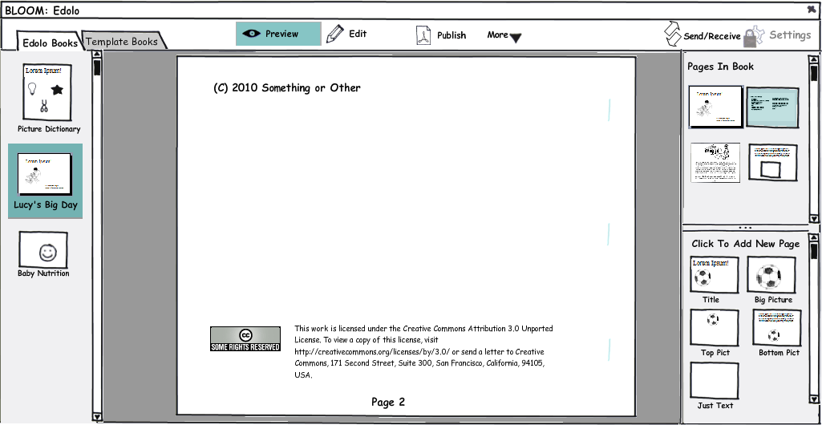
Then in “preview”, we see how that data will appear in the printed document.

Slide 24
Publish Mode
Here, I'm trying to see how much Bloom could help people with the physical act of printing and assembling books. The following is of course specific to this pesky landscape A5 format of the selected book. Other formats would have different instructions. We could easily include a short video, as well.

Slide 25
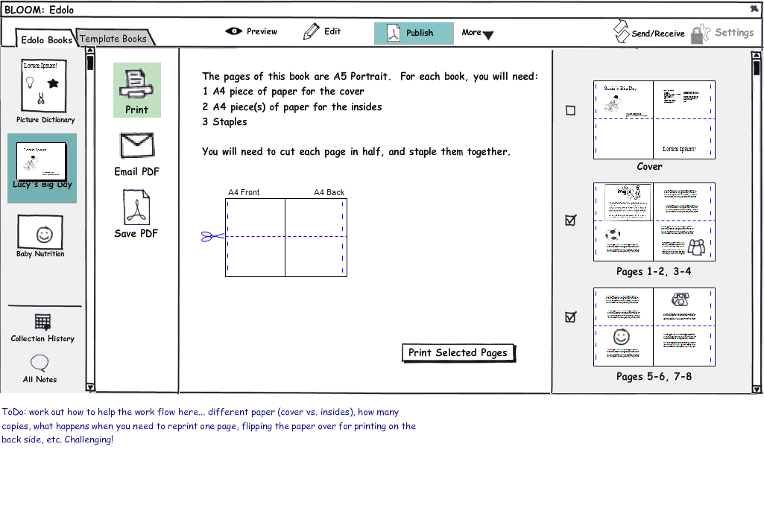

Slide 26

History & Notes
Using the Chorus library, Bloom would be able to send changes and receive the changes of other team members over the internet, via USB flash drives, or a local network. Thus all of our work is safe & viewable by the advisor. Also, any new template books that have been built could show up in our list of available templates.
In addition to this sending and receiving, Chorus opens up the ability to offer History and Notes features.
In the following slides, I look at how that might look if incorporated into Bloom.

Slide 27
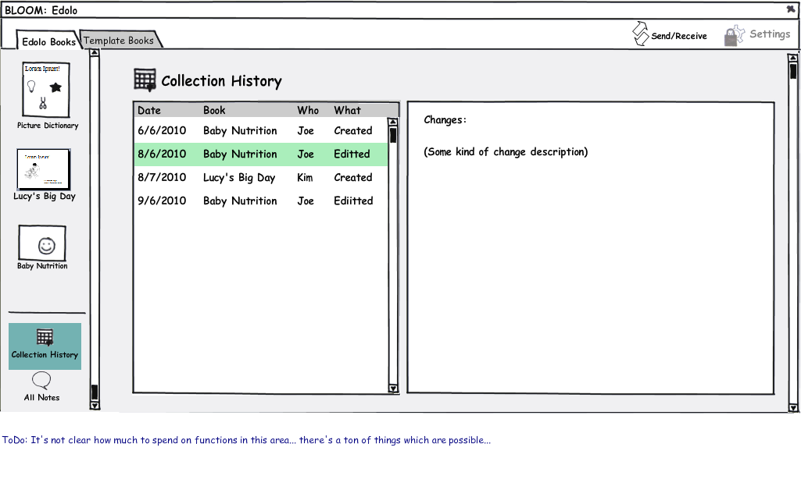

Slide 28
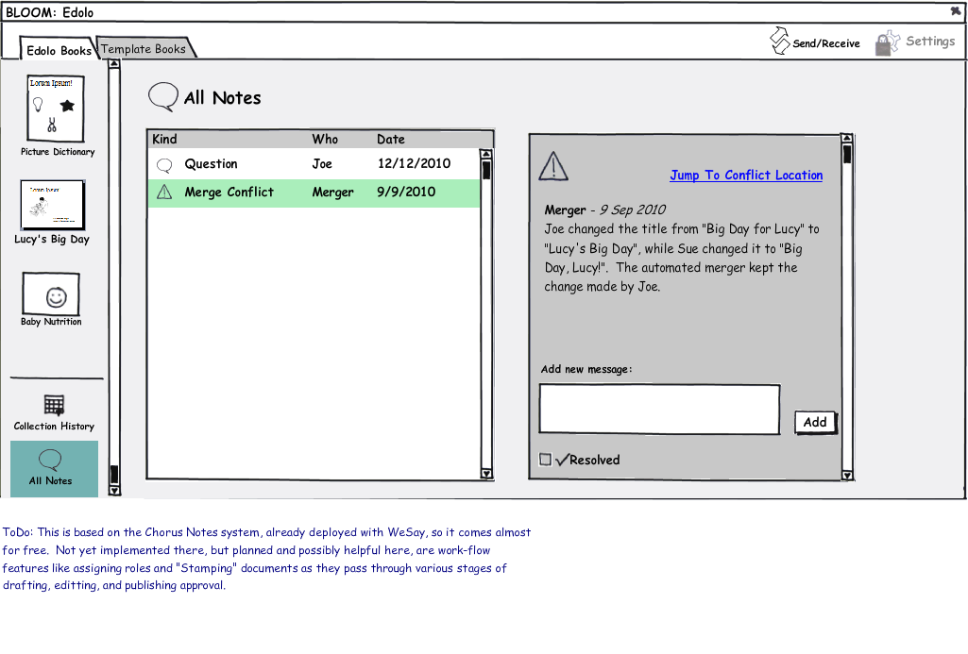

Slide 29
Settings
With WeSay, we had good success with separating the program into 2 parts... the “Configuration Tool” and WeSay itself.
With Bloom, I'm trying to get rid of the separate applications, while keeping the benefits. All settings are under a single tab, which would ordinarily be locked. When locked, the adviser can still get to it by pressing some magic key combination.

Slide 30
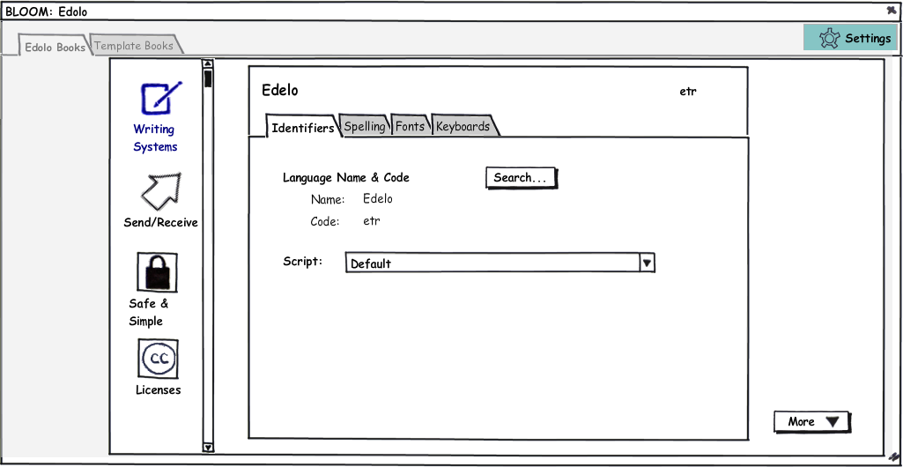

Slide 31
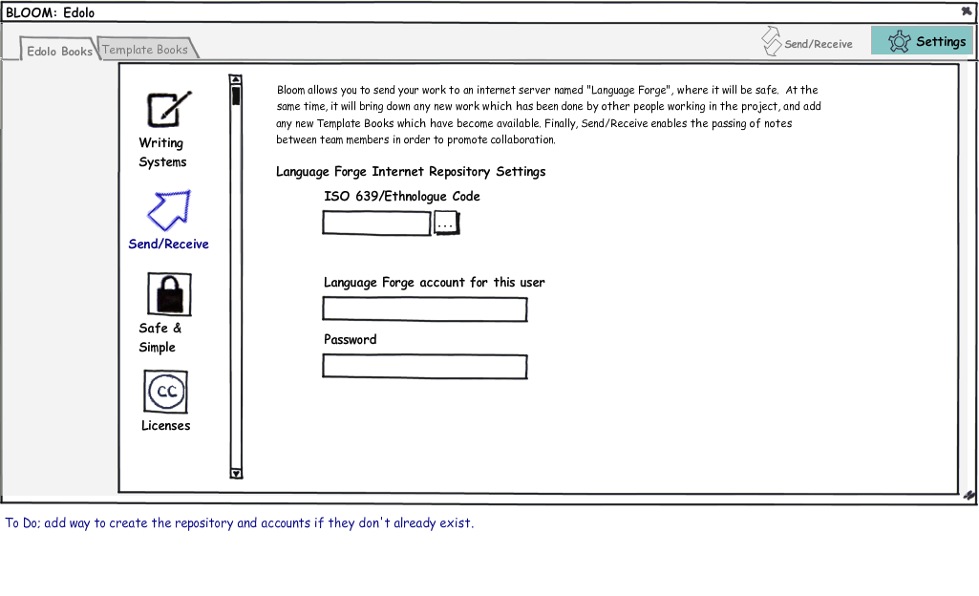

Slide 32
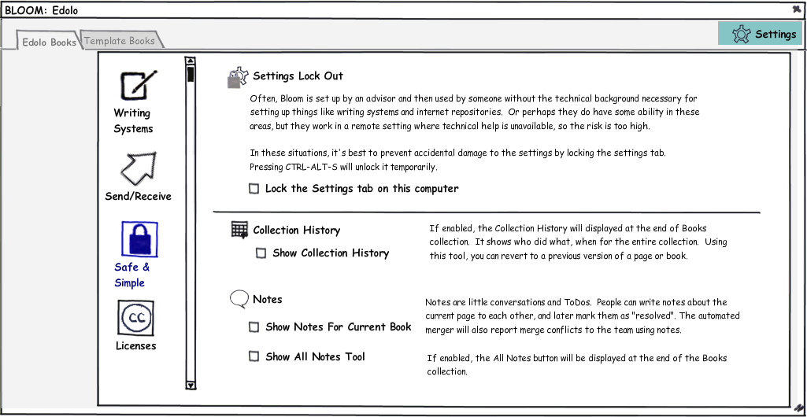

Slide 33
Licenses
In PNG we are promoting shift in attention away from simple “Copyright” with an “all rights reserved” message, to an explicit license which applies to everyone. That is, the copyright is still there, but the copyright holder(s) agree to offer the content for reuse under specified conditions, as in “some rights reserved”. For example, they might agree that derivative works can be made, but only non-commercially, and only if the derivative works still gives them credit.
It is the absence of such licenses which is currently giving many of us so much grief, as we simply seek to get native-authored materials “out there” where they can do the good the authors intended for them to do.
Bloom joins a growing body of software in being license-savvy. This has two parts:
Bloom will require that the user indicate the license that the material is published under, and will embed that license in the document itself an using industry-standard format (XMP). This includes individual illustrations, which may each have their own license.
If/when Bloom supports shellbooks, it will help to enforce the terms of well-known licenses (like Creative Commons). For example, if the license on an illustration requires attribution to the artist, Bloom could make it impossible to remove his/her name.
What Bloom will not attempt is to foil efforts to remove the license by opening Bloom document in some text editor. If you go to that extreme, it’s you who is breaking the law, and it’s not worth our effort to stop you.

Slide 34
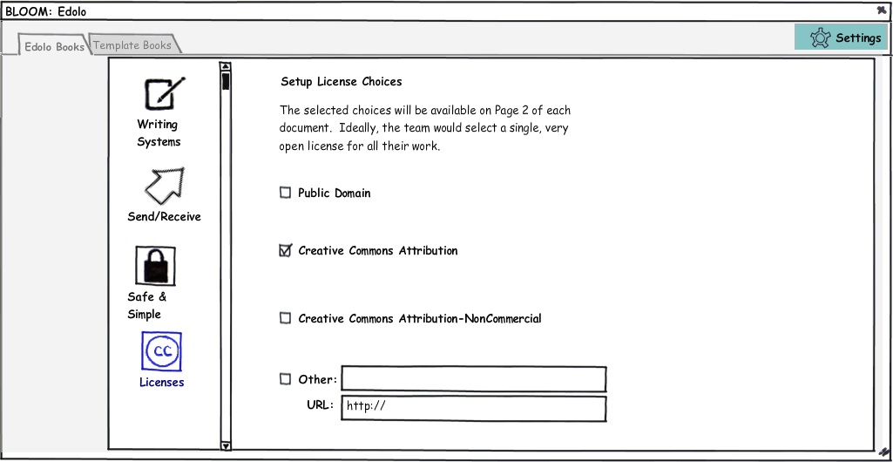

Slide 35
File Formats
The initial Bloom prototype uses a subset of the same format as web pages: xhtml (XML Hypertext Markup Language) + CSS (Cascading Style Sheets). Advantages:
Longevity
Even after Bloom goes away, you’ll always be able to open them.
Lower development/maintenance costs
We can also leverage freely-available components to do screen and print rendering, without having to program and maintain all that ourselves. For example, the prototype uses FireFox’s rendering engine.
Capability
Since Firefox can display Complex Non-Roman scripts, Bloom can too. Text can wrap around images, be laid out in tables, etc.
Other Tools
Using these open standards also means that a technician (not the target audience) may be able to use other tools, such as those from Adobe, to create content for Bloom as well as tweak Bloom-created books for final printing, when necessary.

Slide 36
Format conversion
People often ask, “How hard would it be to get documents from X to Bloom, or Bloom to X?” It’s important that as we evaluate the Bloom concept, we have realistic expectations. I can make some predictions, but I’m afraid they get a bit technical:
It’s helpful to talk about formats in terms of how constrained, or targeted they are. Html, as you can see from the Web, serves many different layout purposes, and PDF can represent any possible page. At the other end of the spectrum, Shell Book Maker’s format is tuned to the job of making basic books. Bloom’s html+css lies in-between, because in order to help the user as much as it does, it will have to require the html to be laid out in particular ways:
Shell Book Maker --> Bloom Html → Any valid Html → PDF
Moving from more targeted to less is normally easier then going the other direction.
Some implications of this:
The development effort required to automate conversion from ShellBook Maker’s format to Bloom’s may be much less than going the other direction.
We should not expect to open an existing complicated document in, say, Publisher or Pagemaker, choose “save as html” and have a Bloom-compatible book. It’s likely that creating Bloom templates/shells would require a technician who can handle actual html and css markup; the skill level should be less than that required, say, for Bible typesetting.
Going the opposite direction, however is easier. Html+CSS created by Bloom will display correctly when opened in any browser, and should be readily importable into full-strength page layout applications.

