Slide 1
Printing through Smartphone using Secured Data Transfer
Aarjan Ghimire (THA075BCT001)
Anish Poudel (THA075BCT008)
Niranjan Adhikari (THA075BCT029)
Department of Electronics and Computer Engineering
Institute of Engineering, Thapathali Campus
Febraury 3, 2022

Slide 2
Presentation Outline
Motivation
Objectives
Scope of Project
Methodology
Results
Discussion of Results
Remaining Tasks
03/02/2022

Slide 3
Motivation
Lack of tailored method to transfer documents.
Eg. Google Drive[1], MEGA[2]
Data transferring process is a back box which raises security concerns
03/02/2022

Slide 4
Project Objectives
To achieve secure document transfer
To eliminate unnecessary steps for printing over internet
03/02/2022

Slide 5
Scope of Project
Secure Document Transfer
Printing Process Automation
Hashing and Encryption of Data
Quick Response Code for better Accessibility
03/02/2022

Slide 6
Project Applications
Print over internet
High data protection because of AES-256[3] and SHA-256[4]
Better user accessibility due to QR code
With slight modification of code may provide better and easy document sharing
03/02/2022

Slide 7
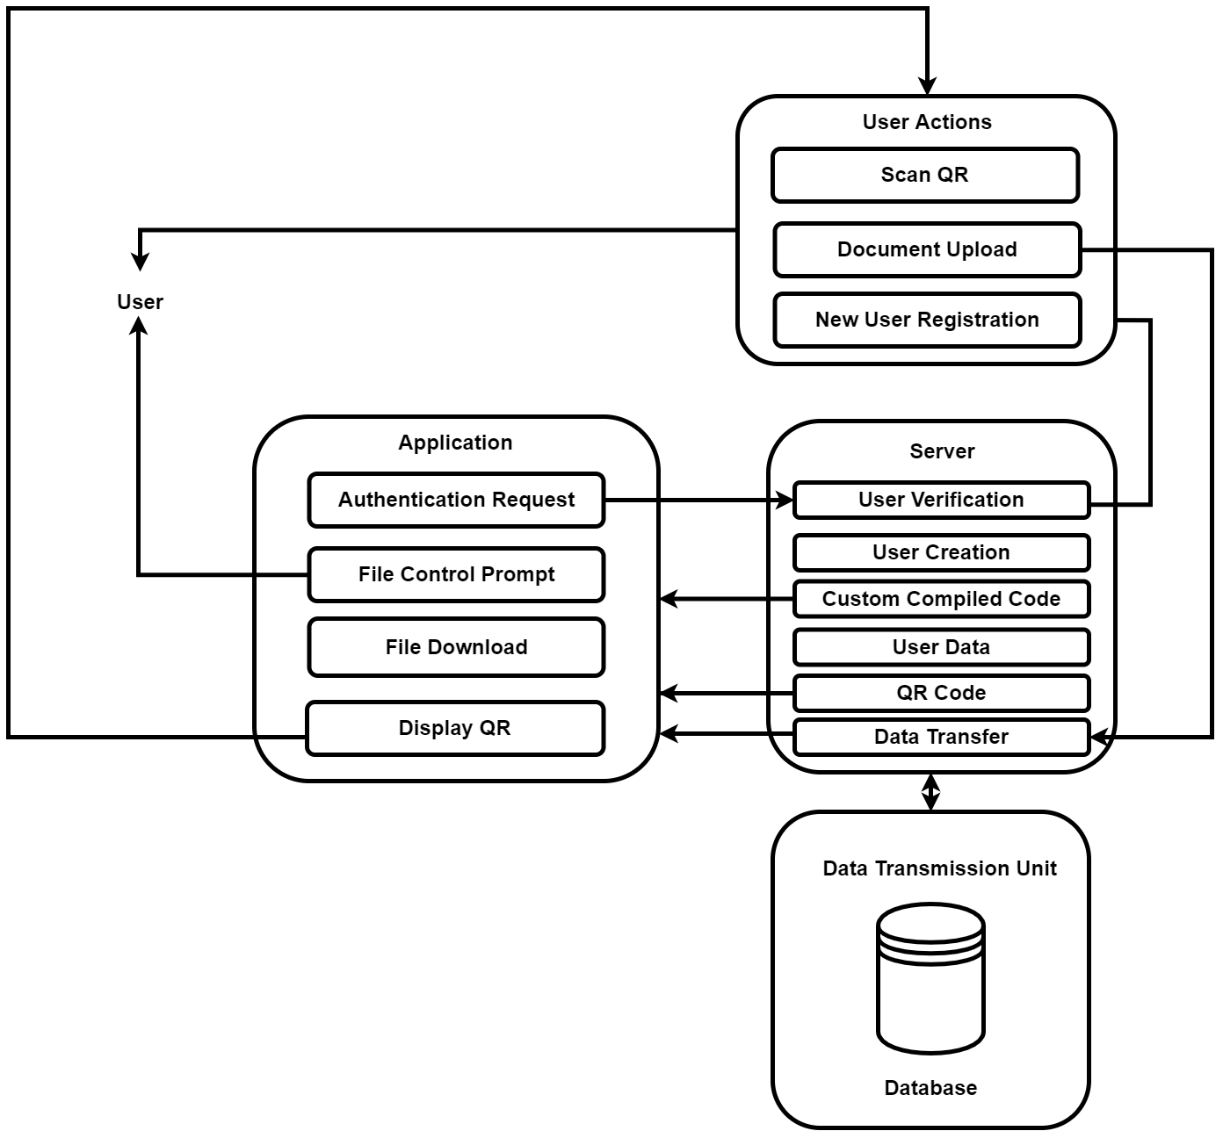
Methodology
Fig: System Diagram
03/02/2022

Slide 8
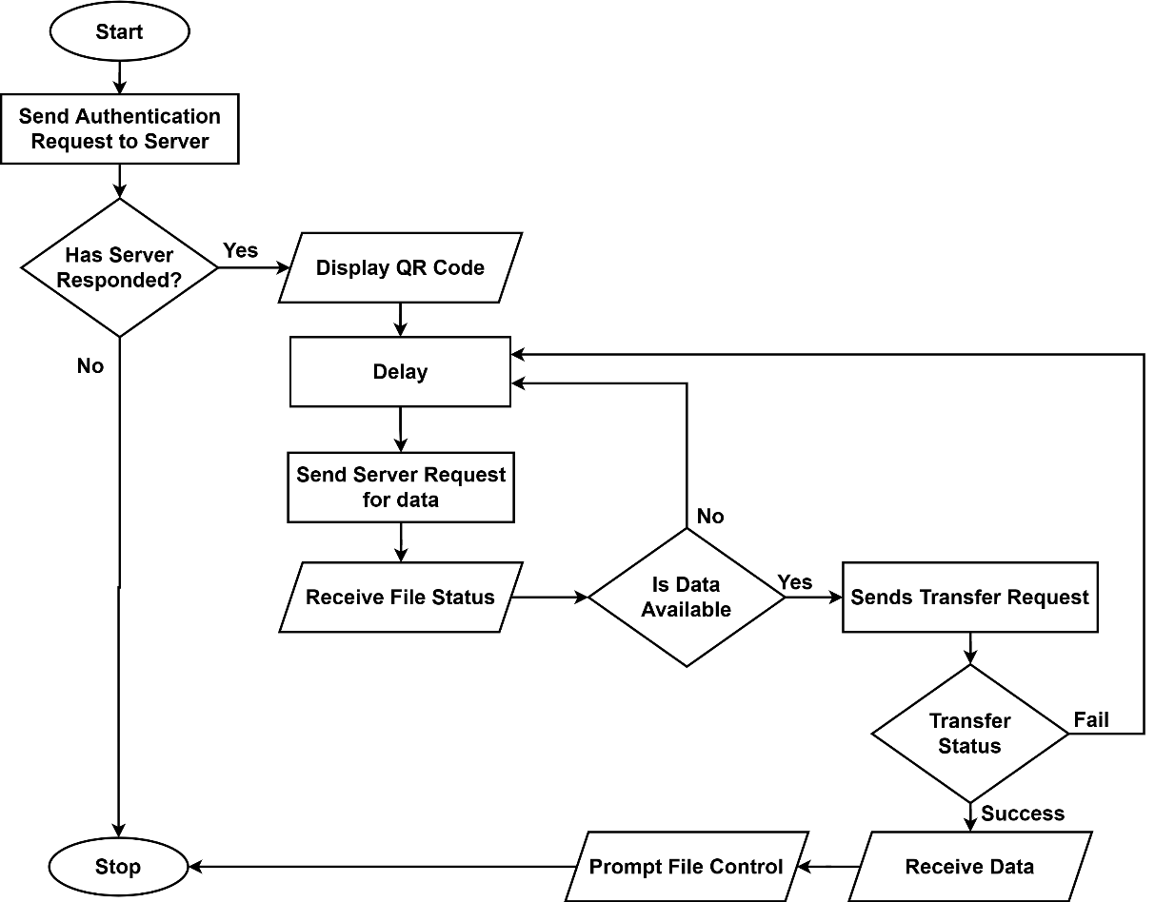
Methodology
Fig: Basic Application Flowchart
03/02/2022

Slide 9
Methodology
Tools that will be used for Project:
Hardware :
Server Space
PC to programming softwares
Internet
Software Tool:
C++
PHP
HTML, CSS, JS
Python
03/02/2022

Slide 10
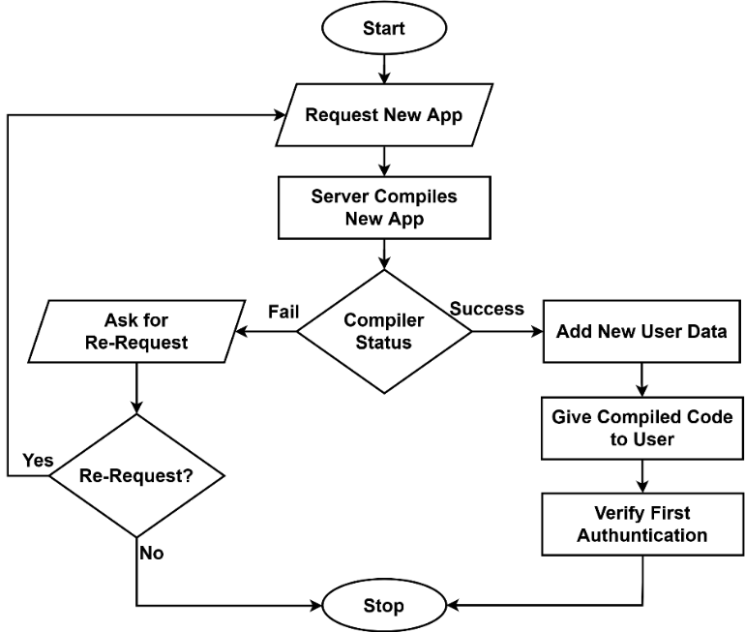
Methodology
Fig: Initial Registration Flowchart
03/02/2022

Slide 11
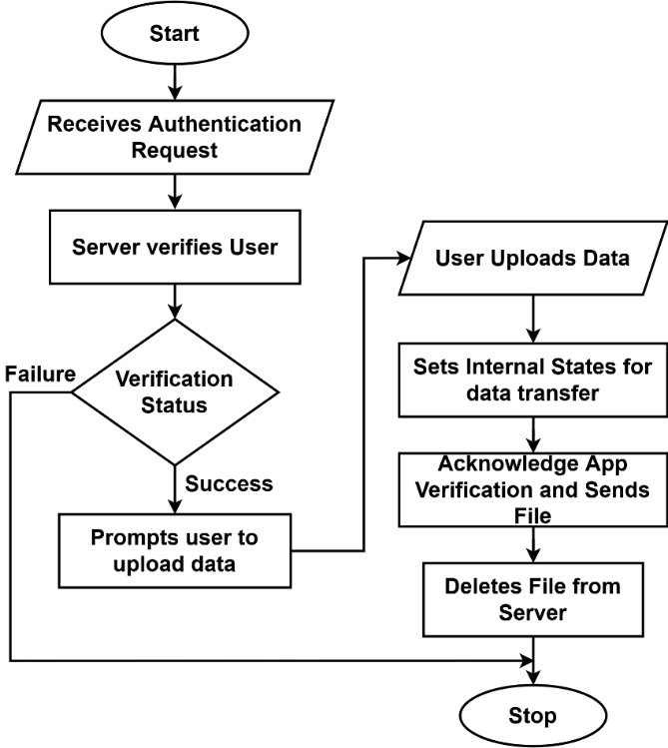
Methodology
Fig: Server Flowchart
03/02/2022

Slide 12
Methodology
Requirements to run the final Product:
Hardware Requirements:
Internet
Printer
Smartphone (QR scanner Available)
PC
Software Requirements:
Browser
Android 9.0 or later /IOS 10.0 or later
03/02/2022

Slide 13
Results
Single User Tracking and Id verification
Testing of SHA-256 algorithm is done
Testing of AES-256 algorithm is successful
Primary objective of printing process is handled
QR display and User uploading has been implemented
03/02/2022

Slide 14
Discussion of Results
The database implementation which holds the user data is still underdevelopment.
Hence, to allow us to test our system, Which only identifies the single user.
SHA-256, a hashing algorithm is developed, so that crucial user information is sent as a hash.
AES-256, a block cypher is developed and tested, so the files can be encrypted and decrypted upon need.
03/02/2022

Slide 15
Discussion of Results
Once the file is received by the application, shell command is passed thus the printing process is handled
The QR is displayed which is generated with the association of user information which allows us to track the user, if the file is for them
The Document is uploaded with the tracker id associated with the QR and the upload is facilitated through the browser’s API
03/02/2022

Slide 16
Remaining Tasks
The database implementation which holds the user data is still underdevelopment hence, to allow us to test our system. Which only identifies the single user.
03/02/2022

Slide 17
References
[1]Google. (2012). Cloud Storage for Work and Home [online]. Available: https://www.google.com/drive/
[2] MEGA Ltd. (2012, November 29). New Zealand, Available: https://mega.io
[3] National Institute of Standards and Technology (NIST). (2001). “Announcing Approval of Federal Information Processing Standard (FIPS) 180-2, Secure Hash Standard" The Daily Journal of United States Government [online], vol. 180. issue 1. Available: https://www.federalregister.gov/documents/2002/08/26/02-21599/announcing-approval-of-federal-information-processing-standard-fips-180-2-secure-hash-standard-a
[4] V. Rijmen, J. Daemen, (2001 November) "Announcing the ADVANCED ENCRYPTION STANDARD (AES)". Federal Information Processing Standards Publication [online]. Vol. 197. Issue 1. Available: https://nvlpubs.nist.gov/nistpubs/FIPS/NIST.FIPS.197.pdf
03/02/2022

