Slide 1

Arduino Programming

Slide 2
Agenda
What is Arduino?
What can I make with Arduino?
Getting started
Digital Inputs and Outputs
Analog Inputs and Outputs
Motors
Putting It All Together
Summary

Slide 3
What is Arduino?
“Arduino is an open-source electronics prototyping platform based on flexible, easy-to-use hardware and software. It's intended for artists, designers, hobbyists, and anyone interested in creating interactive objects or environments.“
http://www.arduino.cc/

Slide 4
What is Arduino?
A programming environment for Windows, Mac or Linux
A hardware specification
Software libraries that can be reused in your programs
All for FREE!*
* Except the price of the hardware you purchase

Slide 5
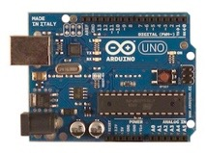
Arduino UNO
The most commonly used Arduino board
We will be using this board in this workshop

Slide 6
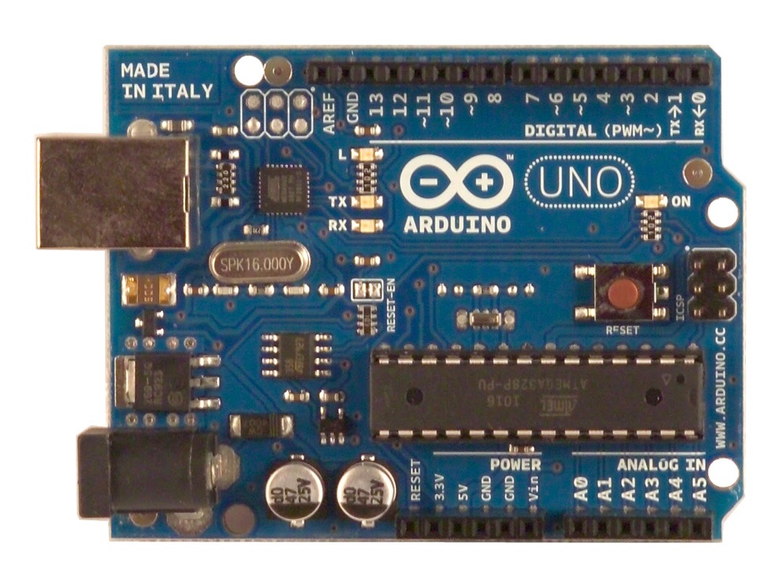
Arduino UNO
Microprocessor – Atmega328
16 Mhz speed
14 Digital I/O Pins
6 Analog Input Pins
32K Program Memory
2K RAM
1k EEPROM
Contains a special program called a “Bootloader”
Allows programming from USB port
Requires 0.5K of Program Memory

Slide 7
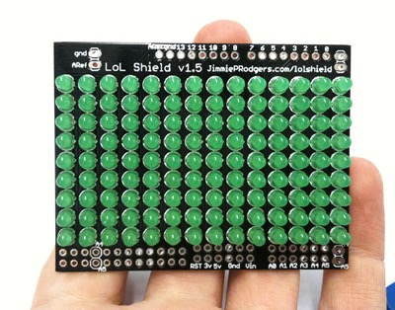
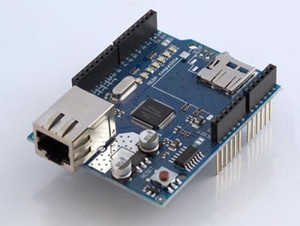
Arduino Shields
Many companies have created Shields that can be used with Arduino boards
Examples
Motor/Servo interface
SD memory card interface
Ethernet network interface
GPS
LED shields
Prototyping shields

Slide 8
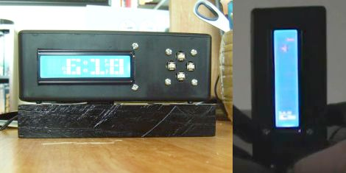
What can I make with Arduino?
Alarm Clock
http://hackaday.com/2011/07/04/alarm-clock-forces-you-to-play-tetris-to-prove-you-are-awake/

Slide 9
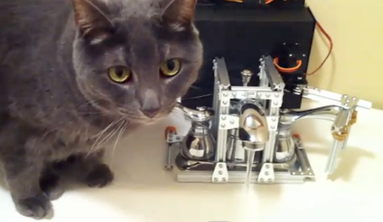
What can I make with Arduino?
Automatic Pet Water Dispenser
http://hackaday.com/2011/05/24/automated-faucet-keeps-your-cat-watered/

Slide 10
Let’s GO!
Get the hardware
Buy an Arduino UNO
Buy (or repurpose) a USB cable
Get the software
http://arduino.cc/en/GuideHomePage
Follow the instructions on this page to install the software
Connect the Arduino to your computer
You are ready to go!

Slide 11
The IDE
This is your ‘Arduino’ software.
Download it for free: https://www.arduino.cc/en/Main/Software
It makes programming easier than command line tools of Ye Olden Days.

Slide 12
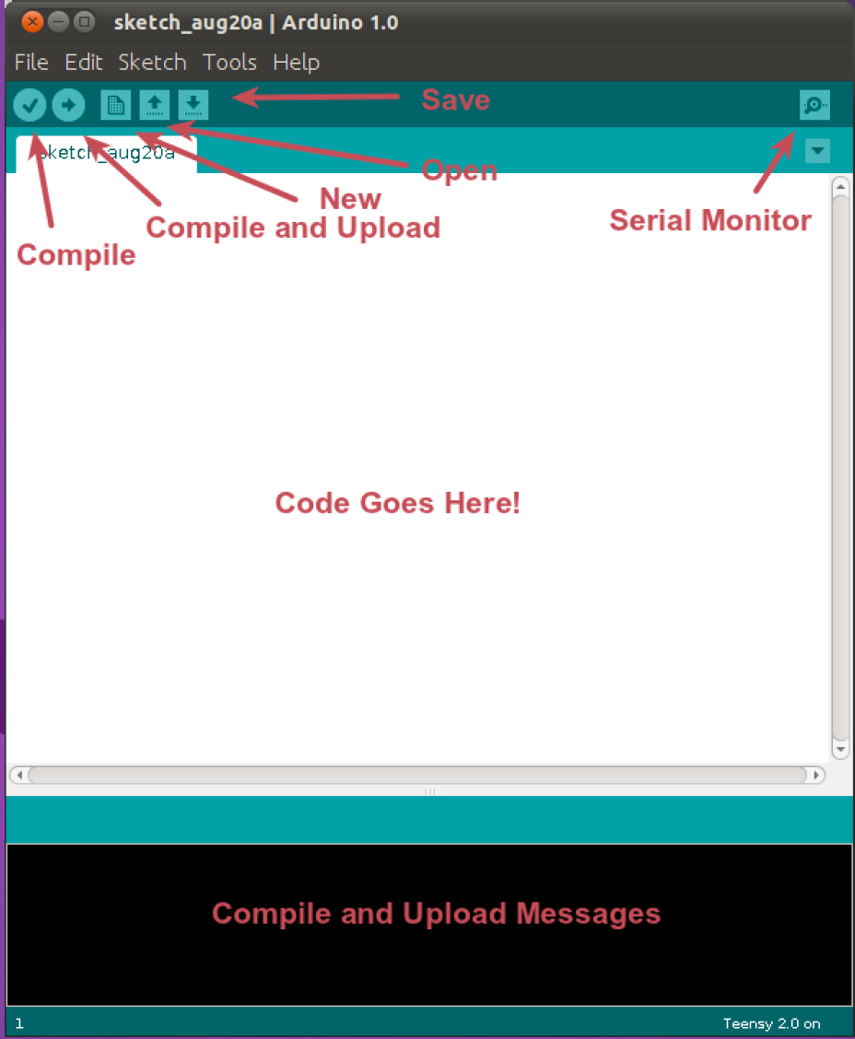

Slide 13
IDE Tips and ‘Gotchas’
If you can’t upload, check Tools->Port
There’s a wealth of example code: File -> Examples
Use the Serial Monitor for debugging, but keep in mind this can affect your program (especially where timing is concerned!)

Slide 14
Lab 1
Blink the onboard LED by uploading File->Examples->Basic->Blink
Congratulations!!!

Slide 15
Review the Sketch
/*
Blink
. . .
*/
// set the LED on
// wait for a second
These are comments
The computer ignores them
Humans can read them to learn about the program

Slide 16
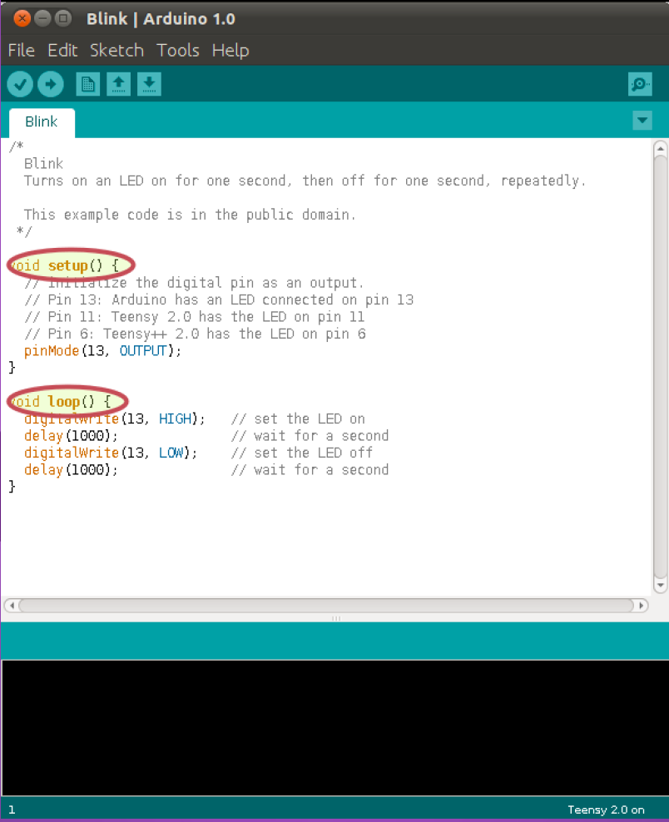

Slide 17
Review the Sketch
void setup() {
pinMode(13, OUTPUT);
}
Brackets { and } contain a block of code
Each line of code in this block runs sequentially
void setup() tells the program to only run them once
When the board turns on
When the reset button is pressed

Slide 18
Review the Sketch
void setup() {
pinMode(13, OUTPUT);
}
Tells the Arduino to setup pin 13 as an Output pin
Each pin you use needs be setup with pinMode
A pin can be set to OUTPUT or INPUT

Slide 19
Review the Sketch
void loop() {
digitalWrite(13, HIGH);
delay(1000);
digitalWrite(13, LOW);
delay(1000);
}
void loop () runs the code block over and over until you turn off the Arduino
This code block only runs after setup is finished

Slide 20
Review the Sketch
void loop() {
digitalWrite(13, HIGH);
delay(1000);
digitalWrite(13, LOW);
delay(1000);
}
HIGH tells the Arduino to turn on the output
LOW tells the Arduino to turn off the output
13 is the pin number

Slide 21
Review the Sketch
void loop() {
digitalWrite(13, HIGH);
delay(1000);
digitalWrite(13, LOW);
delay(1000);
}
Code runs very fast
Delay tells the Arduino to wait a bit
1000 stands for 1,000 milliseconds or one second

Slide 22
Change the Sketch
void loop() {
digitalWrite(13, HIGH);
delay(500);
digitalWrite(13, LOW);
delay(500);
}
Change the 1000’s to 500
Upload the code to the Arduino
What happens now?

Slide 23
Arduino Digital Pins
These pins are used to communicate with the outside world
When an output pin is HIGH, it can provide 5V at 40mA maximum
Trying to get more than 40mA out of the pin will destroy the Microprocessor!
When the output pin is LOW, it provides no current
You can use a transistor and/or a relay to provide a higher voltage or more current

Slide 24
Connecting a new LED
Most LEDs will work with 5V at 20mA or 30mA
Make sure to check them before connecting to your Arduino! – Use your volt meter
An LED requires a resistor to limit the current
Without the resistor, the LED will draw too much current and burn itself out

Slide 25
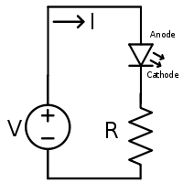
Connecting a new LED
LEDs are polarized devices
One side needs to be connected to + and one side needs to be connected to –
If you connect it backwards, it will not light
Usually:
Minus is short lead and flat side
Plus is long lead and rounded side
A resistor is non-polarized
It can be connected either way

Slide 26
Lab 2
Connect the two LEDs on the breadboard
Modify the code to blink the second LED, too
Blink them all

Slide 27
Input
The pins can be used to accept an input also
Digital pins can read a voltage (1) or no voltage (0)
Analog pins can read voltage between 0V and 5V. You will read a value of 0 and 1023.
Both of these return a value you can put into a variable and/or make decisions based on the value

Slide 28
Input
Example
int x;
x = digitalRead(2);
if ( x == HIGH ) {
digitalWrite(13, HIGH);
} else {
digitalWrite(13, LOW);
}

Slide 29
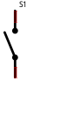
Push Button
A push button can be connected to a digital pin
There is an open circuit normally
There is a closed circuit when pressed
If connected between 5V and a pin, we get 5V when pressed, but an open circuit when not pressed
This is a problem – we need 0V when not pressed

Slide 30
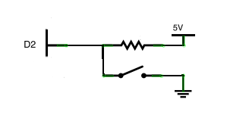
Push Button
There is a solution
A resistor to 5V will make the pin HIGH when the button is not pressed
Pressing it will make the pin LOW
The resistor makes sure we don’t connect 5V directly to Ground

Slide 31
Push Button
This is a common method for using push buttons
The resistor is called a “Pull Up Resistor”
The Arduino has built in pull up resistors on the digital pins
We need to enable them when we need them

Slide 32
Push Button
This code enables the pull up resistor:
pinMode(2, INPUT_PULLUP);

Slide 33
Lab 3
Connect a push button
Load the basic button code (File->Examples->Digital->Button
Turn LEDs on/off based on button press
Load the ‘Debounce’ Example (File->Examples->Digital->Debounce). Experiment with changing the value of the ‘debounceDelay’ variable.

Slide 34
Other Sensors/Devices
There are many other devices you can connect to an Arduino
Servos to move things
GPS to determine location/time
Real Time Clock to know what time it is
Accelerometers
LCD displays
Memory cards to store sounds, images, readings
Distance Sensors
More!

Slide 35
Let’s Go Analog
So far we’ve dealt with the on/off digital world.
Many interesting things we want to measure (temperature, light, pressure, etc) have a range of values.

Slide 36
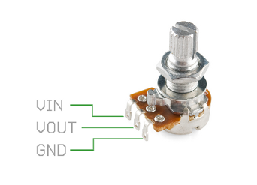
The Potentiometer
Very simple analog input – used to control volume, speed, and so on.
It allows us to vary two resistance values.

Slide 37
The Serial Port
You can communicate between the Arduino and the computer via the USB cable.
This can help you out big time when you are debugging.
It can also help you control programs on the computer or post information to a web site.
Serial.begin(9600);
Serial.println(“Hello World.”);

Slide 38
Lab 3
Connect potentiometer (see next page)
Upload and run code (File->Examples->Analog->AnalogInOutSerial
Turn the knob
Watch the value change in the Serial Monitor
Add an LED on Pin 9. Watch the brightness change as you turn the knob.

Slide 39
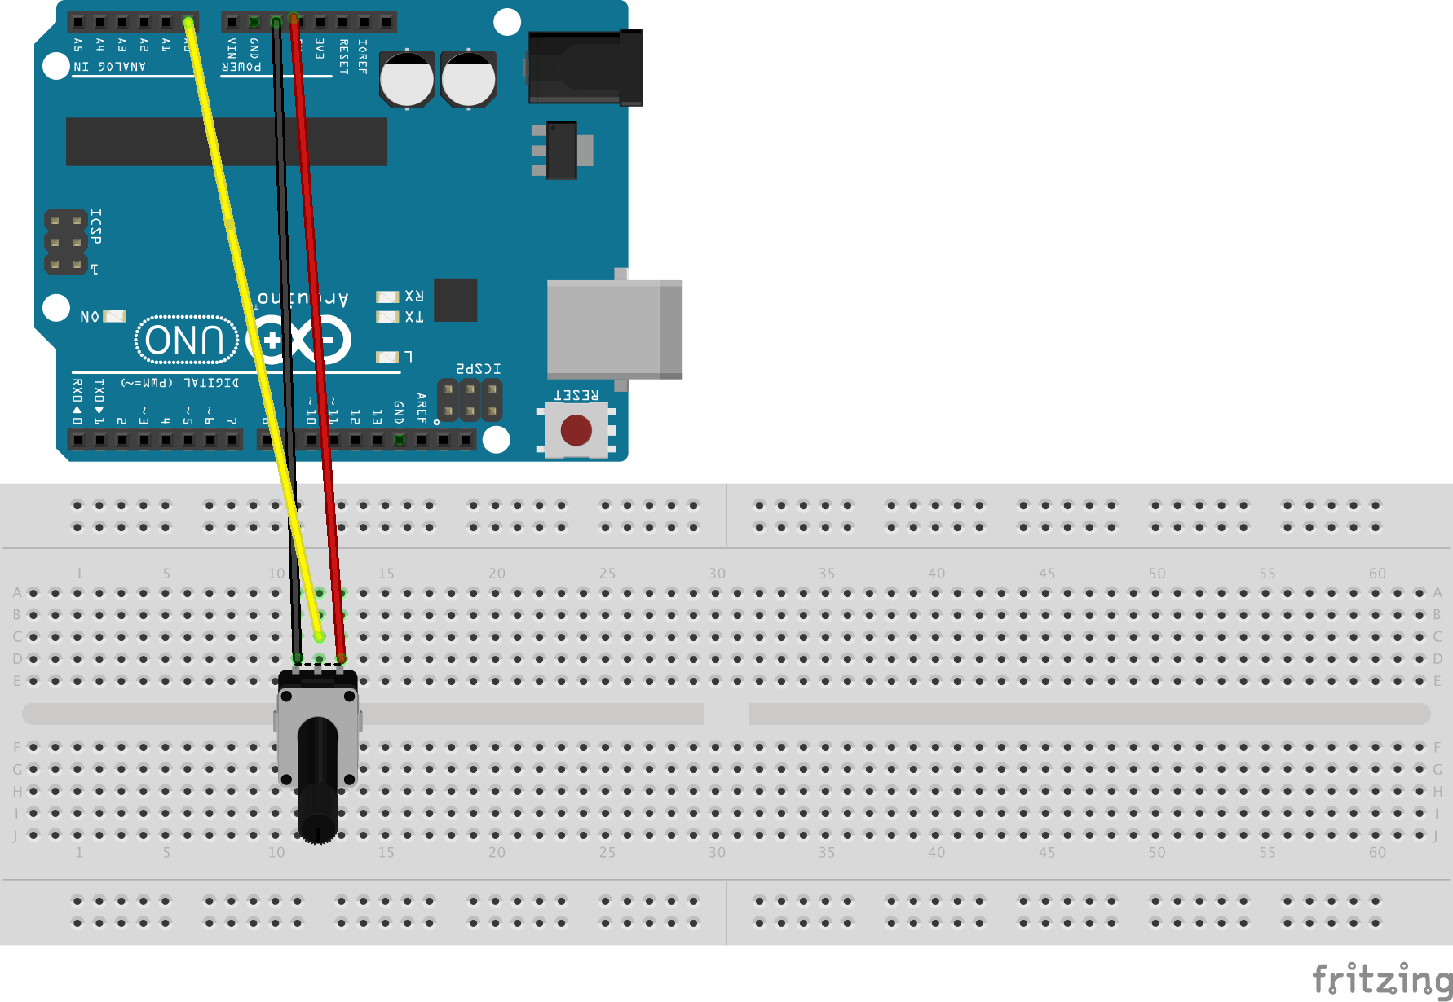

Slide 40
The Voltage Divider
There are many, many sensors based on varying resistance: force sensors, light dependent resistors, flex sensors, and more.
To use these you need to create a ‘voltage divider’.
These are based on Ohm’s Law: V = IR

Slide 41
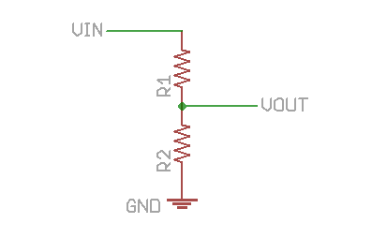
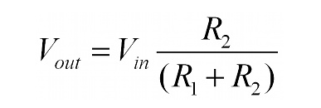
The Voltage Divider

Slide 42
Light Sensor
R2 will be our photocell
R1 will be a resistor of our choice
Rule of thumb is: R1 should be in the middle of the range (but don’t get hung up on an exact value. Experiment!)

Slide 43
Lab 4
Wire up the photocell (next page)
Same code as Lab 3
Take note of the max and min values
Try to pick a value for a dark/light threshold.

Slide 44
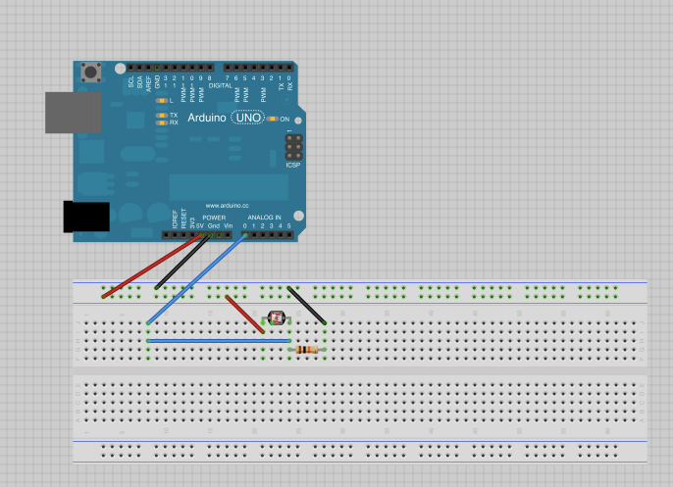

Slide 45
Analog Output
Flashing a light is neat, but what about fading one in and out?
Or changing the color of an RGB LED?
Or changing the speed of a motor?

Slide 46
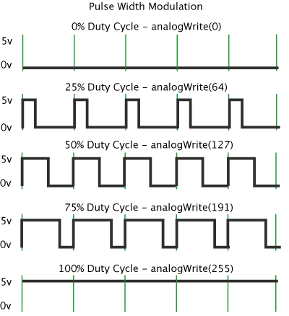
PWM (Pulse Width Modulation)

Slide 47
Lab 5
Wire up the Breadboard
Load the code (File->Examples->Analog->Fading). Take note of the for loop.
Watch the light fade in and out
Experiment with the code to get different effects

Slide 48
Making Things Move
So far we’ve communicated with the world by blinking or writing to Serial.
Let’s make things move!

Slide 49
Lab 6: Neopixels
Neopixels are Adafruit’s rebranding of WS2812B Addressable RGB LEDs (‘Neopixel’ is way catchier)
You can chain them together and control as many pixels as you want (or can power) with a single pin!
You can buy strips and rings of them.
However, the code is not built in to the Arduino IDE, so you have to install a library
This is something you often need for new parts

Slide 50
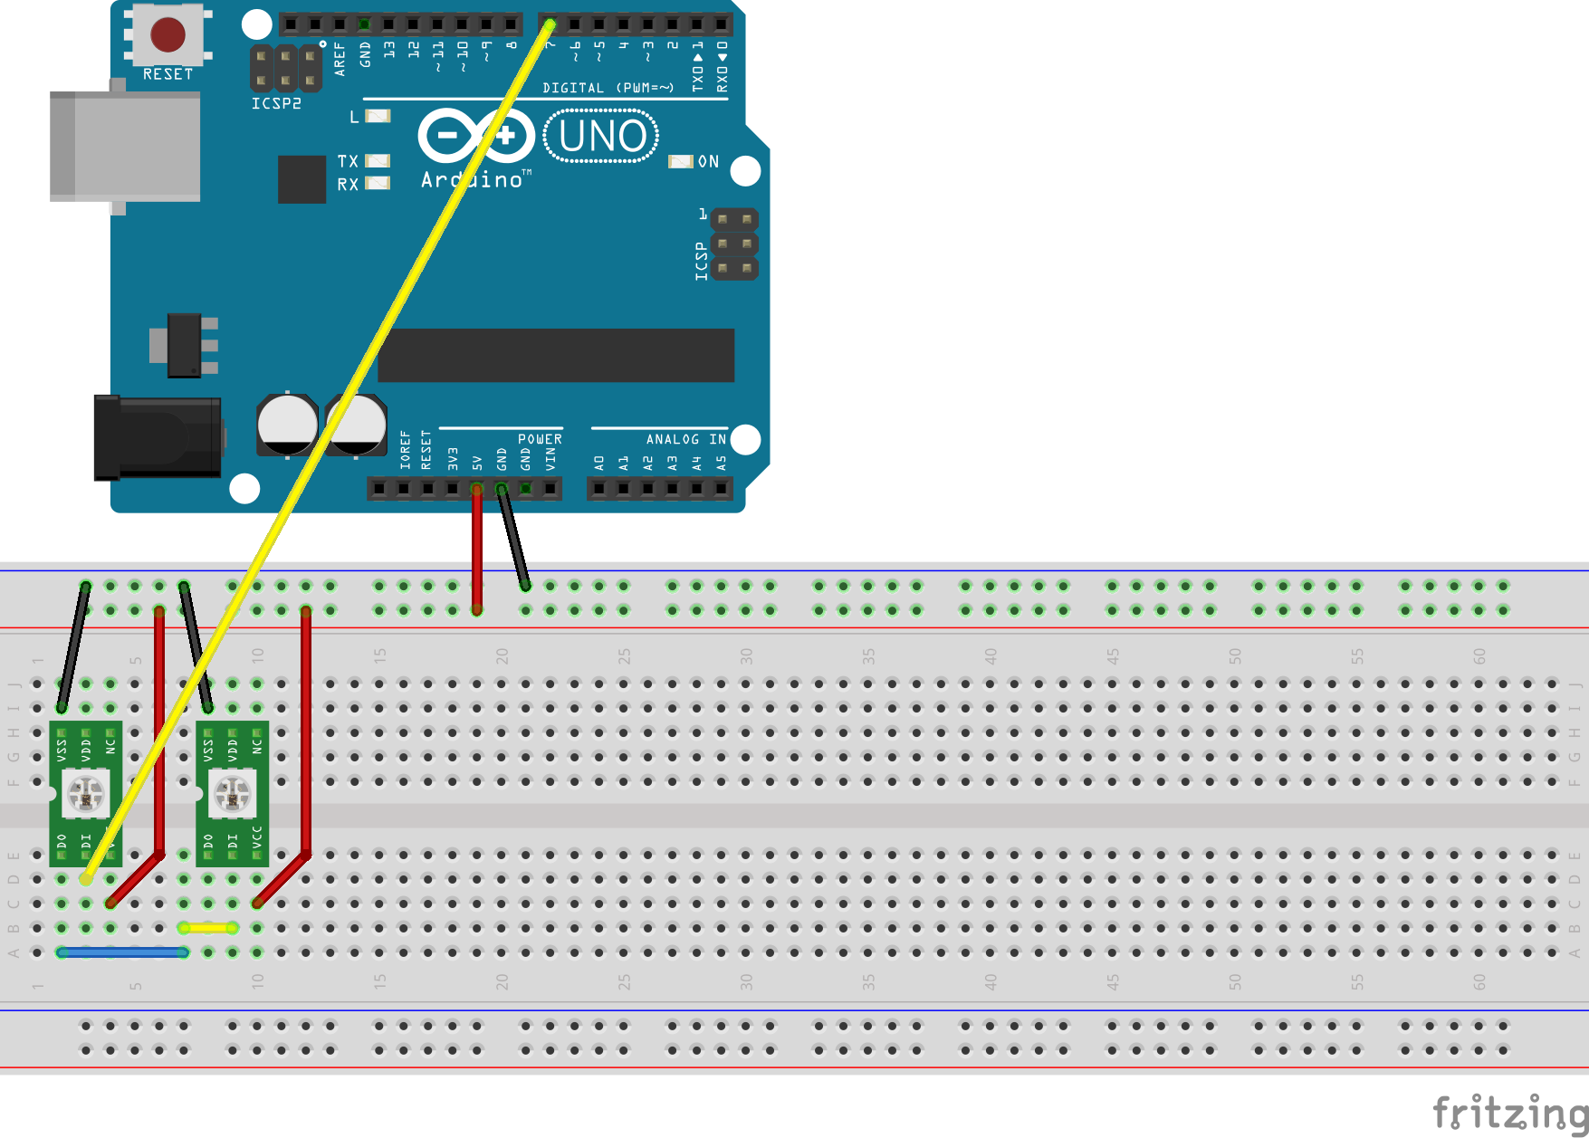
Wire it Up
Wire it up as shown below. (Wire color is important - your Neopixels look different).

Slide 51
Installing the Library
Get the library from https://github.com/adafruit/Adafruit_NeoPixel
Go to Sketch->Import Library->Add Library
Find the file you just downloaded
Restart the IDE after Importing it (otherwise you won’t see the examples)

Slide 52
Code
Open the ‘NeopixelsWorkshop.ino’ file in the ‘NeopixelsWorkshop’ folder.
#include <Adafruit_NeoPixel.h>
// Which pin on the Arduino is connected to the NeoPixels?
#define PIN 7
// How many NeoPixels are attached to the Arduino?
#define NUMPIXELS 2
// When we setup the NeoPixel library
// we tell it how many pixels, and which pin to use
// to send signals.
Adafruit_NeoPixel pixels = Adafruit_NeoPixel(NUMPIXELS, PIN, NEO_GRB + NEO_KHZ800);

Slide 53
…and more code
Our ‘strip’ is an object. We call functions or ‘methods’ tied to it:
void setup() {
strip.begin();
strip.show(); // Initialize all pixels to 'off'
}

Slide 54
…and more
To set a pixel’s color, specify the number (start at zero). Do this for as many pixels as you want, then call the function to show these colors.
pixels.setPixelColor(1, pixels.Color(i,255-i,0));
pixels.show();
Can you guess what this program does before you upload it?
Have fun…be creative!

Slide 55
Other Senses
With a piezo or small speaker, your Arduino can make some noise, or music (or ‘music’).
As with game controllers, vibrating motors can stimulate the sense of touch (this is called a ‘haptic interface’).
Arduino projects exist that involve smell (breathalyzer, scent generators).
For taste…KegBot? ZipWhip’s cappuccino robot?

Slide 56
Lab 7 – The Light Theremin
Combine previous projects (photocell and the piezo playing music) to create an instrument that generates a pitch based on how much light is hitting the photocell
Feel free to get really creative with this.
For extra creativity points, do something totally different.

Slide 57
Summary
We have learned
The Arduino platform components
how to connect an Arduino board to the computer
How to connect LEDs, buttons, a light sensor, a piezo buzzer, and servos
How to send information back to the computer

Slide 58
Resources
http://www.arduino.cc
Getting Started With Arduino (Make: Projects) book
Arduino: A Quick Start Guide book
The adafruit learning system: https://learn.adafruit.com/

Slide 59
Where to buy stuff
Adafruit http://www.adafruit.com/
Spark Fun http://www.sparkfun.com/
Maker Shed http://www.makershed.com/
Digikey http://www.digikey.com/
Mouser http://www.mouser.com/
Radio Shack http://www.radioshack.com/
Find parts: http://www.octopart.com/
Sometimes Amazon has parts too
Ebay can have deals but usually the parts are shipped from overseas and take a long time

Slide 60
Where to get help
http://arduino.cc/forum/
Your local Hackerspace!

Slide 61
Electronics 101
Electronic devices depend on the movement of electrons
The amount of electrons moving from one molecule to another is called Current which is measured in Amps
Batteries provide a lot of electrons that are ready to move
The difference in potential (the number of free electrons) between two points is called Electromotive Force which is measured in Volts

Slide 62
Electronics 101
Materials that allow easy movement of electrons are called Conductors
Copper, silver, gold, aluminum are examples
Materials that do not allow easy movement of electrons are called Insulators
Glass, paper, rubber are examples
Some materials are poor conductors and poor insulators.
Carbon is an example

Slide 63
Electronics 101
Materials that aren’t good conductors or good inductors provide Resistance to the movement of electrons
Resistance is measured in Ohms

Slide 64
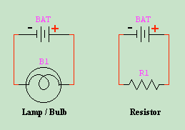
Electronics 101
Electrons flow from the negative terminal of the battery through the circuit to the positive terminal.
But – when they discovered this, they thought current came from the positive terminal to the negative
This is called conventional current flow
I
Oops!

Slide 65
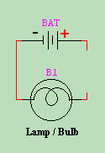
Electronics 101
There needs to be a complete circuit for current to flow
No Flow!
Current will Flow!

Slide 66
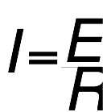
Electronics 101
Volts, Amps and Ohms are related
This is called Ohms Law
I = Current in Amps
E = EMF in Volts
R = Resistance in Ohms

Slide 67
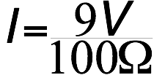
Electronics 101
Example
BAT = 9 volts
R1 = 100 ohms
How many amps?
I = 0.09 Amps or 90mA

Slide 68
Electronics 101
When dealing with really big numbers or really small numbers, there are prefixes you can use
k = kilo = 1,000 (e.g. 10 kHz = 10,000 Hz)
M = mega = 1,000,000 (e.g 1 MHz = 1,000 kHz)
m = milli = 1/1,000 (e.g 33mA = 0.033A)
u = micro = 1/1,000,000 (e.g 2uV = 0.000002V)
n = nano = 1/1,000,000,000
p = pico = 1/1,000,000,000,000

