Slide 1
smart materials for DIY projects :: openMaterials :: catarina mota
Smart materials: materials that have one or more properties that
can be significantly changed in a controlled fashion by external stimuli,
such as stress, temperature, moisture, pH, electric or magnetic fields.
—wikipedia

Slide 2
conductive paint
smart materials for DIY projects :: openMaterials :: catarina mota
conductive paint, wire glue and nickel print
:: conductive paint is infused with silver or copper particles. Tends to crack and is expensive due to the high content of silver.
:: wire glue is a lead free conductive adhesive made with micro-carbons. It's an affordable alternative to expensive silver-loaded epoxies and easy to apply (stir well and apply with a toothpick). It takes a few hours to cure and is intended for low currents (not sure how it performs in high power circuits). It's weak as a glue but decent as a conductor.
:: nickel print is a conductive ink designed for PCB repair and RF shielding. Can be used as a conductive ink, but has slightly more resistance than silver based paint. Conducts better than the graphite based glues and is much cheaper than silver based paint.
:: suppliers: thinkgeek, MG chemicals

Slide 3
smart materials for DIY projects :: openMaterials :: catarina mota
UV reactive materials
:: aka solar active, materials impregnated with varying amounts of photochromic pigment that respond to the UV component of daylight by changing from a pale white to bright colors. When not exposed to UV rays photochromic materials revert back to their original color.
:: photochromic pigments (made of micron-size microcapsules of photochromic dye dispersed in water) when mixed with a binder, such as an acrylic base, can be permanently applied to any surface.
:: materials impregnated with photochormic pigments include paint/ink, fabric, sewing thread, glass, plastic, paper, leather, and more.
:: photochromic materials are compounds that undergo a reversible photochemical reaction where an absorption band in the visible part of the electromagnetic spectrum changes dramatically in strength or wavelength.
:: + info @ openMaterials
Notes:
UV Beads
UV thread
UV pigment

Slide 4
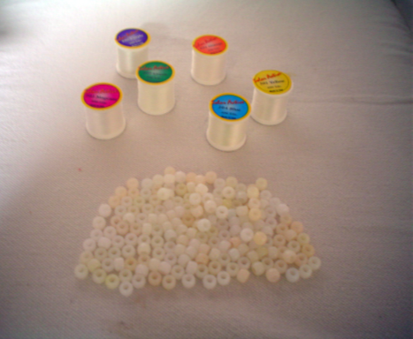
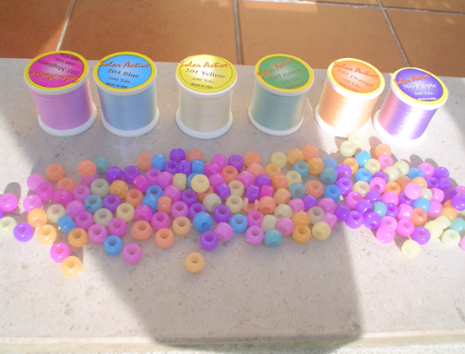
UV reactive materials :: example
smart materials for DIY projects :: openMaterials :: catarina mota
UV reactive materials
UV reactive beads and thread (indoors and outdoors)

Slide 5
smart materials for DIY projects :: openMaterials :: catarina mota
thermochromic materials
:: thermochromic pigments change color when exposed to heat and turn back to their original color when the temperature drops again.
:: thermochromic pigments can be used to make color changing paint, fabric, tiles and film.
:: thermochromic materials can be activated through body heat, a hairdryer, a space heater, nichrome or just a hot summer day.
:: most thermochromic materials are based on liquid crystal technology. At specific temperatures the liquid crystals re-orientate to produce an apparent change of color. The liquid crystal material itself is micro-encapsulated - i.e., contained within microscopic spherical capsules typically just 10 microns in diameter.
:: + info @ openMaterials
Notes:
Thermochromic fabric
Thermochromic pigments
Thermochromic film

Slide 6
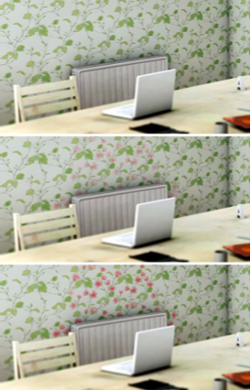
thermocolor film :: example
smart materials for DIY projects :: openMaterials :: catarina mota
thermochromic materials
hand print on thermocolor film
shi yuan :: heat-activated wallpaper

Slide 7
smart materials for DIY projects :: openMaterials :: catarina mota
mylar
:: technically metalized PET film. Is cheap and widely available. The metalized layer is on one side only and is conductive.
:: can be used to make capacitive touch sensors. We are planning to experiment and use it for flexible circuit boards as well.
:: common ways to shape PET films include laser cutting, thermoforming, thermal bonding, glue and solvent bonding and simply cutting with scissors or razor knives.

Slide 8
smart materials for DIY projects :: openMaterials :: catarina mota
polymorph, sugru & mold making putty
:: polymorph, aka polycaprolactone, is a biodegradable polyester with a low melting point of around 60ºC. It can be heated with just hot water and then molded by hand or cast into a mold (avoid using flames to melt polymorph as this will blacken the material. Once it cools to room temperature, polymorph becomes a hard, nylon-like plastic. It can be reheated and reshaped any number of times. Polymorph is usually white, but it can be colored with some colorings.
:: sugru is a multipurpose material developed specifically to “hack things better,” looks and feels like playdoh, comes in air-tight pouches and cures at room temperature, its self-adhesive, resistant from -60 °C to +180 °C, and waterproof.
:: mold making putty: cures in 10 minutes and its finished molds are permanent, flexible and replicate small details. Can withstand temperatures up to 650º F.
:: + info @ openMaterials
:: suppliers: sugru, inventables
Notes:
sugru

Slide 9
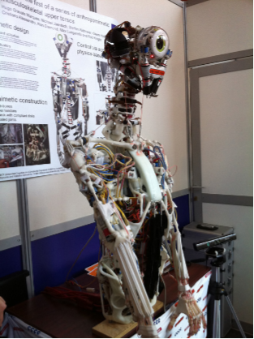
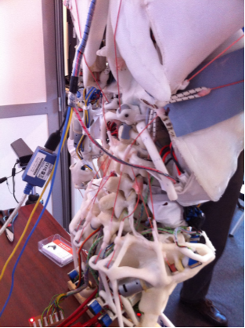
polymorph :: example
smart materials for DIY projects :: openMaterials :: catarina mota
polymorph
ECCEROBOT :: polymorph 'bones'

Slide 10
QTC
smart materials for DIY projects :: openMaterials :: catarina mota
quantum tunneling composite (QTC)
:: smart flexible polymer, with extraordinary electrical properties, used for pressure switching and sensing.
:: in its normal state it’s a near-perfect electrical insulator, but when deformed QTC becomes a metal-like conductor capable of passing very high currents. A QTC pill measuring 4mm square and 1.5mm thick can pass up to 10 amps when squeezed.
:: magnetic in both its insulator and conductive states.
:: ElekTex is a QTC-based electro-conductive fabric made up of two layers of conductive fabric with a thin layer of QTC in the middle.
:: QTC is made of metal filler particles combined with silicone rubber. QTC owes its extraordinary properties to a quantum tunneling phenomenon: electrons tunnel through the material, i.e. conduct, when their physical structure is slightly changed by pressure.
:: + info @ openMaterials
Notes:
QTC +DC motor

Slide 11
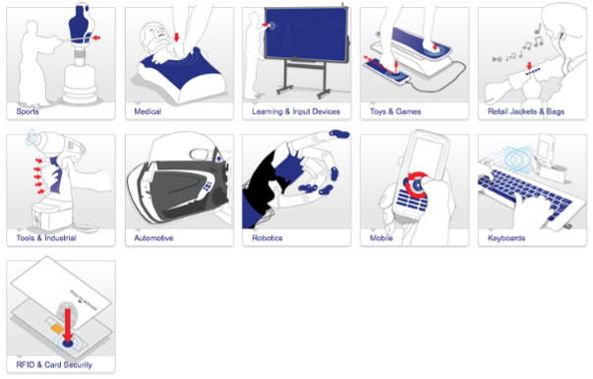
QTC :: applications
smart materials for DIY projects :: openMaterials :: catarina mota
quantum tunneling composite
peratech :: possible applications of quantum tunneling composite

Slide 12
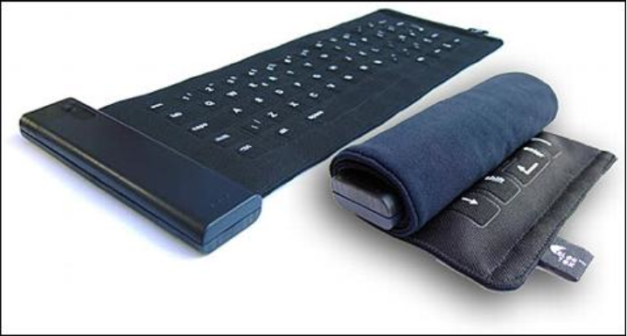
QTC :: keyboards
smart materials for DIY projects :: openMaterials :: catarina mota
QTC :: ElekTex
elektex keyboards

Slide 13
smart materials for DIY projects :: openMaterials :: catarina mota
endlighten or edge diffusing acrylic
:: a type of acrylic that has microscopic particles suspended in the resin. Has a high light transmission. At first glance it appears no different than clear acrylic, but when illuminated from the edge it diffuses the light out the faces of the material.
:: normal acrylic faces show little change when edge light unless the surface is etched.
:: is available in sheets and solid tubes.
:: useful for multi-touch projects, LED back lighting and other visual effects.
:: supplier: evonik

Slide 14
smart materials for DIY projects :: openMaterials :: catarina mota
conductive plastics
:: polymer bases infused with conductive additives.
:: electrically conductive plastic board is infused with graphite making it conductive all over.
:: stretch sensing band is made out of a synthetic rubber base mixed with carbon black additives. When stretched the relative proximity between the conductive particles decreases thus increasing resistance.
:: conductive acetate is a clear material, with the look and feel of acetate, coated on one side with a film of metal only a few atoms thick.
:: suppliers: inventables, mindsets, lessEMF
Notes:
Conductive plastic board
Stretch sensing rubber

Slide 15
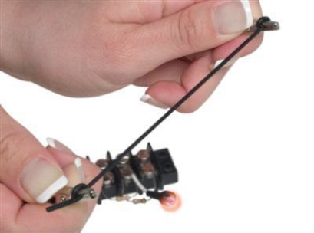
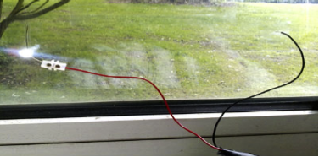
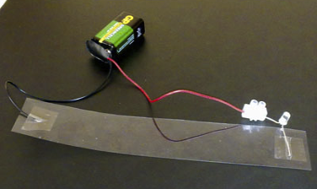
smart materials for DIY projects :: openMaterials :: catarina mota
conductive plastics
stretch sensing rubber
conductive acetate

Slide 16
smart materials for DIY projects :: openMaterials :: catarina mota
shape memory polymers
:: shape memory polymers (SMP) can be re-shaped when exposed to heat and will retain this new shape after cooling down. But once exposed again to the change-over temperature the polymer will revert back to its original shape. The physical properties, behavior and change-over temperature vary greatly from SMP to SMP.
:: SMP applications include smart mandrels which can be first shaped into the desired form and them easily removed by re-heating the material.
:: the secret behind SMPs lies in their molecular network structure, which contains at least two separate phases. The phase showing the highest thermal transition is the temperature that must be exceeded to establish the physical crosslinks responsible for the permanent shape. The switching segments, on the other hand, are the segments with the ability to soften past a certain transition temperature and are responsible for the temporary shape.
:: + info @ openMaterials
Notes:
SMP strips: change-over temp – 38C/100F, shape temp - 71C/160F
SMP sheet: change-over and shape temp - 70C/158F
Spring

Slide 17
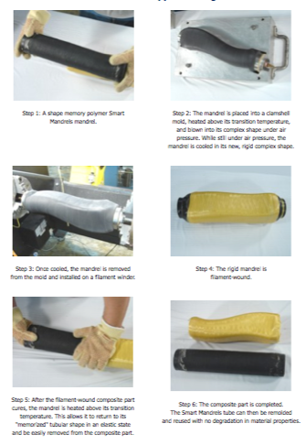

smart materials for DIY projects :: openMaterials :: catarina mota
smart mandrels

Slide 18
EL wire
electrotextiles :: thread & yarn
smart materials for DIY projects :: openMaterials :: catarina mota
EL wire
:: electroluminescent (EL) wire glows when an alternating current is passed through it
:: consists of 4 or 5 concentric layers: a core copper conductive wire coated in phosphor, around which are wrapped two other very fine conductive wires, followed by a clear protective sleeve and/or a colored PVC sleeve. Current flowing through both the core and the two thin copper wires creates an electrical field and causes the phosphor to glow
:: requires an inverter to step up the current provided by batteries and should be handled with care as there is a risk of getting zapped
:: exists in a varied diameters (from 1.2mm to 5mm) and colors (produced by both the inverter frequency and the plastic sleeve)
:: + info @ openMaterials
Notes:
Butterfly

Slide 19
electrotextiles :: fabrics
smart materials for DIY projects :: openMaterials :: catarina mota
electrotextiles
:: fabrics with electrical properties made by blending or coating textiles with copper and/or nickel and/or silver fibers, available in many textures such as nylon, lycra, clearmesh, softmesh, zelt, thermoadhesive (iron-on), etc.
:: electrolycra, aka conductive stretch fabric, has special properties: in addition to being highly conductive, it warms up when current passes through a thin strip of the material, and its resistance increases or decreases when it’s stretched
:: velostat is an anti-static film whose resistance decreases when pressed
:: these materials can be used to make a variety of sensors by layering them in appropriate combinations of conductivity and resistance
:: conductive thread is silver plated nylon thread, conductive yarn contains inox. Resistance increases with length of thread. On some yarns the resistance increases when the material is stretched. Resistive thread is good for embroidering resistors and making textile potentiometers.
:: + info @ openMaterials
Notes:
Voodoo doll
Electrotextile switches
Electrotextile swatches

Slide 20
EL wire
electrotextiles :: thread & yarn
smart materials for DIY projects :: openMaterials :: catarina mota
conductive edibles
:: sugar coated with sterling silver power
:: the resistor jeltone is a functional gelatin toy piano
:: pumpkins make decent capacitive sensors :)
Notes:
Butterfly

Slide 21
bye bye
smart materials for DIY projects :: openMaterials :: catarina mota
catarina@openmaterials.org
openmaterials.org
nycresistor.org

