Slide 1
Precipitation In
Des Moines, IA
Client: Tom Skilling, Former Chief Meteorologist of WGN

Slide 2

Fully Specify Model
1. Random Component
$$Y_{i}∼Bernoulli\left(π_{i}\right)$$
2. Systematic Component
$$\log\left(\frac{π_{i}}{1−π_{i}}\right)=β_{0}+β_{1}Spring_{i}+β_{2}Summer_{i}+β_{3}Fall_{i}+β_{4}MaxDewPoint_{i}+β_{5}AvgWindSpeed_{i}+β_{6}MaxRH_{i}$$

Slide 3
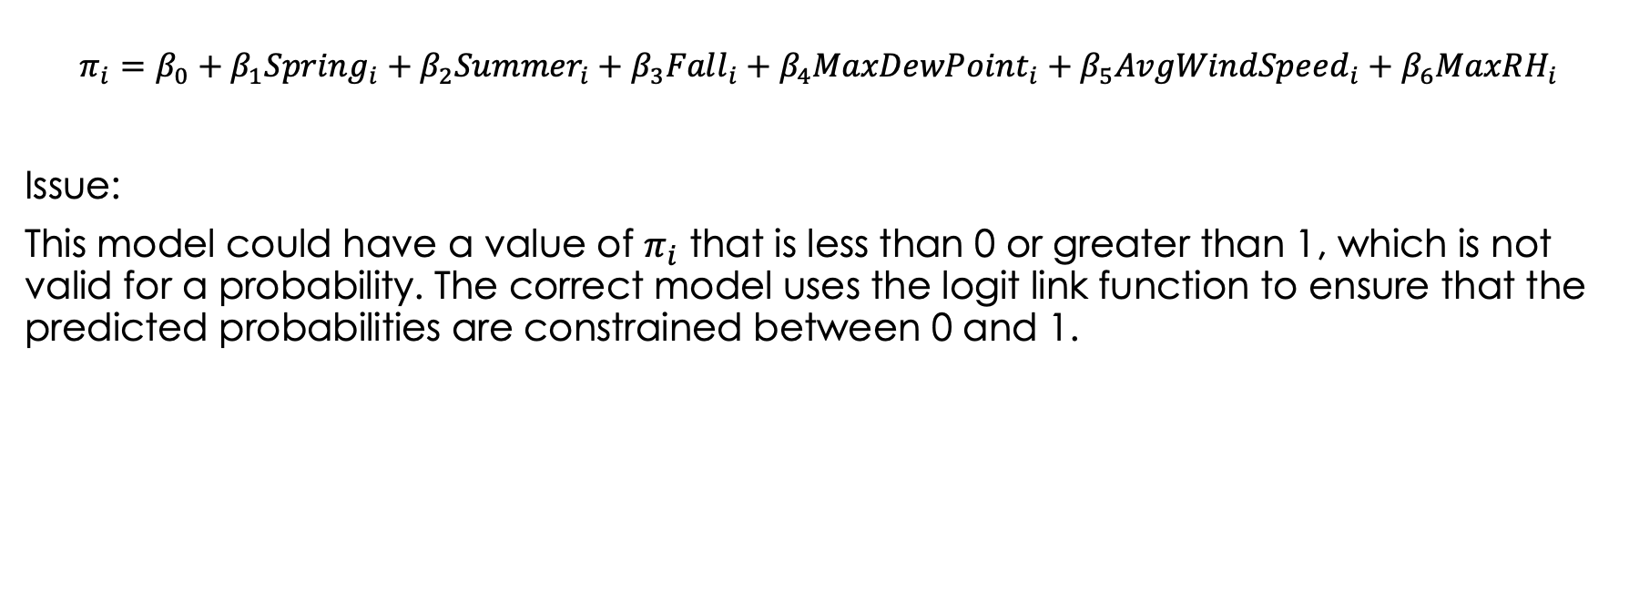
Why Other Models Could Be Incorrect
$$π_{i}=β_{0}+β_{1}Spring_{i}+β_{2}Summer_{i}+β_{3}Fall_{i}+β_{4}MaxDewPoint_{i}+β_{5}AvgWindSpeed_{i}+β_{6}MaxRH_{i}$$
Issue:
This model could have a value of $π_{i}$ that is less than 0 or greater than 1, which is not valid for a probability. The correct model uses the logit link function to ensure that the predicted probabilities are constrained between 0 and 1.

Slide 4
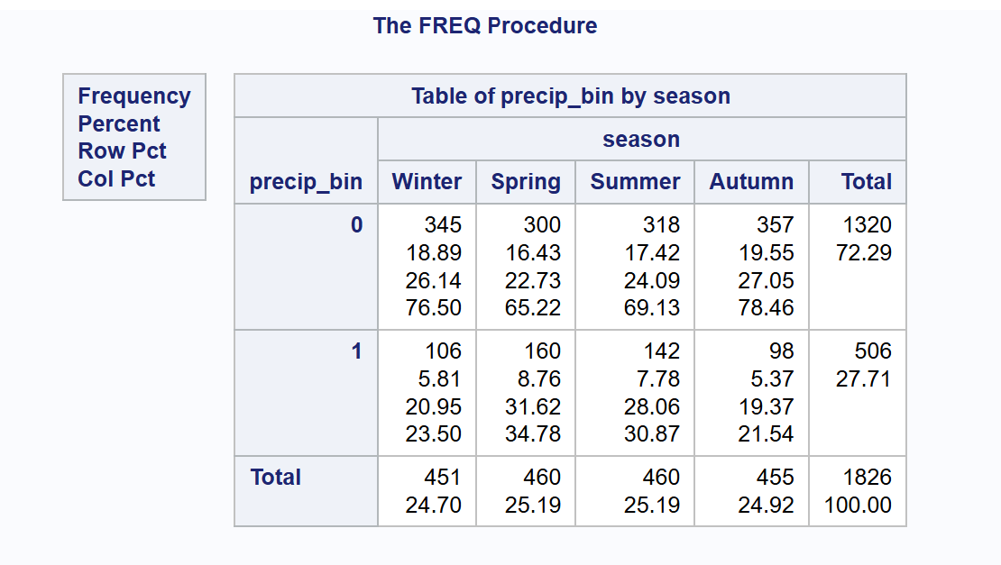
Complete Separation
Step 1: Make a table with the categorical x (season) and binary y (precip_bin)
There are no empty cells in the table, meaning there is no complete separation

Slide 5
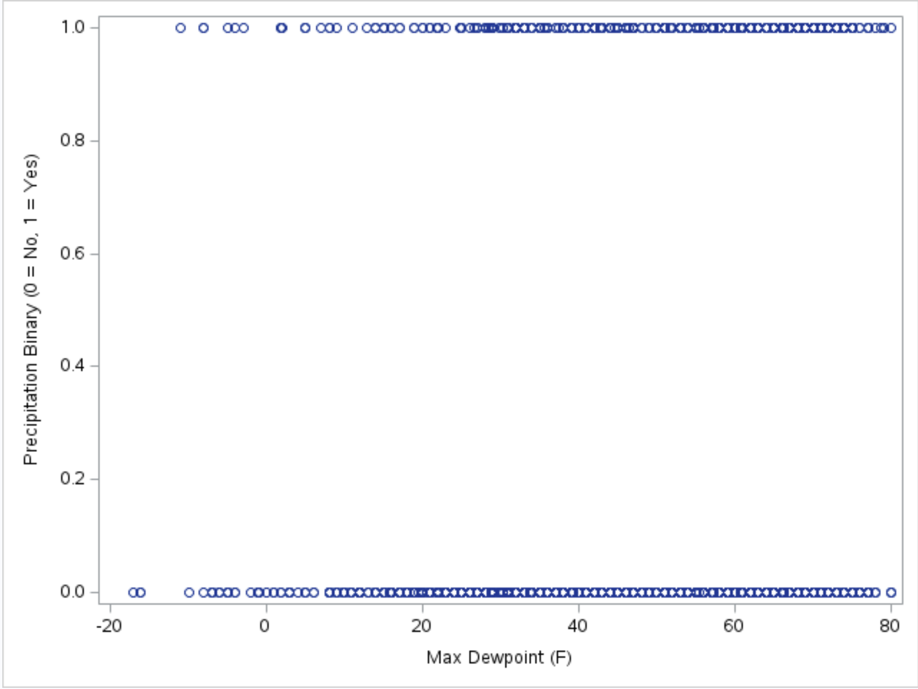
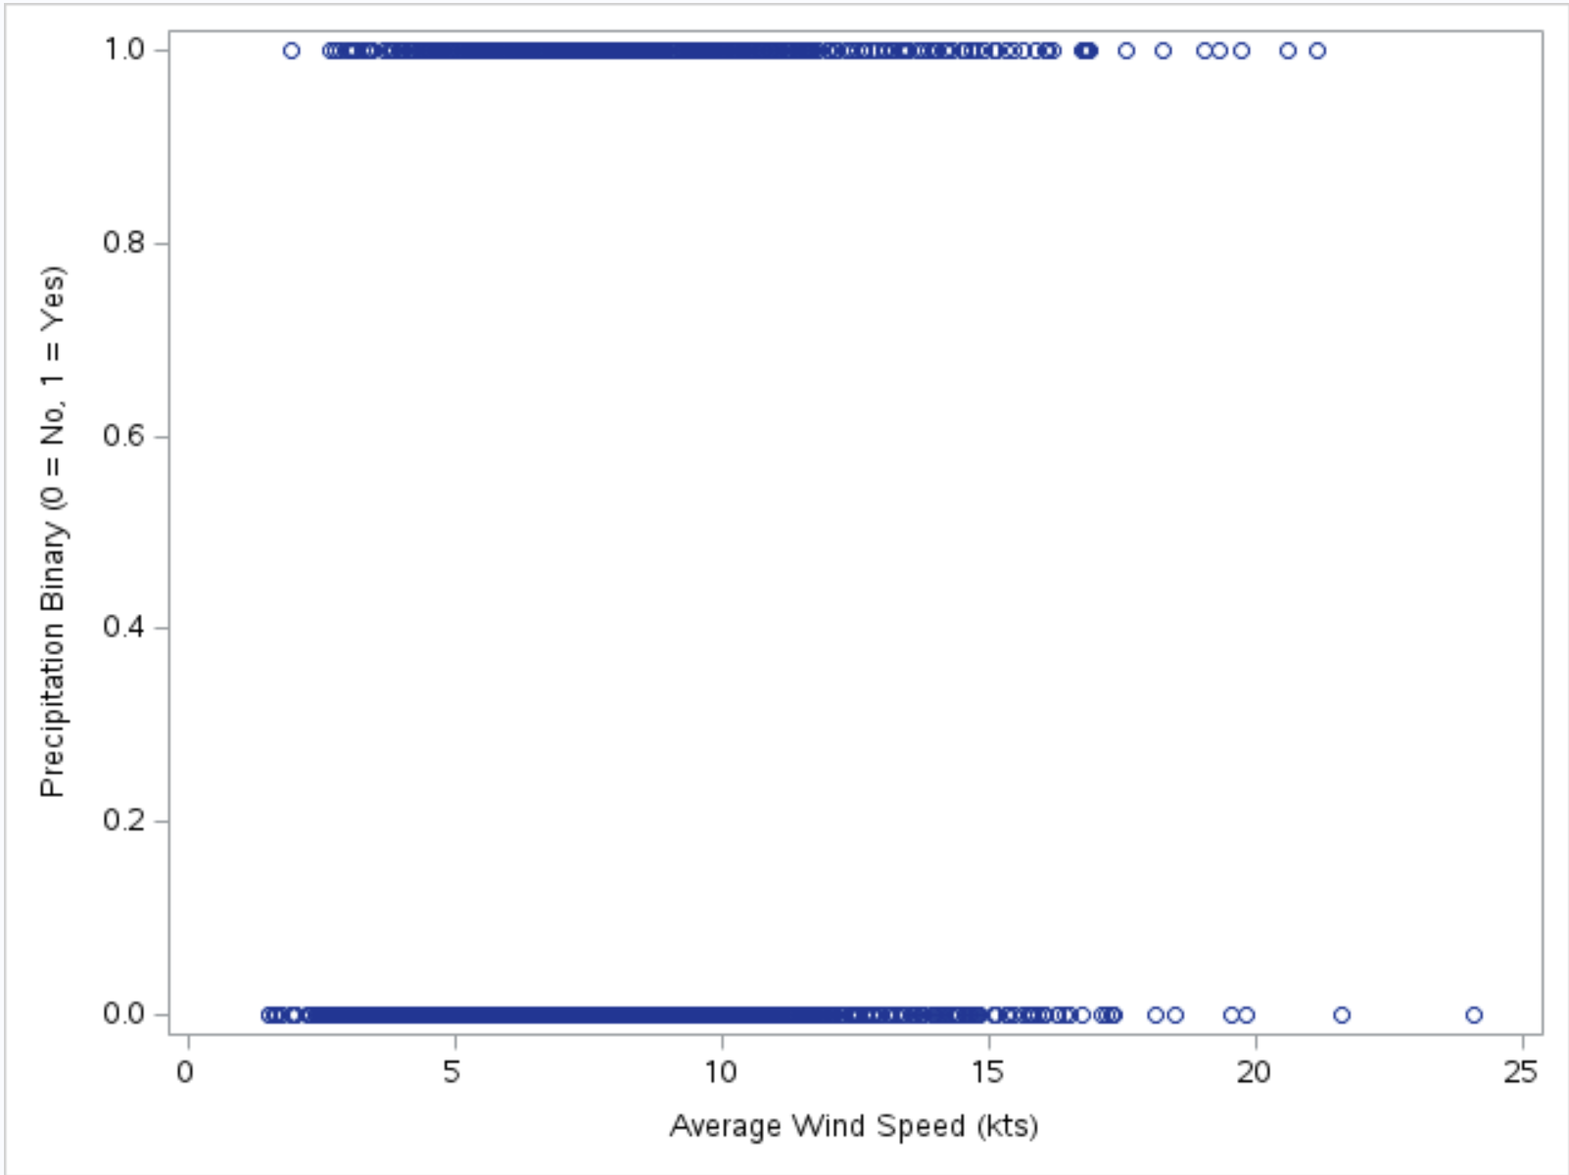
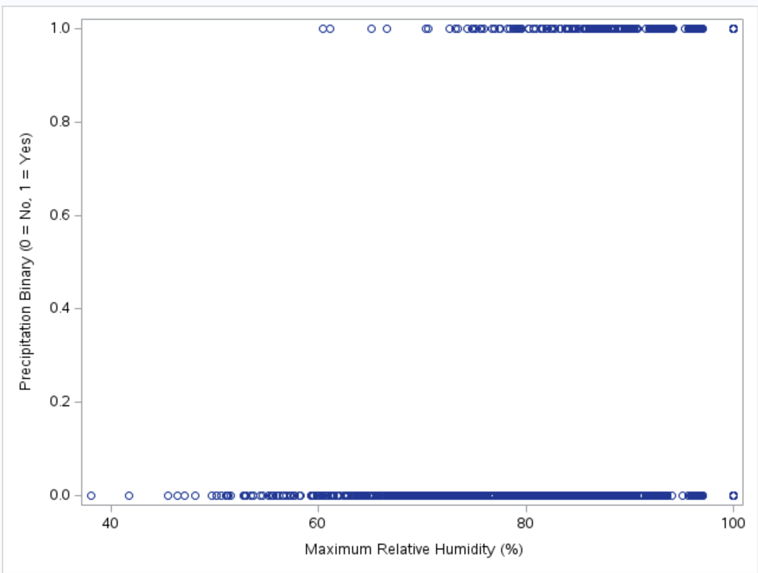
Complete Separation
Step 2: Make a scatterplot between numeric x's (max_dewpoint_f, avg_wind_speed_kts, max_rh) and binary y (precip_bin)
There is no complete separation in any of the three scatterplots

Slide 6
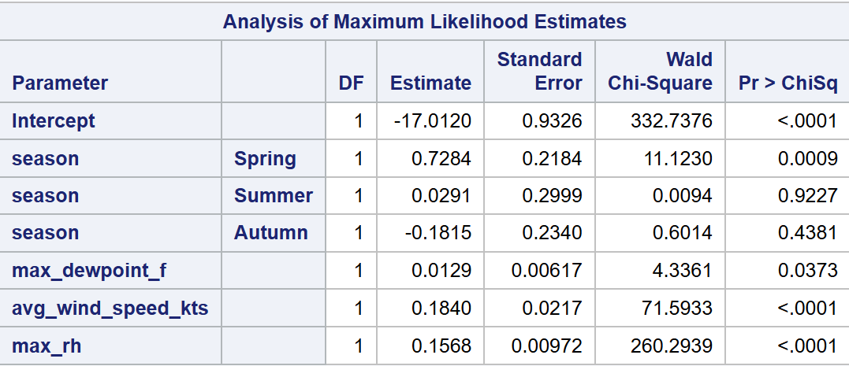
Complete Separation
Step 3: Does the logistic regression model consist of large standard errors (larger than 5)?
No standard errors exceed 5, meaning there is no complete separation

Slide 7
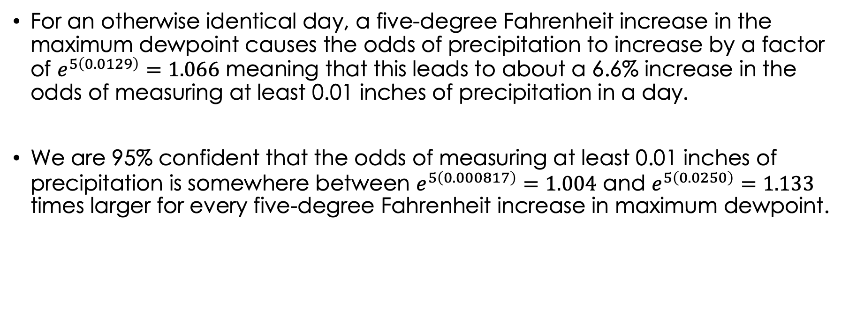
Higher Dew Points Can Lead to Increased Precipitation
For an otherwise identical day, a five-degree Fahrenheit increase in the maximum dewpoint causes the odds of precipitation to increase by a factor of $e^{5\left(0.0129\right)}=1.066$ meaning that this leads to about a 6.6% increase in the odds of measuring at least 0.01 inches of precipitation in a day.
We are 95% confident that the odds of measuring at least 0.01 inches of precipitation is somewhere between $e^{5\left(0.000817\right)}=1.004$ and $e^{5\left(0.0250\right)}=1.133$ times larger for every five-degree Fahrenheit increase in maximum dewpoint.

Slide 8
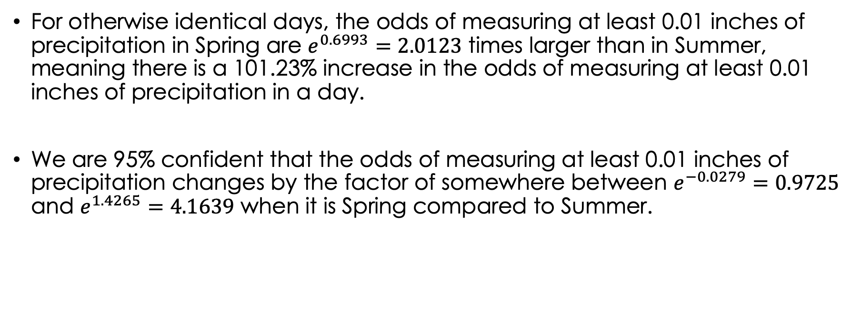
Spring is on Average Rainier than Summer
For otherwise identical days, the odds of measuring at least 0.01 inches of precipitation in Spring are $e^{0.6993}=2.0123$ times larger than in Summer, meaning there is a 101.23% increase in the odds of measuring at least 0.01 inches of precipitation in a day.
We are 95% confident that the odds of measuring at least 0.01 inches of precipitation changes by the factor of somewhere between $e^{−0.0279}=0.9725$ and $e^{1.4265}=4.1639$ when it is Spring compared to Summer.

Slide 9
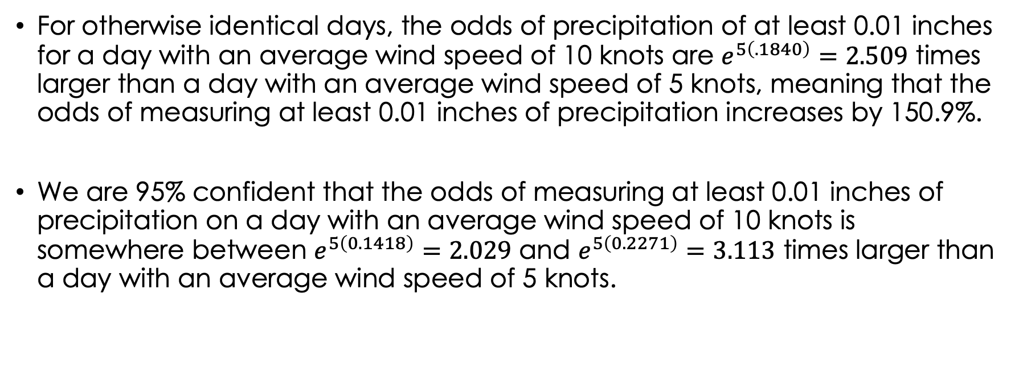
Windier Days can lead to Higher Precipitation
For otherwise identical days, the odds of precipitation of at least 0.01 inches for a day with an average wind speed of 10 knots are $e^{5\left(.1840\right)}=2.509$ times larger than a day with an average wind speed of 5 knots, meaning that the odds of measuring at least 0.01 inches of precipitation increases by 150.9%.
We are 95% confident that the odds of measuring at least 0.01 inches of precipitation on a day with an average wind speed of 10 knots is somewhere between $e^{5\left(0.1418\right)}=2.029$ and $e^{5\left(0.2271\right)}=3.113$ times larger than a day with an average wind speed of 5 knots.

Slide 10
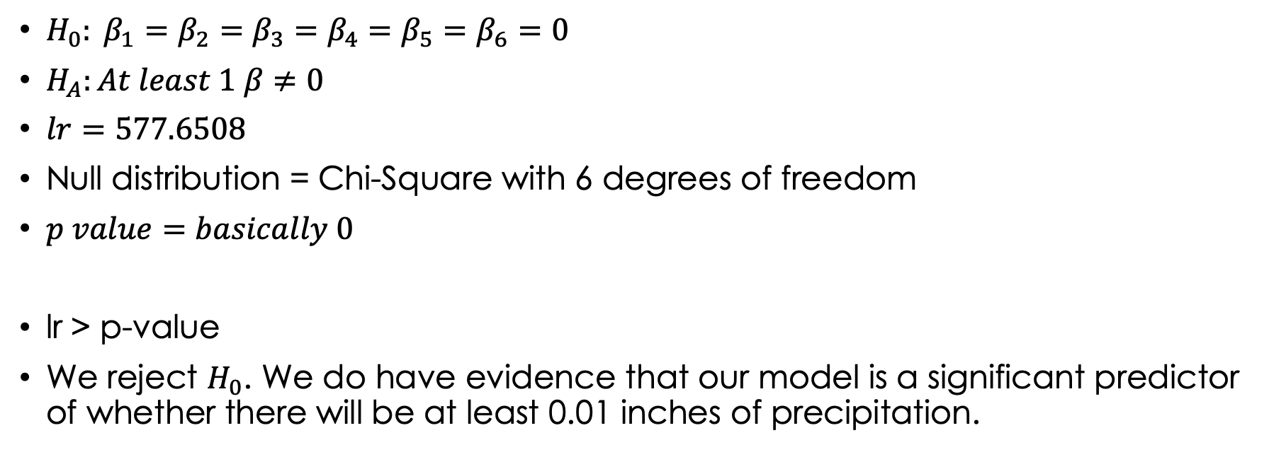
Is our Model significant?
$H_{0}: β_{1}=β_{2}=β_{3}=β_{4}=β_{5}=β_{6}=0$
$H_{A}:At least 1 β≠0$
$lr=577.6508$
Null distribution = Chi-Square with 6 degrees of freedom
$p value=basically 0$
lr > p-value
We reject $H_{0}$. We do have evidence that our model is a significant predictor of whether there will be at least 0.01 inches of precipitation.

Slide 11
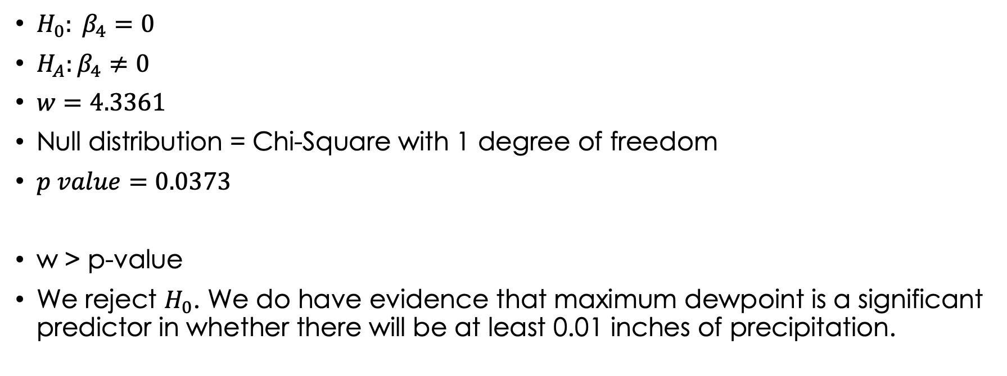
Dewpoint is very much significant
$H_{0}: β_{4}=0$
$H_{A}:β_{4}≠0$
$w=4.3361$
Null distribution = Chi-Square with 1 degree of freedom
$p value=0.0373$
w > p-value
We reject $H_{0}$. We do have evidence that maximum dewpoint is a significant predictor in whether there will be at least 0.01 inches of precipitation.

Slide 12
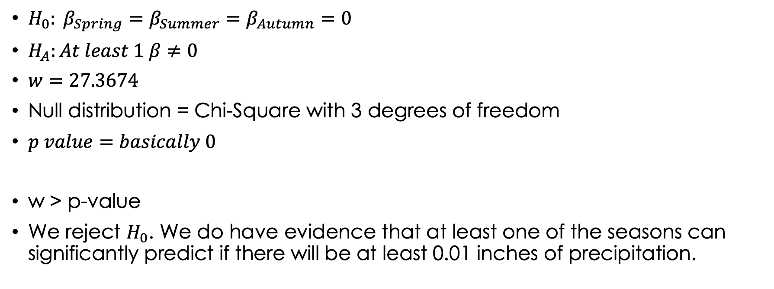
April showers bring may flowers
$H_{0}: β_{Spring}=β_{Summer}=β_{Autumn}=0$
$H_{A}:At least 1 β≠0$
$w=27.3674$
Null distribution = Chi-Square with 3 degrees of freedom
$p value=basically 0$
w > p-value
We reject $H_{0}$. We do have evidence that at least one of the seasons can significantly predict if there will be at least 0.01 inches of precipitation.

Slide 13
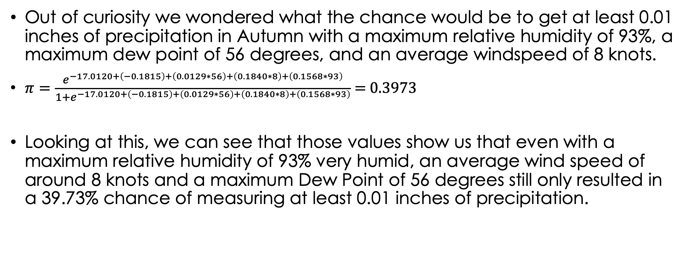
The Leaves are falling
Out of curiosity we wondered what the chance would be to get at least 0.01 inches of precipitation in Autumn with a maximum relative humidity of 93%, a maximum dew point of 56 degrees, and an average windspeed of 8 knots.
$π=\frac{e^{−17.0120+\left(−0.1815\right)+\left(0.0129∗56\right)+\left(0.1840∗8\right)+\left(0.1568∗93\right)}}{1+e^{−17.0120+\left(−0.1815\right)+\left(0.0129∗56\right)+\left(0.1840∗8\right)+\left(0.1568∗93\right)}}$ = 0.3973
Looking at this, we can see that those values show us that even with a maximum relative humidity of 93% very humid, an average wind speed of around 8 knots and a maximum Dew Point of 56 degrees still only resulted in a 39.73% chance of measuring at least 0.01 inches of precipitation.

Slide 14
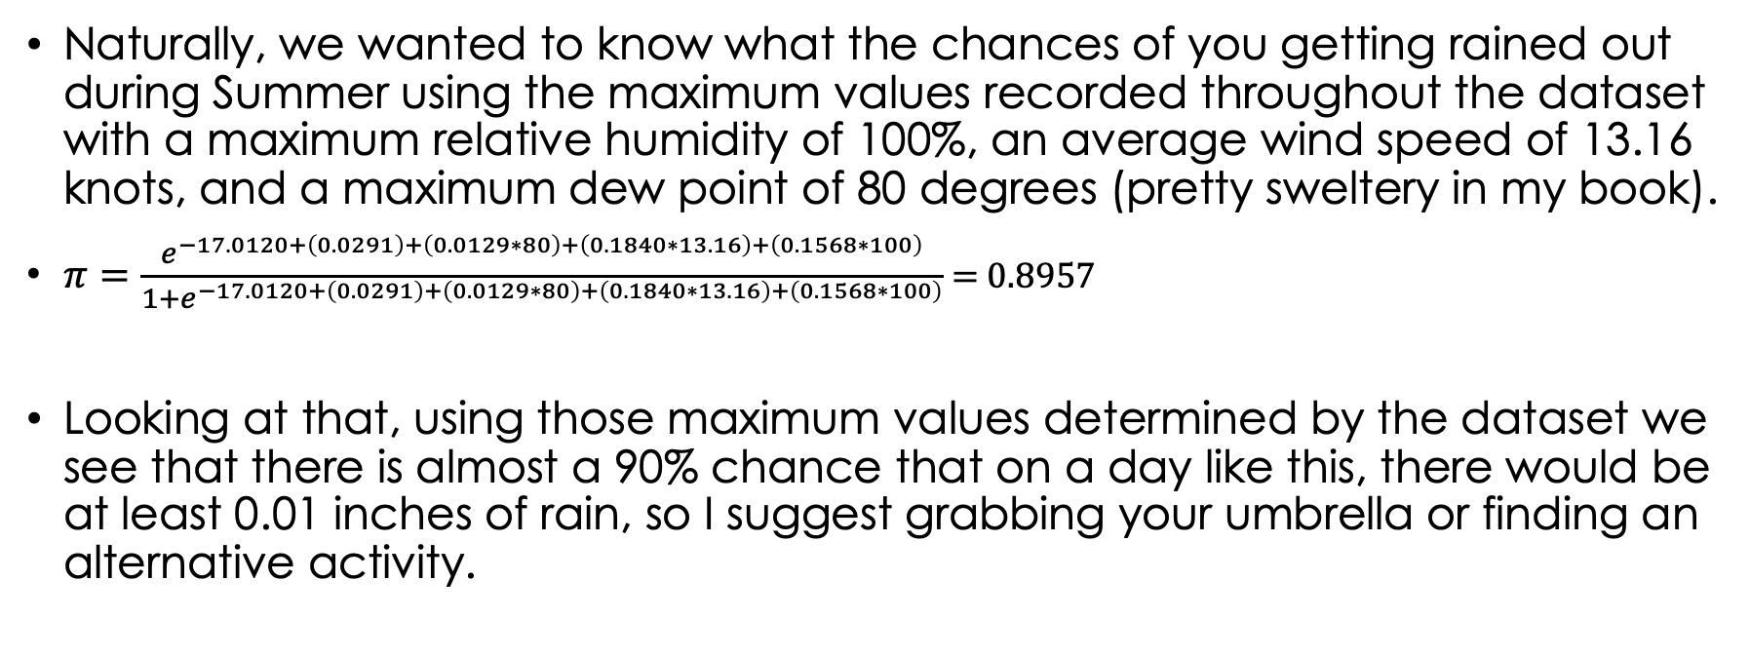
Maybe you should bring an Umbrella
Naturally, we wanted to know what the chances of you getting rained out during Summer using the maximum values recorded throughout the dataset with a maximum relative humidity of 100%, an average wind speed of 13.16 knots, and a maximum dew point of 80 degrees (pretty sweltery in my book).
$π=\frac{e^{−17.0120+\left(0.0291\right)+\left(0.0129∗80\right)+\left(0.1840∗13.16\right)+\left(0.1568∗100\right)}}{1+e^{−17.0120+\left(0.0291\right)+\left(0.0129∗80\right)+\left(0.1840∗13.16\right)+\left(0.1568∗100\right)}}$ = 0.8957
Looking at that, using those maximum values determined by the dataset we see that there is almost a 90% chance that on a day like this, there would be at least 0.01 inches of rain, so I suggest grabbing your umbrella or finding an alternative activity.

