Slide 1


Hecatonchire Project, July 2013
Leveraging Memory Mirroring for Transparent Memory Scale-out with Zero-Downtime Fault-Tolerance for Remote Hosts
Roei Tell, Peter Izsak, Aidan Shribman, Steve Walsh and Benoit Hudzia
IEEE Symposium on Computers and Communications, July 2013

Slide 2

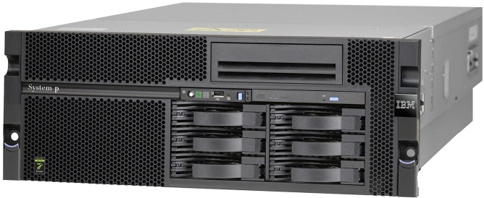
Hecatonchire Project, July 2013
SAP HANA: Scale-out use case
Leading Example
Transparent Memory Scale-out
Memory Mirroring
Hecatonchire Project
A Standard Configuration: (at t₀)
8 Intel Xeon E7-8870
1TB RAM (for 5TB uncompressed data)
10.8TB Storage
Solution:
“Off the shelf”
IBM x3950 X5 Server System
94,707$ - 122,547$
SAP HANA PAM: Supported Hardware Platforms for SAP HANA Single Node, June 2013
https://websmp209.sap-ag.de/~sapidb/011000358700000701932011E

Slide 3
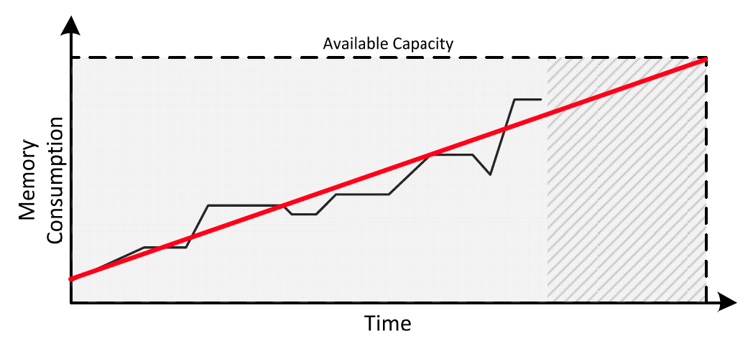
Hecatonchire Project, July 2013
SAP HANA: Scale-out use case
Leading Example
Transparent Memory Scale-out
Memory Mirroring
Hecatonchire Project
VMWare “Best Practices”: Capacity Planning; VMWare Blogs. Author: Sudhir Bhatti
https://blogs.vmware.com/management/2012/09/capacity-management-planning-private-cloud.html
Notes:
VMWare’s recommendations for infrastructure providers (not necessarily virtualization-related).

Slide 4
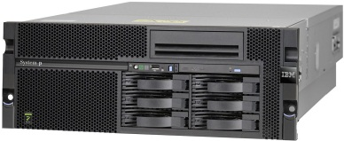

Hecatonchire Project, July 2013
SAP HANA: Scale-out use case
Leading Example
Transparent Memory Scale-out
Memory Mirroring
Hecatonchire Project
Updated configuration: (at t₁)
8 Intel Xeon E7-8870
2TB RAM (for 10TB uncompressed data)
21.6TB Storage
No additional CPU requirements!
Standard alternatives:
Scale-up
Hardware utilization
Repetitive process
Scale-out
Application changes
Current practice for SAP HANA!
Notes:
Key differentiator: MEMORY is what’s needed!

Slide 5
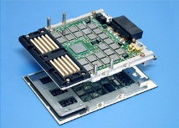
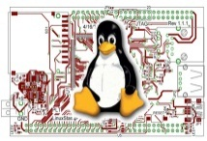

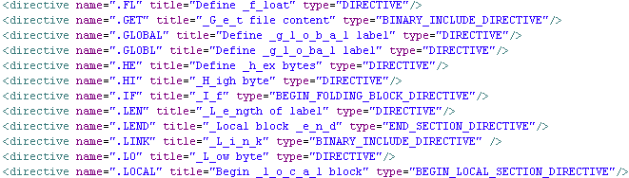
Hecatonchire Project, July 2013
Transparent memory scale-out
Transparent memory scale-out operates in the infrastructure level (avoids application changes).
Leading Example
Transparent Memory Scale-out
Memory Mirroring
Hecatonchire Project
Hardware: memory modules Dash, MemNet
Operating System: block devices, swap changes
Hecatonchire, R²MS, Ivy, Mirage, Clouds
Performance
Virtualization: specialized hypervisors
MemX, vNuma
Compilers: automatic application adaptation
Midway, Orca
J. Protic, M. Tomasevic, and V. Milutinovic, Eds. (1997). “Distributed Shared Memory: Concepts and Systems”

Slide 6
Hecatonchire Project, July 2013
Transparent memory scale-out: fault tolerance
Leading Example
Transparent Memory Scale-out
Memory Mirroring
Hecatonchire Project
Transparently handle fault tolerance
Show-stopper (since “day one”)
Enterprise environments (long-running, mission-critical)
Challenge: zero-downtime guarantee for remote hosts

Slide 7
Hecatonchire Project, July 2013
Transparent memory scale-out: our contribution
Leading Example
Transparent Memory Scale-out
Memory Mirroring
Hecatonchire Project
1985 Initial idea (Cheriton, Li)
1988-1996 1st generation prototypes
Limited by network performance
2006- 2nd generation implementations
Performance cap lifted
Our claim: Practical fault-tolerance
now possible using memory mirroring

Slide 8

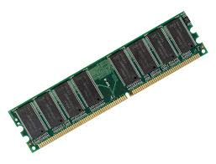
Hecatonchire Project, July 2013
Transparent memory scale-out: OS approach
Leading Example
Transparent Memory Scale-out
Memory Mirroring
Hecatonchire Project
Virtual Address Space
0-1000
1001-2000
2001-3000
3001-4000
4001-5000
…
Virtual Address
Physical Address
OS, MMU

Slide 9

Hecatonchire Project, July 2013
Transparent memory scale-out: OS approach
Leading Example
Transparent Memory Scale-out
Memory Mirroring
Hecatonchire Project
Virtual Address Space
0-1000
1001-2000
2001-3000
3001-4000
4001-5000
…
Memory Providers
Contribute part of their memory
Continue functioning normally

Slide 10
Hecatonchire Project, July 2013
Transparent memory scale-out: OS approach
Leading Example
Transparent Memory Scale-out
Memory Mirroring
Hecatonchire Project
Virtual Address Space
0-1000
1001-2000
2001-3000
3001-4000
4001-5000
…
Virtual address
Remote identifier
Virtual address
Remote physical address
OS, MMU (mod.)
OS on remote host (mod.)
OS on remote host
Transparent memory scale-out for SAP HANA?

Slide 11

Hecatonchire Project, July 2013
Transparent memory scale-out: 1st generation
Extensive research and prototyping (80’s, 90’s).
Performance of Ethernet as the main blocker:
Bandwidth: 10-100Mbps.
Latency: several ms range.
Leading Example
Transparent Memory Scale-out
Memory Mirroring
Hecatonchire Project
Example (Markatos, 1996):
FFT over 24MB input with 32MB machine and 10Mbps Ethernet.
E.P. Markatos and G. Dramatinos (1996). “Implementation of a reliable memory pager”. Also see: V. Cholvi-Juan and R.H. Campbell (1996). “Distributed Shared Memory on Loosely Coupled Systems”.
A good review: J. Protic, M. Tomasevic and V. Milutinovic (Eds., 1997). “Distributed Shared Memory: Concepts and Systems”.
Notes:
Ask the audience: how do we model application memory demands vs. interconnects speed? In practice, they used evaluations with benchmarks.

Slide 12
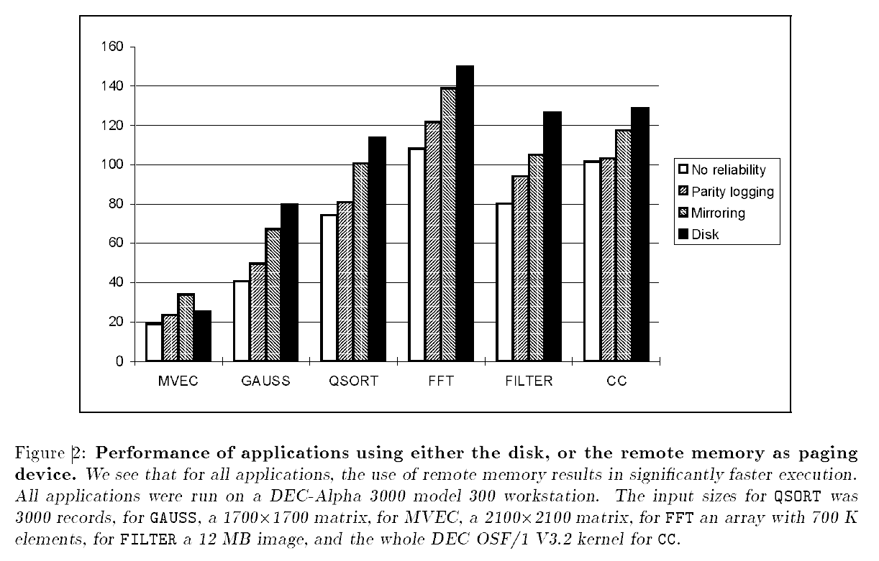
Hecatonchire Project, July 2013
Transparent memory scale-out: 1st generation
Fault-Tolerance further exhausts bandwidth!
Memory mirroring considered worst alternative.
Leading Example
Transparent Memory Scale-out
Memory Mirroring
Hecatonchire Project
E.P. Markatos and G. Dramatinos (1996). “Implementation of a reliable memory pager”.
Notes:
BANDWIDTH is the key, it is a show-stopper bottleneck.

Slide 13
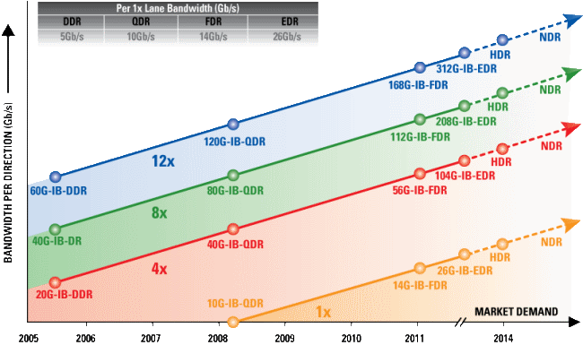

Hecatonchire Project, July 2013
Transparent memory scale-out: 2nd generation
Leading Example
Transparent Memory Scale-out
Memory Mirroring
Hecatonchire Project
Performance of Infiniband / 100Gbps Ethernet :
Bandwidth: $≥$ 100Gbps ($×{10}^{3}$)
Latency: several $μs$ range $(×{10}^{−3}$)
http://www.infinibandta.org/content/pages.php?pg=technology_overview
Notes:
Looking for a solid way to claim “current bandwidth is enough”. Focus on RATE of growth, not on values by themselves (Xeon Phi has enormous bandwidth).

Slide 14
Hecatonchire Project, July 2013
Transparent memory scale-out: 2nd generation
Leading Example
Transparent Memory Scale-out
Memory Mirroring
Hecatonchire Project
Estimate of maximal bandwidth (Gb/s) –
Intel Xeon memory chipsets vs. Infiniband
(expected)
Growth rate of interconnect bandwidth faster?
http://www.infinibandta.org/content/pages.php?pg=technology_overview
http://ark.intel.com
Notes:
Looking for a solid way to claim “current bandwidth is enough”. Focus on RATE of growth, not on values by themselves (Xeon Phi has enormous bandwidth).

Slide 15
Hecatonchire Project, July 2013
Transparent memory scale-out: 2nd generation
Leading Example
Transparent Memory Scale-out
Memory Mirroring
Hecatonchire Project
“R²MS achieves up to 92% performance of adequate local memory cases. R²MS imposes minimal performance overhead”.
H. Han, H. Jung, S. Kang, and H. Yeom (2011). “Performance evaluation of a remote memory system with commodity hardware for large-memory data processing”.
“HPDB performs only 1.45 times slower than local memory system”.
R.N. Shuang Liang and D.K. Panda (2005). “Swapping to remote memory over InfiniBand: An approach using a High Performance Network Block Device”.
“vNUMA performance can be surprisingly good and is dominated by application DSM rather than kernel paging overheads”.
M. Chapman and G. Heiser (2005). “Implementing transparent shared memory on clusters using virtual machines”.
Performance issue solved?

Slide 16
Hecatonchire Project, July 2013
Memory mirroring: basic approach
Leading Example
Transparent Memory Scale-out
Memory Mirroring
Hecatonchire Project
Virtual Address Space
0-1000
1001-2000
2001-3000
3001-4000
4001-5000
…
Double memory requirement
Double bandwidth requirement
Zero-downtime crash recovery
Notes:
Most intuitive approach, first to be tried and rejected.

Slide 17
Hecatonchire Project, July 2013
Memory mirroring: implementation
Leading Example
Transparent Memory Scale-out
Memory Mirroring
Hecatonchire Project
Open-source software (part of Hecatonchire project).
OS-level, integrated with:
Virtual memory, swap.
Standard data structures, MMU & TLB.
Non-intrusive:
Alternative to swap system.
Branch only upon identification.
Multi-layered:
Linux Kernel module + minor adaptations.
KVM/QEMU hypervisor adaptations.
User-level library.
High-performance:
Lockless algorithms.
Mimic & adapt swap behavior.

Slide 18
Hecatonchire Project, July 2013
Memory mirroring: implementation
Leading Example
Transparent Memory Scale-out
Memory Mirroring
Hecatonchire Project
Average Page Fault Resolution Time
(With prefetch)

Slide 19
Hecatonchire Project, July 2013
Memory mirroring: synthetic evaluation
Leading Example
Transparent Memory Scale-out
Memory Mirroring
Hecatonchire Project
Quicksort over 1GB of data
Main host: Intel i5-2500, 16GB RAM; memory capped with a cgroup.
Memory providers: Intel i5-2500, 16GB RAM; Intel Xeon X5650, 96GB RAM
Parallel execution, 4 threads (corresponding to 4 cores).
Notes:
Overhead effectively doubled (!). Does it matter? Quicksort has very high ratio of memory access vs. computation.

Slide 20
Hecatonchire Project, July 2013
Memory mirroring: SAP-HANA evaluation
Leading Example
Transparent Memory Scale-out
Memory Mirroring
Hecatonchire Project
SAP-H over 18GB of data
Main host: Intel Xeon X5650, 96GB RAM. Memory capped with a cgroup.
Memory providers: 2 * Intel i5-2500, 16GB RAM.
OLAP queries (only reads, no writes).
Notes:
Overheads very low in a real-world case.

Slide 21
Hecatonchire Project, July 2013
Memory mirroring: pitfalls, alternatives
Double amount of required memory
Resiliency for main host still needed
Alternative: RAID-5 style parity bits (R²MS)
Only 25% additional memory required
Downtime of 10sec / 1GB of data
Leading Example
Transparent Memory Scale-out
Memory Mirroring
Hecatonchire Project
H. Han, H. Jung, S. Kang, and H. Yeom (2011). “Performance evaluation of a remote memory system with commodity hardware for large-memory data processing”.

Slide 22
Hecatonchire Project, July 2013
Memory mirroring: conclusions
Leading Example
Transparent Memory Scale-out
Memory Mirroring
Hecatonchire Project
Transparent memory scale-out - now possible with zero-downtime guarantee for remote hosts
Practical and simple approach, usable in commercial/enterprise settings
Improvements possible in terms of memory utilization?

Slide 23
Hecatonchire Project, July 2013
Hecatonchire open-source project
Leading Example
Transparent Memory Scale-out
Memory Mirroring
Hecatonchire Project
SAP HANA Cloud: dynamically deploy instances on an array of commodity hosts.

Slide 24
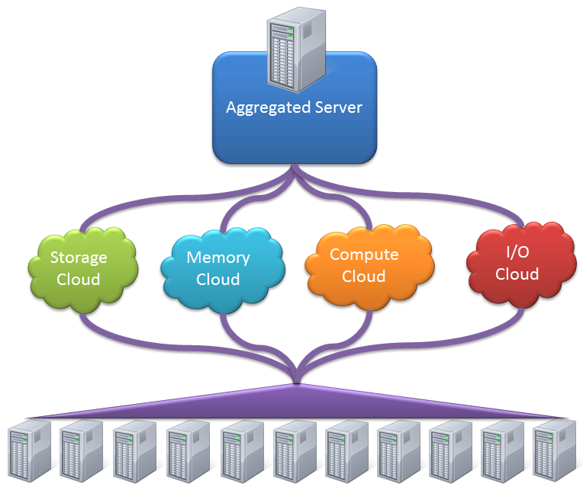
Hecatonchire Project, July 2013
Hecatonchire open-source project
Leading Example
Transparent Memory Scale-out
Memory Mirroring
Hecatonchire Project
Current virtualization: guests constrained by host size
Inverse virtualization: host aggregation into larger guests
http://www.hecatonchire.com

Slide 25


Hecatonchire Project, July 2013
Hecatonchire open-source project
Actively supporting and encouraging users, contributors and collaborators!
Leading Example
Transparent Memory Scale-out
Memory Mirroring
Hecatonchire Project
http://www.hecatonchire.com
http://github.com/hecatonchire

Slide 26
Hecatonchire Project, July 2013
Hecatonchire open-source project
Leading Example
Transparent Memory Scale-out
Memory Mirroring
Hecatonchire Project
Thank you for your time!
Any questions?
Contact us, we are friendly:
benoit.hudzia@sap.com (project lead)
roei.tell@sap.com (presenter)
aidan.shribman@sap.com
peter.izsak@sap.com
steve.walsh@sap.com

