Slide 1


C++ Programming 1. Introduction
Xueyuan Gong
School of Intelligent Systems Science and Engineering

Slide 2
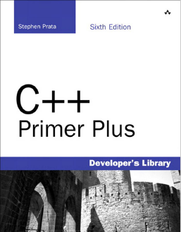
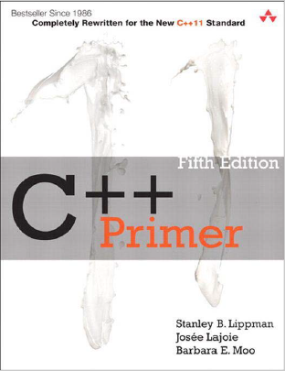
Books
Text book
C++ Prime Plus
Stephen Prata
Developer’s Library
Reference book
C++ Prime
Stanley B. Lippman
ADDISON WESLEY

Slide 3
Schedule
Ch1: Introduction | Ch10: Static and friend
Ch2: Basics of C++ programming | Ch11: Inheritance
Ch3: Array | Ch12: Derivation
Ch4: Function | Ch13: Operator
Ch5: Pointer | Ch14: Polymorphism
Ch6: Reference | Ch15: Input and output
Ch7: Struct and union | Ch16: Template and exception
Ch8: Class | Ch17: Review
Ch9: Object | Ch18: Review

Slide 4
Grading
Attendance: 10%
Homework: 30%
Final exam: 60%
Total = Attendance + Homework + Final exam

Slide 5
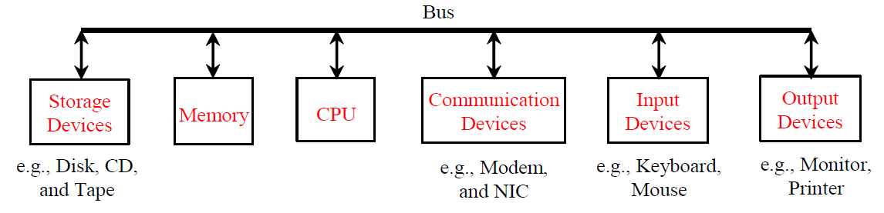
What is a Computer?
A computer consists of a CPU, memory, hard disk, monitor, and communication devices.

Slide 6
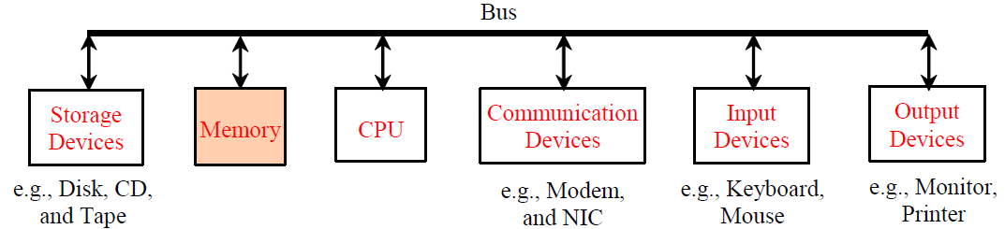
Memory
Memory is to store data and program instructions for CPU to execute. A memory unit is an ordered sequence of bytes, each holds eight bits. A program and its data must be brought to memory before they can be executed. A memory byte is never empty, but its initial content may be meaningless to your program. The current content of a memory byte is lost whenever new information is placed in it.

Slide 7
How Data is Stored
Data of various kinds are encoded as a series of bits (zeros and ones)
The encoding scheme varies. For example, character ‘J’ is represented by 01001010 in one byte
A byte is the minimum storage unit

Slide 8
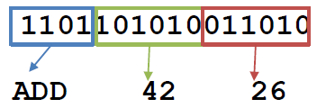
Machine Language
Machine language is a set of primitive instructions built into every computer
The instructions are in the form of binary code, so you have to enter binary codes for various instructions.
Early computer systems used to punch the 0’s and 1’s on special cardboard paper (punch cards)
Imagine making a single mistake and you have to do it all again. Impractical!

Slide 9
Assembly Language
Assembly languages were developed to make programming a bit easier
Instead of writing programs in 0’s and 1’s, we write the program in terms of the desired operation (ADD, SUB, MOV), the numerical numbers, memory locations, etc
Since the computer cannot understand assembly language, a program called assembler is used to convert assembly language programs back into machine code

Slide 10
High-Level Language
There are dozens of computer processor types: INTEL/AMD (found mostly in PCs, laptops, servers), ARM (found mostly in tablets, phones, some laptops), MIPS, RISC-V, etc
Each has a different design→ different machine code → different assembly language
Imagine learning different assembly languages to develop a program that runs on all these different computers. IMPRACTICAL!
The high-level languages are English-like and easy to learn and program

Slide 11
High-Level Languages
Old High-Level Languages
COBOL (COmmon Business Oriented Language), FORTRAN (FORmula TRANslation), BASIC (Beginner All-purpose Symbolic Instructional Code), Pascal, Ada, Delphi
Popular High-Level Languages
C (used a lot in hardware programming / similar to C++)
C++ (an object-oriented language, based on C)
Java (a popular object-oriented language, similar to C++)
Python (used widely in data analysis and artificial intelligence )
JavaScript (front-end/back-end, and mobile development)
Also: C#, Visual Basic, MATLAB, Go, Ruby, Swift, Objective-C, Rust, Scala, Perl

Slide 12
Compiling vs. Interpretation
Some programming languages like Python/MATLAB have interpreters that translate and execute a program line by line as long as they are correct as seen in Fig. (a).
C++ needs a compiler that translates the entire source program into a machine language file for execution Fig. (b). All the program must be in machine code before execution.

Slide 13
The C++ Toolchain Main Programs
A program written in a high-level language is called a source program
The preprocessor strips out user comments and does replacements for the include statements
A program called a compiler is used to translate the preprocessed source program into the assembly code of the target machine
A program called the assembler then translates the assembly code to a machine language program called an object program
The object program is often then linked using a linker with other supporting library code before the object can be executed on the machine

