Slide 1


C++ Programming 2. Basic Operations
Xueyuan Gong
School of Intelligent Systems Science and Engineering

Slide 2
Data Types
simple
structured
integer enum
floating
array struct union class
char short int long bool
address
float double long double
pointer reference

Slide 3
Numerical Data Types
Name | Translate | Size（Byte） | Range
bool | 布尔型 |  | true，false
char（signed char） | 字符型 | 1 | -128～127
unsigned char | 无符号字符型 | 1 | 0～255
short（signed short） | 短整型 | 2 | -32768～32767
unsigned short | 无符号短整型 | 2 | 0～65535
int（signed int） | 基本整型 | 4 | -2147483648～2147483647
unsigned int | 无符号整型 | 4 | 0～4294967295
long（signed long） | 长整型 | 4 | -2147483648～2147483647
unsigned long | 无符号长整型 | 4 | 0～4294967295
float | 单精度型 | 4 | -3.4×10⁻³⁸～3.4×10³⁸
double | 双精度型 | 8 | -1.7×10⁻³⁰⁸～1.7×10³⁰⁸

Slide 4
Declaring Variables
datatype variable1, variable2,..., variablen;
int x;
// Declare x to be an
// integer variable;
double radius; // Declare radius to
// be a double variable;
char a;
// Declare a to be a
// character variable;

Slide 5
Declaring Variables
int i, j, k; // Declare three integers
int i = 10; // Declare and initialize int i(1), j(2); // Is equivalent to
int i = 1, j = 2;

Slide 6
Assignment Statements
An assignment statement designates a value for a variable. An assignment statement can be used as an expression in C++.
x = 1;
// Assign 1 to x;
y = x + 1; radius = 1.0; a = 'A';
// Assign 2 to y;
// Assign 1.0 to radius;
// Assign 'A' to a;

Slide 7
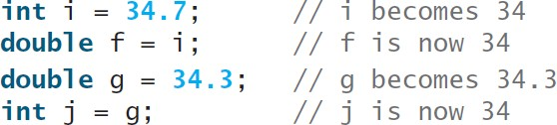
Numeric Type Conversion
Consider the following statements:
short i = 100; long k = i * 3 + 4;
double d = i * 3.1 + k / 2;

Slide 8
Type Casting
Implicit casting
double d = 3; // type widening
Explicit casting
int | i | = | static_cast<int>(3.0);
 |  |  | // type narrowing
int | i | = | (int)3.9; // C-style casting
// Fraction part is truncated

Slide 9
Octal and Hex Literals
By default, an integer literal is a decimal number.
To denote a binary integer literal, use a leading
0b or 0B (zero b).
To denote an octal integer literal, use a leading 0
(zero)
To denote a hexadecimal integer literal, use a leading 0x or 0X (zero x).
cout << 10 << " " << 0b10 << " " << 010
<< " " << 0x10;
10 2 8 16

Slide 10
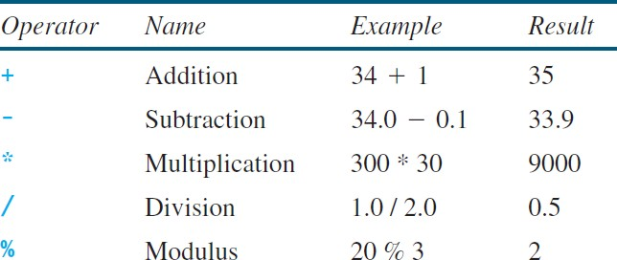
Numeric Operators

Slide 11
Increment and Decrement Operators
Operator | Name | Description
++var | pre- increment | Increments var by 1 and evaluates to the new value in var after the increment.
var++ | post- increment | Evaluates to the original value in var and increments var by 1.
--var | pre- decrement | Decrements var by 1 and evaluates to the new value in var after the decrement.
var-- | post- decrement | Evaluates to the original value in var and decrements var by 1.

Slide 12
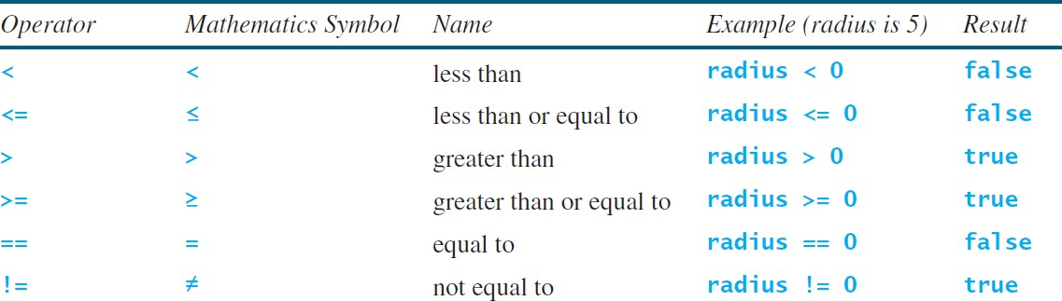
The bool Type and Operators
Often in a program you need to compare two values, such as whether i is greater than j. C++ provides six relational operators (also known as comparison operators):

Slide 13
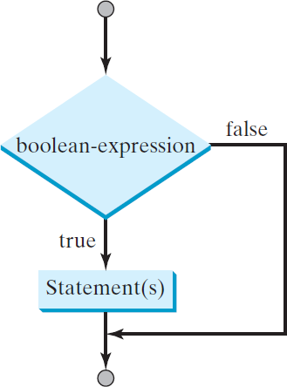
One-way if Statements
if (booleanExpression)
{
statement(s);
}
if (radius >= 0)
{
area = radius * radius * PI;
cout << "The area for the circle of " <<
" radius " << radius << " is " << area;
}

Slide 14
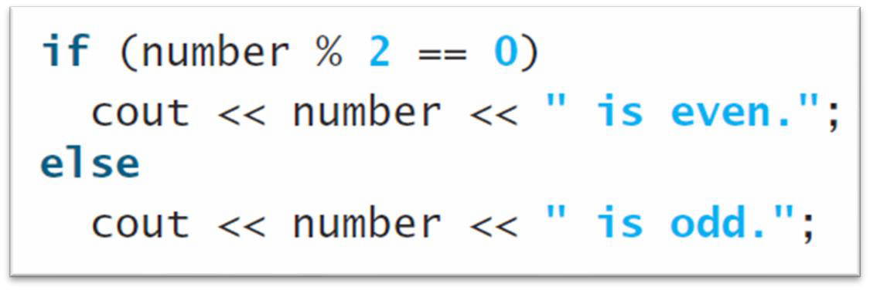
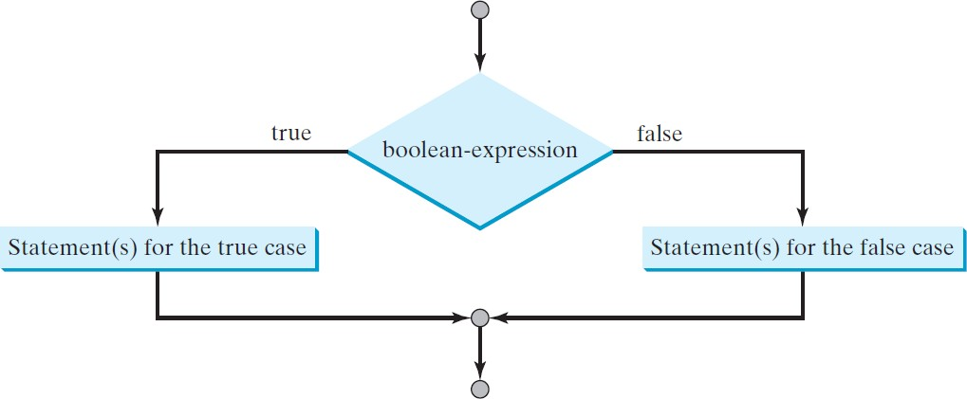
Two-Way if-else Statement
if (booleanExpression)
{
statement(s)-for-the-true-case;
}
else
{
statement(s)-for-the-false-case;
}

Slide 15
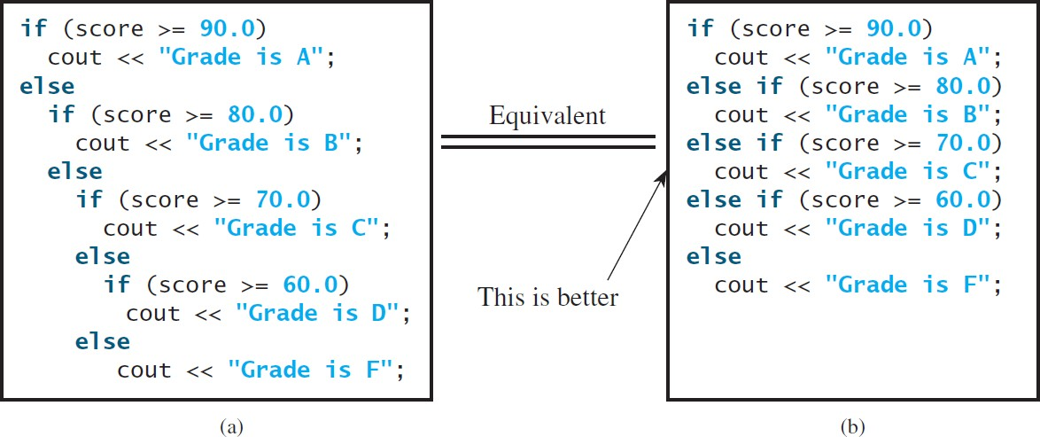
Multiple Alternative if Statements

Slide 16
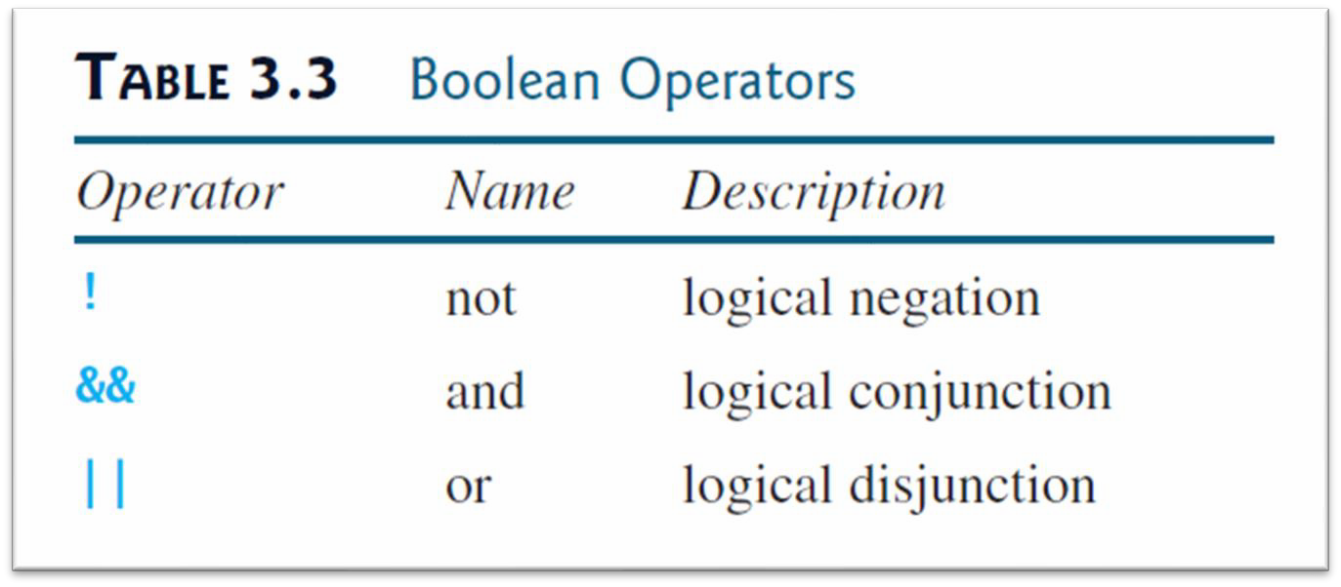
Logical Operators
The logical operators !, &&, and || can be used to create a compound Boolean expression.

Slide 17
Short-Circuit Operator
When evaluating p1 && p2, C++ first evaluates p1 and then evaluates p2 if p1 is true; if p1 is false, it does not evaluate p2.
When evaluating p1 || p2, C++ first evaluates p1 and then evaluates p2 if p1 is false; if p1 is true, it does not evaluate p2.
Therefore, && is referred to as the conditional or
short-circuit AND operator, and || is referred to as the conditional or short-circuit OR operator.

Slide 18
switch Statements
switch | (status)
{
case | 0: compute | taxes | for | single filers;
 | break;
case | 1: compute | taxes | for | married file jointly;
 | break;
case | 2: compute | taxes | for | married file separately;
 | break;
case | 3: compute | taxes | for | head of household;
 | break;
default: cout << "Errors: invalid status" << endl;
}

Slide 19
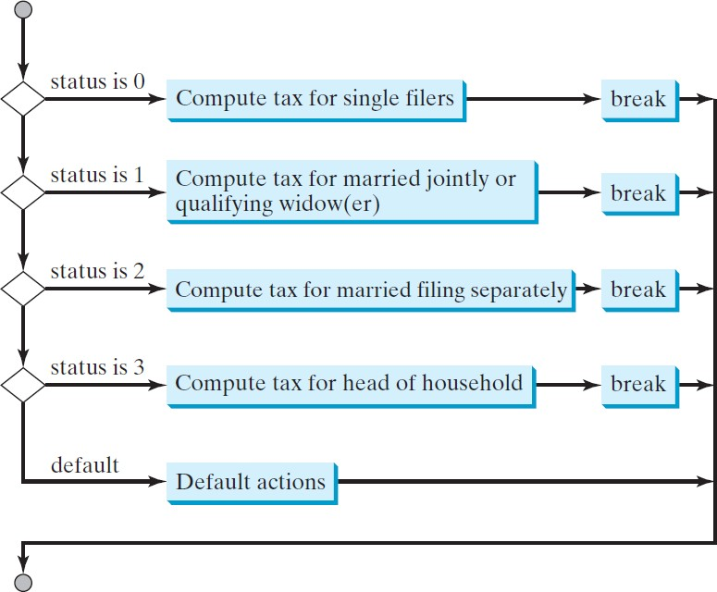
switch Statement Flow Chart

Slide 20
Conditional Expressions
A conditional expression evaluates an expression based on a condition.
Syntax:
(booleanExpression) ? expression1 : expression2
The result of this conditional expression is expression1 if boolean-expression is true; otherwise, the result is expression2.

Slide 21
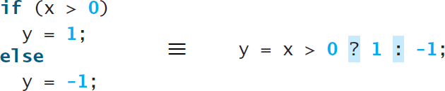

Examples
Equivalent statements:
Finding the max:
Odd of even:

Slide 22
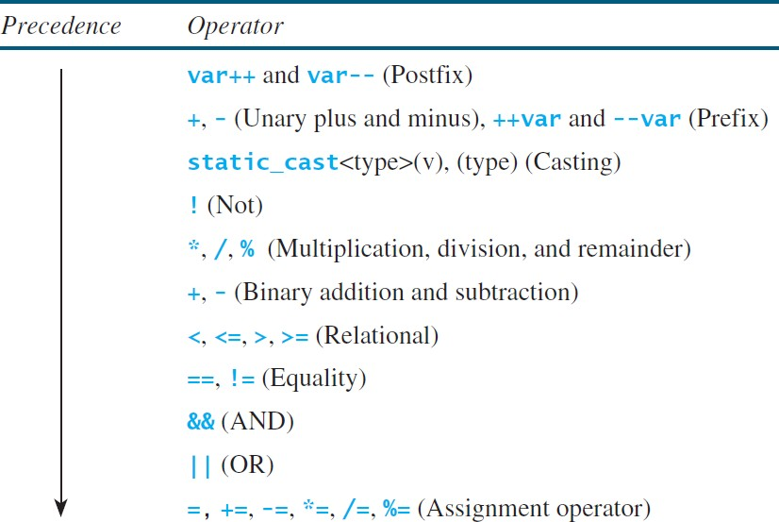
Operator Precedence

Slide 23
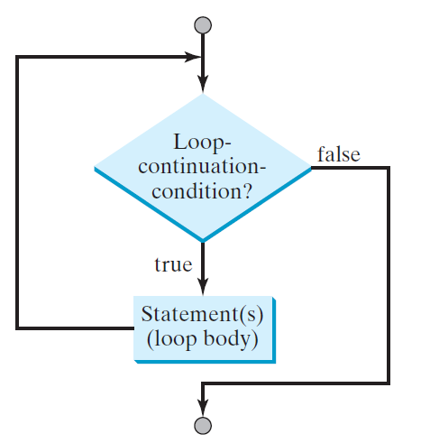
while Loop
A while loop executes statements repeatedly while the condition is true.
int count = 0; while (count < 100)
{
cout << "Welcome to C++!\n"; count++;
}

Slide 24
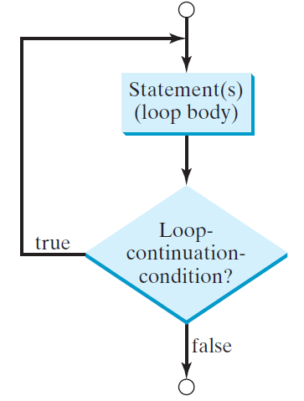
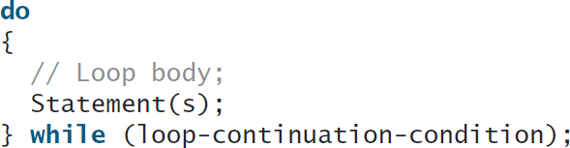
do-while Loop
A do-while loop is the same as a while loop except that it executes the loop body first and then checks the loop continuation condition.

Slide 25
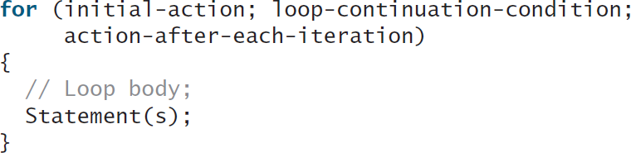
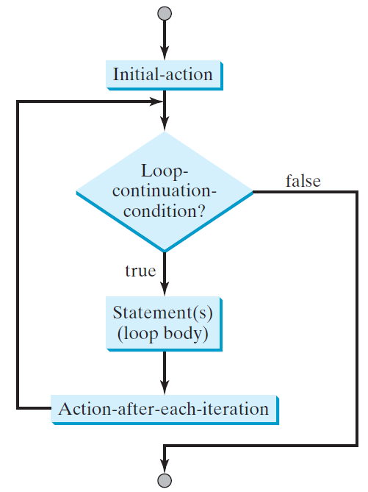
for Loop
A for loop has a concise syntax for writing loops.

Slide 26
break
Use break in a loop to immediately terminate the loop.
Example: adding integers from 1 to 20 until sum is greater than or equal to 100.
while (number < 20)
{
number++;
sum += number; if (sum >= 100)
break;
}

Slide 27
continue
Use continue in a loop to proceed to the next iteration.
Example: adding integers from 1 to 20 except 10 and 11.
while (number < 20)
{
number++;
if (number == 10 || number == 11) continue;
sum += number;
}

