Slide 1


C++ Programming 3. Array
Xueyuan Gong
School of Intelligent Systems Science and Engineering

Slide 2
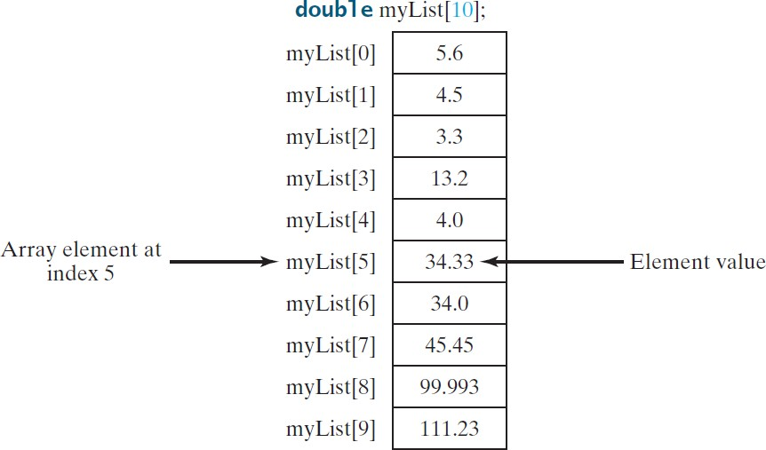
Introduction
Array is a data structure that represents a collection of the same types of data.

Slide 3
Declaring Array Variables
datatype arrayRefVar[arraySize];
Example:
double myList[10];
C++ requires that the array size used to declare an array must be a constant expression. For example, the following code is illegal:
int size = 10;
double myList[size]; // Wrong
But it would be OK, if size is a constant as follow:
const int size = 10;
double myList[size], list2[5]; // Correct6

Slide 4
Accessing Array Elements
The array elements are accessed through the index. Array indices are 0-based; that is, they start from 0 to arraySize-1.
Each element in the array is represented using the following syntax, known as an indexed variable:
arrayName[index];
For example, myList[9] represents the last element in the array myList.

Slide 5
Array Initializers
Declaring, creating, initializing in one step:
dataType arrayName[arraySize] = {value0, value1,
..., valuek};
Examples:
double myList[4] = {1.9, 2.9, 3.4, 3.5};
double myList[] = {1.9, 2.9, 3.4, 3.5};
double myList[4] = {1.9, 2.9};

Slide 6

C style string
You can define arrays of characters.
char city[] = { 'D', 'a', 'l', 'l', 'a', 's' };
C-strings are defined as follows:
char city[] = "Dallas";
In this case, C++ adds the character '\0', called the null terminator, to indicate the end of the string.

Slide 7
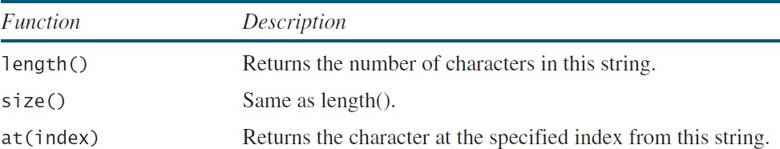
C++ style string
A string is a sequence of characters.
#include <string>
string s;
string message = "Programming is fun";

Slide 8
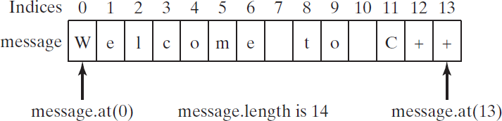
string Subscript Operator
C++ provides the subscript operator for accessing the character at a specified index in a string using the syntax stringName[index].
string s = "welcome to C++"; s.at(0) = 'W';
cout << s.length() << s[0] << endl; 14W

Slide 9
Declaring Two-Dimensional Arrays
elementType arrayName[ROW_SIZE][COLUMN_SIZE];
Example
int distances[7][7];
An element in a two-dimensional array is accessed through a row and column index.
int bostonToDalas = distances[1][5]; 5

Slide 10
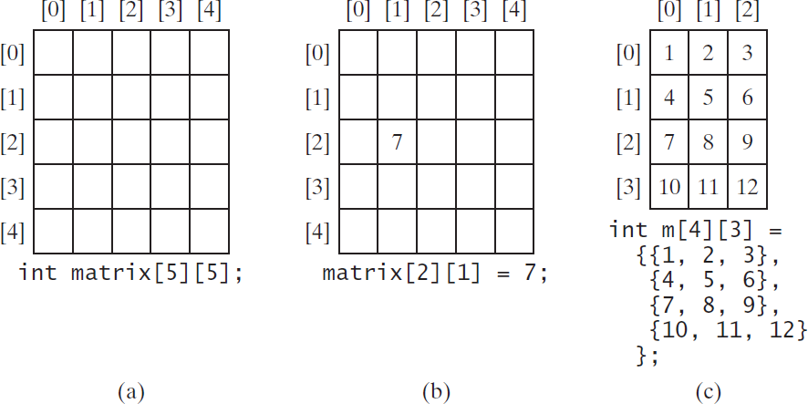
Two-Dimensional Array Illustration

