Slide 1


C++ Programming 3. Function
Xueyuan Gong
School of Intelligent Systems Science and Engineering

Slide 2
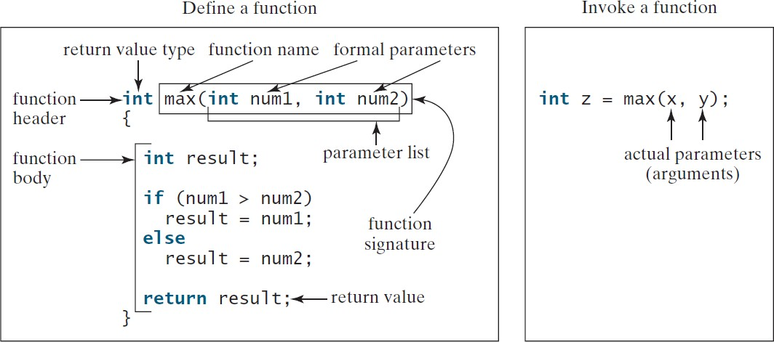
Defining a Function
•
A function is a collection of statements that are grouped together to perform an operation.
A function definition consists of its function
•
name, parameters, return value type, and
body.
8

Slide 3
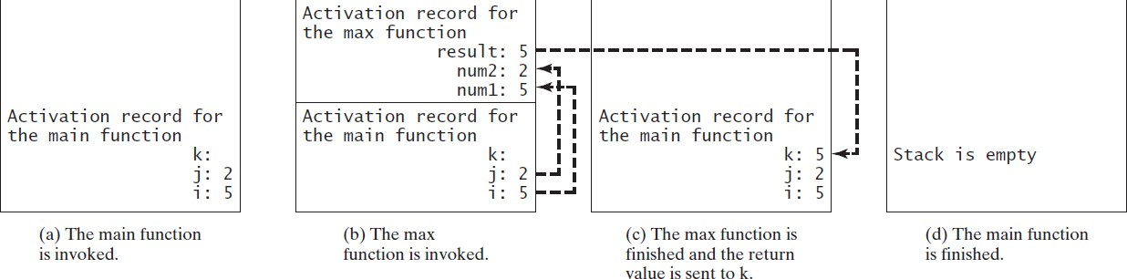
Call Stacks
•
Each time a function is invoked, the system creates an activation record.
The activation record is placed in an area of memory known as a call stack.
•

Slide 4
Inline Functions
C++ provides inline functions for improving performance for short functions.
•
Inline functions are not called; rather, the compiler copies the function code in line at the point of each invocation.
To specify an inline function, precede the function declaration with the inline keyword.
Inline functions are desirable for short
•
•
functions but not
for long ones.

Slide 5
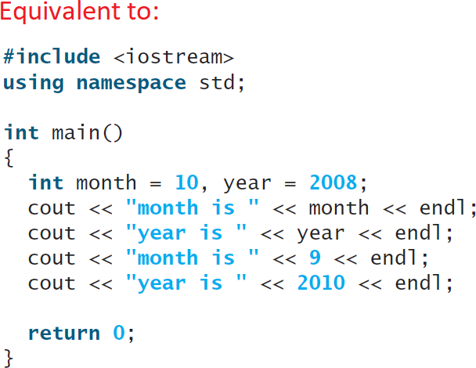
InlineDemo.cpp
#include <iostream> using namespace std;
inline void f(int month, int year)
{
cout << "month is " << month << end cout << "year is " << year << endl;
}
int main()
{
int month = 10, year = 2008;
f(month, year); // Invoke inline function f(9, 2010); // Invoke inline function
return 0;
}
l;

Slide 6
Scope of Variables
Scope: the part of the program where the variable can be referenced.
The scope of a variable starts from its declaration and continues to the end of the block that contains the variable.
A variable can be declared as a local, a global, or a static local.
A local variable: a variable defined inside a function.
You can declare a local variable with the same name in different blocks.

Slide 7
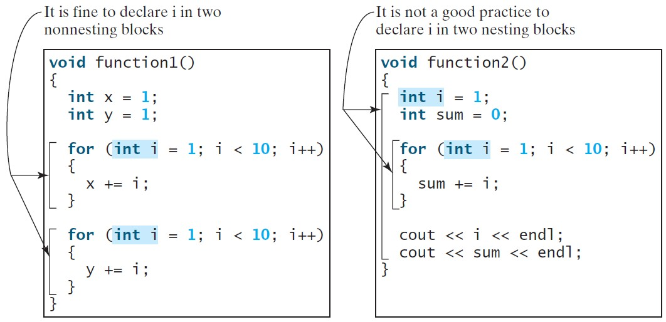
Scope of Local Variables
It is acceptable to declare a local variable with the same name in different non-nesting blocks.
Avoid using same variable name in nesting blocks to minimize making mistakes.
55

Slide 8
Global Variables
Global variables are declared outside all functions and are accessible to all functions in their scope.
Local variables do not have default values, but global variables are defaulted to zero.

Slide 9
Static Local Variables
After a function completes its execution, all its local variables are destroyed.
To retain the value stored in local variables so that they can be used in the next call, use static local variables.
Static local variables are permanently allocated in the memory for the lifetime of the program.
To declare a static variable, use the keyword static.

Slide 10
Recursion
Recursion is a technique that leads to elegant solutions to problems that are difficult to program using simple loops.
A recursive function is one that invokes itself.
Suppose you want to find all the files under a directory that contains a particular word. How do you solve this problem? There are several ways to solve this problem. An intuitive solution is to use recursion by searching the files in the subdirectories recursively.

Slide 11
Computing Factorial
factorial(4) = 4 * factorial(3)
= 4 * 3 * factorial(2)
= 4 * 3 * (2 * factorial(1))
= 4 * 3 * ( 2 * (1 * factorial(0)))
= 4 * 3 * ( 2 * ( 1 * 1)))
= 4 * 3 * ( 2 * 1)
= 4 * 3 * 2
= 4 * 6
= 24

Slide 12
ComputeFactorial.cpp
#include <iostream> using namespace std;
// Return the factorial for a specified index long long factorial(int n)
{
if (n == 0) // Base case return 1;
else
return n * factorial(n -
1); // Recursive call
}
int main()
{
// Prompt the user to enter an integer
cout << "Please enter a non-negative integer: "; int n;
cin >> n;
// Display factorial
cout << "Factorial of " << n << " is " << factorial(n);
return 0;
Factorial of 4 is 24
}

Slide 13
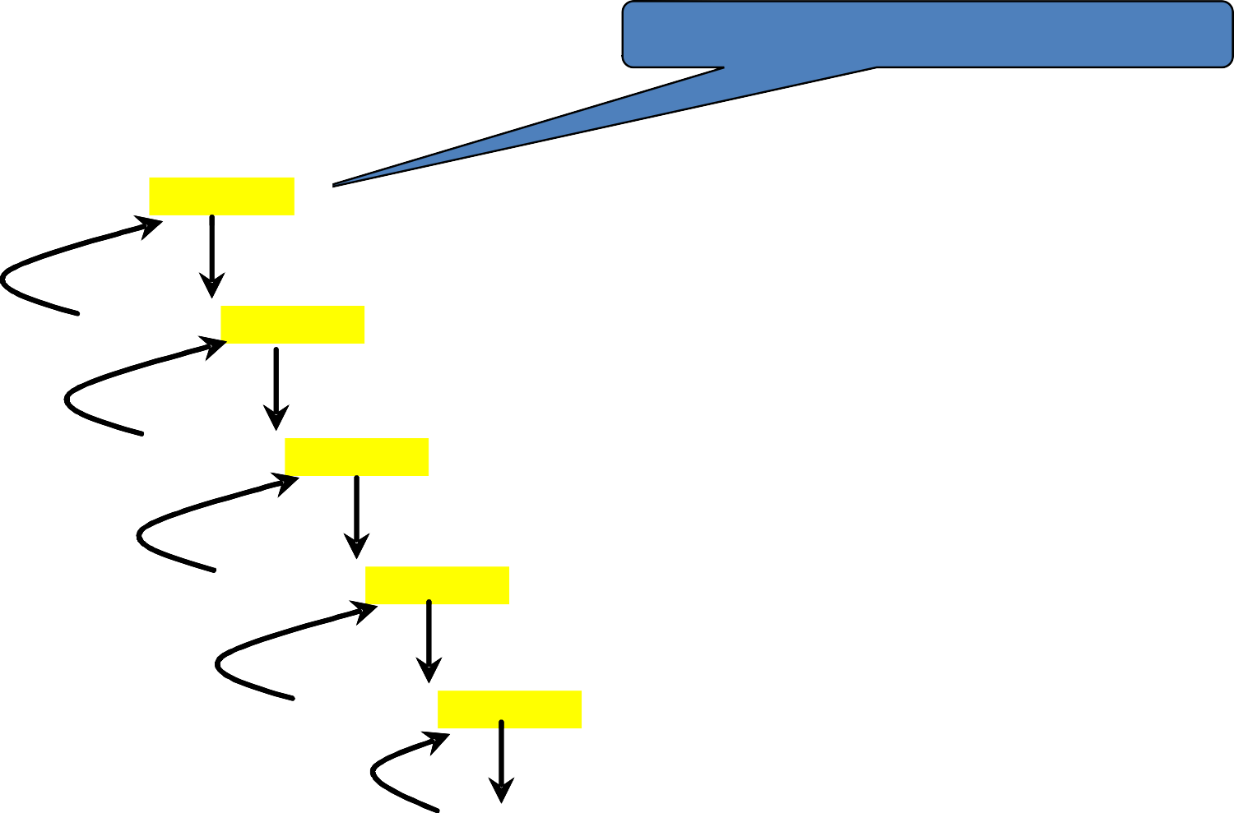
Trace Recursive factorial
Executes factorial(4)
factorial(4)
Step 0: executes factorial(4)
Step 9: return 24
return 4 * factorial(3)
Step 8: return 6
Step 1: executes factorial(3)
return 3 * factorial(2)
Step 2: executes factorial(2)
Stack
Space Required for factorial(4)
Main function
Step 7: return 2
return 2 * factorial(1)
Step 6: return 1
Step 3: executes factorial(1)
return 1 * factorial(0)
Step 5: return 1
Step 4: executes factorial(0)
return 1

Slide 14
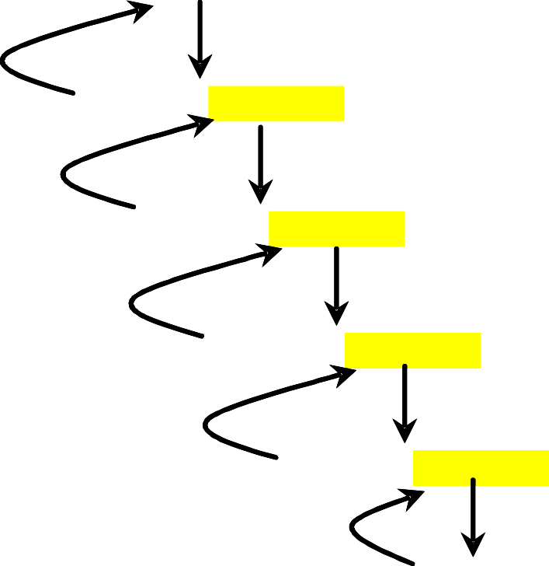
Trace Recursive factorial
factorial(4)
Step 0: executes factorial(4)
Step 9: return 24
Executes factorial(3)
return 4 * factorial(3)
Step 8: return 6
Step 1: executes factorial(3)
return 3 * factorial(2)
Step 2: executes factorial(2)
Stack
Space Required for factorial(3)
Space Required for factorial(4)
Main function
Step 7: return 2
return 2 * factorial(1)
Step 6: return 1
Step 3: executes factorial(1)
return 1 * factorial(0)
Step 5: return 1
Step 4: executes factorial(0)
return 1

Slide 15
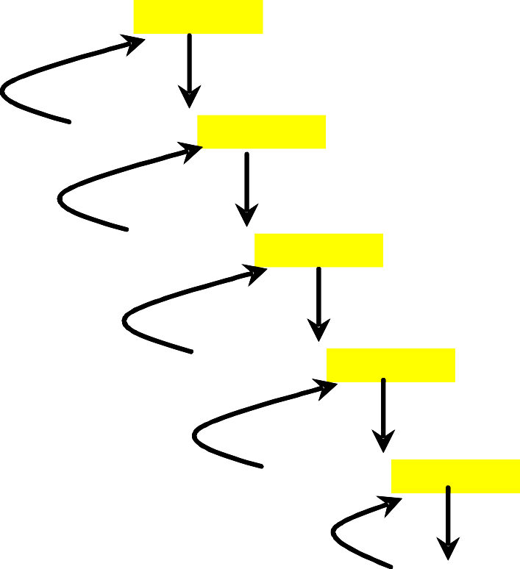
Trace Recursive factorial
factorial(4)
Executes factorial(2)
Step 0: executes factorial(4)
Step 9: return 24
return 4 * factorial(3)
Step 8: return 6
Step 1: executes factorial(3)
return 3 * factorial(2)
Step 2: executes factorial(2)
Stack
Space Required for factorial(2)
Space Required for factorial(3)
Space Required for factorial(4)
Main function
Step 7: return 2
return 2 * factorial(1)
Step 6: return 1
Step 3: executes factorial(1)
return 1 * factorial(0)
Step 5: return 1
Step 4: executes factorial(0)
return 1

Slide 16
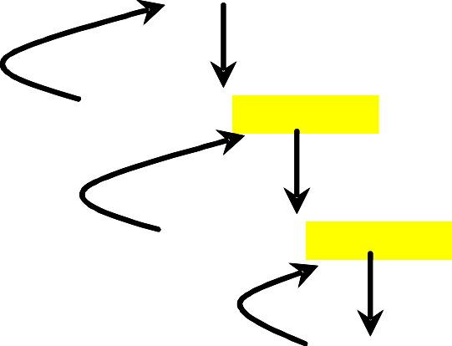
Trace Recursive factorial
factorial(4)
Executes factorial(1)
Step 0: executes factorial(4)
Step 9: return 24
return 4 *
factorial(3)
Step 8: return 6
Step 1: executes factorial(3)
return 3 *
factorial(2
)
Step 2: executes factorial(2)
Stack
Space Required for factorial(1)
Space Required for factorial(2)
Space Required for factorial(3)
Space Required for factorial(4)
Main function
Step 7: return 2
return 2 * factorial(1)
Step 6: return 1
Step 3: executes factorial(1)
return 1 * factorial(0)
Step 5: return 1
Step 4: executes factorial(0)
return 1

Slide 17
Trace Recursive factorial
factorial(4)
Executes factorial(0)
Step 0: executes factorial(4)
Step 9: return 24
return 4 * factorial(3)
Step 8: return 6
Step 1: executes factorial(3)
return 3 * factorial(2)
Step 2: executes factorial(2)
Stack
Space Required for factorial(0)
Space Required for factorial(1)
Space Required for factorial(2)
Space Required for factorial(3)
Space Required for factorial(4)
Main function
Step 7: return 2
return 2 * factorial(1)
Step 6: return 1
Step 3: executes factorial(1)
return 1 * factorial(0)
Step 5: return 1
Step 4: executes factorial(0)
return 1

Slide 18
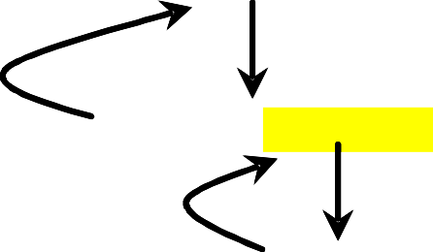
Trace Recursive factorial
factorial(4)
returns 1
Step 0: executes factorial(4)
Step 9: return 24
return 4 * factorial(3)
Step 8: return 6
Step 1: executes factorial(3)
return 3 * factorial(2)
Step 2: executes factorial(2)
Stack
Space Required for factorial(0)
Space Required for factorial(1)
Space Required for factorial(2)
Space Required for factorial(3)
Space Required for factorial(4)
Main function
Step 7: return 2
return 2 * factorial(1)
Step 6: return 1
Step 3: executes factorial(1)
return 1 * factorial(0)
Step 5: return 1
Step 4: executes factorial(0)
return 1

Slide 19
Trace Recursive factorial
factorial(4)
returns factorial(0)
Step 0: executes factorial(4)
Step 9: return 24
return 4 *
factorial(3)
Step 8: return 6
Step 1: executes factorial(3)
factorial(2)
return 3 *
Step 2: executes factorial(2)
Stack
Space Required for factorial(0)
Space Required for factorial(1)
Space Required for factorial(2)
Space Required for factorial(3)
Space Required for factorial(4)
Main function
Step 7: return 2
return 2 *
factorial(1)
Step 6: return 1
Step 3: executes factorial(1)
return 1 * factorial(0)
Step 5: return 1
Step 4: executes factorial(0)
return 1

Slide 20

Trace Recursive factorial
factorial(4)
returns factorial(1)
Step 0: executes factorial(4)
Step 9: return 24
return 4 * factorial(3)
Step 8: return 6
Step 1: executes factorial(3)
return 3 *
factorial(2)
Step 2: executes factorial(2)
Stack
Space Required for factorial(1)
Space Required for factorial(2)
Space Required for factorial(3)
Space Required for factorial(4)
Main function
Step 7: return 2
return 2 * factorial(1)
Step 6: return 1
Step 3: executes factorial(1)
return 1 * factorial(0)
Step 5: return 1
Step 4: executes factorial(0)
return 1

Slide 21
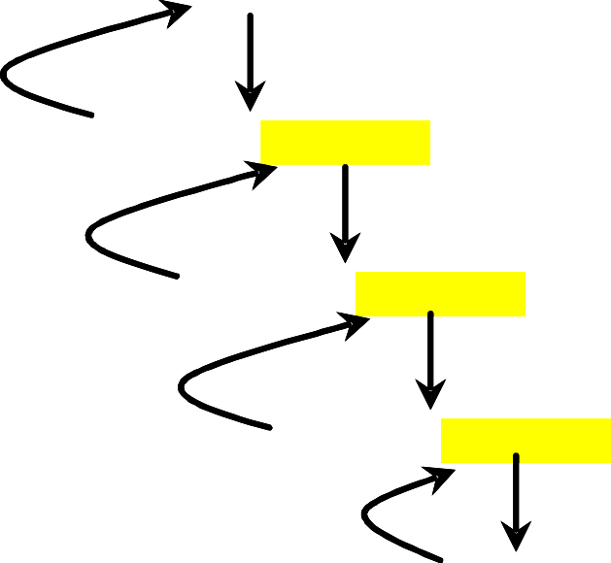
Trace Recursive factorial
factorial(4)
returns factorial(2)
Step 0: executes factorial(4)
Step 9: return 24
return 4 *
factorial(3)
Step 8: return 6
Step 1: executes factorial(3)
return 3 * factorial(2)
Step 2: executes factorial(2)
Stack
Space Required for factorial(2)
Space Required for factorial(3)
Space Required for factorial(4)
Main function
Step 7: return 2
return 2 * factorial(1)
Step 6: return 1
Step 3: executes factorial(1)
return 1 * factorial(0)
Step 5: return 1
Step 4: executes factorial(0)
return 1

Slide 22

Trace Recursive factorial
factorial(4)
returns factorial(3)
Step 0: executes factorial(4)
Step 9: return 24
return 4 * factorial(3)
Step 8: return 6
Step 1: executes factorial(3)
return 3 * factorial(2)
Step 2: executes factorial(2)
Stack
Space Required for factorial(3)
Space Required for factorial(4)
Main function
Step 7: return 2
return 2 * factorial(1)
Step 6: return 1
Step 3: executes factorial(1)
return 1 * factorial(0)
Step 5: return 1
Step 4: executes factorial(0)
return 1

Slide 23
Trace Recursive factorial
returns factorial(4)
factorial(4)
Step 0: executes factorial(4)
Step 9: return 24
return 4 * factorial(3)
Step 8: return 6
Step 1: executes factorial(3)
return 3 * factorial(2)
Step 2: executes factorial(2)
Stack
Space Required for factorial(4)
Main function
Step 7: return 2
return 2 * factorial(1)
Step 6: return 1
Step 3: executes factorial(1)
return 1 * factorial(0)
Step 5: return 1
Step 4: executes factorial(0)
return 1

