Slide 1
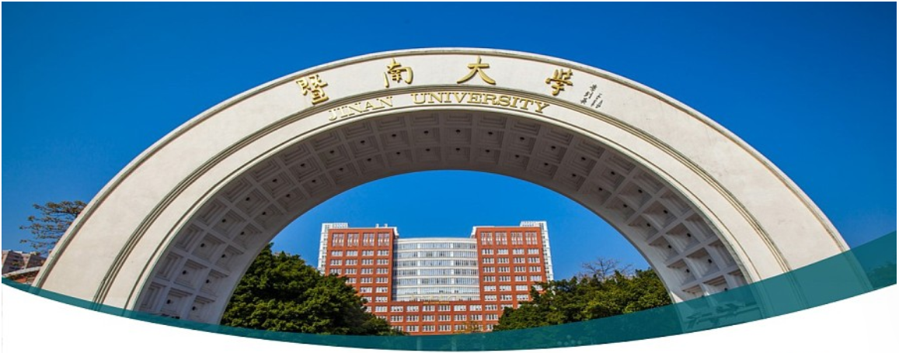

C++ Programming 3. Function
Xueyuan Gong
School of Intelligent Systems Science and Engineering

Slide 2
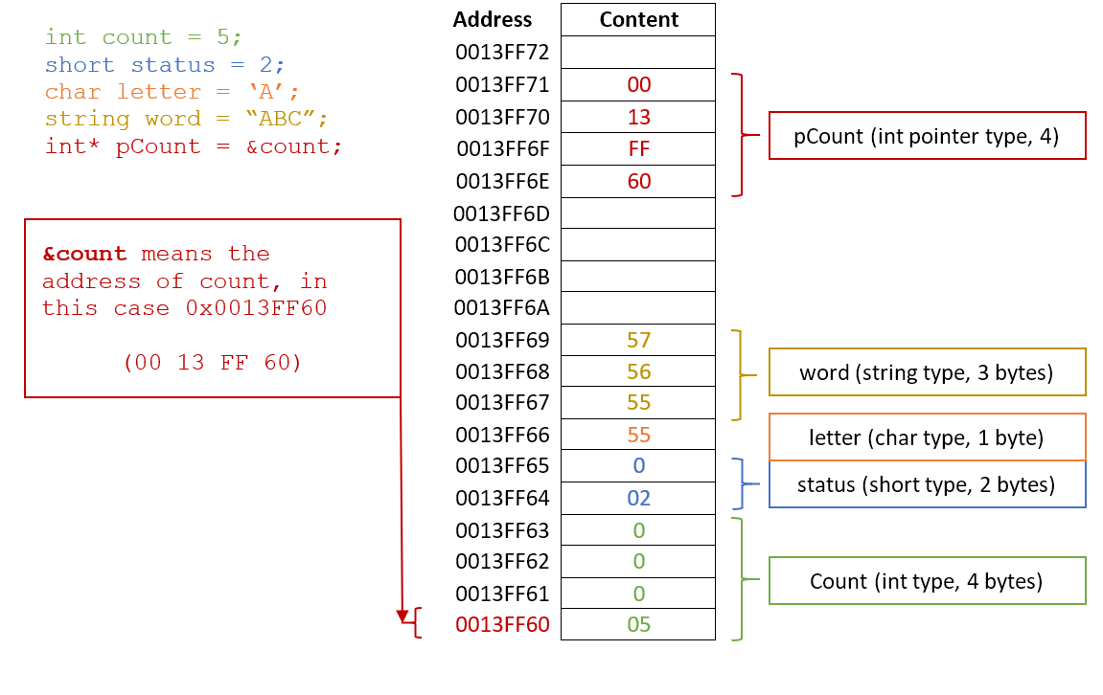
Pointer Basics

Slide 3
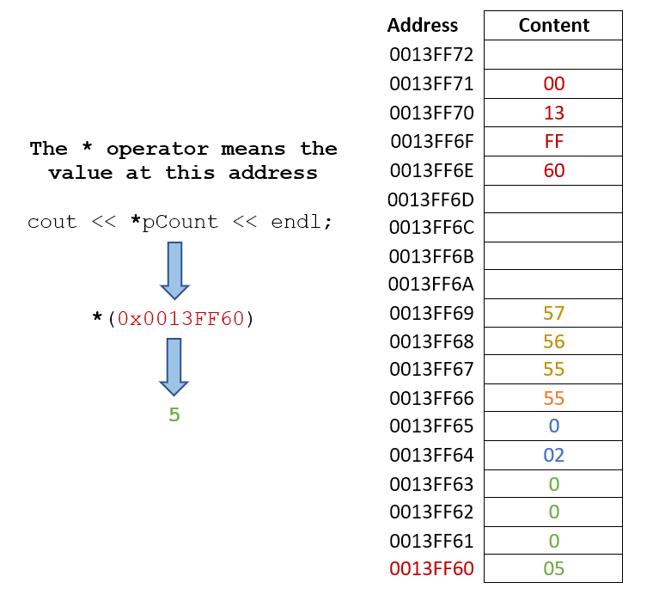
Pointer Basics

Slide 4
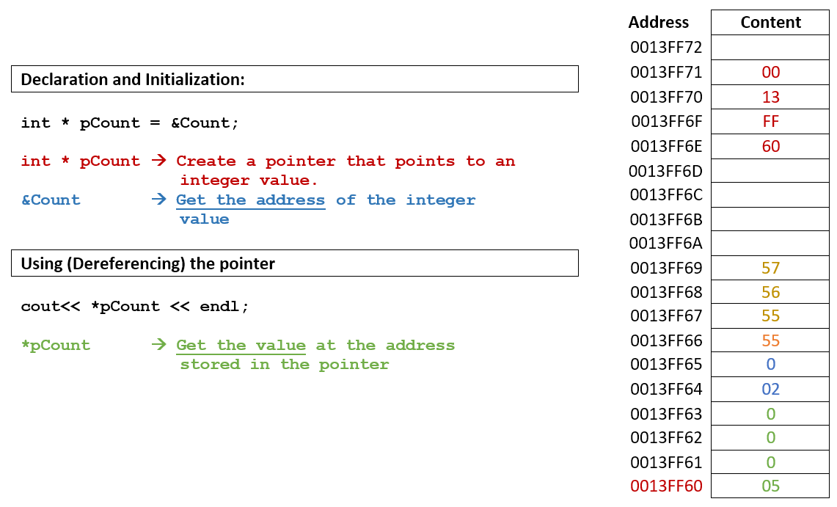
Pointer Basics

Slide 5
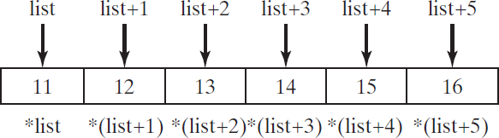
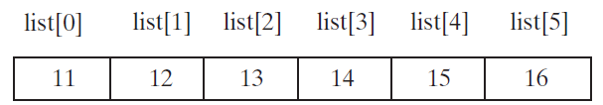
Arrays and Pointers
•
An array variable without a bracket and a subscript actually represents the starting address of the array.
The array variable is essentially a pointer. Suppose you declare an array of int value as follows:
int li 6 };
•
st[6] = { 11, 12, 13, 14, 15, 1

Slide 6
Pass-by-value
swap1(num1, num2)
// Swap two variables using
// pass-by-value
void swap1(int n1, int n2)
{
int temp = n1; n1 = n2;
n2 = temp;
}

Slide 7
Pass-by-reference
swap2(num1, num2)
// Swap two variables using
// pass-by-reference
void swap2(int& n1, int& n2)
{
int temp = n1; n1 = n2;
n2 = temp;
}
After invoking the swap function, num1 is 2 and num2 is 1

Slide 8
Pass-by-pointer
swap3(&num1,&num2)
// Pass two pointers by value
void swap3(int* p1, int* p2)
{
int temp = *p1;
*p1 = *p2;
*p2 = temp;
}
After invoking the swap function, num1 is 2 and num2 is 1

Slide 9
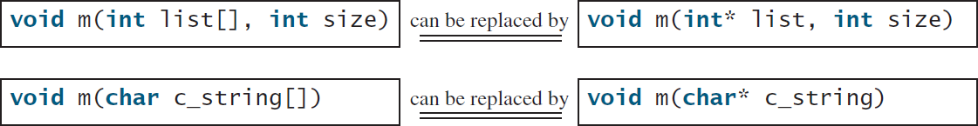
Array Parameter or Pointer Parameter
•
An array parameter in a function can always be replaced using a pointer parameter.

Slide 10
Returning a Pointer from Functions
You can use pointers as parameters in a function.
A C++ function may return a pointer as well.

